Slide 1
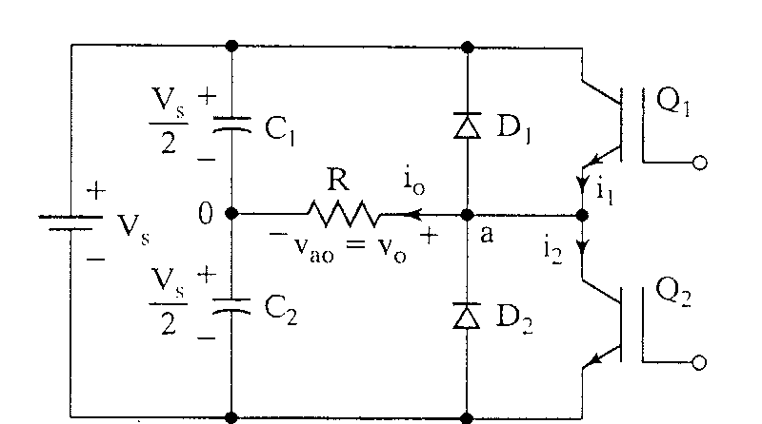
Single-phase half-bridge inverter

Slide 2
Operational Details
3-wire DC source
Consists of 2 choppers, 3-wire DC source
Transistors switched on and off alternately
Need to isolate the gate signal for Q₁ (upper device)
Each provides opposite polarity of V_{s}/2 across the load

Slide 3
Q₁ on, Q₂ off, v_{o} = V_{s}/2
Peak Reverse Voltage of Q₂ = V_{s}

Slide 4
Q₁ off, Q₂ on, v_{o} = -V_{s}/2

Slide 5
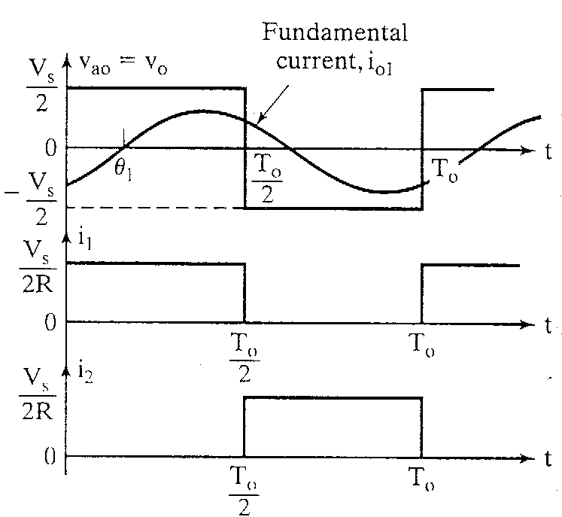
Waveforms with resistive load

Slide 6

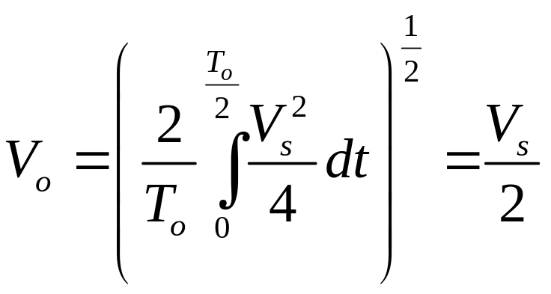
Look at the output voltage
rms value of the output voltage, V_{o}

Slide 7
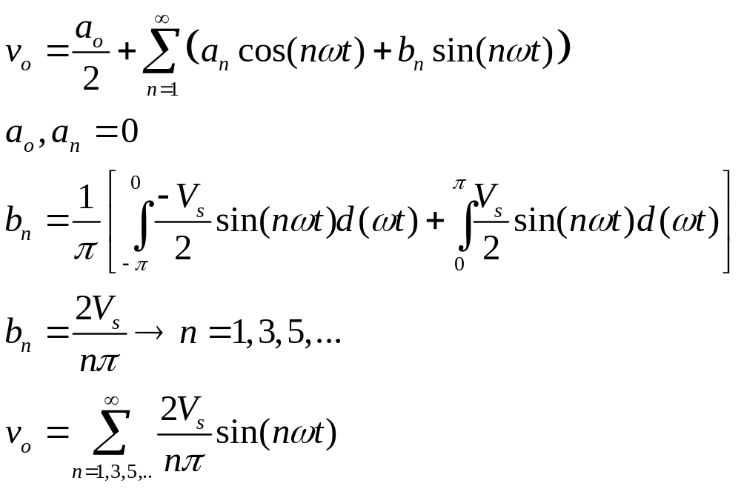
Fourier Series of the instantaneous output voltage

Slide 8
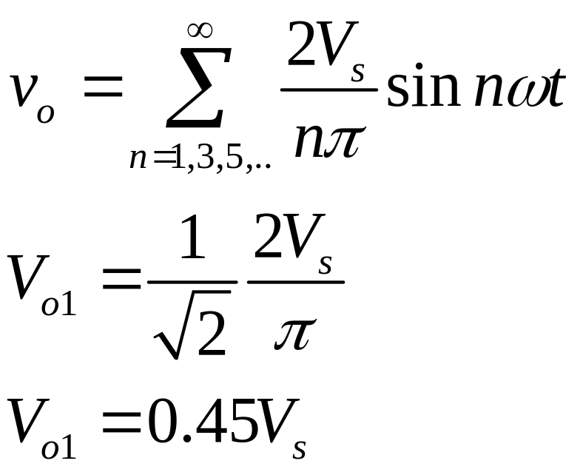
rms value of the fundamental component

Slide 9
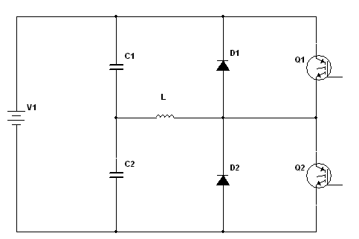
When the load is highly inductive

Slide 10
Turn off Q₁ at t = T_{o}/2
Current falls to 0 via D₂, L, V_{s}/2 lower
+
V_{s}/2
-
+
V_{s}/2
-

Slide 11
Turn off Q₂ at t = T_{o}
Current falls to 0 via D₁, L, V_{s}/2 upper
+
V_{s}/2
-
+
V_{s}/2
-

Slide 12
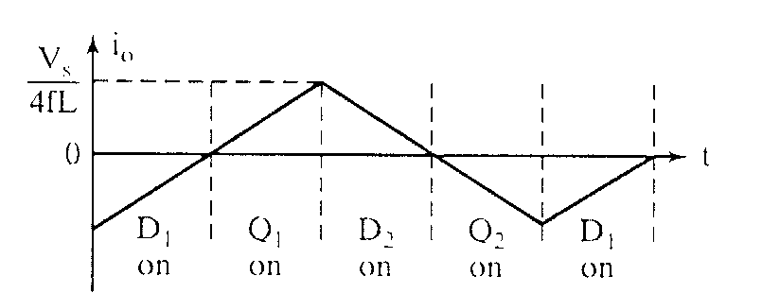
Load Current for a highly inductive load
Transistors are only switched on for a quarter-cycle, or 90°

Slide 13
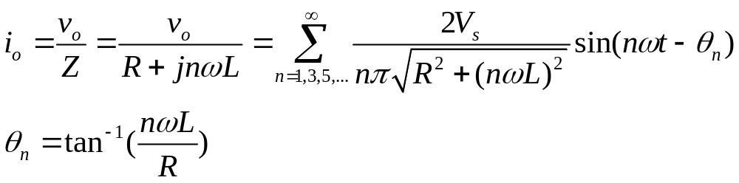
Fourier Series of the output current for an RL load

Slide 14
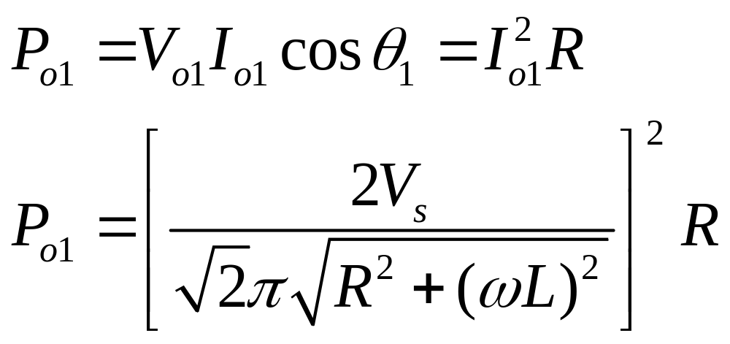
Fundamental Output Power
In most cases, the useful power

Slide 15
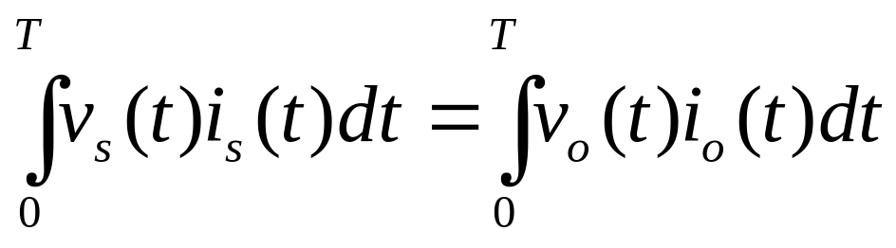
DC Supply Current
If the inverter is lossless, average power absorbed by the load equals the average power supplied by the dc source.
For an inductive load, the current is approximately sinusoidal and the fundamental component of the output voltage supplies the power to the load. Also, the dc supply voltage remains essentially at V_{s}.

Slide 16
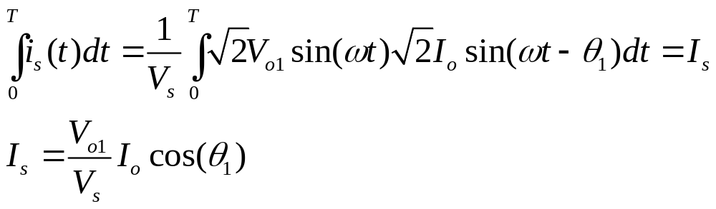
DC Supply Current (continued)

Slide 17
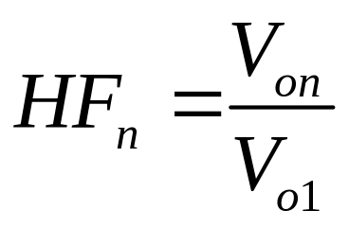
Performance Parameters
Harmonic factor of the nth harmonic (HF_{n})
for n>1
V_{on} = rms value of the nth harmonic component
V₀₁ = rms value of the fundamental component

Slide 18
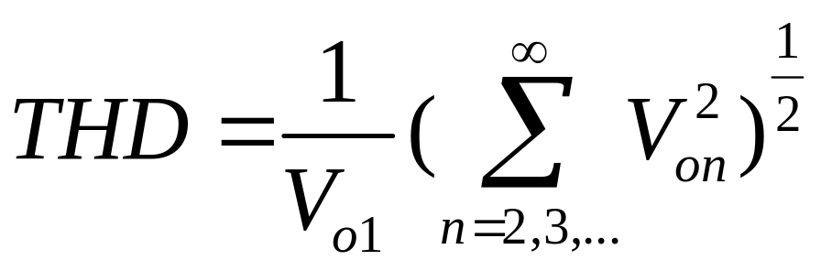
Performance Parameters (continued)
Total Harmonic Distortion (THD)
Measures the “closeness” in shape between a waveform and its fundamental component

Slide 19
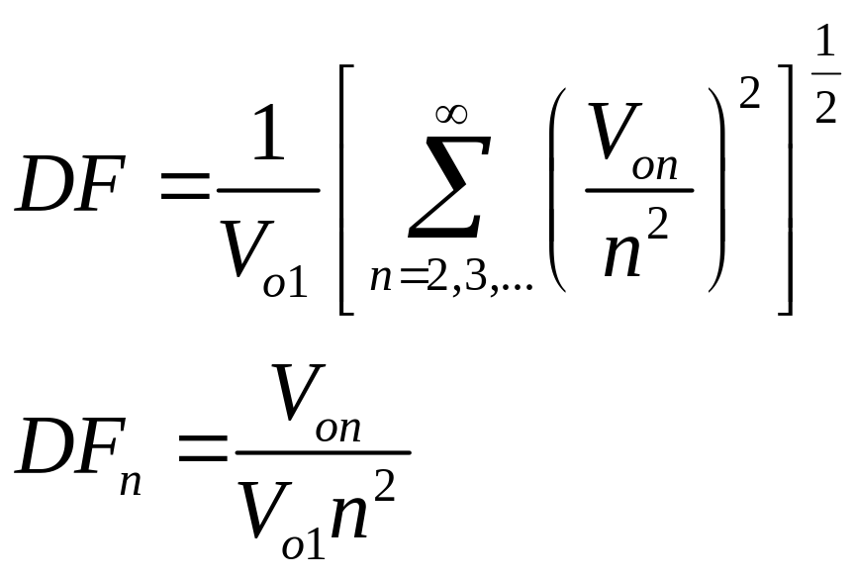
Performance Parameters (continued)
Distortion Factor (DF)
Indicates the amount of HD that remains in a particular waveform after the harmonics have been subjected to second-order attenuation.
for n>1

Slide 20
Performance Parameters (continued)
Lowest order harmonic (LOH)
The harmonic component whose frequency is closest to the fundamental, and its amplitude is greater than or equal to 3% of the amplitude of the fundamental component.

Slide 21
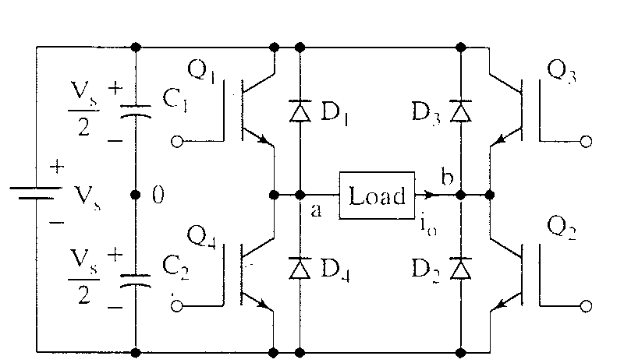
Single-phase full-bridge inverter

Slide 22
Operational Details
Consists of 4 choppers and a 3-wire DC source
Q₁-Q₂ and Q₃-Q₄ switched on and off alternately
Need to isolate the gate signal for Q₁ and Q₃ (upper)
Each pair provide opposite polarity of V_{s}across the load

Slide 23
Q₁-Q₂ on, Q₃-Q₄ off, v_{o} = V_{s}
+ V_{s} -

Slide 24
Q₃-Q₄ on, Q₁-Q₂ off, v_{o} = -V_{s}
- V_{s} +

Slide 25
When the load is highly inductive
Turn Q₁-Q₂ off – Q₃-Q₄ off

Slide 26
Turn Q₃-Q₄ off – Q₁-Q₂ off

Slide 27
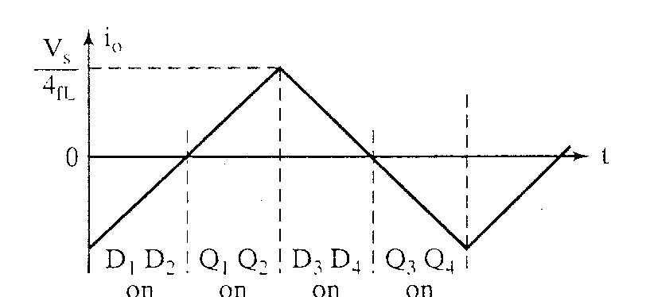
Load current for a highly inductive load

Slide 28
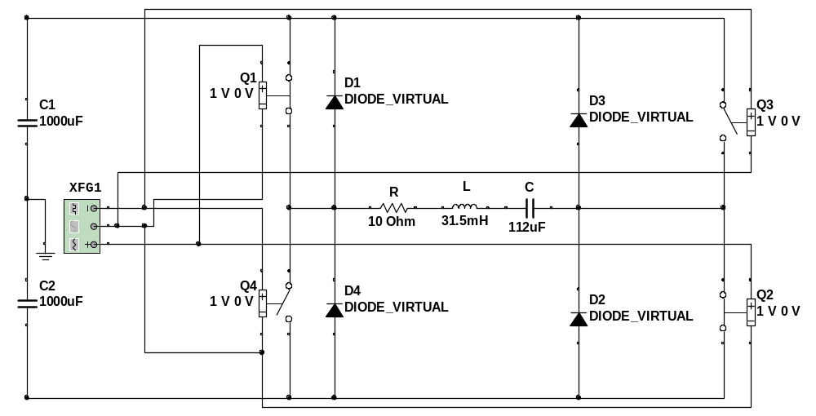
Example 6.3 – MultiSim7

Slide 29
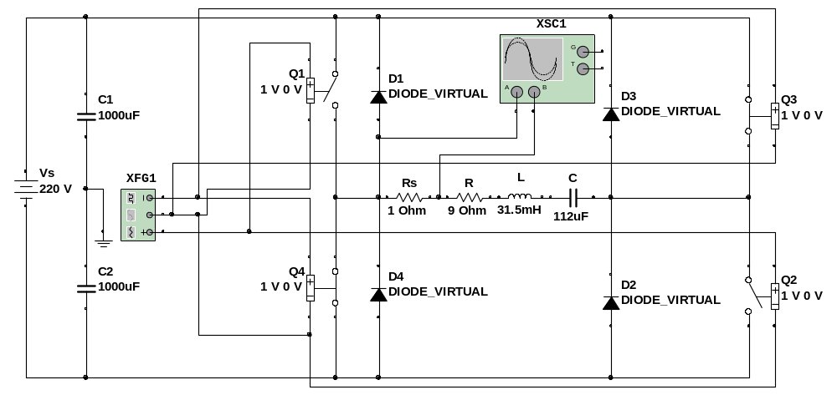
Example 6.3 using the scope

Slide 30
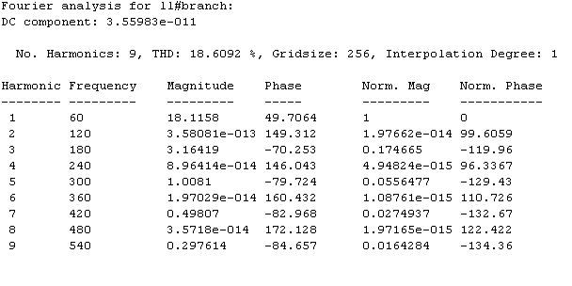
Fourier Analysis of load current

