Slide 1
Recommenders
Where are recommenders used? (Hint: everywhere!)
What does our dataset look like?
What are the high-level approaches to building a recommender?
Content-based
Collaborative filtering
Matrix factorization
How do we evaluate our recommender system?
How to deal with “cold start”?
What are the computational performance concerns?
Ryan Henning
(heavily based on Dan Becker’s slides
and on Giovanna's notes)
Notes:
This presentation is inspired by Dan Becker’s slides and by Gio’s markdown notes.

Slide 2
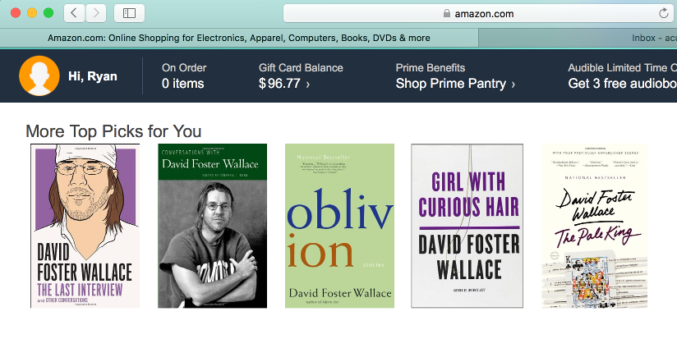
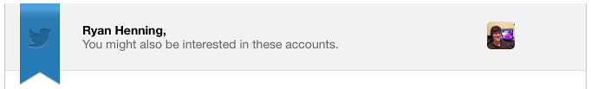


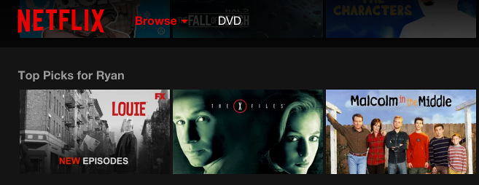
Where are recommenders used?
Notes:
Anyone want to name others?

Slide 3
Business Goals:
What will the user like?
What will the user buy?
What will the user click?
Name a business that cares are each of these, and tell us why they care.
Notes:
Facebook: like. They want you to be sucked in to their website, never leave, loose touch with reality, and in the end click a lot of their ads.
Amazon: buy. Obviously.
Google: click. Their ads!

Slide 4
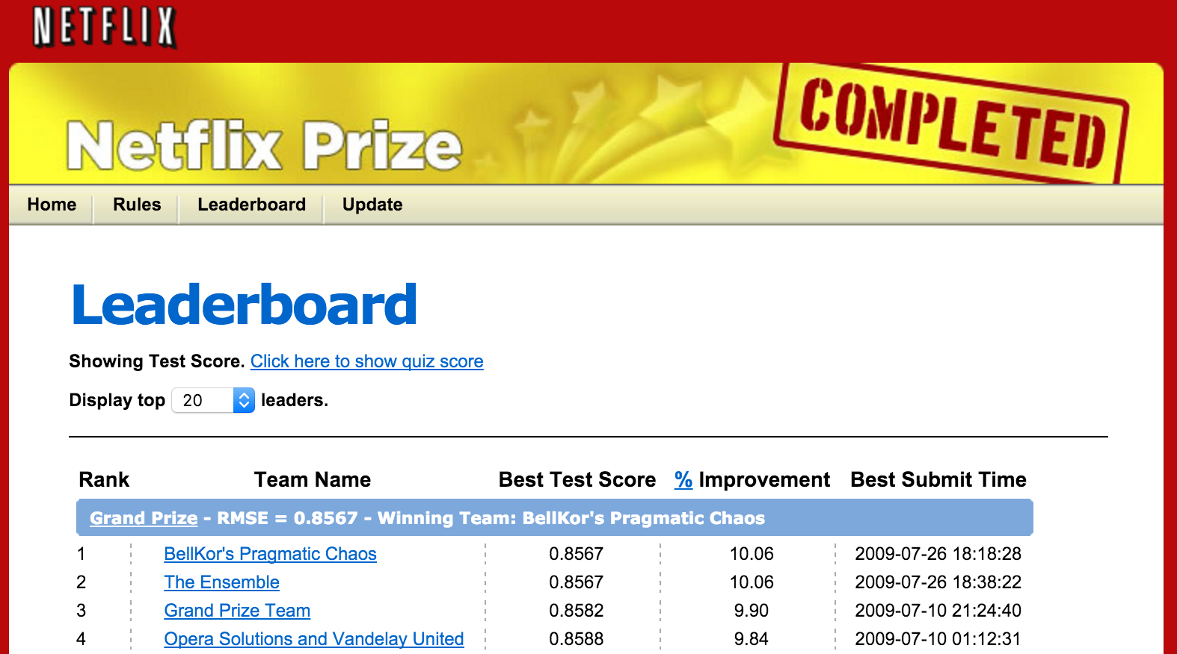
Data Science Canon:
Netflix’s $1,000,000 Prize (Oct. 2006 - July 2009)
Goal: Beat Netflix’s own recommender by 10%.
Took almost 3 years.
The winning team used gradient boosted decision trees over the predictions of 500 other models.
Netflix never deployed the winning algorithm.
Notes:
http://www.netflixprize.com/
https://en.wikipedia.org/wiki/Netflix_Prize
https://www.techdirt.com/blog/innovation/articles/20120409/03412518422/why-netflix-never-implemented-algorithm-that-won-netflix-1-million-challenge.shtml
http://blog.echen.me/2011/10/24/winning-the-netflix-prize-a-summary/
This really popularized recommender systems.
Training Dataset: 100,480,507 ratings that 480,189 users gave to 17,770 movies
Test Dataset: 2,817,131 rating predictions (predict a rating 1-5 for each)
Evaluation Metric: RMSE
The training set is such that the average user rated over 200 movies, and the average movie was rated by over 5000 users.
Netflix would award the $1M prize to the team whose model beat Netflix’s own model by 10% (i.e. had a RMSE reduced by 10% compared to Netflix’s model’s RMSE). Aka, go from RMSE of
The task was so hard that Netflix had to reward “progress prizes” every year to teams who were doing best so far. After one year: 8.43% improvement. After (almost) three years: 10.06% improvement. The final winning team (and the second-place team, for that matter) was a merger of several top teams.
Netflix never put the winning algorithm into production.

Slide 5
Let’s learn recommenders.
Today we’ll learn:
How to build a recommender,
How to evaluate your recommender, and
How to deploy your recommender.
… and tomorrow we’ll do a case study with recommender systems.

Slide 6
What are the high-level approaches to building a recommender?
Popularity:
Make the same recommendation to every user, based only on the popularity of an item.
E.g. Twitter “Moments”
Content-based (aka, Content filtering):
Predictions are made based on the properties/characteristics of an item.
User behavior is not considered.
E.g. Pandora Radio
Collaborative filtering:
Only consider past user behavior. (not content properties...)
User-User similarity: …
Item-Item similarity: ...
E.g.
Netflix & Amazon Recommendations,
Google Ads,
Facebook Ads, Search, Friends Rec., News feed, Trending news, Rank Notifications, Rank Comments
Matrix Factorization Methods:
Find latent features (aka, factors)
Notes:
Popularity can be measured by most-viewed, most-liked, etc.
Content-based uses things like category, price, genre, etc to find similar items. This is basically just supervised learning which we’ve been doing for weeks now! E.g. Pandora trains a new model for every radio station, using song properties as features and vote-up/-down as target.
Collaborative filtering is “collaborative” in the sense that it users the decision made by other users to predict your future ratings. Decisions are made entirely by the behavior (“collaboration”) of users. In this case, similar items are found by comparing them in user-space.
Often, you’ll use a hybrid approach (content-based + collaborative filtering).
We’ll talk about matrix factorization methods this afternoon, but recall how we’ve already done some of this with SVD and NMF.
In this rest of this lecture, we’ll be looking at collaborative filtering.
Ref:
https://www.quora.com/What-are-the-most-interesting-things-Facebook-is-doing-in-ML-research

Slide 7
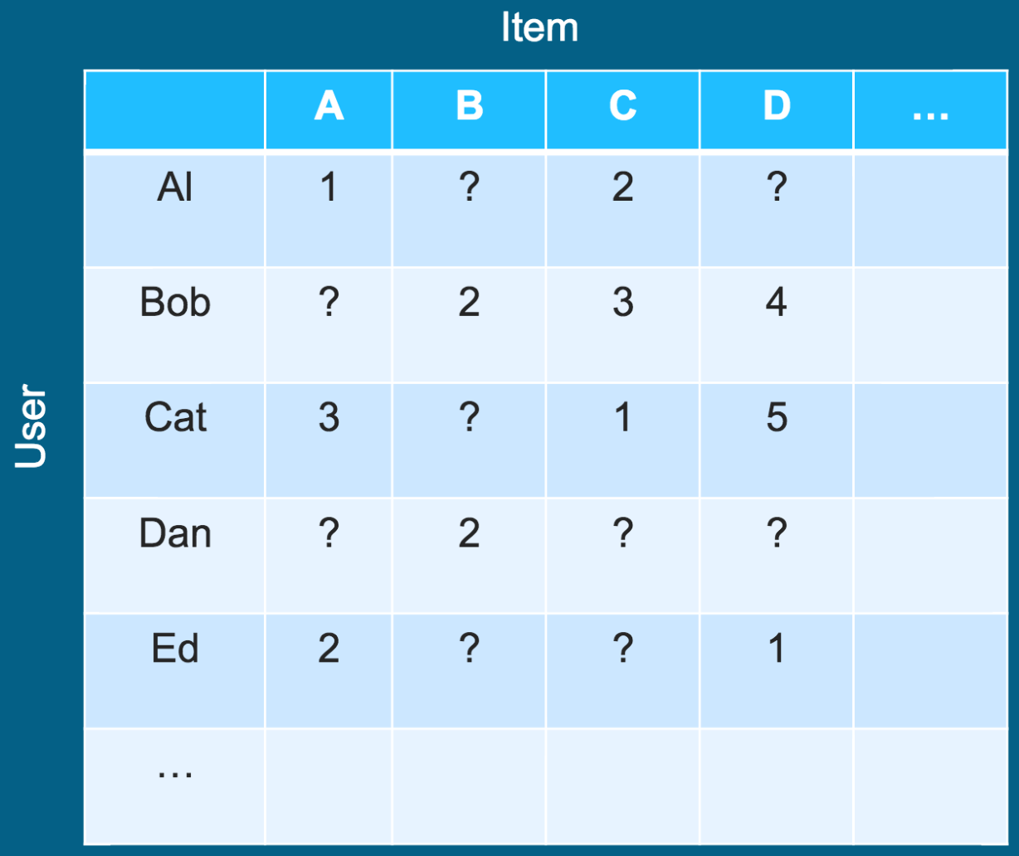
What does our dataset look like? (these looks like explicit ratings to me...)
What company might have data like this?
Btw, we call this the utility matrix.
Notes:
Netfix, Amazon reviews, ...

Slide 8
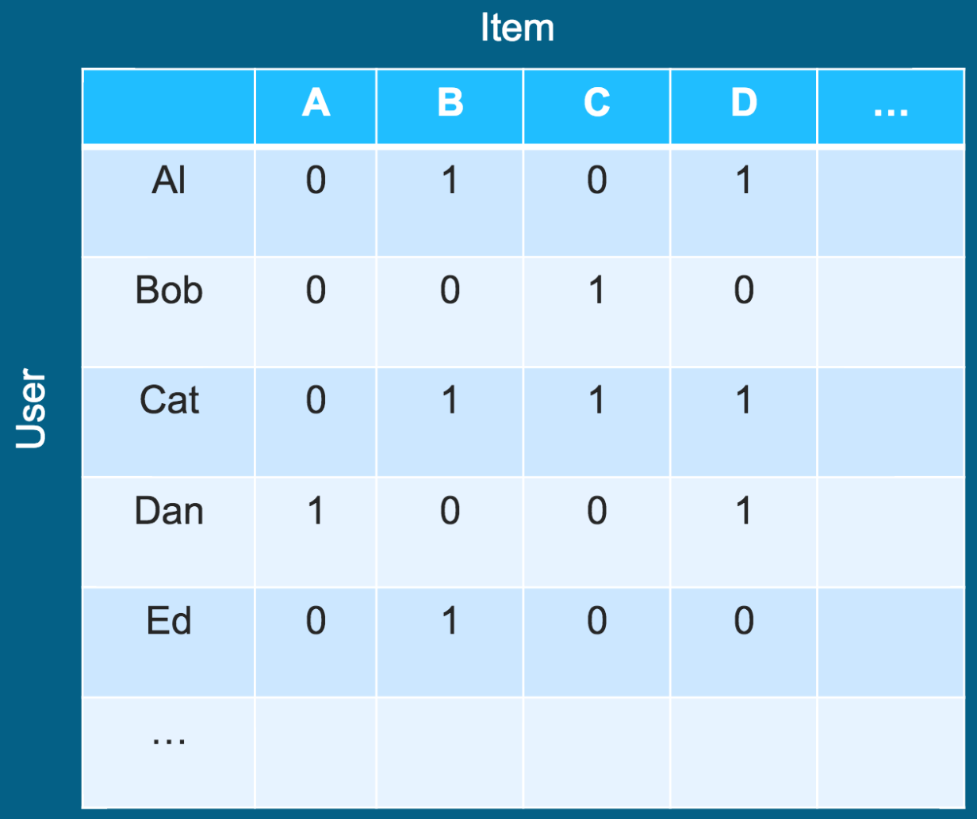
What does our dataset look like? (these looks like implicit boolean rating to me...)
What company might have data like this?
Btw, we call this the utility matrix.
Notes:
Amazon purchases, Facebook likes, Twitter hashtags, Youtube views, Article views ...

Slide 9
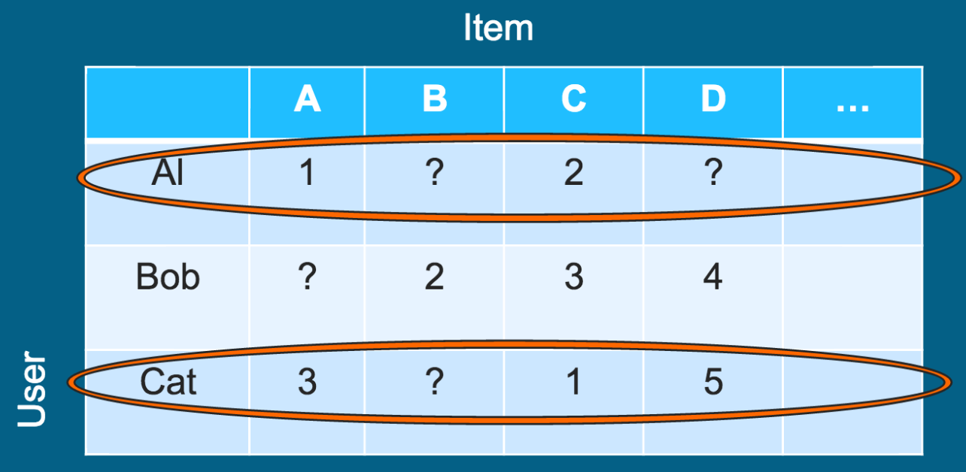
User-User similarities
We look at all pairs of users and calculate their similarity.
How can we calculate the similarity of these row vectors?
(We’ll get there.)

Slide 10
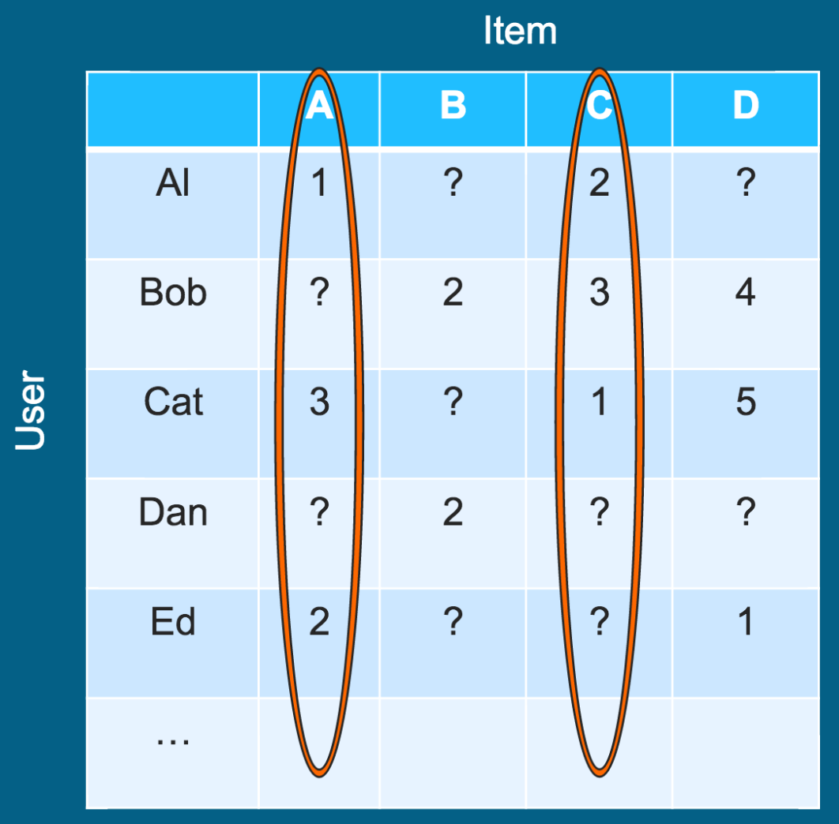
Item-Item similarities
We look at all pairs of items and calculate their similarity.
How can we calculate the similarity of these column vectors? (We’ll get there.)

Slide 11
User-User or Item-Item?
User-User:
Item-Item:
Let:
m = #users,
n = #items
We want to compute the similarity of all pairs.
What is the algorithmic efficiency of each approach?
User-User: O(m²n)
Item-Item: O(mn²)
Which one is better?
Notes:
Item-Item is better for two main reason: (1) it’s more efficient for most business where m>n, and (2) the similarities will be more stable (user pairs will have less overlap than item pairs), also this is related to “cold start” a bit -- e.g. a user may not have made many rating, so comparing two of those users would give unpredictable results.
We will do item-item for the rest of this presentation.

Slide 12
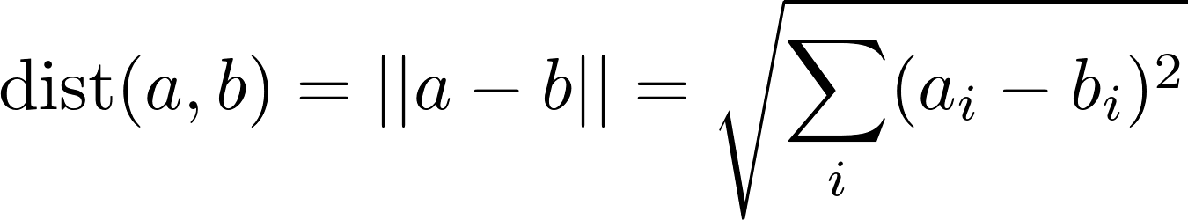
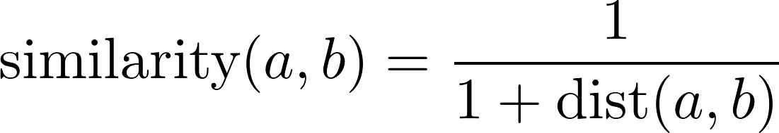
Similarity Metric using Euclidean Distance
What’s the range?
When use this?
But we’re interested in a similarity, so let’s do this instead:
What’s the range?
Notes:
The problem with dist(a, b) is that it grows unbounded and also we want 0 to mean “dissimilar”. When we switch to the similarity equation, the range is now (0, 1]
Use this… probably never.
\text{dist}(a, b) = || a-b || = \sqrt{\sum_i (a_i - b_i)^2}
\text{similarity}(a, b) = \frac{1} {1 + \text{dist}(a, b)}

Slide 13
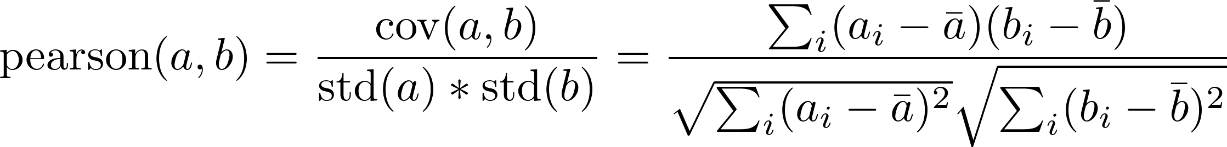
Similarity Metric using Pearson Correlation
What’s the range?
When use this?
But we’re interested in a similarity, so let’s do this instead:
What’s the range?
Notes:
The range of the pearson correlation is [-1, 1].
It measures how much the two vectors each deviate from their mean together. It isn't sensitive to a user who consistently rates low or high. E.g. the following two vector have pearson=1: (5, 5, 3), (2, 2, 1)
>>> import numpy as np
>>> print np.corrcoef([[5, 5, 3], [2, 2, 1]])[1, 0]
1.0
\text{pearson}(a, b) = \frac{\text{cov}(a, b)} {\text{std}(a) * \text{std}(b)} = \frac{ \sum_i (a_i - \bar{a}) (b_i - \bar{b}) } { \sqrt{ \sum_i (a_i - \bar{a})^2 } \sqrt{ \sum_i (b_i - \bar{b})^2 } }
\text{similarity}(a, b) = 0.5 + 0.5*\text{pearson}(a, b)

Slide 14
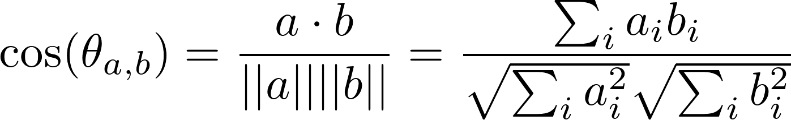
Similarity Metric using Cosine Similarity
What’s the range?
When use this?
But we’re interested in a standardized similarity, so let’s do this instead:
What’s the range?
Notes:
The range of cos is [-1, 1]
Use this when you care about the angle… duh. You often care about the angle for this sort of thing though. E.g. These two vectors have cos=1: (6, 6, 3), (2, 2, 1)
>>> import numpy as np
>>> a = np.array([6, 6, 3])
>>> b = np.array([2, 2, 1])
>>> a.dot(b) / np.linalg.norm(a) / np.linalg.norm(b)
1.0
\text{cos}(\theta_{a,b}) = \frac{ a \cdot b } {||a|| ||b||} = \frac{ \sum_i a_i b_i } { \sqrt{\sum_i a_i^2} \sqrt{\sum_i b_i^2} }
\text{similarity}(a, b) = 0.5 + 0.5 * \text{cos}(\theta_{a,b})

Slide 15
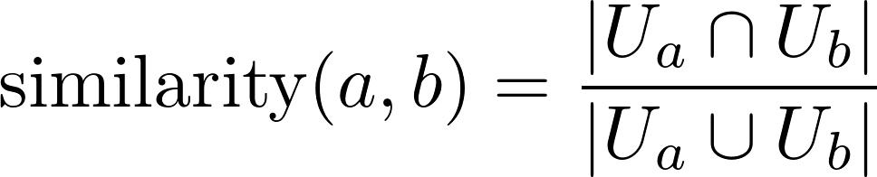
Similarity Metric using Jaccard Index
What’s the range?
When use this?
Notes:
Jaccard will be in [0, 1]. So that’s already good.
Use this one when you have a binary (implicit) utility matrix! E.g. Amazon’s purchase history.
\text{similarity}(a, b) = \frac{ | U_a \cap U_b | } { | U_a \cup U_b | }
U_k \text{ denotes the set of users who rated item } k

Slide 16
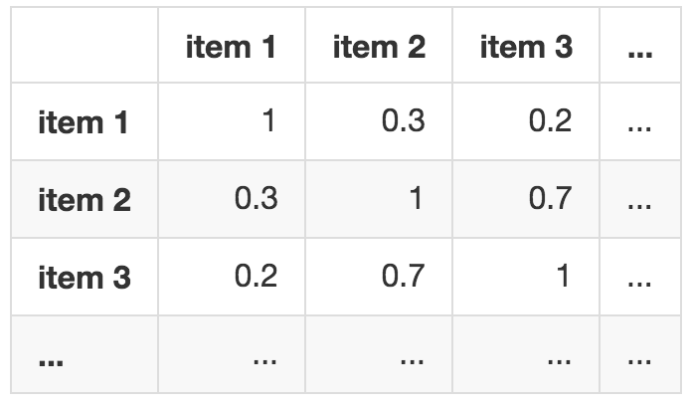
The Similarity Matrix
Pick a similarity metric, create the similarity matrix:

Slide 17
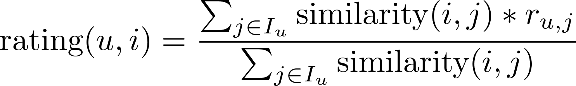
How to make predictions
Say user u hasn’t rated item i. We want to predict the rating that this user would give this item.
We order by descending predicted rating for a single user, and recommend the top k items to the user.
Notes:
We can think of this as a weighted average of the user's ratings of other items.
This reminds me of how GPA is calculated.
\text{rating}(u, i) = \frac{ \sum_{j \in I_u} \text{similarity}(i, j) * r_{u,j} } { \sum_{j \in I_u} \text{similarity}(i, j) }
I_u = \text{ set of items rated by user } u
r_{u,j} = \text{ user } u\text{'s rating of item } j

Slide 18
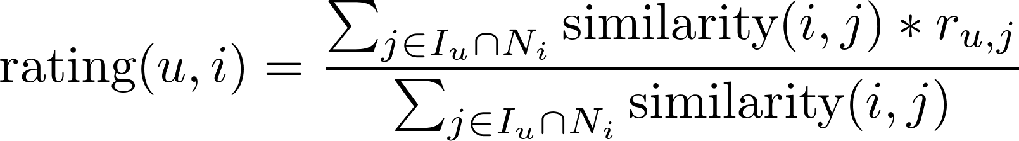
How to make predictions (using neighborhoods)
This calculation of predicted ratings can be very costly. To mitigate this issue, we will only consider the n most similar items to an item when calculating the prediction.
Notes:
\text{rating}(u, i) = \frac{ \sum_{j \in I_u \cap N_i} \text{similarity}(i, j) * r_{u,j} } { \sum_{j \in I_u \cap N_i} \text{similarity}(i, j) }
I_u = \text{ set of items rated by user } u
r_{u,j} = \text{ user } u\text{'s rating of item } j
N_i \text{ is the } n \text{ items which are most similar to item } i

Slide 19
Deploying the recommender
In the middle of the night:
Compute similarities between all pairs of items.
Compute the neighborhood of each item.
At request time:
Predict scores for candidate items, and make a recommendation.

Slide 20
How do we evaluate our recommender system?
Is it possible to do cross-validation like normal?
Before we continue, let’s review: Why do we perform cross-validation?
Quick warning: Recommenders are inherently hard to validate. There is a lot of discussion in academia (research papers) and industry (here, Kaggle, Netflix, etc) about this. There is no ONE answer for all dataset.

Slide 21
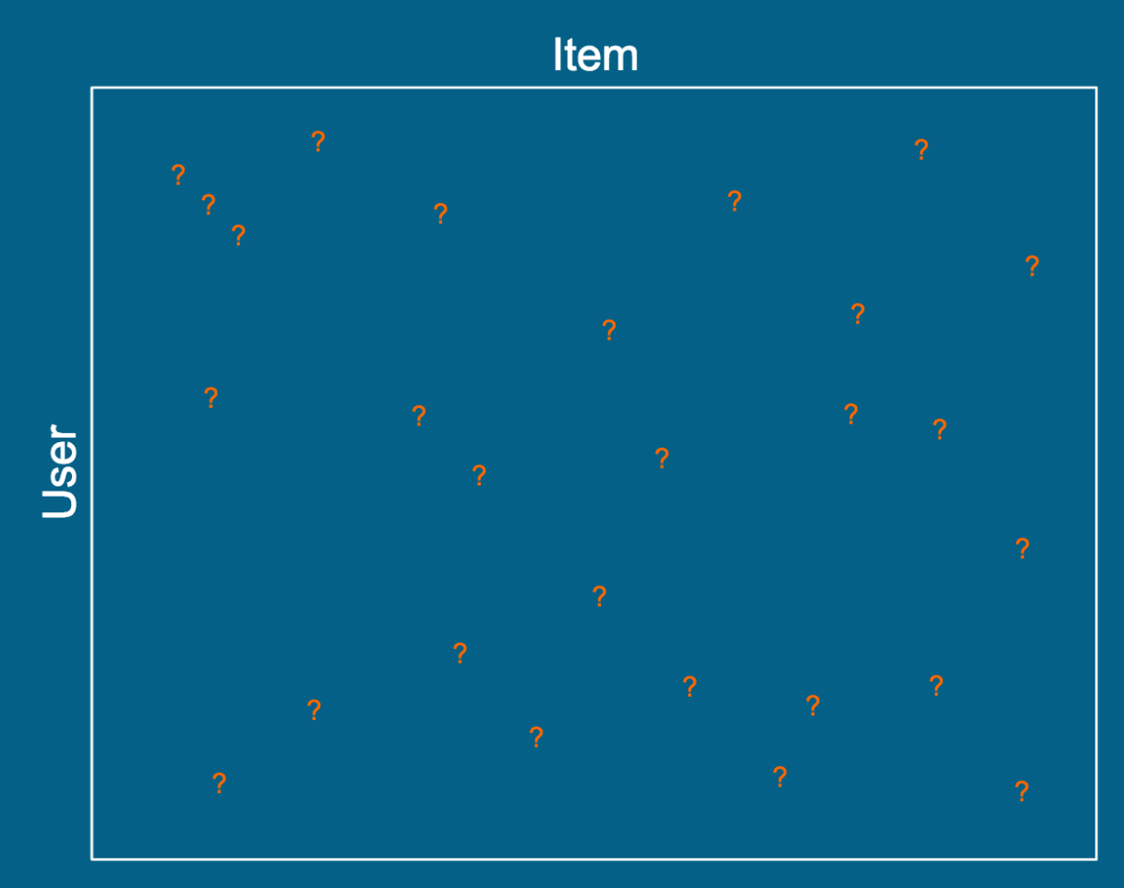
The closest thing to cross-validation
For this slide, the question marks denote the holdout set (not missing values).
We can calculate MSE between the targets and our predictions over the holdout set.
(K-fold cross-validation is optional.)
Recall: Why do we perform cross-validation?
Why isn’t the method above a true estimate of a recommender's performance in the field?
Why would A/B testing be better?
Notes:
Cross-validation is all about trying to measure our models future performance in the field.
In the field, we’re not really making rating predictions, but rather we’re trying to recommend the thing the user would want to see next. So, what we’re measuring here is different from what our model should be doing well in the field. Two ways to look at this:
1. We want to recommend the thing the user would want to see next, but we don’t actually have that information, so we can’t properly test our model, really. (E.g. Our predicted “top 10” probably will not have ratings by the user.)
2. We only care that our model recommends things in the right order, and we only care about the ordering of the top-rated items. So, in this cross-validation method, if the target is 2, and we predict 1, that’s not really so bad, but we’ll still get punished by MSE.
So… ideally we would A/B test our recommenders. But we still need to chose which ones to user as A and B!

Slide 22
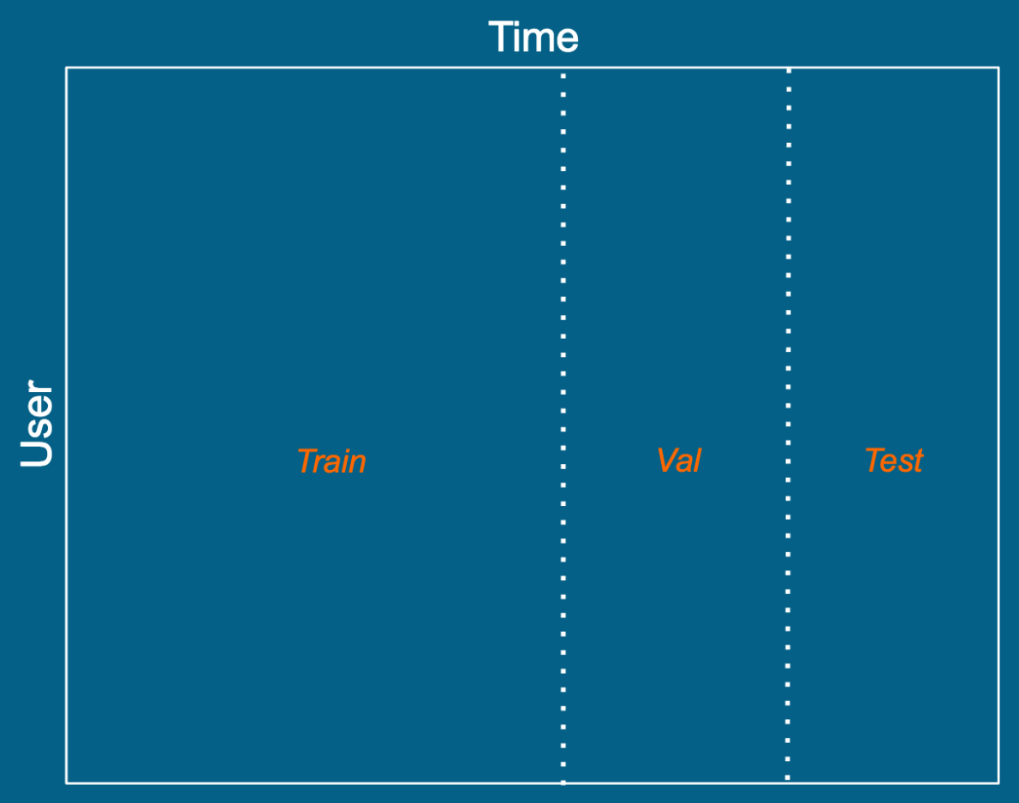
Alternate way to validate:
What’s the deal with this?
I.e. Why might we prefer doing this instead of the more “normal” cross-validation from the previous slide?
Notes:
This might capture more of how the recommender will perform in the wild, especially if the items have temporal behavior (as “new releases” on netflix probably do, but probably not items for sale on Amazon). The idea is that since we’re making future predictions, we’ll make the holdout set the future. This still has one of the same problems as the previous slide: in the wild, we only care that the top recommendations are good, but we still can’t actually measure that. E.g. Say our model recommends 10 movies… we look in the holdout set (from the future), and the user still hasn’t rated those movies. We CAN’T evaluate those recommendations as either good OR bad.

Slide 23
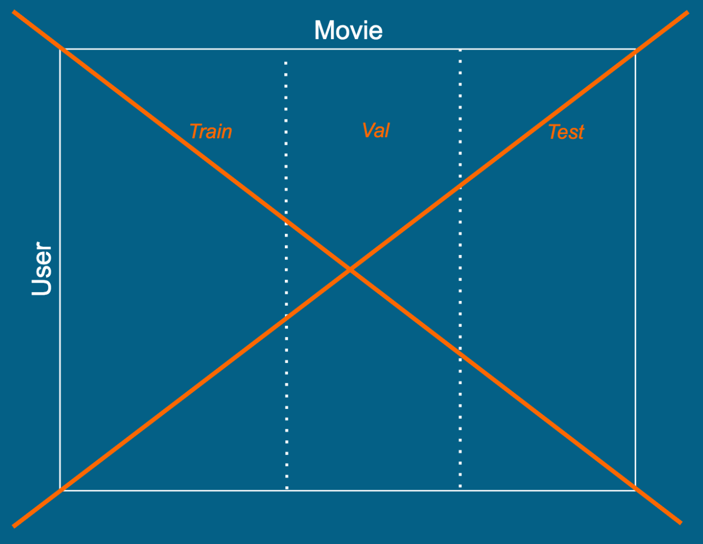
DON’T DO THIS! Why?
Notes:
Quick note: The label “Movie” can be seen more generally as “Item”.
Why is this bad? Remember, we’re taking similarities between items (movies, in this case). So if we train on only part of the items, how can we possible make predictions about items we have no data about? They’ll all be seen as equal (no info about any of them when we go to make predictions).

Slide 24
How to deal with “cold start”?
Scenario: A new user signs up. What will our recommender do (assume we’re using item-item similarities)?
One strategy: Force users to rate 5 items as part of the signup process. AND/OR Recommend popular items at first.
Scenario: A new item is introduced. What will our recommender do (assume we’re using item-item similarities)?
One strategy: Put it in the “new releases” section until enough users rate it AND/OR use item metatdata if any exists.
Notes:
In the case of a new user (assuming item-item similarities), the new user will not have rated anything. How does that affect our equations? Well, if the user has rated nothing, we’ll be dividing by zero in our rating() formula; that’s bad. If the user rates 1 item, all predications for that user will be the same. If the user rates 2 items (assume a different rating is given for each), then we’ll pick the item that is most similar to the top rated item of the 2 rated--but what if they rated both poorly? So, to get a good feel for the user, we need several rating first, both positive (high) and negative (low).
In the case of a new item (assuming item-item similarities), the new item will be rated by no user. How will that affect our equations? Well, this new item will be most similar to other items that have not been rated much (either these other items are also new, or they are just not popular). But that’s not necessarily true… not all new items are similar, and not all unpopular items are similar.

Slide 25
How to deal with “cold start”?
Scenario: A new user signs up. What will our recommender do (assume we’re Youtube and we’re using item popularity to make recommendations)?
This really isn’t a problem...
Scenario: A new item is introduced. What will our recommender do (assume we’re Youtube and we’re using item popularity to make recommendations)?
One strategy: Don’t use total number of views as the popularity metric (we’d have a rich-get-richer situation). Use something else...
Notes:
In the case of Youtube, an item would be a video.
The “something else” that we should use (in the right senario) might be something like “view velocity”. Equals (something like) #view-in-last-hour / #total-views. This can be seen as a way of normalizing to the number of past views the video has. One issue with this is if we have like <5 views. The velocity could be huge if just the poster’s family views the video within an hour. So, maybe we stick the video in “new releases” until it gets >20 views, then switch to “view velocity”. Or use “channel popularity” until the video gets enough views, then switch to “view velocity”.

Slide 26
Matrix Factorization for Recommendation
Warning: There are a lot of acronyms in this lecture!
UV Decomposition (UVD)
SVD vs UVD
UVD vs NMF
UVD via Stochastic Gradient Descent (SGD)
Matrix Factorization for Recommendation:
Basic system:
UVD + SGD... FTW
Intermediate topics:
regularization
accounting for biases
Ryan Henning
Notes:
http://citeseer.ist.psu.edu/viewdoc/summary?doi=10.1.1.147.8295

Slide 27

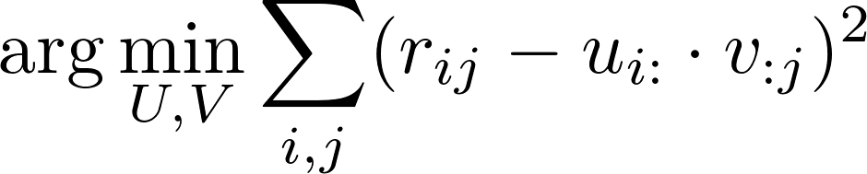
UV Decomposition (UVD)
You choose k.
UV approximates R by necessity if k is less than the rank of R.
Usually choose: k << min(n,m)
Compute U and V such that:
Least Squares!
Notes:
See: https://en.wikipedia.org/wiki/Rank_factorization
The reason you choose k << min(n,m) is because we want a dimensionality reduction and to find latent features (aka, factors).
R_{m \times n} \approx U_{m \times k} V_{k \times n}
r_{ij} \approx u_{i:} \cdot v_{:j}
\arg \min_{U,V} \sum_{i,j} (r_{ij} - u_{i:} \cdot v_{:j})^2

Slide 28
SVD vs UVD
SVD:
R = USV^{T}
U is an orthogonal matrix
S is a diagonal matrix of decreasing positive “singular” values
V is an orthogonal matrix
Has a unique, exact solution
UVD:
R ~= UV
U and V will not (likely) be orthogonal
Has many approximate, non-unique solutions:
non-convex optimization; has many local minima
Has a tunable parameter k

Slide 29
UVD vs NMF
UVD:
By convention: R ~= UV
… (see previous slides)
NMF:
By convention: V ~= WH
Same as UVD, but with one extra constraint: all values of V, W, and H must be non-negative!
NMF is a specialization of UVD!
Both are approximate factorizations, and both optimize to reduce the RSS.

Slide 30
UVD vs NMF (continued)
UVD and NMF are both solved using either:
Alternating Least Squares (ALS)
Stochastic Gradient Descent (SGD)
You did ALS yesterday, so let’s do SGD today!
(and we’ll see why SGD has some advantages for recommender systems)

Slide 31
UVD via Stochastic Gradient Descent (SGD)
Boardwork… (take notes!)

Slide 32
ALS vs SGD
ALS:
Parallelizes very well
Available in Spark/MLlib
Only appropriate for matrices that don’t have missing values (we’ll call this a dense matrix in this lecture)
SGD:
Faster (if on single machine)
Requires tuning learning rate
Anecdotal evidence of better results…
Works with missing values (we’ll call this a sparse matrix in this lecture) (we’ll see how missing values are handled soon!)

Slide 33
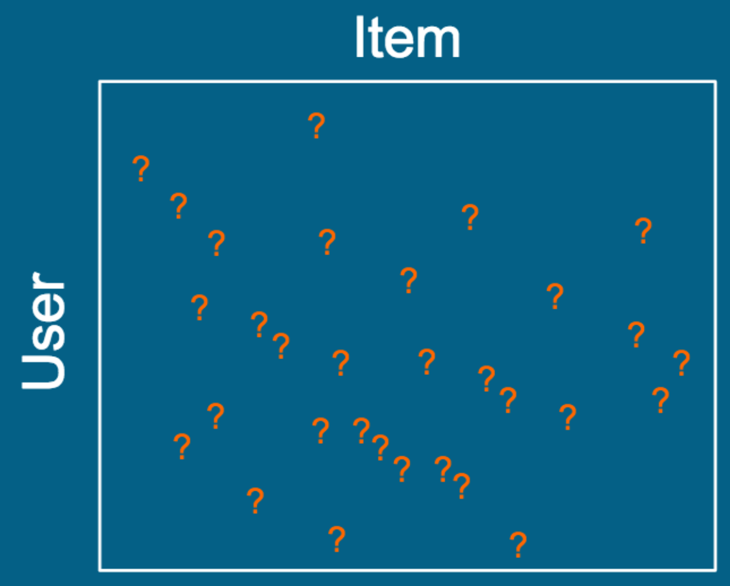
Matrix Factorization for Recommendation
Recall: An explicit-rating utility matrix is usually VERY sparse…
We’ve previously used SVD to find latent features (aka, factors)... Would SVD be good for this sparse utility matrix? (Hint: No!)
What’s the problem with using SVD on this sparse utility matrix?

Slide 34
Would UVD (or NMF) work better than SVD to find latent factors when the utility matrix is sparse?
(Hint: Consider ways to change the SGD algorithm to handle missing values in the sparse utility matrix.)

Slide 35
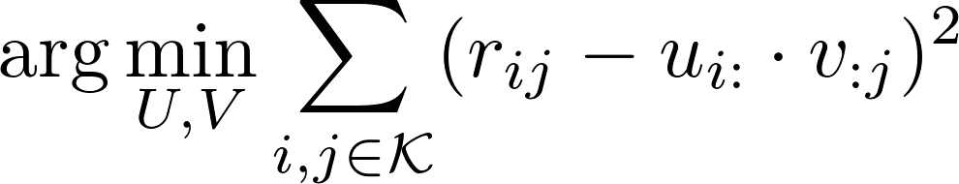
SVD vs UVD (revisited)
SVD:
R = USV^{T}
...
Bad if R has missing values!
You are forced to fill in missing values.
Solution fits these fill-values (which is silly).
Makes for a much larger memory footprint.
Slow to compute for large matrices.
UVD:
R ~= UV
…
Handles missing values when computed via SGD.
Set of indices of known rating
Notes:
\arg \min_{U,V} \sum_{i,j \in \mathcal{K}} (r_{ij} - u_{i:} \cdot v_{:j})^2

Slide 36
UVD (or NMF) + SGD… FTW!
UVD + SGD makes a lot of sense for recommender systems.
In fact, NMF + SGD is ‘best in class’ option for many recommender domains:
No need to impute missing values.
Use regularization to avoid overfitting.
Optionally include biases terms to communicate prior knowledge.
Can handle time-dynamics (e.g. change in user preference over time).
Used by the winning entry in the Netflix challenge.

Slide 37
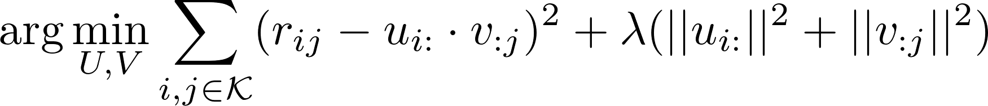
Warning: Don’t forget to regularize!
Since now we’re fitting a large parameter set to sparse data, you’ll most certainly need to regularize!
Tune lambda: the amount of regularization
Notes:
\arg \min_{U,V} \sum_{i,j \in \mathcal{K}} (r_{ij} - u_{i:} \cdot v_{:j})^2 + \lambda (||u_{i:}||^2 + ||v_{:j}||^2)

Slide 38

Accounting for Biases (let’s capture our domain knowledge!)
In practice, much of the observed variation in rating values is due to item bias and user bias:
Some items (e.g. movies) have a tendency to be rated high, some low.
Some users have a tendency to rate high, some low.
We can capture this prior domain knowledge using a few bias terms:
Item j’s average deviation from the overall average
The overall bias of the rating by user i for item j
The overall average rating
(i.e. the overall bias)
User i’s average deviation from the overall average
Notes:
b_{ij} = \mu + b^*_i + b'_j

Slide 39

We added bais terms… now:
The 4 parts of a prediction
The prediction of how user i will interact with item j
The prediction of user i rating item j
User i’s tendency to deviate from the average
Item j’s tendency to deviate from the average
The average rating
Notes:
r_{ij} \approx \mu + b^*_i + b'_j + u_{i:} \cdot v_{:j}

Slide 40
Accounting for Biases (the new cost function)
Ratings are now estimated as:
The new cost function, with the biases included:
New part!
New part!
Notes:
r_{ij} \approx \mu + b^*_i + b'_j + u_{i:} \cdot v_{:j}
\arg \min_{U,V, b^*, b'} \sum_{i,j \in \mathcal{K}} (r_{ij} - \mu - b^*_i - b'_j - u_{i:} \cdot v_{:j})^2 + \lambda_1 (||u_{i:}||^2 + ||v_{:j}||^2) + \lambda_2 ( (b^*_i)^2 + (b'_j)^2)

Slide 41
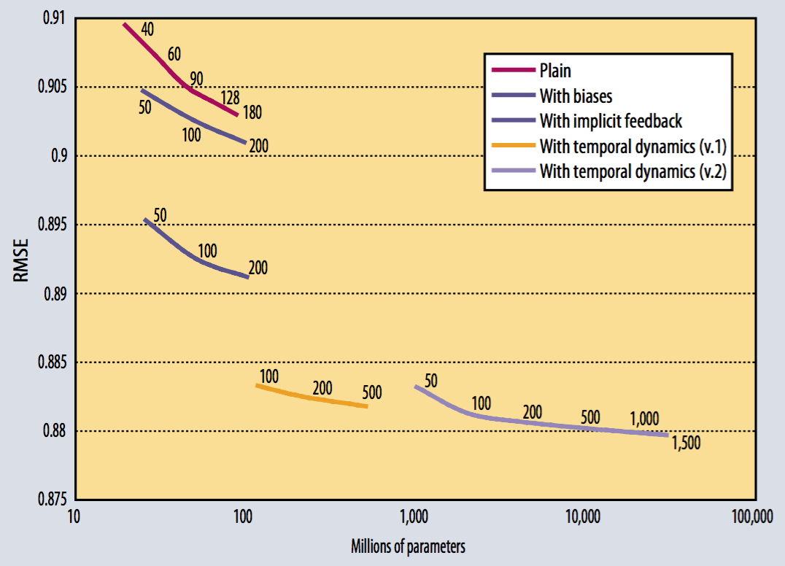
From the paper: “Matrix Factorization Techniques for Recommender Systems”
Root mean square error over the Netflix dataset using various matrix factorization models.
Numbers on the chart denote each model’s dimensionality (k).
The more refined models perform better (have lower error).
Netflix’s inhouse model performs at RMSE=0.9514 on this dataset, so even the simple matrix factorization models are beating it!
Read the paper for details; it’s a good read!

