Slide 1
Dimensionality Reduction

Slide 2
Curse of Dimensionality
[Wikipedia] The curse of dimensionality (Bellman, 1961) refers to various phenomena that arise when analyzing and organizing data in high- dimensional spaces (often with hundreds or thousands of dimensions) that do not occur in low-dimensional settings such as the three-dimensional physical space of everyday experience.
Counterintuitive geometry of hyperspace! Sparsity of sample data points!
●
●

Slide 3
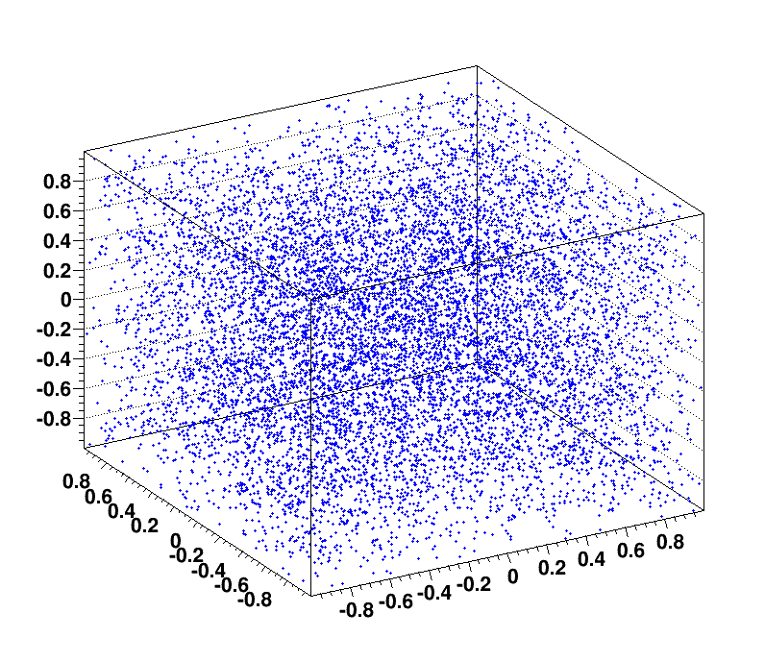
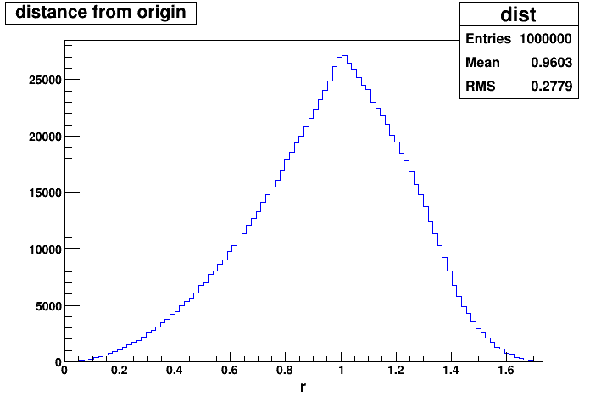
Distance in Hyperspace
Distance between nearest neighbors is very large!
Simple simulation: uniformly distributed points in a cube.

Slide 4
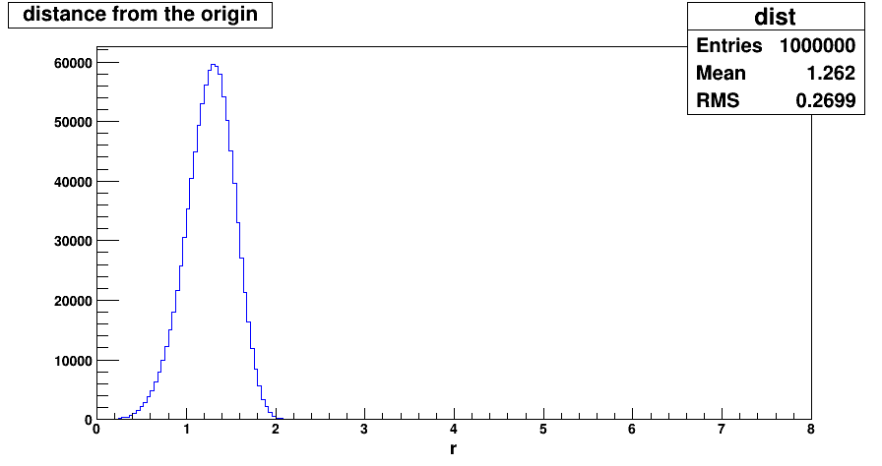
Distance in Hyperspace
Distance between nearest neighbors is very large!
Simple simulation: uniformly distributed points in a hypercube.
5 D

Slide 5
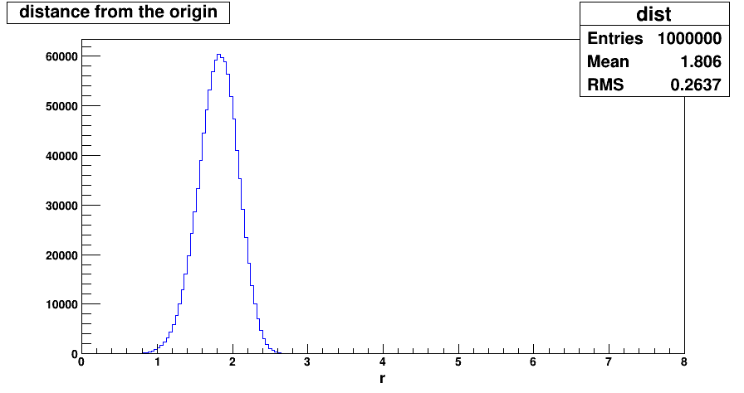
Distance in Hyperspace
Distance between nearest neighbors is very large!
Simple simulation: uniformly distributed points in a hypercube.
10 D

Slide 6
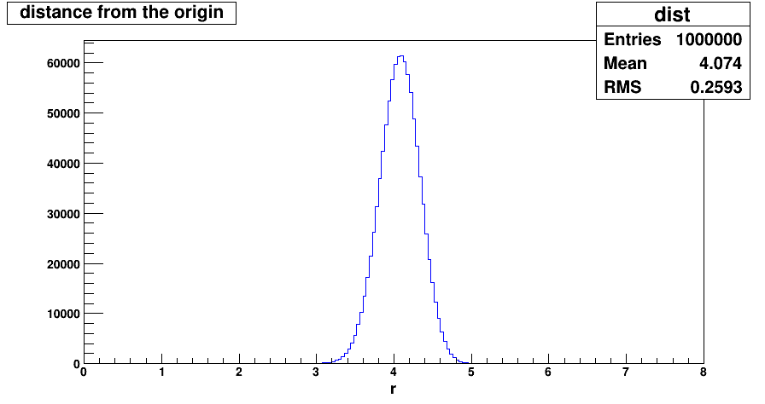
Distance in Hyperspace
Distance between nearest neighbors is very large!
Simple simulation: uniformly distributed points in a hypercube.
50 D

Slide 7
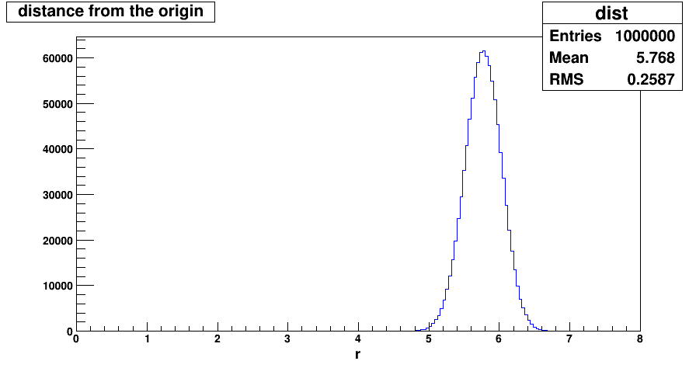
Distance in Hyperspace
Distance between nearest neighbors is very large!
Simple simulation: uniformly distributed points in a hypercube.
100 D
Most data points are closer to the boundary of the sample space.

Slide 8
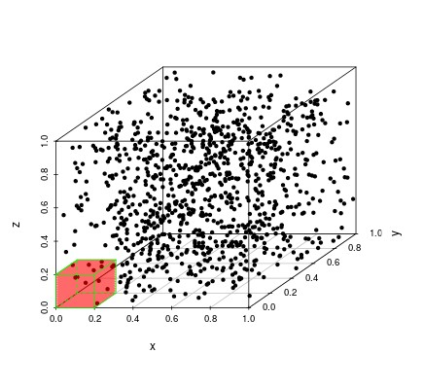
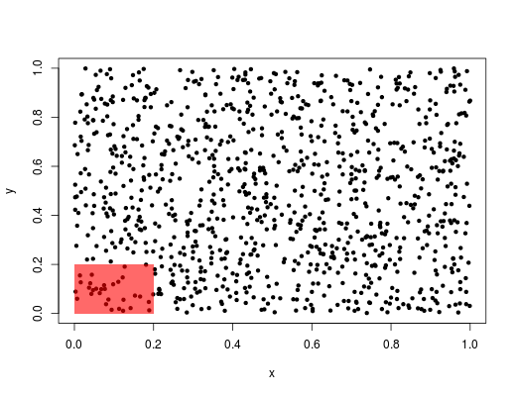
Sample Sparsity
When the dimensionality d increases, the volume of the space increases so fast that the available data becomes sparse.
Consider uniformly distributed data points. N = 1000 Cover 20% of range of each feather.
Fraction of data points captured: 2D : 3.1%
3D : 0.5%

Slide 9
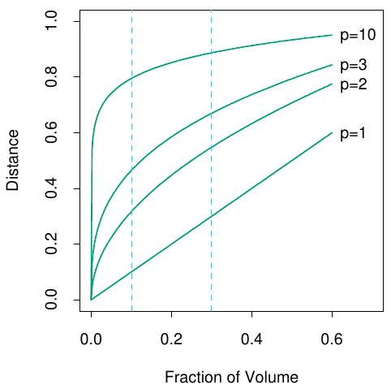
Sample Sparsity
For fraction r of unit volume: Edge length: e ( r )=r^{1 / d}
In ten dimensions we need to cover 80% of the range of each coordinate to capture 10% of the data.
Reducing r gives fewer observations to average - higher variance of fit.
d
d d
d
e (r)

Slide 10
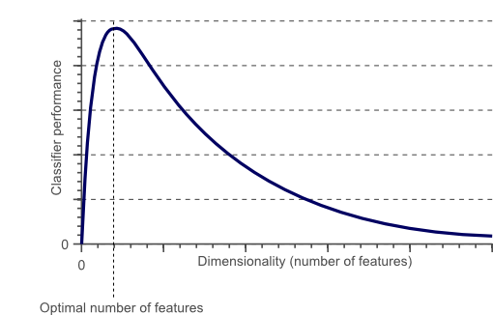
Classifier Performance
As the dimensionality increases, the classifier’s performance increases until the optimal number of features is reached.
Increasing the dimensionality further without increasing the number of training samples results in a decrease in classifier performance.

Slide 11
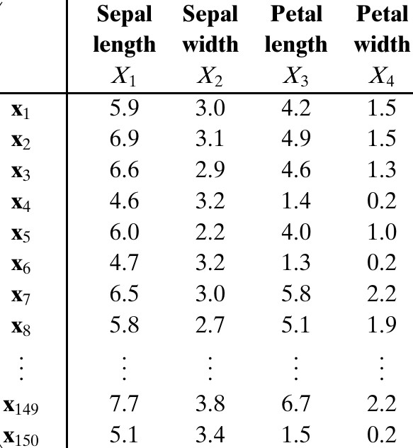
Data Matrix
D = [
]
^{x}11 ^{x}12 ^{⋯ x}1 d x x₂₂ ⋯ x
⋮ ⋮ ⋱ ⋮
^{x}n 1 ^{x}n 2 ^{⋯ x}nd
21
2 d
D = [
]
T
x₁
x
⋮
T
2
T
x_{n}
x_{i}
^{T} are dimensional row vectors.
Extract from Iris data set.
D = [y₁ y₂ ⋯ y_{d} ]
y _{j}
are column vectors.

Slide 12
Rank and Dimensionality
Linear Independence
For any set of n vectors, a linear combination is an expression of the form:
c₁ y₁+c₂ y₂ +⋯+c_{n} y_{n}
Now consider an equation:
c₁ y₁+c₂ y₂+⋯+ c_{n} y_{n}=0
If this equation holds only if all ci's are zero, then yi's are linearly independent vectors.
If the equation holds with ci's not equal to zero, then the vectors are linearly dependent. This means, we can express at least one of the vectors as linear combination of the others. e.g.,
y₁=k ₂ y₂ +⋯+ k _{n} y_{n} where k _{j} =−c _{j} / c₁

Slide 13
Rank and Dimensionality
The rank of a matrix D
Maximum number of linearly independent column vectors of D
Maximum number of linearly independent row vectors of D.
D = [y₁ y₂ ⋯ y_{d} ]
D is a [n x d] matrix. Then, the rank(D) = r ≤ min(n, d)
Rank of data matrix gives the dimensionality of the data.

Slide 14
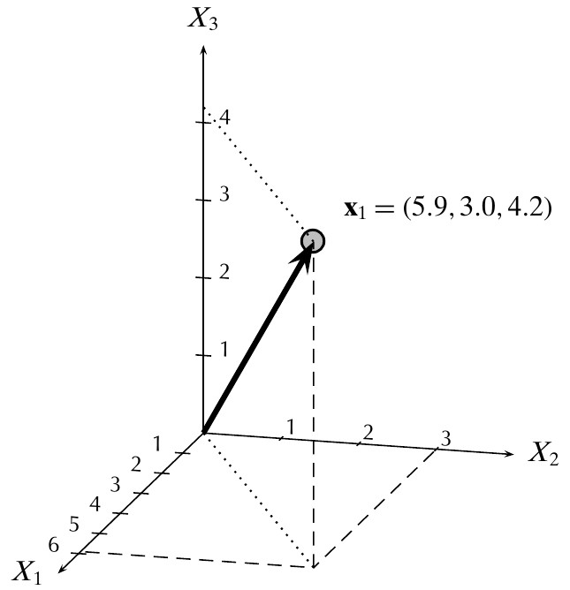
Rank and Dimensionality
The number of linearly independent basis vectors needed to represent a data vector, gives the dimensionality of the data. e.g.,
x= x₁ e₁+ x₂ e₂ +⋯+ x_{d} e_{d}
The data points apparently reside in a d-
dimensional attribute space.
But, if r < d, then the data points actually reside in a lower r-dimensional space.
3 dimensional space

Slide 15
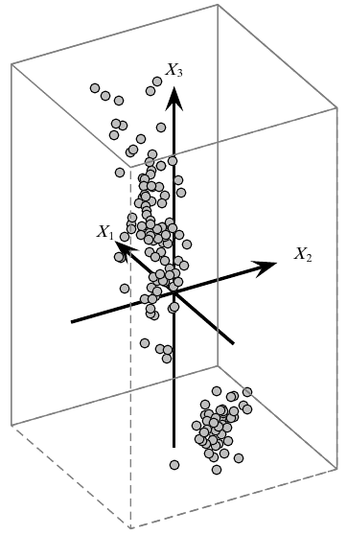
Dimensionality Reduction
[ ]
T
x₁
T
D =
x₂
⋮
T
e₃
x_{n}
T T
Each point
x_{i} =( x_{1,} x_{2,} … x_{d} )
is a vector
in d-dimensional vector space.
We can write x as
d
x=∑ x_{i} e_{i}
i =1
where ei are orthonormal basis vectors:
e₂
e₁
T
e_{i} e _{j} =1
=0
if i= j
if i≠ j

Slide 16
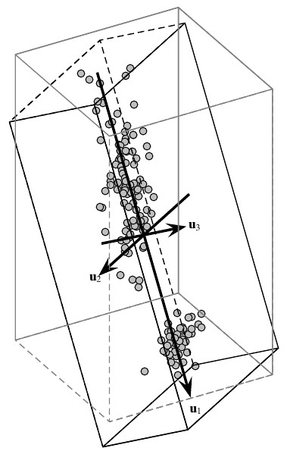
Dimensionality Reduction
[ ]
T
x₁
T
D =
x₂
⋮
T
x_{n}
T T
Each point
x_{i} =( x_{1,} x_{2,} … x_{d} )
is a vector
in d-dimensional vector space.
Given any other set of d orthonormal vectors:
d
x=∑ a_{i} u_{i}
i =1
where ui are orthonormal basis vectors, and
T
u_{i} u _{j} =1
=0
if i= j
if i≠ j

Slide 17
Dimensionality Reduction
[ ]
T
a₁
T
A =
a₂
⋮
T
a_{n}
T T
Each point
a_{i} =(a_{1,} a_{2,}… a_{d} )
is a vector
in d-dimensional vector space.
a _{j} =u _{j} x
T
In vector form:
a=U^{T} x
U=(u₁ u₂ … u_{d} )

Slide 18
Dimensionality Reduction
Because there are potentially infinite choices for the set of orthonormal basis vectors, one natural question is whether there exists an optimal basis, for a suitable notion of optimality.
Can we find a reduced dimensionality subspace that still preserves the essential characteristics of the data.
Basic idea is to project data points from a d dimensional space to an r
dimensional space where r < d.
r
x ' =∑ a_{i} u_{i}
i=1
d
ϵ= ∑ a_{i} u_{i} =x−x '
i =r + 1
error vector

Slide 19
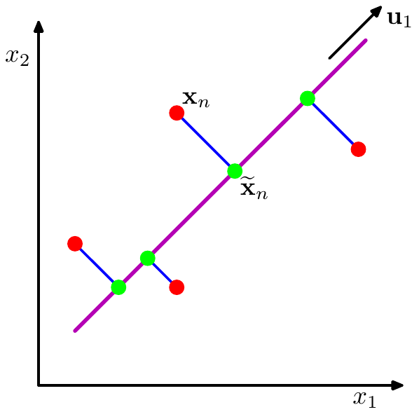
Principle Component Analysis
Principal Component Analysis (PCA) is a technique that seeks a r- dimensional basis that best captures the variance in the data.
The direction with the largest projected variance is called the first principal component.
The orthogonal direction that captures the second largest projected variance is called the second principal component, and so on.
x_{i}
x_{i} '

Slide 20
Principle Component Analysis
First Principle Component: We have to choose the direction u such that the variance of the projected points is maximized.
The projected variance along u is:
n
2
1
n
∑
i=1
2
σ =
(a −μ )
u
i u
For centered data:
σ²=u^{T} Σ u
u
Σ is covariance matrix of centered D.
Σ= ¹ D^{T} D
n

Slide 21
Principle Component Analysis
Maximizing σ (with constraint u^{T}u = 1) gives:
Σ u=λ u
σ_{u}=λ
2
To maximize projected variance, we maximize the eigenvalue of Σ
Eigenvector u with maximum λ specifies the direction of most variance, also called the first principal component.

Slide 22
Principle Component Analysis
To find the best r-dim approximation to D, we compute the eigenvalues of the covariance matrix Σ.
Eigenvalues of Σ are non-negative, and we can sort them in decreasing order:
λ₁≥λ₂≥… λ_{r} ≥λ_{r + 1} …≥λ_{d} ≥0
Eigenvector corresponding to λ1 gives first principle component, eigenvector corresponding to λ2 gives the second principle component, and so on.

Slide 23
Principle Component Analysis
Reduced r-dimensional data matrix is then:
A=[ α₁
α ₂ … α _{r} ]
Total variance of A:
r
var ( A )=∑ λ_{i}
i =1
The first r-principal components maximize the projected variance var(A), and thus they also minimize the MSE.
1
n
MSE =
∑
T
ϵ ϵ
ϵ_{i} =x_{i} −x_{i} '
^{n} i=1
i i
=var ( D)−var (A)

Slide 24
Principle Component Analysis
Choosing the dimensionality: how many dimensions, r, to use for a good approximation.
Compute the fraction of the total variance captured by the first r principal components:
λ₁ +λ₂+…+ λ_{r}
var (A)
var (D)
^{f (r )=} λ + λ +…+ λ ⁼
1
2
d
Starting from the first principal component, then keep on adding additional components, and stop at the smallest value r, for which f (r ) ≥ α.
In practice, α is usually set to 0.9 or higher, so that the reduced dataset captures at least 90% of the total variance.

Slide 25
PCA for n < d
The covariance matrix is a d x d matrix.
Typical algorithms for finding eigenvectors of d x d matrix have a computational cost that scales like O(d³).
For n<d, there are only n non-zero eigenvalues of covariance matrix.
Starting from the eigenvalue equation:
Σ u_{i} =λ_{i} u_{i}
We can write an eigenvalue equation:
1
n
T
DD v =λ v
i i i
where v_{i} = Du_{i}.
This is an eigenvalue equation of n x n matrix!
u =
1 T
√
D v
i
n λ
i
In summary, to apply this approach we first evaluate DD^{T} and then find its eigenvectors and eigenvalues, and then compute the eigenvectors in the original data space.
i

Slide 26
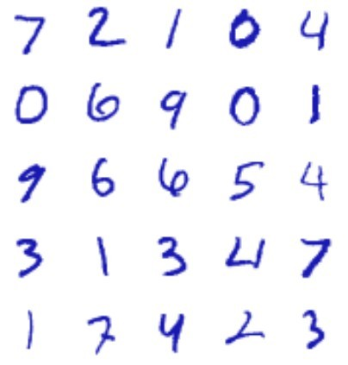
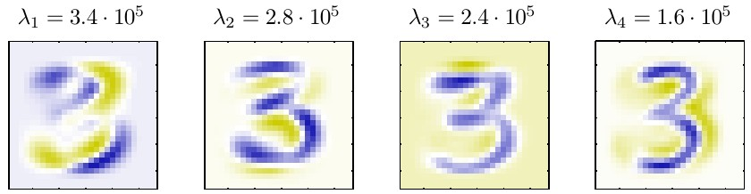
Application of PCA
PCA for Image Compression: Handwritten digits from MNIST data set.
Each digit is centered in 28 x 28 pixel box. So,each digit can be represented as a vector in 784-dimensional vector space.
Each eigenvector of the covariance matrix is a vector in in the original d-dimensional space, we
can represent the eigenvectors as images of the same size as the data points.
u₁
u₂
u₃
u₄

Slide 27
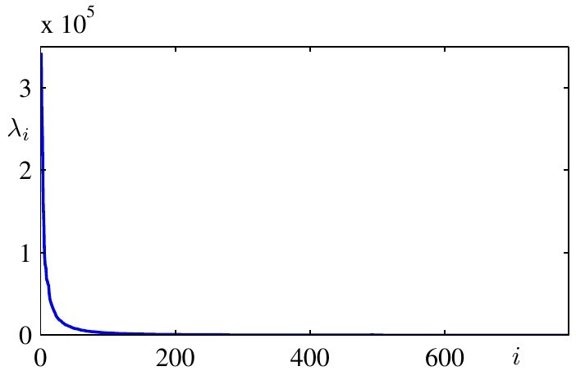
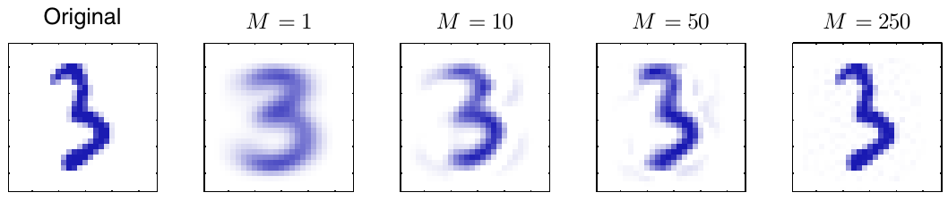
Application of PCA
Plot of the complete spectrum of eigenvalues, sorted into decreasing order.
An original example from the digits data set together with its PCA reconstructions obtained by retaining r principal components for various values of r.
r r r r

Slide 28
Singular Value Decomposition
PCA yields the following decomposition of covariance matrix:
2 T
Σ =U Λ U^{T}
σ_{i} =λ =u
Σ u
i
i
i
( )
λ₁ | 0 | ⋯ | 0
⋮ | λ₂ ⋮ | ⋯ ⋱ | 0 ⋮
Λ =
0
0 0 ⋯ λ
d
Λ is the covariance matrix in new basis.

Slide 29
Singular Value Decomposition
PCA is a special case of more general matrix decomposition:
Singular Value Decomposition (SVD).
An n x d data matrix D can be factorized as:
{
δ If i= j
0 If i≠ j
D=LΔ R^{T}
Δ (i , j )=
i
i = 1, …. n j = 1, …. d
δi : singular values
L : n x n left singular matrix R : d x d right singular matrix Δ : n x d diagonal matrix

Slide 30
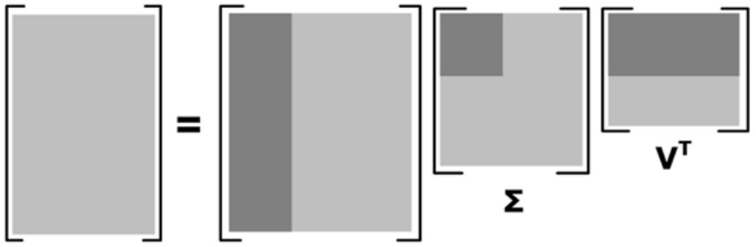
Singular Value Decomposition
If the rank of D is r ≤ min(n, d), then there will be only r nonzero singular values:
δ₁≥δ₂≥…≥δ_{r} ≥0
One can discard those left and right singular vectors that correspond to zero singular values, to obtain the reduced SVD as:
D_{r} =L_{r} Δ _{r} R _{r}
T
L_{r}
Δ_{r}
_{Rr}T
_{R}T
Δ
D
L

Slide 31
Connection Between PCA and SVD
PCA gives:
D^{T} D=n Σ
=U (n Λ) U^{T}
SVD gives:
D^{T} D=(R Δ L^{T} )^{T} (R Δ L^{T} )
2 T
=R Δ R
d
2
where Δd is the d x d diagonal matrix defined as
Δ ² (i , i)=δ²
d i
2
Comparing both:
δ_{i} =n λ_{i}
R=U
The right singular vectors in R are the same as eigenvectors of Σ.
The left singular vectors in L are the eigenvectors of the matrix n x n
matrix DD^{T}, and the corresponding eigenvalues are given as δi .
2

Slide 32
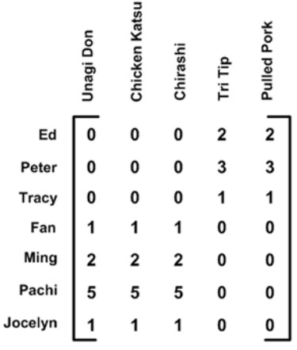
Finding Topics/Concepts
SVD can be used to find latent topics in the data.
0 | 0 | 0 | 2 | 3
0 | 0 | 0 | 4 | 2
0 | 0 | 0 | 3 | 3
1 | 2 | 1 | 0 | 0 | 1 | 2 | 1 | 0 | 0
2 | 1 | 3 | 0 | 0 | 2 | 1 | 3 | 0 | 0
5 | 4 | 3 | 0 | 0 | 5 | 4 | 3 | 0 | 0
1 | 2 | 1 | 0 | 0 | 1 | 2 | 1 | 0 | 0
0 0 0 2 3
0 0 0 4 2
0 0 0 3 3

Slide 33
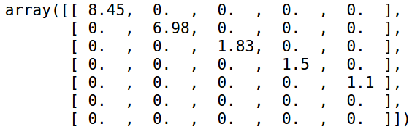
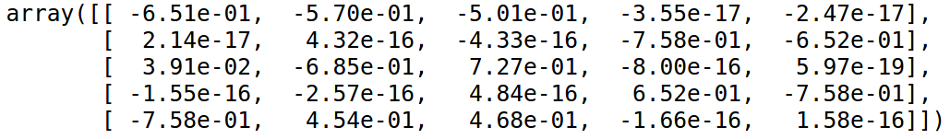
Finding Topics/Concepts
Δ =
0 0 0 2 3
0 0 0 4 2
0 0 0 3 3
1 | 2 | 1 | 0 | 0
2 | 1 | 3 | 0 | 0
5 | 4 | 3 | 0 | 0
1 | 2 | 1 | 0 | 0
R^{T} =

Slide 34
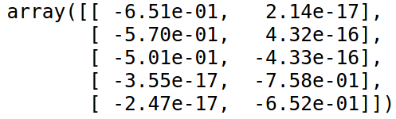
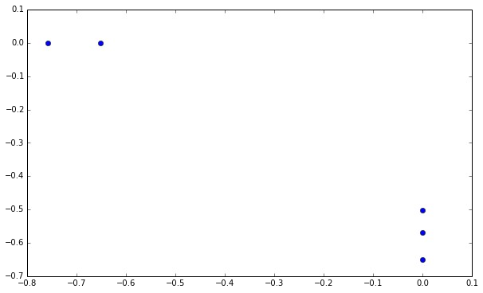
Finding Topics/Concepts
R₂ =
0 0 0 2 3
0 0 0 4 2
0 0 0 3 3
1 | 2 | 1 | 0 | 0
2 | 1 | 3 | 0 | 0
5 | 4 | 3 | 0 | 0
1 | 2 | 1 | 0 | 0

Slide 35
Multidimensional Scaling
Distance Matrix or Proximity Matrix
[ ]
^{δ}1 1 ^{δ}1 2
2 1 ^{δ}2 2
^{δ}n 1 ^{δ}n 2
⋯
⋯
^{δ}1 n
2 n
δ_{i j}=‖x_{i}−x _{j}‖
Euclidean distance between two vectors
Δ=
δ
δ
⋮ | ⋮ | ⋱ | ⋮
⋯
^{δ}nn
MDS is a process used to find lower dimensional representation that give the same distance between points.

Slide 36
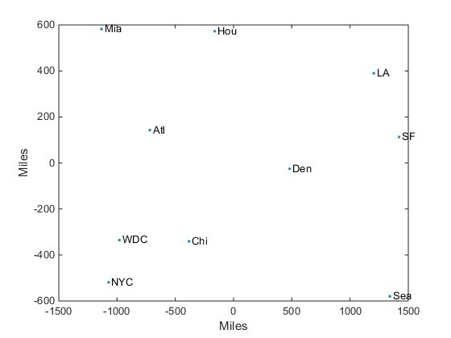
Multidimensional Scaling
The following steps summarize the algorithm of MDS
Calculate the matrix of squared proximities: Δ²
Calculate the matrix B= ¹ J Δ² J
J=I− ¹ 11^{T}
2
n
Obtain SVD of B
B=U Λ U^{T}
For a 2-dim representation, keep two eigenvectors corresponding to the largest eigenvalues.

