Slide 1
Recommender Systems
Dan Becker

Slide 2
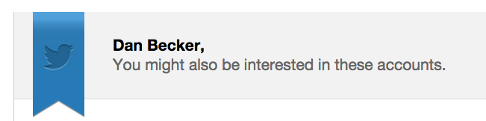
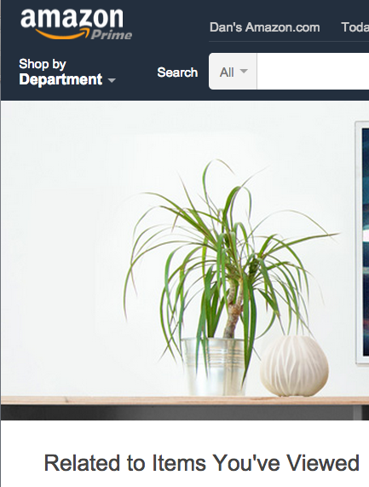

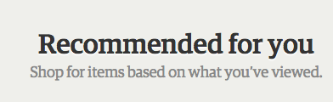


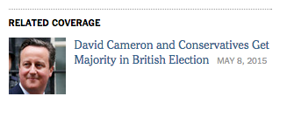


Recommenders Everywhere

Slide 3
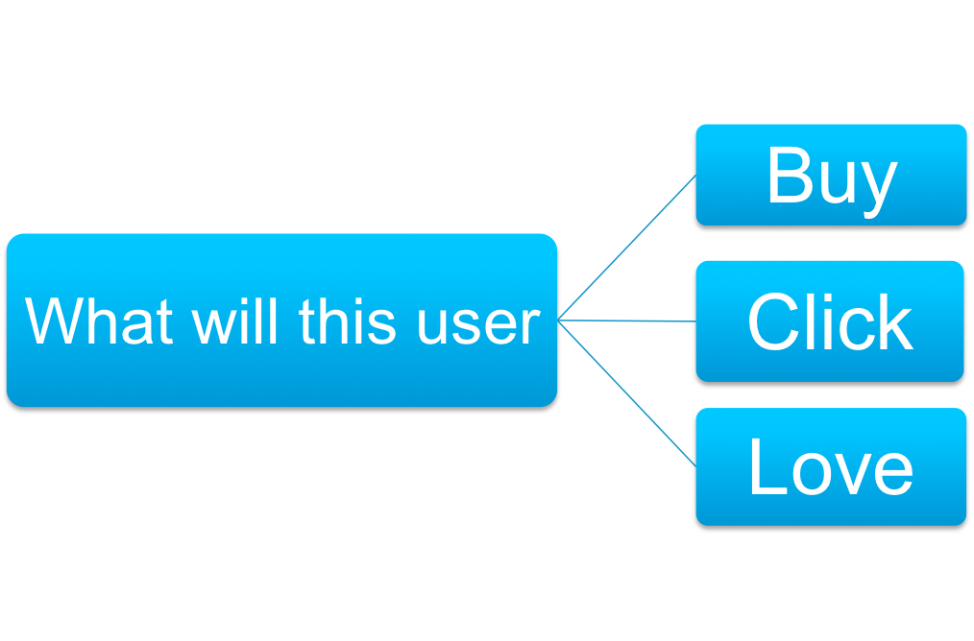
Answer This

Slide 4
What You’ll Learn
How to build, evaluate, deploy and improve models that make recommendations to users.

Slide 5
Example Data
Item
 | A | B | C | D | …
Al | 1 | ? | 2 | ?
Bob | ? | 2 | 3 | 4
Cat | 3 | ? | 1 | 5
Dan | ? | 2 | ? | ?
Ed | 2 | ? | ? | 1
…
User

Slide 6
Binary Data
Item
 | A | B | C | D | …
Al | 0 | 1 | 0 | 1
Bob | 0 | 0 | 1 | 0
Cat | 0 | 1 | 1 | 1
Dan | 1 | 0 | 0 | 1
Ed | 0 | 1 | 0 | 0
…
User

Slide 7
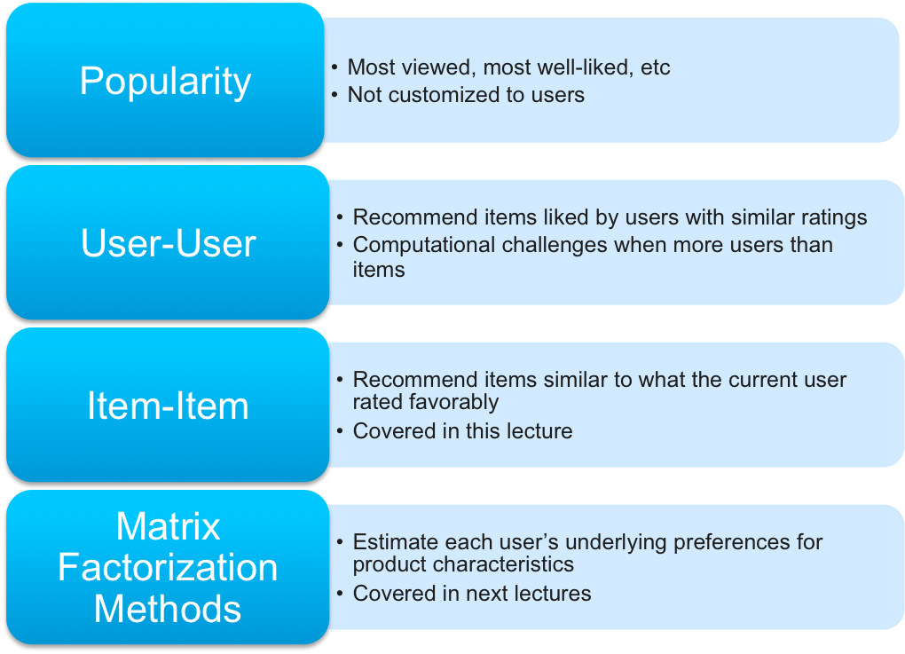
Most Popular Techniques

Slide 8
Item
 | A | B | C | D | …
Al | 1 | ? | 2 | ?
Bob | ? | 2 | 3 | 4
Cat | 3 | ? | 1 | 5
User Ratings as Vectors
User

Slide 9
Item
 | A | B | C | D
Al | 1 | ? | 2 | ?
Bob | ? | 2 | 3 | 4
Cat | 3 | ? | 1 | 5
Dan | ? | 2 | ? | ?
Ed | 2 | ? | ? | 1
…
Item Ratings as Vectors
User

Slide 10
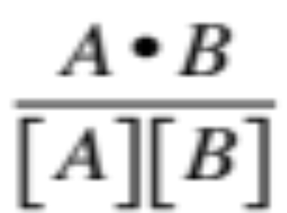
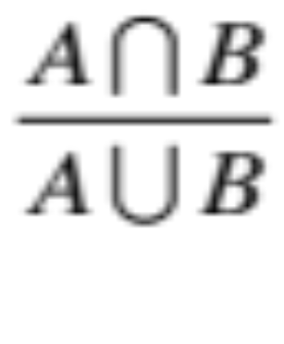

Metric Name | Useful For | Formula
Cosine | Numeric Ratings
Jacard | Binary / Event Data
Measuring Similarity

Slide 11


Metric Name | Useful For | Formula
Cosine | Numeric Ratings
Jacard | Binary / Event Data
Measuring Similarity
Cosine Sim
Adjusted Cosine Sim

Slide 12
Item-Item Recommendation Algorithm
In The Middle of the Night
Compute similarity metric for all pairs of items
Create “neighborhood” of similar items for each item to rate
At Request Time
Predict scores for candidate items

Slide 13
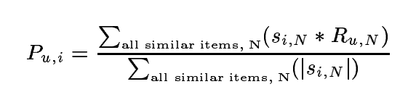
At Request Time
Item-Item Recommendation Algorithm
Predict scores for candidate items

Slide 14
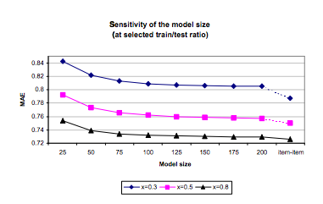
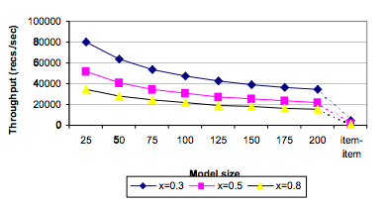
Item-Item Recommendation Algorithm

Slide 15
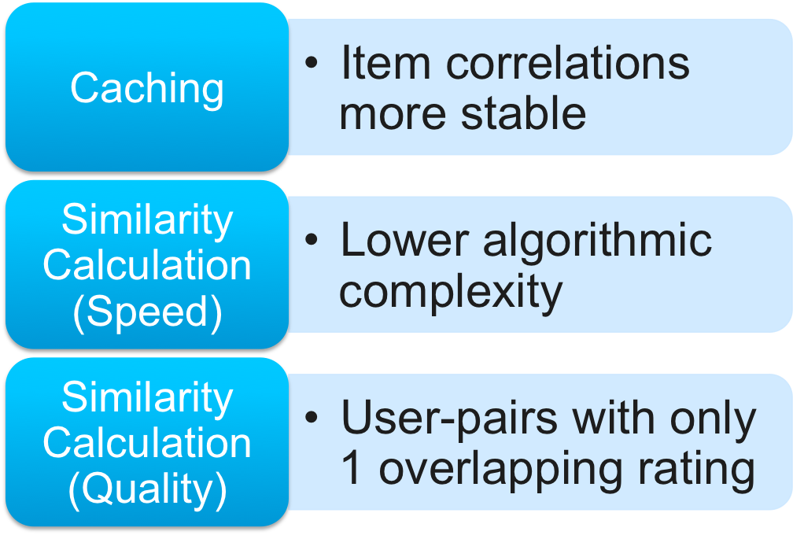
Why Item-Item rather Than User-User

Slide 16

Validation Strategies
Simple Time-Based
Time
User
Train
Val
Test

Slide 17
Validation Strategies
More Complex Time-Based
Time
User
Train
Val
Test

Slide 18
Validation Strategies
K-Fold
Time
User

Slide 19
Thought Experiment:
Why Doesn’t This Work
Time
Train
Val
User
Test

Slide 20
Another Bad Validation Strategy
Movie
Train
Val
Test
User

Slide 21
Validation Strategies
Purely Random Holdout
(Optionally K-fold)
Item
?
?
?
?
?
?
?
?
?
?
?
?
?
?
User
?
?
?
?
?
?
?
?
?
?
?
?
?

