Slide 1
Matrix Factorization for Recommendation Engines
Dan Becker
April 1, 2015

Slide 2
Goals
Conceptual Understanding of Latent Factor Models for Recommender Systems
High level understanding of Latent Factor Model implementation using FunkSVD algorithm
Ability to tune model performance

Slide 3
The Setup
Movie
 | A | B | C | D | …
Alice | 1 | ? | 2 | ?
Bob | ? | 2 | 3 | 4
Charlie | 3 | ? | 1 | 5
Dan | ? | 2 | ? | ?
…
User

Slide 4
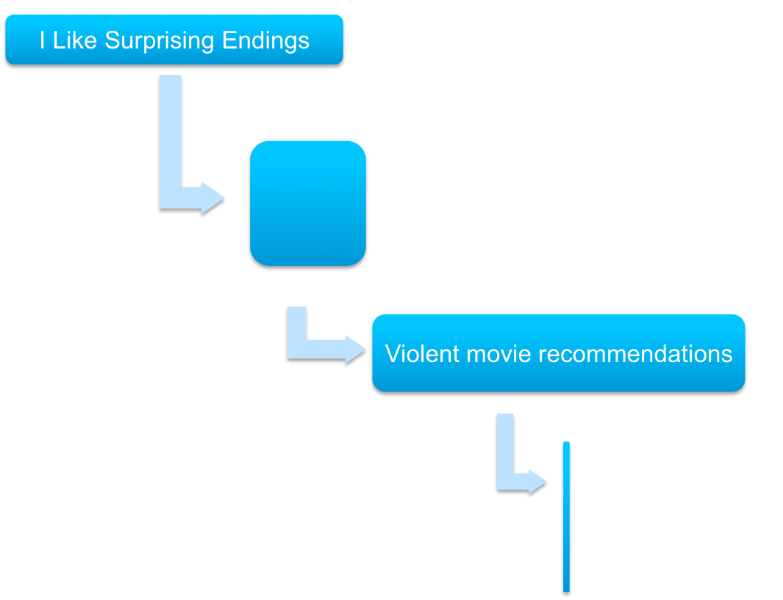



The Problem With Item-Item Recommendations

Slide 5
Movies (And Everything Else) Have Many Attributes
Movie Attributes
Action
Comedy
Drama
…
Tom Hanks
Brad Pitt
Jeff Bridges
…
Happy ending
Sad Ending
…
Movie length
Subtitles
…

Slide 6
A Familiar Looking Model
Predicted rating = B₀ + B₁ * level of action
+ B₂ * level of comedy
+ B₃ * level of drama
+ …
+ B_{n} * Tom Hanks
+ B_{n+1} * Brad Pitt
+ …
+ B_{k} * length
+ …
+ e

Slide 7
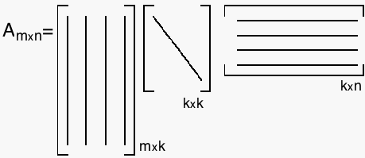
Singular Value Decomposition
User Matrix
Item Matrix

Slide 8
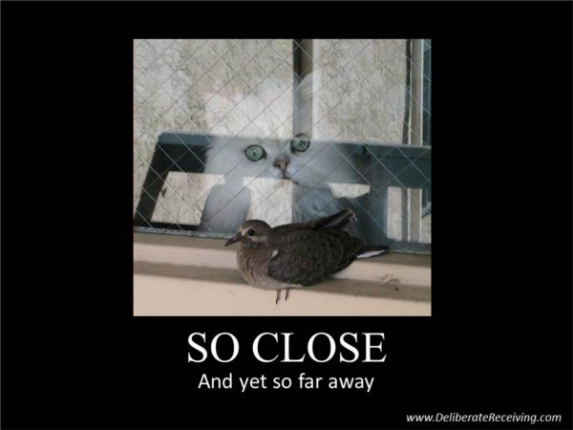
SVD Doesn’t Work With Missing Values

Slide 9
Start By Simplifying the Problem
UV Decomposition
User Matrix
Item Matrix

Slide 10
Evaluate Where we Can
Item
?
?
?
?
?
?
?
?
?
?
User
?
?
?
?
?
?
?
?
?
?
?
?
?
?
?
?
?
?
?
?
?

Slide 11
Every Rating is Product of Two Vectors
Item
?
We can perfectly replicate every observed rating.
Want to approximate it by reducing k to to avoid overfitting.
?
?
?
?
?
?
?
?
?
User
?
?
?
?
?
?
?
?
?
?
?
?
?
?
?
?
?
?
?
?
?

Slide 12
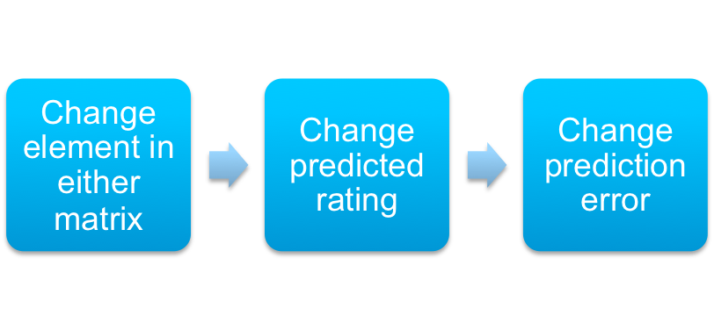
We Can Optimize Matrices
p
p

Slide 13
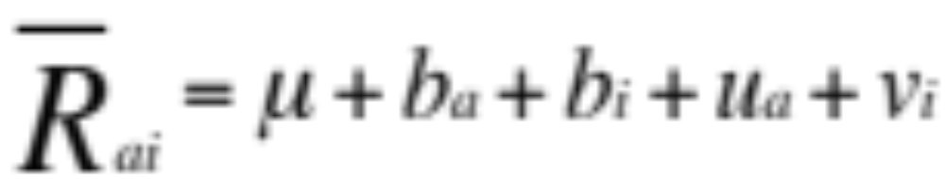
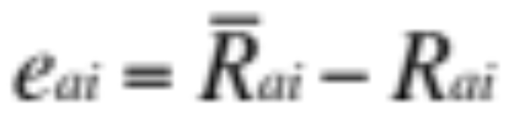
We Can Optimize Matrices
p
p

Slide 14
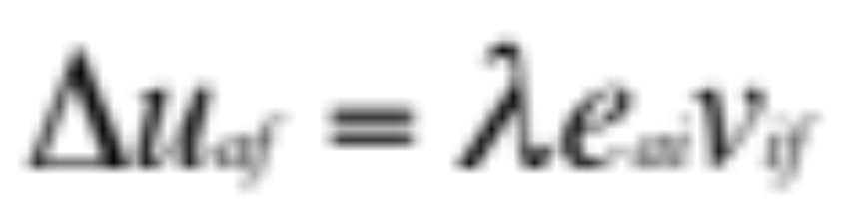
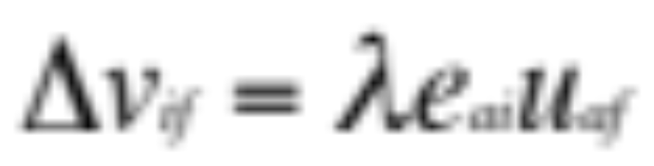
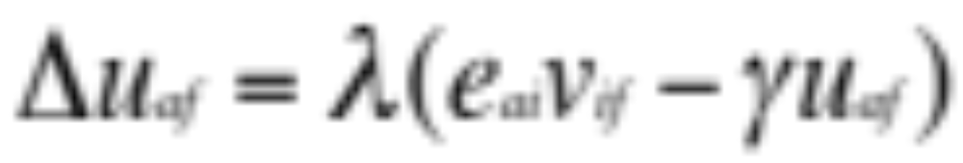
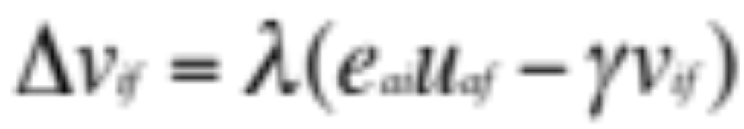
SGD Update Rules for Mean Squared Error
Without Regularization
With Regularization

Slide 15
FunkSVD Algorithm
Initialize U and V matrices
for each feature:
while objective function improves:
for each user:
for each item that user has rated:
predict rating
calculate error
update U element for that user-feature pair
update V element for that item-feature pair
Hints on Metaparameters:
Learning rate around 0.001
Regularization factor around 0.01

Slide 16

Alternating Least Squares SVD
Initialize U and V
until convergence

Slide 17
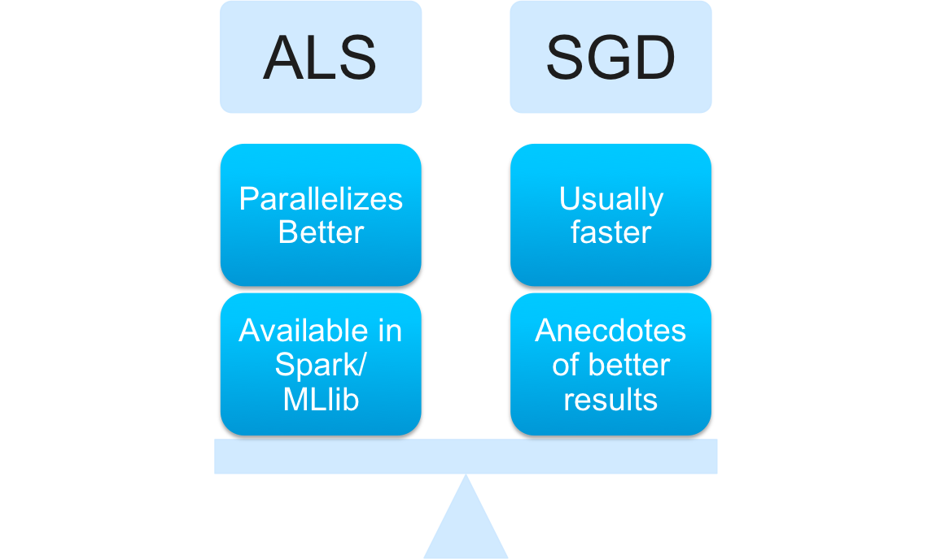
Alternating Least Squares vs
Stochastic Gradient Descent

