Slide 1
Four Common Problems with Recommenders
And How to Address Them

Slide 2
The Problems
Wrong Metric
Cold Start Problem
Difficulty Utilizing All Useful Data
Speed and Stability

Slide 3
Sum Squared Errors Not Right Metric When Recommending Small Subset of Items
 | True | Model A Pred | Model B Pred
Item 1 | 5 | 3 | 5
Item 2 | 3 | 3 | 3
Item 3 | 3 | 3 | 3
Item 4 | 3 | 3 | 1
Item 5 | 3 | 3 | 1
Item 6 | 2 | 4 | 2

Slide 4
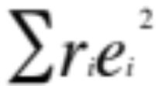
Metrics Solutions
Alternative metrics
  Average of Top N Recommendations
  Objective function asymmetries
SGD / Optimization
  Differentiable and convex objective function
Approximate true objective with something optimizable

Slide 5
Cold Start Problem
Recommendations for new people or items are typically bad

Slide 6
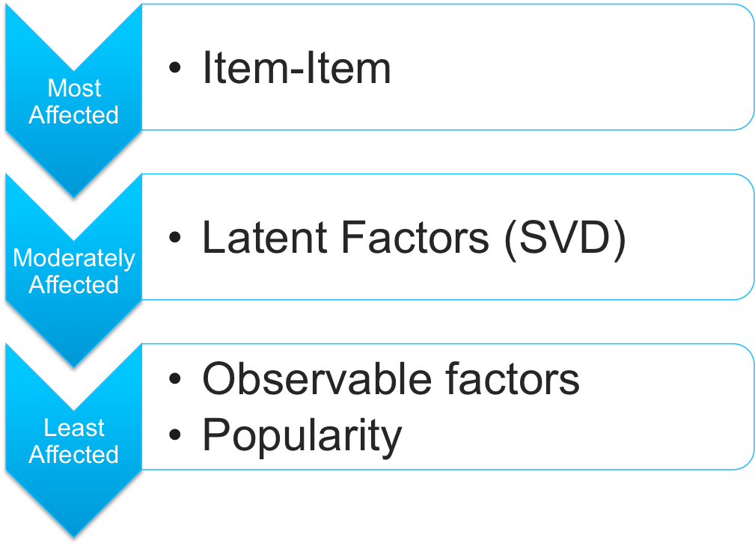
Cold Starts Problems in Various Recommender Systems

Slide 7
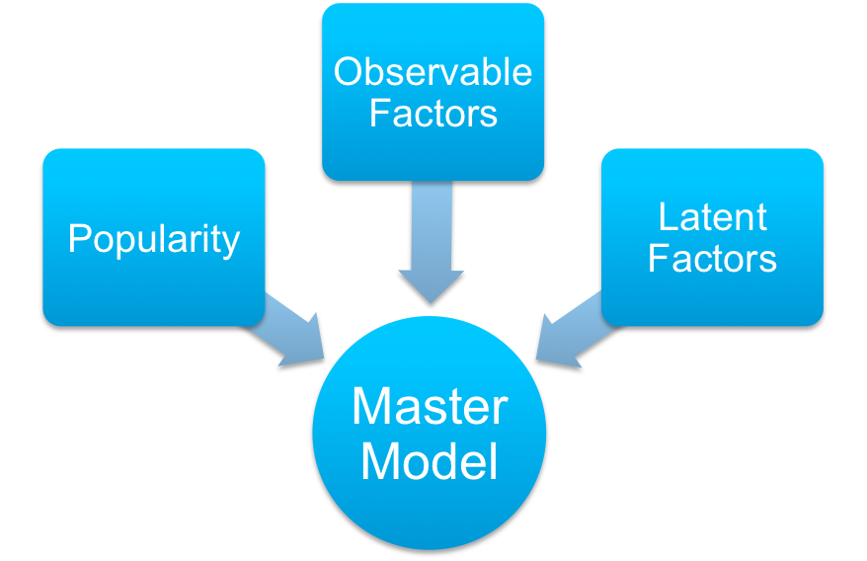
Address Cold-Starts Without Sacrificing the Rest of Your Model
Master model can use weighted average or switching
Commonly solved with UI/UX rather than data science

Slide 8
What Predictive Data Do We Have That SVD Isn’t Using

Slide 9
What Predictive Data Do We Have That SVD Isn’t Using
Average Ratings for Each User or Item (biases)
Known Item Characteristics
Known User Characteristics
Implicit Feedback

Slide 10
Adding Item and/or User Biases
Subtract bias before factorization, add back when predicting
Preserve sparsity
Item bias more important than user bias

Slide 11
Integrating Known Item Characteristics
SVD Feature
Item Matrix
 | Latent 1 | Latent 2 | Latent 3 | Observed 1 | Observed 2
Item A | ? | ? | ? | 1 | 3
Item B | ? | ? | ? | 0 | 0
Item C | ? | ? | ? | 1 | 5
User Taste Matrix
 | Latent 1 | Latent 2 | Latent 3 | Observed 1 | Observed 2
Al | ? | ? | ? | ? | ?
Betty | ? | ? | ? | ? | ?
Carl | ? | ? | ? | ? | ?

Slide 12


Implicit Feedback
SVD++
The items a user has chosen to purchase/rate tells us about their tastes.
SVD
SVD++

Slide 13
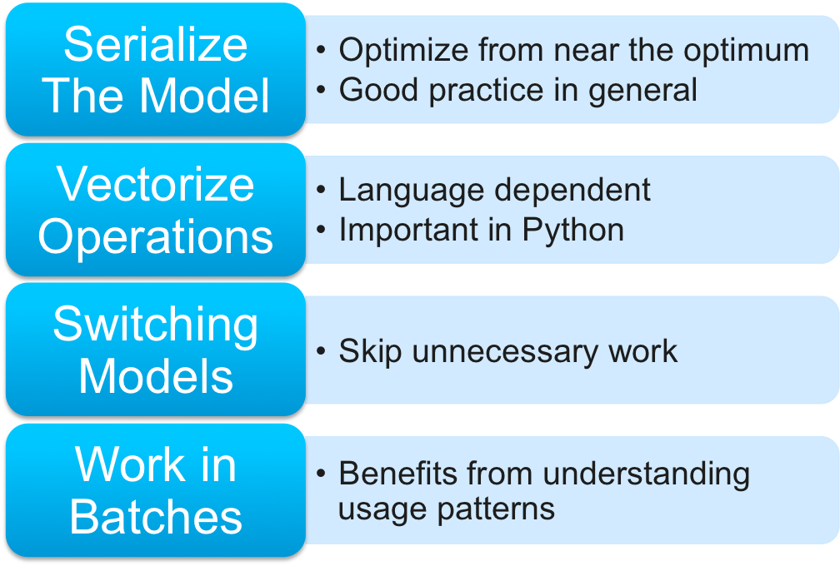
Execution Speed Tips

Slide 14


Another Take on Speed / Stability

Slide 15
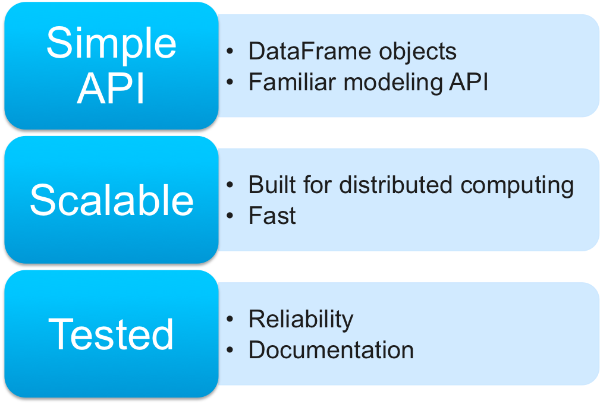
Spark and GraphLab

Slide 16
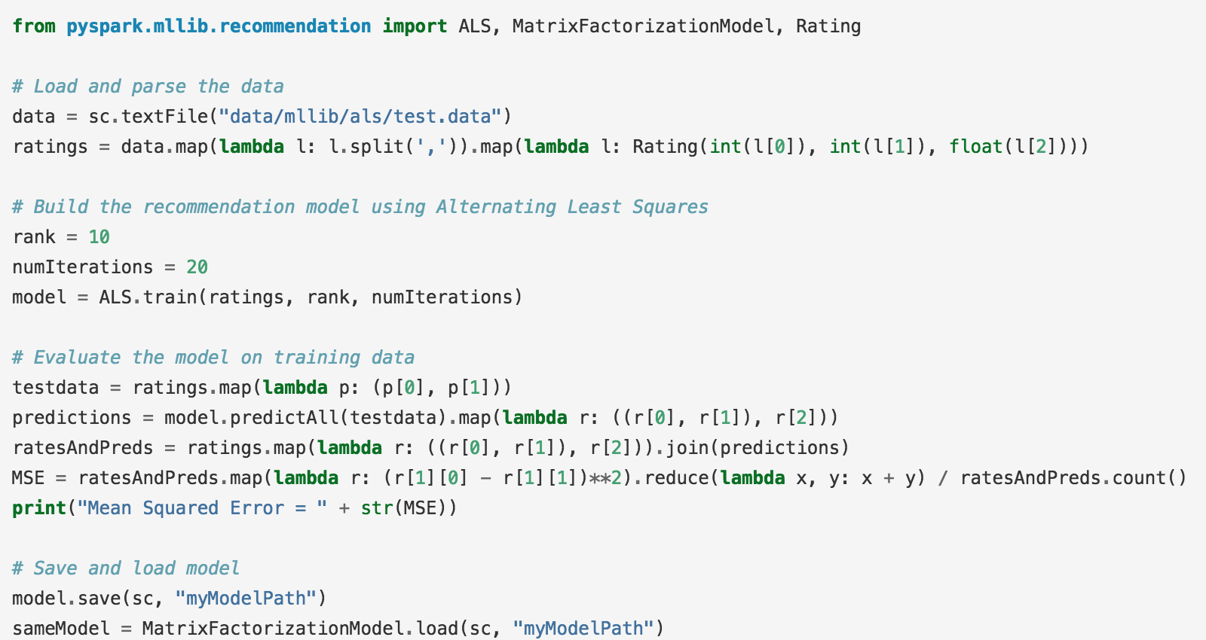
MlLib Example

Slide 17
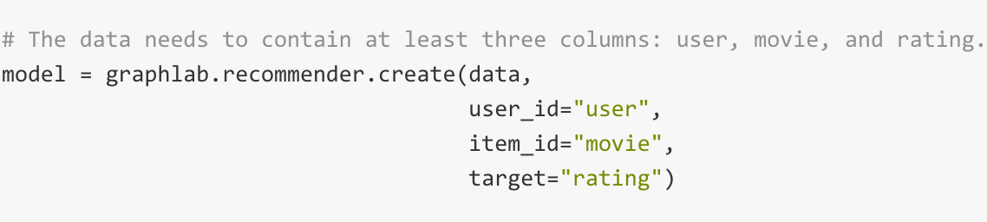
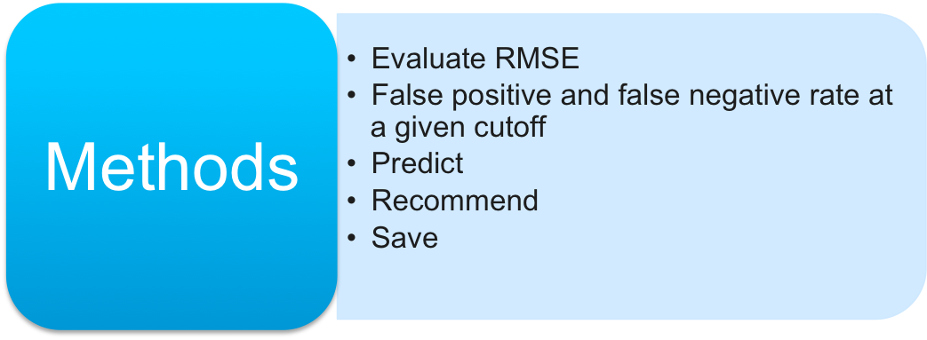
GraphLab.
Recommender

Slide 18
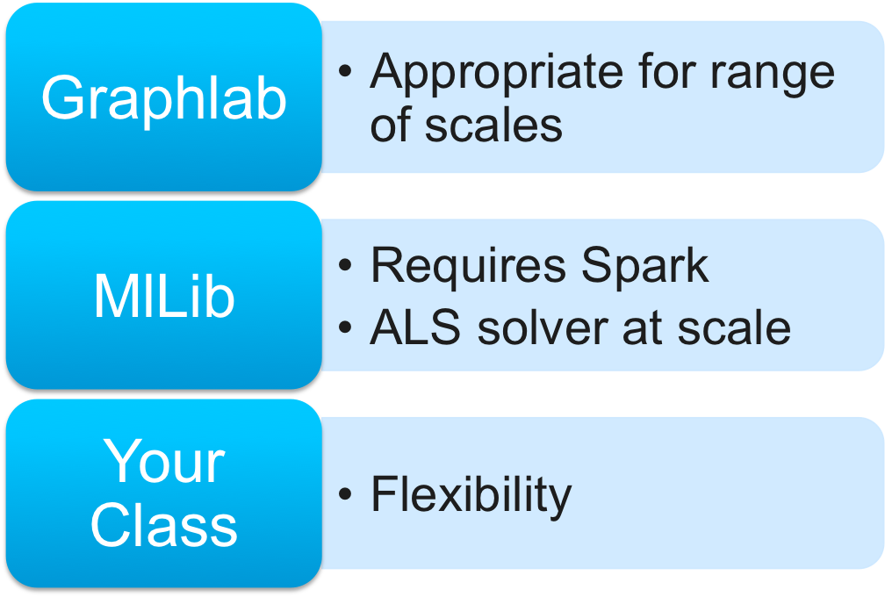
Should You Use Graphlab or Spark

Slide 19
Framework Conclusions
Fast, reliable, well documented
Harder to extend
Only part of what you need

