Slide 1
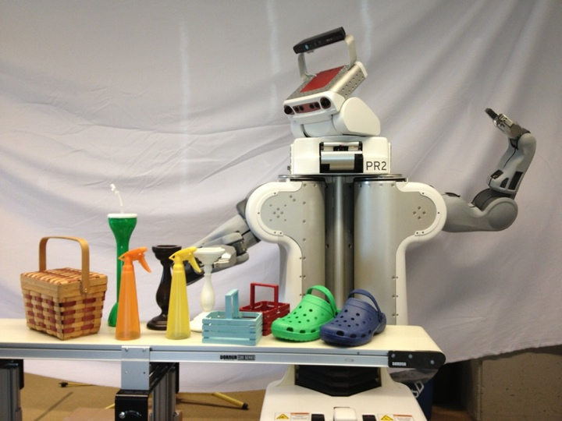
Perception and Motion Planning for Pick-and-Place of Dynamic Objects
Anthony Cowley, Benjamin Cohen, and Camillo J. Taylor
GRASP Laboratory, University of Pennsylvania, USA
William Marshall
Lehigh University, USA
Maxim Likhachev
Robotics Institute, Carnegie Mellon University, USA
Manipulation of moving objects by a PR2
3D object recognition and 2D pose tracking at 20 Hz
Collision free, kinematically feasible motion planning with optional constraints (e.g. keep an object upright)
A mobile manipulator working at a conveyor belt moving at 33 cm/s

