Slide 1
A discussion of numerical methods for material interface capturing.
Will Matern
Sean Davis
Slide <number>

Slide 2
Outline
Contact discontinuities
Problems observed in numerical methods
Description of methods reviewed
  Lax-Wendroff with limiters
  MPDATA
  MUSCL (w/ and w/o ACM)
  SUPG
Results
  2D Advection Equations
  Sod Shock Tube Problem
Conclusions
Slide <number>

Slide 3
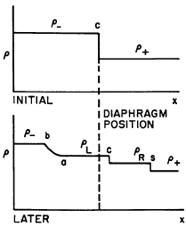
Contact discontinuities
A discontinuity that occurs in density but other quantities like pressure, velocity, and specific internal energy are continuous.
From Harlow and Amsden - “Fluid Dynamics”
Slide <number>

Slide 4
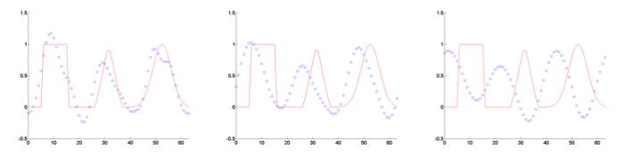
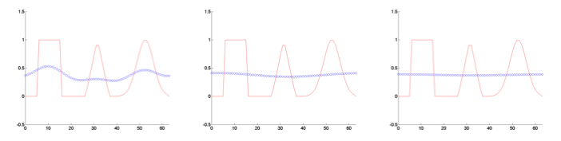
Problems observed in numerical methods when shock capturing (and at material discontinuities)
Oscillations – High Order schemes
  Ex) Lax-Wendroff
Large dissipation – First Order Schemes
Slide <number>

Slide 5
Description of methods reviewed
Lax-Wendroff w/ Limiters
  1st order near discontinuities, 2nd order elsewhere
  For linear equations is mathematically guaranteed to be TVD
MPDATA
  Modified equation approach
  Add diffusion, solve, then anti-diffuse the solution.
MUSCL w/ and w/o ACM
  ACM – Slope limiter method for sharpening discontinuities.
Streamline Upwind Petrov-Galerkin (SUPG)
  Petrov-Galerkin – Test functions are not the same as trial functions.
  Finite Element approach – in 1D reduces to adding artificial diffusion.
  Is not TVD
Slide <number>

Slide 6
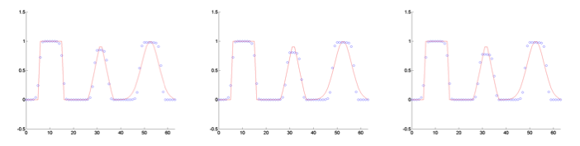
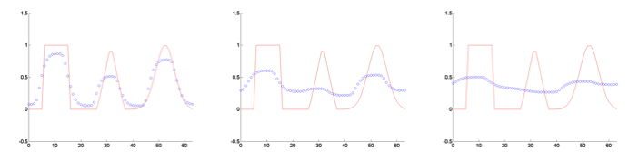
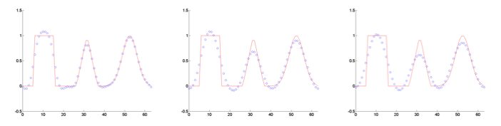
Results for 2D Advection
Lax-Wendroff (not TVD)
MUSCL
Lax-Wendroff (Superbee)
SUPG
MPDATA
Slide <number>

Slide 7

Sod Shock Tube
Slide <number>

Slide 8
Conclusions
MUSCL scheme most effective for problems with discontinuities. However, can unnaturally sharpen the solution.
MPDATA scheme too dissipative
Lax-Wendroff with slope limiters is effective but more dissipative then other methods.
SUPG -balances well between diffusion and discontinuity sharpness without introducing unnatural sharpening. However, requires matrix operations.
Slide <number>

Slide 9
Future Directions
FEM approach for full Euler equations
Implement schemes for advection on the GPU (include in CLAMR)
Alternative methods
Slide <number>

Slide 10
Question, Comments, Suggestions?
Slide <number>

