Slide 1
A Review of Methods for Capturing Material Discontinuities
With an Introduction to GPU Programming
Sean Davis
Slide <number>

Slide 2
BIO
Undergraduate Degree
  McGill University in Montreal, Quebec (Canada)
  Major: Mechanical Engineering with a concentration in Aeronautical Engineering
  Graduated in the Spring of 2009
Graduate Study
  Joint Doctoral Program with San Diego State University and the University of California at San Diego
  Research Topic: High order ENO/WENO methods for the solution of high speed multiphase flows with shocks and particles
  Expected Graduation in the Spring of 2015
Slide <number>

Slide 3
Descriptions of methods reviewed
Lax-Wendroff w/o Limiters
  Conservative 2nd order scheme
  Approximate solution has oscillations around sharp gradients
Lax-Wendroff w/ Limiters
  1st order near discontinuities, 2nd order elsewhere
  For linear equations is mathematically guaranteed to be TVD
MUSCL
  ACM – Slope limiter method for sharpening discontinuities
  Upwind biased
  uses a minmod function to avoid numerical oscillations in the solution
Streamline Upwind Petrov-Galerkin (SUPG)
  Finite Element approach
  Petrov-Galerkin – Test functions are not the same as trial functions
Slide <number>
Notes:
Add a slide about what limiters were

Slide 4
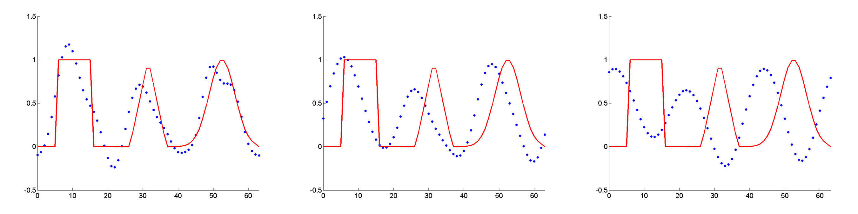
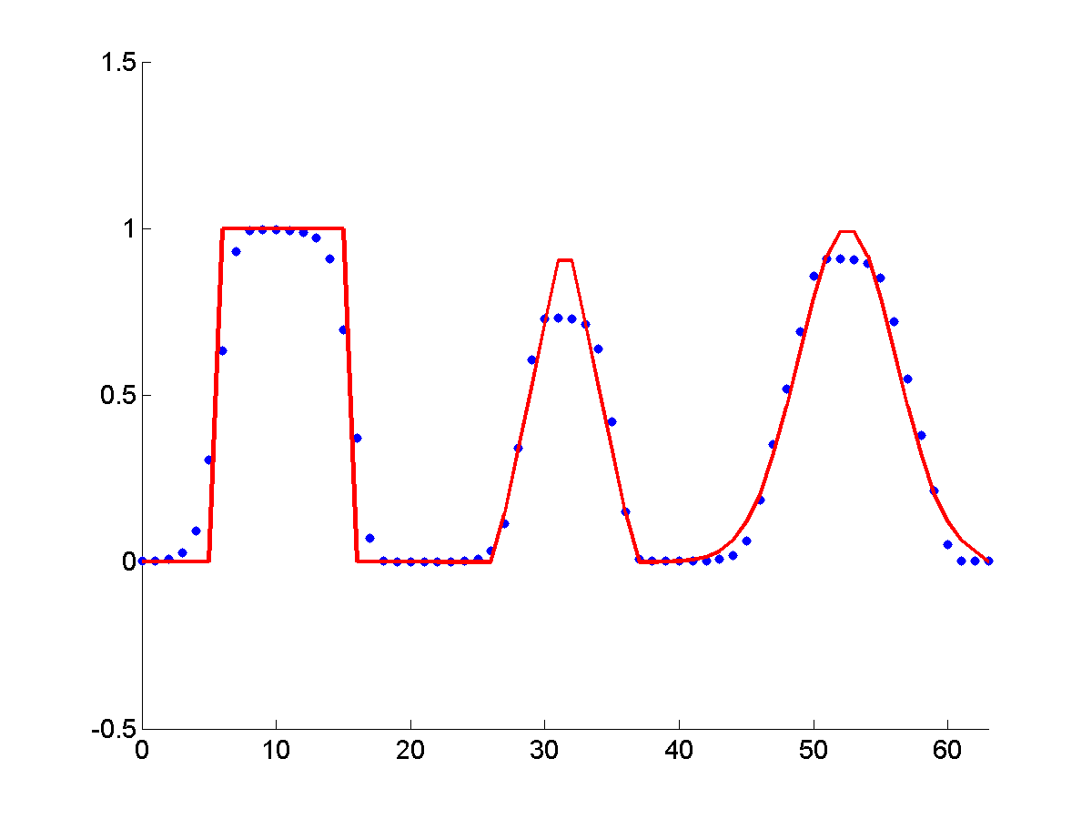
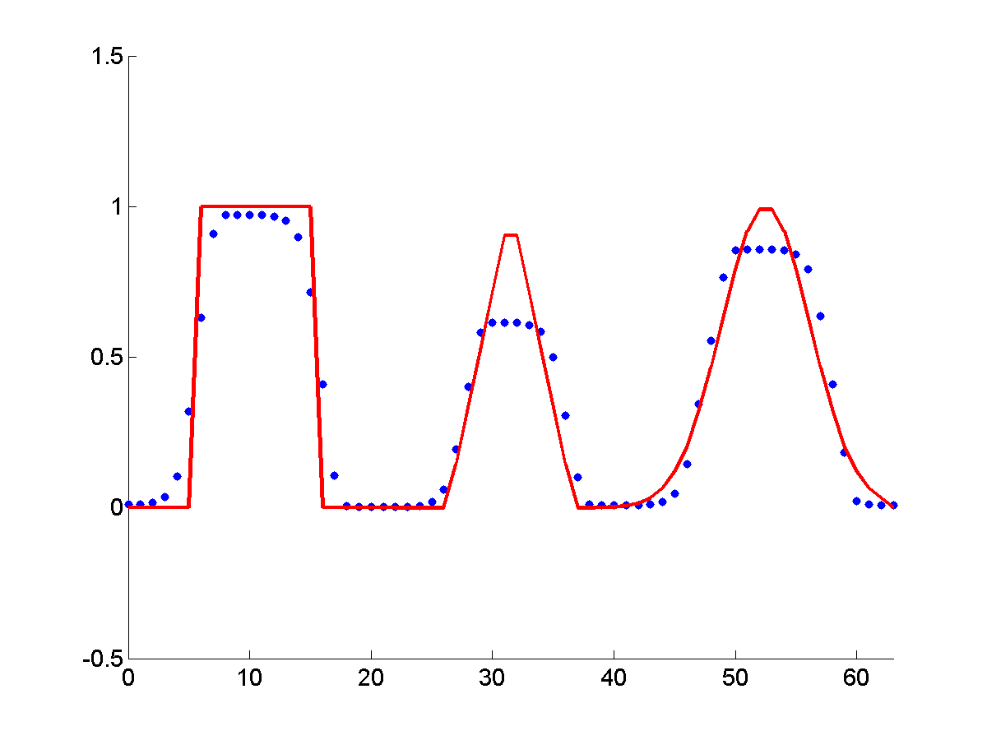
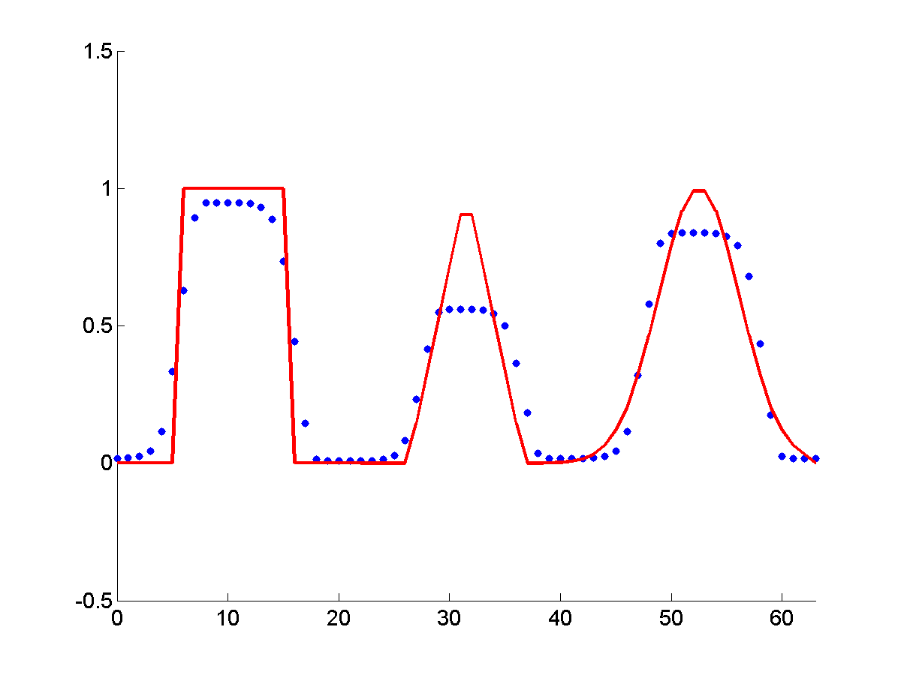
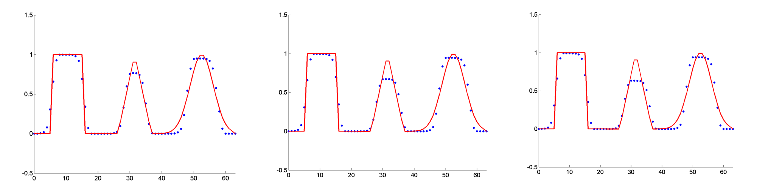
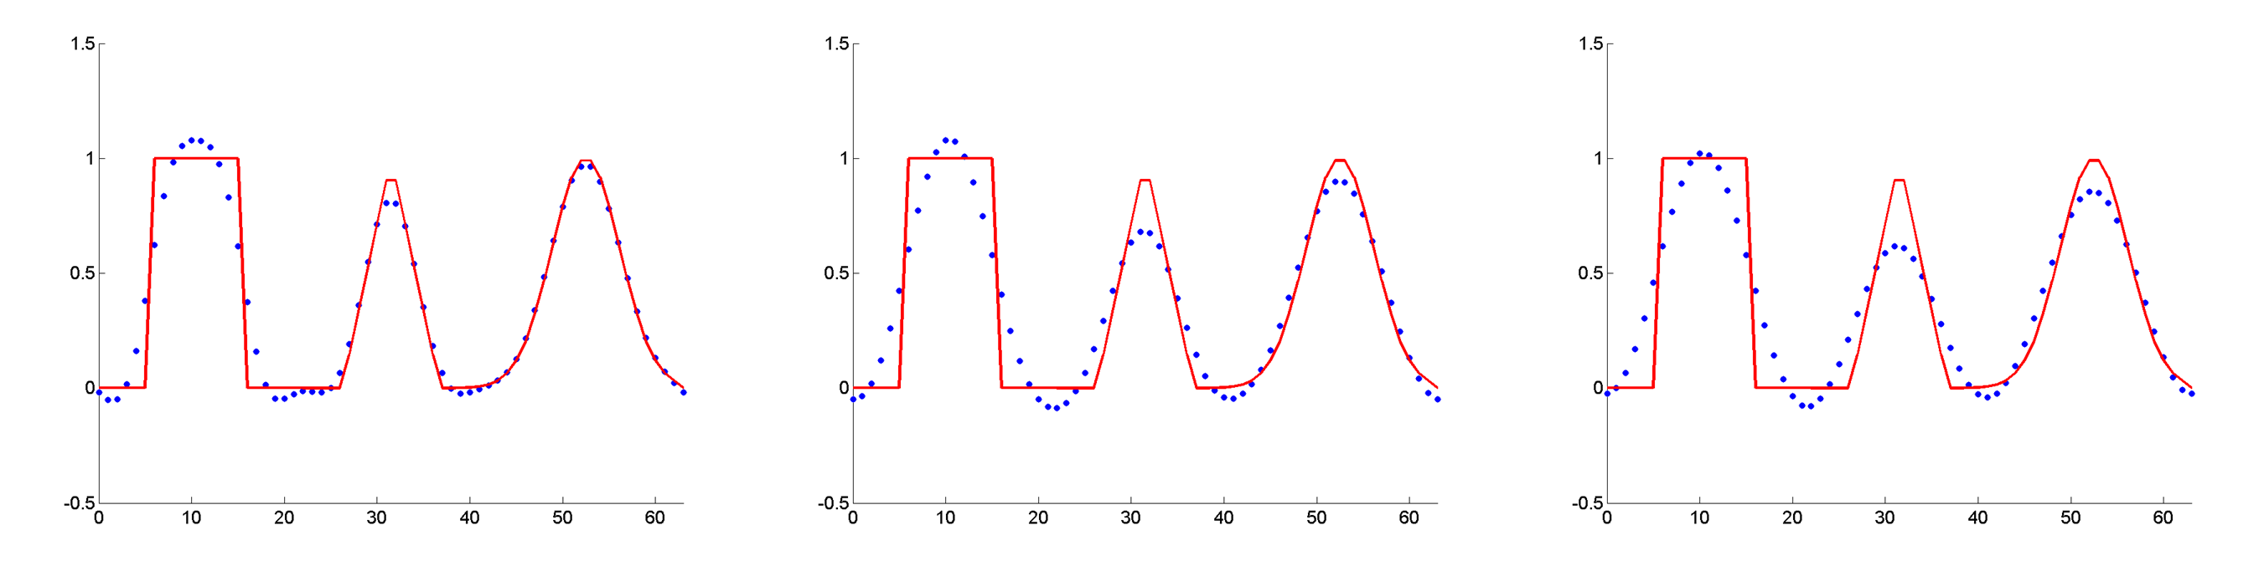
Results for 2D Advection
Lax-Wendroff (not TVD):
Lax-Wendroff (Superbee):
MUSCL:
SUPG:
Slide <number>
Notes:
Only show the last column.

Slide 5
Acknowledgements
Mentor: Dr. Bob Robey
Workshop Coordinator: Dr. Scott Runnels
David Nicholaeff
Thank you!
Slide <number>

