Slide 1
A discussion of numerical methods for capturing discontinuities in PDEs
with an introduction to GPU programming
Sean Davis
Will Matern
Slide <number>

Slide 2
Outline
Discontinuities
Problems observed in numerical methods
Description of methods reviewed
  Lax-Wendroff with limiters
  MPDATA
  MUSCL
  SUPG
Results
  2D Advection Equations
Conclusions
Introduction to GPU Programming
Slide <number>

Slide 3
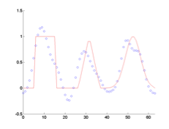
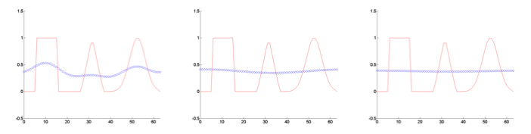
Problems observed in numerical methods for equations with discontinuities
Oscillations – High Order schemes
  Ex) Lax-Wendroff
Large dissipation – First Order Schemes
Slide <number>

Slide 4
Description of methods reviewed
Lax-Wendroff w/ Limiters
  1st order near discontinuities, 2nd order elsewhere
  For linear equations is mathematically guaranteed to be TVD
Slide <number>

Slide 5
Description of methods reviewed
MPDATA
  Modified equation approach
  Add diffusion, solve, then anti-diffuse the solution.
Slide <number>

Slide 6
Description of methods reviewed
MUSCL
  ACM – Slope limiter method for sharpening discontinuities.
Slide <number>

Slide 7
Description of methods reviewed
Streamline Upwind Petrov-Galerkin (SUPG)
  Finite Element approach
  Petrov-Galerkin – Test functions are not the same as trial functions.
  In 1D reduces to adding artificial diffusion.
  Is not TVD
Slide <number>

Slide 8
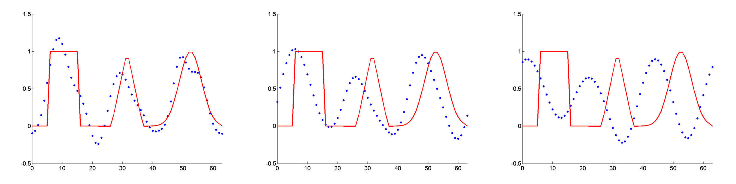
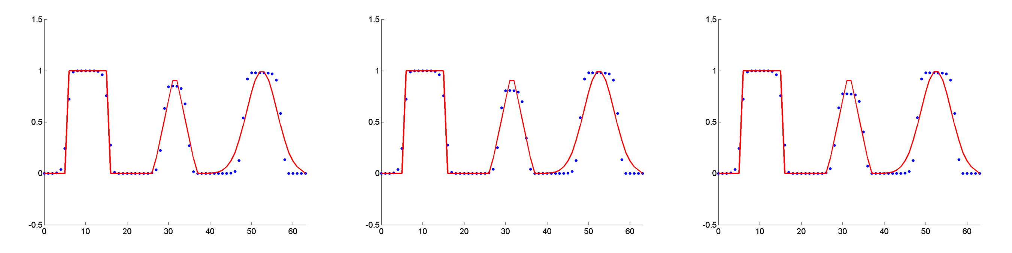
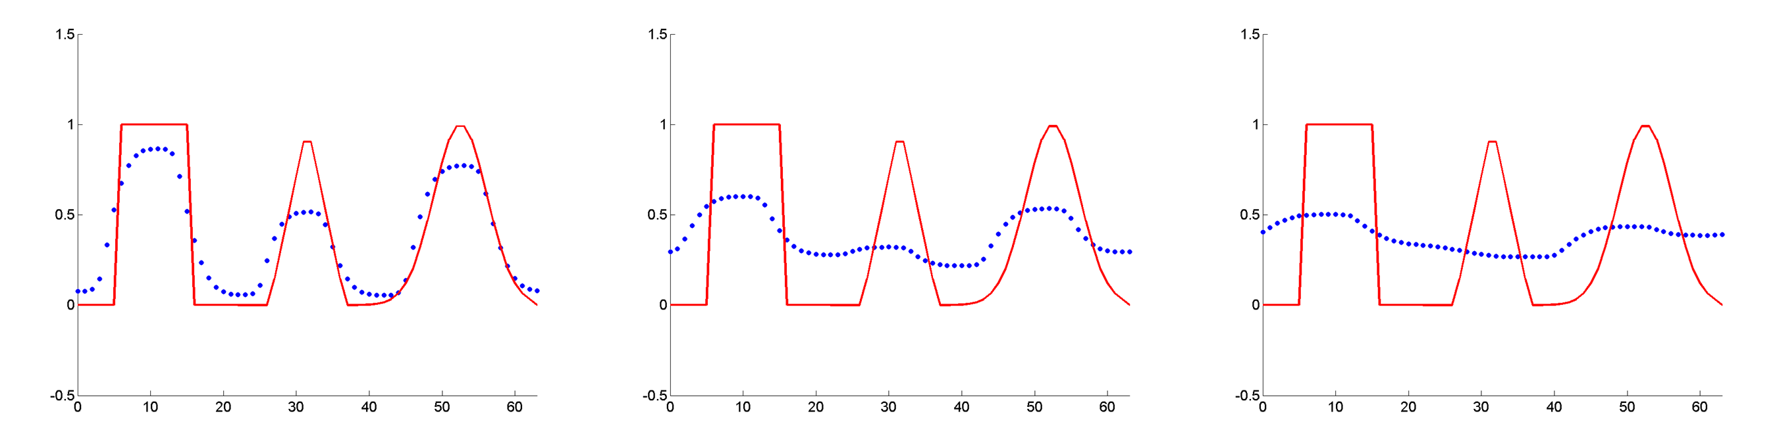
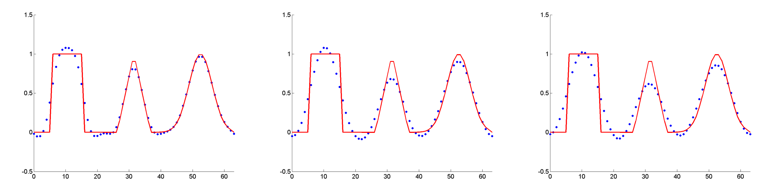
Results for 2D Advection
Lax-Wendroff (not TVD)
MUSCL
Lax-Wendroff (Superbee)
SUPG
MPDATA
Slide <number>

Slide 9
Conclusions
MUSCL scheme most effective for problems with discontinuities. However, can unnaturally sharpen the solution.
MPDATA scheme too dissipative
Lax-Wendroff with slope limiters is effective but more dissipative then other methods.
SUPG -balances well between diffusion and discontinuity sharpness without introducing unnatural sharpening. However, requires matrix operations.
Slide <number>

Slide 10
GPUs at a glance
Different architecture from a CPU.
  Many low throughput processing units
  Cores all share memory
  Workgroups
Higher FLOPS (floating points operations per second) per dollar than CPUs.
Must use a language compiled for GPU
  OpenCL – Open programming language that can make use of multiple CPUs (on the same node) and a GPU. Can combine with MPI for multiple nodes.
  CUDA – Nvidia only.
Slide <number>

Slide 11
GPU architecture
Global Memory
  Available to entire device
Local Memory
  Available to the work group only
  ***I think this isn’t well defined in OpenCL and can spill over to Global without warning
Private Memory
  Available to work item only
Constant Memory
  Read only, can be faster than global
SIMD group size – efficient code is a multiple of this
  Nvidia – Warp size is 32
  ATI – Workgroup size is 64
  http://stackoverflow.com/questions/7093488/opencl-how-to-i-query-for-a-devices-simd-width
Slide <number>

Slide 12
Future Directions
FEM approach for full Euler equations
Implement schemes for advection on the GPU (include in CLAMR)
Implement these schemes to solve the full Euler Equations
Alternative numerical methods
Slide <number>

Slide 13
Question, Comments, Suggestions?
Slide <number>

