Slide 1



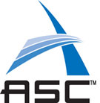
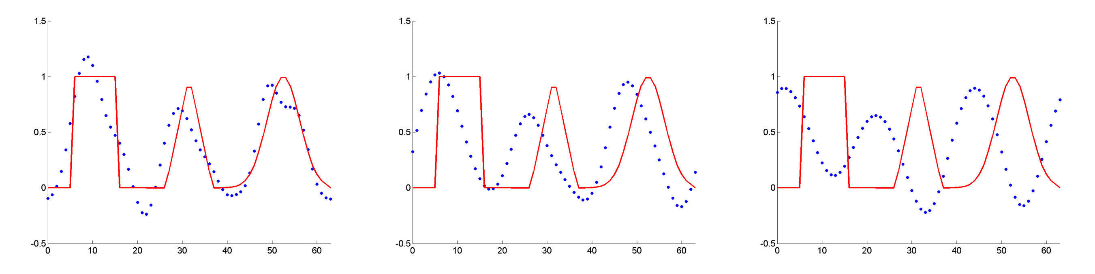
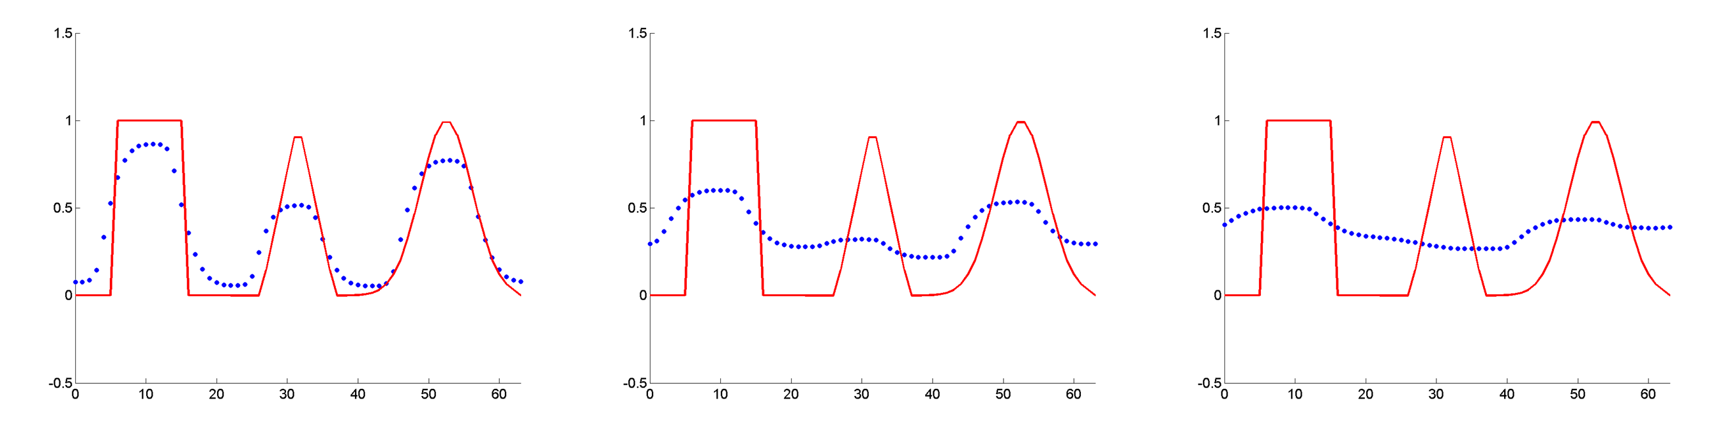
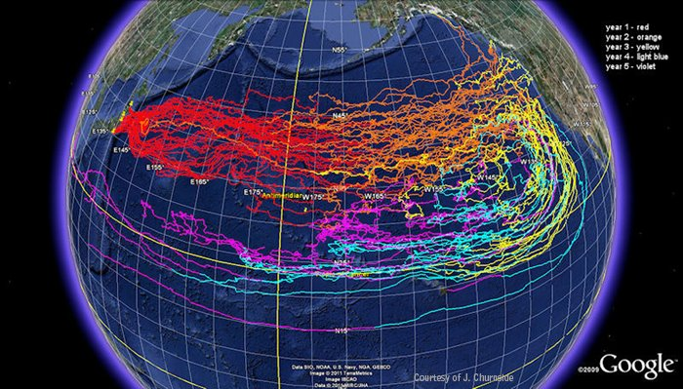
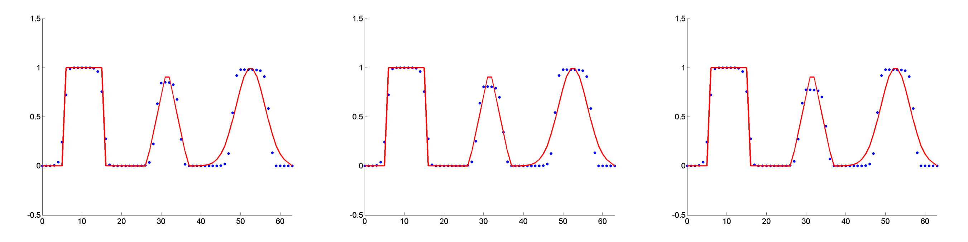
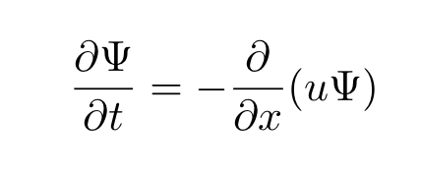
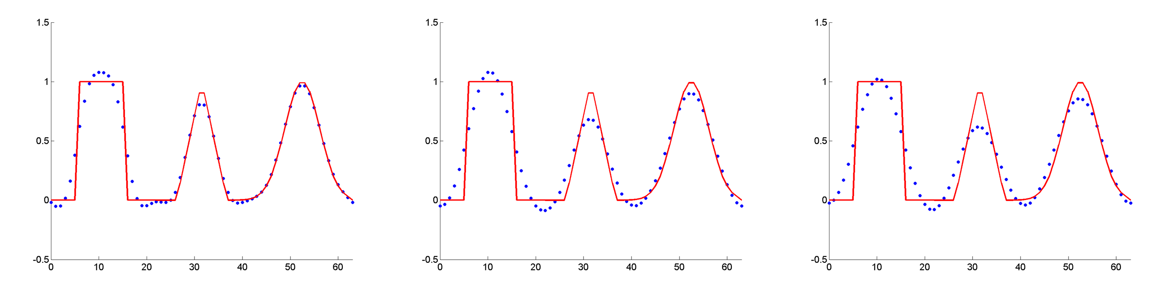
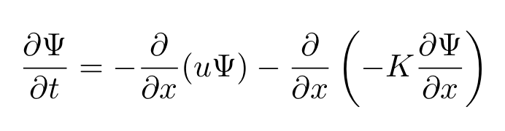
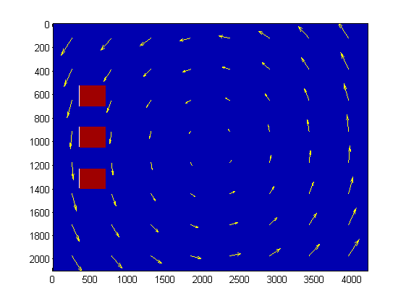
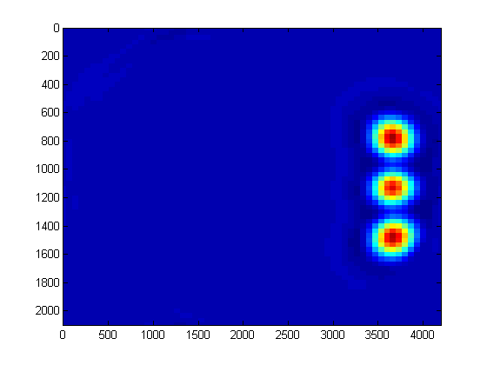
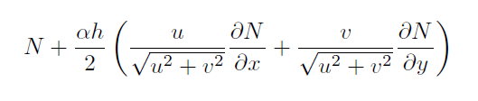
We review some classic numerical techniques used to analyze contact discontinuities and compare their effectiveness. Several finite difference methods (the Lax-Wendroff method, a Multidimensional Positive Definite Advection Transport Algorithm (MPDATA) method and a Monotone Upwind Scheme for Conservation Laws (MUSCL) with an Artificial Compression Method (ACM)) as well as the finite element Streamlined Upwind Petrov-Galerkin (SUPG) method were considered. These methods were applied to solve the 2D advection equation. Based on these results we were able to conclude that the MUSCL scheme with artificial compression produces the sharpest interfaces but can inappropriately steepen the solution. The SUPG method seems to represent a good balance between stability and interface sharpness without any inappropriate steepening. However, for solutions with discontinuities, the MUSCL scheme is superior. Some of the finite difference methods and a combined finite element/finite difference method (based on the Lax-Wendroff and SUPG method) were also used to solve the Euler equations. A brief description of the results from the different methods is given at the end.
Lax-Wendroff and TVD
Introduction
The Lax-Wendroff method is a finite difference method designed for hyperbolic PDEs that is second order accurate in both space and time. This scheme can be understood as a two-step method. On the first step the fluxes at a half step in both space and time are calculated. On the second step of the method the half-step fluxes are used to calculate the new value of the conserved variable at each point in the domain. This scheme works well for smooth data but can run into trouble when the solution develops a discontinuity. When this occurs, the solution becomes highly oscillatory around the discontinuity.
It has been shown by numerous authors that there is a simple fix for oscillations around discontinuities. First order schemes for hyperbolic PDEs (such as upwind finite differencing) do not lead to oscillations like higher order schemes (Lax-Wendroff). Flux limiters work by interpolating between the flux calculated by a first order scheme and the flux calculated by a higher order scheme. A flux limiter ranges from 0 to 1. When it is equal to 0 the first order method is recovered and when it is equal to 1 the second order method is recovered. Flux limiters are calculated based on the gradient at a location. When the gradient is high, the flux limiter is close to 0 and when it is low it is close to 1. By adding a flux limiter oscillations near a discontinuity are eliminated.
It has been mathematically shown that certain formulas for flux limiters in linear PDEs lead to schemes which are monotonicity preserving. This means that if the solution is monotonic at a certain time step it will remain monotonic at the next time step. This property is equivalent to saying that the scheme will not introduce new extrema and that the scheme is Total Variation Diminishing (TVD).
LA-UR-12-23452
Wave Advection Tests
Lax-Wendroff
Lax-Wendroff with a Superbee TVD Limiter
MUSCL
SUPG
(a) (b) (c)
The evolution of three types of waves: a square wave, a triangular wave and a Gaussian wave was traced for three time steps. Column (a) shows the waves at time t = 1, column (b) t = 5, and column (c) t = 10. The red lines show the analytical solution whereas the blue dots represent the computed solution using the various methods.
This research is relevant to many technological/environmental fields ranging from such varied applications as instability resolution to flow tracking.
Applications
MPDATA
Introduced by Smolarkiewicz in the early 1980s, the MPDATA algorithm is a finite-difference approximation for the advective terms in the fluid equations. A donor-cell approximation to the equation is defined in terms of the local Courant number. By using a modified equation analysis, it can be seen that a diffusive convective flux term is added to the model equation, which damps out nonphysical oscillations. As an example, the pure advection equation,
becomes,
using an upstream approximation. This added dissipation error is then subtracted out of the solution using an antidiffusive velocity to cancel the additional convective flux.
Courtesy of J. Churnside/NOAA's Office of Oceanic and Atmospheric Research.
Motivational Problem
Before
After
The earthquake and resulting tsunami in Japan caused a release of radioactive material into the pacific ocean. The idea of tracking these flows and accurately resolving the material interfaces between the radioactive and non radioactive material provided motivation for this research.
ACM
Harten’s ACM was initially intended to be used to sharpen contact discontinuities for first order accurate schemes. However, this technique has been extended to higher order methods such as Essentially Non-Oscillatory (ENO) schemes and Monotone Upstream-centered Schemes for Conservation Laws (MUSCL) among others. ACM is a slope modification method which relies on a switch to increase or decrease the slope of a function near a discontinuity. For the purposes of this presentation, the advection equation is solved using a MUSCL scheme with ACM while the Euler Equations are computed using an ENO method with ACM.
Euler Equations
Unlike the above finite difference schemes, which are easily extendable to the 2D Euler equations, the SUPG method was designed specifically for linear advection/diffusion equations. Thus, there is no apparent way to generalize the SUPG method to the Euler equations. Instead, SUPG was used to solve the mass conservation equation (a linear advection equation) and Lax-Wendroff scheme was used to solve the momentum and energy equations. However this combined finite difference/finite element scheme proved to be unstable.
SUPG
In the finite element method a set of trial functions are assumed to represent the solution of a differential equation over a region. These trial functions have certain degrees of freedom that must be solved for. The differential equation is multiplied by test functions and then integrated over the region that the differential equation is to be solved on. This generally yields algebraic equations for the degrees of freedom.
In the continuous Galerkin (CG) approach, the test functions are assumed to be the same as the trial functions. However, when sharp gradients are present CG methods produce highly oscillatory solutions. This can be helped by introducing the more general Petrov-Galerkin (PG) approach in which the test functions can be different from the trial functions. The streamline upwind Petrov-Galerkin (SUPG) approach chooses a specific set of test functions which can be shown to significantly reduce oscillations in the solution. For the 2D advection equation these test functions are the same as the CG test functions with two additional terms:
Where N is one of the test functions, α is an arbitrary parameter usually taken to be 1, h is a 1D length of an element, and u-v are the velocity in the x-y direction, respectively.
Conclusions and Future Directions
From the above diagrams it is apparent that the MUSCL scheme was most effective at preventing diffusion of material interfaces. However, the MUSCL is the most expensive scheme and also unnaturally sharpens normally smooth waves as is evident from the evolution of the initially Gaussian distribution. The SUPG scheme gradually diffuses the solution while the Lax-Wendroff TVD and the MPDATA schemes are overly dissipative. The choice of method is therefore problem specific and most production scale codes should have the option to switch between algorithms. Several of these schemes have been implemented in a Euler equation solver for further testing and stability analysis. Additionally, we are in the process of applying the ACM to a threaded GPU shallow water equation solver. A mixed finite element/finite difference approach for the Euler equations was unsuccessful and thus a full finite element approach is planned.

