Slide 1

Demystifying GPU Microarchitecture through Microbenchmarking
Henry Wong

Slide 2


GPUs
Graphics Processing Units
  Increasingly programmable
10x arithmetic and memory bandwidth vs. CPU
  Commodity hardware
  Requires 1000-way parallelization
NVIDIA CUDA
  Write GPU thread in C variant
  Compiled into native instructions and run in parallel on GPU
Notes:
This paper is about the microarchitecture of the Nvidia GT200 (GTX280) GPU that is revealed through microbenchmarks, as well as the benchmark techniques themselves.
We discovered some interesting undocumented microarchitectural features of the GPU, including operation of the core and cache hierarchies.
GPUs originally only computed 3D graphics rendering, but have been increasing in programmability to the point of being used for non-graphics computation.
They are an interesting alternative to computation on CPUs by providing an order of magnitude of performance for highly-parallel code.
In NVIDIA GPUs, this computation is written as a single scalar thread in almost-C, which is then compiled and many instances run on the GPU.

Slide 3

How Well Do We Know the GPU?
How much do we know?
  We know enough to write programs
  We know basic performance tuning
    Caches exist
    Approximate memory speeds
    Instruction throughput
Why do we want to know more?
  Detailed optimization
  Compiler optimizations. e.g., Ocelot
  Performance modeling. e.g., GPGPU-Sim
Notes:
But how much do we know about the GPU that's running our code?
Why do we want to know more?
The most obvious is more performance tuning.
etc.

Slide 4
Outline
Background on CUDA
Pipeline latency and throughput
Branch divergence
Syncthreads barrier synchronization
Memory Hierarchies
  Cache and TLB organization
  Cache sharing
...more in the paper
Notes:
Background on CUDA
Pipeline latency and throughput
* It behaves differently from just many cores
Branch divergence
* When the illusion of independent threads breaks...
Syncthreads barrier synchronization
* we do what the manual says not to and observe interaction with branch divergence...
Memory Hierarchies (undocumented)
* Cache and TLB organization
* Cache sharing
Just a sampling: more in the paper

Slide 5
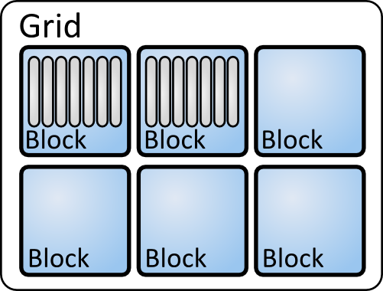


CUDA Software Model
Grid
  Block
    Thread
Threads branch independently
Threads inside Block may interact
Blocks are independent
Notes:
We'll start with a brief background on CUDA.
In CUDA, users write one scalar kernel thread; many instances of that one thread execute in parallel when a grid is launched.
These threads can branch independently.
For scalability, these parallel threads are grouped into independent blocks.
A number of blocks make up a grid.
Grid contains blocks, which contain threads, all of which are the same.

Slide 6
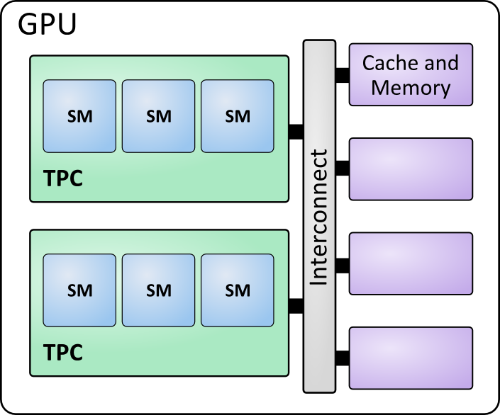
CUDA Blocks and SMs
Blocks are assigned to SMs
Software
Hardware
Notes:
At runtime, thread Blocks are assigned to Streaming Multiprocessors as they become available.

Slide 7
CUDA Hardware Model
SM: Streaming Multiprocessor
  Warp: Groups of 32 threads like a vector
TPC: Thread Processing Cluster
Interconnect
Memory Hierarchy
Notes:
The SM behaves similarly to a multithreaded vector processor. Groups of 32 Threads are grouped int “Warps”, which serve as length 32 “vectors”. The key difference is the branch divergence mechanism that still allows threads to branch independently.
Here's a hint that there's a conflict between the user thinking threads are independent, and hardware executing groups of threads as vectors.
The TPC is a group of 3 SMs, texture units, and some caches.
A GPU contains an interconnect connecting memory with clusters of SMs.

Slide 8
Goal and Methodology
Aim to discover microarchitecture beyond documentation
Microbenchmarks
  Measure code timing and behaviour
  Infer microarchitecture
Measure time using clock() function
    two clock cycle resolution
Notes:
So with what we know about the architecture as a starting point, we aim to discover even more of the architecture.
We essentially use one measurement tool: The timing of microbenchmarks. The microbenchmarks are crafted so that their timing exposes microarchitectural organization.
We used clock() as the timing source. It gives timing in units of SM clock cycles.
[Possibly move outline of results here if removing slide 4]
[Even with just one measuring tool, we can infer many interesting aspects of the microarchitecture.]

Slide 9
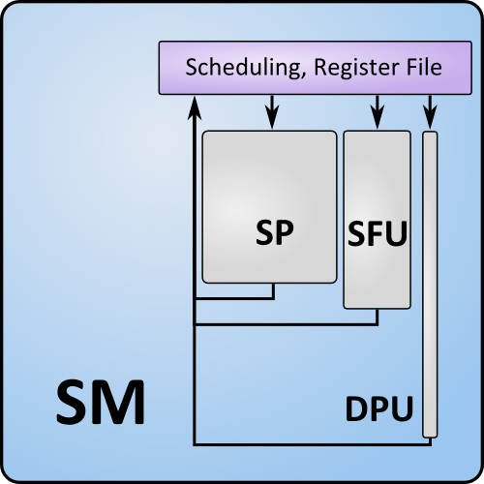
Arithmetic Pipeline: Methodology
Objective: Measure instruction latency and throughput
  Latency: One thread
  Throughput: Many threads
Measure runtime of microbenchmark core
  Avoid compiler optimizing away code
  Discard first iteration: Cold instruction cache
for (i=0;i<2;i++) {
start_time = clock();
t1 += t2;
t2 += t1;
...
t1 += t2;
stop_time = clock();
}
Notes:
We'll start with measuring instruction latency and throughput. There are three types of arithmetic units inside the SM.
Shown is an example of a microbenchmark for measuring addition.
To measure pipeline latency, this benchmark uses data-dependent additions. Running many warps measures the throughput when there is an abundance of independent threads.
We have to be careful that compiler optimizations don't remove our code. We also discard the first iteration of the benchmark to warm up caches. [click]

Slide 10
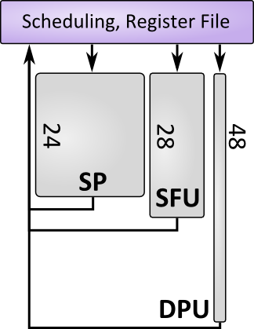
Arithmetic Pipeline: Results
Three types of arithmetic units
  SP: 24 cycles, 8 ops/clk
  SFU: 28 cycles, 2 ops/clk
  DPU: 48 cycles, 1 op/clk
Peak SM throughput
  11.2 ops/clk: MUL or MAD + MUL
Notes:
There are three types of arithmetic units.
In contrast to CPUs (1), the latency is very long (>24). This means there needs to be a continuous stream of 192 independent instructions to sustain full throughput in one SM.
We also tried to measure peak arithmetic throughput. We achieved 11.2 ops/clk running a mix of MAD and MUL, somewhat short of the 16 NV's numbers seem to suggest.

Slide 11
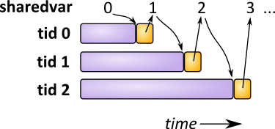
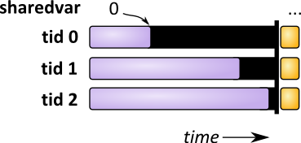
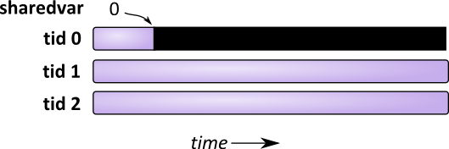
SIMT Control Flow
Warps run in lock-step but threads can branch independently
Branch divergence
  Taken and fall-through paths are serialized
  Taken path (usually “else”) executed first
  Fall-through path pushed onto a stack
int __shared__ sharedvar = 0;
while (! sharedvar == tid) ;
sharedvar++;
Notes:
Recall: SM is a length 32 vector processor running Warps 32 threads, but software model allows threads to branch independently.
Handling Branch divergence gives the illusion of independent threads that branch differently. The two paths are serialized, with the taken path executed first.
Once both paths are finished, the warp reconverges and continues.
Here is an example with a loop where the taken path stays in the loop, and we expect each thread to leave the loop when sharedvar == tid.
SIMT requires that the taken path be finished before reconvergence, meaning no thread can leave the loop until all threads leave the loop
In this example, this results in deadlock because threads are not independent

Slide 12
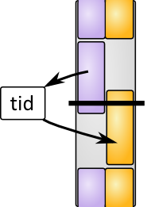
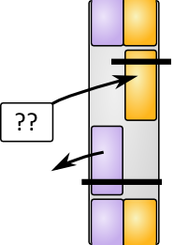



Barrier Synchronization
Syncthreads: Synchronizes Warps, not threads
  Does not resync diverged warps
  Will sync with other warps
Warp0
Warp1
if (warp0) {
if (tid < 16) {
shared_array[tid] = tid;
__syncthreads();
}
else {
__syncthreads();
out[tid] = shared_array[tid%16]
}
}
if (warp1) {
__syncthreads();
__syncthreads();
}
if (tid < 16) {
shared_array[tid] = tid;
__syncthreads();
}
else {
__syncthreads();
out[tid] = shared_array[tid%16]
}
1
2
Notes:
We also looked at __syncthreads. We discovered that syncthreads operates on warps, despite its name.
This is relevant with branch divergence.
Diverged warp, value passed using a shared variable with a barrier to enforce ordering.
We observed that the second block executes first anyway, showing that syncthreads doesn't sync threads in a warp.
Even more interesting is if we extend this example to two warps. Although one might expect two syncs in the second warp to be mismatched with one in the first, we find that this isn't the case.
A diverged warp (serialized) that syncs on both paths counts as syncing twice.

Slide 13
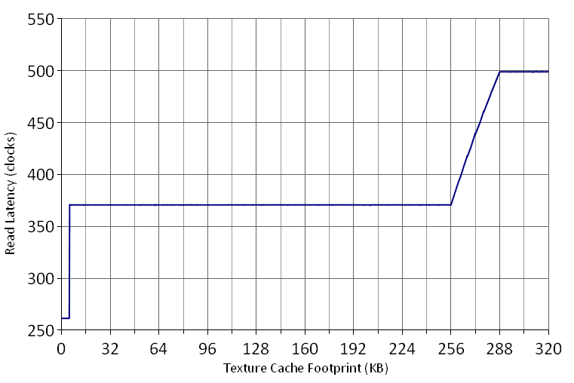
Texture Memory
Average latency vs. memory footprint, stride accesses
  5 KB L1 cache, 20-way
  256 KB L2 cache, 8-way
Notes:
A latency vs. footprint plot can reveal a lot about the memory hierarchy.
This plot is generated from texture memory reads. Cache hits have lower latency than cache misses. We can see that there are two levels of caches, 5 KB and 256 KB in size. We also see that the L1 hit latency is 261 clocks.
We'll zoom in on the L1-L2 transistion...

Slide 14
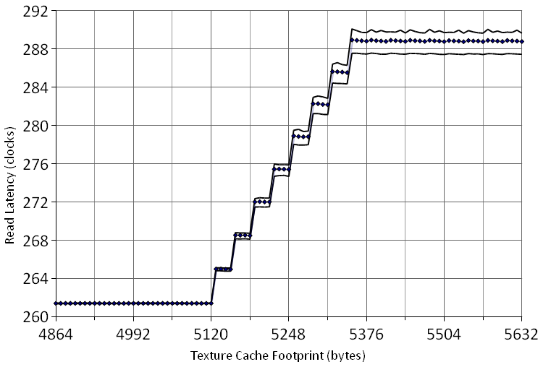
Texture L1
5 KB, 32-byte lines, 8 cache sets, 20-way set associative
L2 is located across a non-uniform interconnect
L1 Miss
L1 Hit
Notes:
A simple-looking plot like this actually provides a surprising amount of information about the cache organization.
* 5 KB
* Line size is 32 bytes
* 8 cache sets
* Cache way is 256 bytes -> 20 way associativity
We also noticed that average L2 latency varied depending on which TPC ran the test code. The max and min are plotted. This suggests the L2 is located across some non-uniform interconnect, probably outside the TPCs.
Differing locations of caches naturally leads to the question of how caches are shared.

Slide 15
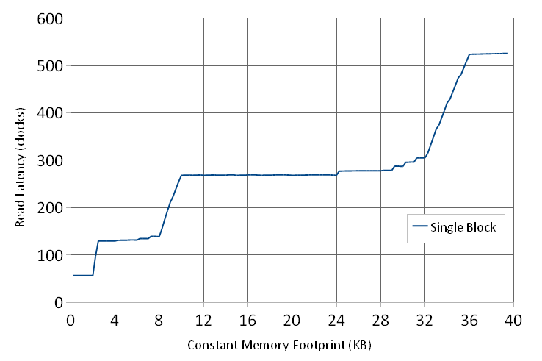
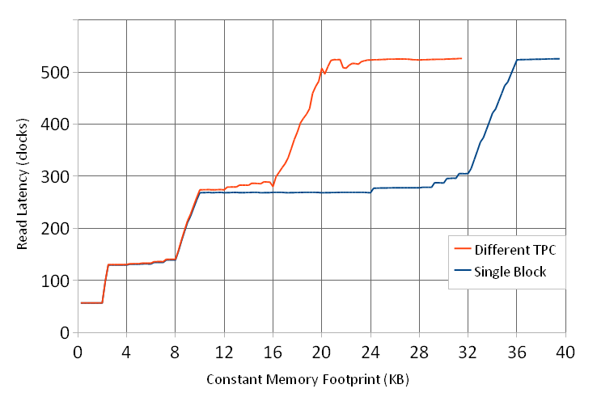
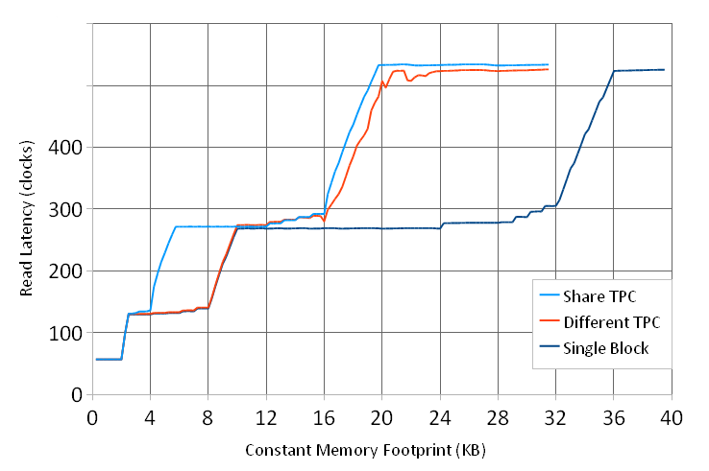
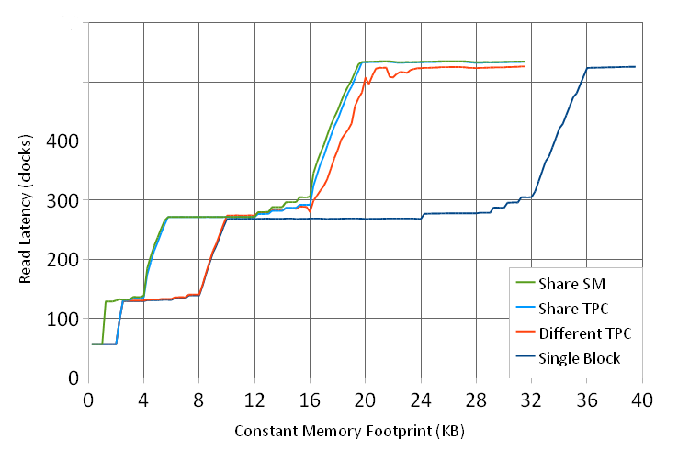
Constant Cache Sharing
Three levels of constant cache
Two Blocks accessing constant memory
  L3: Global
  L2: Per-TPC
  L1: Per-SM
L3
L2
L1
Notes:
Here we look at constant cache sharing. We see the constant cache has 3 levels at 2KB, 8KB, and 32KB
To detect sharing, we run two streams of stride accesses and see if they interfere. Interference indicates the two thread blocks are accessing the same cache.
For two Blocks on different TPCs, we see the apparent L3 size is halved. L2 and L1 is unchanged. L3 is global.
For two Blocks in the same TPC, the L2 is affected too. L2 is per TPC
Finally, two Blocks in the same SM always interfere. L1 is per-SM.

Slide 16
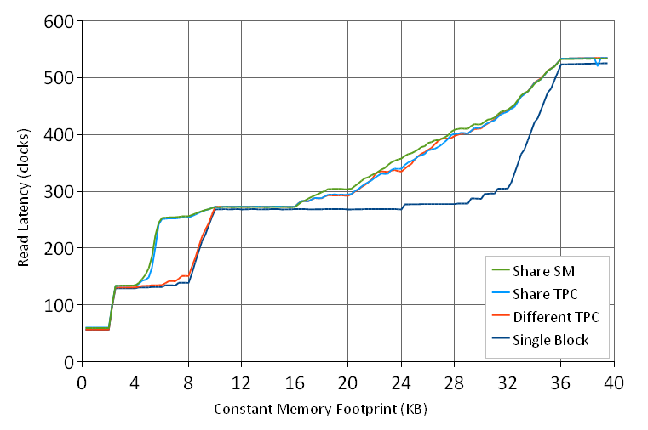
Constant and Instruction Cache Sharing
Two different types of accesses
L2 and L3 are Constant and Instruction caches
Notes:
We can also repeat the previous experiment with two types of accesses. Here we have one Block accessing constant memory and one thrashing the Instruction cache. We see that the L2 and L3 interfere like before, but not the L1, so the L2 and L3 actually cache instructions and constant memory.

Slide 17
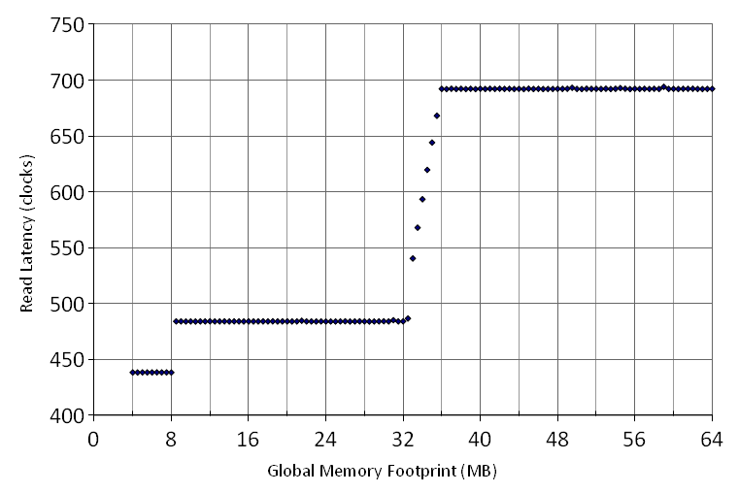
Global Memory TLBs
8 MB L1, 512 KB line, 16-way
32 MB L2, 4 KB line, 8-way
  L2 non-trivial to measure
32 MB
L2
8 MB
L1
Notes:
A similar technique can be applied to measure TLB properties (using larger strides and arrays)
Global memory has two levels of TLBs, holding 8 MB and 32 MB of mappings. 4 KB L2 line size puts an upper bound on the page size, and we have no reason to believe the page is smaller than 4 KB.
There are some interesting things that can be observed in the interaction of caching with TLBs, which can be found in the paper.?

Slide 18
Conclusions
Microbenchmarking reveals undocumented microarchitecture features
  Three arithmetic unit types: latency and throughput
  Branch divergence using a stack
  Barrier synchronization on warps
  Memory Hierarchy
    Cache organization and sharing
    TLBs
Applications
  Measuring other architectures and microarchitectural features
  For GPU code optimization and performance modeling
Notes:
In this talk, we've sampled some microbenchmarking techniques that reveal undocumented features of the GT200.
Measured latency and throughput of 3 arith. unit types; observed branch divergence using a stack; that barrier sync operates on warps; undocumented details on cache organization and translation.
The techniques presented can serve as a starting point for uncovering other microarchitectural details, or other architectures.
Our measurements of the GT200 GPU can aid in code optimization and accurate performance modeling.
“The ultimate goal is to know the hardware better, so that we can harvest its full potential” -- Myrto :)

Slide 19
Questions...

Slide 20
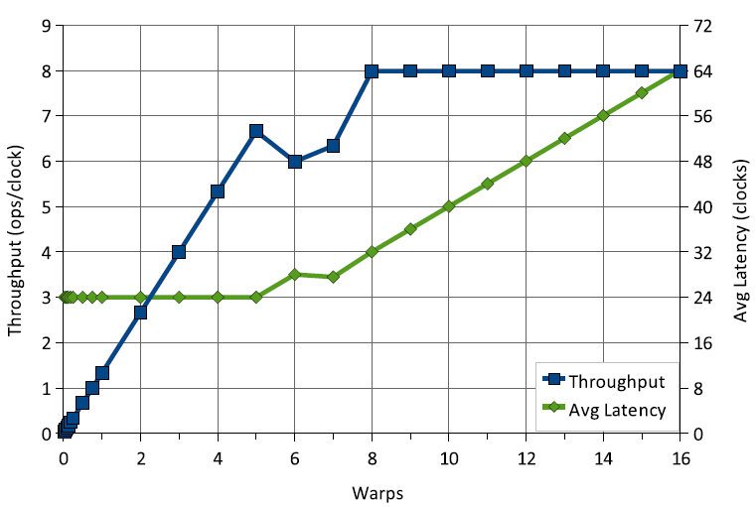
Filling the SP Pipeline
6 warps (24 clocks, 192 “threads”) should fill pipeline
  2 warps if sufficient instruction-level independence (not shown)
24-cycle SP pipeline latency
Fair scheduling on average
Notes:
A consequence of long pipeline latencies is that many independent instructions (192) are required to fully use the SP arithmetic units.

Slide 21
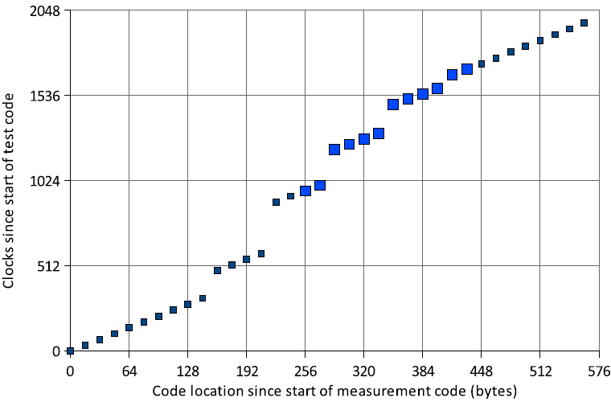
Instruction Fetch?
Capture burst of timing at each iteration, then average
  One thread measures timing
  Other warps thrash one line of L1 instruction cache
Instructions are fetched from L1 in groups of 64 bytes
Notes:
An interesting variation on measurement is to capture a burst of timing information each iteration, then average over the iterations.
In the absence of slowdowns, we should see a straight line of 16 clocks per timing sample.
In this plot, we thrash one cache line in the L1 instruction cache, and see that instead of simply slowing down due to cache misses (change of slope), we see that the impact of L1 misses only occur at 64-byte boundaries. This suggests instructions are fetched from the L1 in 64 byte chunks.

