Slide 1
A Review of Methods for Capturing Material Discontinuities (part 2)
with an introduction to GPU programming
Will Matern
Mentor: Bob Robey
Slide <number>

Slide 2
Resume
As an undergrad did research on mathematical modeling of lungs.
  Fluid/structure interaction
  Surface tension plays a large role
  Derived and wrote code to numerically solve equations governing surface tension/fluid/structure problem.
B.S. in Mechanical Engineering from the University of New Hampshire.
Starting Biomedical Engineering Ph.D program at Johns Hopkins this fall.
Slide <number>

Slide 3
GPUs at a glance
Much higher FLOPS (floating points operations per second) per dollar than CPUs.
Different architecture from a CPU.
  Many low throughput processing units
  Cores share global memory
  Warps/Wavefronts – groups of cores run same code.
Must use a language compiled for GPU
  OpenCL – Open programming language for multiple CPUs (on same node) and GPU.
  CUDA – Nvidia only.
This Project: OpenCL
Slide <number>

Slide 4
Generalizing to the shallow water equations
Previously: Methods for capturing discontinuities in 2D advection equation.
Goal: Solve a harder problem with these methods (eventually the Euler Equations).
The shallow water equations:
  Develops discontinuities/shocks
We implemented advection for a dye in shallow water on GPU.
Slide <number>

Slide 5
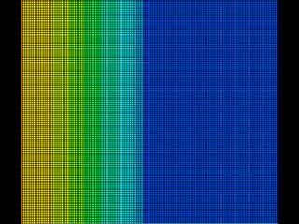
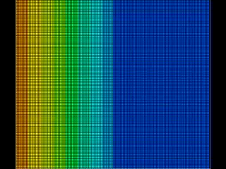
Shallow Water Simulations on the GPU
Fluid Height
Inert Tracer Concentration
Slide <number>

Slide 6
Thank You!
Slide <number>

