Slide 1
Comparison of Methods for Capturing Material Discontinuities
With an Introduction to GPU Programming
Sean Davis

Slide 2



BIO
Undergraduate Degree
McGill University in Montreal, Quebec (Canada)
Major: Mechanical Engineering with a concentration in Aeronautical Engineering
Graduate Study
Joint Doctoral Program with San Diego State University and the University of California at San Diego
Research Topic: High order ENO/WENO methods for the solution of high speed multiphase flows with shocks and particles
Expected Graduation in the Spring of 2015

Slide 3
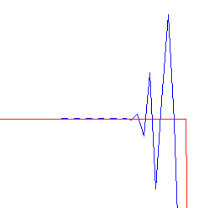
Limiters
Godunov’s Theorem – Any linear scheme above first order accurate (space) cannot be Total Variation Diminishing (TVD).
Solution: Limiters (a nonlinear scheme)
Exact Solution
Non-TVD Solution

Slide 4
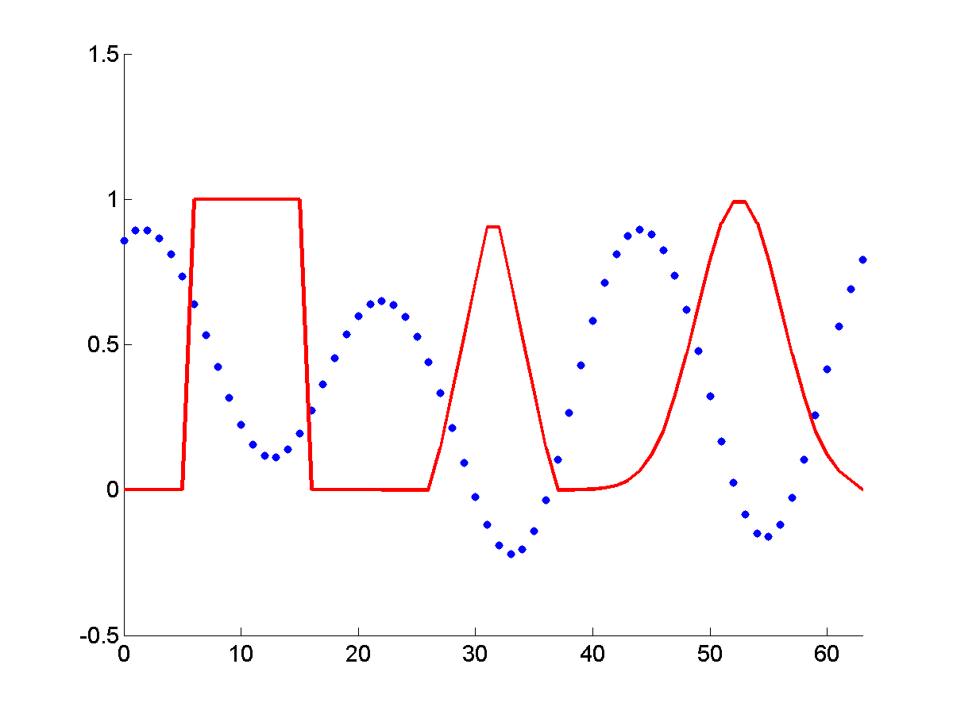
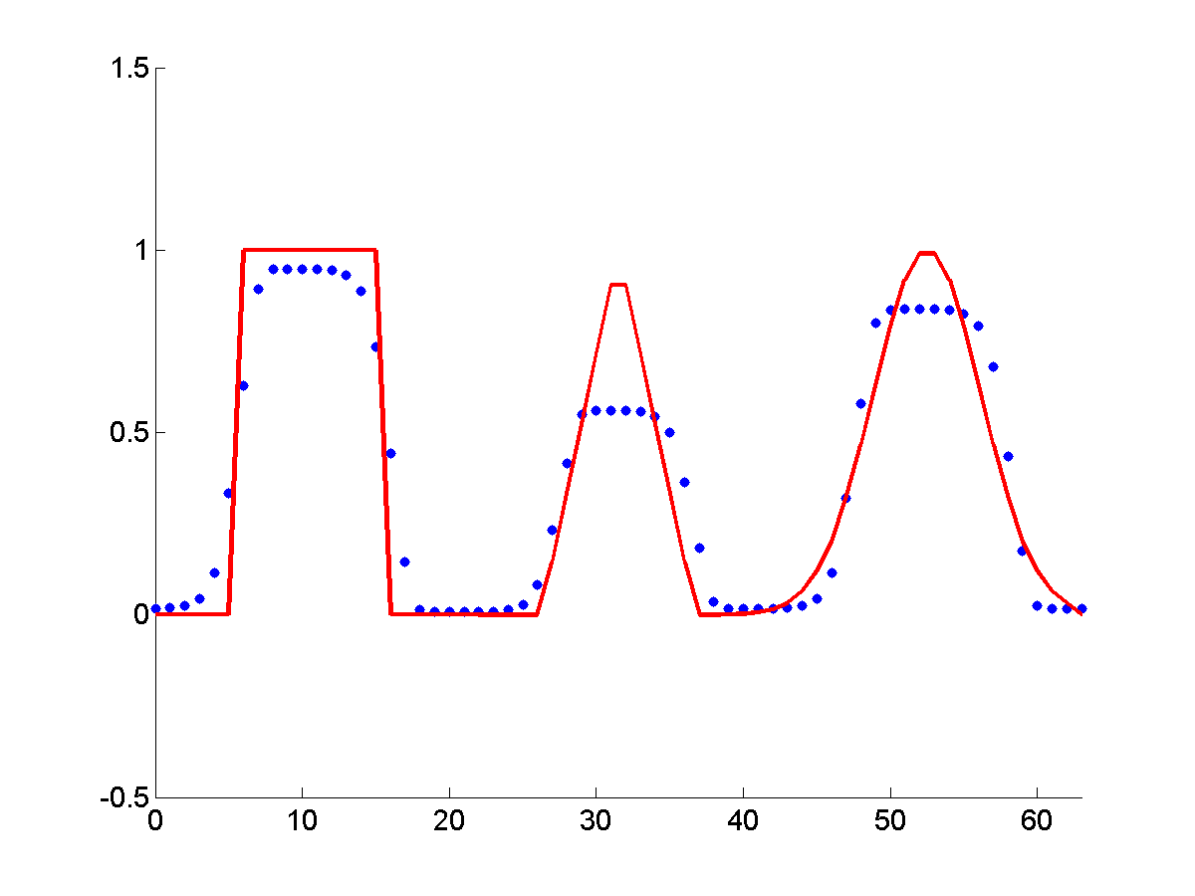
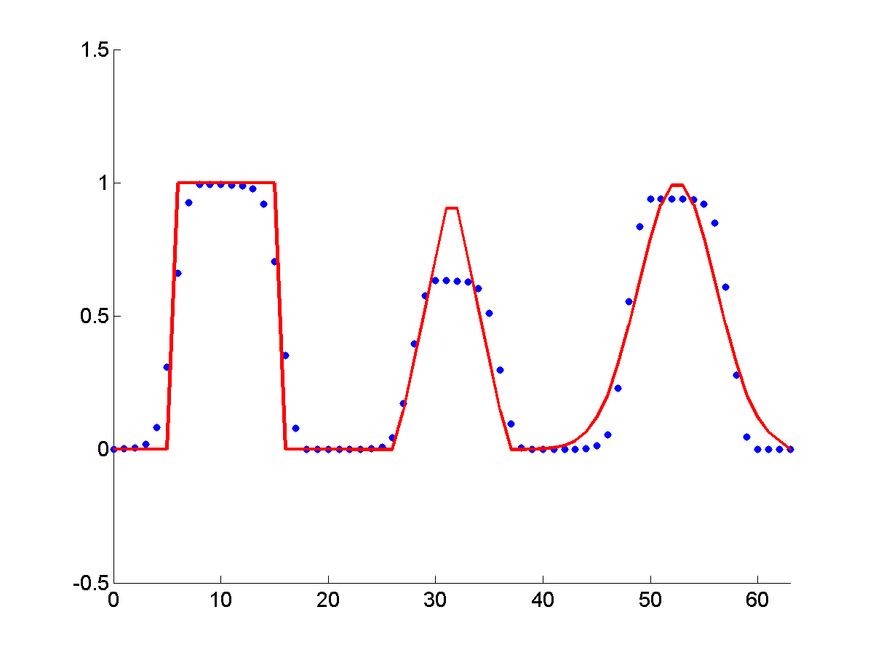
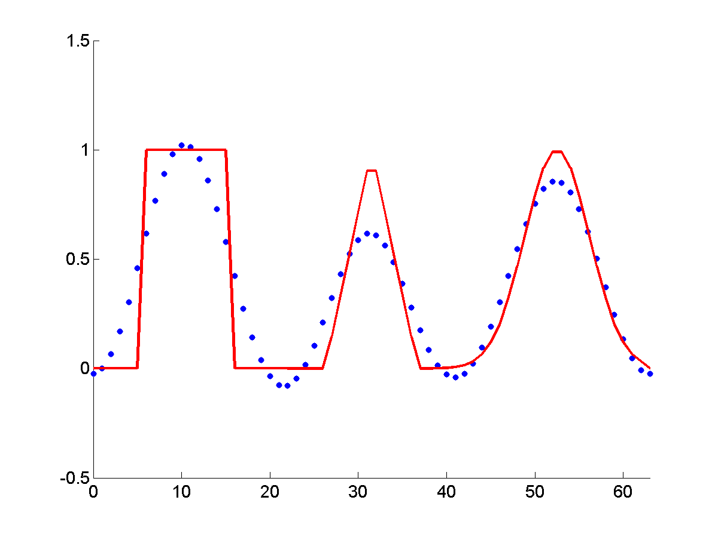
Results for 1D Advection in a 2D Code after 10 Periods
Lax-Wendroff (not TVD):
Lax-Wendroff (Superbee):
MUSCL:
SUPG:
Notes:
Only show the last column.

Slide 5
Acknowledgements
Mentor: Dr. Bob Robey
Partner: Will Matern
Workshop Coordinator: Dr. Scott Runnels
Collaborator: David Nicholaeff
Thank you!

