Slide 1


Slide 2

What is R?
Based on S, designed at Bell Laboratories
(source of UNIX, C, C++, information theory, ...)
Designed for
interactive statistics
Created mostly
by John Chambers

Slide 3
R is open source S
Ross Ihaka and Robert Gentleman created R in New Zealand in the mid-1990s
An R Core development group maintains and develops R (John Chambers is a member)

Slide 4
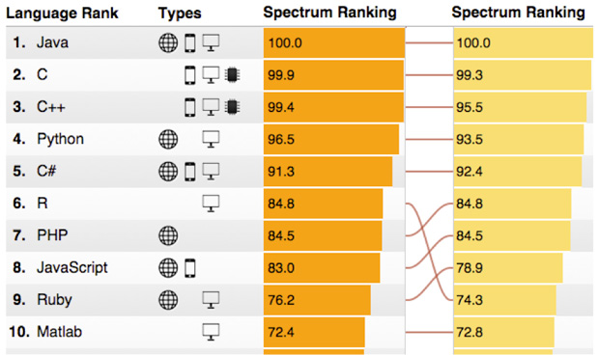
Source:
http://spectrum.ieee.org/computing/software/the-2015-top-ten-programming-languages

Slide 5
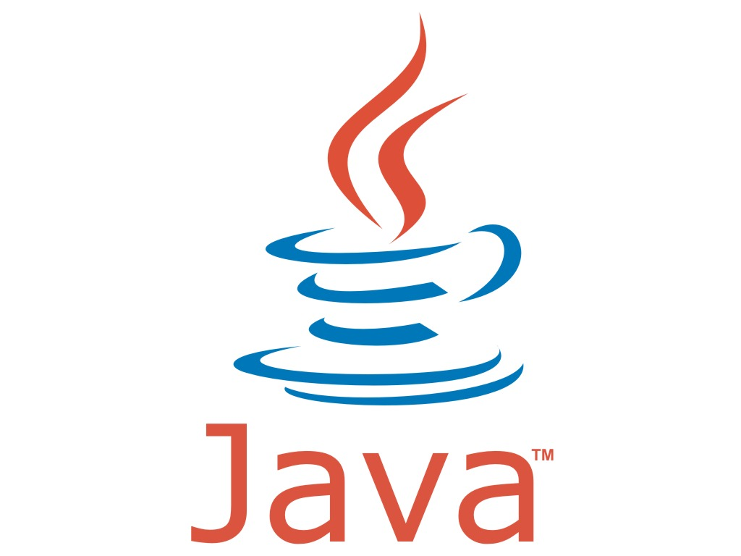
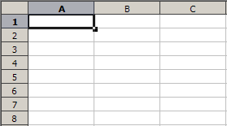
What R programming is like:
+

Slide 6

(Or maybe...)
+

Slide 7
Albany R Users Group
It's on Meetup:
http://www.meetup.com/Albany-R-Users-Group/
More tutorials I like:
http://www.r-tutor.com/r-introduction
http://rstatistics.net/r-tutorial-exercise-for-beginners/

