Slide 1
Reducing the computational load of a novel kernel function
Individual Project, Warren Boult

Slide 2
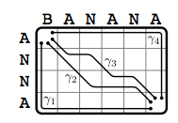
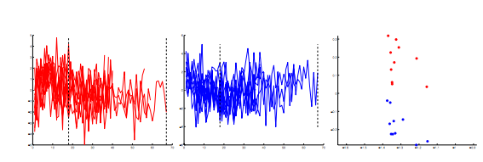
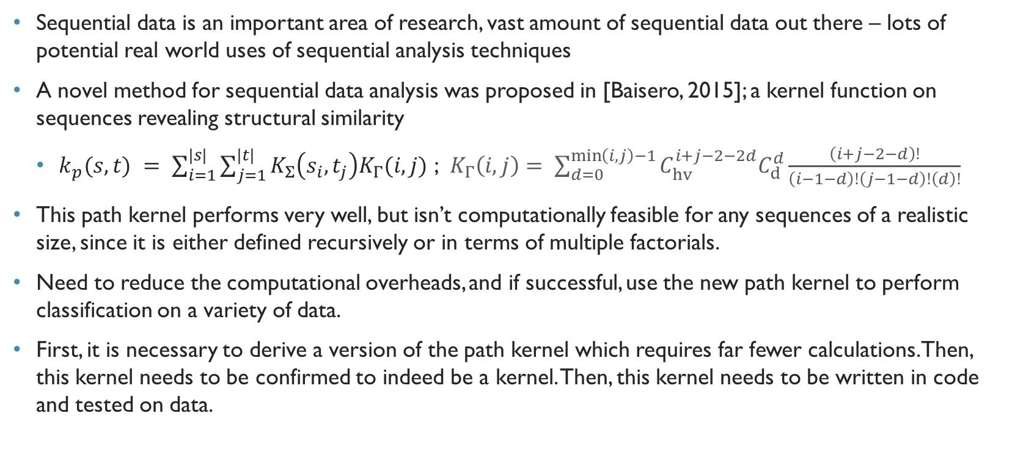
Aims and approach
Sequential data is an important area of research, vast amount of sequential data out there – lots of potential real world uses of sequential analysis techniques
A novel method for sequential data analysis was proposed in [Baisero, 2015]; a kernel function on sequences revealing structural similarity
$k_{p}(s, t) = \sum_{i=1}^{|s|}{\sum_{j=1}^{|t|}{K_{Σ}\left(s_{i},t_{j}\right)K_{Γ}(i,j)}}$ ; $K_{Γ}\left(i,j\right)= \sum_{d=0}^{\min\left(i,j\right)−1}{C_{hv}^{i+j−2−2d}C_{d}^{d}\frac{\left(i+j−2−d\right)!}{\left(i−1−d\right)!\left(j−1−d\right)!\left(d\right)!}}$
This path kernel performs very well, but isn’t computationally feasible for any sequences of a realistic size, since it is either defined recursively or in terms of multiple factorials.
Need to reduce the computational overheads, and if successful, use the new path kernel to perform classification on a variety of data.
First, it is necessary to derive a version of the path kernel which requires far fewer calculations. Then, this kernel needs to be confirmed to indeed be a kernel. Then, this kernel needs to be written in code and tested on data.

Slide 3
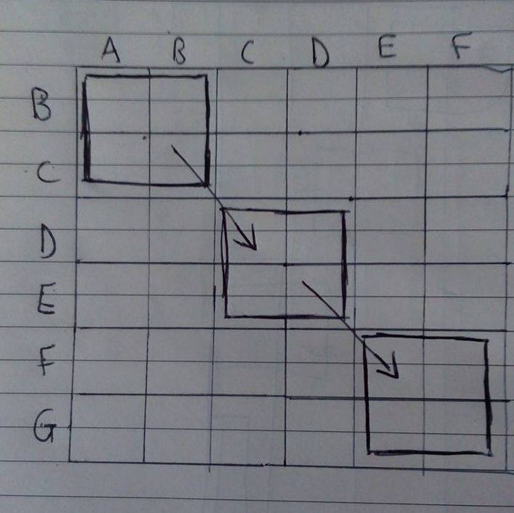
Work done so far
Done lots of reading of relevant literature, immersed myself in the various mathematical concepts involved, in order to fully understand how I can go about developing my solution
Implemented a few kernels in code, to further my understanding of kernel methods and their application to data classification
Implemented the path kernel proposed in [Baisero, 2015], and implemented kernel PCA in order to visualise the separating performance of path kernel
Started doing research on possible ways to reduce computational complexity of kernel, mostly by only considering a subset of all alignments of the sequences, with most probable approach a ‘front’ based computation of the path matrix
Notes:
ADD AN IMAGE OF A FRONT MOVING OVER A MATRIX

Slide 4
Next Steps
First on the list is to finish deriving a mathematically valid function only considering a subset of the sequence alignments – hope to complete within next couple of weeks
Then, the solution needs to implemented in Python, and tested on the experimental data to ensure classification performance still remains. If not, further tinkering with the maths
Once a valid and strong-performing new kernel function is obtained, can apply it to lots of new data and explore possibilities

Slide 5
YouTube link: https://www.youtube.com/watch?v=g9K4YVYzKUE

