Slide 1
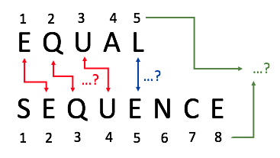

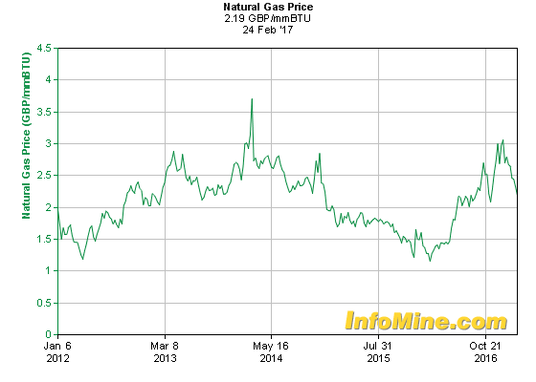
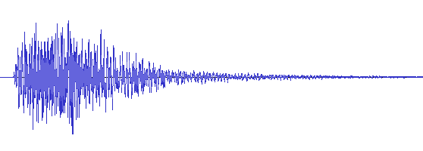
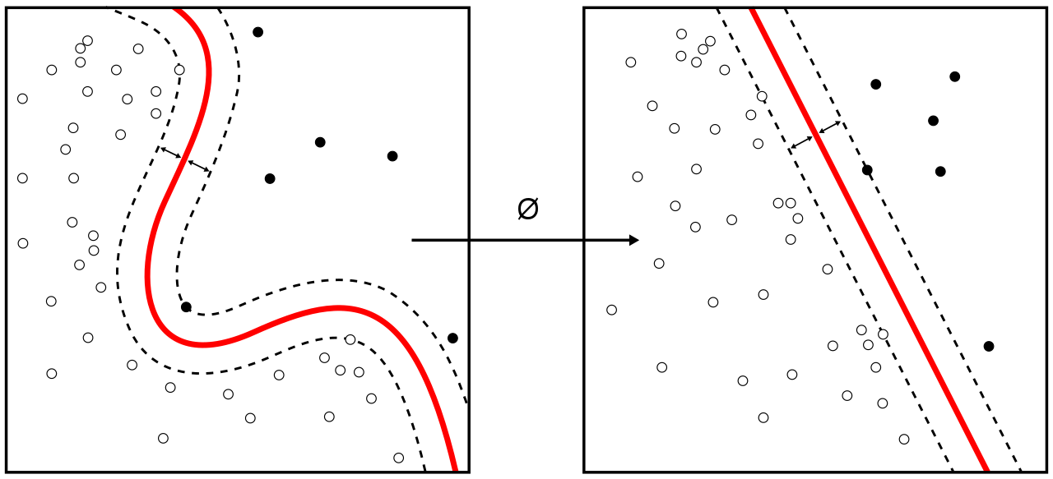
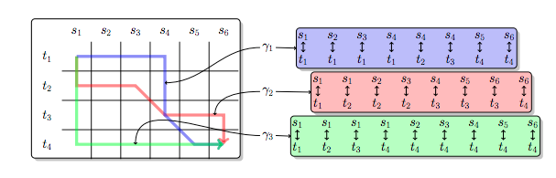
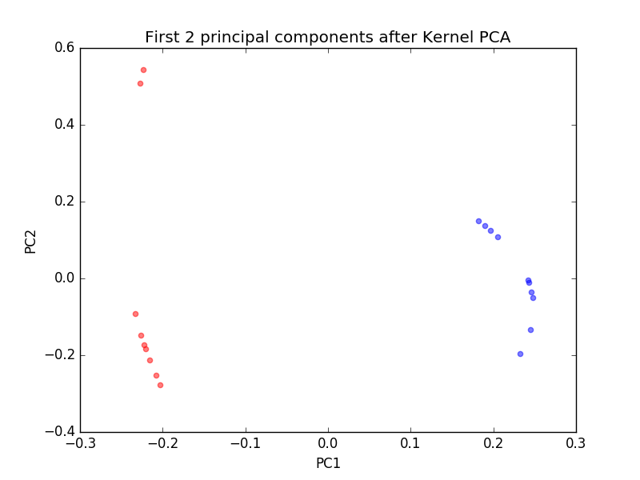
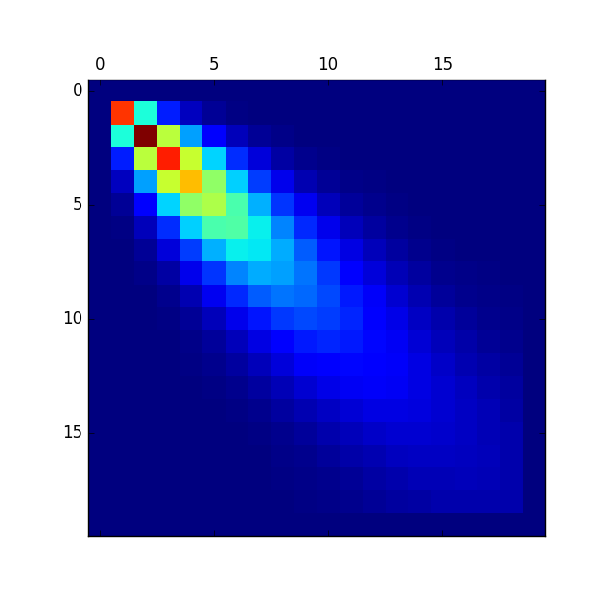
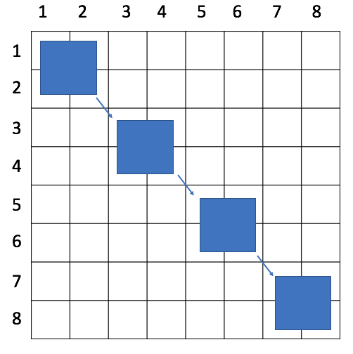
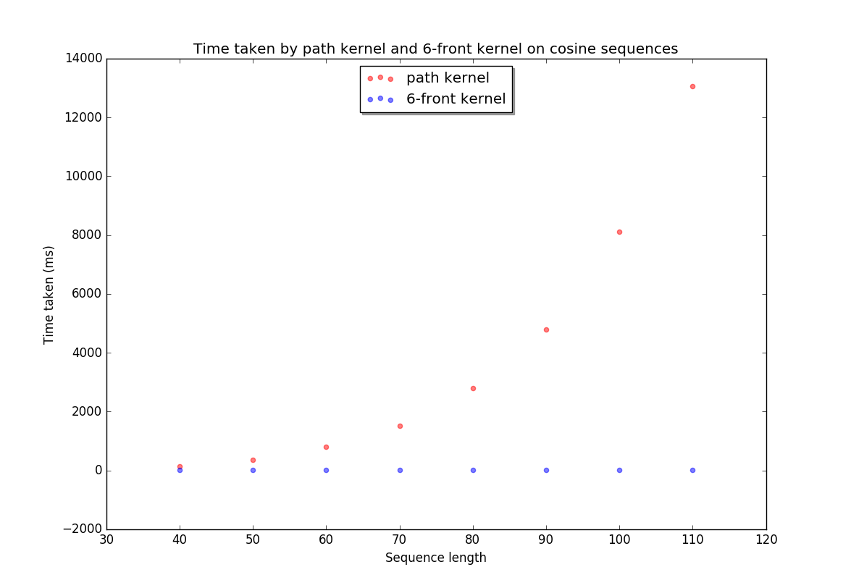
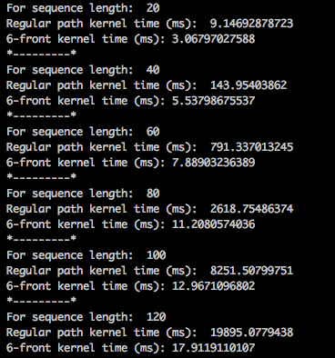
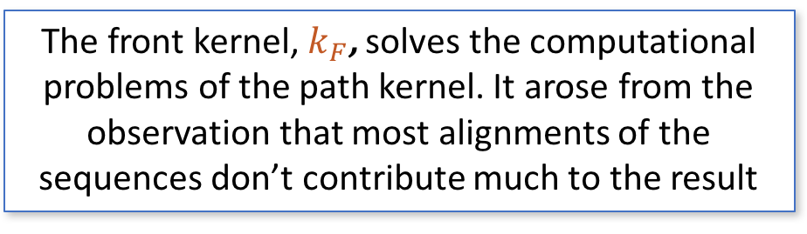
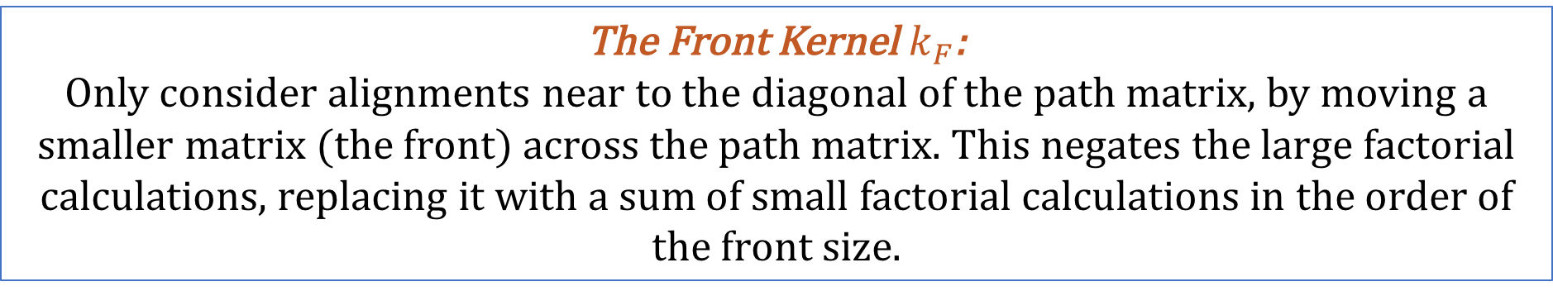
Reducing the computational complexity of a novel kernel function
Warren Boult
Sequential data is all around us! Text documents, DNA strands, time series data like audio clips or maybe gas prices over time; sequences are found everywhere in life, and so the possibilities are great if we can analyse this data well.
Analysing sequences of differing lengths sounds unintuitive, but if we can map our sequences to some kind of feature space, we an apply most machine learning algorithms to the data. E.g bag-of-words
Bag-of-words model example:
Take 2 simple documents:
1. ‘I wake up in the morning and watch TV’
2. ‘I wake up in the morning and read the paper’
We build a list (the ‘bag of words’):
[ ‘I’, ‘wake’, ‘up’, ’in’, ‘the’, ‘morning’, ’and’, ‘watch’, ‘TV’, ‘read’, ‘paper’ ]
Then we make word count vectors (the feature vectors) for each document:
[1,1,1,1,1,1,1,1,1,0,0]
[1,1,1,1,2,1,1,0,0,1,1]
requires us to be able to identify meaningful subsequences, such as words in a text document
… But how can we analyse sequential data? Sequences are much more complex than other forms of data:
We want to compare aligning individual symbols
We want to compare structure: E, Q and U appear consecutively in each sequence, how do we account for this?
How can we analyse 2 different length sequences?
how do we deal with highly dynamic types of data?
We want to gain information about the structure; this if the fundamental problem of sequential data analysis
Kernel functions can give us the mapping into a feature space, without computing the feature vector explicitly
Kernels are thus a good place to look for developing a new sequential analysis method:
The implicit feature space allows us to apply a kernel to many data types, with no need to extract actual features
We can handle varied sequence lengths, now we have an (implicit) feature vector
Kernel functions sound useful, but we need one that can measure similarity in the structure of sequences. Enter the path kernel…
The Path Kernel $k_{p}$:
$k_{p}(s, t) = \sum_{i=1}^{|s|}{\sum_{j=1}^{|t|}{K_{Σ}\left(s_{i},t_{j}\right)K_{Γ}\left(i,j\right)}}$ → $K_{Γ}\left(i,j\right)= \sum_{d=0}^{\min\left(i,j\right)−1}{C_{hv}^{i+j−2−2d}C_{d}^{d}\frac{\left(i+j−2−d\right)!}{\left(i−1−d\right)!\left(j−1−d\right)!\left(d\right)!}}$
The path kernel compiles structural information by considering all possible alignments of the two sequences. It performs better than similar classification methods on a variety of datasets.
Alignments of sequences s and t
Lots of nasty large factorial calculations here though - becomes infeasible to calculate quickly: fac(10) is already greater than 1 million, and fac(13) > 1 billion !
An alignment of the 2 sequences:
E E E Q U A A A L L
S E Q Q Q U E N C E
The Front Kernel $k_{F}$:
Only consider alignments near to the diagonal of the path matrix, by moving a smaller matrix (the front) across the path matrix. This negates the large factorial calculations, replacing it with a sum of small factorial calculations in the order of the front size.
The front kernel performs equally well on classification tests, and performs vastly better time-wise
The front kernel, $k_{F}$, solves the computational problems of the path kernel. It arose from the observation that most alignments of the sequences don’t contribute much to the result
Front moving over path matrix
Notes:
Part 1 DONE. TODO parts 2, 3

