Slide 1
ECE 592 Quantum Chemistry Project
https://pages.github.ncsu.edu/wmccray/ECE592ProjectB1/
KELVIN DSOUZA
BILLY MCCRAY
Notes:
billy

Slide 2
Motivation for Quantum Computational Chemistry
Quantum computers have inherent advantages over classical computers for simulating chemical processes
Classical computers can do at best an approximate simulation of a chemical process
When performing chemical simulations on a quantum computer you are simulating quantum processes with a quantum mechanical system
Quantum computers have the potential to do much more precise simulations of chemical reactions than classical computers.
Quantum computing will likely allow us to build much more robust simulations of chemical reactions in the future.
Notes:
Billy

Slide 3
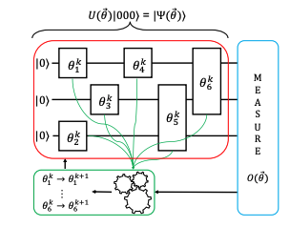
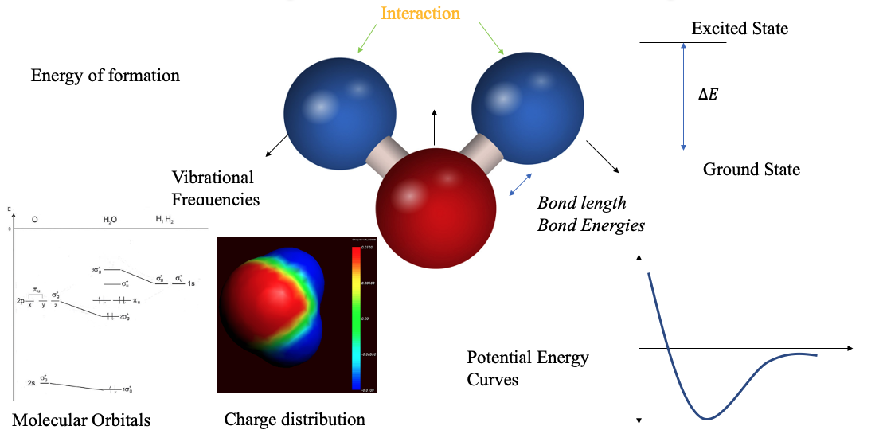
Methods of Computational Chemistry
Computational chemistry simulations typically solve the adiabatic Schrodinger equation
The adiabatic Schrodinger equation is a complicated function of all the electronic and spin coordinates of the molecule being simulated.
Scales exponentially with the size of the molecule.
Even the most powerful classical supercomputer in the world at present isn’t able to properly simulate a caffeine atom. (IBM et al.)
Once quantum computing technology matures we will likely be able to simulate any molecule.
(McArdle et al.)
Notes:
Billy

Slide 4





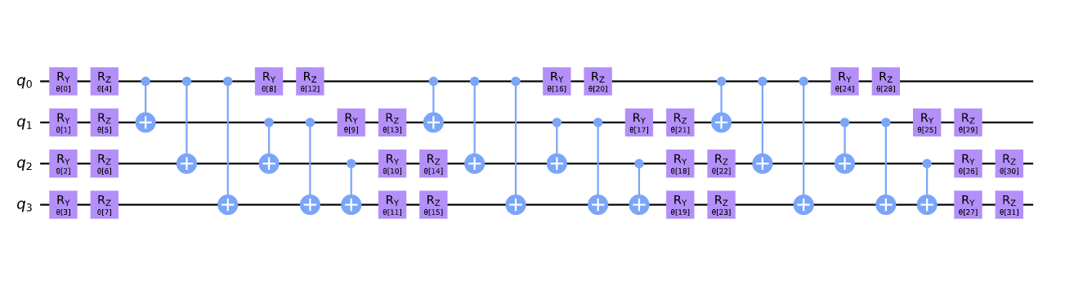
The Variational Quantum Eigensolver (VQE)
VQE is a hybrid algorithm (using both a classical and quantum computer) where the minimum ground energy state of a molecule is calculated.
The process is iterated until what is evaluated to be a reasonable minimum of the ground energy state is found.
The minimum ground energy state should be the actual physical configuration of the molecule. (Lanes et al.)
Notes:
Kelvin-

Slide 5
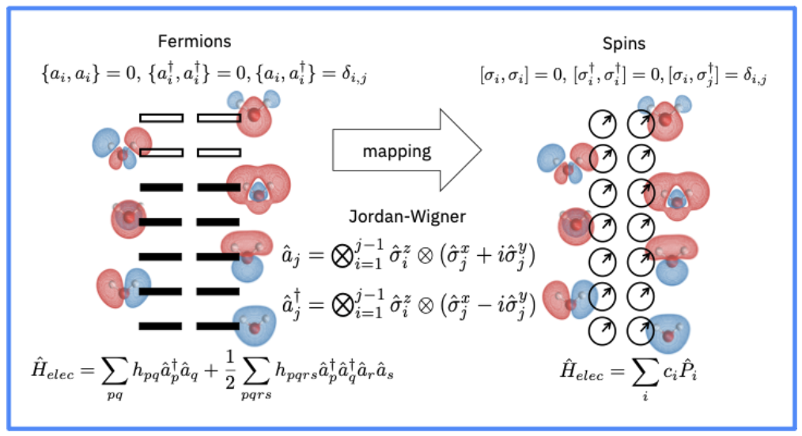
The Variational Quantum Eigensolver (VQE)
Optimizers:
Simultaneous Perturbation Stochastic Approximation optimizer (SPSA).
Sequential Least Squares Programming optimizer (SLSQP)
Constrained Optimization by Linear Approximation optimizer (COBYLA).
Challenges:
Noise
Size of the Problem
Fermions to Quibit mapping
PARITY
JORDAN_WIGNER
Bravyi-Kitaev
Notes:
Kelvin

Slide 6
Results
Step 1: Define a Molecule
0.73A
H
H
-PySCF driver initialization
Step 2: Prepare Qubit Hamiltonian
-Fermionic Operator –JORDAN_WIGNER
Molecule | Simulator | Energy (Hartree)
H-H | State-vector | -0.716063482
 | QASM | -0.740731781
 | IBMQ | -0.72763698789
 | PySCF | -0.74361971
-Qubits mapping – 2 qubits
Step 3: Define VQE Solver and initial state
-OPTIMIZER–SPSA
-Initial State–HartreeFock
Ran the algorithm on a quantum backend and retrieve the results
Step 4: Run Calculation

Slide 7
Qiskit/Python Software Tools Used to Implement the H2 Atom Simulation
Qiskit Aqua
HartreeFock from Qiskit.chemistry.components.initial_states
Produces an initial ansatz
NumPyMinimumEigensolver
Produces iterative ansatzs after the initial iteration of the algorithm
Variational Quantum Eigensolver (VQE)
UCCSD from qiskit.chemistry.components.variationa_forms
Helps integrate the initial ansatz from the HartreeFock package into the VQE package (Lanes et al.)
Numpy
A Python package used to perform some of the calculations done in the simulation
PySCFDriver From qiskit.chemistry.drivers
A Qiskit chemistry driver that utilizes the PySCF library

Slide 8
Conclusions
In this project, a program simulating a Hydrogen atom on the qiskit simulators was used as a template to write an application simulating atoms molecule using Qiskit and the VQE algorithm (Wood and Marques).
As quantum computers become more powerful quantum computational chemistry will likely allow us to develop better medicines and better materials.
Bibliography
IBM, et al. “An Introduction to Quantum Computing with IBM Qiskit.” Youtube.com, 31 Oct. 2020, https://www.youtube.com/watch?v=RB6E7tvDCPE. Accessed 5 Nov 2020.
Lanes, Olivia, et al. “The Variational Quantum Eigensolver — Programming on Quantum Computers — Coding with Qiskit S2E4.” youtube.com, Qiskit, 6 Nov 2020, https://www.youtube.com/watch?v=Z-A6G0WVI9w. Accessed 7 Nov 2020.
Li, Gushu, et al. “Towards Efficient Superconducting Quantum Processor Architecture Design.” ASPLOS, 20 March 2020, https://asplos-conference.org/2020/program.html. Accessed 7 October 2020.
McArdle, Sam, et al. “Quantum computational chemistry.” arXiv:1808.10402 [quant-ph], Rev. Mod. Phys. 92, 15003 (2020), 27 January 2020, https://arxiv.org/abs/1808.10402. Accessed 8 October 2020.
Wood, Steve, and Manoel Marques. “qiskit-aqua.” GitHub, https://github.com/Qiskit/qiskit-aqua. Accessed 22 10 2020.

