Slide 1

Low Rank Approximations, PCA, and CCA
Abhinav Gopal, Shrey Vasavada, William McEachen, Grace Kull, Jai Bansal

Slide 2
LOW RANK APPROXIMATIONS |
EECS 189
What is a low rank approximation?
Large amounts of data is expensive
Furthermore, some *unimportant* aspects of data reflect noise
How do we create an approximation of the data with just the important features?
Option: Reduce features
How? Choose the most “important” features of the matrix
Decompose to svd and only use the top “k” values
∑_{i⋲(1...k)}u_{i}σ_{i}v^{T}_{i}

Slide 3
LOW RANK APPROXIMATIONS |
EECS 189
Notice from the previous slide that our low rank approximation’s column space was the k vectors v_{i}
These vectors represent the directions of most variance in our data
Idea: Use these vectors in Xw = y prediction tasks
Project X onto these important directions, and use this projection to predict y.

Slide 4
EECS 189
PCA |
This brings us to PCA!
Procedure
Compute SVD for matrix X
Get the top k eigenvectors v^{T}_{i} and choose these eigenvectors
Get the principal components by finding Z_{k}= XV_{k}
Get the approximation for X by doing Zv^{T}_{k}
Use this approximation and do least squares

Slide 5
EECS 189
PCA |
Great, but flawed, way to approximate a matrix and eliminate noise.
Why? Relies on the assumption that the largest variance directions are the most important ones.
Very easy to modify data in order to render PCA useless
What is the workaround?
We try to find the actual correlation between X and y.

Slide 6
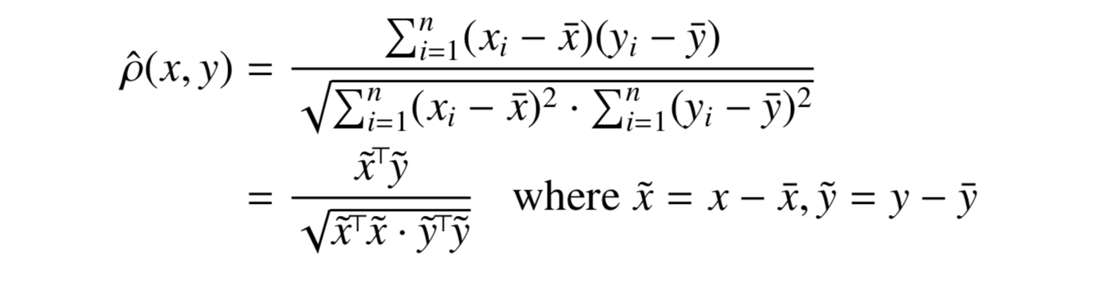
EECS 189
CCA |
This brings us to CCA
Canonical Correlation Analysis
CCA uses the pearson correlation coefficient in order to determine the relationship between X and y.

Slide 7
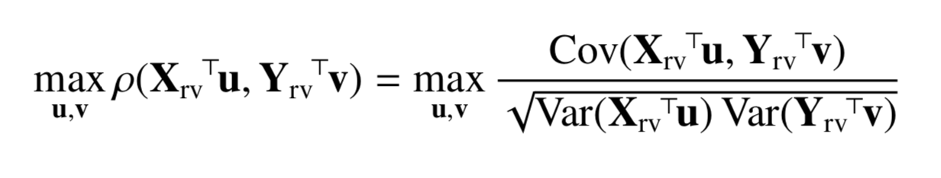
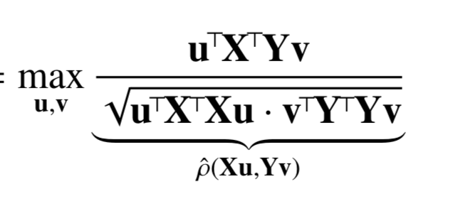
EECS 189
CCA |
Goal: To Solve
X_{rv} and Y_{rv} are both real vectors that correspond to the size of X and Y.
With some algebra, we find that the problem becomes

Slide 8
EECS 189
CCA |
Whiten the X and Y matrices (make their covariance 0) by
Use W_{x} = U_{x}S^{1/2}_{x}U_{x}^{T}
Use W_{y} = U_{y}S^{1/2}_{y}U_{y}
SVD of X^{T}X = U_{x}S_{x}V_{x}^{T}
SVD of Y^{T}Y = U_{y}S_{y}V_{y}^{T}
Use X_{w} = XW_{x}, Y_{w} = YW_{Y}

Slide 9
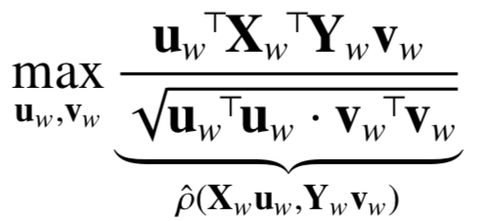
EECS 189
CCA |
With the change of variables u_{w} = W_{x} ⁻¹u and v_{w} = W_{y} ⁻¹v, the max expression becomes:
Now, let’s decorrelate X_{w} and Y_{w} , making (X_{w}D_{x})^{T}(Y_{w}D_{y})
We decorrelate them with the choice of
U for D_{x} and V for D_{y} , where USV^{T} = X_{w}^{T}Y_{w}

Slide 10
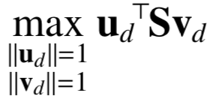
EECS 189
CCA |
Changing variables with
u_{d} = D_{x} ^{T}u_{w} and v_{d} = D_{y} ^{T}v_{w}, the maximization becomes the following:

Slide 11
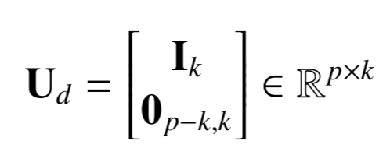
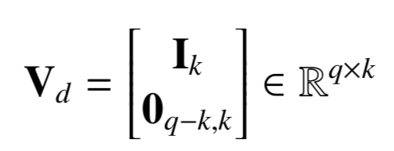
EECS 189
CCA |
Finally, we get the associated eigenvectors of interest!
U = W_{x}D_{x}U_{d}, V = W_{y}D_{y}V_{d}, with

