Slide 1
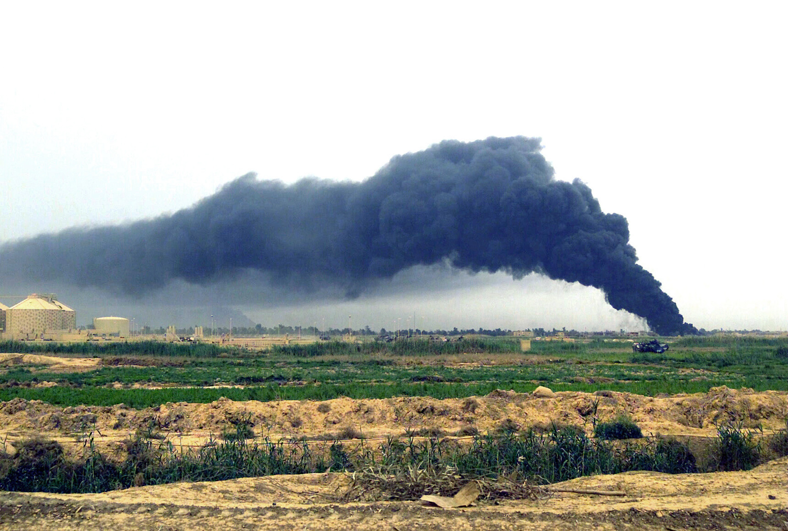
Global Terrorism Analysis
An analysis of terrorism female education rates

Slide 2


The Data
START dataset of 200,000+ global terrorist event from 1970 to 2018
Each event has many detailed indicators
The effort to recover 1993 data is ongoing
National Consortium For The
Study of Terrorism and Responses to Terrorism
World education statistics from 163 countries and regions from 1965-2015
My primary interest was global education statistics for women in each of these 163 countries

Slide 3
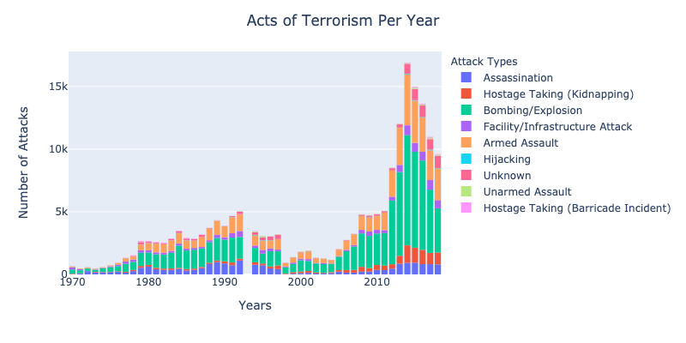
The rises and falls of terrorism

Slide 4
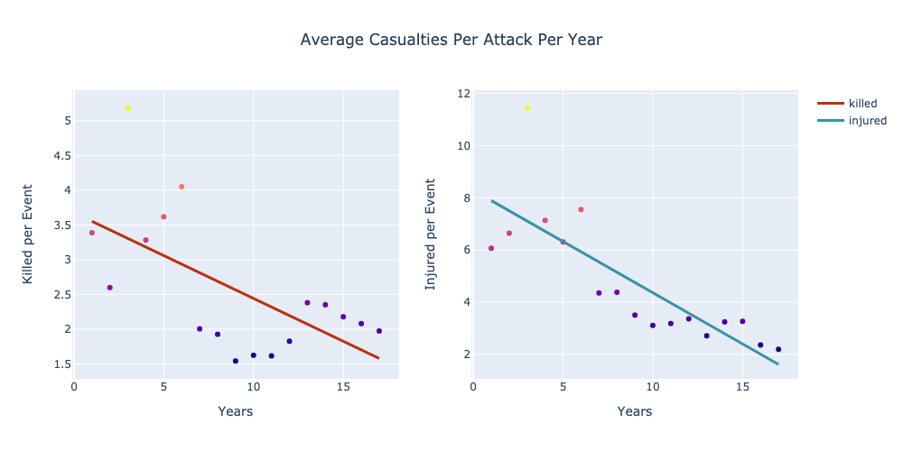
An Emerging Threat, an Evolution of Response

Slide 5
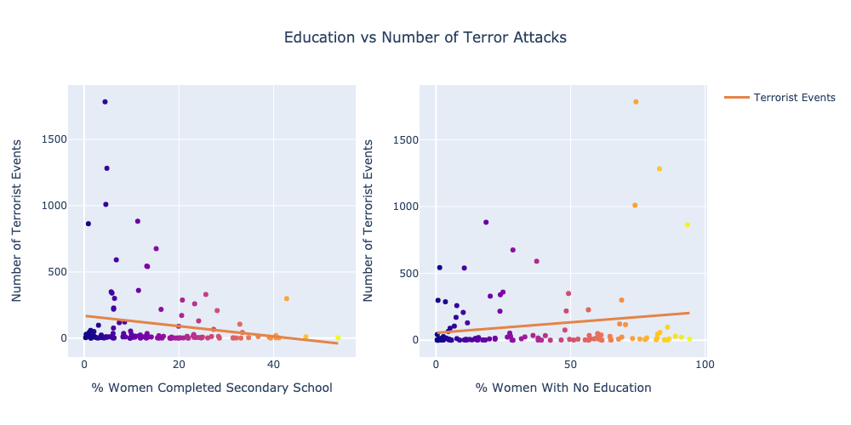
Education as an additional response
H0: There is no statistically significant relationship between terrorism and the education of women
HA: There is a statistically significant relationship
Test Conducted
Spearman R
Due to nonlinearity of data
Alpha of 0.05
P Value: 0.010
Correlation: -0.227
P Value: 0.009
Correlation: 0.231

Slide 6

Questions?

