Slide 1
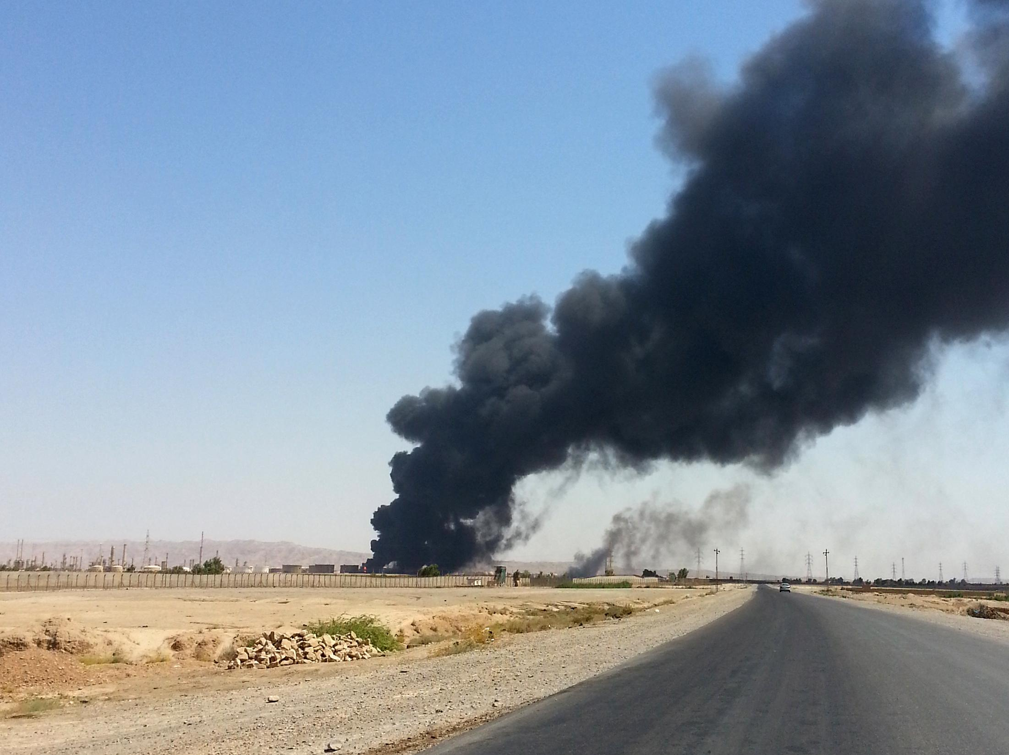
Global Terrorism Analysis
An analysis of terrorism female education rates
Notes:
My name is walker mcfarlan and I have done a global analysis on terrorism and the interaction between terrorism and female education rates per country

Slide 2


The Data
200,000+ events
1970 to 2018
National Consortium For The
Study of Terrorism and Responses to Terrorism
163 countries and regions
1965 to 2015
Notes:
The datasets I have collected are from the National Consortium for the Study of Terrorism and Responses to Terrorism and the World Bank Group. The Start dataset has over 200,000 different terrorist events from 1970 to 2018. It is important to note 1993 is missing from the START dataset. Educational data from World Bank Group includes 163 different countries and regions from 1965 to 2015.

Slide 3
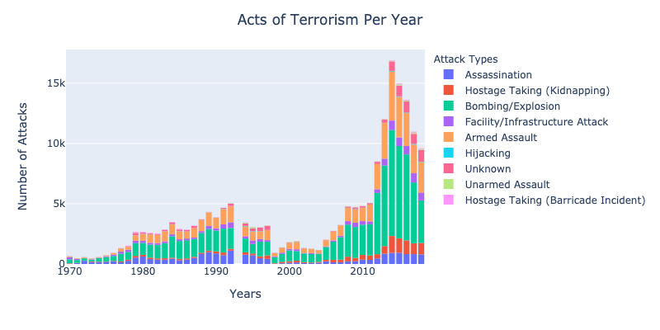
The rises and falls of terrorism
Notes:
To give everyone a picture of modern terrorism I have plotted terrorist events by year by attack type. We can see a an increase in the 80’s and 90’s and also a significant increase in the 2010s. This is due to the rise of ISIS. 2014 is the peak, and this is when the united states starting combating ISIS in Iraq. It is also worth noting the most common types of attacks are bombings and armed assaults.

Slide 4
How does education interact with terrorism?
Education as a humanitarian approach
Metrics used:
% of women that have completed secondary education
% of women with no education
H0: There is no statistically significant relationship between terrorism and the education of women
HA: There is a statistically significant relationship

Slide 5
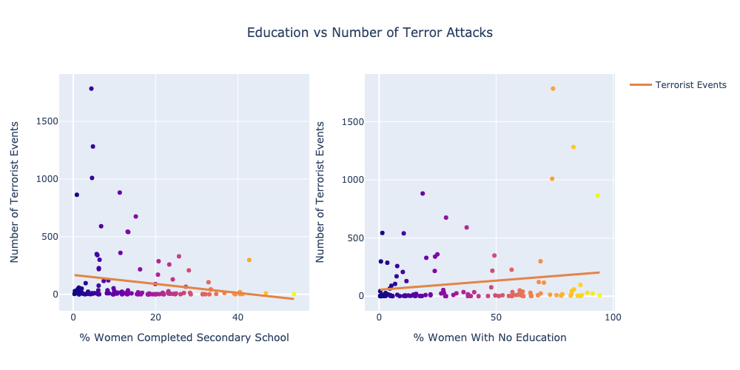
Education as an additional response
Test Conducted
Spearman Rho
Due to nonlinearity of data
Alpha of 0.05
P Value: 0.010
Correlation: -0.227
P Value: 0.009
Correlation: 0.231
Notes:
The two primary educational metrics I am interested in are percent of women that have completed secondary school per country and the percent of women with no education per country. These two metrics give varying degrees of stringencies for education, plus the education of women speaks to a country’s sociopolitical atmosphere.
I found both educational data per country and terrorist events per country to be very nonlinear. This is why I used Spearman R to correlate the relationship. Even after a log transformation of the data, there was great skewness. It was interesting to see the mean education rates for both these educational metrics fall around the 20% mark around the world.
After conducting the Spearman R, I have found the P value to be below my alpha threshold and thus I am able to accept my null hypothesis.

Slide 6
Conclusions
While education does have a correlation with terrorism, it is important to remember terrorism is an enormously complex problem
Further Research
Country by Country analysis
Region by Region
Geopolitical Structures
Interaction between GDP and Terrorism

