Slide 1
Physically-Based Simulation Project Plan: Position Based Fluids
Group 17
Mengdi, Memedi, Danieletto

Slide 2
Simulation Scenario
Splashy water simulation
Motivation: Do it fast, preferably realtime.
Implementation of a fluid simulation that may be inaccurate, but believable.

Slide 3
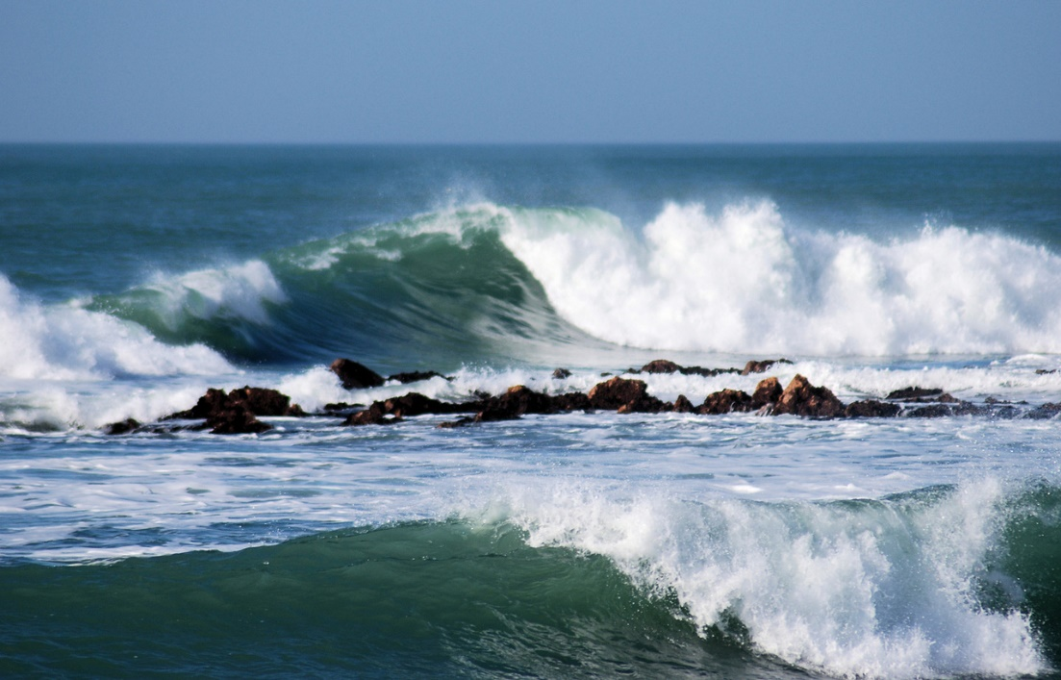
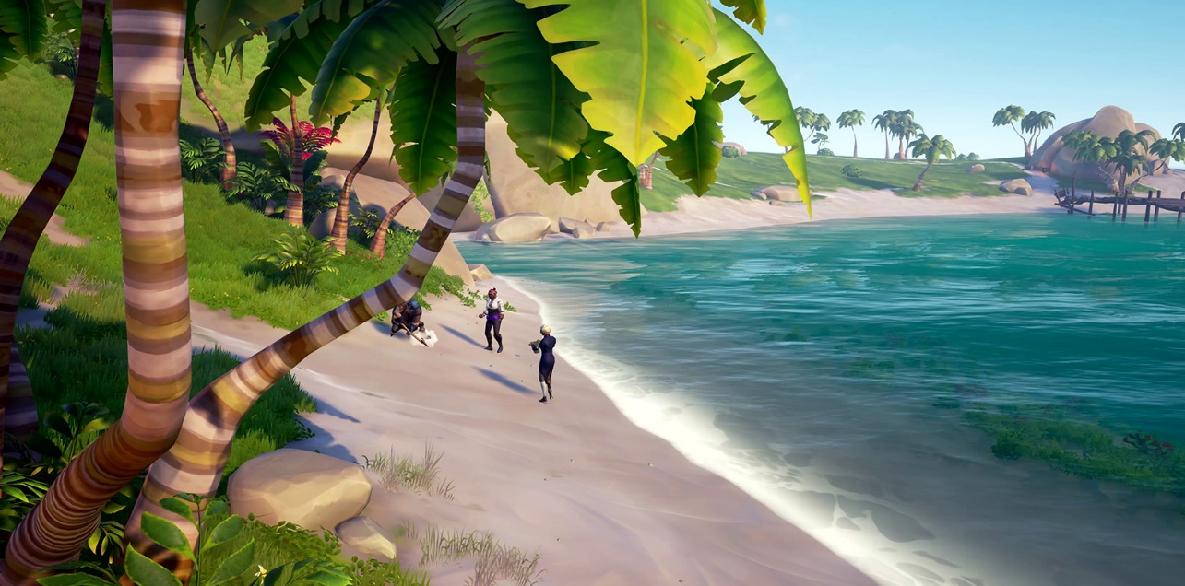
Inspirational Images
Image by Paul Martlew
Screenshot from Sea of Thieves - Microsoft
Notes:
Upper left: Photo by Paul Martlew from FreeImages
Lower right: screenshot from game Sea of Thieves. www.seaofthieves.com

Slide 4
Simulation Methods
Position Based Dynamics (PBD)
Directly update position of particles
Enforce physicality through constraints
Reference paper:
Macklin, M. and Müller, M., 2013. Position based fluids. ACM Transactions on Graphics (TOG), 32(4), pp.1-12.

Slide 5
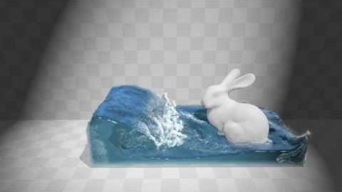
Related Work

Slide 6
Minimal Target
Particle based water simulation
Parallelized for fast simulation speed
Example Scene showing its performance

Slide 7
Desired Target
Particle based water simulation
(near) realtime simulation speed
Simulation adapting to realtime input from player.

Slide 8
Bonus Target
Nice shading
GPU based implementation for maximum speed.

Slide 9
Milestones
Create simple Scenes with particles and obstacles
Implement constraint solver
Implement update loop
Port to GPU
Improve shading to make it look like actual water.

Slide 10
Timeline
Constraint Solver
15/11
Simulation steps
24/11
Improved Shading
15/12
Scenes
03/11
Optimizations / GPU port
10/12

