Slide 1

Mental Health in the Classroom
William Lewandowski

Slide 2
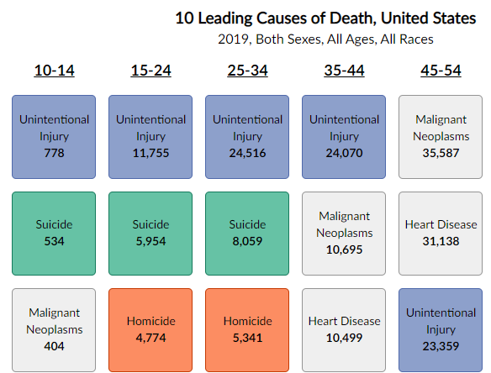

Slide 3
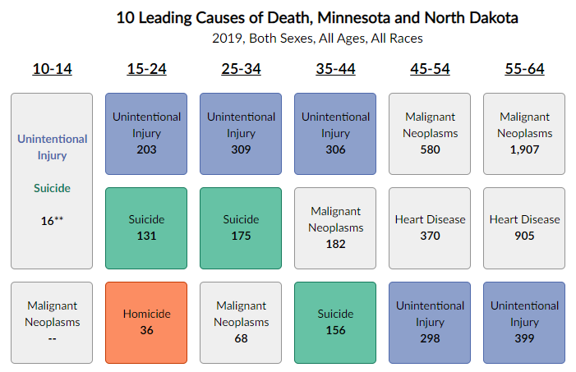

Slide 4
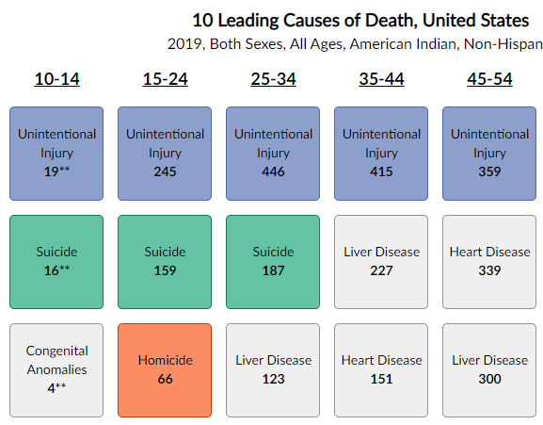

Slide 5
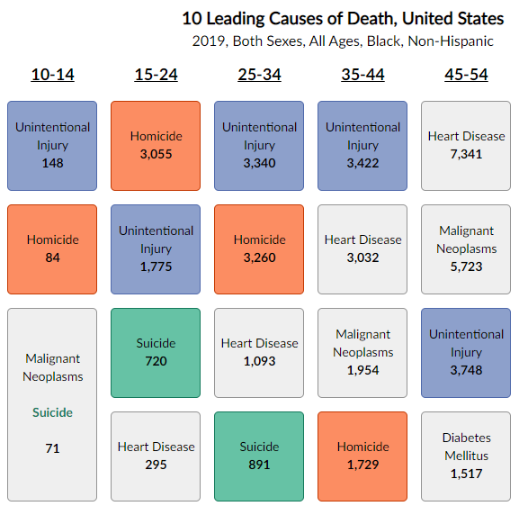

Slide 6
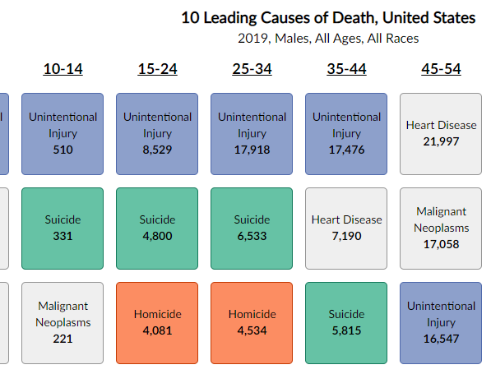

Slide 7
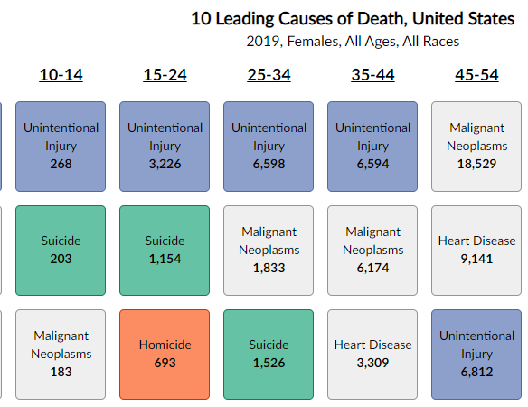

Slide 8
LGBQ Youth and Trans Youth
LGBQ youth 2x more likely to be suicidal / 4x more likely to attempt than heterosexual counterparts
Trans youth are far more likely to experience both of those than their non-trans counterparts
28% LGBQ youth / 40% Trans youth = depressed most / all the time
This doesn’t even discuss race! Per a study conducted in 2017, between 2010 and 2014, looking at the murders of trans individuals, they found that of a sample of 69 homicides, all but one were trans women and nearly half were black and nearly half were between the ages of 15 and 35.

Slide 9
