Slide 1


Neural Networks via Stochastic Gradient Descent on Structured Data
William Duggan
Wmd4 / 31567410
wmd4@njit.edu
Data mining - cs634 – dr. Jason wang

Slide 2
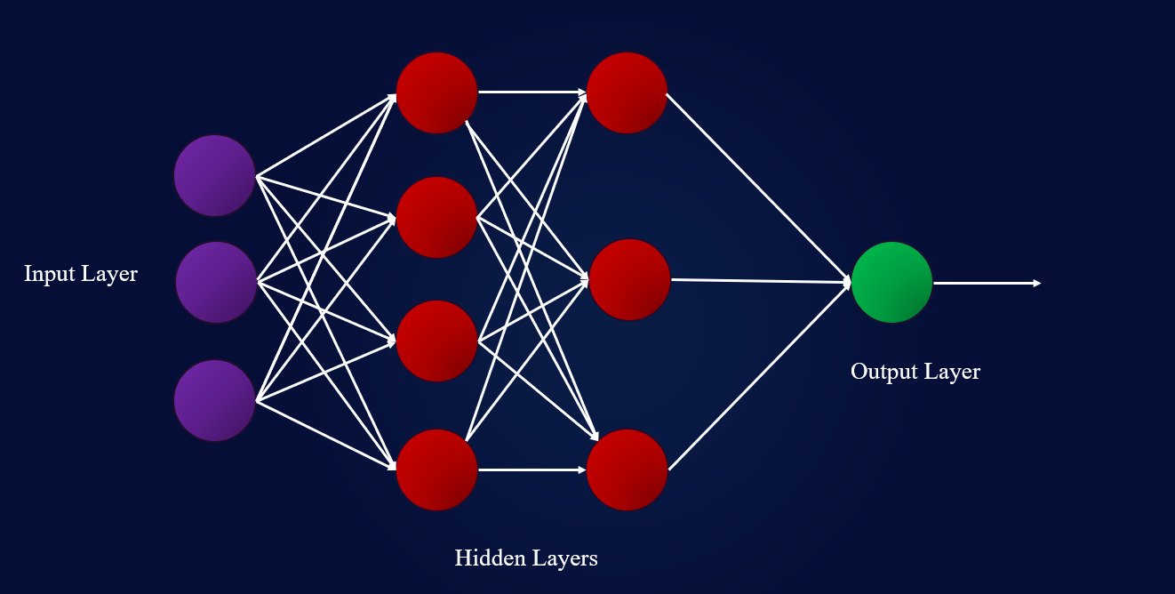
Deep Learning approach for k-class classification: “Learning with stochastic gradient descent (SGD) in the overparameterized setting (i.e., learning a large network with number of parameters larger than the number of training data points) does not lead to overfitting.” - Journal script found on first page
Published by:
2-layer neural network basic structure:
Behnam Neyshabur, Ryota Tomioka, and Nathan Srebro &
Chiyuan Zhang, Samy Bengio, Moritz Hardt, Benjamin Recht, and Oriol Vinyals
All links to pictures provided when hovering over them if taken from a source URL.

Slide 3
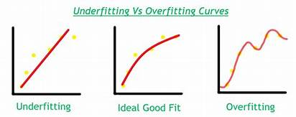
Briefly: Underfitting vs Overfitting
Overfitting is an error that occurs in data modeling as a result of a particular function aligning too closely to a minimal set of data points.
When a model has been compromised by overfitting, the model may lose its value as a predictive tool for users.
A data model can also be underfitted, meaning it is too simple, with too few data points to be effective.
Overfitting is a more frequent problem than underfitting.
Underfitting typically occurs as a result of trying to avoid overfitting.

Slide 4
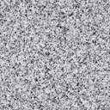
Relating this to an example case:
Study hours | Sleep hours | Month | Grade | Result
4 | 6 | Jan | 89% | Pass
12 | 4 | Feb | 68% | Fail
10 | 5 | Mar | 50% | Fail
2 | 8 | Apr | 63% | Fail
18 | 6.5 | May | 88% | Pass
50 | 5.5 | Jun | 55% | Fail
6 | 8 | Jul | 91% | Pass
22 | 7 | Aug | 92% | Pass
3 | 5 | Sep | 71% | Pass
Features: Independent Variable:
Study hours Result
Sleep hours
Month
Grade

Slide 5
Studying vs Sleep?
Study hours | Sleep hours | Month | Grade | Result
4 | 6 | Jan | 89% | Pass
12 | 4 | Feb | 68% | Fail
10 | 5 | Mar | 50% | Fail
2 | 8 | Apr | 63% | Fail
18 | 6.5 | May | 88% | Pass
50 | 5.5 | Jun | 55% | Fail
6 | 8 | Jul | 91% | Pass
22 | 7 | Aug | 92% | Pass
3 | 5 | Sep | 71% | Pass
Total study hours: 127
Avg study hours: 14.1
Total Sleep hours: 55
Avg sleep hours: 6.1
Optimizing studying and sleeping to get a passing result from last years data

Slide 6
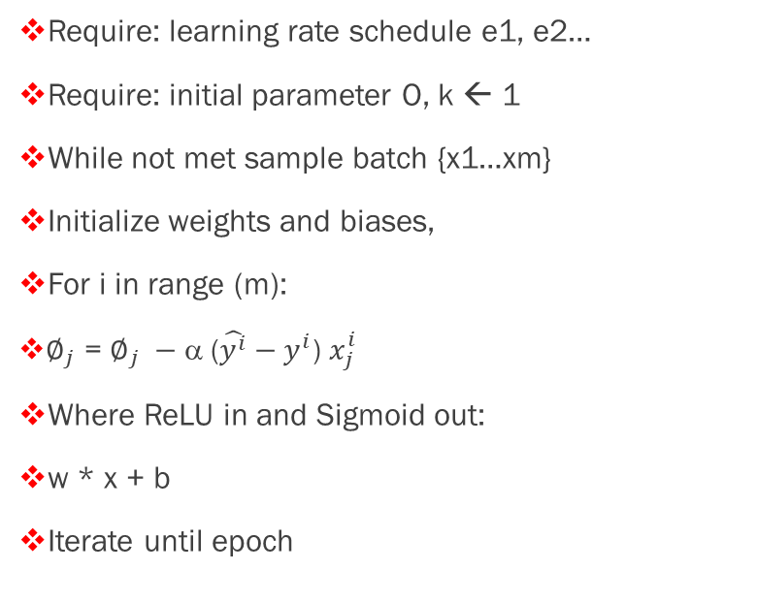
Deep training my patterns…
If we take 365 days, the average hours slept, avergage hours studying, month, etc to randomly initialize data, SGD can better classify optimal learning patterns.
Adding sigmoid function allows probability to determine if output result will in fact result in binary classification to “Pass” or “Fail.”
365 days
24 hours / day study
24 hours / day sleep
Quiz/Test scores
Pass / Fail
Require: learning rate schedule e1, e2…
Require: initial parameter O, k ← 1
While not met sample batch {x1…xm}
Initialize weights and biases,
For і in range (m):
$∅_{j}$ = $∅_{j} −$ α ($\hat{y^{i}}−y^{i}$) $x_{j}^{i}$
Where ReLU in and Sigmoid out:
w * x + b
Iterate until epoch

Slide 7
Key steps:
Step 1: Randomly initialize weights to small numbers close to 0 (but not 0).
Step 2: Input the first observation of dataset in the input layer, each feature in one input node.
Step 3: Forward-propagation, the neurons are activated in a way that the impact of each neuron’s activation is limited by the weights. Propagate the activations until getting the predicted result.
Step 4: Compare the predicted result to the actual result. Measure the generated error.
Step 5: Back-propagation, the error is sent back. Update weights according to how much they are responsible for the error. The learning rate decides by how much we update the weights by over each row.
Step 6: Repeat steps 1 to 5 and update the weights by each batch of observations. Iterate until epoch.
Step 7: When the whole training set passes through the network until epoch, redo more epochs as desired.

Slide 8




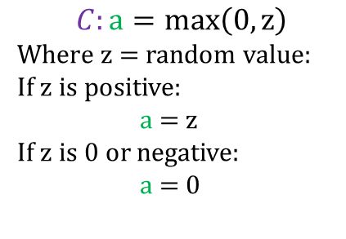
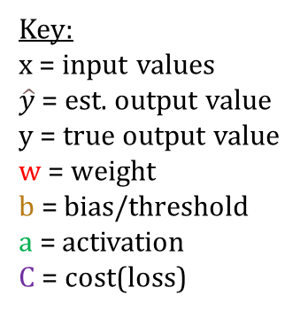








Key:
x = input values
$\hat{y}$ = est. output value
y = true output value
w = weight
b = bias/threshold
a = activation
C = cost(loss)
Dataset
Input layer
Hidden layer
Output layer
$$w_{1}$$
$$a_{1}$$
$$x_{1}$$
$$w_{2}$$
$$a_{4}$$
x
Random shuffle
$$w_{3}$$
$$a_{2}$$
$$\hat{y}$$
$$\hat{y}$$
vs y
$$x_{2}$$
$$a_{5}$$
Batches
$$a_{3}$$
Forward propagation
w and b parameter update
$$C:a=max\left(0, z\right)$$
Where z = random value:
If z is positive:
a = z
If z is 0 or negative:
a = 0
Backward propagation
2-layer SGD with ReLU activation

