Slide 1
DATA 211 Final Project
Wendy Mendoza Gutierrez

Slide 2
How does working affect my daily water consumption?
Question

Slide 3
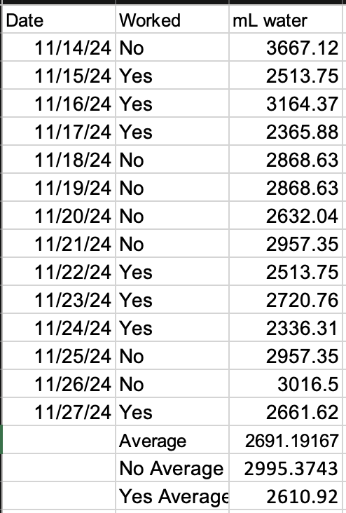
Independent: Worked & not worked Dependent: Daily water consumption 14 observations 7 work observations
Variables

Slide 4
The average amount of water consumed (mL) on days worked is significantly less than the average amount of water consumed (mL) on days not worked.
Claim 1

Slide 5
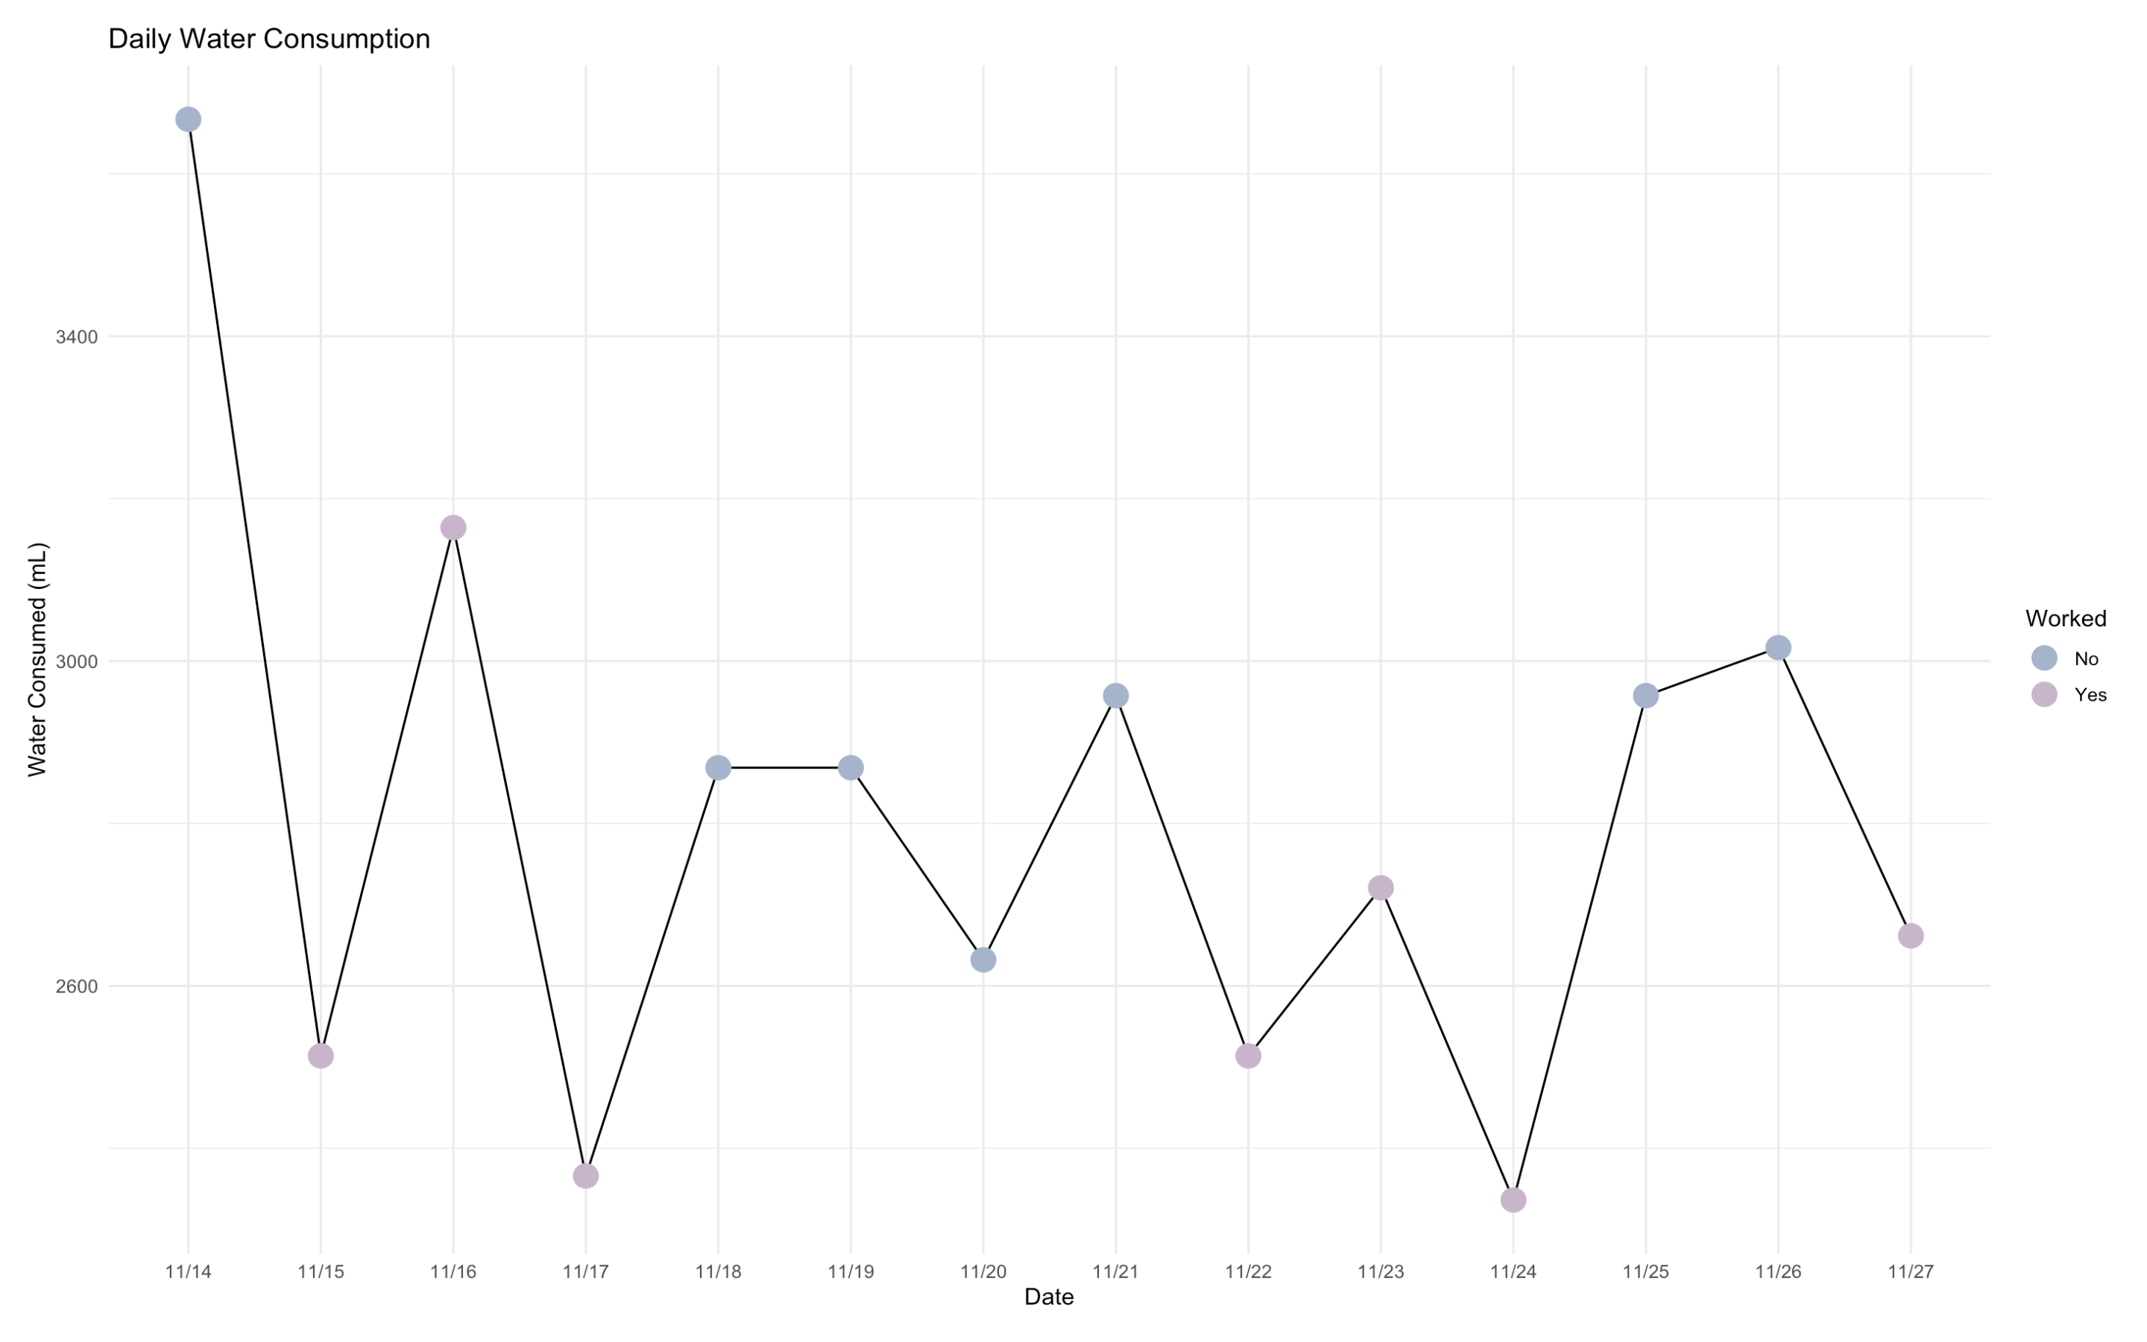
Notes:
Line graph showing my water intake for the 14 days of observation.

Slide 6
w = worked nw = not worked Null Hypothesis: μ_{w} = μ_{nw} Alternative Hypothesis: μ_{w <} μ_{nw}
Step 1

Slide 7
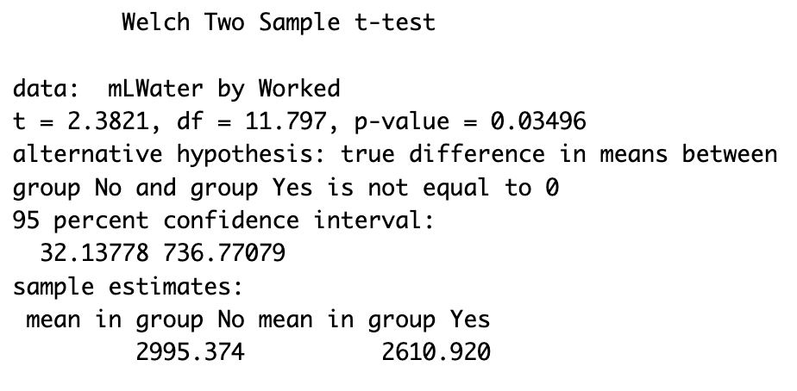
Two Sample T-test
Step 2
Step 3
T-statistic: 2.3821
P-value: 0.03496

Slide 8
Using a significance level of 0.05, reject the Null Hypothesis
Step 4

Slide 9
Since the p-value 0.03496 is less than the significance level 0.05, we reject the null hypothesis. There is enough evidence to support the claim that the average amount of water consumed (mL) on days worked is significantly less than the average amount of water consumed (mL) on days not worked.
Conclusion

Slide 10
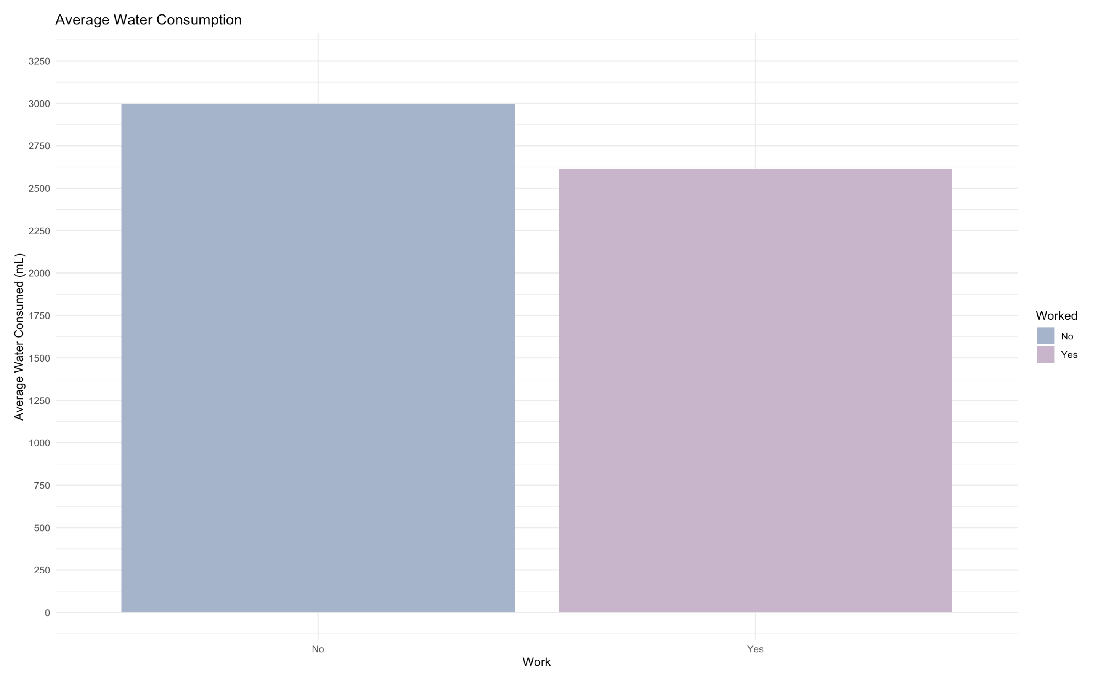
Notes:
Bar graph showing the average mL intake by work status

Slide 11
The U.S. National Academies of Sciences, Engineering, and Medicine determined that an adequate daily fluid intake is: About 15.5 cups (3700 mL) of fluids a day for men About 11.5 cups (2700 mL) of fluids a day for women (Mayo Clinic)
Recommended Daily Fluid Intake
Notes:
For my second claim, I test my average water intake to the recommended daily fluid intake

Slide 12
The average water consumed is significantly different than the recommended 2700 mL daily fluid intake.
Claim 2

Slide 13
μ = my average daily fluid consumption Null Hypothesis: μ = 2700 Alternative Hypothesis: μ ≠ 2700
Step 1

Slide 14
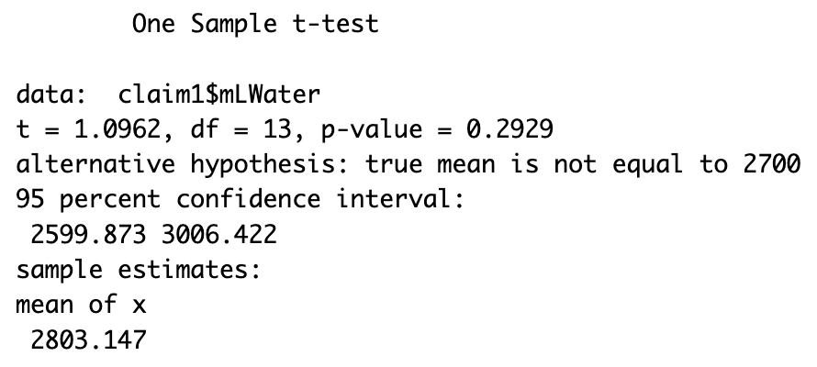
One Sample T-test
Step 2
Step 3
T-statistic: 1.0962
P-value: 0.2929

Slide 15
Using a significance level of 0.05, fail to reject the Null Hypothesis.
Step 4

Slide 16
Since the p-value 0.2929 is greater than the significance level 0.05, we fail to reject the null hypothesis. There is not enough evidence to support the claim that the average water consumed is significantly different than the recommended 2700 mL.
Conclusion

Slide 17
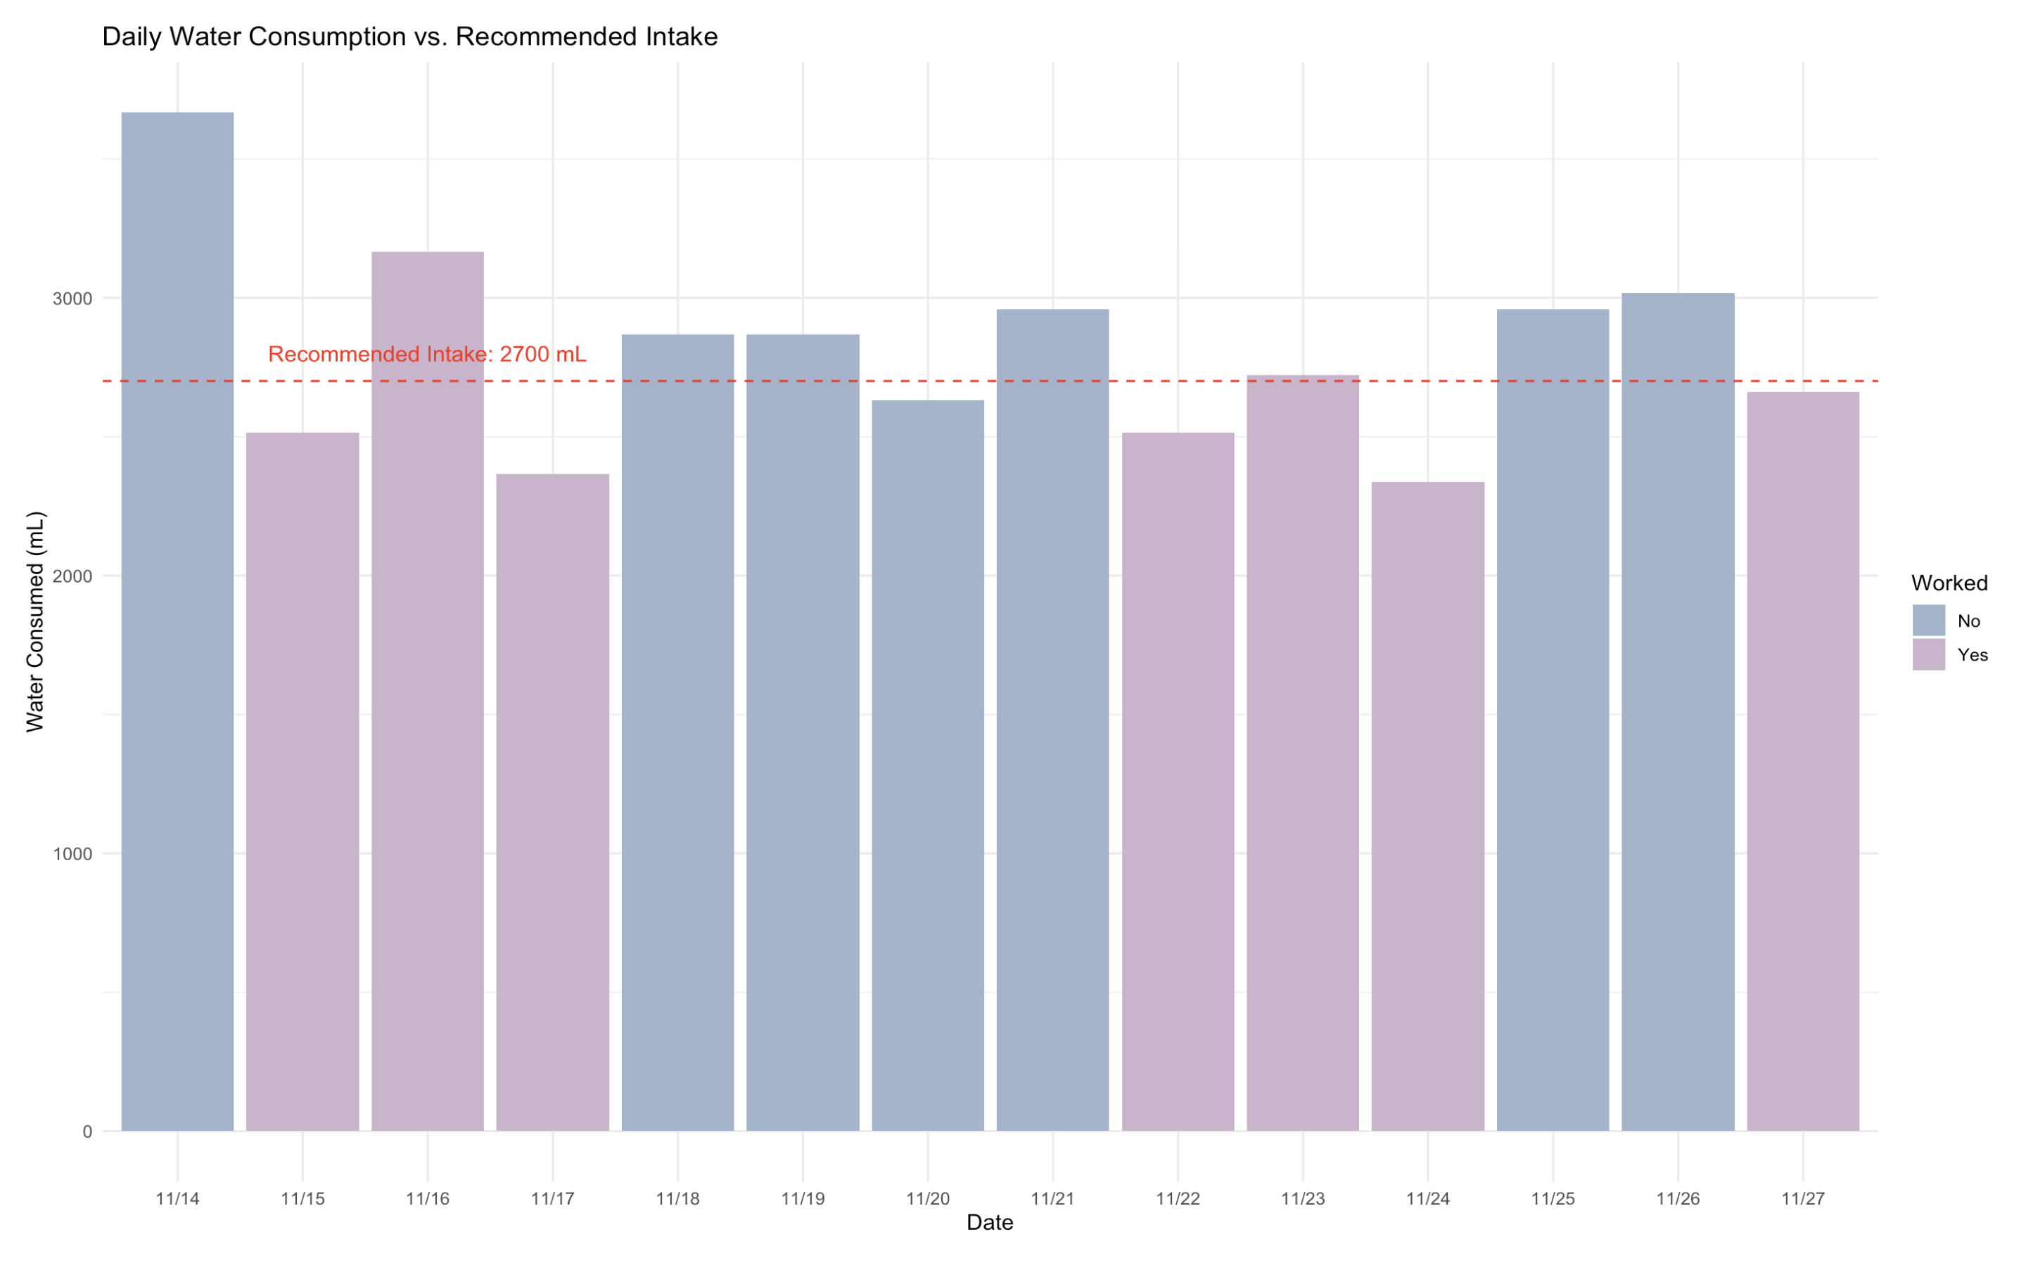
Notes:
Bar graph comparing the amount of mL consumed with line showing the recommended daily fluid intake.

