Slide 1


Slide 2
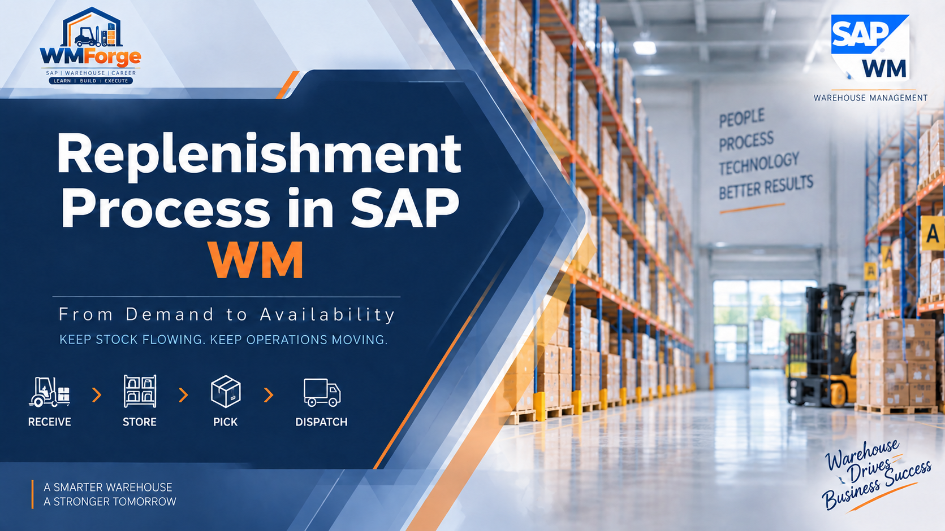
Replenishment is the process of refilling the picking bin when stock falls below the predefined minimum quantity, then we move the material from Reserved storage are to the picking bin area, ensuring that the warehouse operation does not interrupt, and customer order can be picked efficiently.

Slide 3

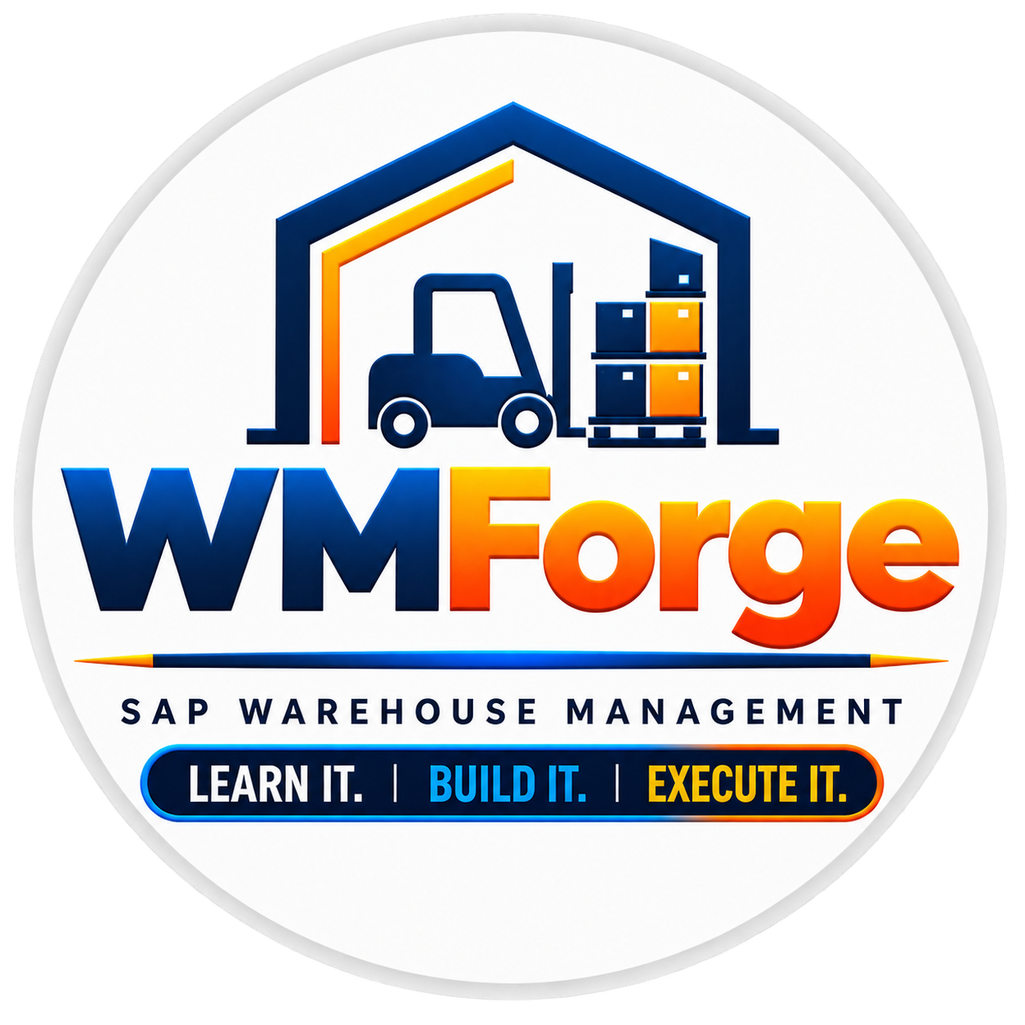
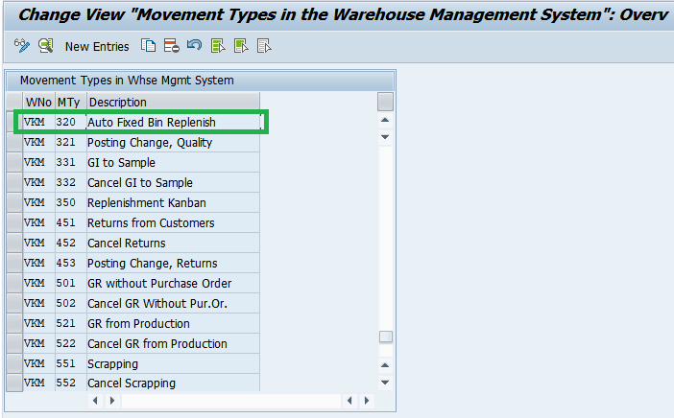
Configuration Before Execution
SPRO → Logistics Execution → Warehouse Management → Activities → Transfer → Define Stock Transfer and Replenishment Control
In this step, we assign the required movement type to our warehouse.
Here, we assign Movement Type 320 – Auto Fixed Bin Replenishment to our warehouse.
This configuration tells SAP which movement type should be used when the system performs the automatic fixed-bin replenishment process.

Slide 4
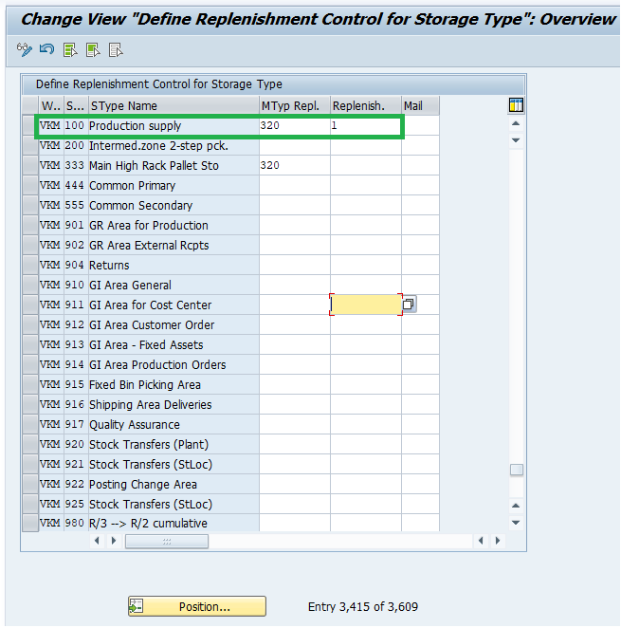
Configuration Before Execution
SPRO → Logistics Execution → Warehouse Management → Activities → Transfer → Define Stock Transfer and Replenishment Control
After maintaining the replenishment movement type for our warehouse, the next configuration step is to define the Replenishment Control for the Storage Type.
So, basically, this Configuration connects the storage type with the replenishment movement type, so SAP knows which WM movement to use when stock needs to be replenished.

Slide 5
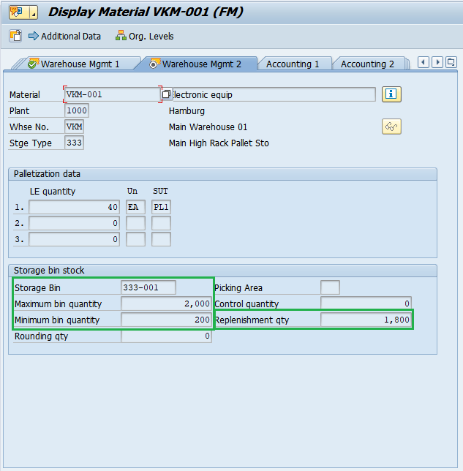
Material-level setup for the fixed bin
T-Code : MM02/03
Here in Warehouse Managemnet View 2 of Material Master, we maintain the fixed-bin replenishment settings for the material in MM03. We define the fixed bin where the material will be stored, along with the maximum quantity, minimum quantity, and replenishment quantity.
These values help SAP determine when the fixed bin needs replenishment and how much stock needs to be replenished.

Slide 6
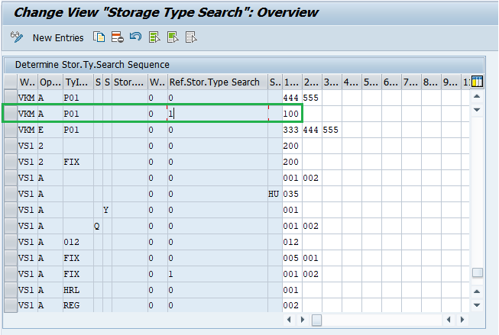
SPRO → Logistics Execution → Warehouse Management → Strategies → Activate Storage Type Search → Determine Search Sequence
Here, we define the source storage type from which SAP will pick the replenishment stock. In our setup, Storage Type 100 is maintained as the reserve storage area.
Notice the Ref. Stor. Type Search value 1. This reference tells SAP which storage-type search sequence to use for this replenishment movement, so the system can determine the appropriate source storage type/bin from where the stock should be picked

Slide 7
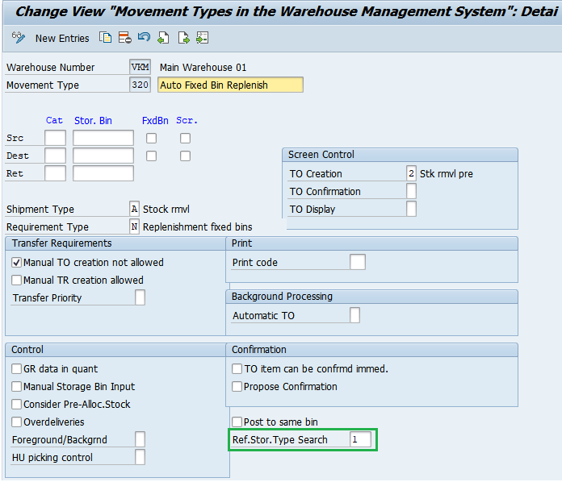
SPRO → Logistics Execution → Warehouse Management → Activities → Transfers → Define Movement Types
Here, we maintain Movement Type 320 for our automatic fixed-bin replenishment process. Notice that the Ref. Stor. Type Search is maintained as 1.
This is important because the same reference 1 is maintained in our Storage Type Search configuration. This connects Movement Type 320 with that particular storage-type search sequence, allowing SAP to determine the appropriate source storage type for the replenishment movement.

Slide 8
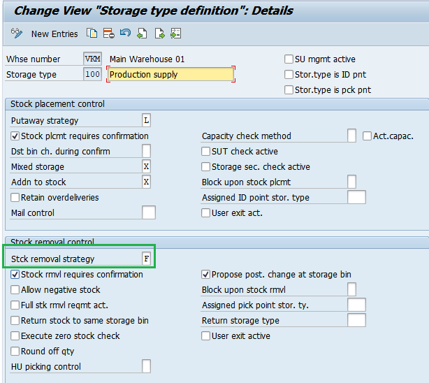
SPRO → Logistics Execution → Warehouse Management → Master Data → Define Storage Types → Details of selected Storgae Types
For Storage Type 100, we have maintained the Stock Removal Strategy as F, which represents FIFO — First In, First Out. This means that when SAP needs to pick replenishment stock from Storage Type 100, the system will look for the oldest available quant and propose the corresponding source bin

Slide 9
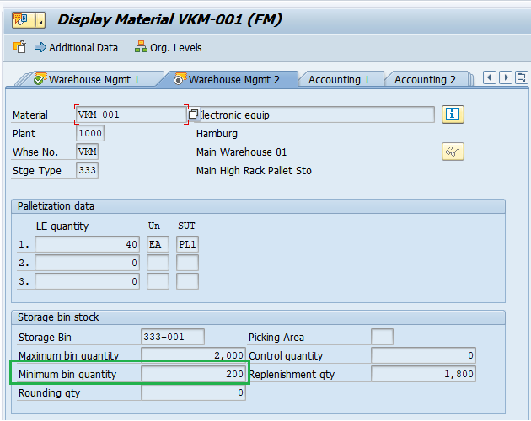
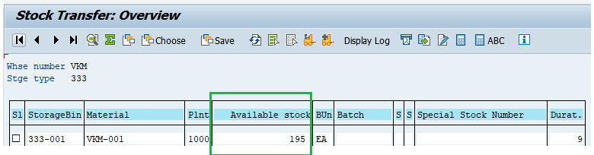
Execution Start From here
T-Code: LT10 (To Check the available stock)
First, we check the current stock in the fixed bin using LT10. Here, the available stock is only 195 EA, while the minimum quantity maintained for this material in the Material Master is 200 EA.
Since the current stock has fallen below the predefined minimum level, the fixed bin requires replenishment. We can now proceed with the replenishment process to bring the stock back to the required level

Slide 10
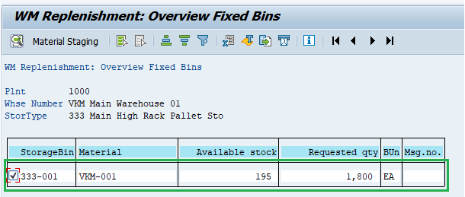
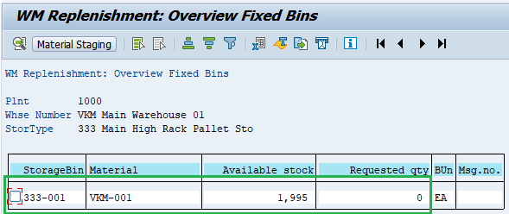
T-Code: LP21 (To trigger the Replenishment)
BEFORE
AFTER
Now we trigger the replenishment process using LP21. The system identifies the fixed bin where the stock is below the minimum level and automatically proposes the replenishment quantity maintained in the Material Master.
In our example, the system is suggesting 1,800 EA as the requested quantity. We review the proposed quantity and select the required line. Once everything looks correct, we click on Material Staging to trigger the replenishment. and check the available stock and Requested qty after material staging

Slide 11
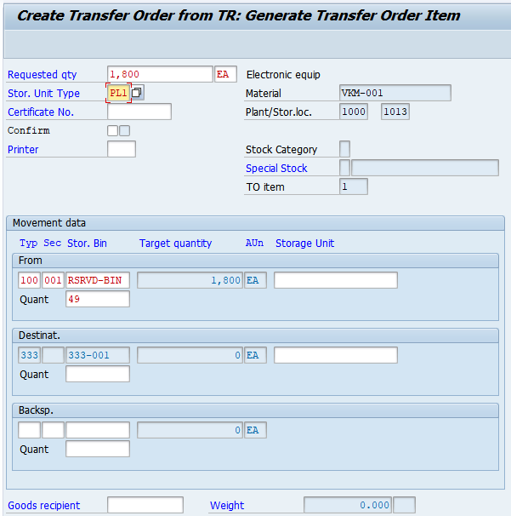
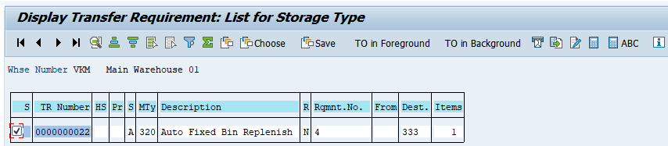

T-Code: LB10 (To Check the Transfer Requirement)
Once we trigger the replenishment through Material Staging, SAP creates a Transfer Requirement for the required quantity. We can check this TR using LB10.
Now, we need to convert this Transfer Requirement into a Transfer Order. For this, we select TO in Foreground.
Based on the configuration we maintained earlier — especially the Storage Type Search and the FIFO stock removal strategy — SAP automatically determines and proposes the source storage type and bin from which the replenishment stock should be picked.

Slide 12
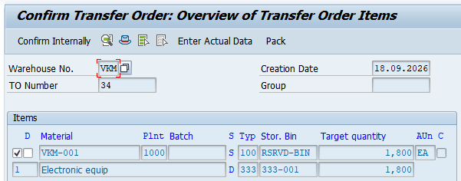
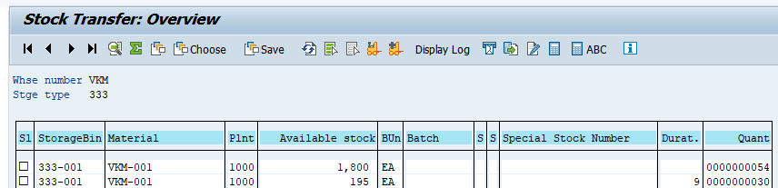
T-Code: LT12 (To Confirm the Transfer Order)
After confirmation, we can check the available stock in bin 333-001. Here, the 1,800 EA replenishment quantity has been added to the existing 195 EA, giving us a total of 1,995 EA.
You can also see the stock appearing as separate entries. This is because SAP WM manages warehouse stock as individual quants, so the newly transferred stock can remain as a separate quant from the existing stock
Then Once the TO is created, Now we need to Confirm it using LT12. To Confirm, Click on Confirm Internally, Once the TO is confirmed, the replenishment movement is completed and the requested stock is moved into the fixed bin

