Slide 1
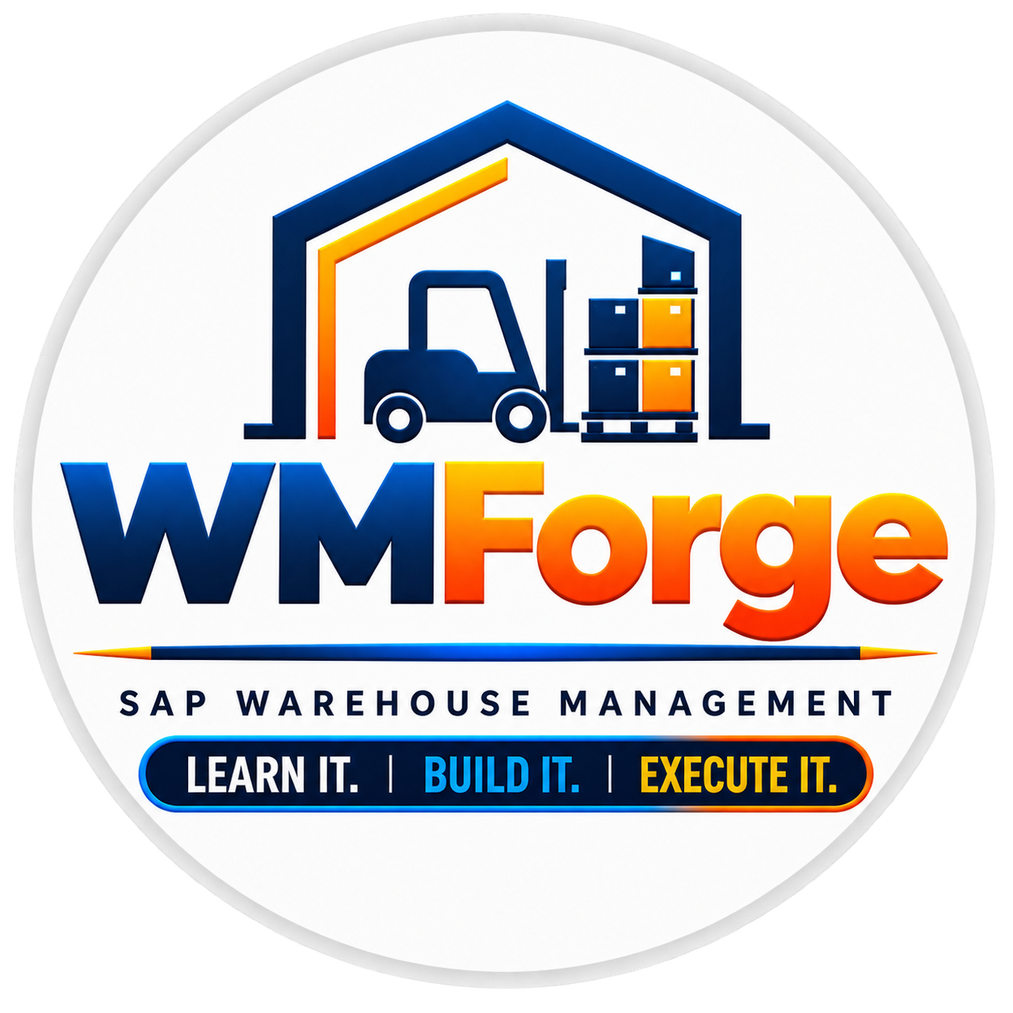


Slide 2

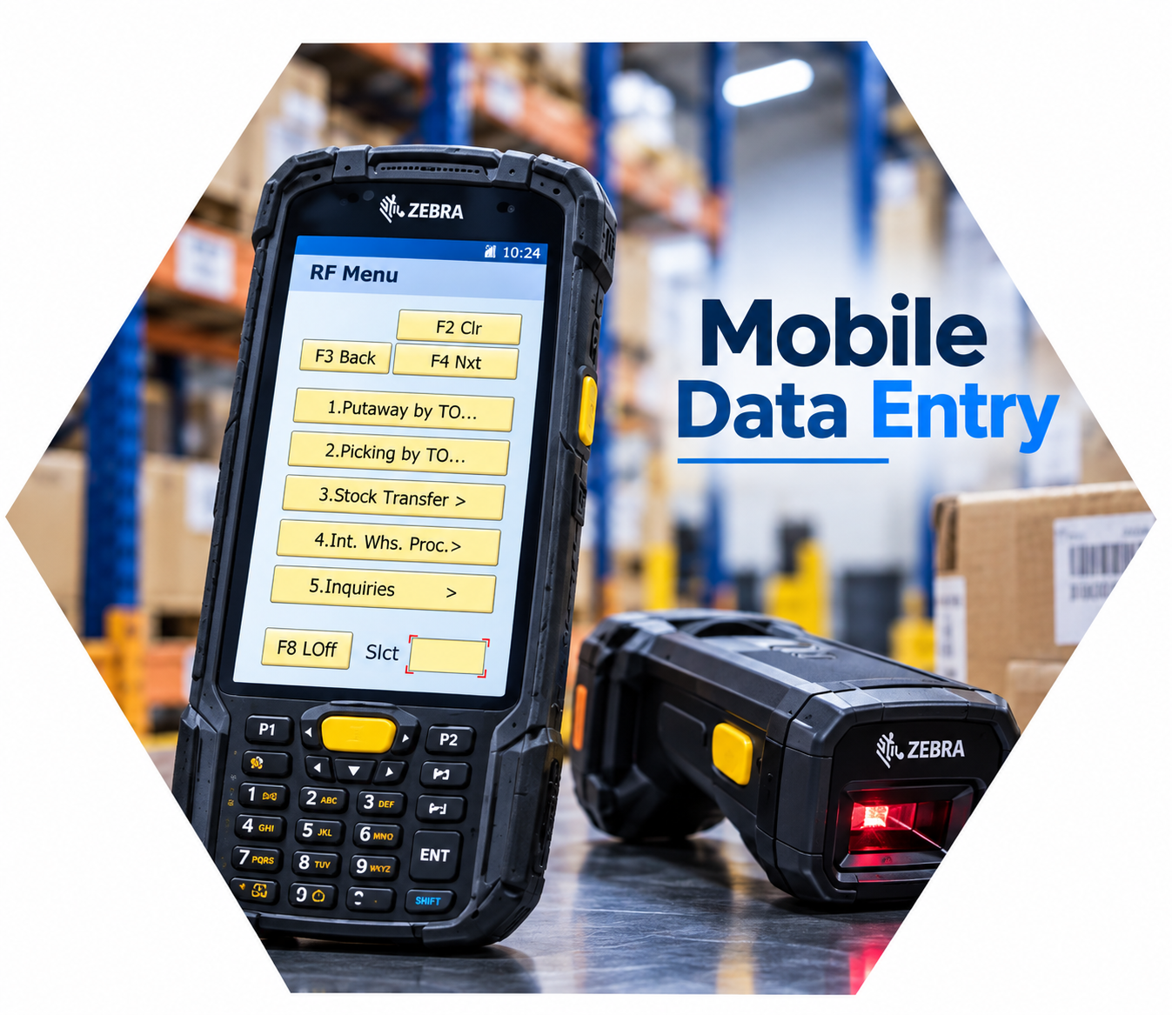
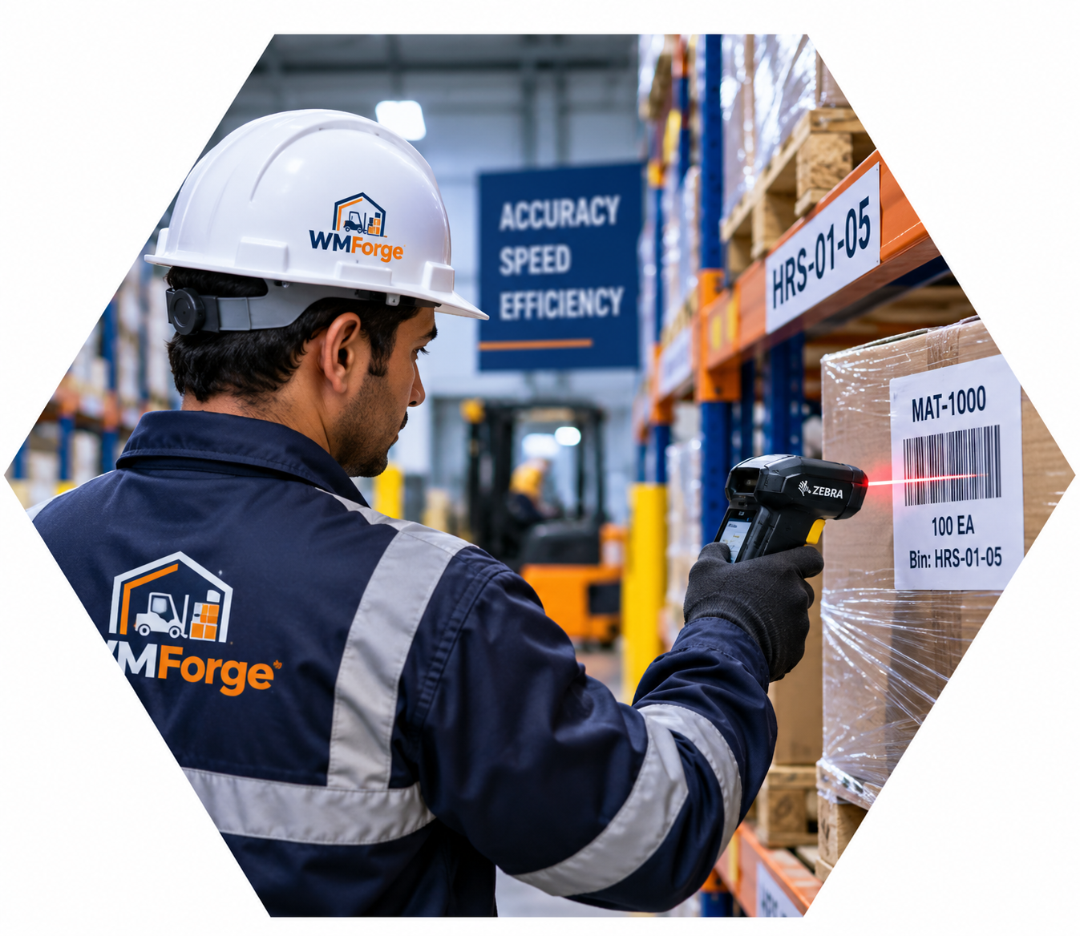

Mobile
Data
Entry
Mobile Data Entry (LE-MOB), also known as the RF (Radio Frequency) Solution, is a feature in SAP Warehouse Management that allows warehouse operators to perform warehouse activities using handheld RF devices instead of paper documents.
The RF device communicates directly with SAP, receives warehouse tasks, allows users to scan barcodes, and updates SAP in real time. This makes warehouse operations faster, more accurate, and paperless.
Why Do We Use RF?
In a warehouse, workers perform hundreds of activities such as Goods Receipt, Putaway, Picking, Goods Issue, and Inventory Counting every day.
If these activities are performed using paper documents, they are slower and there is a higher chance of mistakes.
To solve this problem, SAP provides the RF Solution, where warehouse operators receive their work directly on a handheld scanner, scan the required barcodes, and immediately update SAP after completing the task.

Slide 3
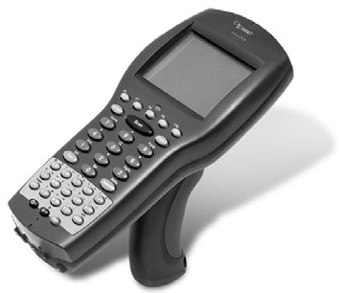
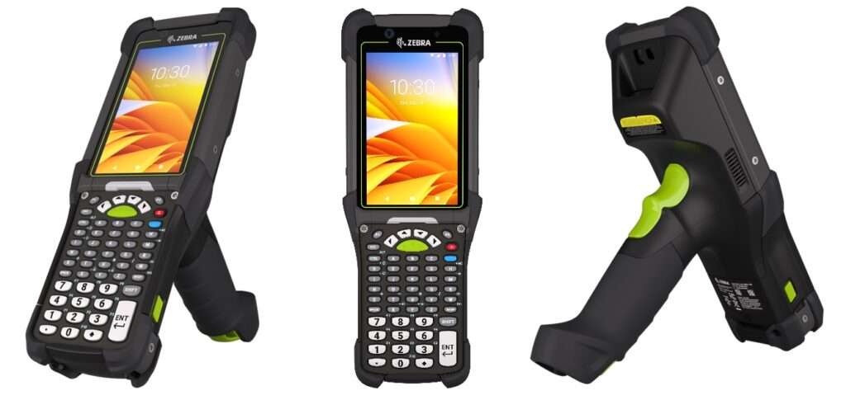
RF Device Types
Character-Based Devices
GUI Devices- Modern handheld devices
GUI devices provide a user-friendly graphical interface for warehouse operators. They typically include touch screens, physical buttons, and graphical displays, making warehouse transactions faster and easier to execute.
Scren Size for Forklift- 8 lines 40 charcaters each.
and for handheld device- 16 lines 20 characters each
Character-based devices use a simple text-based interface to display SAP WM information.
They have limited graphics but are reliable and efficient for performing warehouse tasks such as picking, putaway, and stock transfers.
Scren Size for Forklift- 8 lines 40 charcaters each.
and for handheld device- 16 lines 20 characters each

Slide 4
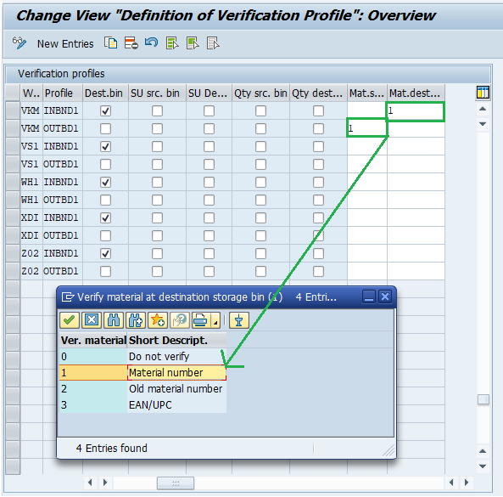
Configuration
SPRO → IMG → Logistics Execution → Mobile Data Entry → Verification Control → Define Profiles
Define Verification Profile
Explanation
A Verification Profile defines which fields the warehouse operator needs to verify during RF transactions.
For example, the system can require verification of fields such as:
Source storage bin
Destination storage bin
Storage unit identification at the source storage bin
Storage unit identification at the destination storage bin
Quantity of the material to be picked at the source storage bin
Quantity of the material to be put away at the destination storage bin
Material identification at the source storage bin
Material identification at the destination storage bin

Slide 5
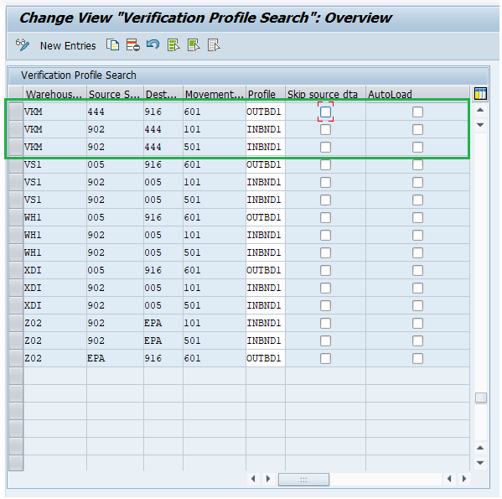
Assign Verification Profiles to Goods Movements
SPRO → IMG → Logistics Execution → Mobile Data Entry → Verification Control → Assign Verification Profiles to Goods Movements
Explanation
Assign the appropriate verification profile to the relevant movement types/goods movements.
This means that you define in a warehouse number in which source and destination storage types and with which movement type the respective profile is to be used.
The indicator determines whether the system first displays the source location or directly shows the destination location to the user.
If you set the automatic load control indicator, thenhandling unit(s) will be loaded automatically when the respective pick transfer orders have been confirmed.

Slide 6
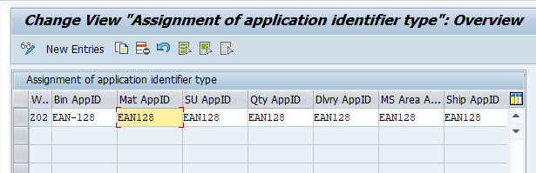
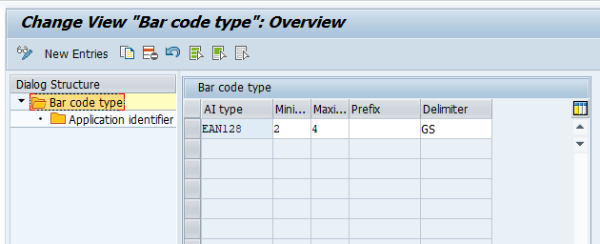
Assign Bar Code Types to Warehouse
Assign the supported bar code types to the relevant warehouse number.
IMG → Logistics Execution → Mobile Data Entry → Bar Code → Assign Bar Code Types to Warehouses
VKM
Define the bar code specifications that will be used for identifying materials, storage units, handling units, et
IMG → Logistics Execution → Mobile Data Entry → Bar Code → Maintain Bar Code Specification

Slide 7
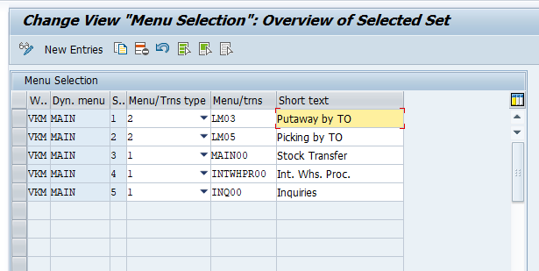
Configure Menu Management
SPRO → IMG → Logistics Execution → Mobile Data Entry → Menu Management
In this section you can configure the settings for menu management and you can set up the menu sequence for a particular user. You can assign different "dynamic" menus or transactions to a menu. These must then be described with an appropriate text.
If you have actual menus, these in turn are assigned either to further menus or to transactions.
To be able to distinguish between a menu and a transaction, you can choose a type.

Slide 8
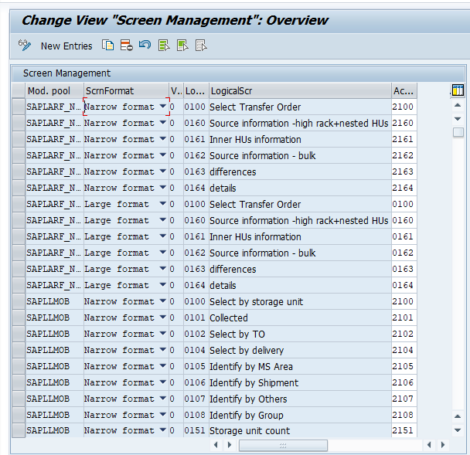
Define Screen Management
SPRO → IMG → Logistics Execution → Mobile Data Entry → Define Screen Management
Screen Management controls how information is displayed to the warehouse operator on the RF/mobile device.
In simple words, it connects the logical RF screen with the screen format that should be shown to the user.
We can define different formats, such as narrow or large, depending on the type of RF device being used.
It can also control what information the user sees first, such as the source location or the destination location.
Here you can:
•Define logical screen names
•Assign screen formats
•Configure narrow and large screen formats

Slide 9
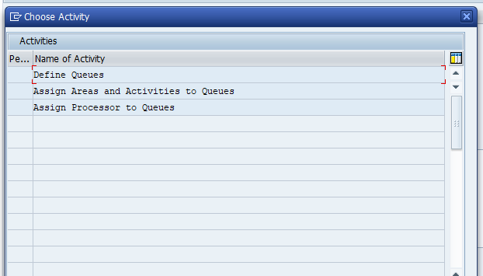
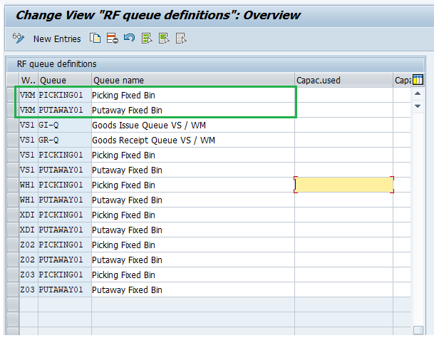
Define RF Queues
SPRO →IMG → Logistics Execution → Mobile Data Entry → RF Queue Management
Think of a queue as a work bucket. We group similar warehouse activities into a queue and then assign that queue to the appropriate users or warehouse areas.
Suppose we have 10 warehouse operators, but 4 of them are responsible for picking. We can assign those users to the Picking Queue. When picking work is available, those users can process the tasks assigned to their queue through RF.
Create and maintain queues for different warehouse activities. Typical examples include:
Picking, Putaway, Goods Receipt
Queues help organize warehouse work and distribute activities efficiently.

Slide 10
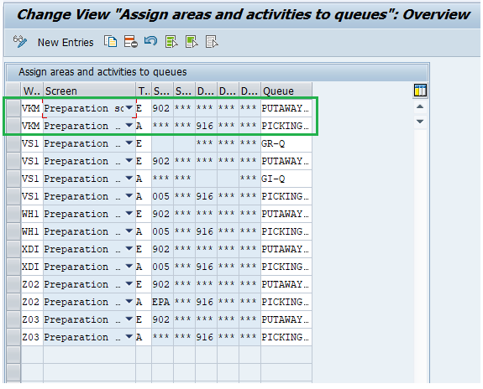
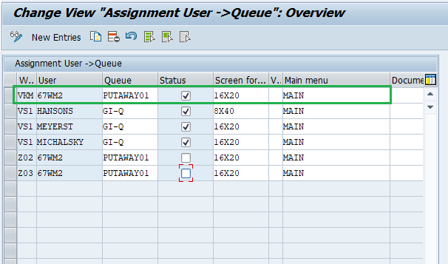
Assign Areas and Activities to Queues
Assign Processors to Queues
SPRO →IMG → Logistics Execution → Mobile Data Entry → RF Queue Management
SAP looks at where a Transfer Order is moving stock from and where it is moving stock to, and based on those details, it decides which RF queue the TO should go to
Assign the relevant warehouse areas and activities to the appropriate queues.
Assign the relevant warehouse users/processors to the queues.
This determines which users can process the warehouse activities assigned to those queues.

Slide 11
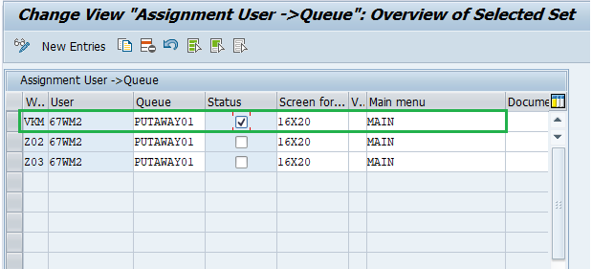
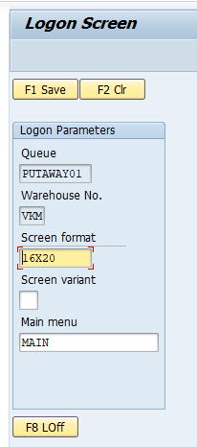
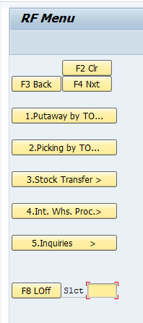
Add User for Mobile Data Entry
Log On to Mobile Data Entry
T-Code: LRFMD
T-Code: LM00
SAP looks at where a Transfer Order is moving stock from and where it is moving stock to, and based on those details, it decides which RF queue the TO should go to
Assign the relevant warehouse areas and activities to the appropriate queues.
This is the RF/Mobile Data Entry initial logon transaction.
After logging in, the user can access the RF menu and perform the warehouse activities assigned to them.

Slide 12

Thank You for Watching
Mobile Data Entry in SAP WM
Connecting Warehouse Operations with Real-Time SAP Execution
RF Support Following Functions:
Good Receipt
Good Issues
Putaway
Picking
Packing and Unpacking
Inventory Counting
Serial Number Capturing (LM80)

