Slide 1


Shelf Life
Expiration Date in SAP WM
In a warehouse, simply knowing how much stock is available is not enough. We also need to know when that stock will expire. SLED helps SAP track the expiration dates of materials so that users can check shelf-life requirements during goods receipt and manage stock based on its remaining shelf life.
PREPARED BY: ANSHUL kHATIYAN
EMAIL :- wmforgeofficial@gmail.com

Slide 2
Configuration :
Activate SLED Check in Inventory Management (MM)
Activate SLED per warehouse and Define Stock Removal Strategy in SAP WM
Maintain SLED Parameters in Material Master
Execution :
Create Purchase Order and Check Remaining Shelf Life
Post Goods Receipt and Enter Manufacturing Date
Validate Shelf Life Expiration Date, Error Messages and Verify SLED/Best Before Date After Goods Receipt
Agenda
EMAIL :- wmforgeofficial@gmail.com

Slide 3
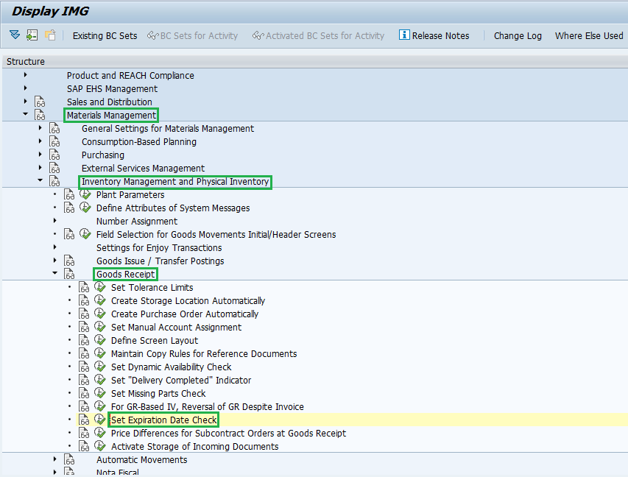
Activate SLED Check in Inventory Management (MM)
Activate SLED Check in Inventory Management (MM)
Activating the Shelf Life Expiration Date (SLED) check is the first step in configuring shelf-life management in SAP WM. It enables SAP to check shelf-life information during goods receipt based on the settings maintained for the relevant plant and movement type.
- T-code: SPRO
- Configuration Path: Materials Management → Inventory Management and Physical Inventory → Goods Receipt → Set Expiration Date Check
EMAIL :- wmforgeofficial@gmail.com

Slide 4
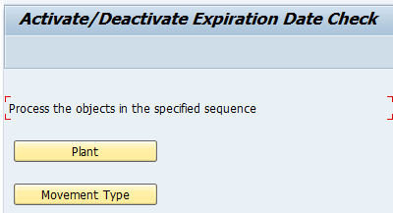
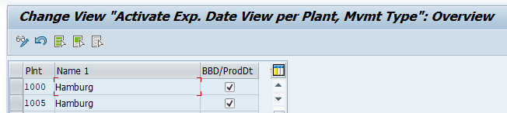
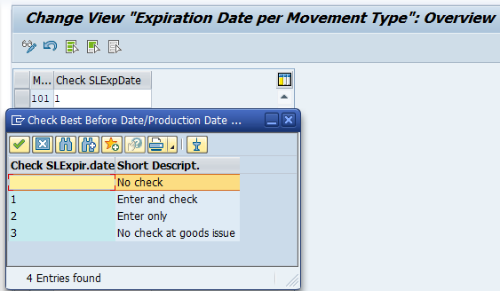
- Plant: Select the required plant and activate the SLED (BBD/ProdDt) check.
- Movement Type: Select the relevant movement type, such as 101 for goods receipt against a purchase order.
- SLED Check Indicator:
1 – Enter and check SLED: Enter the expiration date and let SAP validate it.
2 – Enter manufacturing date and calculate SLED: Enter the manufacturing date, and SAP calculates the expiration date using the material's total shelf life.
3 – No Check at Goods Issue: Do not perform the SLED check during the relevant goods issue movement.
EMAIL :- wmforgeofficial@gmail.com

Slide 5
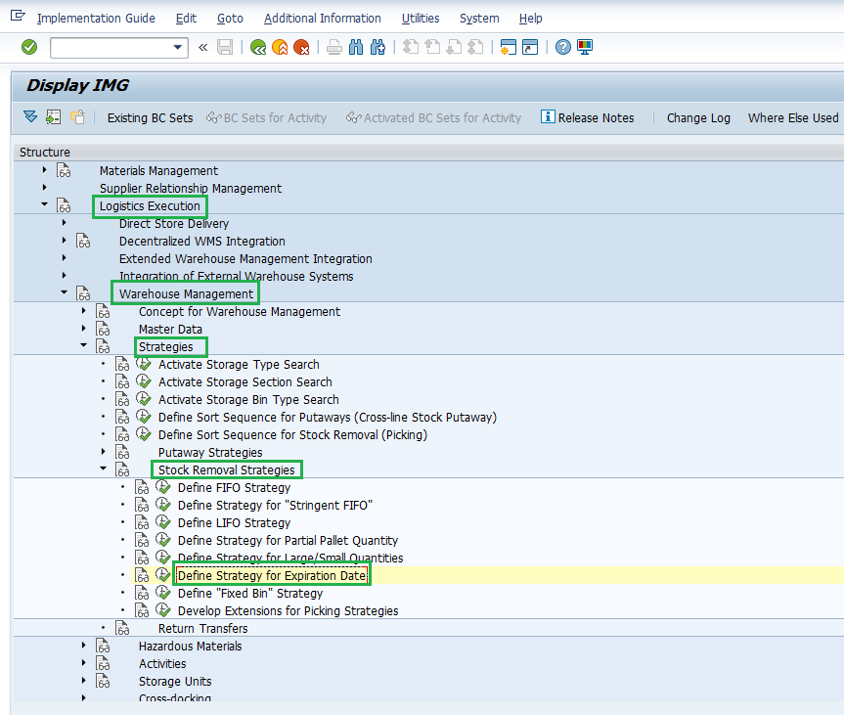
Activate SLED per warehouse and Define Stock Removal Strategy in SAP WM
Activating SLED management and defining the stock removal strategy in SAP WM helps the warehouse manage materials according to their expiration dates. Once the relevant settings are configured, SAP can use the shelf-life information maintained for stock to determine which material should be picked first. In classic SAP WM, the Shortest Remaining Shelf Life strategy (H) is used to prioritize stock with the shortest remaining shelf life, supporting the FEFO (First Expired, First Out) approach.
- T-code: SPRO
- Configuration path: Logistics Execution → Warehouse Management → Strategies → Stock Removal Strategies → Define Strategy for expiration date
EMAIL :- wmforgeofficial@gmail.com

Slide 6
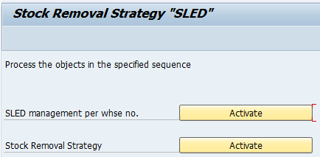
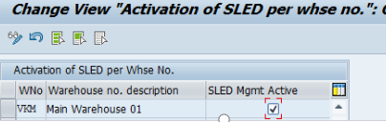
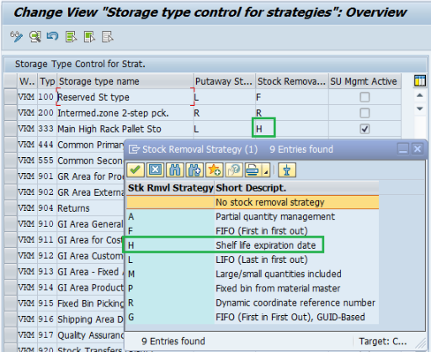
.1. Activate SLED Management per Warehouse
- In the first screen, select Activate beside SLED management per whse no.
- In the next screen, activate the SLED Mgmt Active checkbox for the relevant warehouse number, as shown for warehouse VKM in your screenshot.
2. Activate Stock Removal Strategy
- Return to the Stock Removal Strategy "SLED" screen.
- Select Activate beside Stock Removal Strategy to activate the SLED stock-removal strategy configuration.
This step enables the configuration used to determine which stock should be selected first based on its expiration date.
3. Assign Strategy H to the Storage Type
- In the Storage Type Control for Strategies screen, locate the storage type where you want to apply SLED-based picking.
- In the Stock Removal column, select H – Shelf life expiration date.
- In our screenshot, strategy H is assigned to storage type 333 — Main High Rack Pallet Storage.
Practical example: Suppose the same material is stored in two bins: Bin A contains stock expiring on 10 November, and Bin B contains stock expiring on 25 November. With strategy H, SAP can propose stock from Bin A first when creating a stock-removal transfer order, provided the relevant stock is eligible and the configured search sequence includes it.
EMAIL :- wmforgeofficial@gmail.com

Slide 7
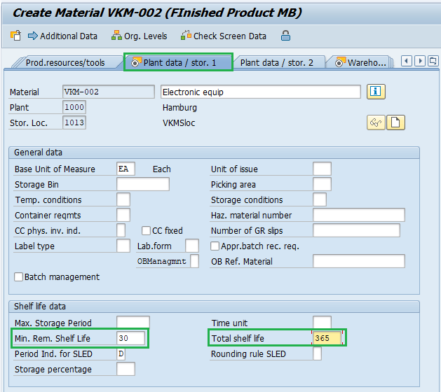
Maintain SLED Parameters in Material Master
For a material to trigger SLED processing, specific fields must be maintained in the Material Master.
T-Code: MM01 (Create) or MM02 (Change)
Views Required: Plant Data / Stor. 1
Key Fields to Maintain:
  Min. Rem. Shelf Life: The minimum number of days the material must have left before expiring for the system to accept it during goods receipt.
  Total Shelf Life: The total lifespan of the material from the date of manufacture. If maintained, entering the manufacturing date during goods receipt will cause SAP to automatically calculate the expiration date.
June 2035
EMAIL :- wmforgeofficial@gmail.com

Slide 8
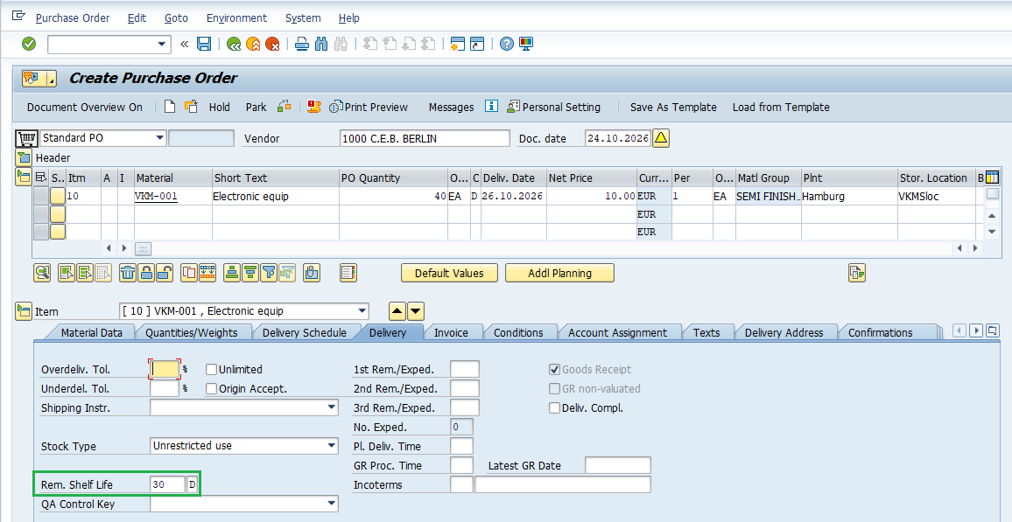
EXECUTION: Create Purchase Order and Check Remaining Shelf Life
June 2035
Create PO Using ME21N and you can see the remaining shelf life day below in delivery tab (highlighted with green), same which we have maintain in material master during configuration.
EMAIL :- wmforgeofficial@gmail.com

Slide 9
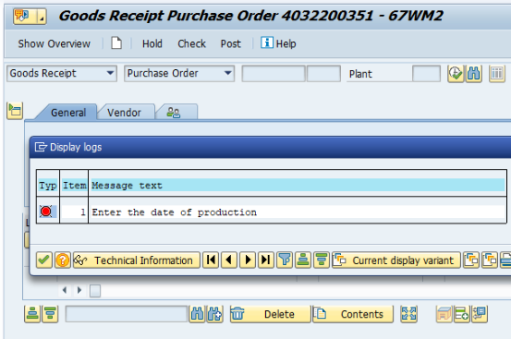
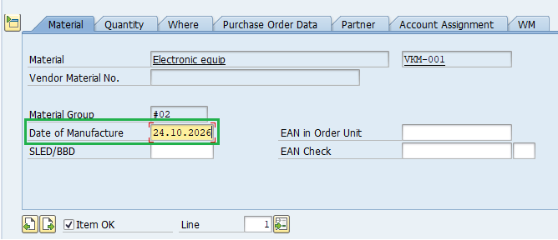
Post Goods Receipt and Enter Manufacturing Date
Now Post MIGO with reference to the newly created PO and when you will do the system check, it will ask you to Enter the date of production
Then you need to enter the Date of Manufacture it should be past date or the same day date and not future date
EMAIL :- wmforgeofficial@gmail.com

Slide 10
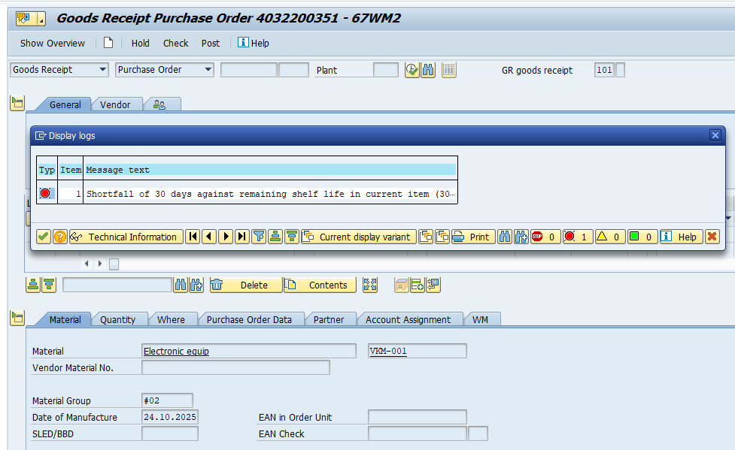
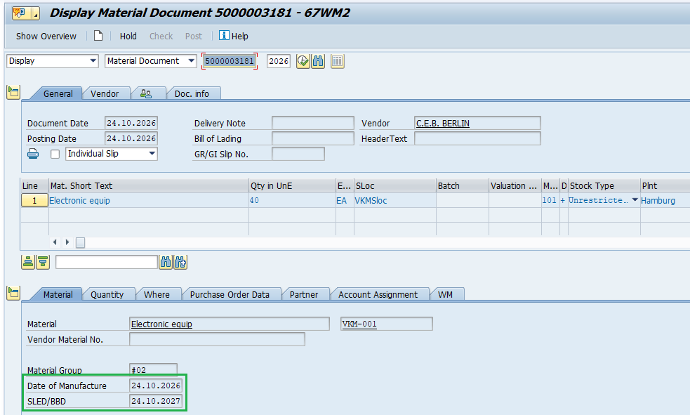
Validate Shelf Life Expiration Date, Error Messages and Verify SLED/Best Before Date After Goods Receipt
And if the manufacture date is older than the total shelf life we have maintain in material master then also it will throw the error
And once we post the goods reciept you can check the shelf life expiration date/Best Before date now in same Material tab
EMAIL :- wmforgeofficial@gmail.com

Slide 11

Thank you!
Feel free to approach us if you have any questions.
wmforgeofficial@gmail.com

