Slide 1
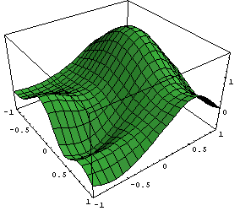
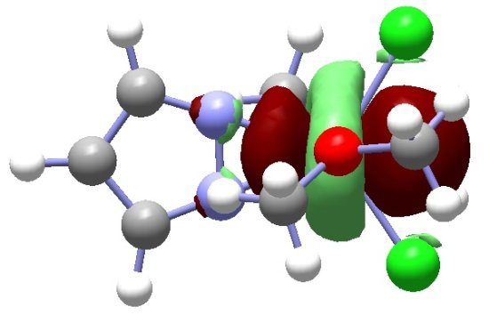
Chemistry 6440 / 7440
Geometry Optimization
  Copyright © 1990-1998, Gaussian, Inc.
Notes:
Undergrads should be registered for CHM6440, grads for CHM7440
If you are not registered for the correct course, please change it today

Slide 2
Resources
Foresman and Frisch, Exploring Chemistry with Electronic Structure Methods, Chapter 3
Leach, Chapter 4
Jensen, Chapter 14
D. J. Wales, “Potential Energy Landscapes”, Cambridge Univesity Press, 2003
  Copyright © 1990-1998, Gaussian, Inc.

Slide 3
Important Review Articles
Peter Pulay, "Analytical Derivative Methods in Quantum Chemistry", Adv. Chem. Phys. 69, 241 (1987) (Ab Initio Methods in Quantum Chemistry II, ed. K.P. Lawley (Wiley, 1987))
H.B. Schlegel, "Geometry optimization on Potential Energy Surfaces" in Modern Electronic Structure Theory, ed. D.R. Yarkony (World Scientific Press, 1995)
H.B. Schlegel, “Geometry Optimization 1” in Encyclopedia of Computational Chemistry, ed. PvR Schleyer, NL Allinger, T Clark, J Gasteiger, P Kollman, HF Schaefer PR Schreiner, (Wiley, Chichester, 1998)
Tamar Schlick, “Geometry Optimization 2” in Encyclopedia of Computational Chemistry, ed. PvR Schleyer, NL Allinger, T Clark, J Gasteiger, P Kollman, HF Schaefer PR Schreiner, (Wiley, Chichester, 1998)
Frank Jensen “Transition Structure Optimization Techniques” in Encyclopedia of Computational Chemistry, ed. PvR Schleyer, NL Allinger, T Clark, J Gasteiger, P Kollman, HF Schaefer PR Schreiner, (Wiley, Chichester, 1998)
H. B. Schlegel, “Some practical suggestions for optimizing geometries and locating transition states. in "New Theoretical Concepts for Understanding Organic Reactions", Bertrán, J.; ed., (Kluwer Academic, the Netherlands), NATO-ASI series C 267,.1989, pg 33-53.
H. B. Schlegel, “Exploring Potential Energy Surfaces for Chemical Reactions: An Overview of Practical Methods.” J. Comput. Chem. 2003, 24, 1514-1527.
Hratchian, H. P.; Schlegel, H. B.; Finding Minima, Transition States, and Following Reaction Pathways on Ab Initio Potential Energy Surfaces, in Theory and Applications of Computational Chemistry: The First 40 Years, Dykstra, C.E.; Kim, K. S.; Frenking, G.; Scuseria, G. E. (eds.), Elsevier, 2005, pg 195 - 259.
  Copyright © 1990-1998, Gaussian, Inc.

Slide 4
Optimization of
Equilibrium Geometries
Features of energy surfaces
Energy derivatives
Algorithms for optimizing equilibrium geometries
Algorithms for optimizing transition states
Reaction Paths
  Copyright © 1990-1998, Gaussian, Inc.

Slide 5
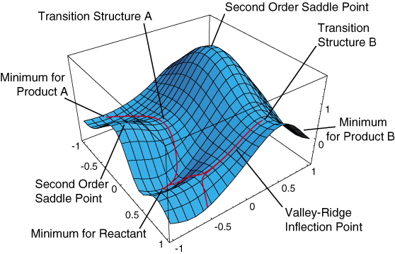
Features of Potential Energy Surfaces
  Copyright © 1990-1998, Gaussian, Inc.
Notes:
- think of a potential energy surface as a hilly landscape, depicting how the energy of the molecule (vertical coordinate) changes with the geometry (horizontal coordinates)
- like any landscape there are hills and valleys, and pathways between them
- here is a simple model of a potential energy surface; a real surface would have as many dimensions as internal coordinates, but this simple model is sufficient to illustrate all the important features
- we have 3 minima that correspond to equilibrium geometries of reactants and products; the position of the minimum energy geometry determines the molecular structure
- we have reaction paths that connect one minimum to another; this gives us the reaction mechanism
- transition states correspond to the highest point along the easiest path between reactants and products, i.e. the mountain pass or first order saddle point; the energy and shape of the potential energy determines the reaction rate
- in general, we want to stay away from local hill tops, since the reaction can proceed more easily by going around the hilltop or second order saddle point
- in some cases, reaction paths branch; for example, descending from one transition state and going into two valleys

Slide 6
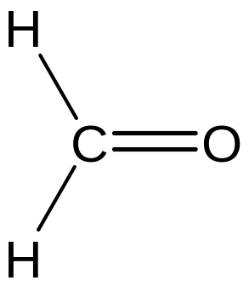
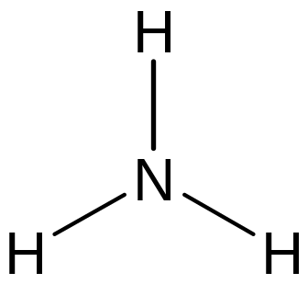
Symmetry and Minima
  Gradients belong to the totally symmetric
  representation for the molecule
  If carried out properly, a gradient-type
  optimization will not lower the symmetry
  Must test if distortion to lower symmetry will
  lower the energy (i.e., may be a saddle point)
  Copyright © 1990-1998, Gaussian, Inc.

Slide 7
Algorithms for Minimization
Univariate search, axial iteration
  Slow convergence
  Energy only, gradients not required
Conjugate gradient and quasi-Newton methods
  Better convergence
  Numerical or analytical gradient required
  Fletcher-Powell, DFP, MS, BFGS, OC
Newton methods
  Rapid convergence
  Require second derivatives
  Copyright © 1990-1998, Gaussian, Inc.

Slide 8
Energy Derivatives
Analytical first derivatives are available for:
  Hartree-Fock
  DFT
  Møller-Plesset perturbation theory
    MP2, MP3, MP4(SDQ)
  Configuration Interaction, CIS, CID, CISD
  CASSCF
  Coupled Cluster, CCSD and QCISD
Analytical second derivatives are available for:
  Hartree-Fock
  DFT
  MP2
  CASSCF
  CIS
  Copyright © 1990-1998, Gaussian, Inc.

Slide 9
Initial guess for geometry & Hessian
Calculate energy and gradient
Minimize along line between
current and previous point
Update Hessian
(Powell, DFP, MS, BFGS, Berny, etc.)
Take a step using the Hessian
(Newton, RFO, Eigenvector following)
Check for convergence
on the gradient and displacement
yes
DONE
no
Update the geometry
  Copyright © 1990-1998, Gaussian, Inc.

Slide 10
Gradient optimization in Gaussian
Initial guess for Hessian
  Empirical guess for Hessian based on a simple valence force field in redundant internal coordinates (TCA 66, 333, (1984)
Line search for minimization
  Fit a constrained quartic to the current and previous function value and gradient
  Constrained so that 2nd derivative always positive
  Find minimum on quartic and interpolate gradient
Update Hessian and displacement
  use gradient information from previous points
  to BFGS for minima
  Copyright © 1990-1998, Gaussian, Inc.

Slide 11
Redundant Internal Coordinates
Generated automatically by program
Start with cartesian coordinates
Identify bonds using covalent radii (check for hydrogen bonds and interfragment bonds)
Construct all angles between bonded atoms (special linear bends coordinate for nearly linear angles)
Construct all dihedral angles between bonded atoms (take care of linear groups)
Construct a diagonal estimate of the initial Hessian (include hydrogen bonds and interfragment bonds)
  Copyright © 1990-1998, Gaussian, Inc.

Slide 12
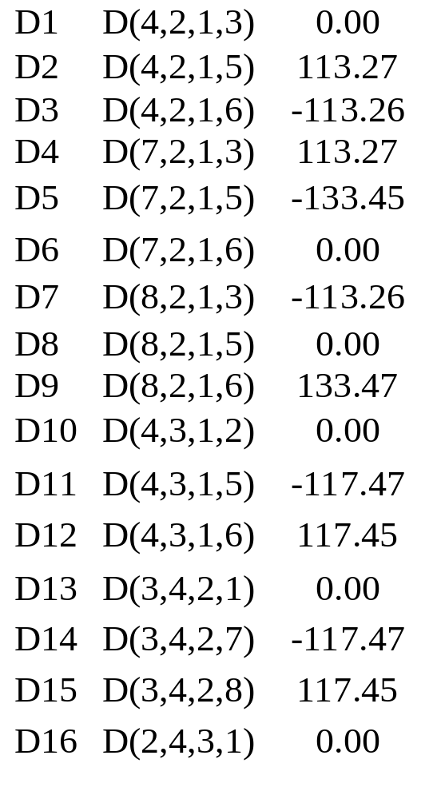
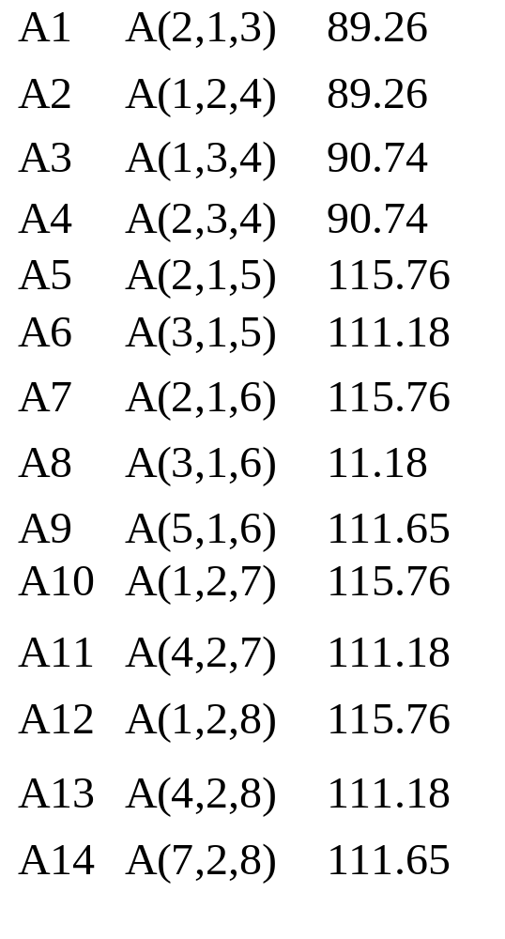
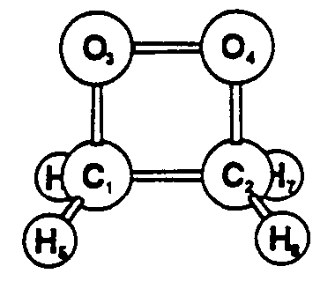
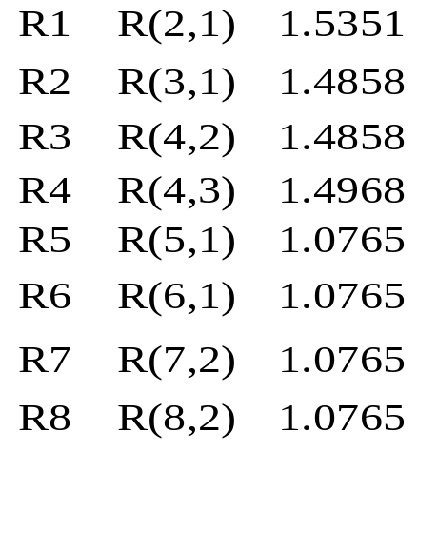
Redundant Internal Coordinates, cont'd
Dioxetane (HF/3-21G)
  Copyright © 1990-1998, Gaussian, Inc.

Slide 13
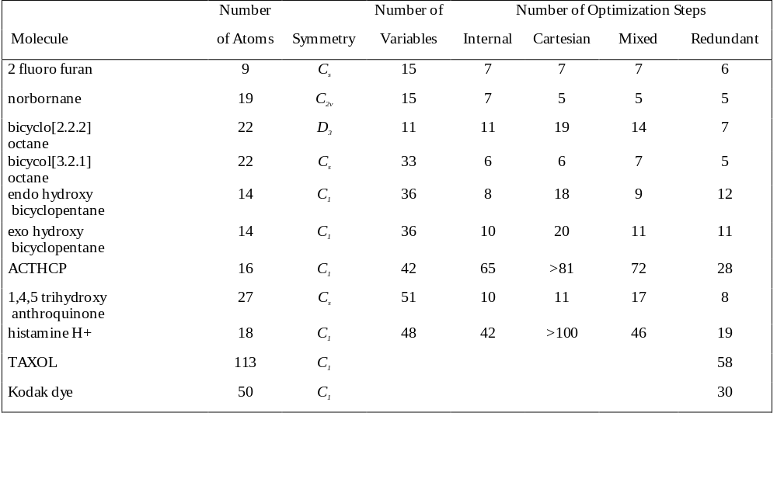
Comparison of geometry optimization performance using internal, cartesian, mixed and redundant internal coordinates.
  Copyright © 1990-1998, Gaussian, Inc.

Slide 14
Estimating the Hessian
Empirical Estimates (default)
Numerical calculation of key elements of the Hessian
Approximate Hessian from a lower-level optimization
Calculations of the full Hessian at a lower level.
(ReadFC, CalcHFFC)
Calculation of the full Hessian at the same level (CalcFC)
Recalculation of the full Hessian at each step in the optimization (CalcAll)
  Copyright © 1990-1998, Gaussian, Inc.

Slide 15
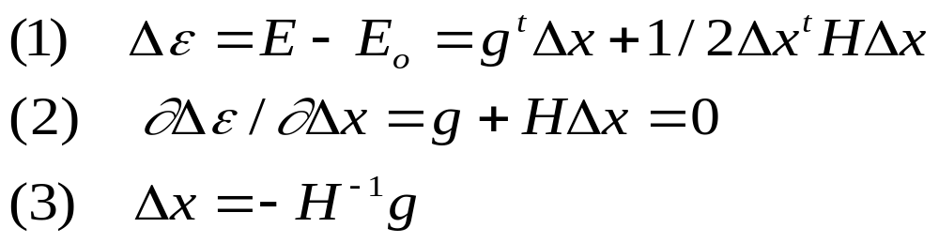
Newton-Raphson step
Taylor expansion:
Work in eigenvector space
Checking for the correct number of negative eigenvalues (change signs if necessary)
Limit total step using trust radius or RFO
Stop if max and rms gradient and displacement below appropriate thresholds
  Copyright © 1990-1998, Gaussian, Inc.

Slide 16
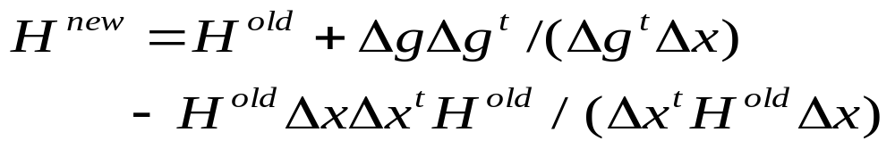
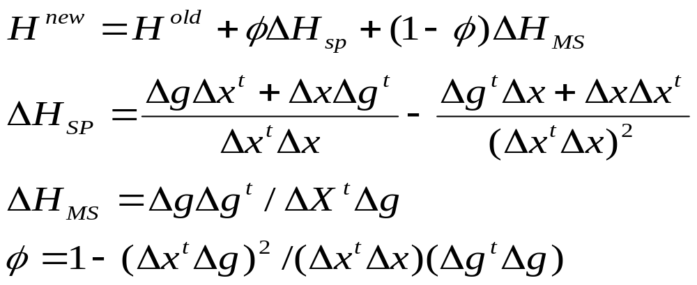
Hessian Update Scheme
Iterate, using all previous points
BFGS update for minimization
Bofill update for transition states (combination of symmetric Powell and Murtagh-Sargent)
  Copyright © 1990-1998, Gaussian, Inc.

Slide 17
Testing Minima
Compute the full Hessian (the partial Hessian from an optimization is not accurate enough and contains no information about lower symmetries).
Check the number of negative eigenvalues:
  0 required for a minimum.
  1 (and only 1) for a transition state
For a minimum, if there are any negative eigenvalues, follow the associated eigenvector to a lower energy structure.
For a transition state, if there are no negative eigenvalues, follow the the lowest eigenvector up hill.
  Copyright © 1990-1998, Gaussian, Inc.

Slide 18
Things to Try When Optimizations Fail
Number of steps exceeded
  Check for very flexible coordinates and/or strongly coupled coordinates
  Increase # of cycles OPT=(Restart, Maxcyc=N)
Maximum step size exceeded
  If it happens too often, check for flexible and/or strongly coupled coordinates
Change in point group during optimization
  Check structure and/or use NoSymm
  Copyright © 1990-1998, Gaussian, Inc.

Slide 19
Options for Coordinate Systems
Opt=Cartesian: Perform optimization in Cartesian coordinates.
Opt=Z-Matrix: Perform optimization in Z-Matrix coordinates.
Opt=Redundant: Perform optimization in redundant internal coordinates (default).
Opt=ModRedundant: Add or modify redundant internal coordinates
  N₁ N₂ [N₃[N₄]] [value] [D|F|A|R] or [H fc]
    D-Numerically differentiate
    F-Freeze coordinate
    A-Activate coordinate
    R-Remove coordinate
    H-Use "fc" as an estimate of the diagonal force constant
  Copyright © 1990-1998, Gaussian, Inc.

Slide 20
More Options to OPT
Maxcycle=n: Sets the maximum number of optimization steps
NoEigenTest: Suppress curvature testing in Berny TS opts.
NoFreeze: Activate all frozen variables (constants).
Expert: Relax limits on force constants and step size.
Tight, VeryTight: Tighten convergence cutoffs (forces & step size)
Loose: Intended for preliminary work
MaxStep=m: Maximum step size = 0.01 * m
  Copyright © 1990-1998, Gaussian, Inc.

Slide 21
Options to GEOM
Checkpoint: Read molecule specification from checkpoint file (usually use Guess=Read also).
Modify: Read and modify molecule specification from checkpoint file (see next slide).
NoCrowd: Allow atoms to be closer than 0.5 Angstroms.
NoKeep: Discard information about frozen variables.
Step=n: Start with nth step from a failed optimization
  Copyright © 1990-1998, Gaussian, Inc.

Slide 22
Geom=Modify Syntax
Syntax for modifications: V value [F|A|D]
  V=variable identifier
  value=new value
  Optional third parameter: F=Freeze, A=Activate, D=Activate and request numerical differentiation; default if omitted=leave variable's status as defined in the checkpoint file.
  Copyright © 1990-1998, Gaussian, Inc.

Slide 23
Relaxed Potential Surface Scan
Opt=Z-matrix or OPT =AddRedundant
Step one or more variables over a grid while optimizing all remaining variables with the Berny method
Syntax: V value S j delta
  V=variable identifier
  value=initial value
  j=number of steps
  delta=increment for value
Examples
  Z-matrix: R 0.8 S 3 0.1
  Redundant internals: 1 3 0.8 S 3 0.1
  Copyright © 1990-1998, Gaussian, Inc.

Slide 24
Features of Potential Energy Surfaces
  Copyright © 1990-1998, Gaussian, Inc.
Notes:
- think of a potential energy surface as a hilly landscape, depicting how the energy of the molecule (vertical coordinate) changes with the geometry (horizontal coordinates)
- like any landscape there are hills and valleys, and pathways between them
- here is a simple model of a potential energy surface; a real surface would have as many dimensions as internal coordinates, but this simple model is sufficient to illustrate all the important features
- we have 3 minima that correspond to equilibrium geometries of reactants and products; the position of the minimum energy geometry determines the molecular structure
- we have reaction paths that connect one minimum to another; this gives us the reaction mechanism
- transition states correspond to the highest point along the easiest path between reactants and products, i.e. the mountain pass or first order saddle point; the energy and shape of the potential energy determines the reaction rate
- in general, we want to stay away from local hill tops, since the reaction can proceed more easily by going around the hilltop or second order saddle point
- in some cases, reaction paths branch; for example, descending from one transition state and going into two valleys

Slide 25
Optimization of Transition Structures
Features of Energy Surfaces
Algorithms for Optimizing Transition States
Practical Suggestions for Optimizations of Transition States
  Keywords: Opt=QST2, IRCMax
Reaction Path Optimization
  Keyword: Opt=Path
Algorithms for Following Reaction Paths
  Keyword: IRC
  Copyright © 1990-1998, Gaussian, Inc.

Slide 26
Algorithms for Finding Transition States
Surface fitting
Linear and quadratic synchronous transit
Coordinate driving
Hill climbing, walking up valleys, eigenvector following
Gradient norm method
Quasi-Newton methods
Newton methods
  Copyright © 1990-1998, Gaussian, Inc.

Slide 27
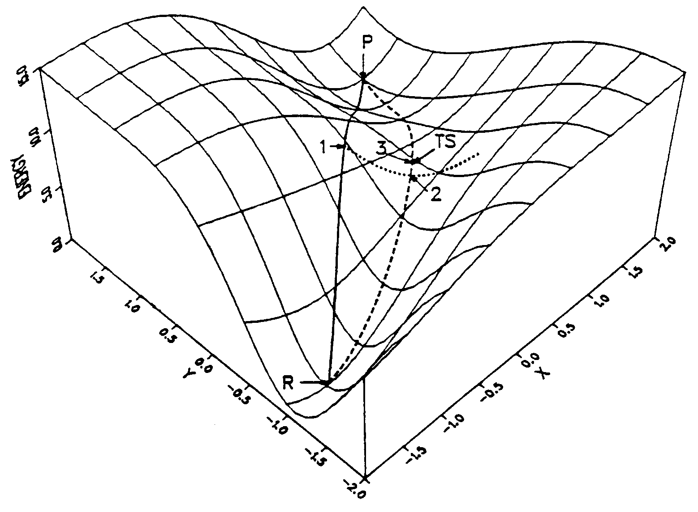
Linear Synchronous Transit and
Quadratic Synchronous Transit
  Copyright © 1990-1998, Gaussian, Inc.

Slide 28
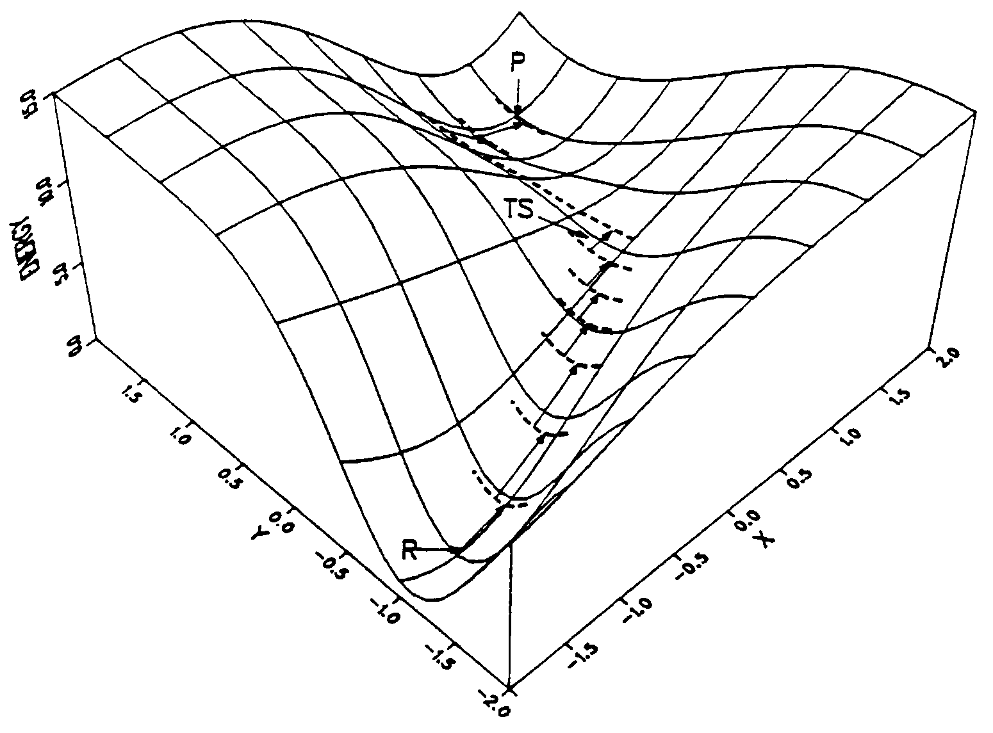
Coordinate Driving
  Copyright © 1990-1998, Gaussian, Inc.

Slide 29
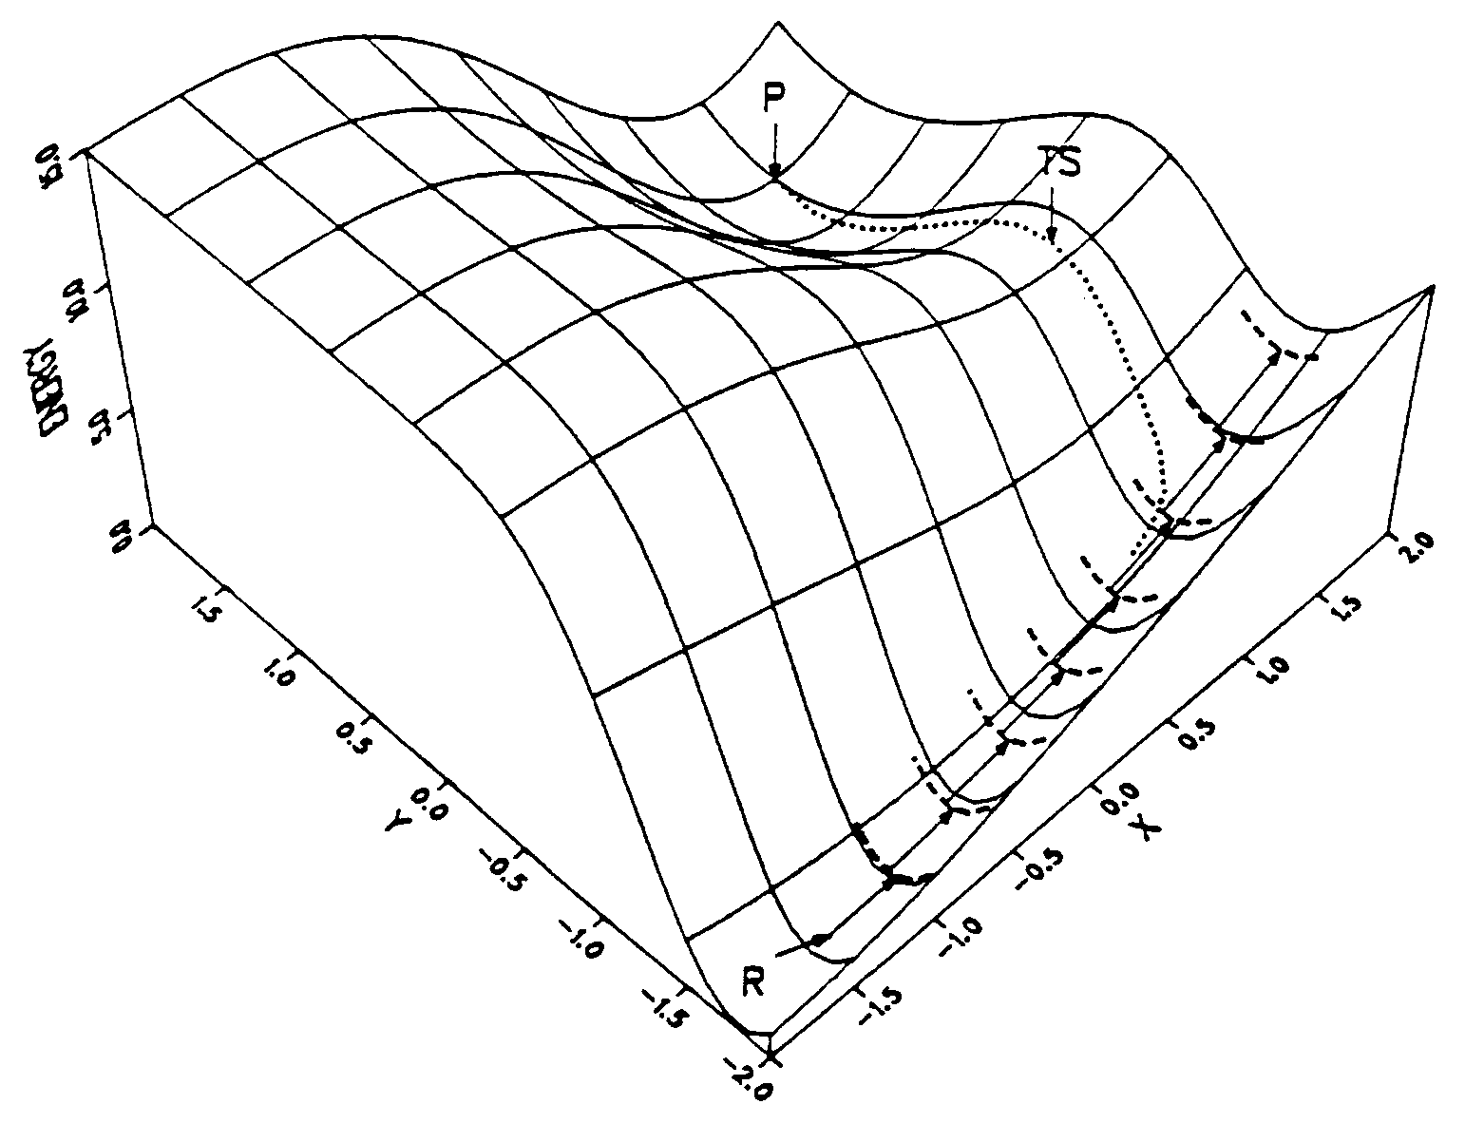
Problems with Coordinate Driving
  Copyright © 1990-1998, Gaussian, Inc.

Slide 30

Walking Up Valleys
  Copyright © 1990-1998, Gaussian, Inc.

Slide 31
Gradient Based Transition Structure Optimization Algorithms
Quadratic Model
  fixed transition vector
  constrained transition vector
  associated surface
  fully variable transition vector
Non Quadratic Models-GDIIS
Eigenvector following/RFO for stepsize control
Bofill update of Hessian, rather than BFGS
Test Hessian for correct number of negative eigenvalues
  Copyright © 1990-1998, Gaussian, Inc.

Slide 32
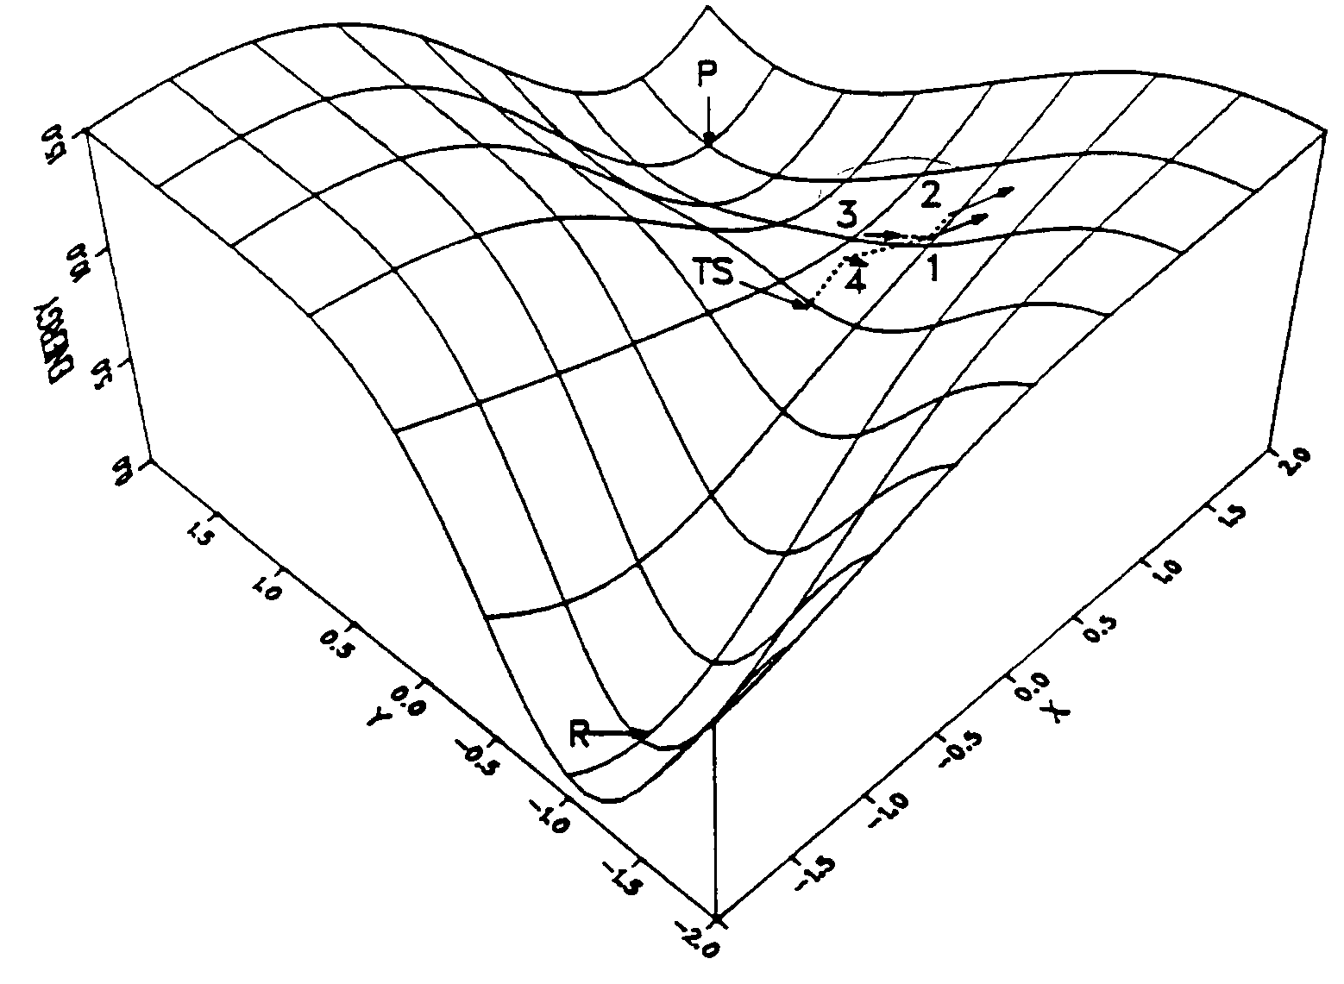
Gradient Method
  Copyright © 1990-1998, Gaussian, Inc.

Slide 33
Optimization of Transition States
OPT = TS or OPT(Saddle=n)
  Input initial estimate of the transition state geometry
  Make sure that the coordinates dominating the transition vector are not strongly coupled to the remaining coordinates
  Make sure that the initial Hessian has a negative eigenvalue with an approximate eigenvector.
  Use CALCFC or READFC if possible.
  Copyright © 1990-1998, Gaussian, Inc.

Slide 34
Example for Transition State
Optimization Using Z-Matrix
    # OPT = (TS, Z-matrix)
    HCN -> HNC transition state
    0 1
    C
    N 1 RCN
    X 1 RCX 2 90.
    H 3 RXH 1 90. 2 0.
    RCN 1.1
    RCX 0.9
    RXH 0.6 D
X₃
H₄
C₁
N₂
  Copyright © 1990-1998, Gaussian, Inc.

Slide 35
Optimization of Transition States
OPT=QST2 and OPT=QST3
Synchronous transit guided transition state search
Optimization in redundant internal coordinates
QST2: input a reactant-like structure and a product-like structure (initial estimate of transition state by linear interpolation in redundant internal coordinates)
QST3: input reactant, product, and estimate of transition state
First few steps search for a maximum along path
Remaining steps use regular transition state optimization method (quasi-Newton with eigenvector following/RFO)
If transition vector deviates too much from path, automatically chooses a better vector to follow.
  Copyright © 1990-1998, Gaussian, Inc.

Slide 36
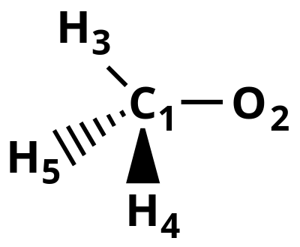
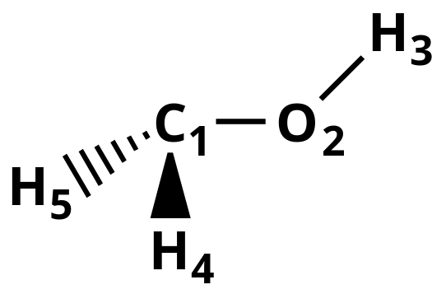
Input for Opt=QST2 or Opt=Path TS Search
#OPT=QST2
H3CO-Title 1
0 2
C1 0.0 0.0 0.0
02 0.0 0.0 1.3
H3 0.0 0.9 -.3
H4 0.8 -.2 -.6
H5 -.8 -.2 -.6
CH2OH - Title 2
0 2
C1 0.0 0.0 0.0
02 0.0 0.0 1.4
H3 0.0 0.92 1.7
H4 0.7 -.1 -.7
H5 -.7 -.1 -.7
  Copyright © 1990-1998, Gaussian, Inc.

Slide 37
Input for QST2 (Cont’d)
Atoms need to be specified in the same order in each structure
Input structures do not correspond to optimized structures.
QST3 adds third title and estimate for TS structure
Mod Redundant input sections follow each structure when this option is used.
  Copyright © 1990-1998, Gaussian, Inc.

Slide 38
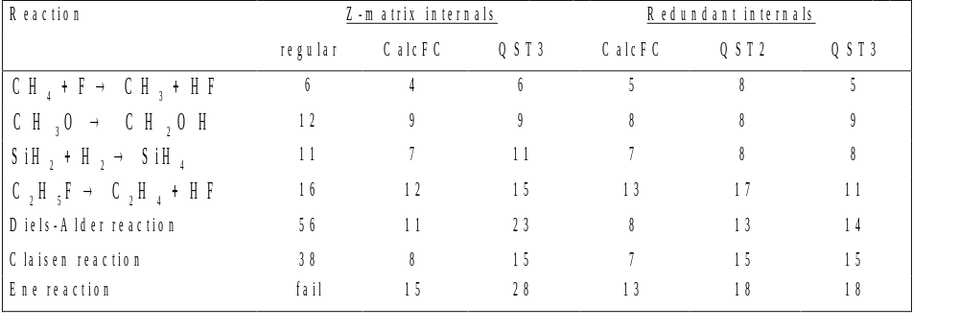
Comparison of the number of steps required to optimize transition state geometries
  Copyright © 1990-1998, Gaussian, Inc.

Slide 39
Estimating the Hessian for Transition States
The initial Hessian must have one negative eigenvalue and a suitable eigenvector associated with this eigenvalue.
  Numerical calculation of key elements of the Hessian
  Approximate Hessian from a lower-level optimization
  Calculations of the full Hessian at a lower level (READFC from a frequency calculation)
  Calculation of the full Hessian at the same level (CALCFC)
  Recalculation of the full Hessian at each step in the optimization (CALCALL)
  Copyright © 1990-1998, Gaussian, Inc.

Slide 40
Testing Transition Structures
Compute the full Hessian (the partial Hessian from an optimization is not accurate enough and contains no information about lower symmetries).
Check the number of negative eigenvalues:
  1 and only 1 for a transition state.
Check the nature of the transition vector (it may be necessary to follow reaction path to be sure that the transition state connects the correct reactants and products).
If there are too many negative eigenvalues, follow the appropriate eigenvector to a lower energy structure.
  Copyright © 1990-1998, Gaussian, Inc.

Slide 41
Things to Try When
Transition State Searches Fail
1) Too many negative eigenvalues of the Hessian during a transition structure optimization
  Follow the eigenvector with the negative eigenvalue that does not correspond to the transition vector
2) No negative eigenvalues of the Hessian during a transition structure optimization
  Relaxed scan above reaction coordinate to look for highest energy (Opt=ModRedundant)
  Copyright © 1990-1998, Gaussian, Inc.

Slide 42
More Options to the OPT Keyword
QST2, QST3: Synchronous transit guided optimization for a transition state
Saddle=n: optimize an nth order saddle point.
NoEigenTest: Continue optimization even if the Hessian
has the wrong number of negative eigenvalues.
  use with care!
  Copyright © 1990-1998, Gaussian, Inc.

Slide 43
Features of Potential Energy Surfaces
  Copyright © 1990-1998, Gaussian, Inc.
Notes:
- think of a potential energy surface as a hilly landscape, depicting how the energy of the molecule (vertical coordinate) changes with the geometry (horizontal coordinates)
- like any landscape there are hills and valleys, and pathways between them
- here is a simple model of a potential energy surface; a real surface would have as many dimensions as internal coordinates, but this simple model is sufficient to illustrate all the important features
- we have 3 minima that correspond to equilibrium geometries of reactants and products; the position of the minimum energy geometry determines the molecular structure
- we have reaction paths that connect one minimum to another; this gives us the reaction mechanism
- transition states correspond to the highest point along the easiest path between reactants and products, i.e. the mountain pass or first order saddle point; the energy and shape of the potential energy determines the reaction rate
- in general, we want to stay away from local hill tops, since the reaction can proceed more easily by going around the hilltop or second order saddle point
- in some cases, reaction paths branch; for example, descending from one transition state and going into two valleys

Slide 44
Reaction Paths
Steepest descent path from transition state to reactants and products
Intrinsic reaction coordinate, in mass-weighted cartesian coordinates used
Keyword: IRC
  Requires optimized TS
  Requires Hessian
  Copyright © 1990-1998, Gaussian, Inc.

Slide 45
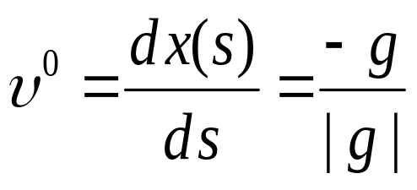
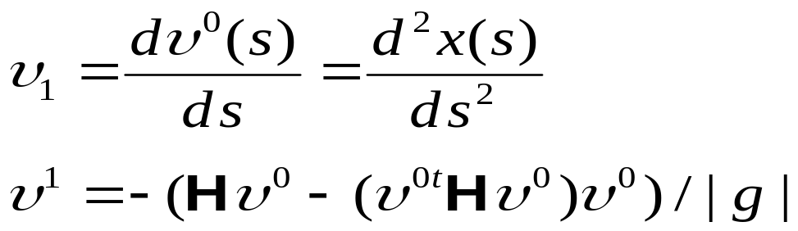
Reaction Paths
Taylor expansion of reaction path
Tangent
Curvature
  Copyright © 1990-1998, Gaussian, Inc.

Slide 46
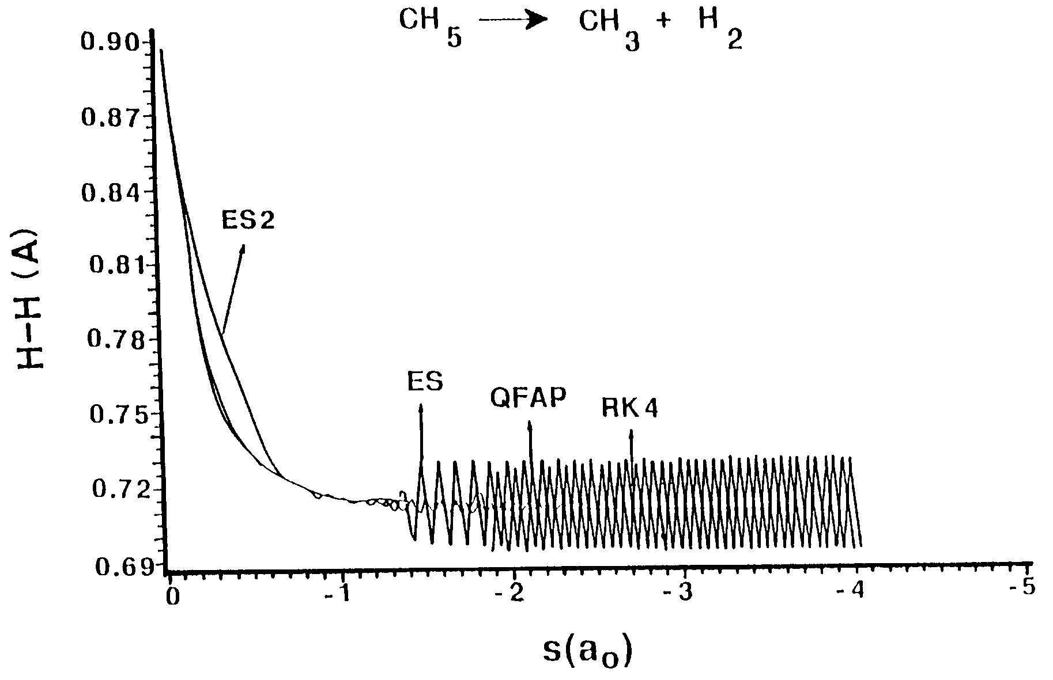
ES =Euler Single Step
ES2=Euler with Stabilization
QFAP=Quadratic Fixed step
size Adams predictor
RK4=Runge Kutta 4th order
  Copyright © 1990-1998, Gaussian, Inc.

Slide 47
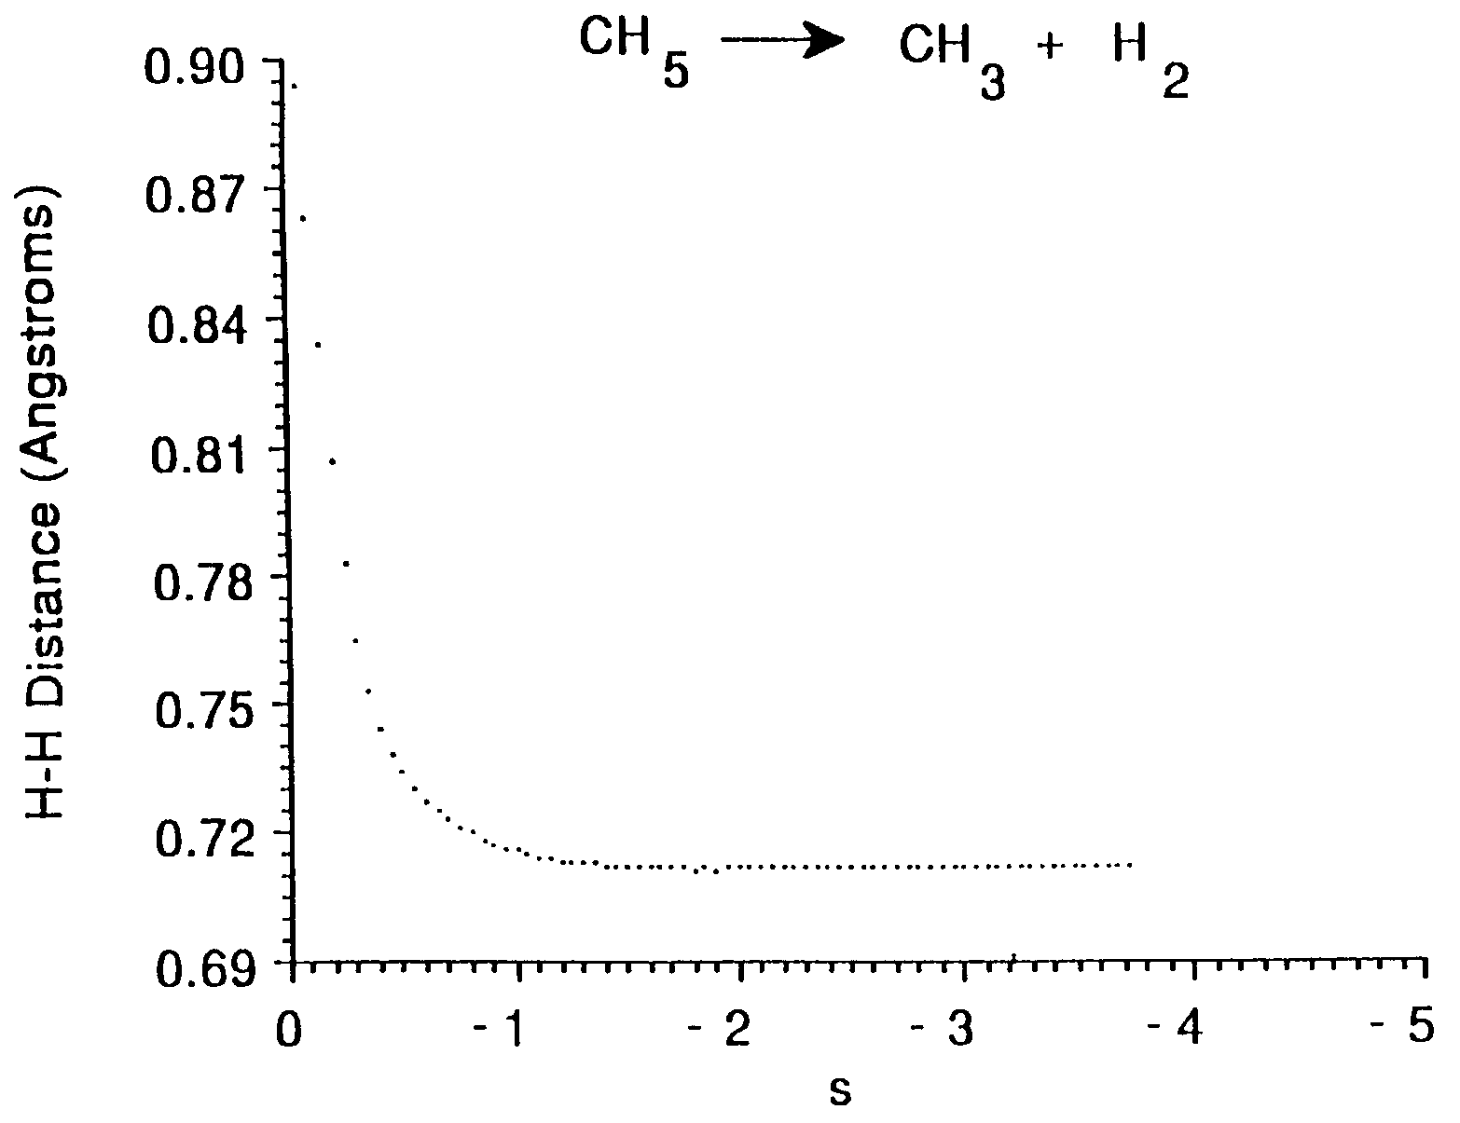
GS=Gonzalez & Schlegel
  Copyright © 1990-1998, Gaussian, Inc.

Slide 48
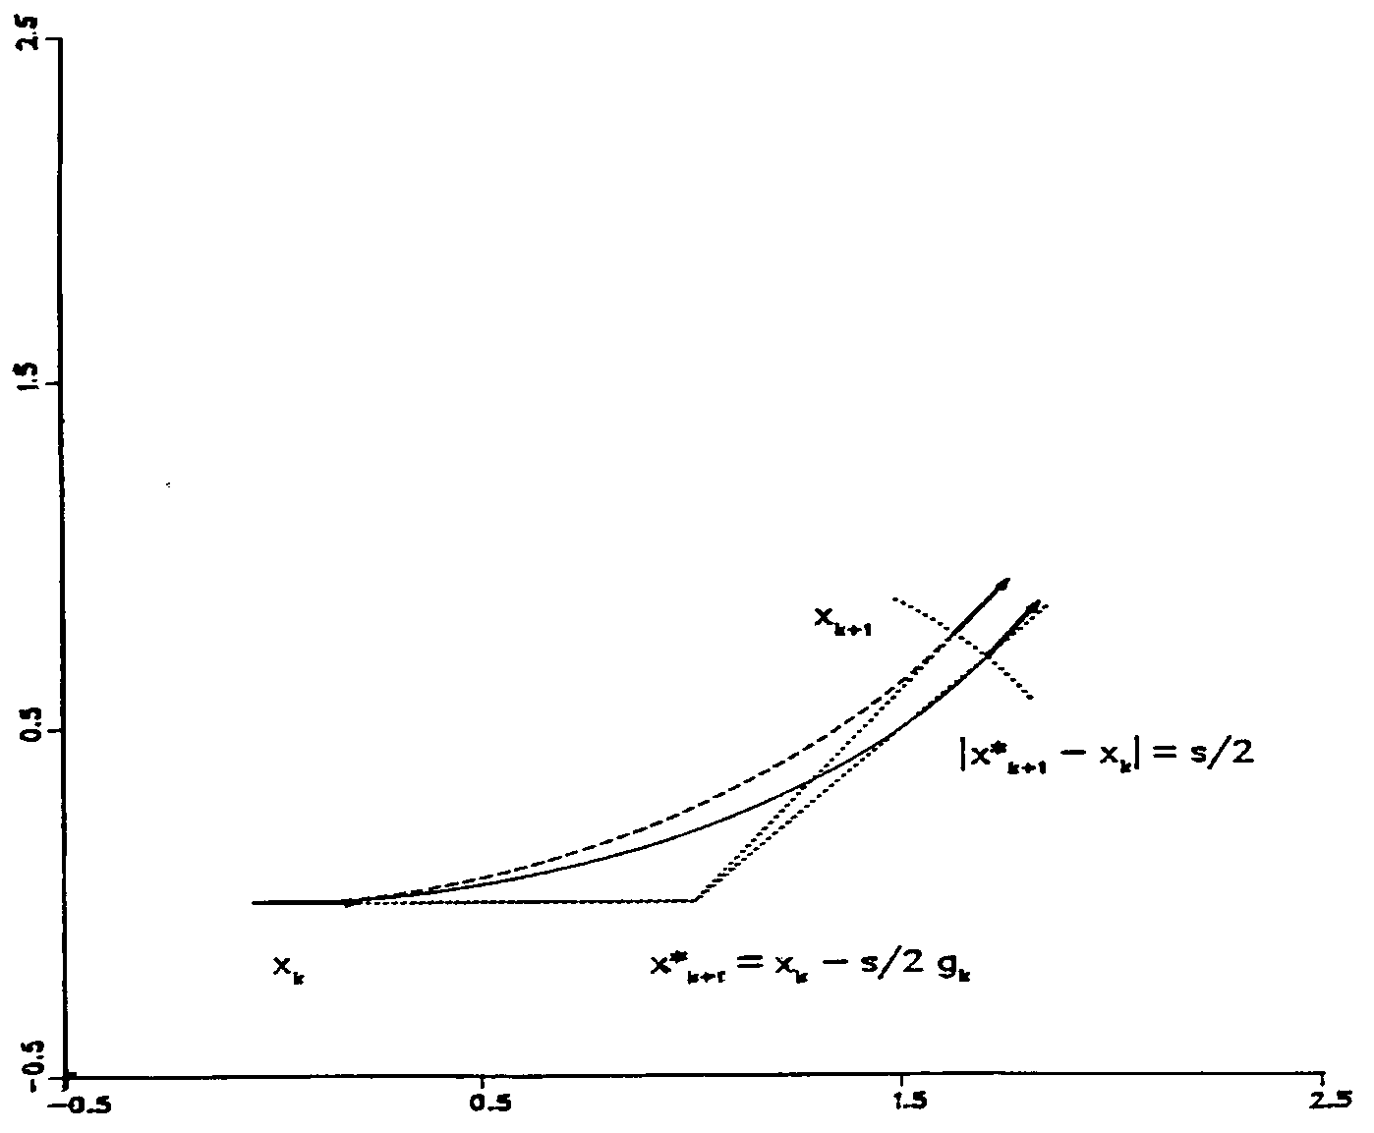
GS IRC Following Algorithm
  Copyright © 1990-1998, Gaussian, Inc.

Slide 49
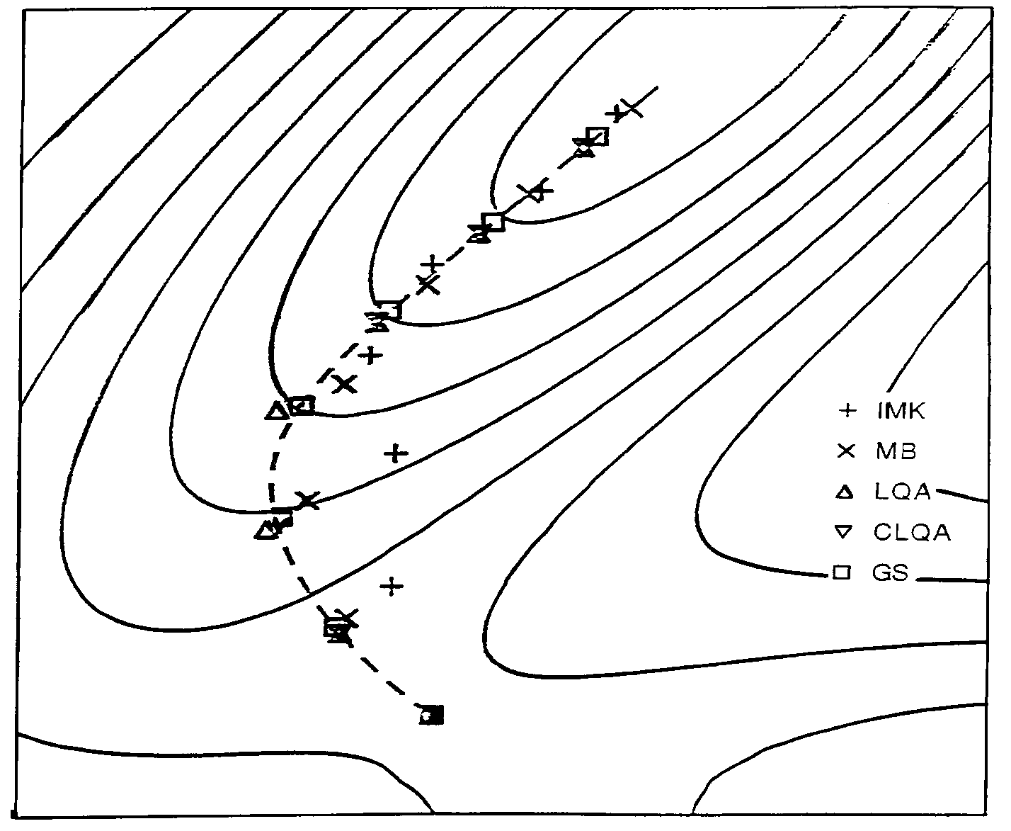
IRC on the Müller/Brown Surface
  Copyright © 1990-1998, Gaussian, Inc.

Slide 50
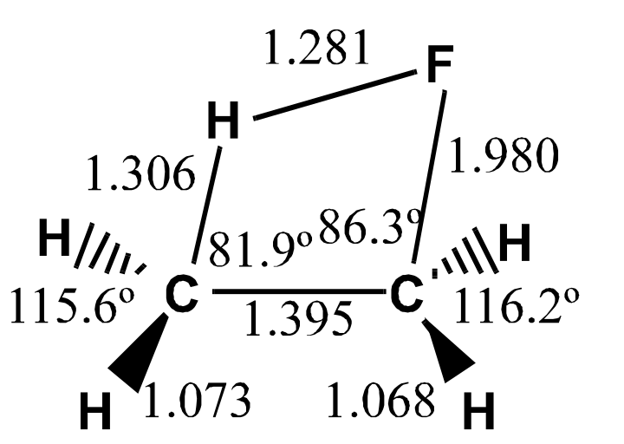
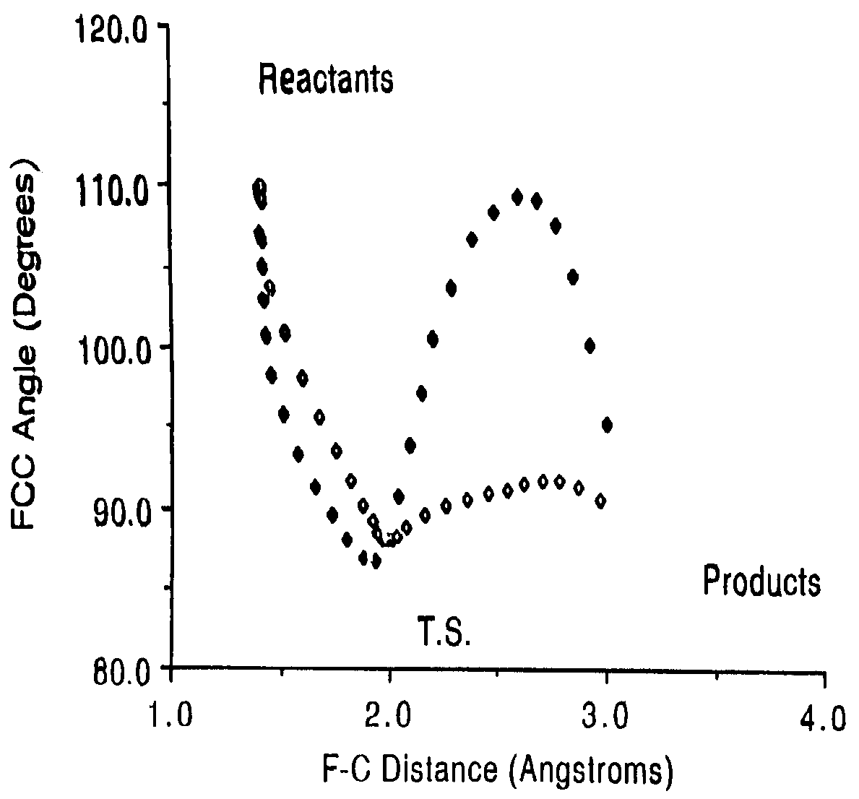
Mass Weighted vs Non-Mass Weighted IRC
Mass Weighted
Non-Mass Weighted
  Copyright © 1990-1998, Gaussian, Inc.

Slide 51
Options to IRC Keyword
RCFC: Read Cartesian FCs from checkpoint file.
CalcFC: Calculate force constants at first point.
Internal, Cartesian, MassWeight: Specify coordinate system in which to follow path. (default=Mass Weight)
VeryTight: Tighten optimization convergence criteria.
ReadVector: Read in vector to follow.
ReadIso: Read in isotopes for each atom.
MaxPoint=n: Examine up to n points in each requested direction.
Forward, Reverse: Limit calc. to the specified direction.
StepSize=n: (n x 0.01au)
NoSymm
  Copyright © 1990-1998, Gaussian, Inc.

Slide 52
IRCMax Method
Finds the maximum method 2 energy point for a specified TS on the method 1 reaction
Syntax:
  IRCMax (method 1//method 2)
Input: TS optimized at method 2
  Copyright © 1990-1998, Gaussian, Inc.

Slide 53
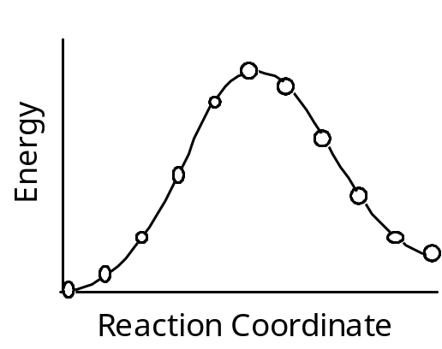
A Combined Method for Transition State Optimization and Reaction Path Following
Relax an approximate path to minimize the integral of the energy along the path
R. Elber, M. Karplus, CPL. 139, 375 (1987)
Optimize the path by finding the transition state and points on the steepest descent path
  P. Y. Ayala, H. B. Schlegel, J. Chem. Phys. 107, 375 (1997)
  Copyright © 1990-1998, Gaussian, Inc.
Notes:
(follow text of slide)

Slide 54
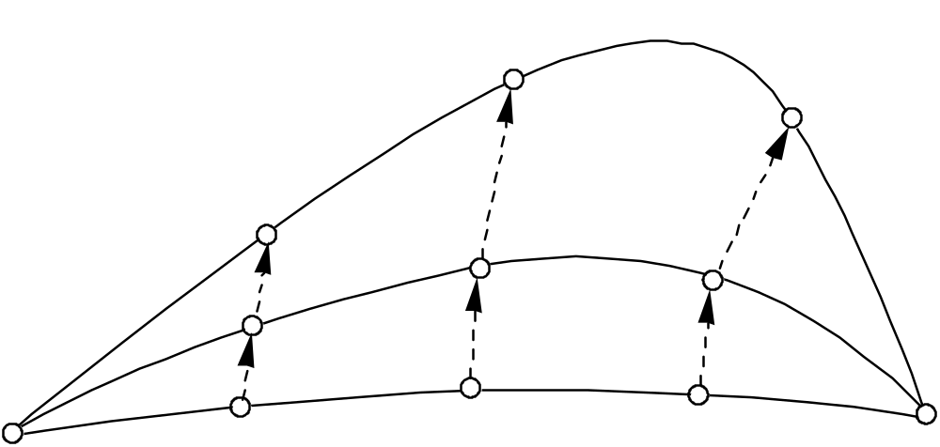
TS
Start with an interpolated path in redundant internal coordinates.
R
P
Calculate the energy and gradient at each point.
Update the Hessian using the neighboring points, as well as the previous point.
Step the highest point toward the TS, the endpoints toward the minima, and the remaining points toward the steepest descent path.
  Copyright © 1990-1998, Gaussian, Inc.
Notes:
(follow text of slide)

Slide 55
4.0
Ene Reaction
H
H
H
C
H
C
H
H
C
C
C
H
Reactant
Min
H
H
H
H
H
H
C
H
C
H
3.0
H
10
C
C
C
H
H
H
H
9
C-H bond formation
H
H
H
C
H
C
H
C
H
H
C
C
H
H
H
H
H
H
8
C
H
C
2.0
C
H
H
H
H
C
C
H
H
H
C
H
H
H
C
H
H
H
C
H
H
C
C
C
H
H
H
H
C
H
H
Initial Path
H
H
C
H
H
C
H
H
H
C
C
6
C
H
H
C
H
H
H
C
C
H
H
C
H
Optimize TS
H
H
H
C
H
H
C
H
H
C
C
Guess TS
Anchor
H
H
H
1.0
1.4
1.6
1.8
2.0
2.2
2.4
2.6
C-C bond breaking
  Copyright © 1990-1998, Gaussian, Inc.
Notes:
- example of method applied to the ene reaction
- involves a 1,5 shift of a hydrogen to one end of a double bond, followed by migration of the double bond, and subsequent breaking of a C-C single bond and forming an additional C-C double bond in the products
- a lot of changes happening in concert
- we started with the reactants, a guess at the TS and something in the product valley; the other points on the path are generated automatically by linear interpolation in internal coordinates
- the path was then relaxed to give the TS and several points on the steepest descent path

Slide 56
Reaction Path Optimization
Opt=Path
  Search for entire reaction path including location of TS
  Faster than separate Opt=QST2 and IRC if both needed
  Good for hard TS, where Opt=QST2 has failed
    Often can figure out if process is two-step of bifurcates
  Same input as Opt=QST2 or QST3
  Copyright © 1990-1998, Gaussian, Inc.

