Slide 1
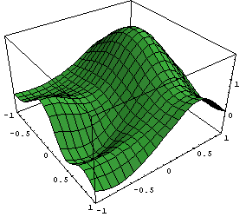
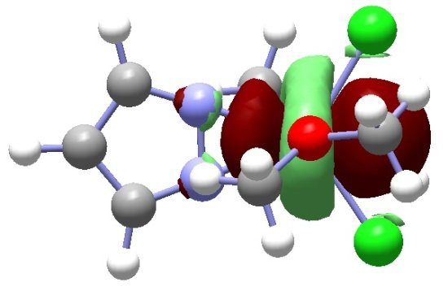
Chemistry 6440 / 7440
Vibrational Frequency Calculations
Notes:
Undergrads should be registered for CHM6440, grads for CHM7440
If you are not registered for the correct course, please change it today

Slide 2
Resources
Wilson, Decius and Cross, Molecular Vibrations, Dover, 1955
Levine, Molecular Spectroscopy, Wiley, 1975
Foresman and Frisch, Exploring Chemistry with Electronic Structure Methods, Chapter 4
Cramer, Chapter 9.3

Slide 3
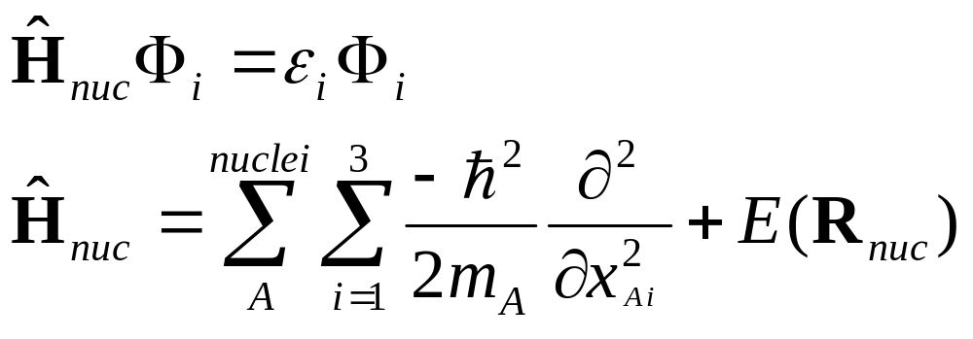
Schrödinger Equation for Nuclear Motion
E(R_{nuc}) – potential energy surface obtained from electronic structure calculations
m_{A} – mass of nucleus A
x_{Ai} – cartesian displacements of nucleus A

Slide 4
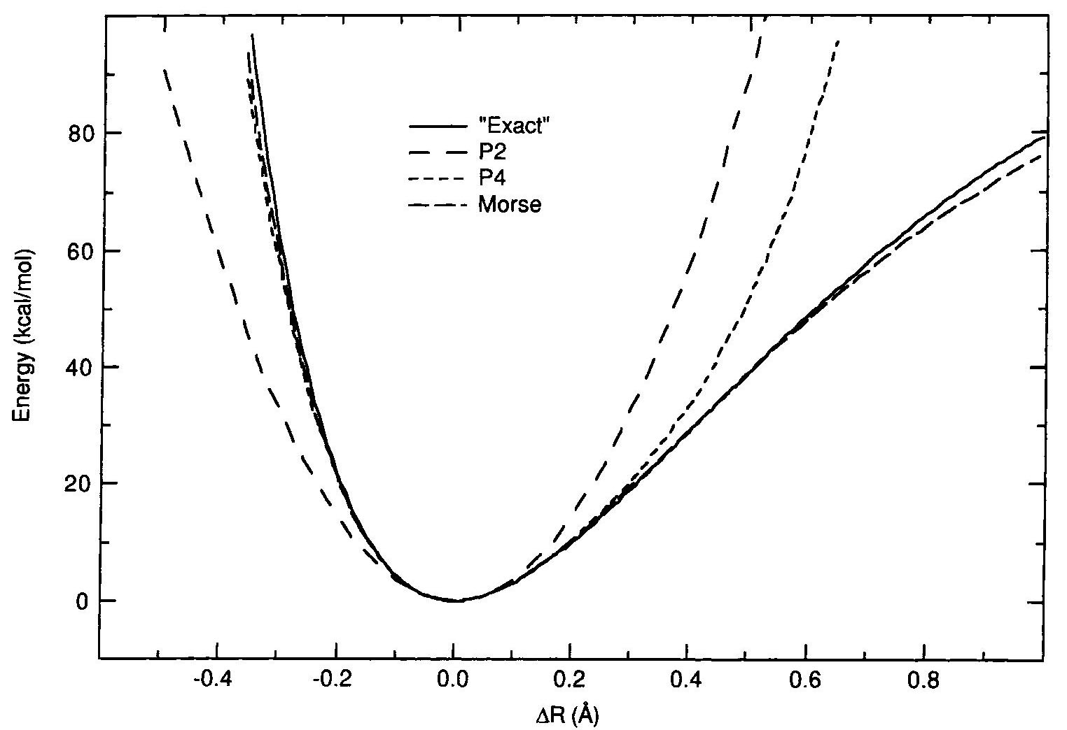
Potential Energy Curve for
Bond Stretching

Slide 5
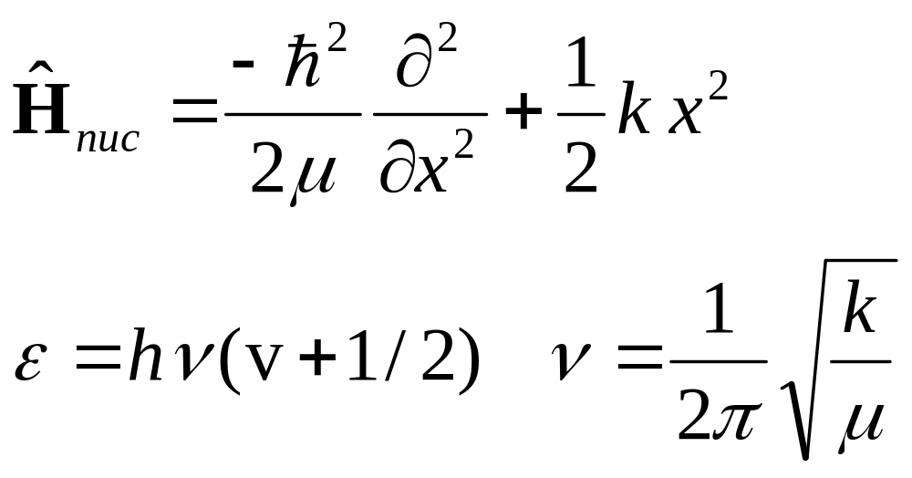
Harmonic Approximation for Bond Stretching
ε – energy of the vibrational levels
ν – vibrational frequency

Slide 6
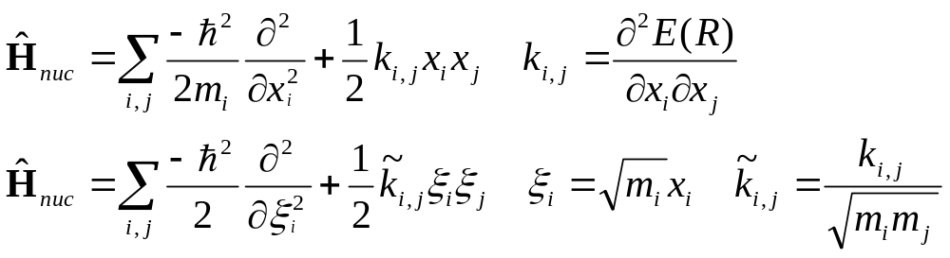
Harmonic Approximation for a Polyatomic Molecule
k_{i,j} – harmonic force constants in Cartesian coordinates (second derivatives of the potential energy surface)
ξ – mass weighted Cartesian coordinates

Slide 7
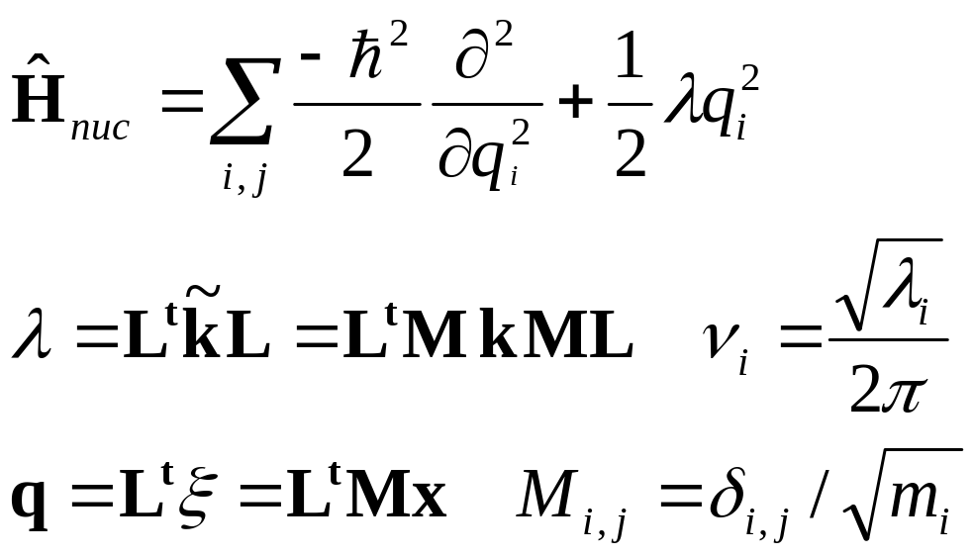
Harmonic Approximation for a Polyatomic Molecule
λ_{I} – eigenvalues of the mass weighted Cartesian force constant matrix
q_{i} – normal modes of vibration

Slide 8
Calculating Vibrational Frequencies
optimize the geometry of the molecule
calculate the second derivatives of the Hartree-Fock energy with respect to the x, y and z coordinates of each nucleus
mass-weight the second derivative matrix and diagonalize
3 modes with zero frequency correspond to translation
3 modes with zero frequency correspond to overall rotation (if the forces are not zero, the normal modes for rotation may have non-zero frequencies; hence it may be necessary to project out the rotational components)

Slide 9
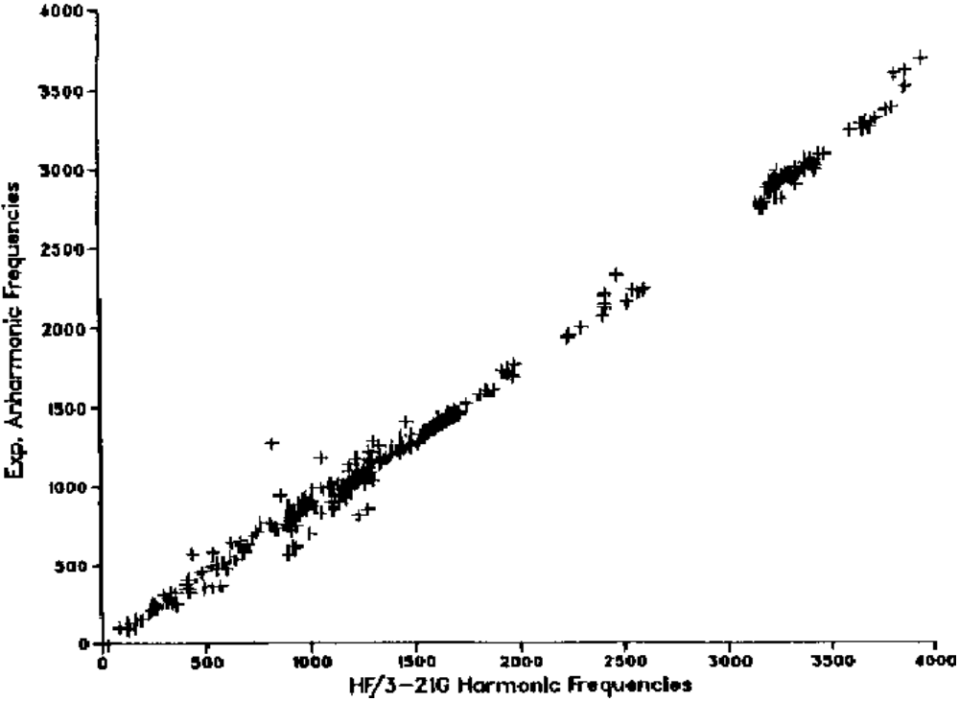
Pople, J. A.; Schlegel, H. B.; Krishnan, R.; DeFrees, D. J.; Binkley, J. S.; Frisch, M. J.; Whiteside, R. A.; Hout, R. F.; Hehre, W. J.; Molecular orbital studies of vibrational frequencies. Int. J. Quantum. Chem., Quantum Chem. Symp., 1981, 15, 269-278.

Slide 10
Scaling of Vibrational Frequencies
calculated harmonic frequencies are typically 10% higher than experimentally observed vibrational frequencies
due to the harmonic approximation, and due to the Hartree-Fock approximation
recommended scale factors for frequencies
  HF/3-21G 0.9085, HF/6-31G(d) 0.8929,
  MP2/6-31G(d) 0.9434, B3LYP/6-31G(d) 0.9613
recommended scale factors for zero point energies
  HF/3-21G 0.9409, HF/6-31G(d) 0.9135,
  MP2/6-31G(d) 0.9676, B3LYP/6-31G(d) 0.9804

Slide 11
Vibrational Intensities
vibrational intensities can be useful in spectral assignments
intensities of vibrational bands in IR spectra depend on the square of the derivative of the dipole moment with respect to the normal modes
intensities of vibrational bands in Raman spectra depend on the square of the derivative of the polarizability with respect to the normal modes

Slide 12
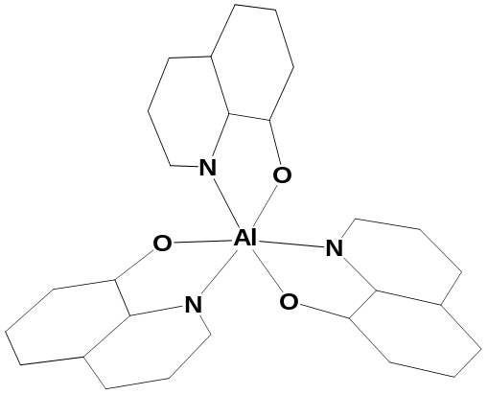
Reflection-Absorption Infrared Spectrum of AlQ3
752
1473
1386
1116
1338
1580
1605
800
1000
1200
1400
1600
Wavenumbers (cm⁻¹)
Notes:
- begining to look at some organic semiconductors
- very good agreement with ALQ3 - an electron transport material
- so many bands that intensities are essential for identifying peaks

Slide 13
Reflection-Absorption Infrared Spectrum of NPB
1468
1314
1586
1284
789
1391
782
819
760
702
518
424
1492
775
1593
1393
1292
799
697
824
753
1275
513
426
1500
1000
500
Wavenumbers (cm⁻¹)
Notes:
- similarly good agreement with NPB, a hole transport material
- understanding the spectra is the first step in characterizing these materials better

