Slide 1

Car-Parrinello Molecular Dynamics Investigation of H₂O Adsorption on α-Al₂O₃(0001)
W. F. Schneider and K. C. Hass
Ford Research Laboratory
W. Andreoni and A. Curioni
IBM Zurich

Slide 2

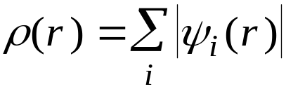
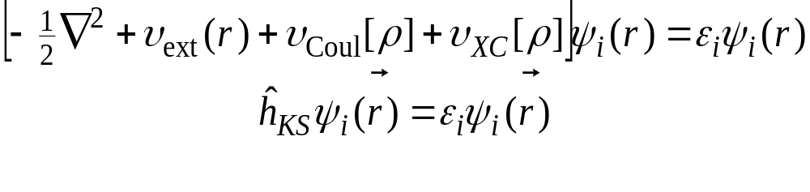
Density Functional Theory
Hohenberg-Kohn theorems:
  Ground state is a unique functional of ρ(r)
  “True” ρ(r) minimizes the system energy
Kohn-Sham construction:
  Express ρ(r) in terms of one-electron orbitals
  Fold unknowns into “exchange-correlation” functional
Exact one-electron formulation

Slide 3
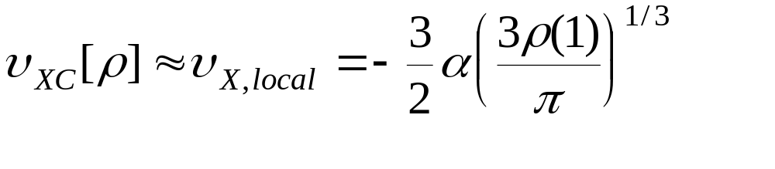
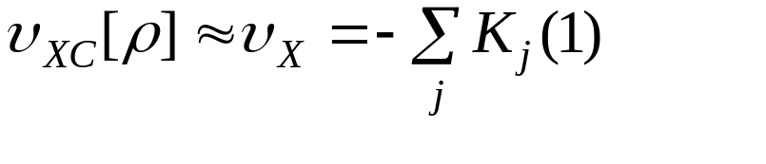

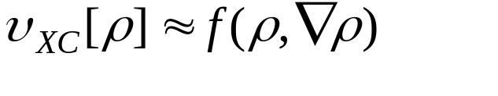
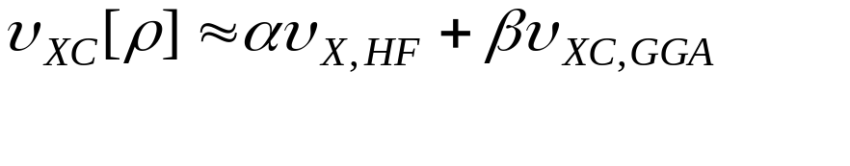
Approximate Kohn-Sham Theories
Xα:
Hartree-Fock:
Local Density Approximation:
Generalized Gradient Approximation
“Hybrid” methods
“VWN” parameterization
Becke ; Perdew-Wang; Lee-Yang-Parr
“adiabatic connection formula”

Slide 4
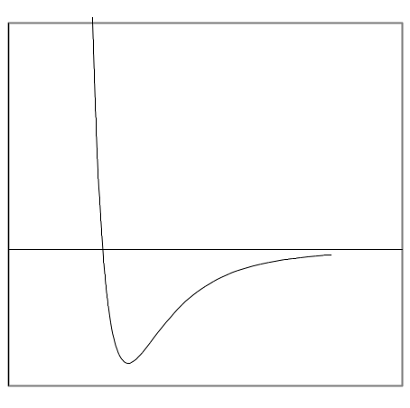
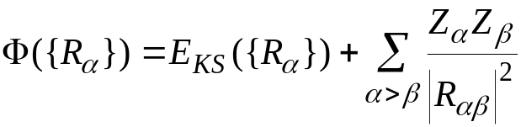
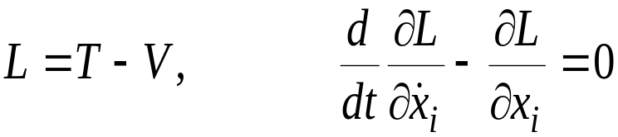
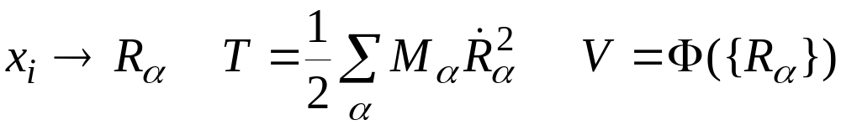
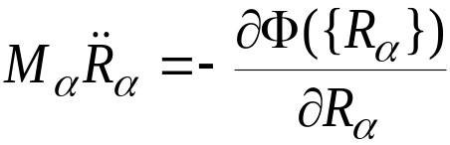
Born-Oppenheimer Dynamics
“Ions move in potential instantaneously generated by electrons”
A
B
R_{α}
Lagrangian Formulation of Equations of Motion
Newton’s equation

Slide 5
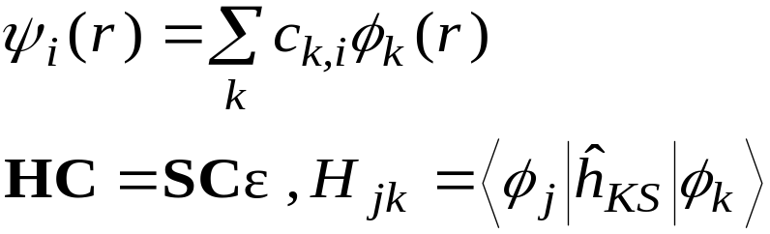
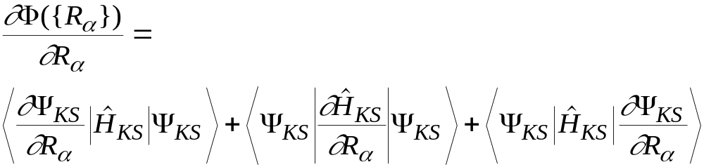
Traditional Ab Initio Molecular Dynamics
Choose initial ionic positions {R_{α}}
  fixes external potential
Expand ψ_{i}(r) in basis
  guess initial expansion coefficients
  fixes electronic potential through ρ(r)
Construct secular matrix and diagonalize
Iterate to self-consistency
Calculate gradient of electronic energy
  Exact forces required for energy conservation
Propogate nuclear positions using Newton’s equation
Repeat

Slide 6
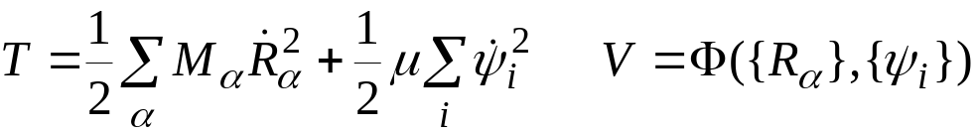

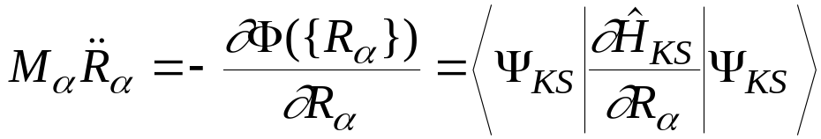

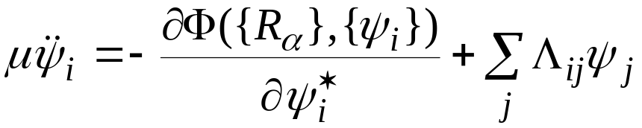

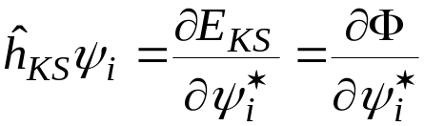
Car-Parrinello Dynamics
Treat both ionic positions and electronic coordinates as dynamical variables
Ionic coordinates
Error in Hellman-Feynman force oscillates, producing stable dynamics
Electronic coordinates
Fictitious mass μ << M_{α} isolates ionic, electronic d.o.f.
Lagrange multipliers maintain wavefunction orthogonality
Potential derivative directly from Hamiltonian

Slide 7
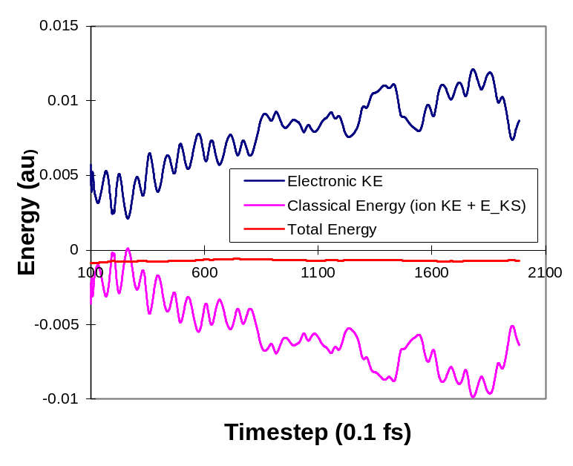


CPMD “Recipe”
Choose initial ionic coordinates R_{α} and electronic “mass” μ
“Quench” wavefunction to B.O. surface
Assign thermal energies to ionic and electronic coordinates
Propogate ionic and electronic coordinates
  Verlet integrator
large μ
longer timestep
greater ion/electron coupling
small μ
shorter timestep
lesser ion/electron coupling
Highly efficient algorithm for producing first-principles molecular dynamics trajectories

Slide 8
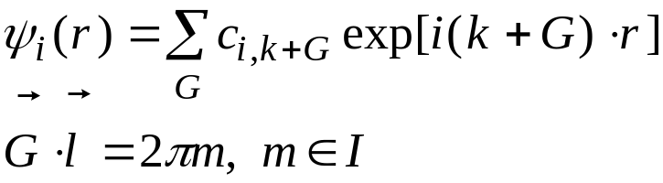

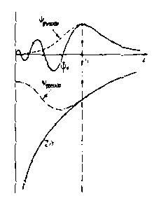
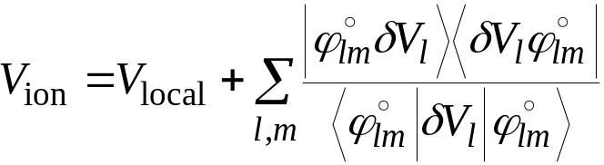
Technical Details
Periodic supercell representation
Plane wave basis set
  Bloch’s theorem
Finite energy cutoff
  produces finite basis set
Single k point (Γ)
Norm-conserving pseudopotentials
  Kleinman-Bylander separtion

