Slide 1
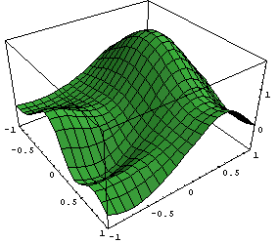
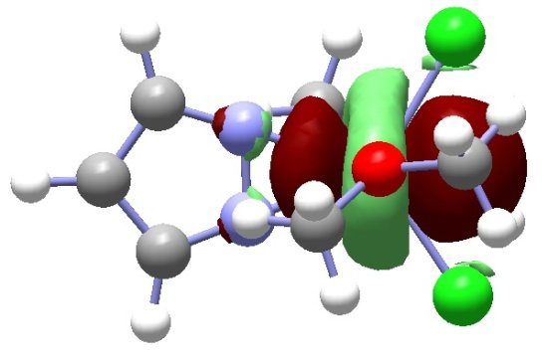
Chemistry 6440 / 7440
Model Chemistries
Notes:
Undergrads should be registered for CHM6440, grads for CHM7440
If you are not registered for the correct course, please change it today

Slide 2
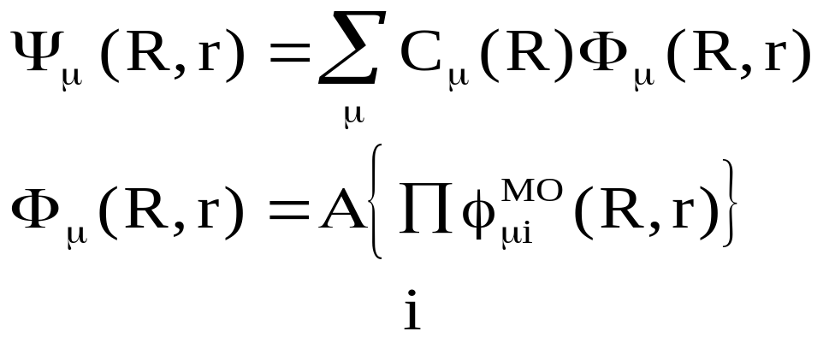
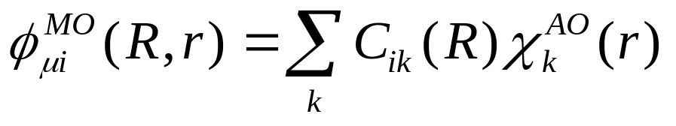
Electronic Structure Theory
Schrodinger equation HΨ = EΨ
The many-electron CI expansion
The one-electron LCAO expansion

Slide 3
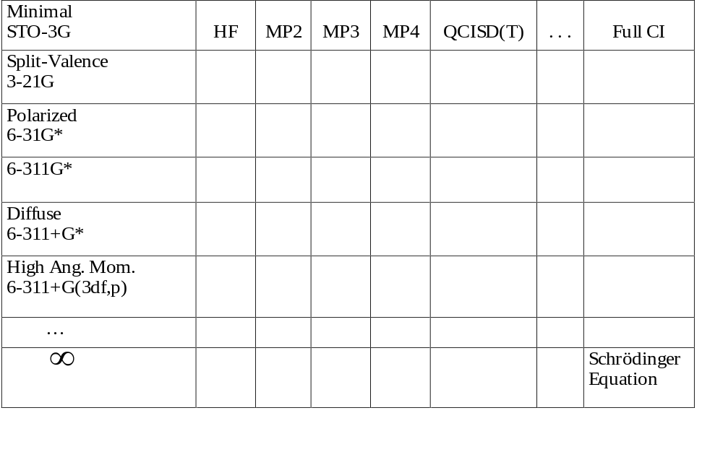
Model Chart
Basis

Slide 4
Model Chemistries
A theoretical model chemistry is a complete algorithm for the calculation of the energy of any molecular system.
It cannot involve subjective decisions in its application.
It must be size consistent so that the energy of every molecular species is uniquely defined.
A simple model chemistry employs a single theoretical method and basis set.
A compound model chemistry combines several theoretical methods and basis sets to achieve higher accuracy at lower cost.
A model chemistry is useful if for some class of molecules it is the most accurate calculation we can afford to do.

Slide 5
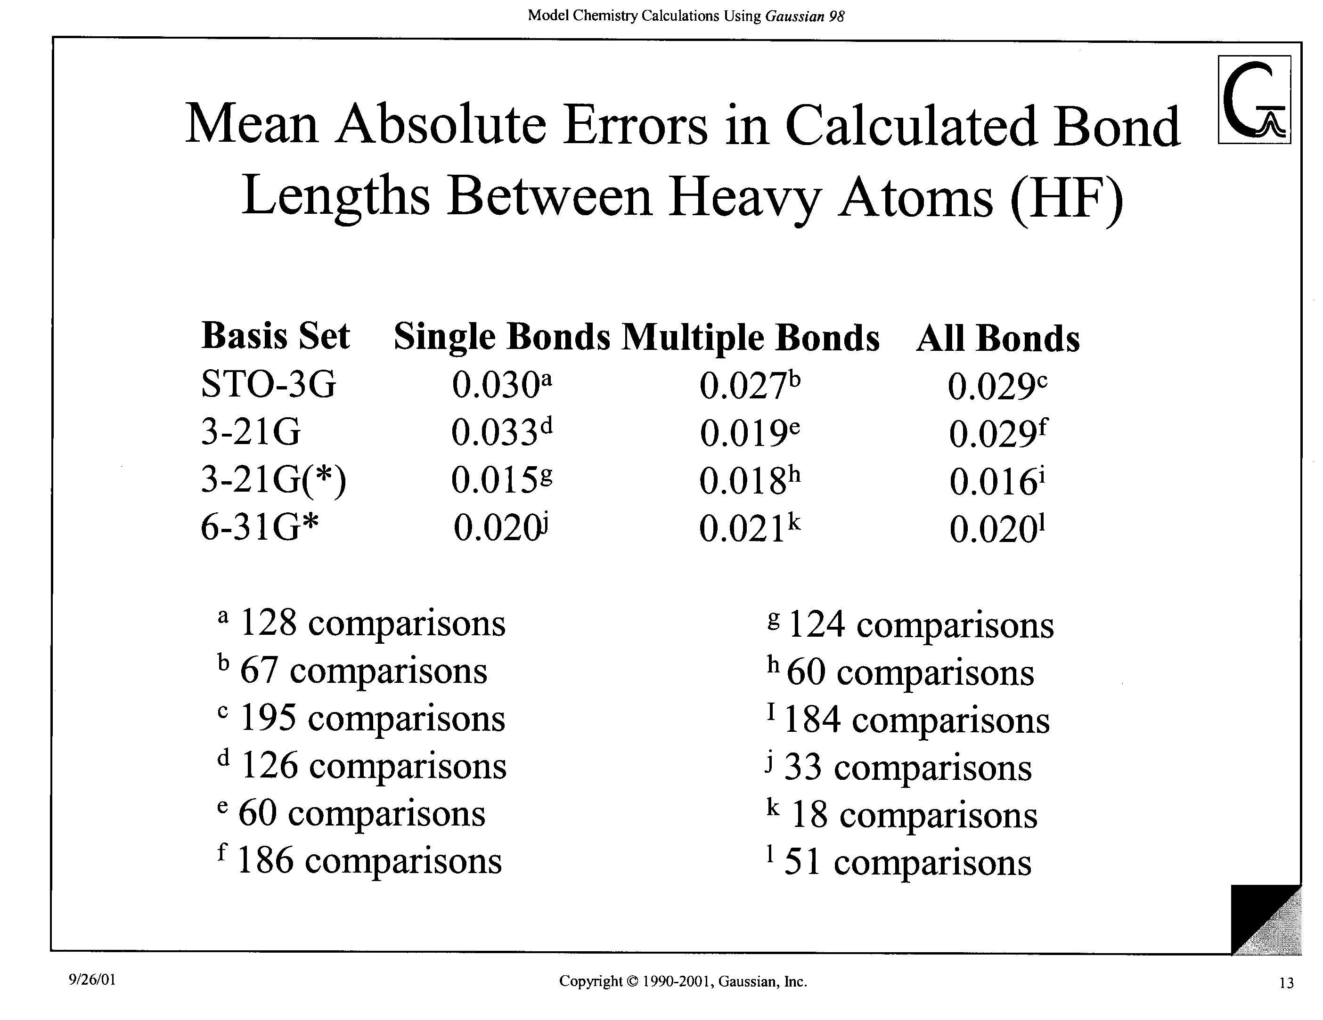

Slide 6
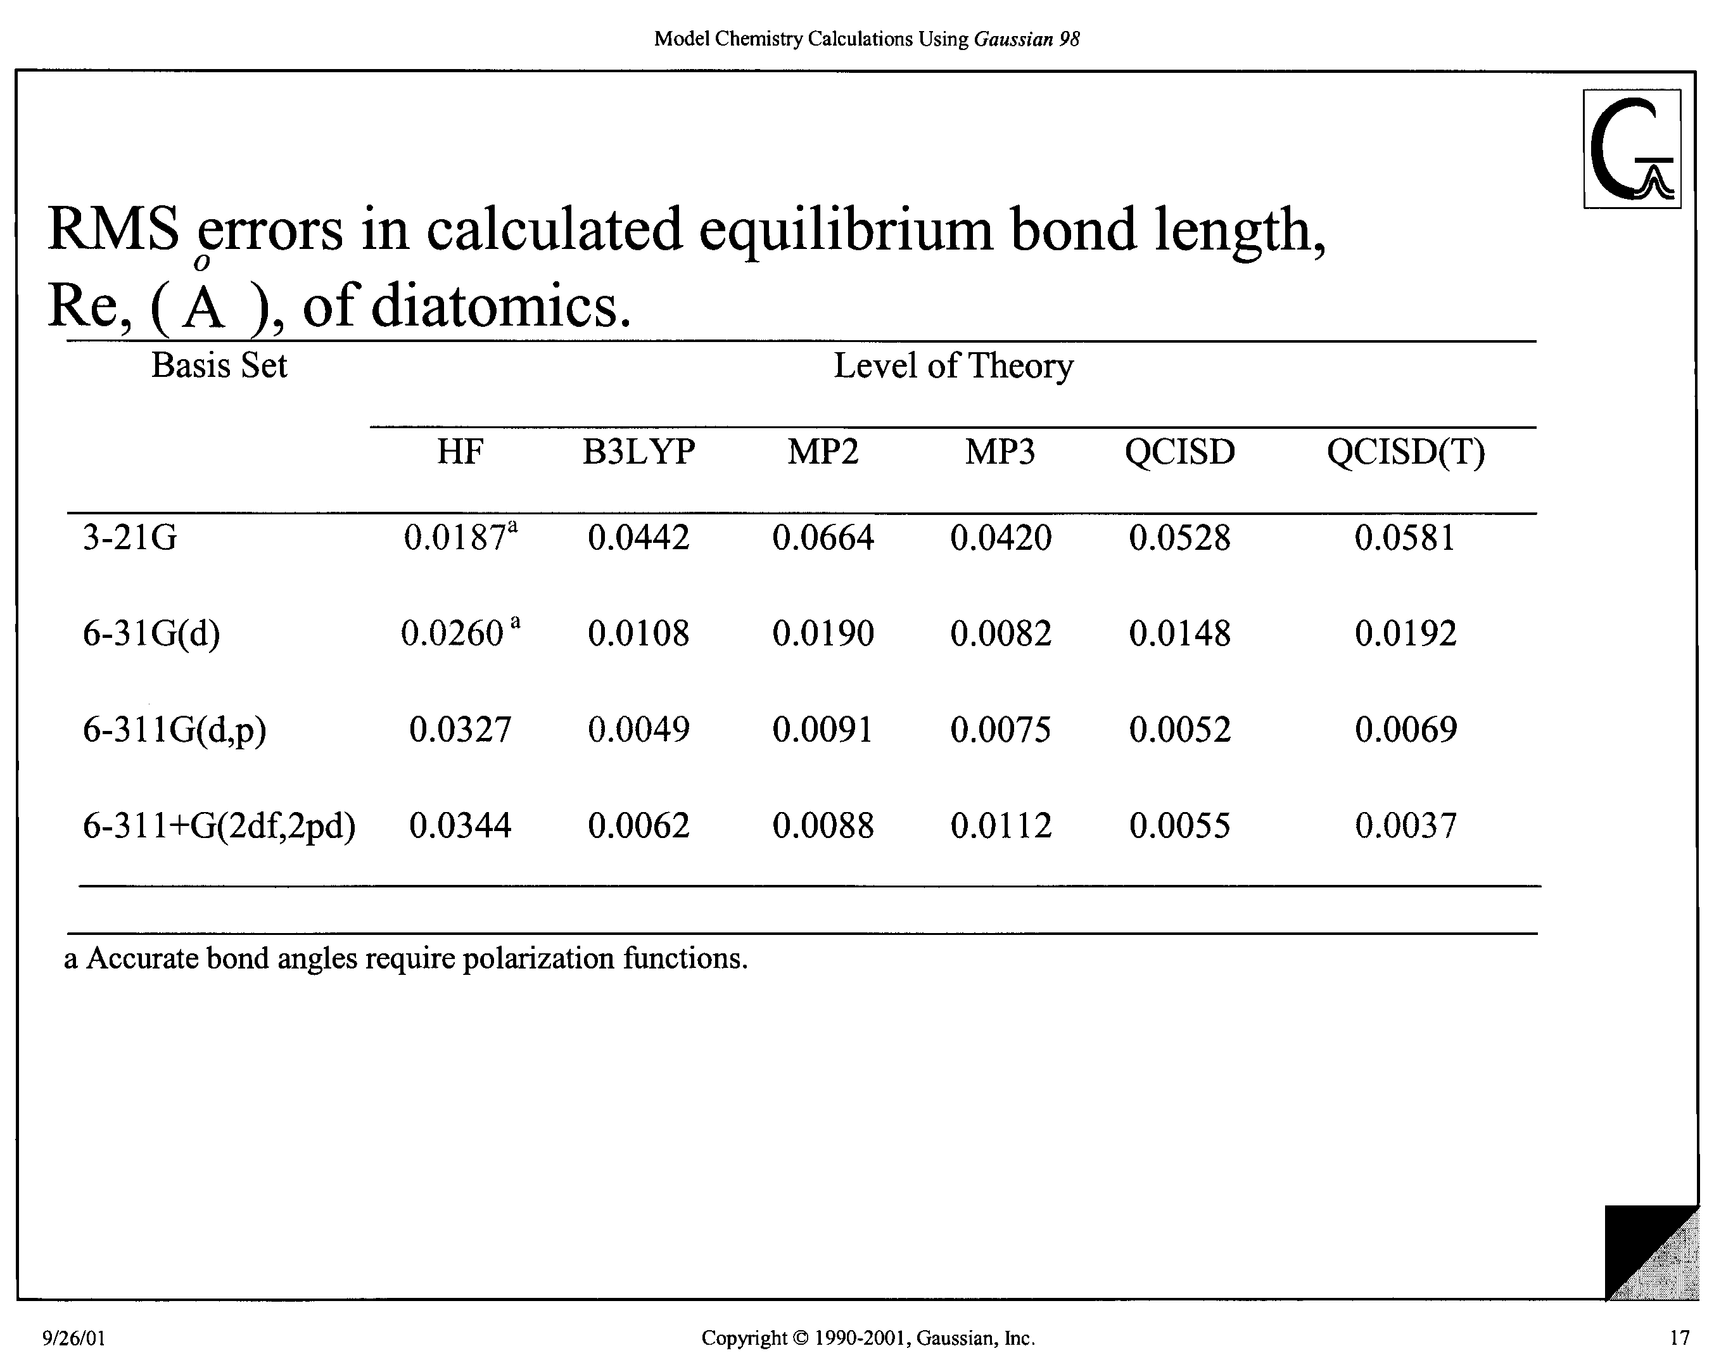

Slide 7
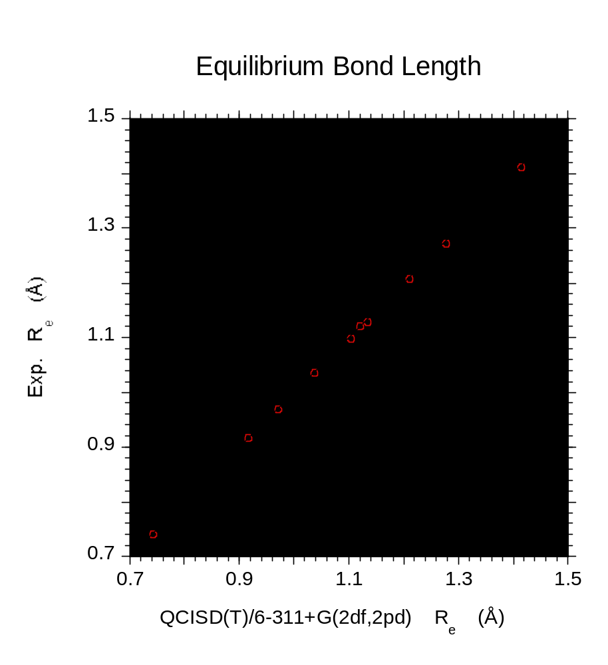

Slide 8
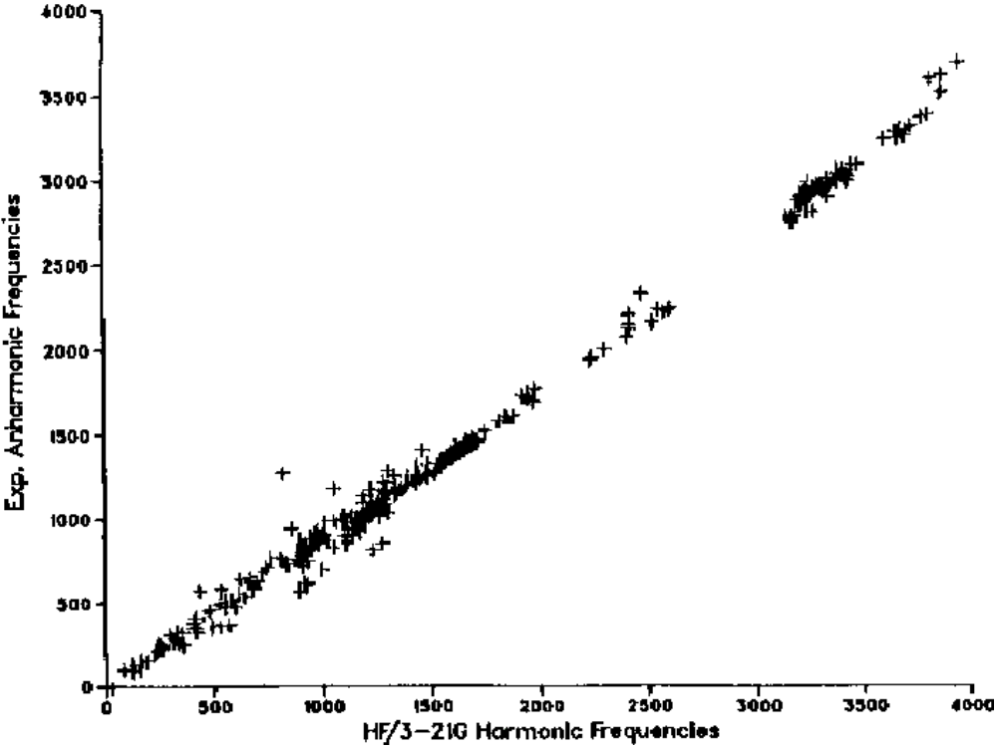

Slide 9
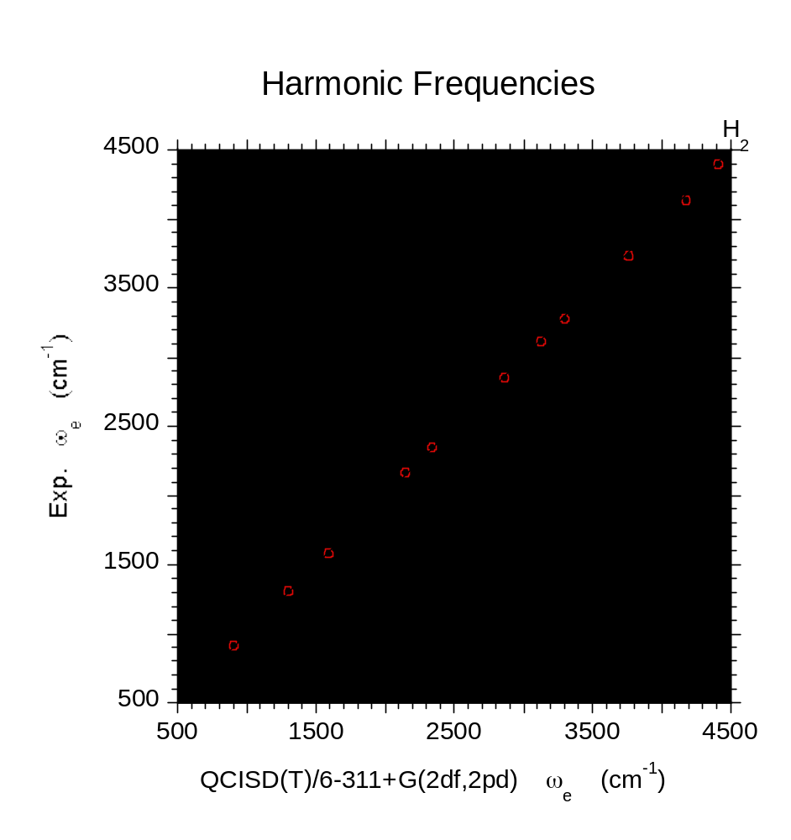

Slide 10
Development of a
Model Chemistry
Set targets
  accuracy goals
  cost/size goals
  validation data set
Define and implement methods
  Specify level of theory for geometry optimization, electronic energy, vibrational zero point energy
Test model on validation data set

Slide 11
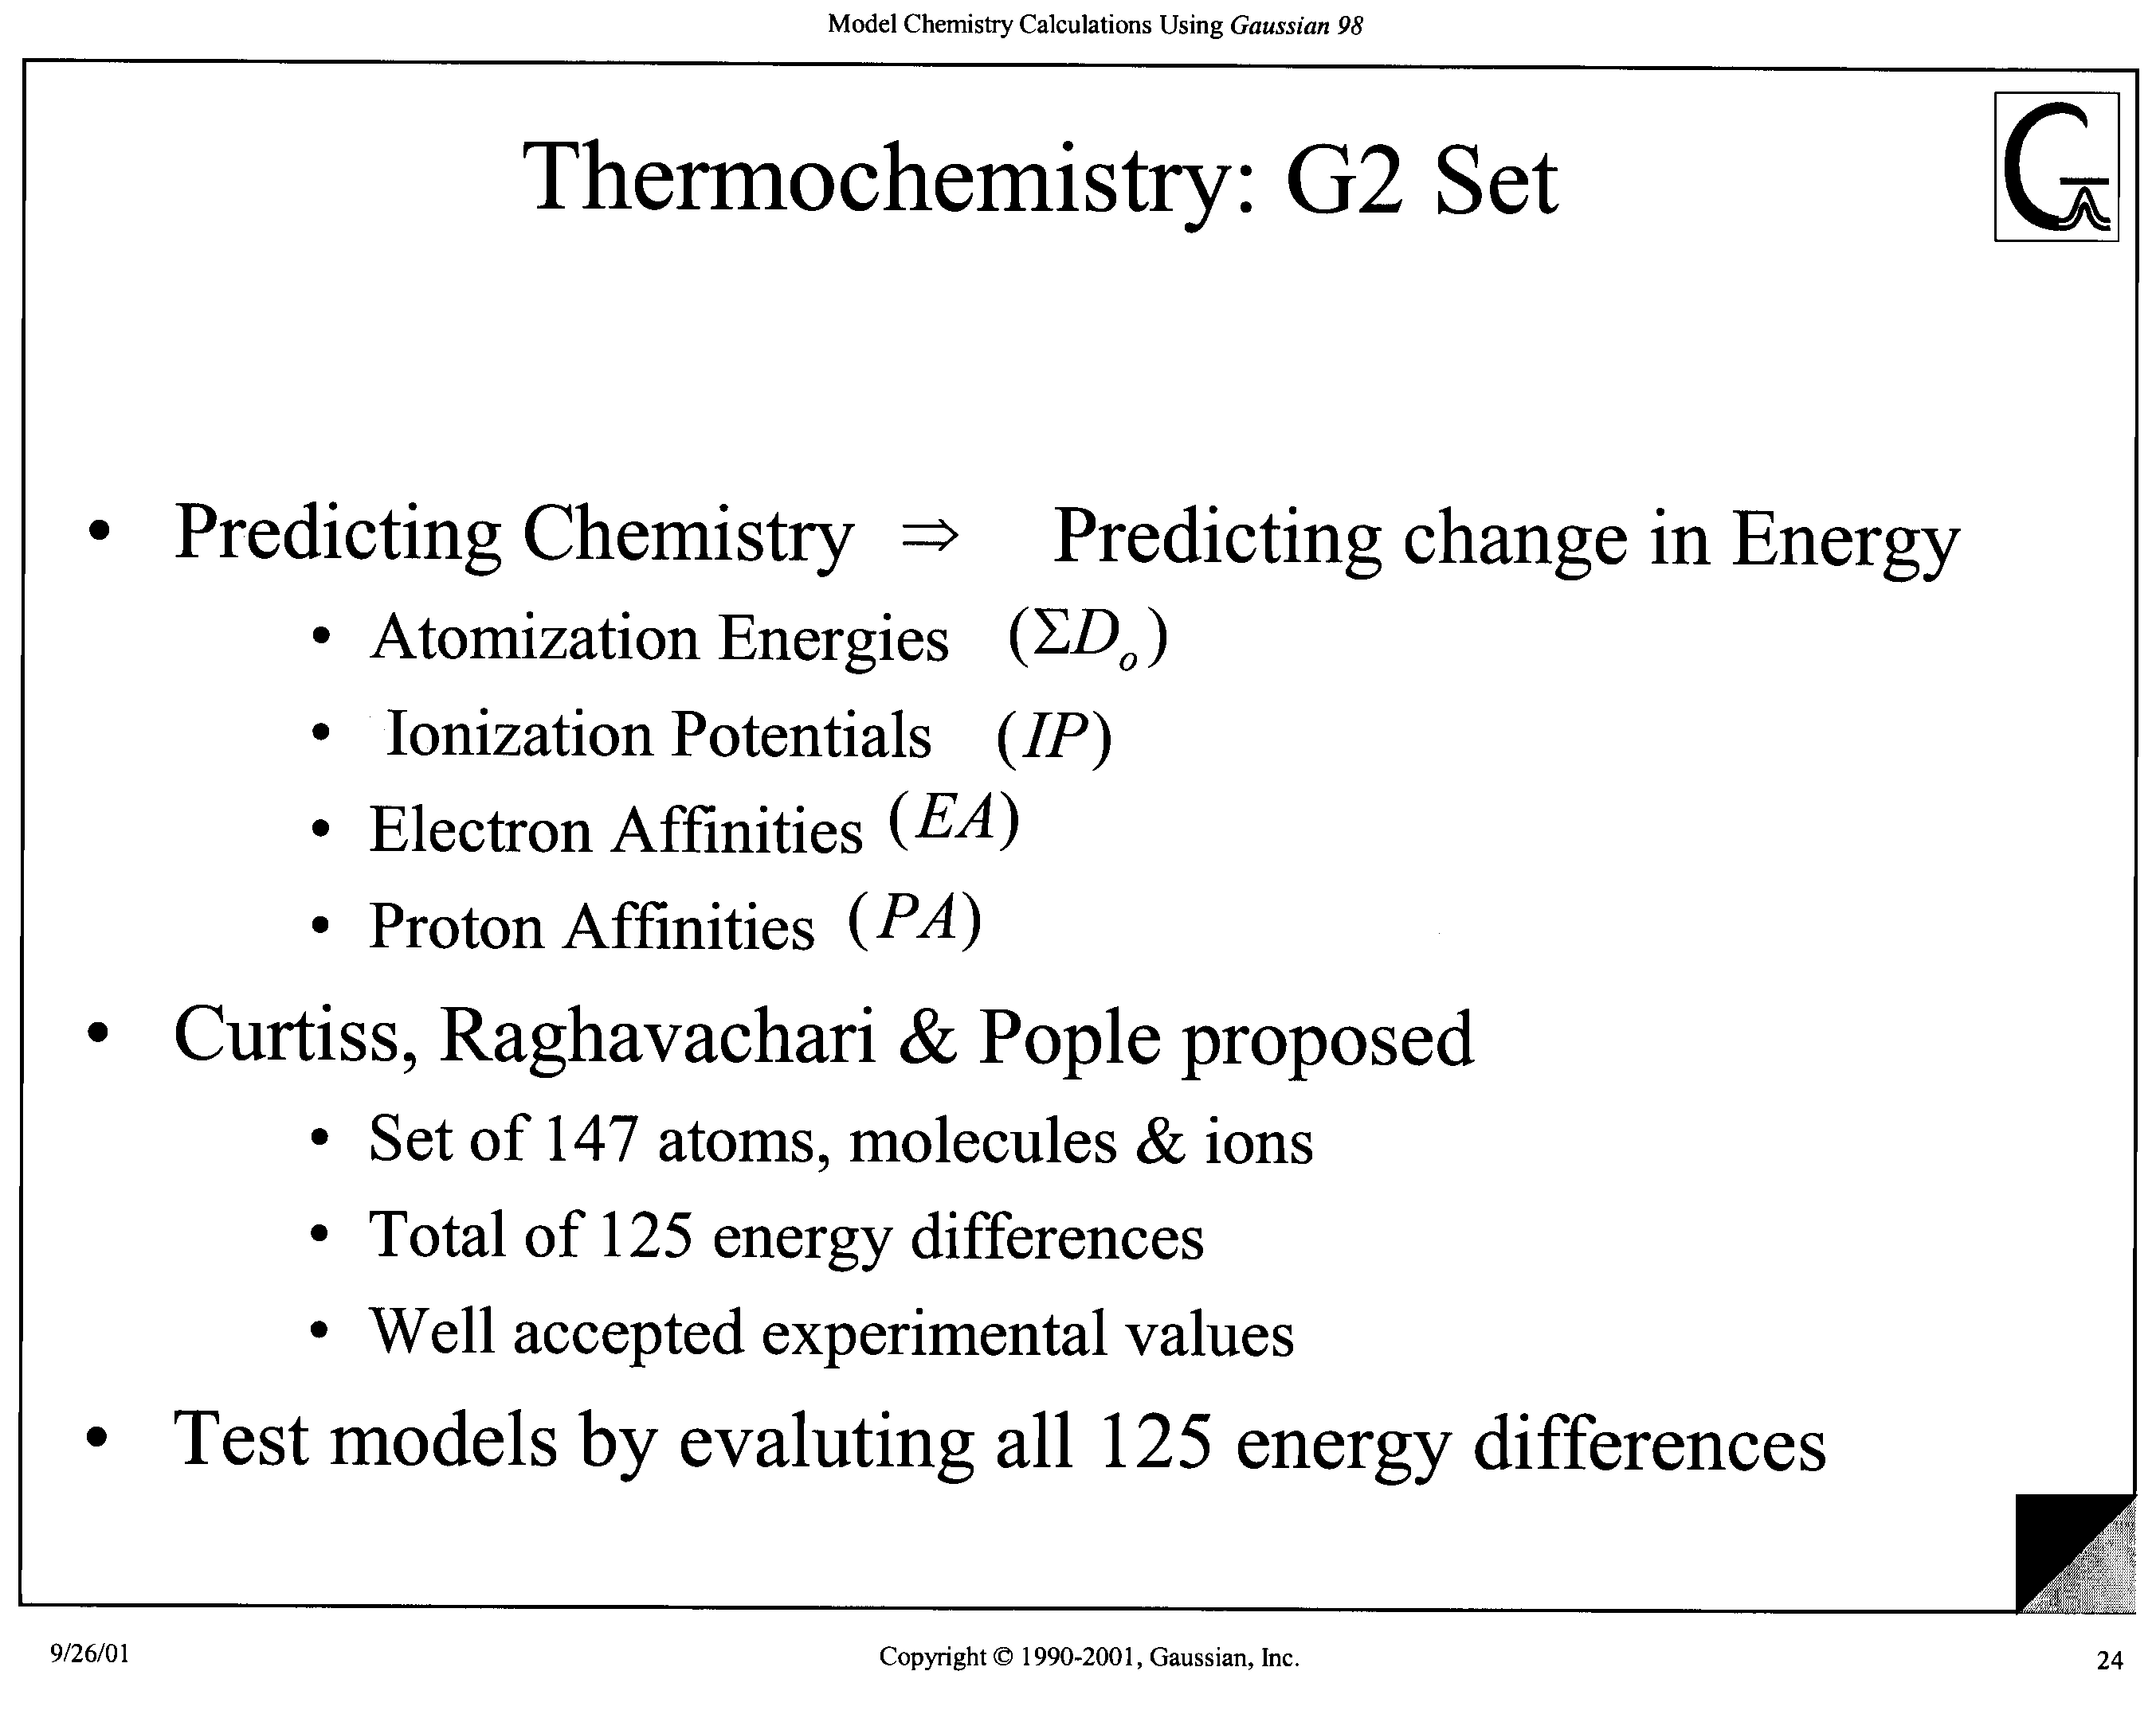

Slide 12
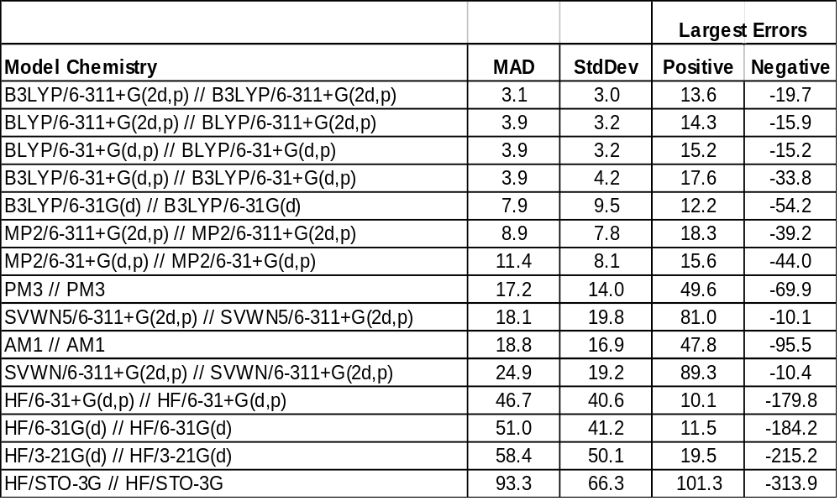
Evaluating Model Chemistries
(Page 147 in Exploring Chemistry)

Slide 13
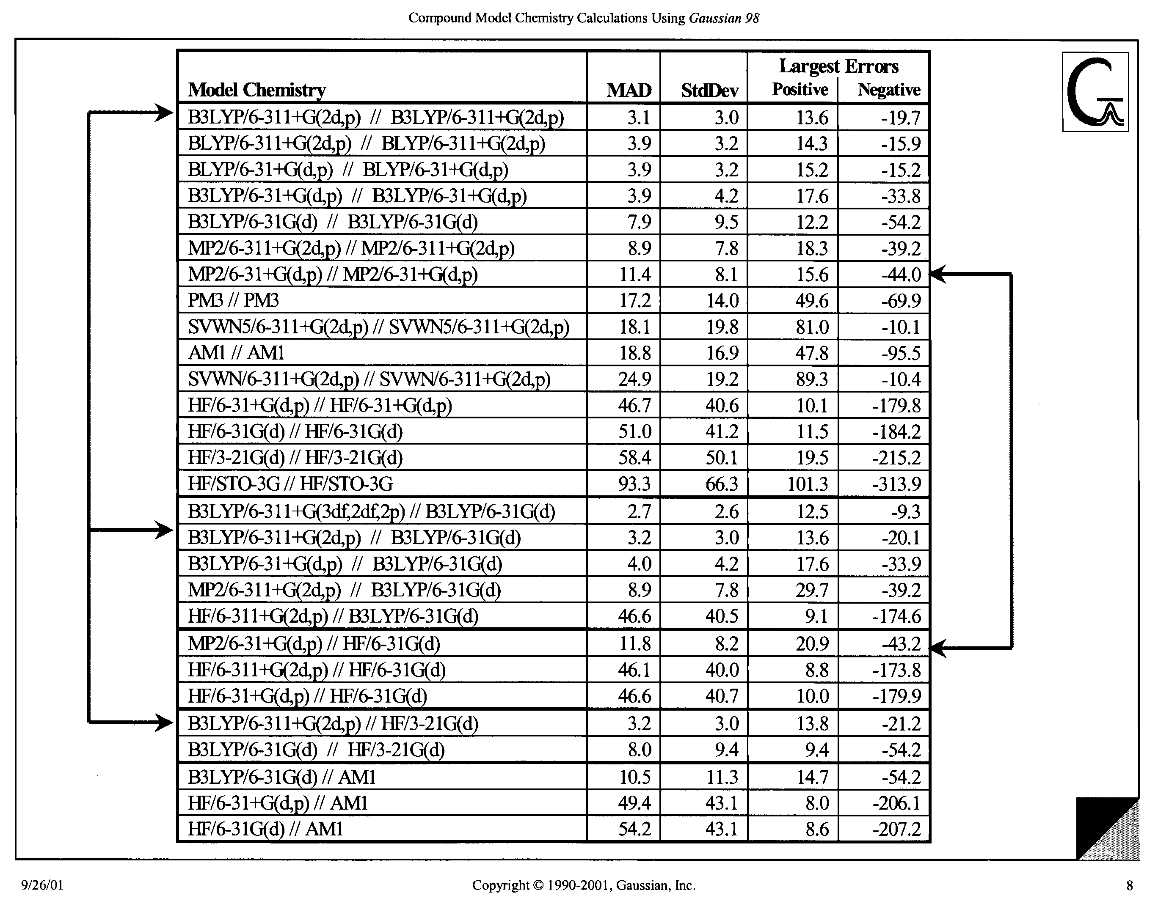

Slide 14
Compound Model Chemistries:
G2 and G2(MP2)
Proposed by J. Pople and co-workers
Goal: Atomization energies to 2 kcal/mol
Strategy: Approximate QCISD(T)/6-311+G(3df,p) by assuming that basis set and correlation corrections are additive
Mean absolute error of 1.21 kcal/mol in 125 comparisons

Slide 15
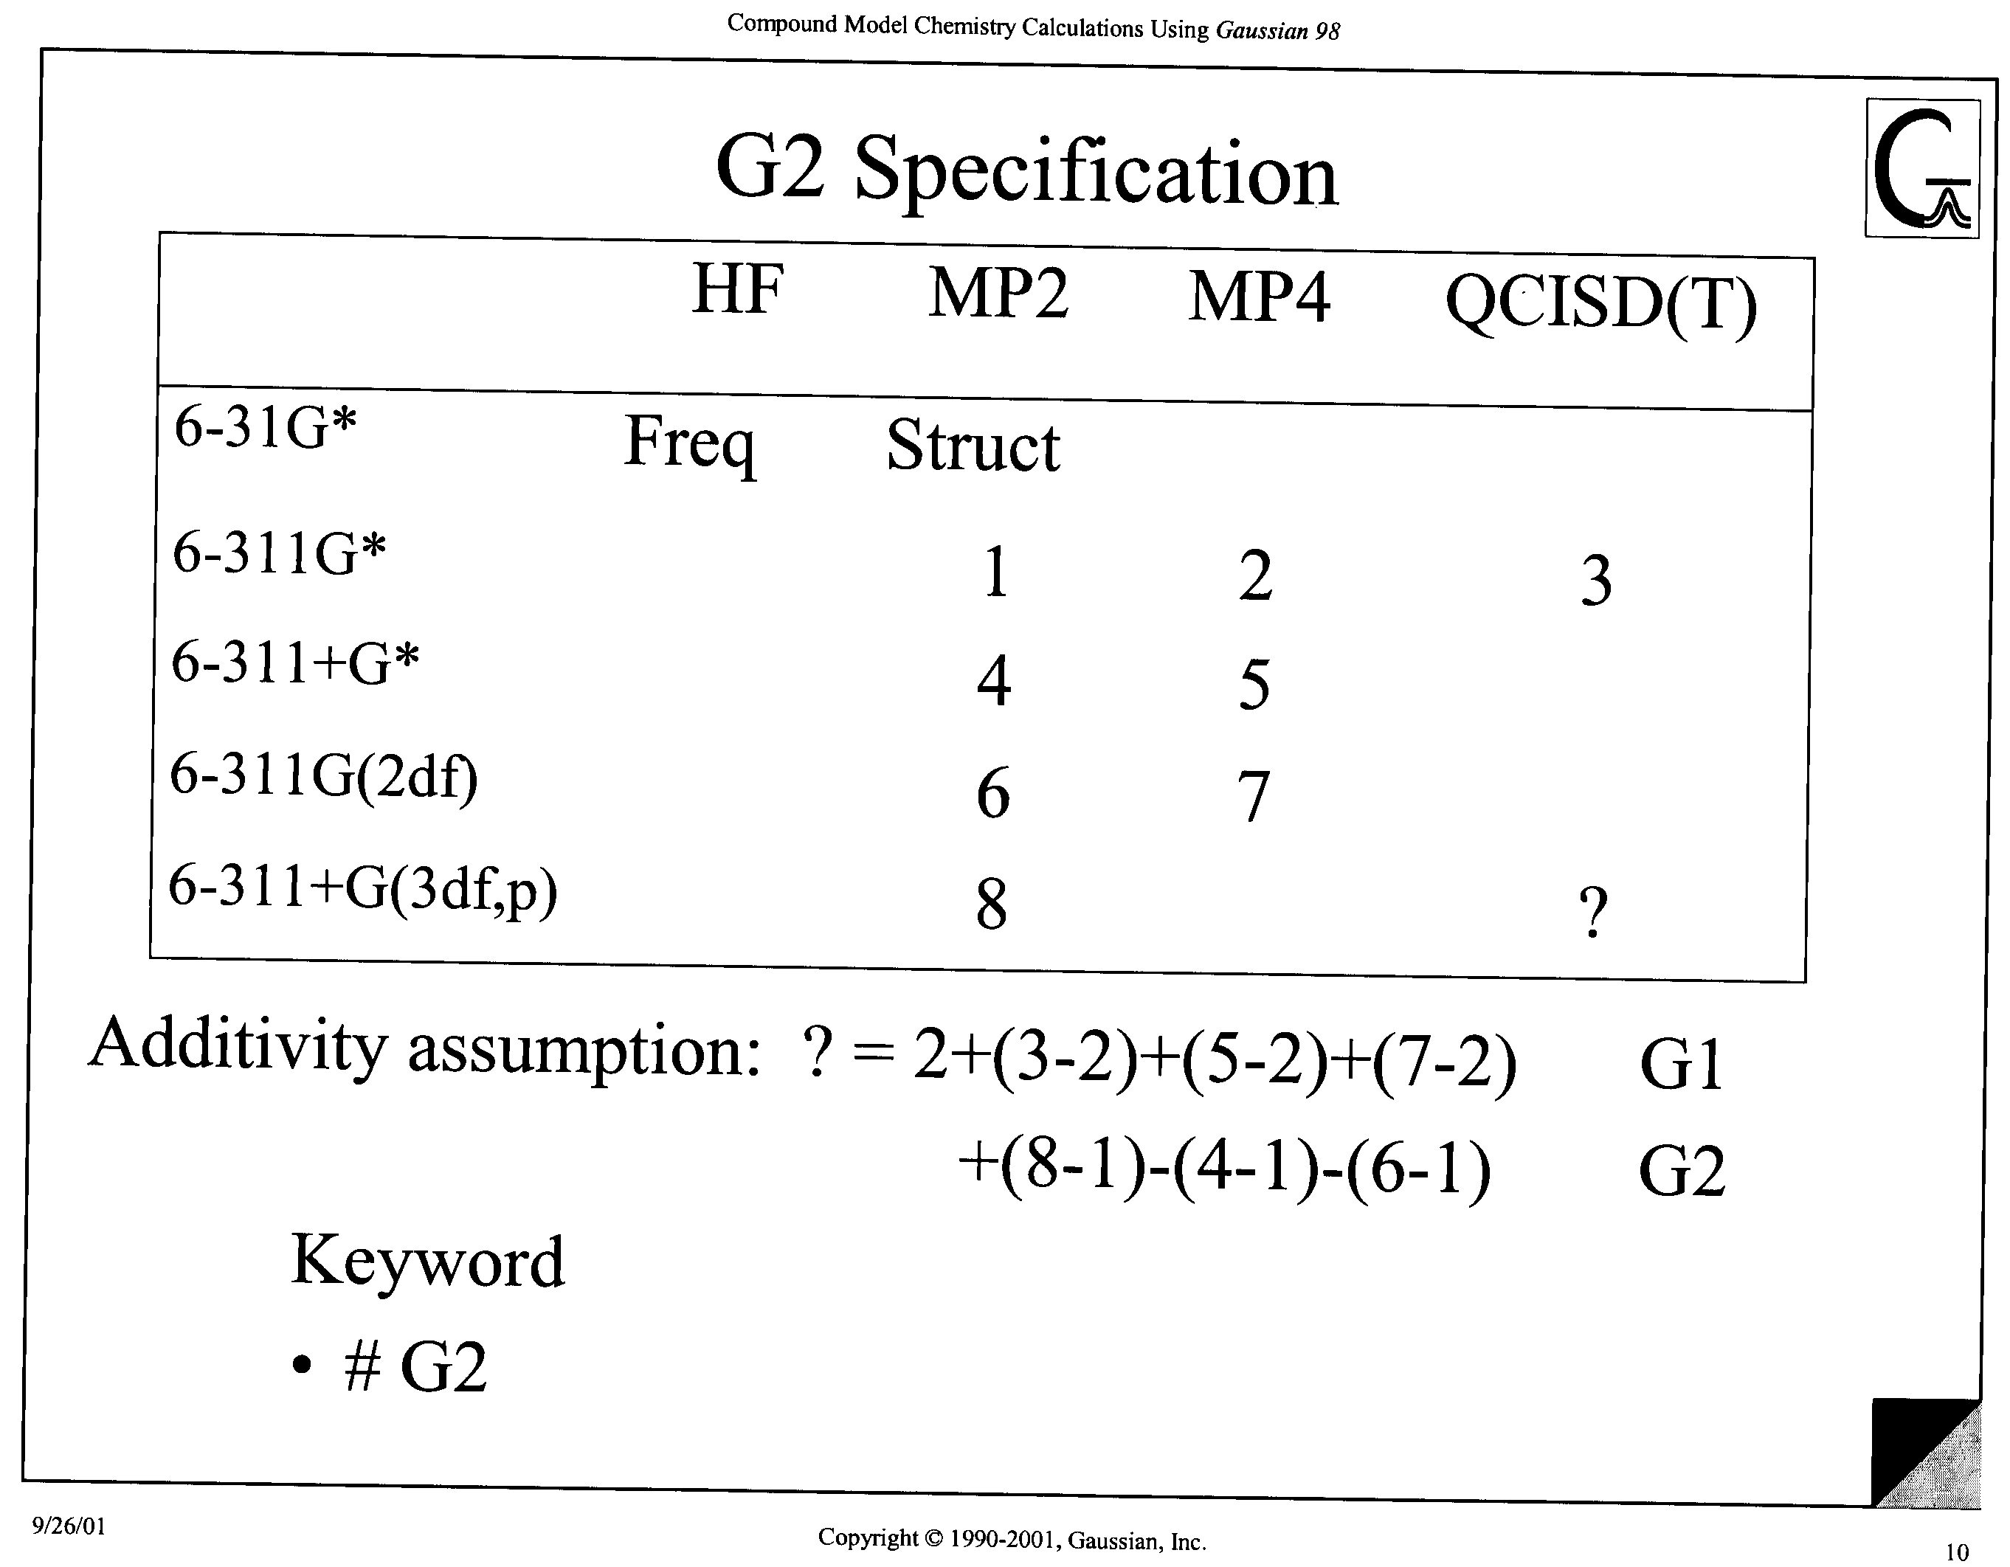

Slide 16
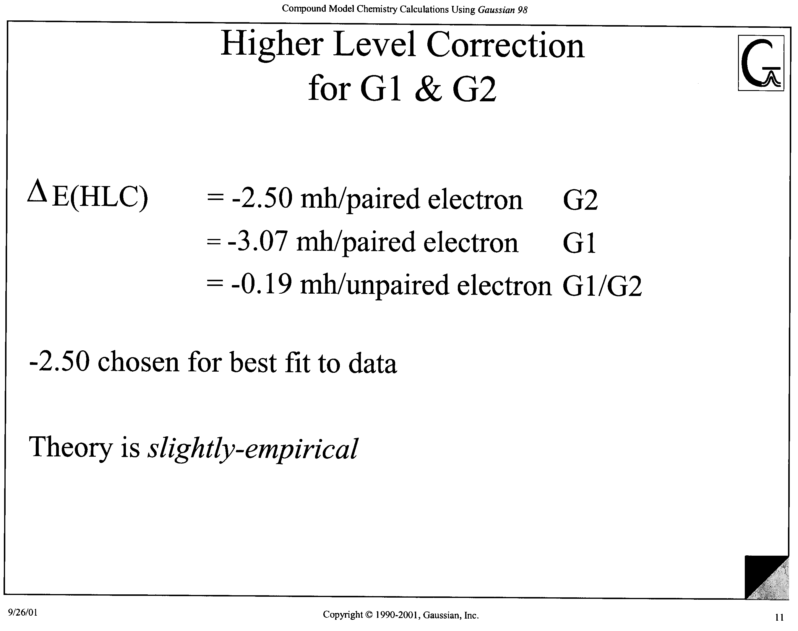

Slide 17
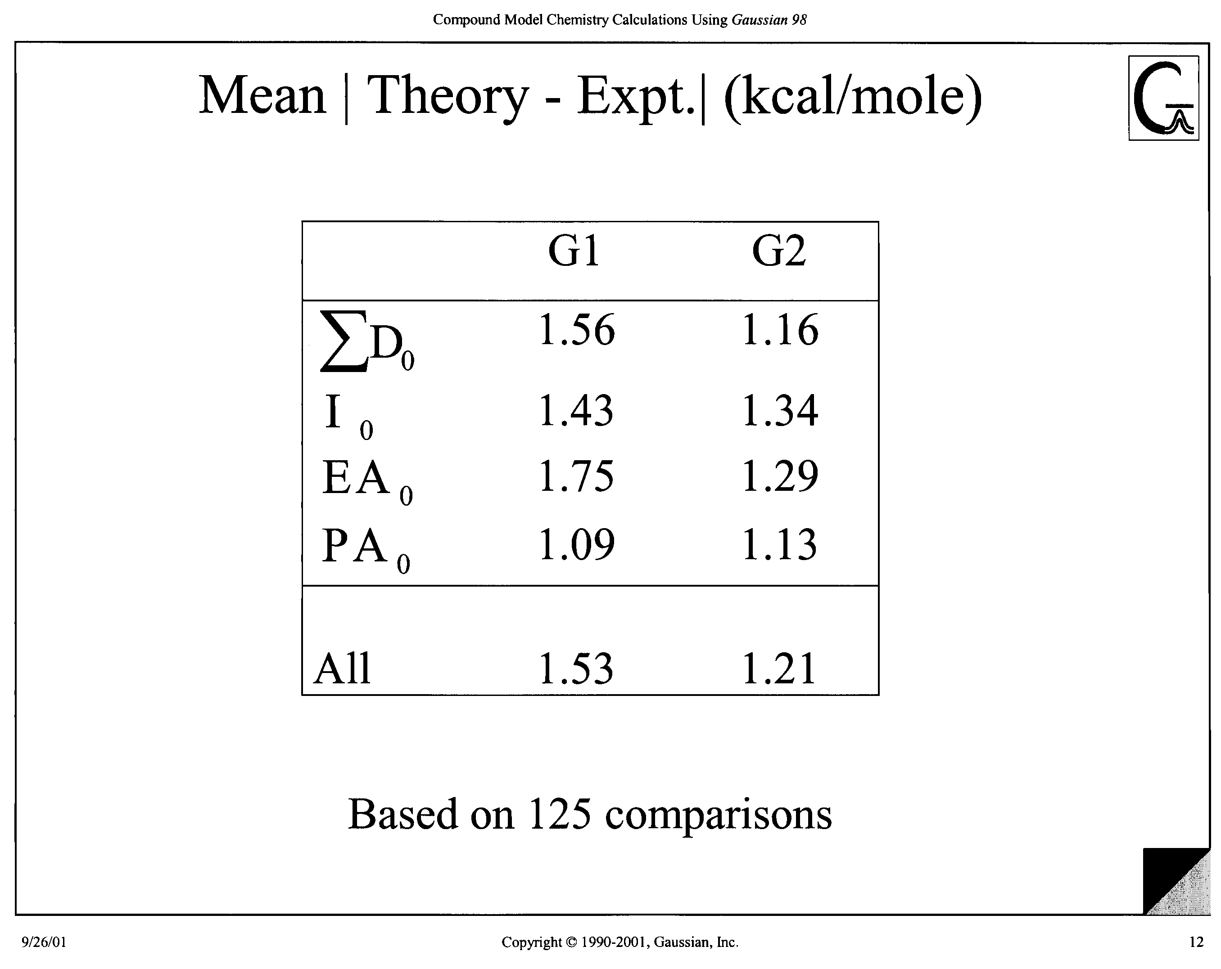

Slide 18
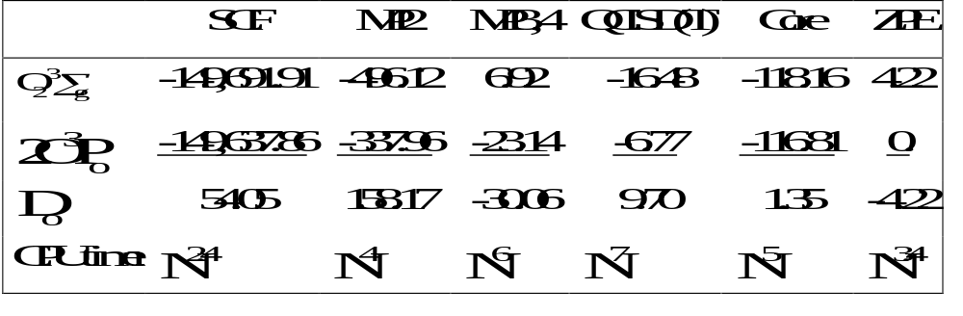
REQUIRED ACCURACY FOR CHEMISTRY
Components of the calculated dissociation energy (mEh) for 0₂.
For 1 millihartree accuracy:
Need SCF energy to six figures
MP2 Contribution to three figures
Higher order correlation to two figures
Core and ZPE contribution to one figure
*Octerski, Joseph W., G.A. Petersson, and J.A. Montgomery, “A complete basis set
model chemistry. V. Extensions to six or more heavy atoms”, J.Chem. Phys., 104,2598, (1996).

Slide 19
Cost-Effective Models
Small basis set, low-order geometry and ZPE
Large SCF basis set
  Medium MP2 basis set
  Small MP3, MP4(SDQ), CCSD(T) basis sets
    Cancellation of errors in 3-body effects (CBS-4)
CBS2 extrapolation of MP2 energy reduces the need for large MP2 basis set
Size consistent empirical corrections

Slide 20
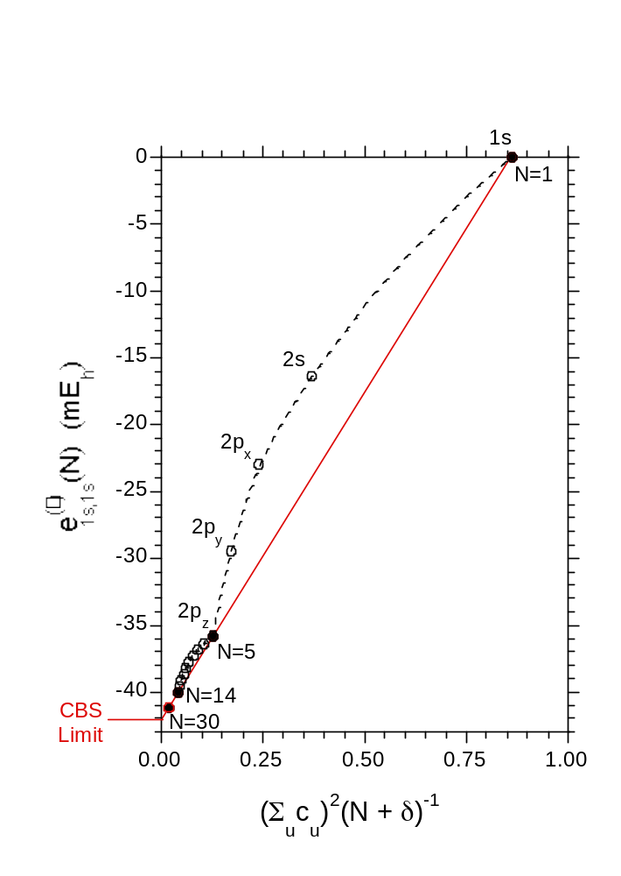

CBS Extrapolation
The slow, N⁻¹, convergence of the correlation energy vs the one-electron basis set expansion is the result of the universal cusp in wave functions as interelectronic distances, .
Thus, we can reasonably expect the N⁻¹ form to also be universal.

Slide 21
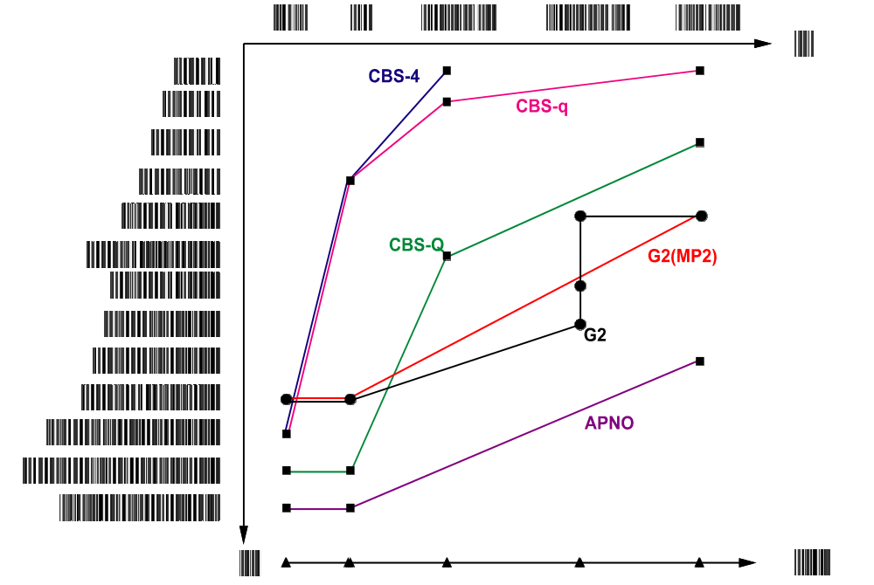
SCF MP2 MP4(SDQ) MP4(SDTQ) QCISD(T)
FCI
6-31G
631G†
6-31+G†
6-31+G††
6-311G(d,p)
6-31+G(d(f),d,p)
6-311+G(d,p)
6-311G(2df,p)
6-311+G(2df,p)
6-311+G(3df,2p)
6-311+G(3d2f,2df,p)
6-311++G(3d2f,2df,2p)
[6s6p3d2f,4s2p1d]
CBS
Exact

Slide 22
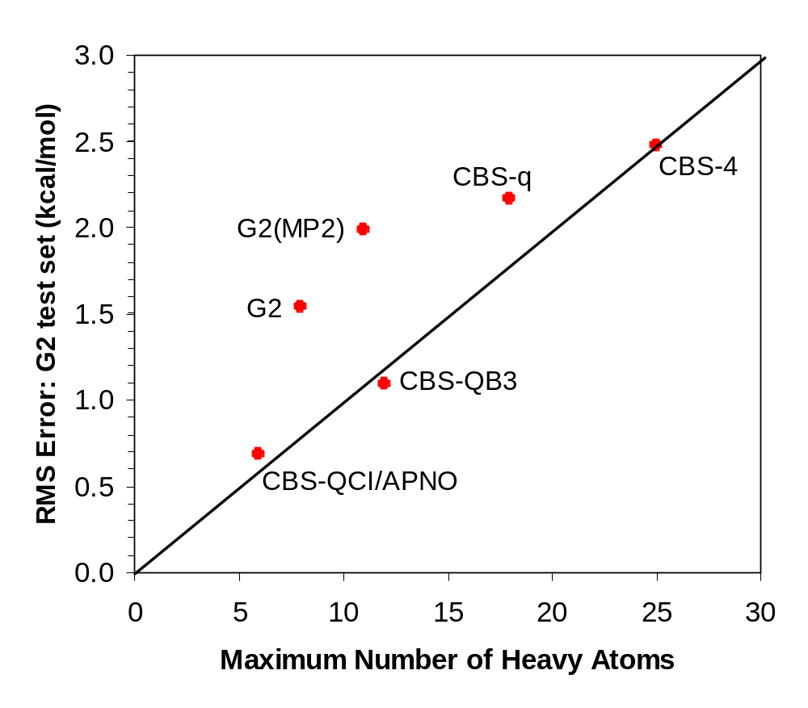

Slide 23
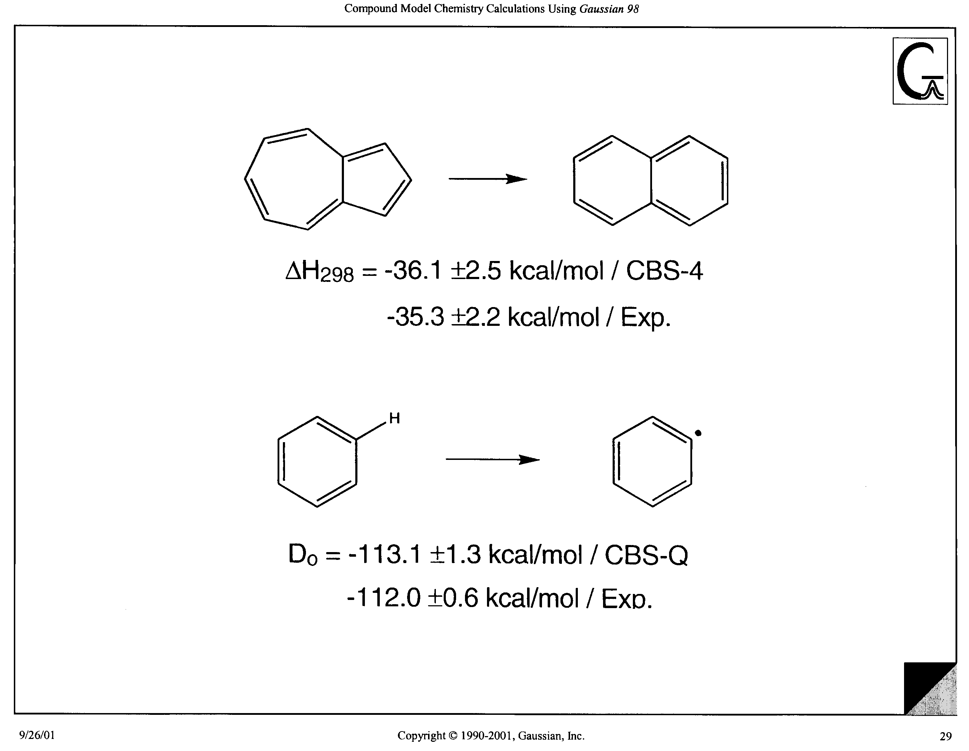

Slide 24
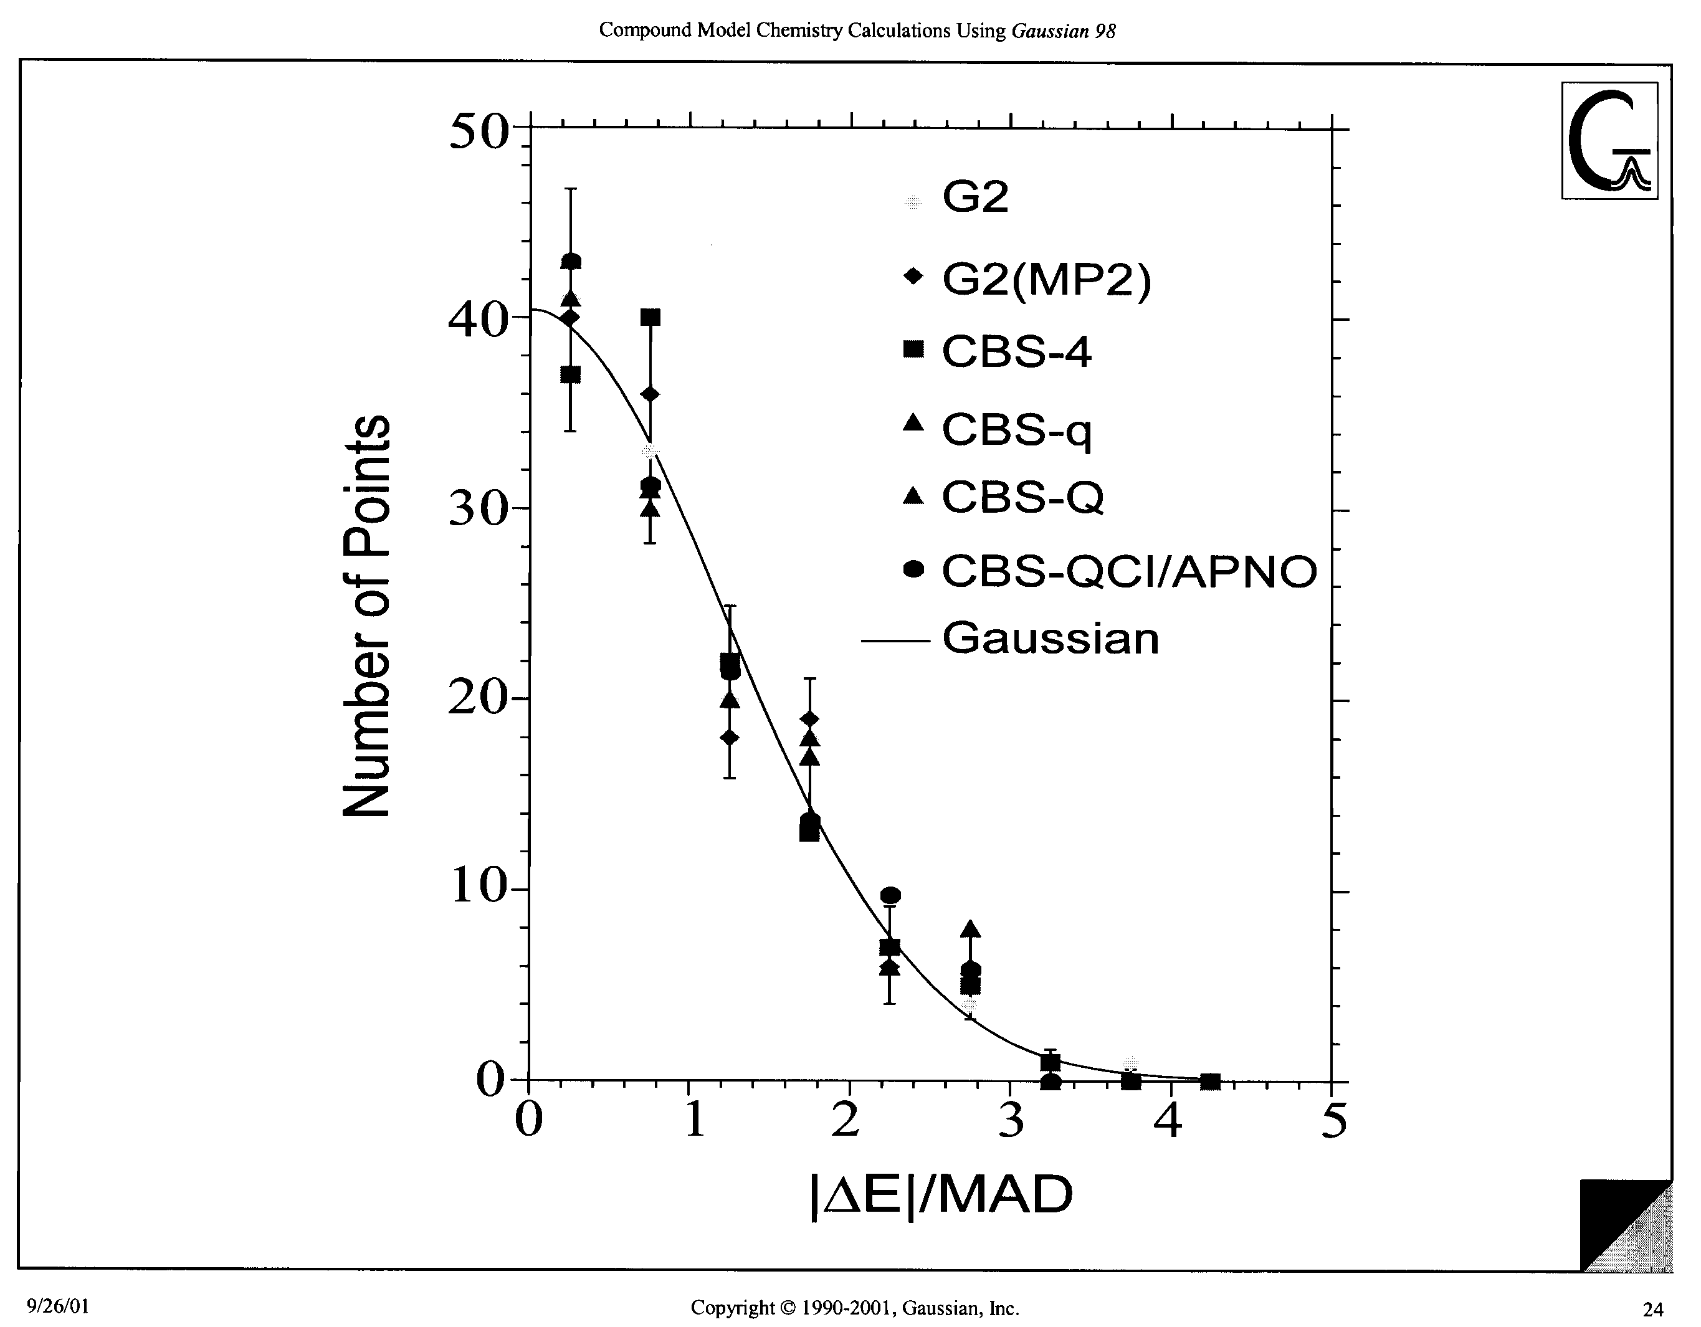

Slide 25
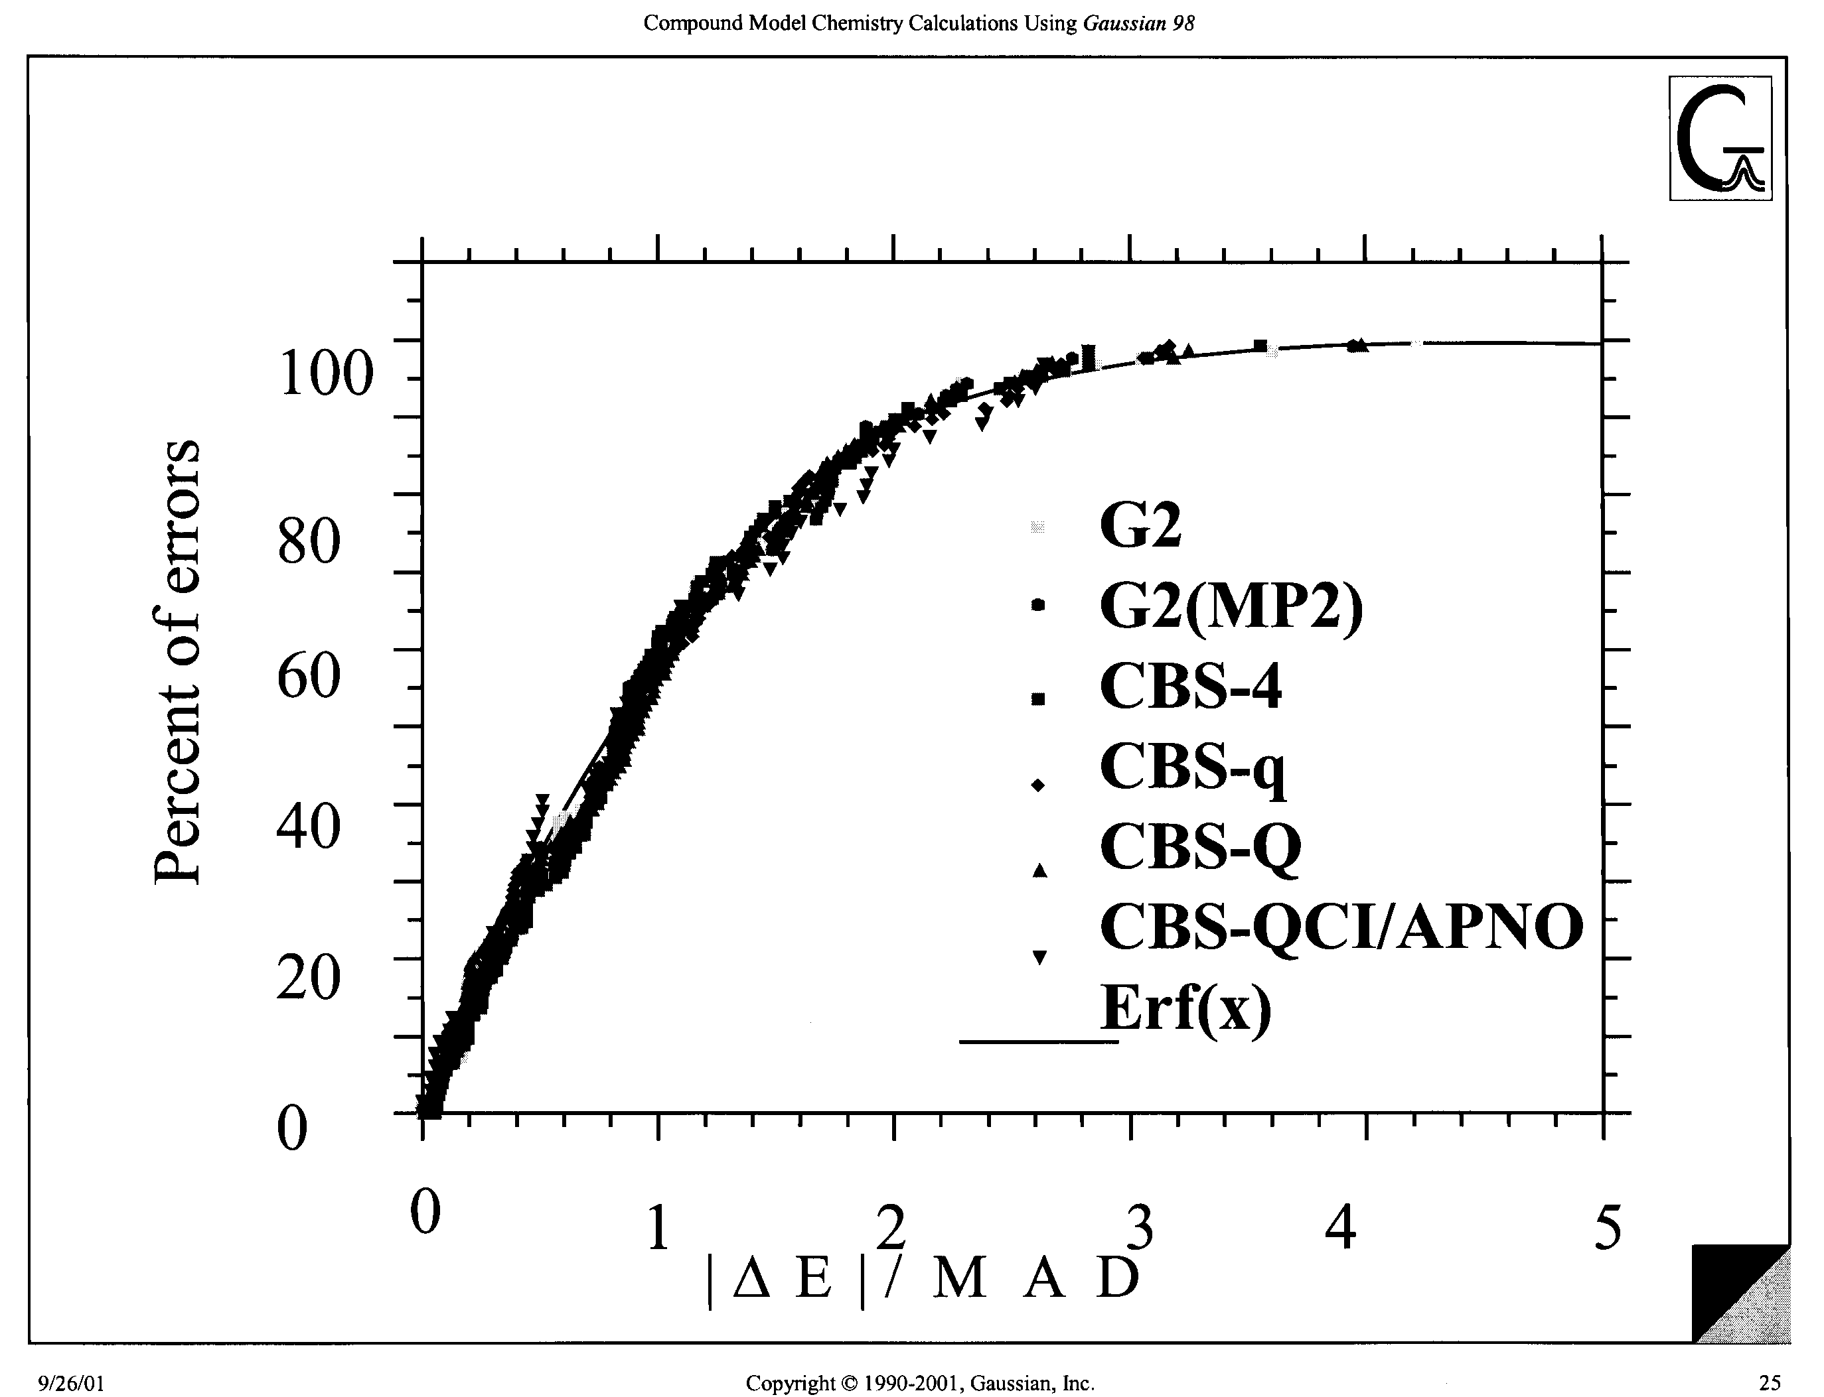

Slide 26
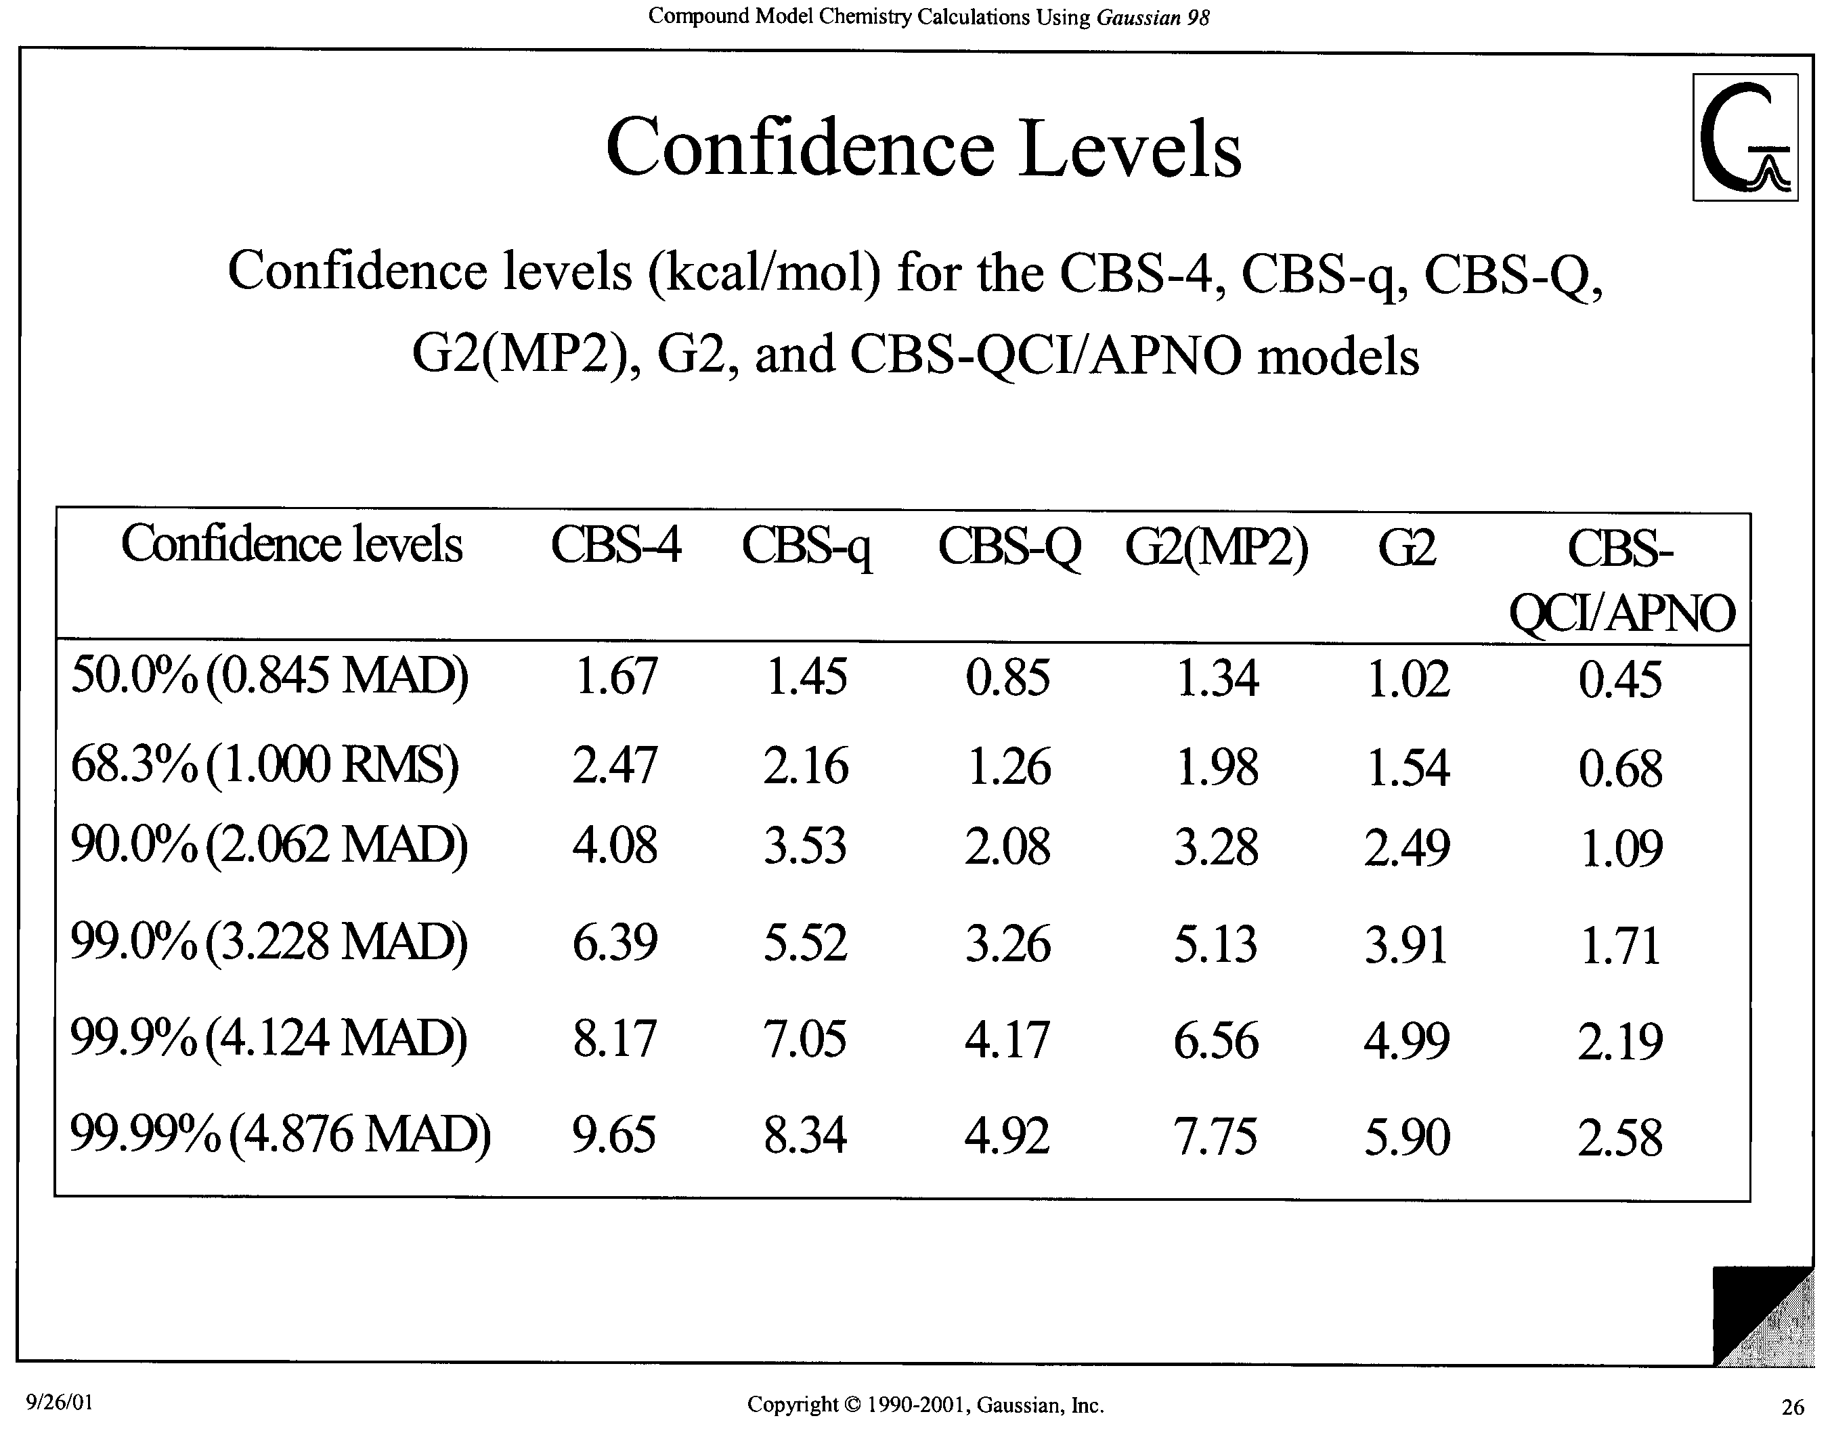

Slide 27
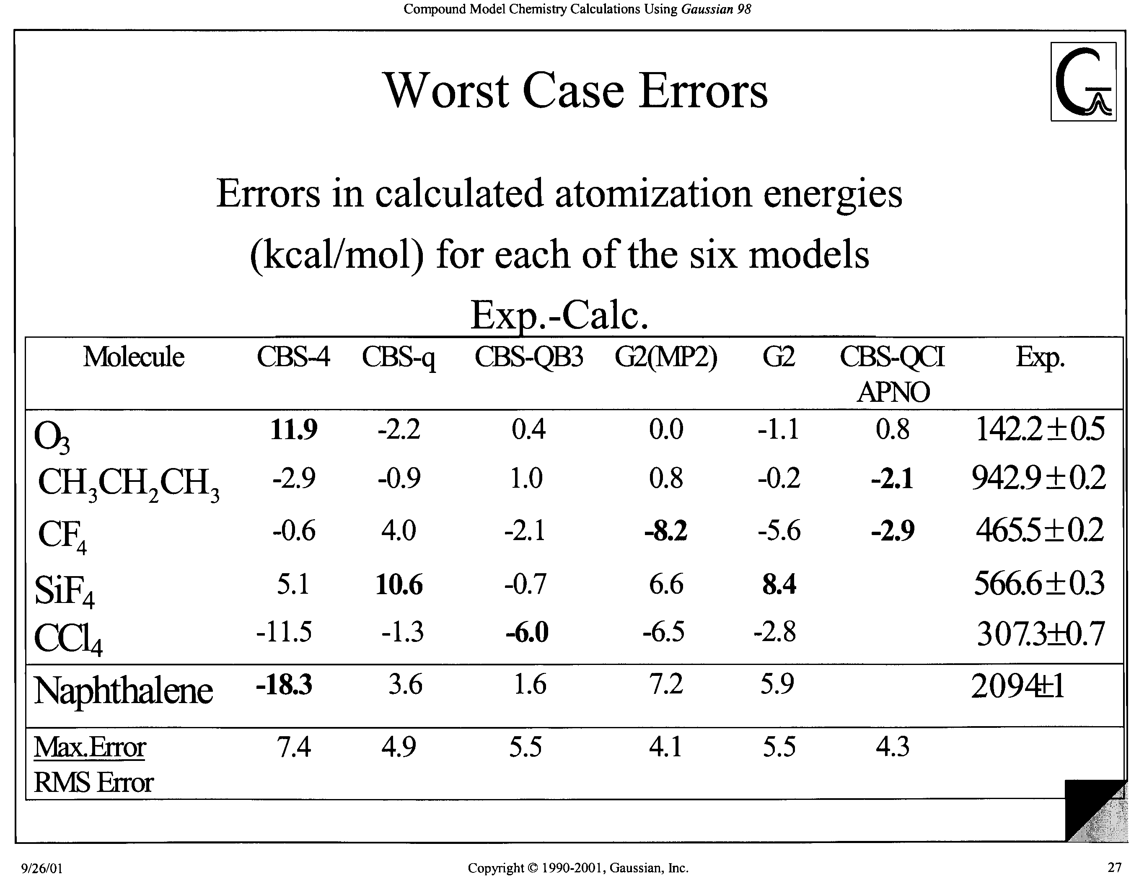

Slide 28
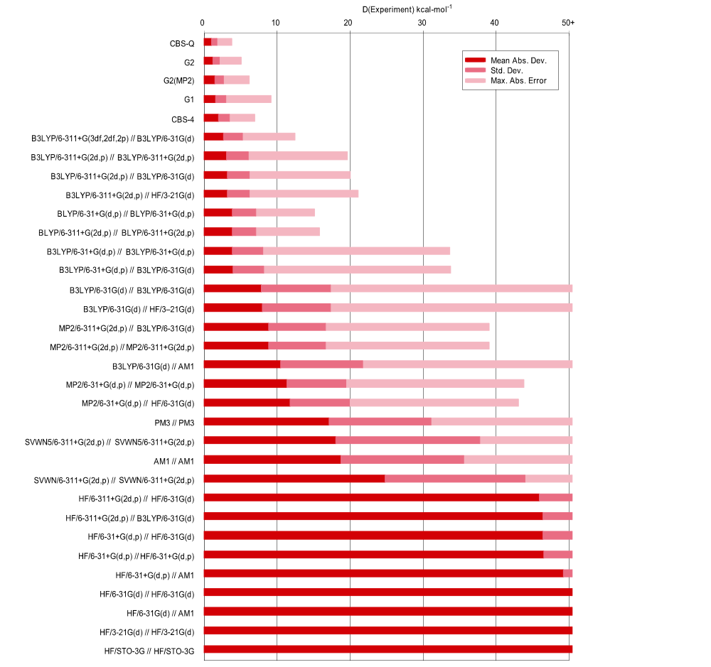

Slide 29
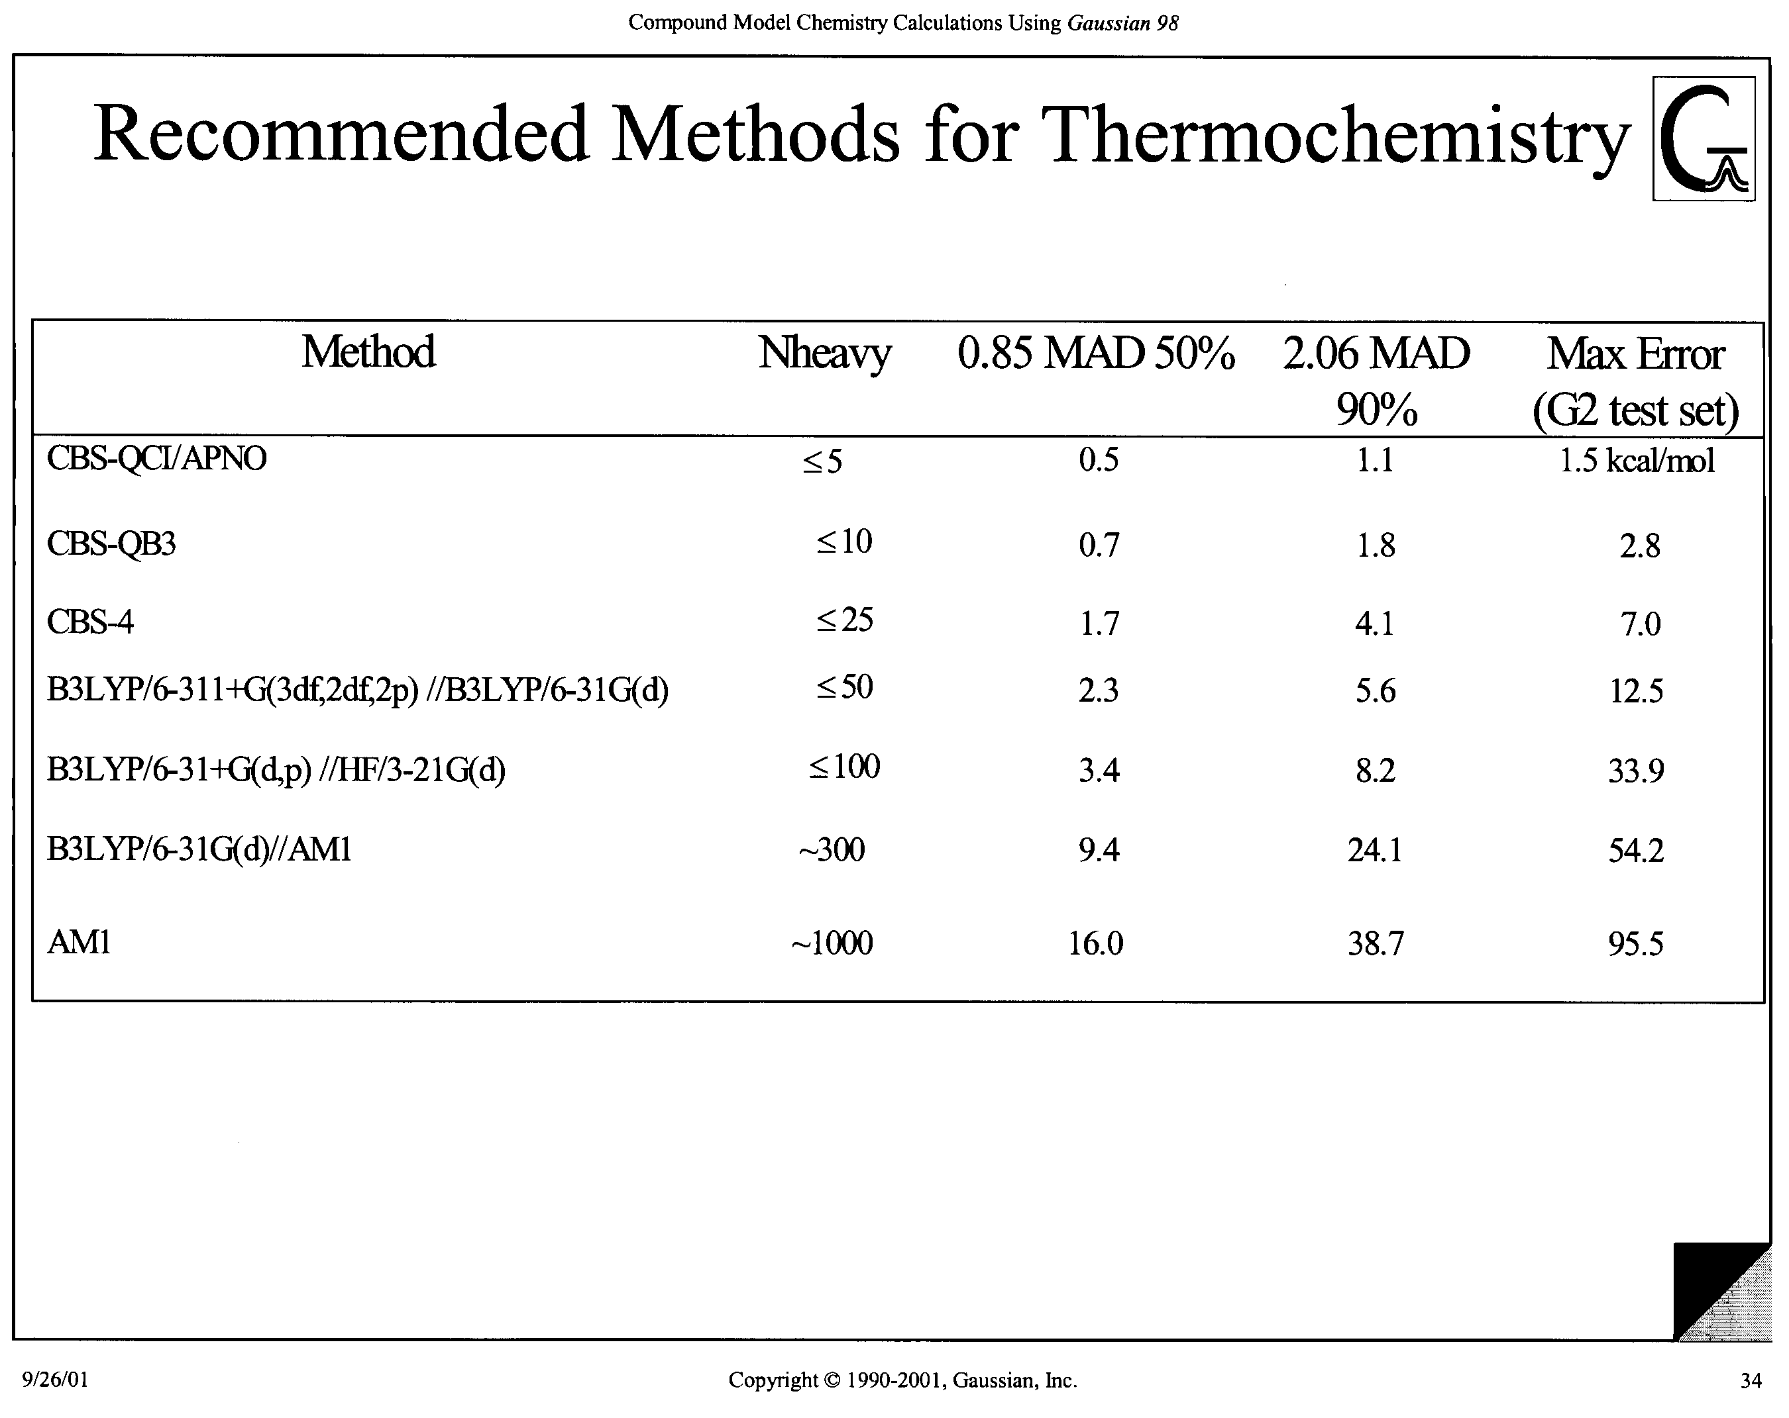

Slide 30
Compound Model Chemistries:
Thermochemistry
The CBS-QCI/APNO model shows the best performance with this test set of any general theoretical model proposed to date, with a mean absolute deviation (MAD) from experiment of 0.53 kcal/mol. Of the models defined for both the first-and second-row elements, the CBS-QB3 model gives the greatest accuracy (MAD=0.87 kcal/mol), followed by G2 theory (MAD=1.21 kcal/mol), G2(MP2) theory (MAD=1.59 kcal/mol), the CBS-q model (MAD=1.71 kcal/mol) and finally, the CBS-4 model (MAD=1.98 kcal/mol). All are at or under the accuracy of ~2 kcal/mole required for meaningful thermochemical predictions.

