Slide 1
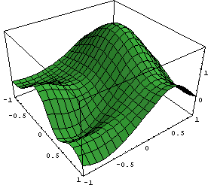
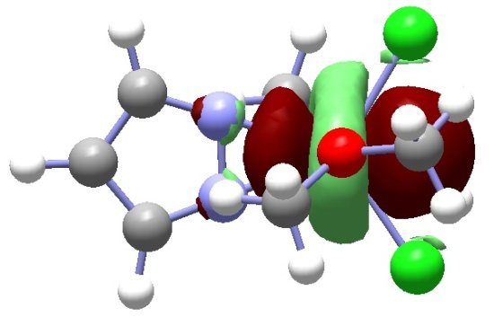
Chemistry 6440 / 7440
Electron Correlation Effects
Notes:
Undergrads should be registered for CHM6440, grads for CHM7440
If you are not registered for the correct course, please change it today

Slide 2
Resources
Cramer, Chapter 7
Jensen, Chapter 4
Foresman and Frisch, Exploring Chemistry with Electronic Structure Methods, Chapter 6

Slide 3
Electron Correlation Energy
in the Hartree-Fock approximation, each electron sees the average density of all of the other electrons
two electrons cannot be in the same place at the same time
electrons must move two avoid each other,
i.e. their motion must be correlated
for a given basis set, the difference between the exact energy and the Hartree-Fock energy is the correlation energy
ca 20 kcal/mol correlation energy per electron pair

Slide 4
General Approaches
include r₁₂ in the wavefunction
  suitable for very small systems
  too many difficult integrals
  Hylleras wavefunction for helium
expand the wavefunction in a more convenient set of many electron functions
  Hartree-Fock determinant and excited determinants
  very many excited determinants, slow to converge
  configuration interaction (CI)

Slide 5
Goals for Correlated Methods
well defined
  applicable to all molecules with no ad-hoc choices
  can be used to construct model chemistries
efficient
  not restricted to very small systems
variational
  upper limit to the exact energy
size extensive
  E(A+B) = E(A) + E(B)
  needed for proper description of thermochemistry
hierarchy of cost vs. accuracy
  so that calculations can be systematically improved

Slide 6
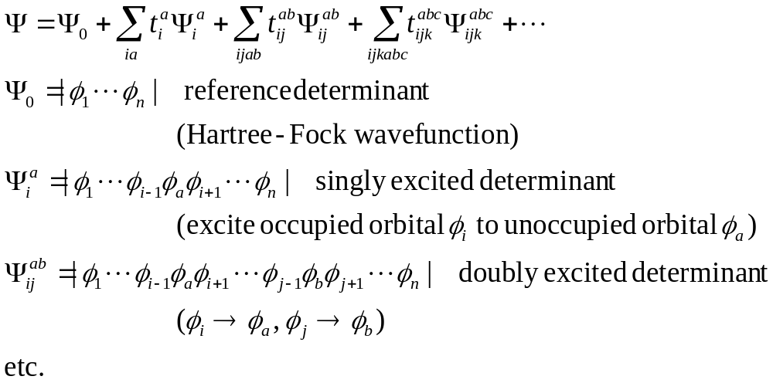
Configuration Interaction

Slide 7
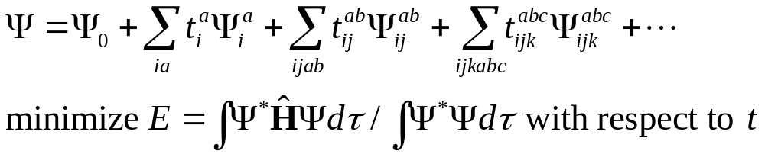
Configuration Interaction
determine CI coefficients using the variational principle
CIS – include all single excitations
  useful for excited states, but not for correlation of the ground state
CISD – include all single and double excitations
  most useful for correlating the ground state
  O²V² determinants (O=number of occ. orb., V=number of unocc. orb.)
CISDT – singles, doubles and triples
  limited to small molecules, ca O³V³ determinants
Full CI – all possible excitations
  ((O+V)!/O!V!)² determinants
  exact for a given basis set
  limited to ca. 14 electrons in 14 orbitals

Slide 8
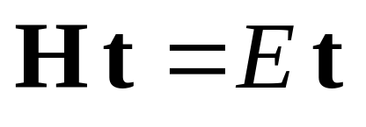
Configuration Interaction
very large eigenvalue problem, can be solved iteratively
only linear terms in the CI coefficients
upper bound to the exact energy (variational)
appliciable to excited states
gradients simpler than for non-variational methods

Slide 9
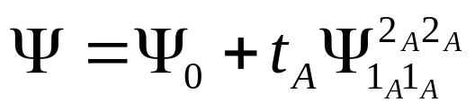
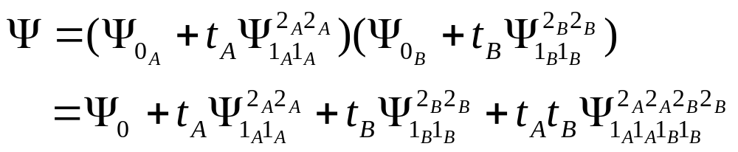
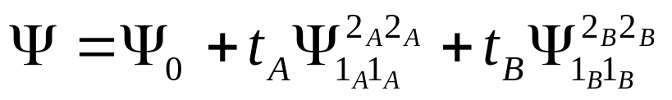
Size Extensivity
E(A+B) =E(A)+E(B) for two systems at long distance
CID for helium with 2 basis functions
two helium’s calculated separately
  E=E(A)+E(B), Ψ= Ψ_{A}Ψ_{B}
CID for two helium’s at long distance
(no quadruply excited determinant)

Slide 10
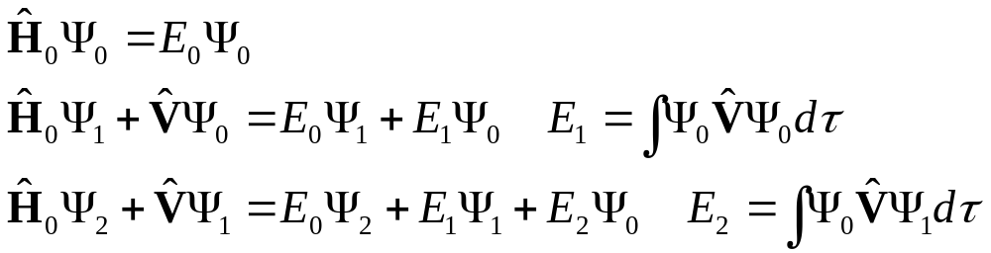
Perturbation Theory
divide the Hamiltonian into an exactly solvable part and a perturbation
expand the Hamiltonian, energy and wavefunction in terms of λ
collect terms with the same power of λ

Slide 11
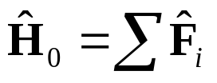
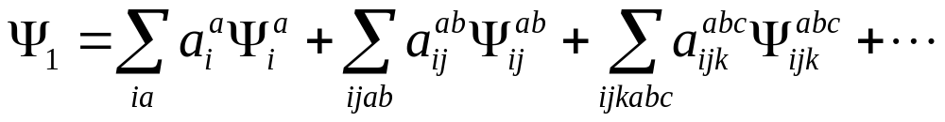
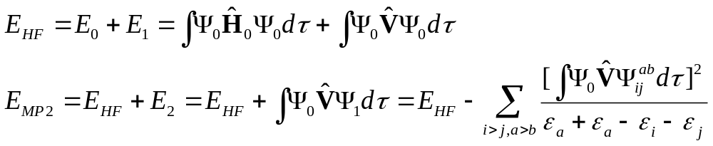
Møller-Plesset Perturbation Theory
choose H₀ such that its eigenfunctions are determinants of molecular orbitals
expand perturbed wavefunctions in terms of the Hartree-Fock determinant and singly, doubly and higher excited determinants
perturbational corrections to the energy

Slide 12
Møller-Plesset Perturbation Theory
size extensive at every order
MP2 - second order relatively cheap (requires only double excitations)
2nd order recovers a large fraction of the correlation energy when Hartree-Fock is a good starting point
practical up to fourth order (single, doubly, triple and quadruple excitations)
MP4 order recovers most of the rest of the correlation energy
series tends to oscillate (even orders lower)
convergence poor if serious spin contamination or if Hartree-Fock not a good starting point

Slide 13
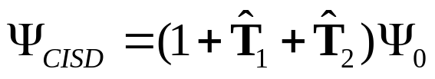
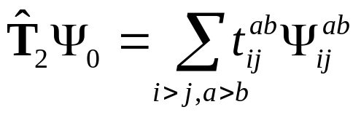
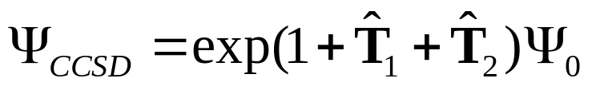
Coupled Cluster Theory
CISD can be written as
T₁ and T₂ generate all possible single and double excitations with the appropriate coefficients
coupled cluster theory wavefunction

Slide 14
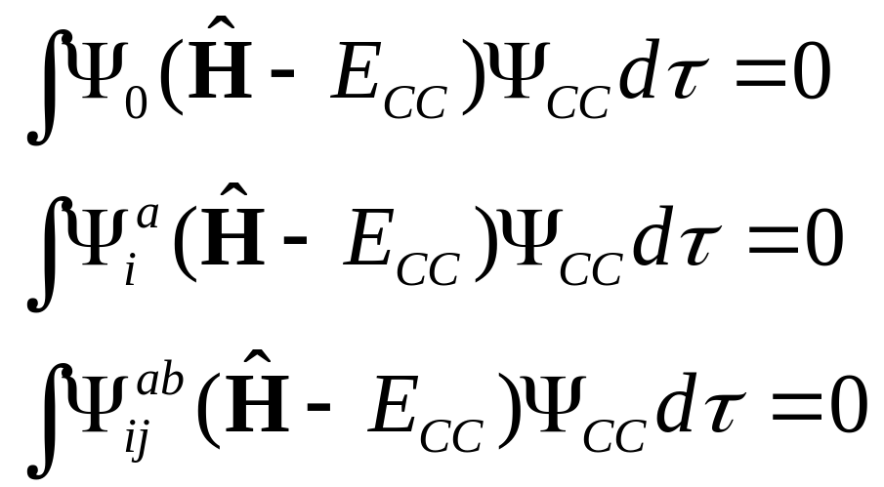
Coupled Cluster Theory
CCSD energy and amplitudes can be obtained by solving

Slide 15
Coupled Cluster Theory
CC equations quadratic in the ampitudes
must be solve iteratively
cost of each iteration similar to MP4SDQ
CC is size extensive
CCSD - single and double excitations correct to infinite order
CCSD - quadruple excitations correct to 4th order
CCSD(T) - add triple excitations by pert. theory
QCISD – configuration interaction with enough quadratic terms added to make it size extensive (equivalent to a truncated form of CCSD)

