Slide 1
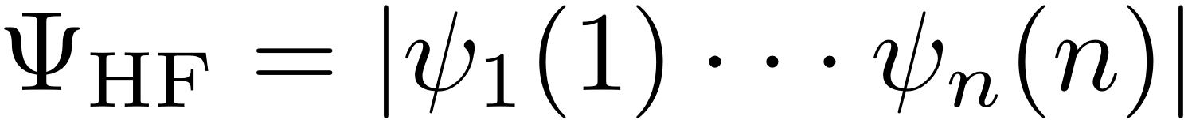
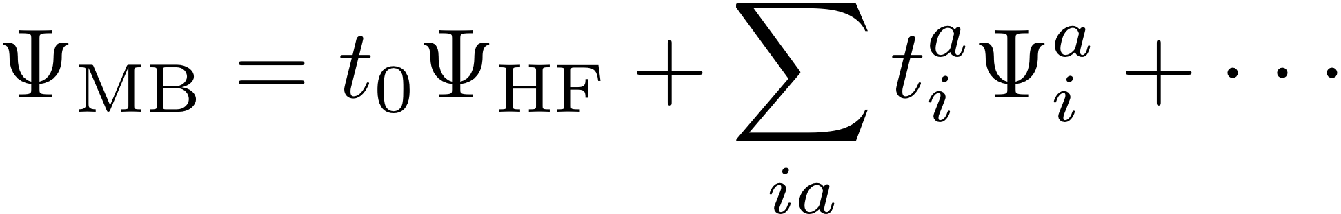
Electron Correlation Summary
Hartree-Fock single determinant
One (spin)-orbital one electron
No electron correlation
Introduce correlation with many-body wavefunction
Add excited state determinants to H-F ground state
Add a handful of excited configurations
Add all configurations of a given excitation type
Add configurations of a given perturbation order
MCSCF
CASSCF
Variational
Not size-consistent
Good for describing static correlation—bond breaking
Not so good for quantitative energies
CIS
CISD
Full CI
Variational
Not size-consistent
Good for describing excited states and spectroscopy
Not so good for quantitative energies
MPn/MBPTn
Coupled-cluster (CC..)
Quadratic CI (QCI..)
Size consistent
Not variational
Good general purpose methods
Excellent structures/energies for “normal” things

