Slide 1

Plane-Wave Pseudopotential Density Functional Theory
S
Bill Schneider
Chemistry Department
Ford Research Laboratory

Slide 2
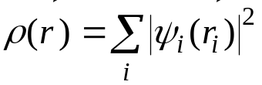
Density Functional Theory
Hohenberg-Kohn theorems
  For a given configuration of nuclei, the electronic energy is uniquely determined by the electron density ρ(r)
  The “true” electron density minimizes this energy
Kohn-Sham construction
  The electron density can be expanded in terms of one-electron orbitals
  The orbitals are determined by coupled, one electron equations
Adopt some approximation for the “exchange-correlation” interaction υ_{XC}[ρ]:
  LDA, GGA, BLYP, PW91, PBE, etc.

Slide 3
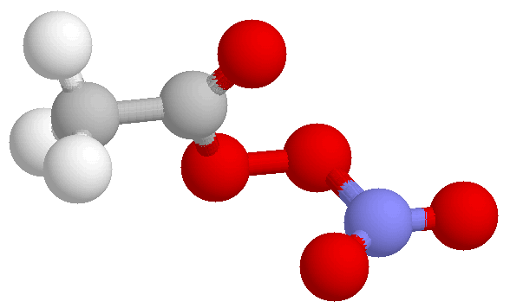
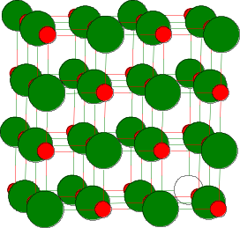
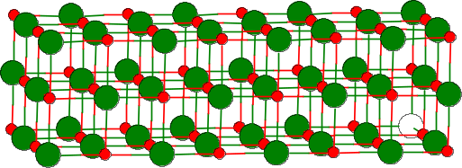
Supercell Models
(peroxyacetyl nitrate)
(MgO bulk)
(MgO slab)
c
c
b
a
b
a
“cluster” models
Isolated molecule in vacuum
(or dielectric continuum)
Gas-phase
Solution-phase
“Localized” chemistry
Amenable to highly
accurate calculations
“supercell” models
3-D periodic boundary conditions applied to atomic configuration
Bulk solids
Bulk liquids
Surfaces and Interfaces
“Delocalized” chemistry
Amenable to highly
efficient calculations

Slide 4
Bloch’s Theorem
a
Atoms:
H
H
H
H
H
H
H
H
H
H
PBC
e⁻
e⁻
e⁻
Potential:
V(r) = V(r+a)
Wavefunctions:
ψº = ∑ χ^{1s}
.
.
.
Ψ^{k} = ∑(-1)^{n} χ^{1s}
Ψ^{k}(r) = Ψº(r) e^{ikr} , |k| < π/a
(recall e^{ikr} is like a cosine function)
Wavefunctions can be written as product of unit-cell-invariant part (1s function here) and cell-periodic part
  Readily extensible to three dimensions (real k → vector k)
Domain of k called “first Brillouin zone”
  “Special” k points assigned names, e.g. k = 0 called “Γ point”

Slide 5
Band Structure
.
.
.
energy
energy
H
H
0
k
π/a
H
H
H
H
H
Molecular orbital diagram
Band structure diagram
Discrete orbital energies become continuous band of energies, indexed by k
Width (“dispersion”) of band determined by overlaps between neighboring cells
  Larger supercells → smaller dispersion
In practice, sufficient to determine orbitals at a discrete number of k points
  “k-point” sampling
  Monkhorst-Pack algorithm used for choosing efficient k-point mesh

Slide 6
Basis Sets
How to represent Ψº(r) within the supercell?
Atom-centered functions:
  Gaussians, slaters, numerical orbitals
  Compact basis, but difficult to construct and to evaluate Hamiltonian
  Implemented in Crystal, DMol, and ADF codes
Plane-wave functions:
  “Particle-in-a-box” basis, especially suited to freely propagating electrons
  Not very “atom-like”, but extremely easy to construct and to evaluate Hamiltonian
  Implemented in Vasp, CASTEP, CPMD, …
H
H
H
H
H
H
H
Atom-centered:
ψº = ∑ χ^{1s}
Plane waves:
|n|=1, λ = a
|n|=2, λ = a/2
.
.
.
a

Slide 7
Plane-wave Basis
Expand ψº(r) in plane-waves (Fourier expansion)
  Periodic boundary conditions restrict allowable plane wave frequencies
  ψº(r) = Σ_{G} c_{G}e^{iGr}, G = 2πn/a, n ∈ I
  Coefficients c_{G} determined by variational principle
Kohn-Sham equations assume convenient form
  Kinetic energy term diagonal
  ⟨e^{iGr}| -½∇² | e^{iG’r}⟩ = ½G² δ_{GG’}
  Potential energy term given by Fourier transform of V(r)
  ⟨e^{iGr} |V(r)| e^{iG’r}⟩ = V(G – G’)
  Solve (# k-points) Kohn-Sham matrices of dimension (# PW) x (# PW)
    direct diagonalization or iterative techniques
“Kinetic energy cutoff” (single parameter!) determines # plane waves
  n_{max} chosen such that ħ²G_{max}²/2m_{e} < KE_{cutoff}
  n_{max} ~ 10⁵ - 10⁶

Slide 8
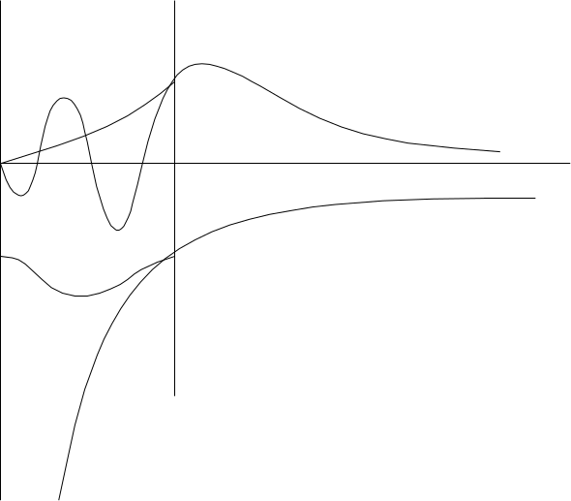
Pseudopotentials
Plane waves are poor choice for treating wavefunctions near atomic cores
  Rapid oscillations → high kinetic energy → “high n” plane waves
Replace core electrons and potential with “pseudopotential”
  Establish radial cutoff between core and valence regions
  Choose specific atomic configurations
  Construct PP to go smoothly into real potential outside of cutoff radius
  Preserves phase and shape of valence wavefunctions outside cutoff
Cutoff radius
ψ_{pseudo}
ψ_{real}
r
V_{pseudo}
V_{ion} ∝ Z/r

Slide 9
Pseudopotential Jargon
Transferability
  Ability of PP to be applied in different chemical environments
Local vs. non-local
  Spherically symmetric (local) vs. l-dependent (non-local)
Norm-conserving
  Preserving |ψ|² of valence wavefunctions
Soft vs. hard
  Hard: closer to true atomic potential, requiring large KE cutoff
  Soft: larger perturbation on atomic potential, allowing smaller KE cutoff
“Ultrasoft” (Vanderbilt)
  Approach which relaxes norm-conservation by introducing “augmentation charges”
  Permits significantly lower KE cutoffs
Appropriate selection of pseudopotentials one of the key challenges in successful PW-PP calculations!

Slide 10
Algorithm
Choose pseudopotentials
Choose plane-wave cutoff
Choose k-space integration density
Choose initial supercell size and “ion” positions
Construct initial electron density
Structural loop
Construct potential
Electronic loop
Solve Kohn-Sham equations
Iterate to self-consistency
Iterate to energy-minimum
Determine new electron density
Calculate forces and stresses
Determine new ion positions (and supercell)

Slide 11
Implementations
VASP (Hafner group, U. Vienna)
CASTEP (Payne group, Cambridge, and MSI)
CPMD (Parrinello group, Stuttgart, and IBM)
DACAPO (Nørskov group, Technical University Denmark)
Highly parallelized and efficient
Extensive pseudopotential libraries
  Incl. ultrasoft PPs
Local and non-local exchange correlation potentials
Multiple electronic and structural relaxation algorithms
  Car-Parrinello particularly efficient combination of these two
Varying analysis capabilities and levels of user friendliness

Slide 12
Applications at Ford Research Lab
Bulk materials properties:
Phase stability and microstructure of Al alloys
  Wolverton, Modelling Simul. Mater. Sci. Eng. 2000, 8, 323
Al and H siting and thermodynamics of bulk γ-aluminas
Ionic transport in mixed-valence oxides
Surface chemical processes:
Water adsorption and dissociation on α-alumina (0001)
  Car-Parrinello dynamics simulations, in collaboration with IBM
  Hass et al., Science 1998, 282, 265
NO reactions on metal surfaces
NO_{x}/SO_{x} storage on base metal oxides

Slide 13
Base Metal Oxide Adsorbents for Automotive Catalysis
Overall objective
  To understand the intermediates, the thermodynamics, and the kinetics of adsorption, oxidation, and bulk accommodation of NO_{x} and SO_{x} on metal oxides of potential interest for automotive catalysis
Work to-date
  Initial stages of adsorption and oxidation of SO_{x} on basal planes, steps, and at point defects on the representative oxides MgO and BaO
Approach
  Periodic supercell, plane-wave simulations
  (Mostly) local density functional theory
  (Mostly) ultrasoft pseudopotentials
  VASP (and some CPMD)

Slide 14
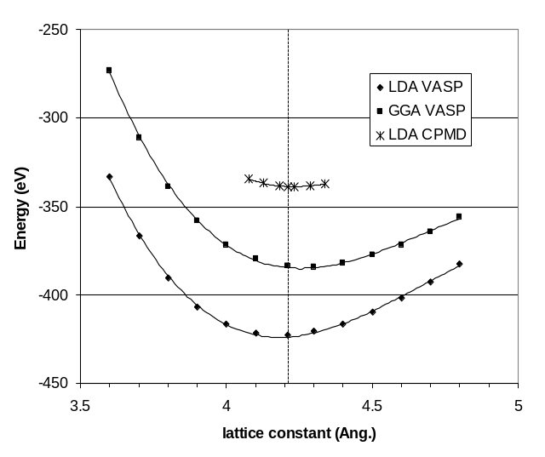
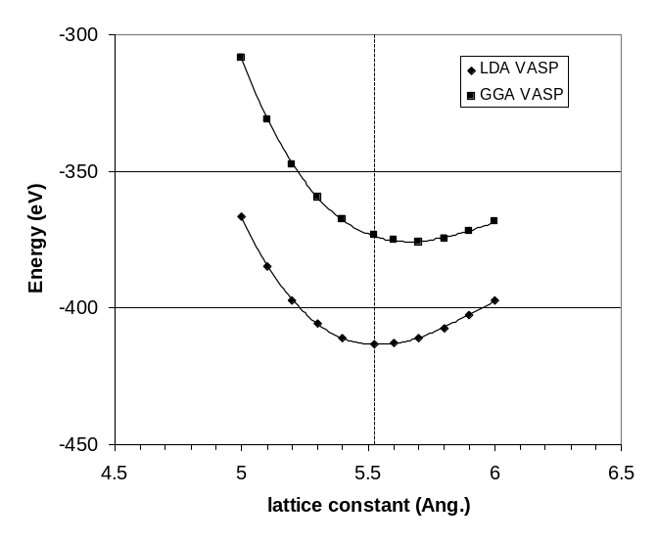
MO (M = Mg, Ba) Bulk Structures
Simple cubic lattice, 64 atoms/supercell (4 x 4 x 4)
2x2x2 k-point integration (1 symmetry unique point)
270 eV kinetic energy cutoff
~10000 plane waves
~< 1000 s/point, 8 node SP2
a
experiment→
experiment→
MgO
Exp’t 4.212 Å
LDA Vasp 4.182
GGA Vasp 4.255
LDA CPMD 4.240
BaO
Exp’t 5.522 Å
LDA Vasp 5.538
GGA Vasp 5.661

Slide 15
MO (001) Surface Models
2×2 unit cell surface
3 layers, 48 atoms/supercell
Bottom layer fixed at experimental bulk location
Vacuum (z) spacing ~3a
Minimal surface relaxation
O
z
Mg
y
Ba
x
0.11 Å
0.025 Å
0.01 Å
0.03 Å
0.015 Å
0.01 Å
0.004 Å
0.04 Å
Fixed
4.212 Å
5.522 Å
MgO
0.02 J/m² relaxation
BaO
0.04 J/m² relaxation

Slide 16
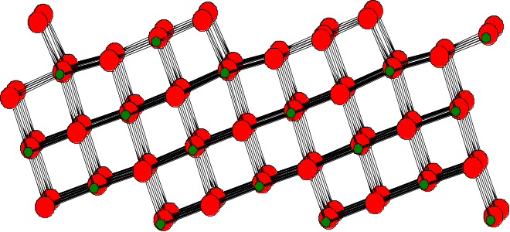
MO Step Defect Models
z
y
x
Fixed
MgO (103) supercells
MgO (103) step relaxations
Monatomic step defects modeled using (103) surface
  48 atoms/supercell; bottom layer fixed at experimental bulk locations
  Primary relaxations at step edge
  0.30 J m⁻² surface relaxation energy

Slide 17
MgO (001) + SO₂
1.47
1.502
117.0
2.17
1.755
2.062
2.448
Physisorbed SO₂
-16 kcal mol⁻¹ LDA
Chemisorbed SO₂
-42 kcal mol⁻¹ LDA
Metastable dipolar physisorption
  Only structure found in cluster simulations
  Converts to chemisorbed at ~200 K in MD simulations (E_{a} ≈ 0.5 kcal mol⁻¹)
Strong “sulfite”-like chemisorption (MgO + SO₂ → MgO·SO₂)
  Specific S–O_{s} and O–Mg_{s} interactions; significant charge transfer to adsorbate
  Pronounced local lattice distortion, dies off over short range

Slide 18
MgO (103) + SO₂
1.655
1.505
1.536
2.132
Chemisorbed SO₂
-62 kcal mol⁻¹ LDA
2.211
SO₂ chemisorbs preferentially on coordinatively unsaturated edge ions
  Similar sulfite-like adsorption geometry
  SO₂ oxygen fill vacant lattice sites
  Introduces pronounced lattice distortions along step edge

Slide 19
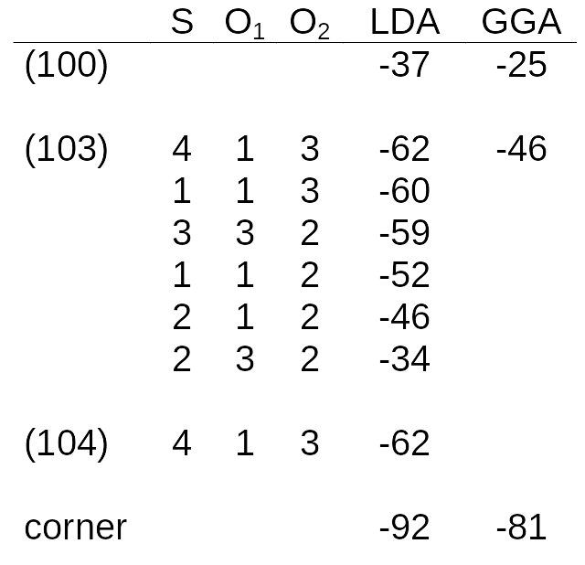
SO₂ Chemisorption on MgO
BE, kcal mol⁻¹
1
2
3
4
1
O
S
O
Multiple SO₂ chemisorption sites
  SO₂ fills “virtual” lattice sites
  Adsorption energy tracks with lattice ion coordinative unsaturation

Slide 20
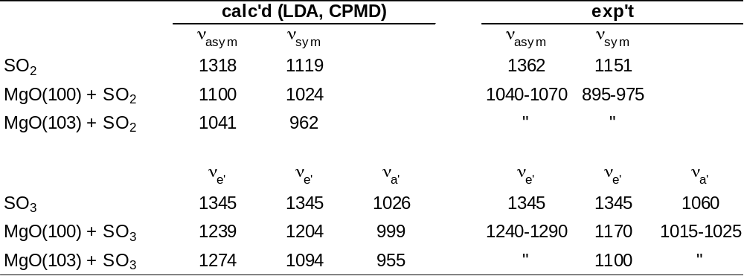
MgO + SO_{x} Vibrational Spectroscopy
S-O Stretch Frequencies (cm⁻¹)
MgO + SO₂: Schoonheydt and Lunsford, J. Catal. 1972, 26, 261-271
MgO + SO₃: Lavelley et al., J. Phys. Chem. 1989, 93, 6581-6582

Slide 21
Point Defects: O Adatoms
1.521
∠OOMg = 136°
1.493
2.502
2.097
MgO (001) + ½ O₂ → MgO·¹O
+1 kcal mol⁻¹ LDA
BaO (001) + ½ O₂ → BaO·¹O
-31 kcal mol⁻¹ LDA
Oxygen adatoms chemisorb preferentially on oxygen ion sites
  ¹O adatoms → “peroxide”-like (O₂²⁻) binding (Kantorovich et al., Surf. Sci. 1997, 374, 373)
  Chemisorption energy comparable to O₂ BDE (118 kcal mol⁻¹)
  Chemisorption energy coverage-independent on BaO up to 1 ML

Slide 22
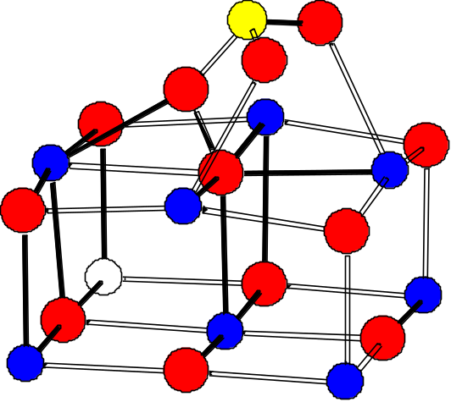
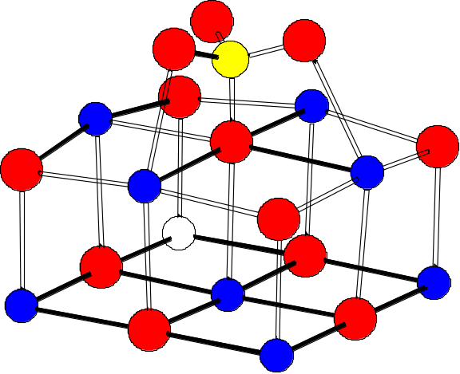
O Adatoms + SO₂: Sulfur Oxidation
BaO·¹O
+
SO₂
?
BaO·¹O ·SO₂
-50 kcal mol⁻¹ LDA
BaO·SO₃
-69 kcal mol⁻¹ LDA
SO₂ chemisorbs strongly at O adatoms
  Similar energetics on MgO and BaO
Probable intermediate for SO₂ insertion into O-O bond
Special approaches required for transition state searches
  Gradient-only based, e.g. nudged elastic band

Slide 23
Conclusions
Plane-wave pseudopotential DFT is a powerful technique for studying bulk and surface properties of materials
PW-PP approach is an extremely useful complement to traditional local orbital approaches to electronic structure
Improvements in computer speed and algorithms, and wider availability of software, promise to make PW-PP approach increasingly popular

Slide 24
Acknowledgments
Ford “CAMS” team
  Ken Hass
  Chris Wolverton
  Alex Bogicevic
IBM collaborators
  Wanda Andreoni
  Alessandro Curioni

