Slide 1
AI IN THE WORKPLACE PART 2
Set it up once.
Use it again.
Exercises 04 to 06: your own agent, branded slides, and a chart you can trust.
04 My First Agent
05 Slides
06 Data Visualisation
Notes:
Three exercises, one idea: write your instructions down once, then reuse them. 04 turns a skill file into a Copilot agent. 05 shows a skill changing a slide deck. 06 builds a chart from real data and has AI check it.

Slide 2
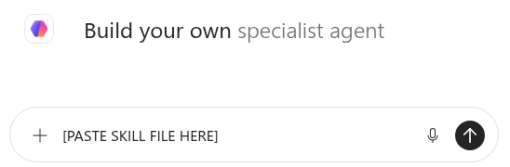
EXERCISE
04 My First Agent
Turn a skill file into your own Copilot agent
1
Click New agent in Copilot Chat
In standard Copilot Chat, top left.
2
Paste the skill into the Describe box
Training_Module_Builder.md: COPY it from the card on the site.
3
Name it Training Module Builder
Then click Create. It now sits in your sidebar.
The Describe box: paste the whole skill here, then send.
An agent keeps your instructions: set it up once, then reuse it and share it.
Notes:
If there is no New agent button, the account may not allow agents. The site has a fallback: attach the skill and the report to a normal chat instead.

Slide 3

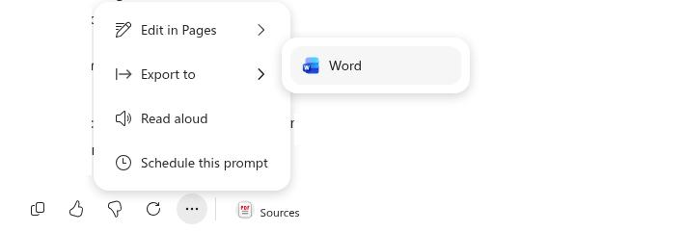
EXERCISE
04 My First Agent
Give it your report, get a training module back
1
Open your agent from the sidebar
It is listed under Agents.
2
Attach your revised Deep Research report
Or the Matts' ready-made copy, then send.
3
Pick any audience when it asks
It asks because a session for everybody reaches nobody.
4
Open it in Word
No Word file? Three dots, Export to, Word.
The human value is in the review. Share your agent only with colleagues who need it.
Notes:
The skill also writes a gap note: everything the source did not say. That is where a person steps in. Save the Word file: Exercise 05 uses it.

Slide 4
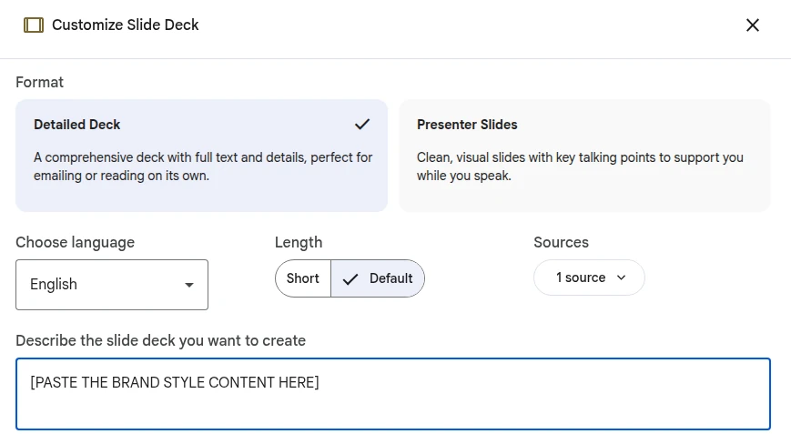
EXERCISE
05 Slides
Same module, two skills, two different decks
1
Add your training module as a source
New Gemini Notebook, Add source, upload the Word file.
2
Click Slide Deck, paste the Cardiff skill
Into the description box. Not as a source.
3
Generate, export, then repeat
Second run: paste the Matts' skill instead.
Slide Deck: the skill goes in the description box, nowhere else.
Everything that differs between the two decks came from the skill file.
Notes:
Paste, do not attach: the description box takes text, and it cuts off at 5,000 characters, so both skills are kept under 4,900. For internal work only; public-facing branding is a job for a human designer.

Slide 5
EXERCISE
06 Data Visualisation
Turn a spreadsheet into an animated story
1
Attach the CSV and turn Canvas on
Real emissions data for 31 UK universities over ten years.
11 of 180
2
Paste the prompt and compare
Open our Canvas app beside yours. Do they agree?
rows in our first chart matched the file it came from. It also dropped 13 universities, and it looked superb.
3
Ask AI to check every number
Against the CSV, then rebuild using those values only.
Our first build, before the repair prompt
A person still signs off the numbers. AI can help with the checking.
Notes:
The dataset is HESA's estates data, pivoted to 307 rows so it fits. A chart that looks right is not the same as a chart that is right: check it against the source file.

Slide 6
Three habits to take back to your desk
1
2
3
Write it down once
Keep the source in charge
Check before you share
A skill or an agent saves you re-explaining the job every time.
Ground the output in your document, and read what it says it left out.
Numbers, names and claims: a person signs off, not the tool.
wmgmm.github.io/education
Notes:
Responsible AI throughout: this is your work, and AI is your assistant.

