Slide 1
COMP4432 Machine Learning
20066851D Li Man Chung
18057243D Wong Man Kit
20028439D Lam Ka Chun

Slide 2
Table of contents
01
Introduction
02
System Design
03
Coding Detail
04
Performance Analysis

Slide 3

01
Introduction

Slide 4
Introduction
Files
Columns
Libraries
abcnews-date-text.csv: A csv file that contains a million news headlines in a period of 18 years from ABC news.
publishe_date: date of article published (yyyyMMdd format)
headline_text: headline in text form (English, lowercase)
numpy
pandas
matplotlib
sklearn
nltk

Slide 5
02
System Design

Slide 6
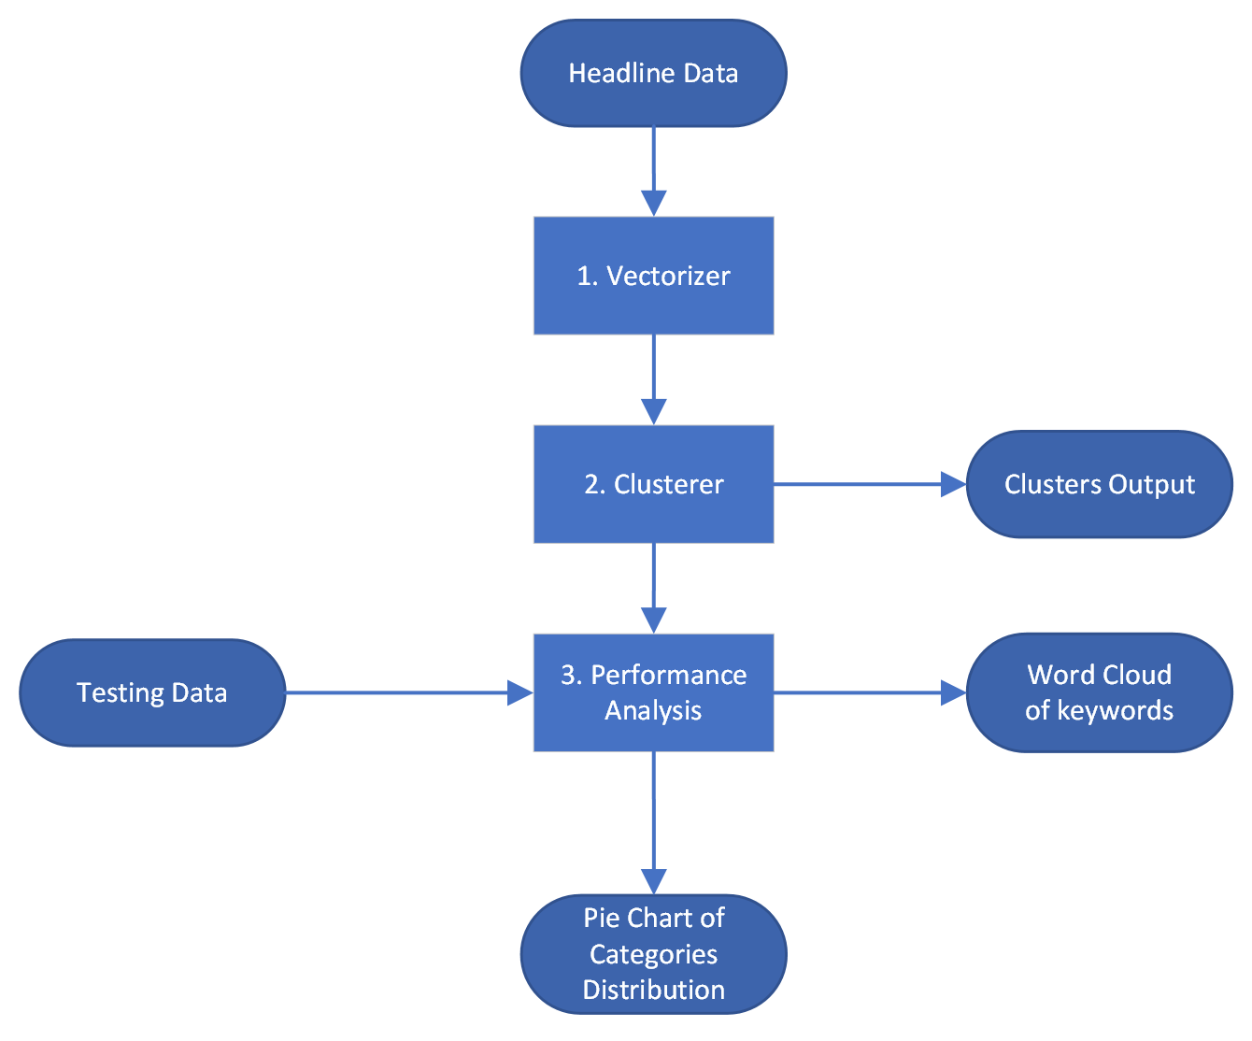
Overall Workflow

Slide 7
Vectorizer Design
1. Vectorizer
Functions:
- String -> Vector
- Dimensionality Reduction (DR)
Selection of Vectorizer
-TF-IDF Vectorizer with stop words and tokenizer
Selection of DR method
-TF-IDF Vectorizer: max_features
-Principal Component Analysis (PCA)
-Latent Semantic Analysis

Slide 8
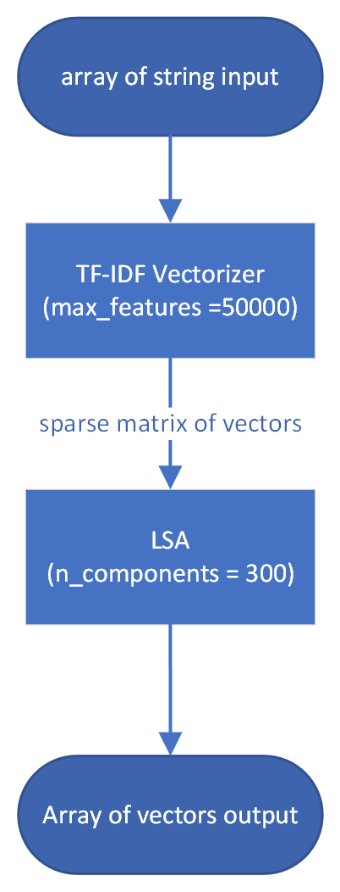
Vectorizer Implementation
1. LSA vs PCA
TF-IDF vectorizer gives sparse matrix (text vectors)
-> LSA >> PCA in speed
2. LSA vs TF-IDF n_features
-TF-IDF Vectorizer select n features with top occurrences
-LSA perform singular value decomposition (SVD)
LSA 300 is selected
-balancing time and performance

Slide 9
Clustering Method Design
2. Clusterer
K-means clustering

Slide 10
Performance Analysis
3. Performance Evaluation Design
News Category Dataset
-An extra labeled dataset
-With 41 categories of news
-Data original source: a news website
Goal: find out what the cluster contains
Selection of evaluator:
-Train a classifier based on labeled data
-Cluster the labelled data and compare the labels
Dataset Source: https://www.kaggle.com/datasets/rmisra/news-category-dataset

Slide 11
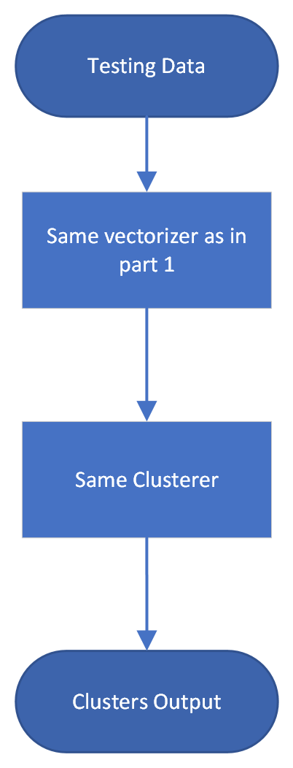
Performance Analysis
Implementation
Training a classifier is rejected:
1. Low accuracy (~30% on test set)
2. Double error
3. Time consuming
Final implementation:
1. Cluster the labeled data in the same way
2. For each cluster, find the distribution of labels
(Which may give hints on what that cluster is about)
3. Draw Word Cloud from occurrence of keywords
4. Draw pie chart of what the cluster contains
Dataset Source: https://www.kaggle.com/datasets/rmisra/news-category-dataset

Slide 12
03
Coding Detail

Slide 13
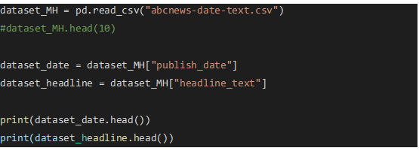
Read the csv file
Read the csv file into pandas fata frame

Slide 14
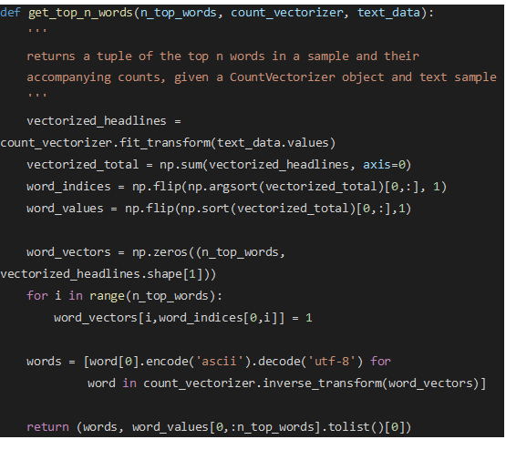
Top words function
Function to get the top words and count it
LDA

Slide 15
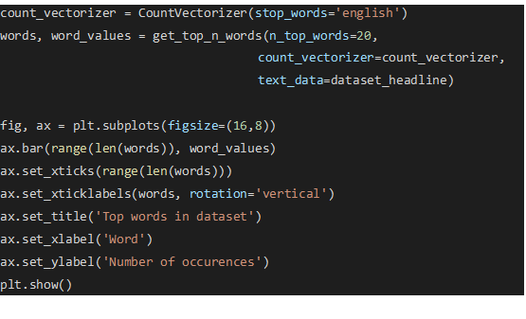
Visualization

Slide 16
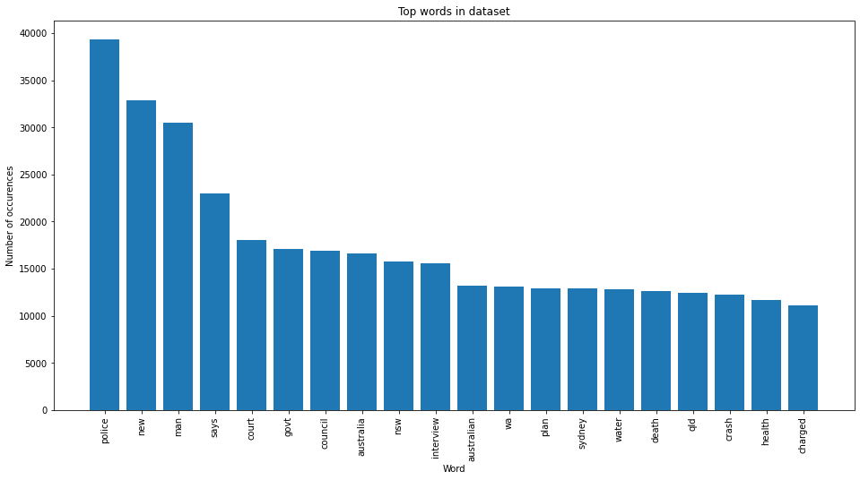
Visualization Result
Top word: Police
High possibility related to "police", "new", "man"
Inferences
meaningful & meaningless
(at the same time)

Slide 17
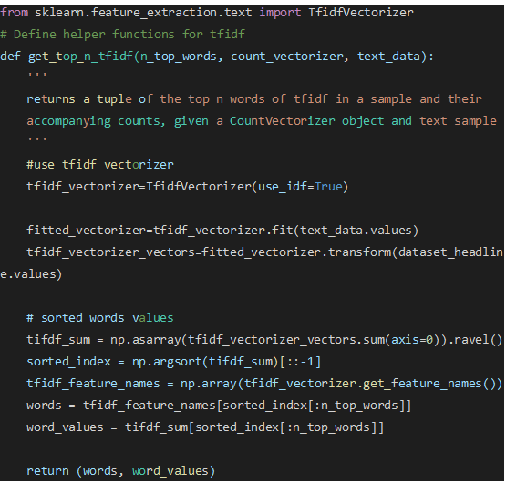
Tf.idf matrix
Further understanding the dataset
Modified from term frequency into tf.idf

Slide 18
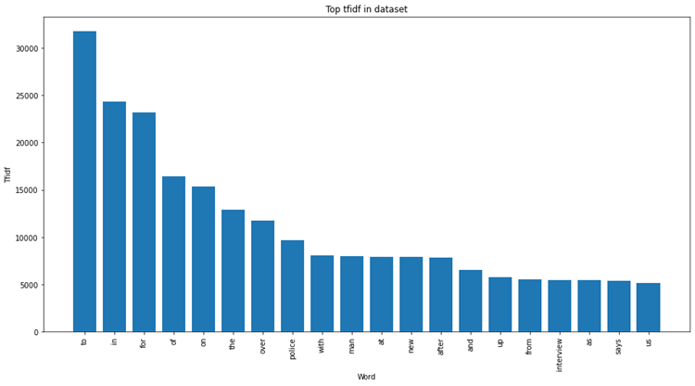
Result
New Problem: Stop word
Meaningless
Cannot represent the documents
Soultion:
Stop word lists from nltk

Slide 19
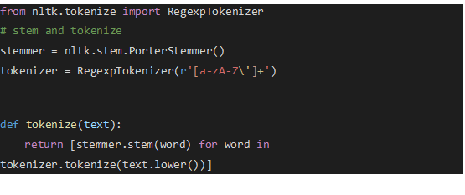
Stop word list
punctuation & stop words
Vectorizer
- Modified tokenizer
- Modified stemmer
- Porter Stemmer
- Regular-Expression tokenizer
Number of features
Original: 104691
New: 77058

Slide 20
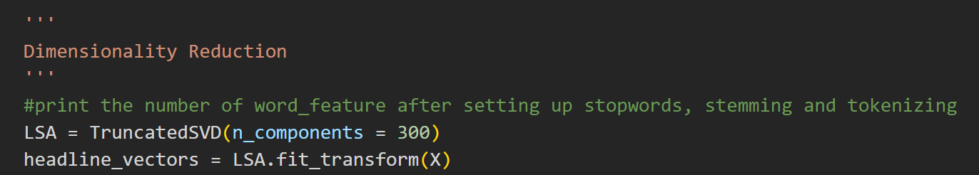
Dimensionality Reduction
Large features dimensions
Large training time
Solution: Dimensionality reduction
- Reduced the components to 100

Slide 21
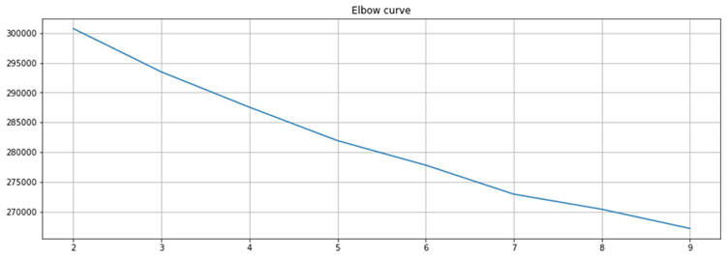
K means clustering
After feature extraction
- Implementation as K means
Important K value -> elbow method
The eblow curve
At K=7

Slide 22
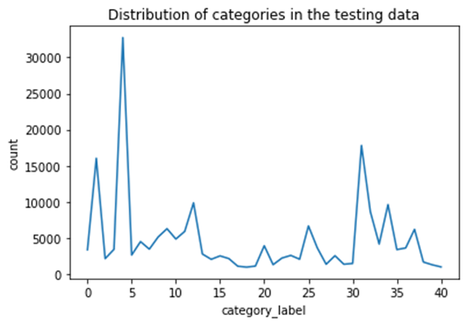
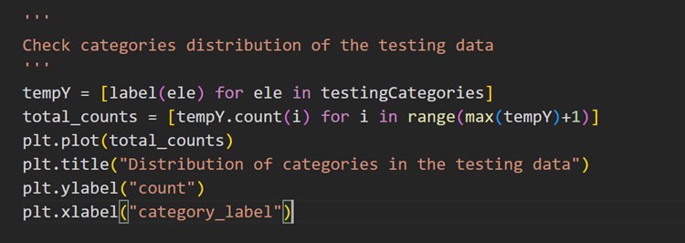
Performance Analysis
plotting of the distribution graph

Slide 23
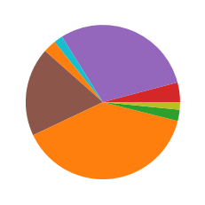
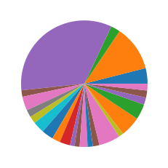
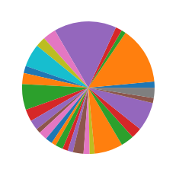
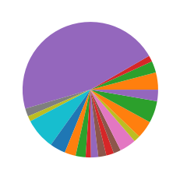
Top-3 categories clusters
'WELLNESS' 'POLITICS' 'HEALTHY LIVING'
'POLITICS' 'ENTERTAINMENT' 'THE WORLDPOST'
'POLITICS' 'ENTERTAINMENT' 'STYLE & BEAUTY'
'POLITICS'
'QUEER VOICES' 'PARENTING'

Slide 24
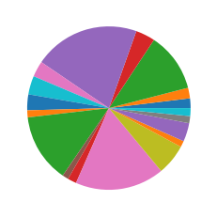
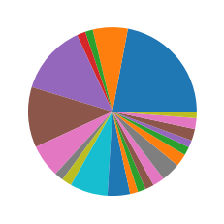
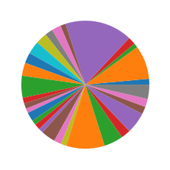
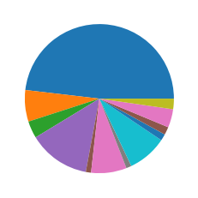
Top-3 categories clusters
'POLITICS'
'THE WORLDPOST' 'TRAVEL'
'CRIME'
'POLITICS'
'WEIRD NEWS'
'POLITICS' 'WELLNESS' 'ENTERTAINMENT'
'CRIME'
'POLITICS'
'QUEER VOICES'

Slide 25
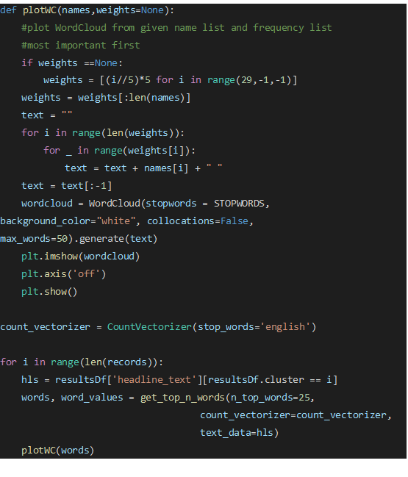
WordCloud Graph

Slide 26
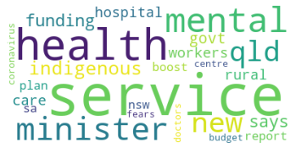
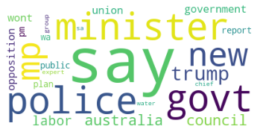
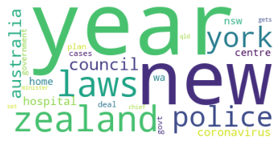
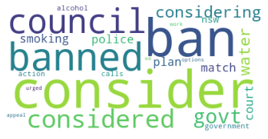
WordCloud Graph

Slide 27
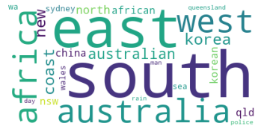
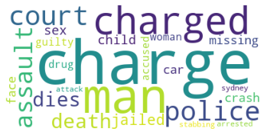
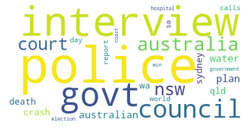
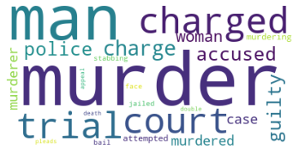
WordCloud Graph

Slide 28
Thanks!

