Slide 1
Node.js

Slide 2
What is it?
Open Source runtime environment for developing server-side web applications
Interprets JavaScript with Google’s V8 JavaScript Engine
Architecture
Event-Driven
Asynchronous I/O
Uses collection of modules to handle core functionality
Runs on a single thread
Non-blocking I/O calls allow support of 10’s of thousands of concurrent connections.
Does not allow vertical scaling
Used by many major corporations
Netflix, Groupon, IBM, LinkedIn

Slide 3
Timeline
Creator: Ryan Dahl
Created originally for Linux
Written in 2009
2011
NPM introduced
Windows Nativity developed by Microsoft and Joyent
2014
io.js split from Node to continue open source development concurrent with Google’s V8 JS Engine
2015
Merged back together and released Node v4.0
ES6 Features brought to Node
Long-term release cycles

Slide 4
Setup
NPM (Node Package Manager CLI)
Twitter NPM Package
Tokens
Keys
Express NPM Package
Simple Routing for node web applications
Embedded Javascript Templates (.ejs)
Simple templating system for express

Slide 5
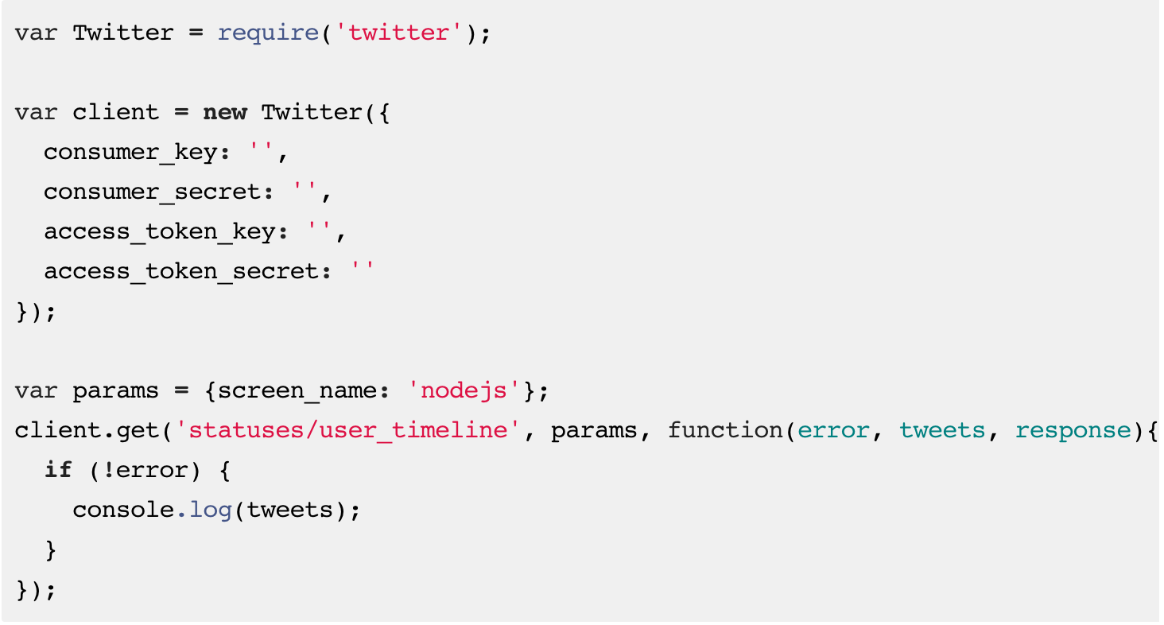
Twitter Usage

Slide 6
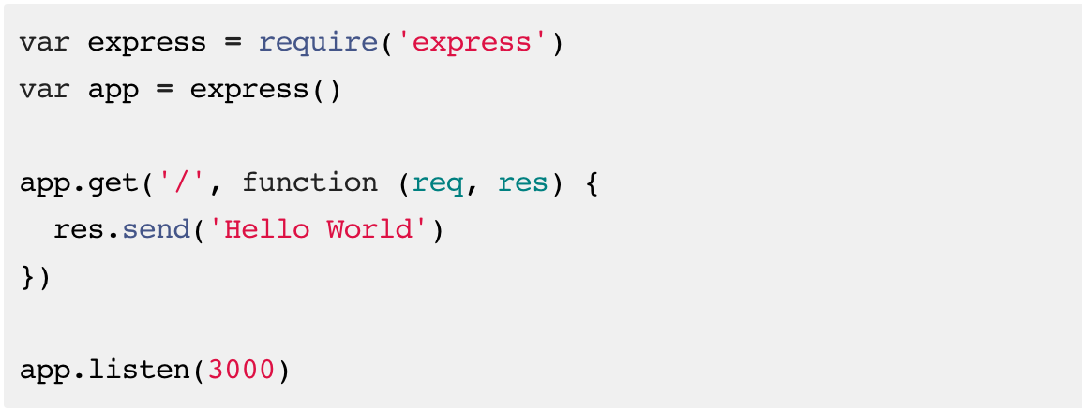
Express Usage

Slide 7
EJS Usage
Calling a template via express
res.render('index.ejs', { count: visitCount });
Variables in HTML
<%= count %>

Slide 8
Bringing Everything Together

