Slide 1

Stock market data of Facebook Inc.
No of Observations: 2202
From January 2015 to January 2021

Slide 2
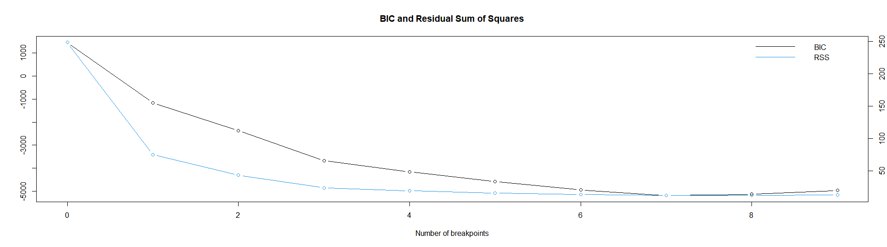
Structural Breaks
Univariate analysis: logged Adjusted close price

Slide 3
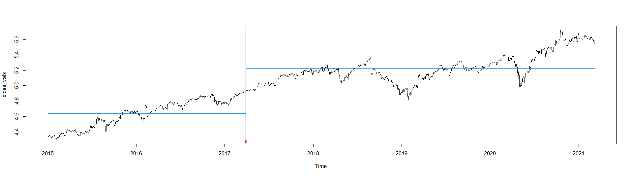
Main structural Break : March 2017
Univariate analysis: Logged Adjusted close price
Dataset after controlling for structural breaks : 1405 observations

Slide 4
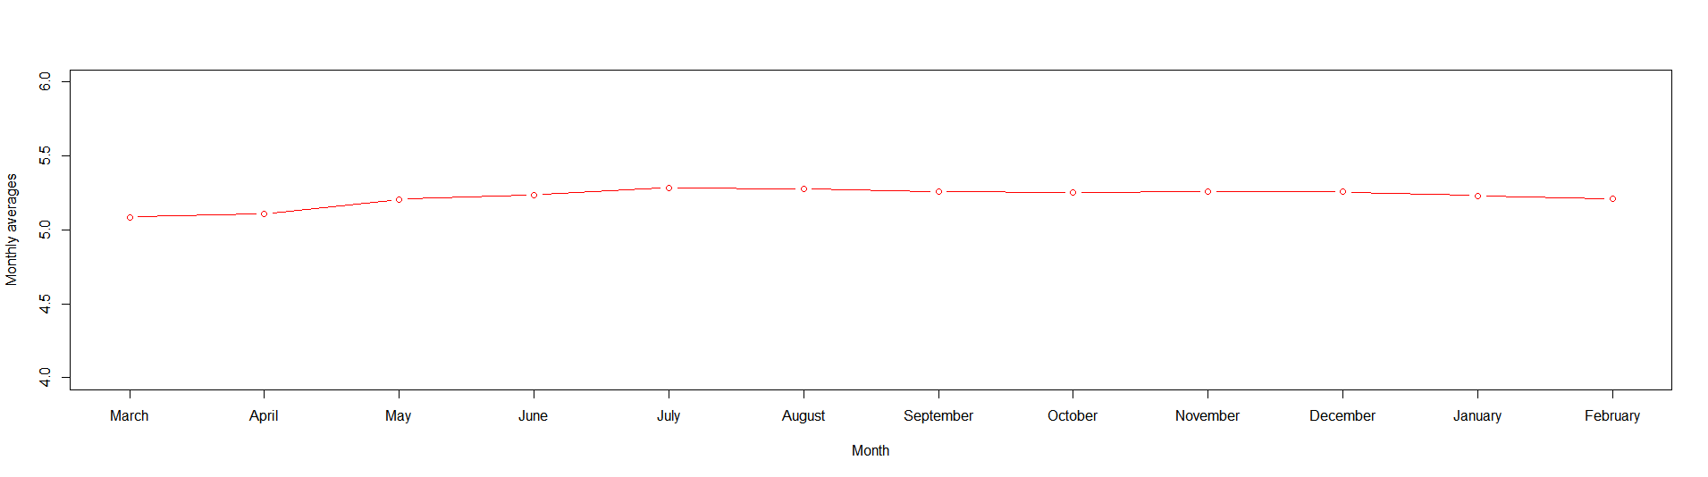
Seasonal effects
Univariate analysis: Logged Adjusted close price

Slide 5
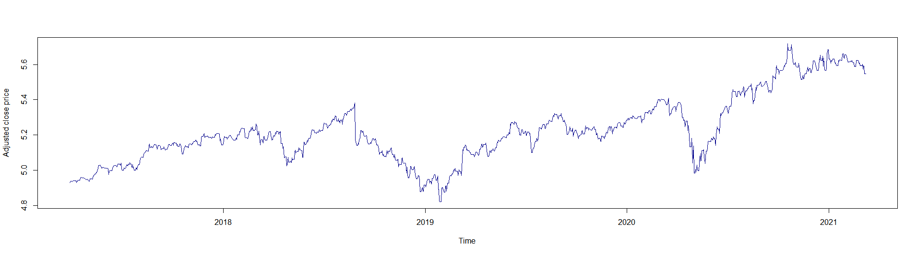
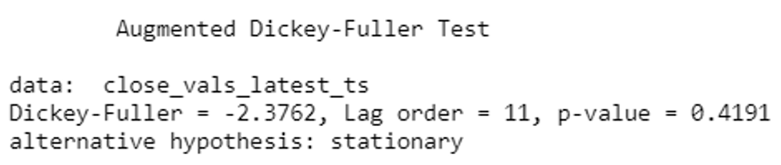
Check stationarity: ADF test
ARIMA model: Identification

Slide 6
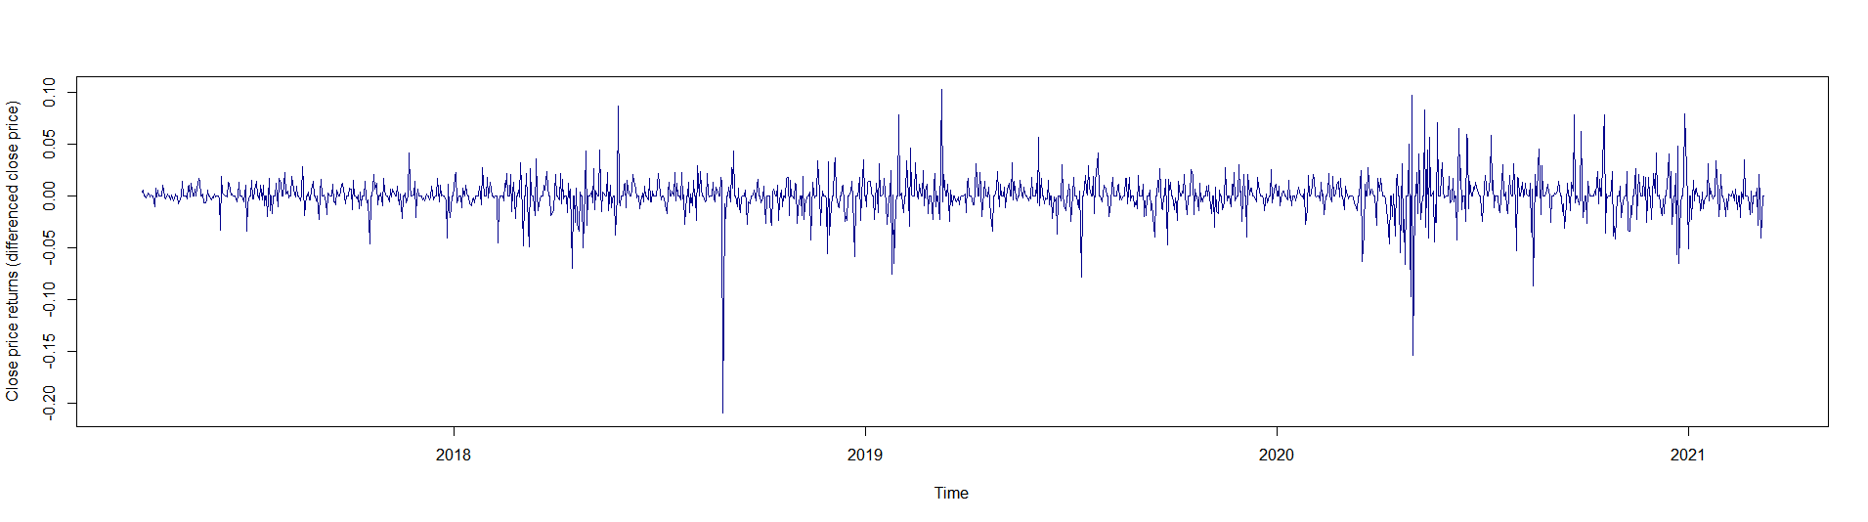
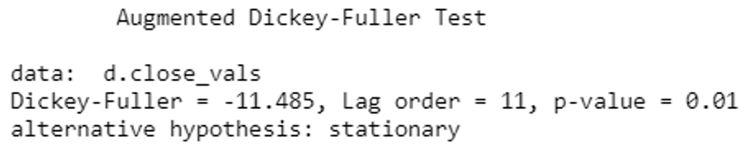
Differencing
ARIMA model: Identification

Slide 7
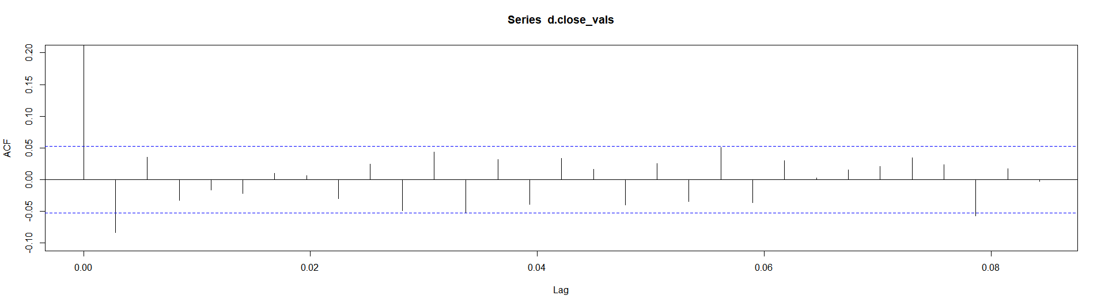
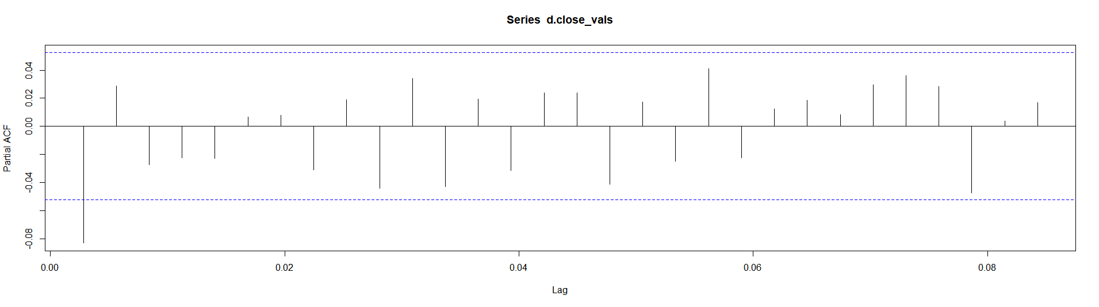
ACF and PACF plots
ARIMA model: Identification
ACF
PACF
p = 1 d = 1 q = 1

Slide 8
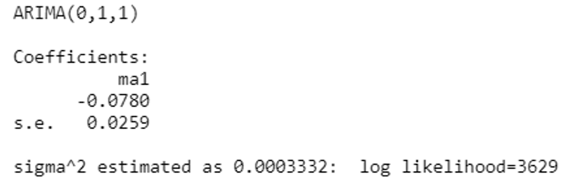
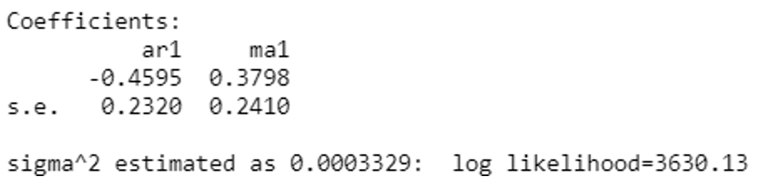
ARIMA (0, 1, 1)
ARIMA model: Estimation
Autoarima Function
ARIMA (1, 1, 1)

Slide 9
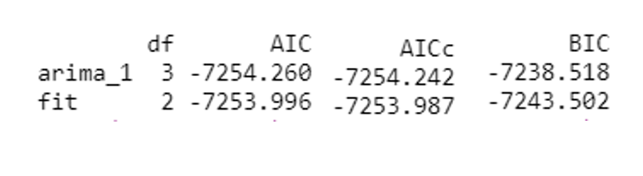
Information criteria
ARIMA model: Estimation
Final Model: ARIMA (1, 1, 1)

Slide 10
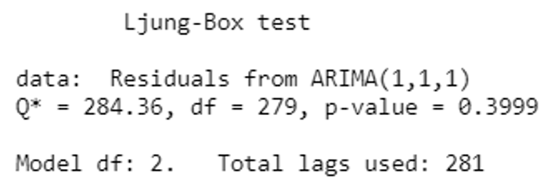
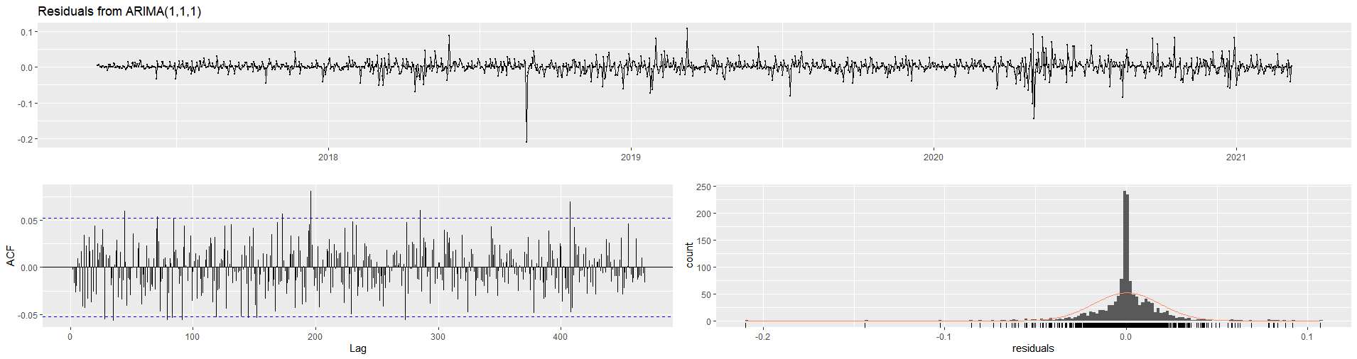
Ljung Box test
ARIMA model: Diagnostic Checking

Slide 11
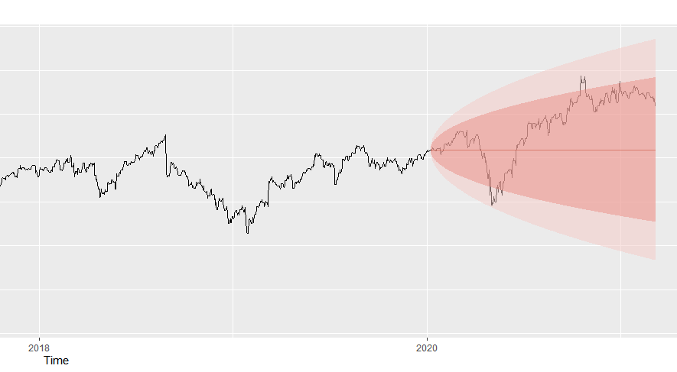
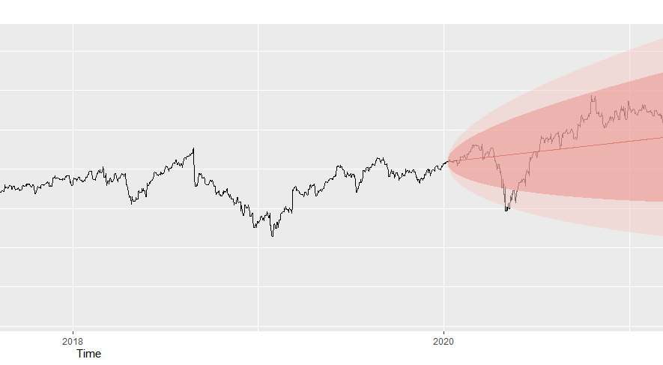
Forecasts of the stock prices
ARIMA(1, 1, 1)
ARIMA model: Forecast
ARIMA(0, 1, 1)
Training set: 991 Observations
Test set: 414 Observations

Slide 12
Evaluation metrics
ARIMA model: Forecast
ARIMA (1, 1, 1)
ARIMA (0, 1, 1)

Slide 13

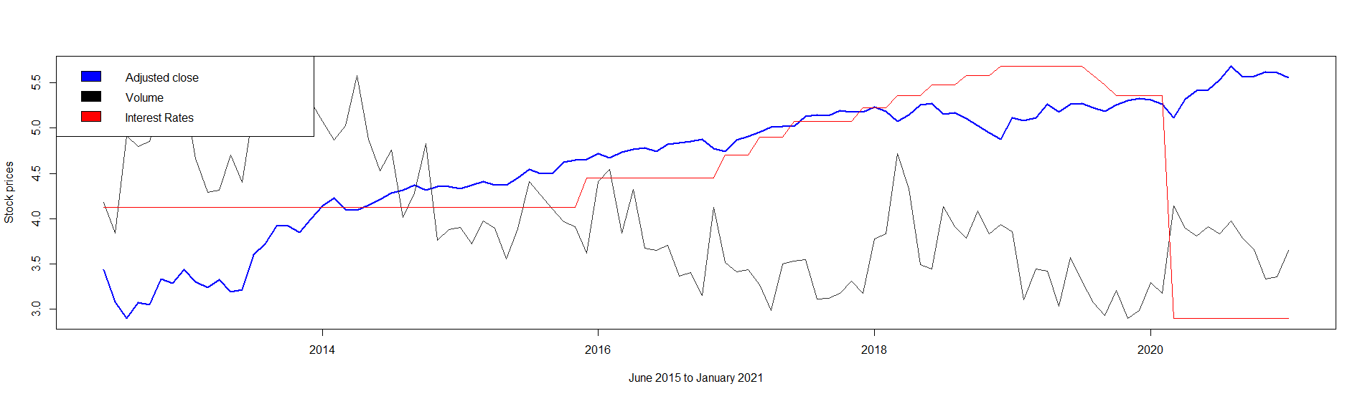
Check Stationarity: ADF test
Multivariate analysis: Adjusted close, Volume and Interest rates
No. of Observations = 104
Monthly Adjusted close prices and Volume of the stocks of Facebook Inc
Interest rates
From June 2012 to January 2021

Slide 14



ADF test : Check Stationarity
Multivariate analysis: Adjusted close, Volume and Interest rates
Adjusted close
Volume
Interest Rates

Slide 15



Differencing
Multivariate analysis: Adjusted close, Volume and Interest rates
Adjusted close returns
Differenced Volume
Differenced Interest rate

Slide 16



Engle Granger Cointegration Test
Multivariate analysis: Adjusted close, Volume and Interest rates
Adjusted close ~ Volume + Interest Rates
Volume ~ Adjusted close + Interest Rates
Volume ~ Adjusted close + Interest Rates

Slide 17
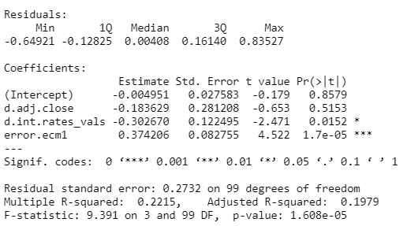
Error Correction Model (ECM)
Multivariate analysis: Adjusted close, Volume and Interest rates
$$∆Volume \sim ∆Adjusted close+ ∆Interest rate+ ECM term$$

Slide 18

Johansen method: Lag selection
Multivariate analysis: Adjusted close, Volume and Interest rates

Slide 19
ARCH effect in data
Modeling volatility in stock prices

Slide 20
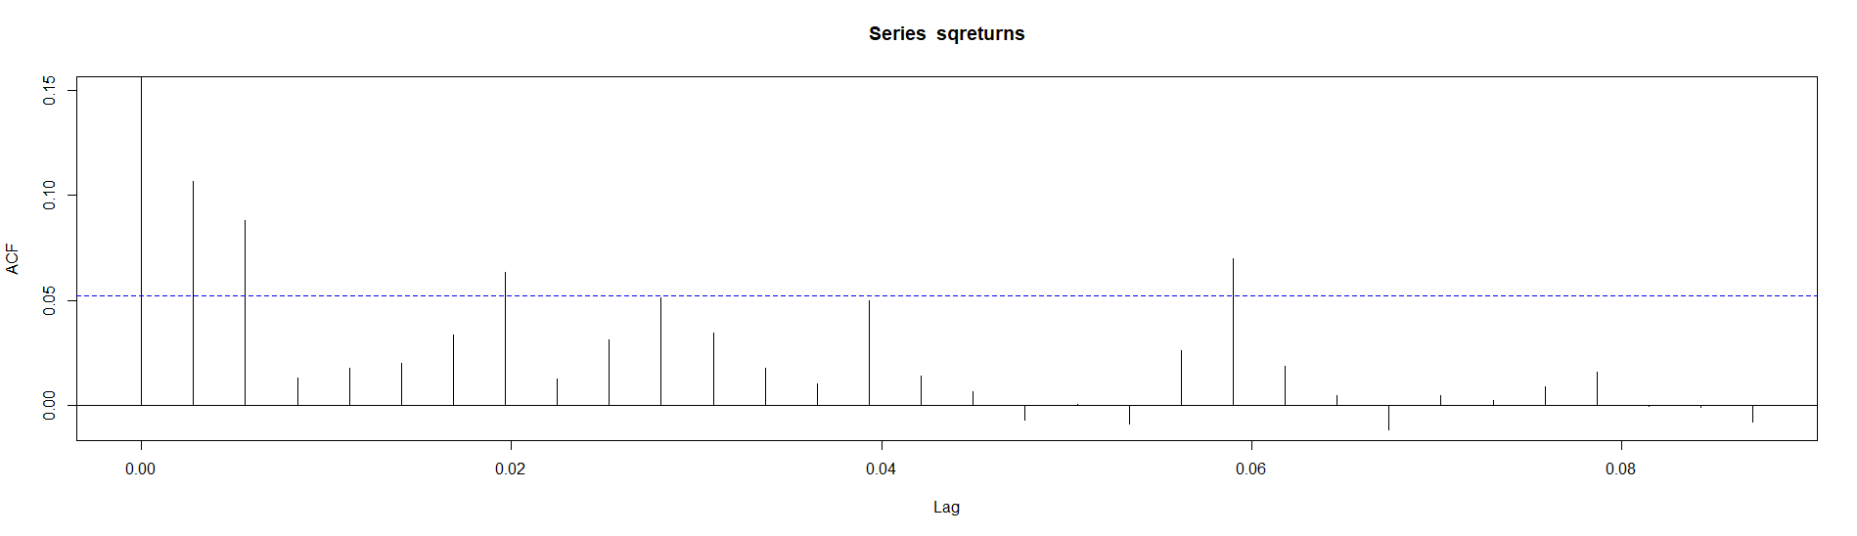
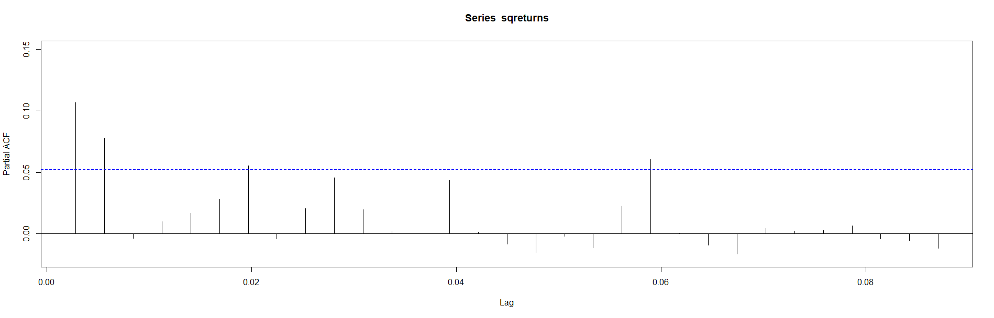
ACF and PACF squared residuals
Modeling volatility in stock prices
ACF
PACF

Slide 21
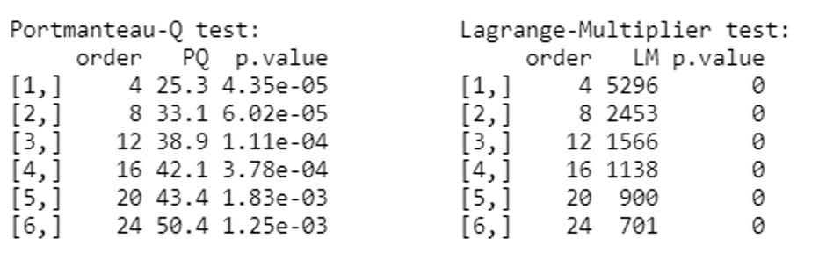
ARCH heteroskedasticity test
Modeling volatility in stock prices

Slide 22
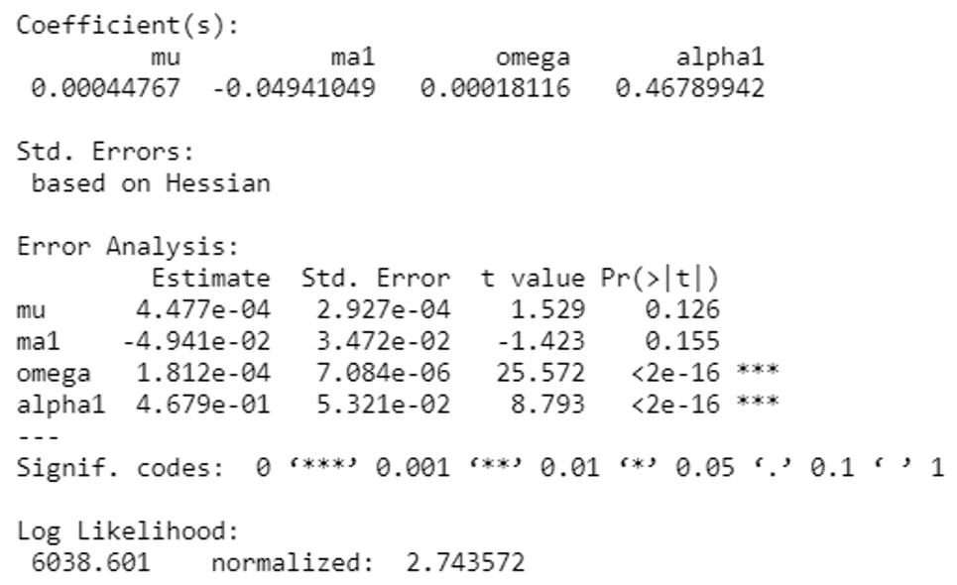
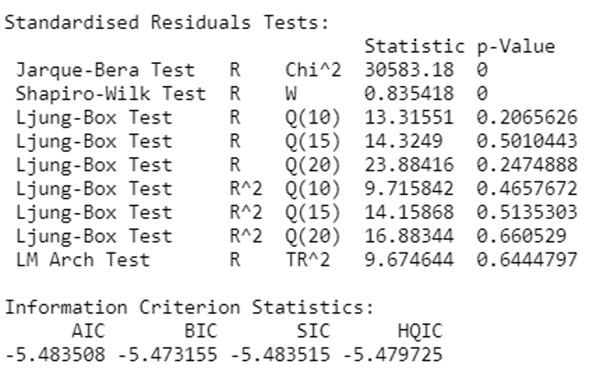
ARCH (1) Model
Modeling volatility in stock prices
Model summary
Model summary

Slide 23
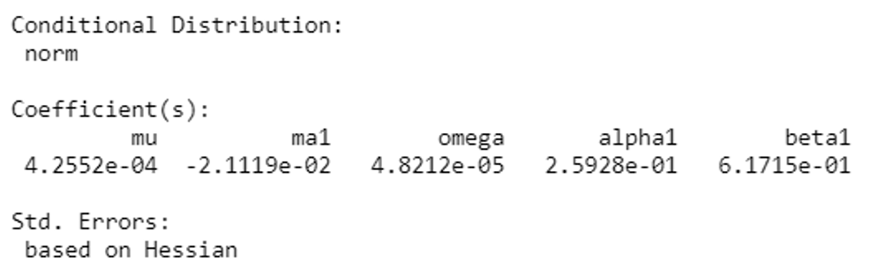
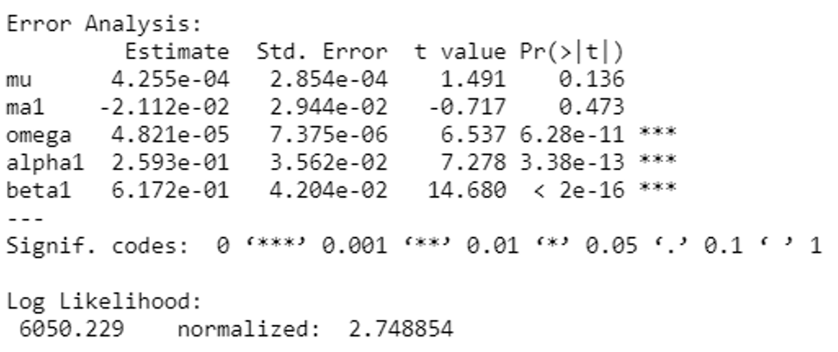
GARCH (1, 1)
Modeling volatility in stock prices

Slide 24
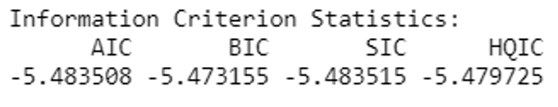
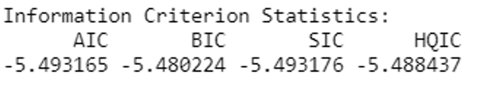
Best Model is GARCH (1, 1)
Modeling volatility in stock prices
ARCH (1) model
GARCH (1, 1) model

Slide 25
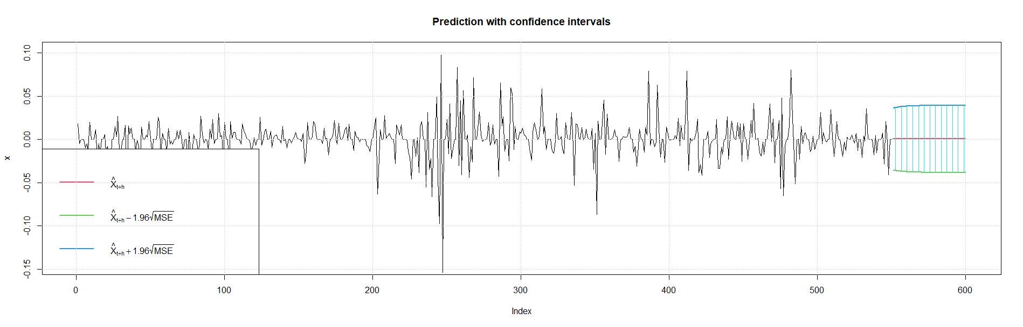
Forecasted Volatility
Modeling volatility in stock prices

Slide 26
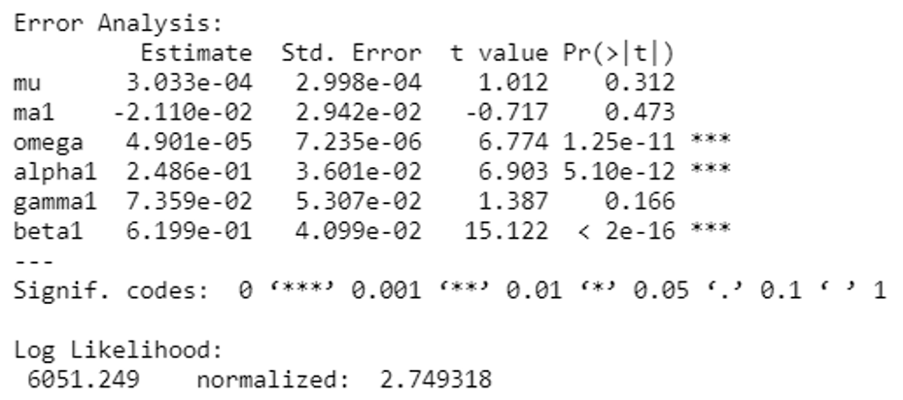
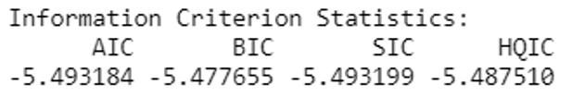
GJR Model
Extensions of the GARCH model

Slide 27
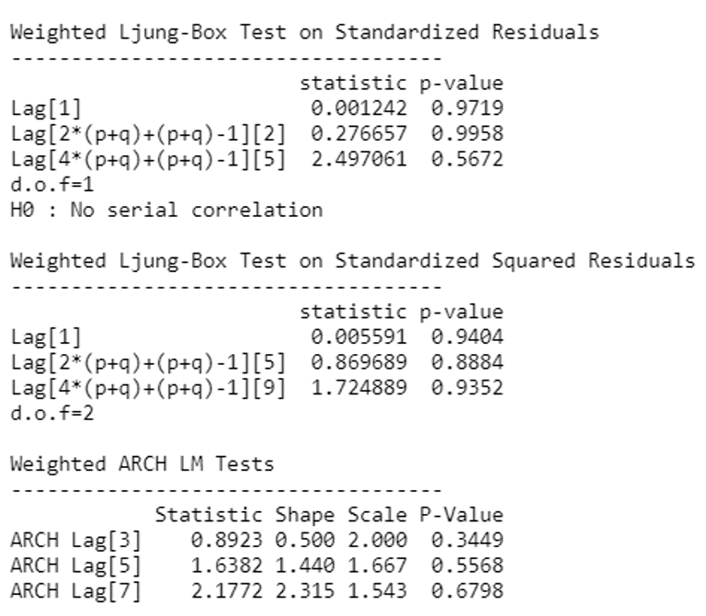
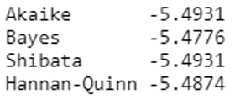
Exponential GARCH Model
Extensions of the GARCH model

Slide 28
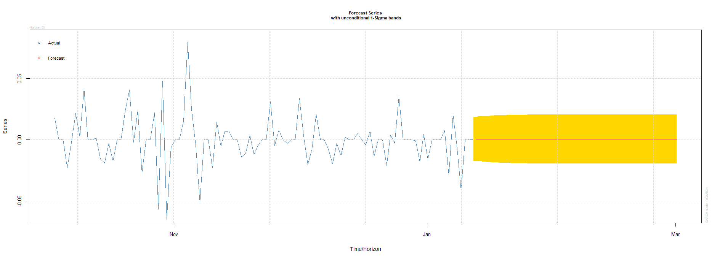
Forecasts of Exponential GARCH Model
Extensions of the GARCH model

Slide 29
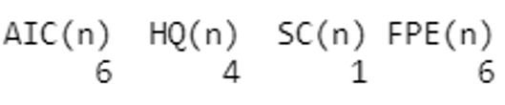
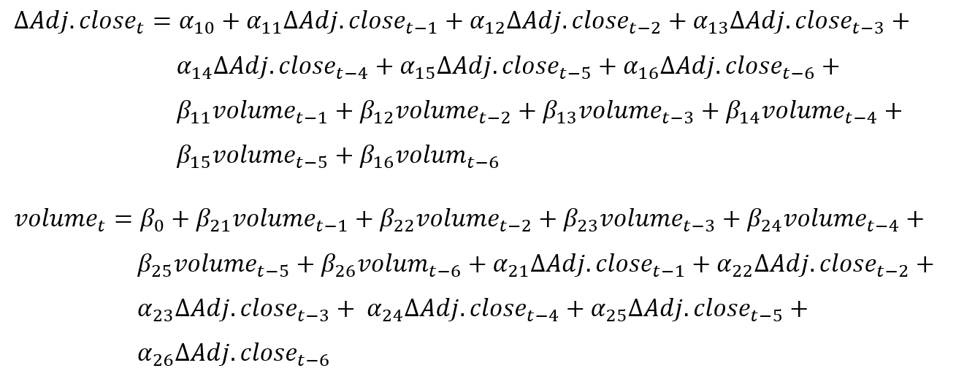
VAR: Lag selection
Multivariate analysis: Adjusted close and Volume

Slide 30
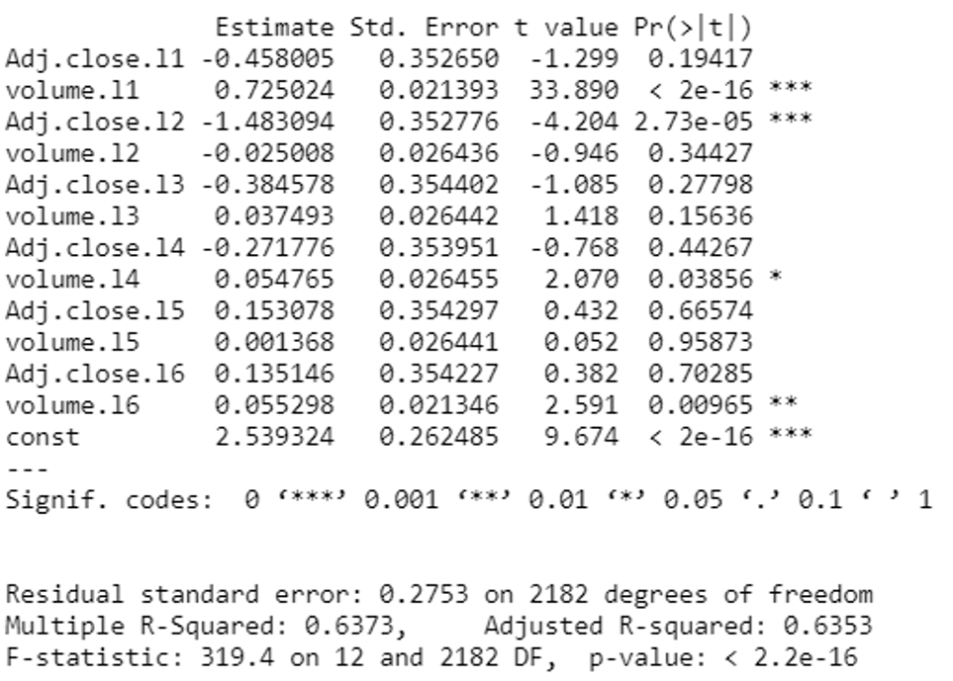
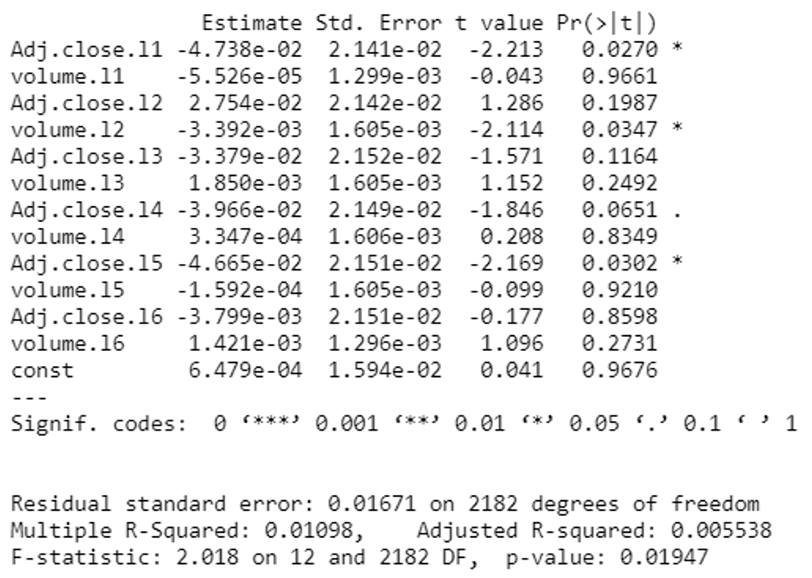
VAR Model summary
Multivariate analysis: Adjusted close and Volume
Estimation results for equation Differenced Adjusted close
Estimation results for equation volume

Slide 31
Causality
Multivariate analysis: Adjusted close and Volume
Granger causality of Adjusted close on Volume
Granger causality of Volume on Adjusted close
Instantaneous Casualty between Volume and Adjusted close

Slide 32
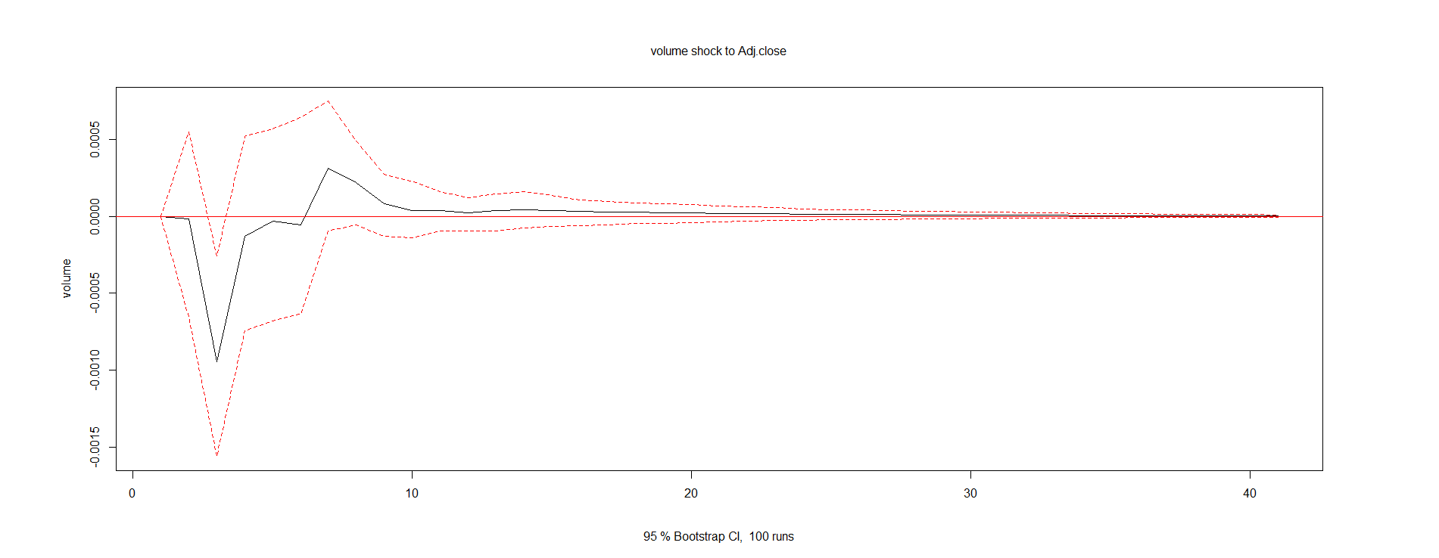
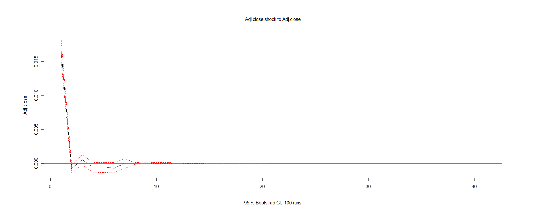
Impulse Response Functions
Multivariate analysis: Adjusted close and Volume
Response in adjusted close to the impulse on volume
Response in Adjusted close to the impulse on adjusted close

Slide 33
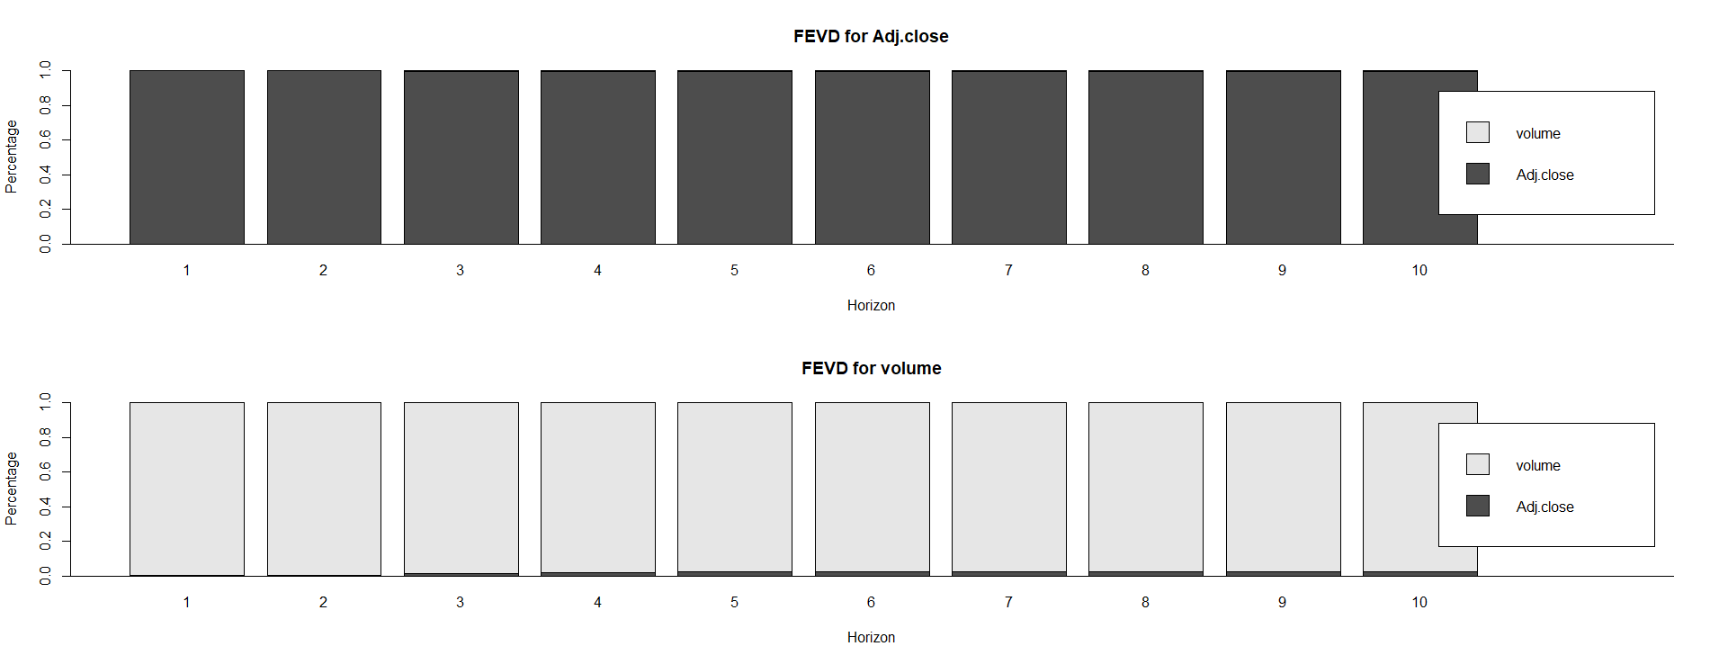
Variance Decomposition
Multivariate analysis: Adjusted close and Volume

Slide 34
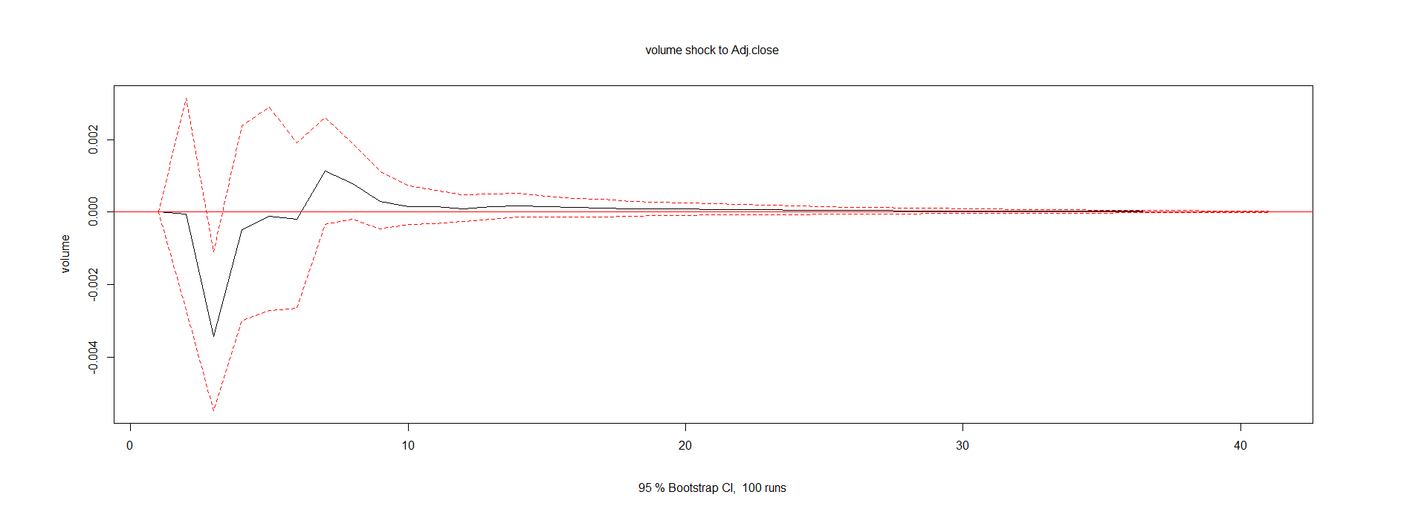
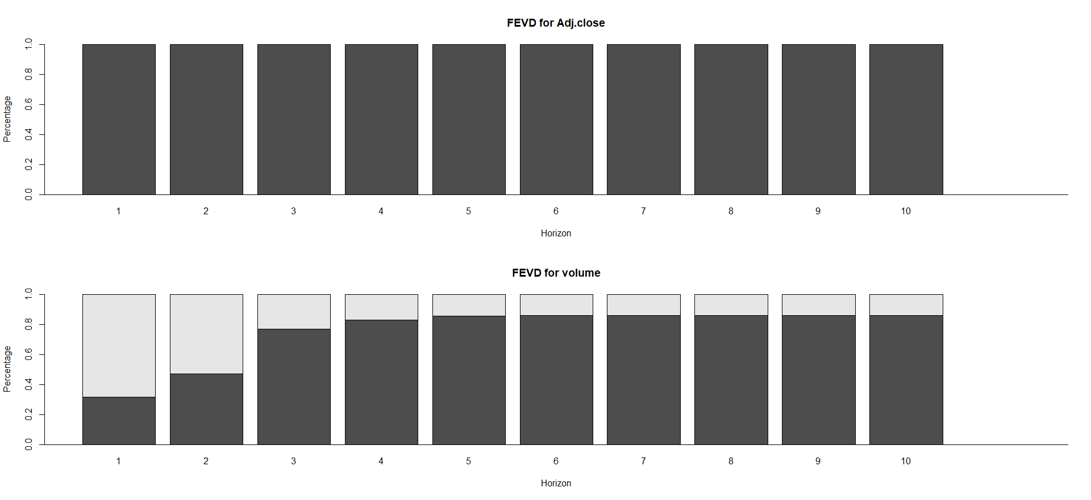
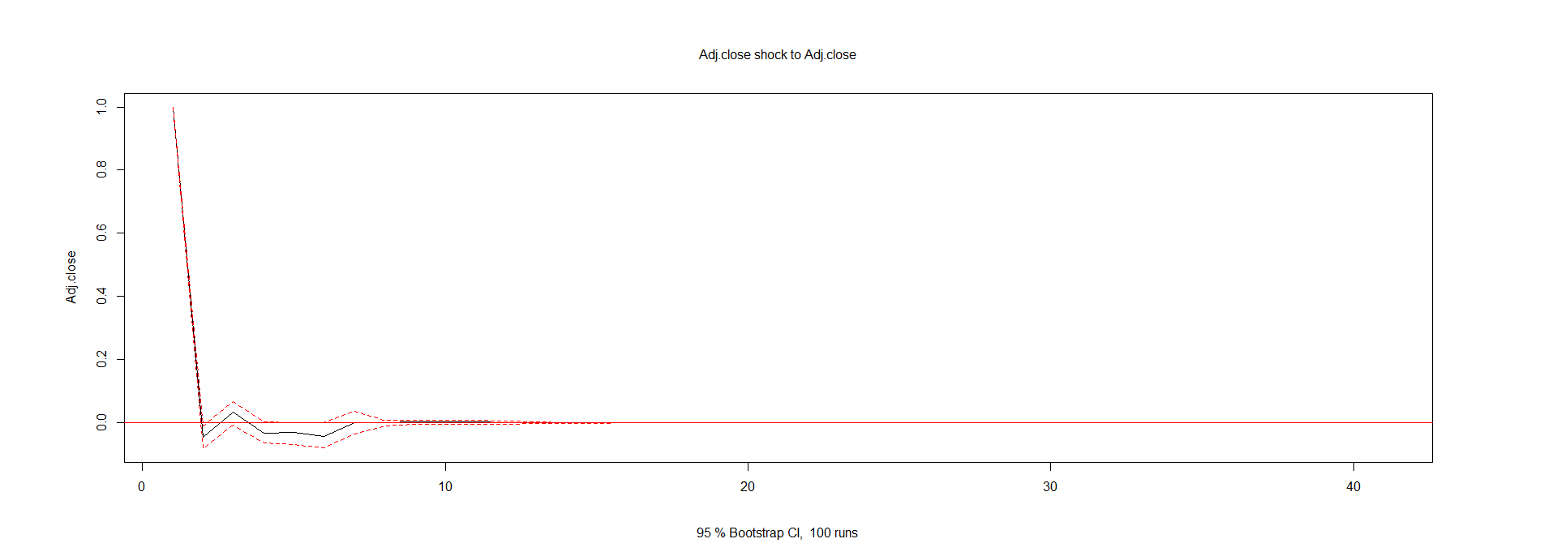
Adding Contemporaneous effects
Multivariate analysis: Adjusted close and Volume

Slide 35

THANK YOU!

