Slide 1

Nashville rock-and-roll marathon and Half-marathon race results (2016-2019)
Presented by Lydia tsang

Slide 2

What are the findings from the data?
In general, 2017 is the slowest year and 2019 is the fastest year!
Look at mean and median in marathons and half-marathons
Who beat Oprah time in marathons(%)
Quartiles in half marathons
My hypothesis

Slide 3


Marathons (mean & median)

Slide 4
half-marathons (mean & median)

Slide 5
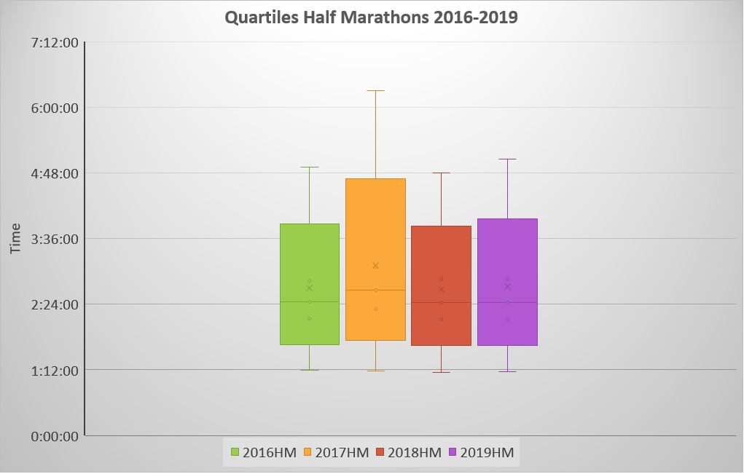

Slide 6

Who beat Oprah time(04:29:20) in marathons(%)?

Slide 7


My Hypothesis for the findings
Time (6am-12 pm) | 04/30/16 | 04/29/17 | 04/28/18 | 04/27/19
°F | 64-70 | 73-84 | 50-72 | 45-72
Humidity | 87% | 69% | 52% | 48%
Wind mph | 3.107 | 11.185 | 8.078 | 7.457
Air temperature would affect runners’ performance
Source: timeanddate.com

Slide 8
Reference
nci.nlm.nih.gov/pmc/articles/PMC3359364
timeanddate.com

Slide 9
Thank you everyone!
Questions???

