Slide 1

Recipes from Pictures
My Wife Made Me Do This.
By: Bill McKee

Slide 2
Objective
A common issue that comes around dinner time is figuring out what you can make with the ingredients you have available.
A solution is to take a picture of those ingredients and get a recipe using A.I..

Slide 3
My Solution
Select a picture of the available ingredients.
Determine the available ingredients from the picture using an object detection model.
Display the detected ingredients and allow the user to modify the list.
Ask ChatGPT to provide a couple of recipes based on those ingredients.
Display the recipes.

Slide 4
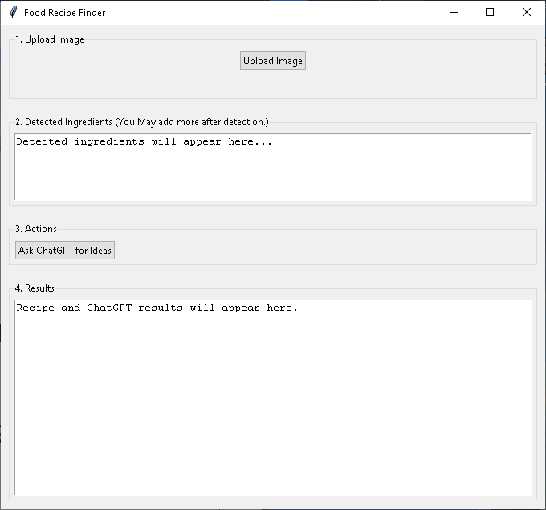
Interface

Slide 5
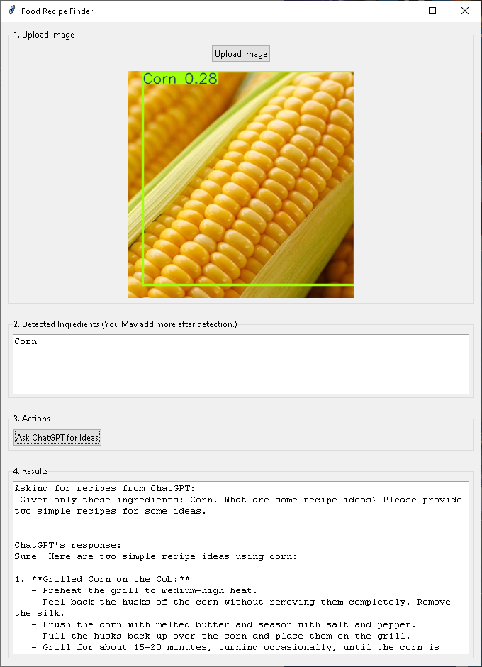
Recipe Results

Slide 6
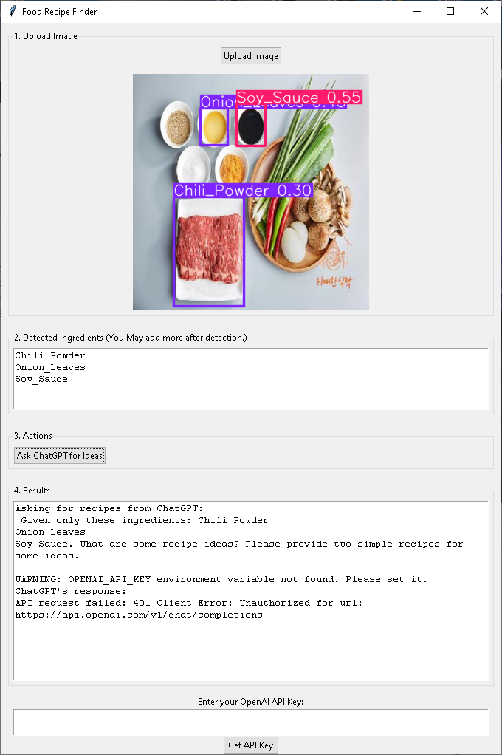
If API Key to ChatGPT is Missing
If there is no environment variable for the ChatGPT API key, then a text box will open so you can paste the key into it. Then click on the button to “Get API Key.”
Now try the “Ask ChatGPT for Ideas” again to get your recipes.

Slide 7
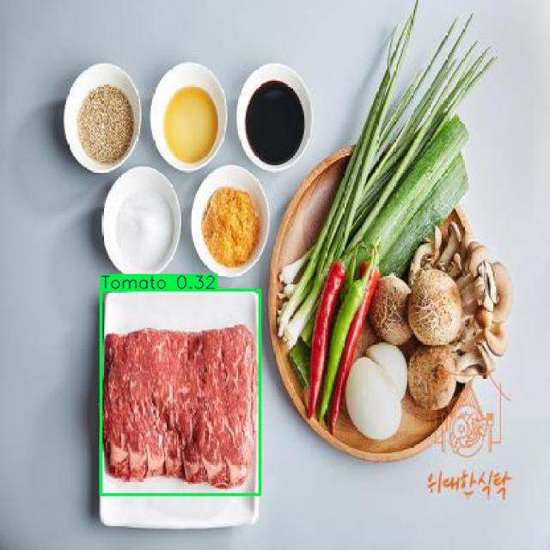
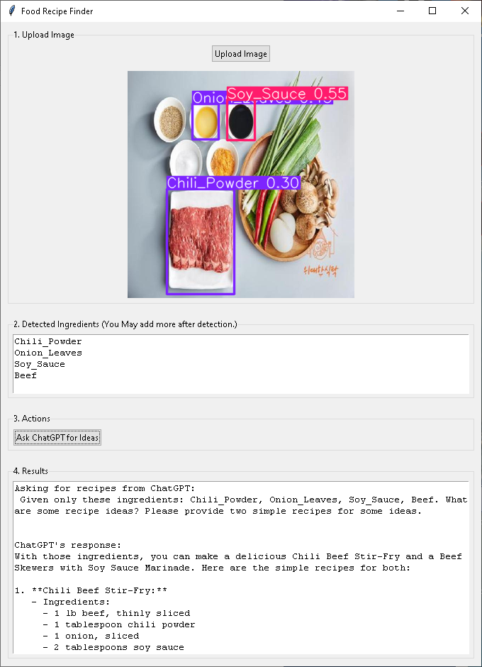
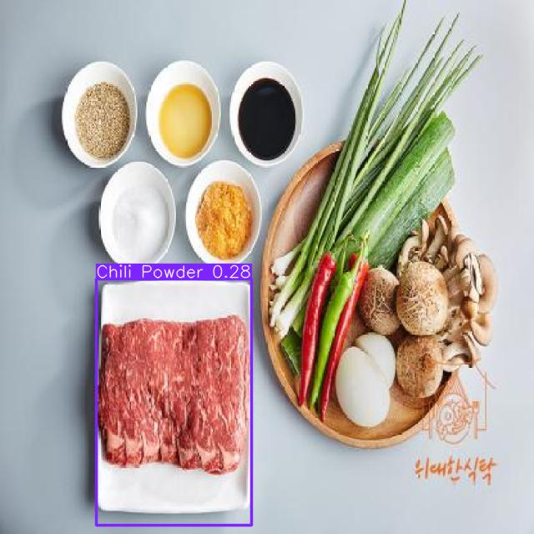
Not Always Perfect
Beef Tomato
Chili Pepper Beef

Slide 8

Some Videos of the Program in Use
Normal Operation
Missing API Operation

Slide 9
Future Improvements
Add the ability to use multiple pictures and concatenate the results.
Develop a better dataset of ingredients.
Improve the object detection model.
Add save and print capabilities for the recipes.
Add the ability to change the number of recipes to be retrieved.
Add the ability to get specialized recipes based on dietary constraints and meal type.
Place each recipe in a different tab of a text box.
Create a specialized LLM for generating recipes.
Make it into a phone application using the cloud to handle the A.I. portion.

Slide 10
References
https://platform.ultralytics.com/
https://universe.roboflow.com/food-recipe-ingredient-images-0gnku/food-ingredients-dataset
https://www.themealdb.com/
https://openai.com/
https://www.nvidia.com/en-us/autonomous-machines/embedded-systems/jetson-thor/
https://colab.research.google.com/

