Slide 1
Hand-Written-Digit
Image Reading
Group 9
Josh Follmer, Well M Mousa, Gary Layman

Slide 2
0
Getting MNIST Data

Slide 3
Downloading the MNIST Dataset
# Preprocessing transformations
transform = transforms.Compose([
transforms.ToTensor(),
transforms.Normalize((0.3,), (0.3,)) # Normalize the images to [-1, 1]
])
# Download the MNIST dataset
train_dataset = datasets.MNIST(root='./data', train=True, transform=transform, download=True)
test_dataset = datasets.MNIST(root='./data', train=False, transform=transform, download=True)
# Create DataLoaders
train_loader = DataLoader(dataset=train_dataset, batch_size=batch_size, shuffle=True)
test_loader = DataLoader(dataset=test_dataset, batch_size=batch_size, shuffle=False)

Slide 4
1
Implementing Neural Network

Slide 5
The Model
# Define the MLP model
class MLP(nn.Module):
def __init__(self):
super(MLP, self).__init__()
self.fc1 = nn.Linear(28*28, 256) # Input layer to hidden layer
self.fc2 = nn.Linear(256, 128) # Hidden layer to another hidden layer
self.fc3 = nn.Linear(128, 10) # Hidden layer to output layer
self.relu = nn.ReLU()
self.softmax = nn.Softmax(dim=1)
def forward(self, x):
x = x.view(-1, 28*28) # Flatten the image
x = self.relu(self.fc1(x))
x = self.relu(self.fc2(x))
x = self.fc3(x) # No activation here; CrossEntropyLoss applies softmax
return x

Slide 6
Training Parameters
# Loss function and optimizer
criterion = nn.CrossEntropyLoss()
optimizer = torch.optim.Adam(model.parameters(), lr=0.001, weight_decay=1e-4)
epochs = 10

Slide 7
2
Training the Data

Slide 8
Training Loop
# Training loop with loss tracking and validation
train_losses = []
print("Training...")
for epoch in range(epochs):
model.train()
total_loss = 0
for images, labels in train_loader:
outputs = model(images)
loss = criterion(outputs, labels)
optimizer.zero_grad()
loss.backward()
optimizer.step()
total_loss += loss.item()
avg_loss = total_loss / len(train_loader)
train_losses.append(avg_loss)
print(f"Epoch [{epoch+1}/{epochs}], Train Loss: {avg_loss:.4f}")

Slide 9
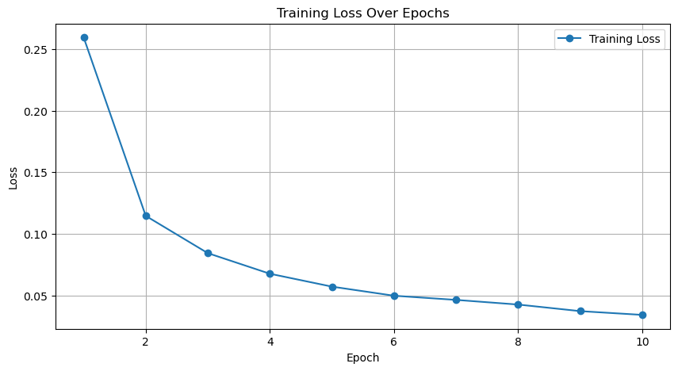
Training Loss by Epoch

Slide 10
3
Test the Trained Model

Slide 11
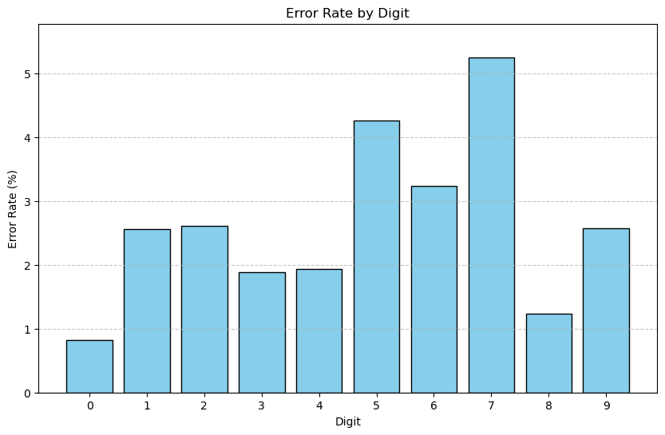
Training Loop Overall Accuracy: 98.04%

Slide 12
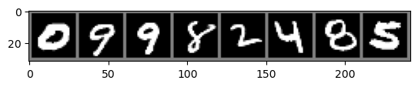

Slide 13
4
Testing on Class Digits

Slide 14
def ProjectDataLoader():
# change working directory to the script's directory
script_dir = os.path.dirname(os.path.abspath(__file__)) # get script's directory
os.chdir(script_dir)
images = []
labels = []
for filename in os.listdir("digits/"):
image_path = os.path.join("digits/", filename)
image = Image.open(image_path).convert("L")
image = image.resize((28, 28))
image_array = np.array(image)
tensor = torch.tensor(image_array, dtype=torch.float32)
normalized_tensor = (tensor - 127.5) / 127.5
images.append(normalized_tensor)
labels.append(filename[0])
images = np.array(images) # shape: (num_images, height, width)
labels = np.array(labels) # shape: (num_images)
return images, labels

Slide 15
import projectdataloader as pdl
# Load custom data
custom images, custom_labels = pdl.ProjectDataLoader()
# Convert labels from string to integer (since the labels are digits as strings like '3', '7', etc.)
custom_labels = [int(label) for label in custom_labels] # Convert each label to an integer
# Convert the list of images into a single tensor (batch_size, 1, 28, 28)
custom images = torch.stack([torch.tensor(image, dtype=torch.float32).unsqueeze(0) for image in custom images]) # Add channel dimension
# Convert labels to a tensor of integers
custom_labels = torch.tensor([int(label) for label in custom_labels], dtype=torch.long)
# Make predictions
model.eval()
with torch.no_grad():
outputs = model(custom images)
_, predicted = torch.max(outputs, 1)
# Calculate overall accuracy
correct = (predicted == custom_labels).sum().item()
total = custom_labels.size(0)
accuracy = 100 * correct / total

Slide 16
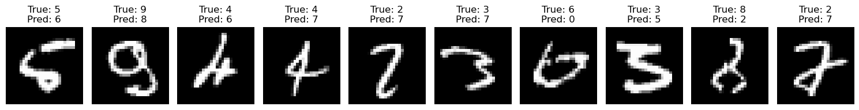
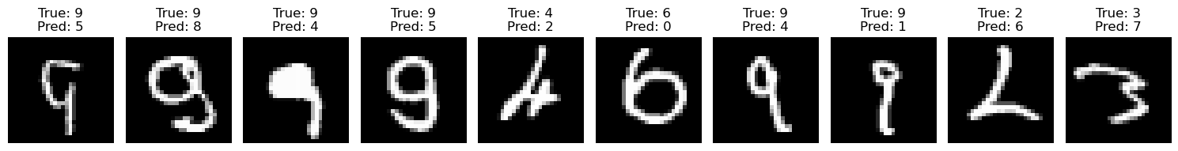
Overall Accuracy: 42.90%

Slide 17
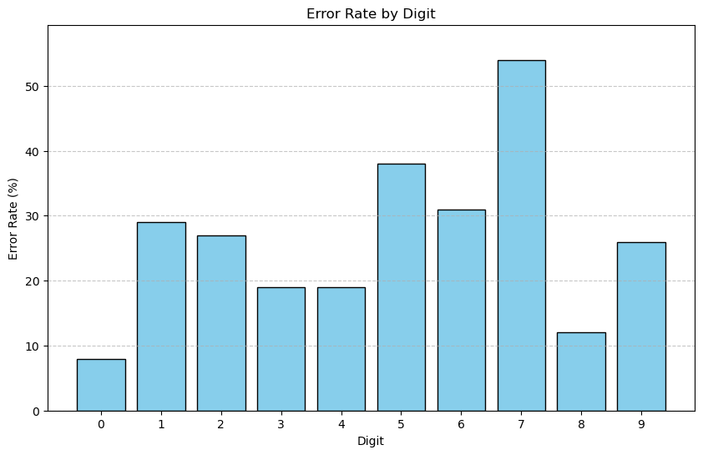

Slide 18
5
Training on the Class Data

Slide 19
# Split data into training and testing sets
dataset = TensorDataset(custom_images, custom_labels)
train_size = int(0.8 * len(dataset))
test_size = len(dataset) - train_size
train_dataset, test_dataset = random_split(dataset, [train_size, test_size])
train_loader = DataLoader(train_dataset, batch_size=64, shuffle=True)
# Fine-tune the model on the new data
num_epochs = 10
for epoch in range(num_epochs):
model.train() # Set model to training mode
running_loss = 0.0
correct = 0
total = 0
for images, labels in train_loader:
optimizer.zero_grad() # Zero gradients
outputs = model(images) # Forward pass
loss = criterion(outputs, labels) # Loss computation
loss.backward() # Backward pass
optimizer.step() # Update weights
# Track metrics
_, predicted = torch.max(outputs, 1)
correct += (predicted == labels).sum().item()
total += labels.size(0)
running_loss += loss.item()

Slide 20
Promising Training
Epoch 1/10, Loss: 1.6404, Accuracy: 50.10% Epoch 2/10, Loss: 1.0404, Accuracy: 65.42% Epoch 3/10, Loss: 0.8815, Accuracy: 69.76% Epoch 4/10, Loss: 0.6786, Accuracy: 77.32% Epoch 5/10, Loss: 0.5644, Accuracy: 80.14% Epoch 6/10, Loss: 0.5220, Accuracy: 81.85% Epoch 7/10, Loss: 0.4671, Accuracy: 84.98% Epoch 8/10, Loss: 0.3886, Accuracy: 87.30% Epoch 9/10, Loss: 0.3918, Accuracy: 87.60% Epoch 10/10, Loss: 0.3448, Accuracy: 88.91%

Slide 21
6
Test the Revised Trained Model

Slide 22
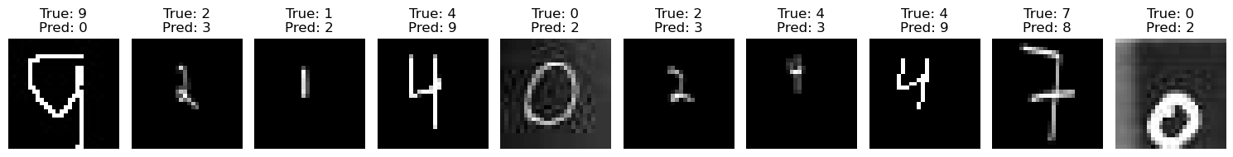
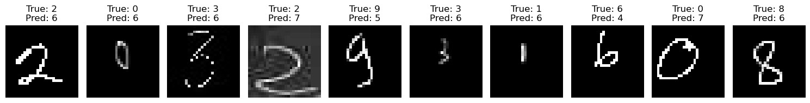
Overall Accuracy: 75.40%

Slide 23
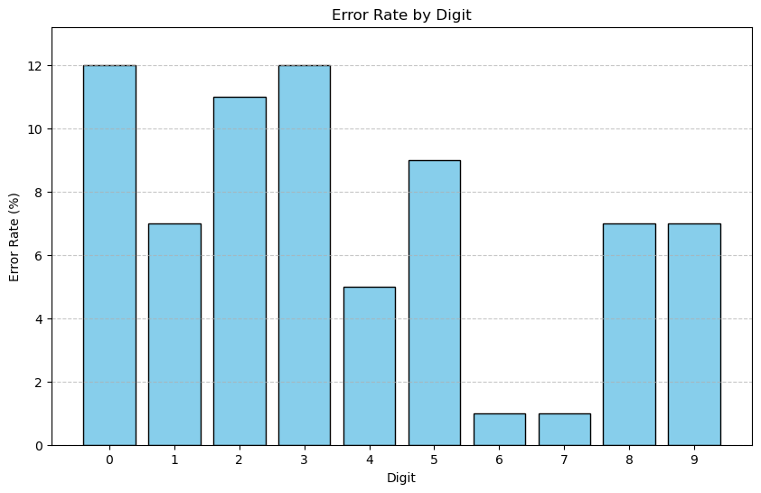

Slide 24
Questions?

Slide 25
THANK YOU

