Slide 1
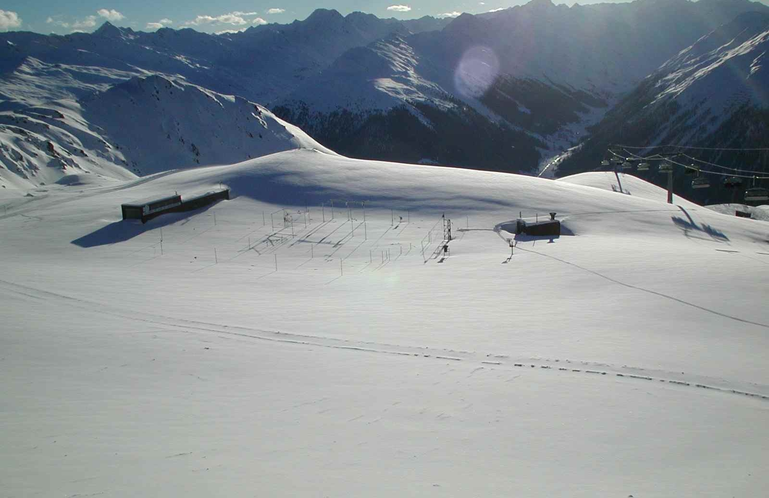
TT-TDCF meeting, online, 2 May 2024
New BUFR Template for Snow Surface Temperature
Charles Fierz, SLF/WSL

Slide 2
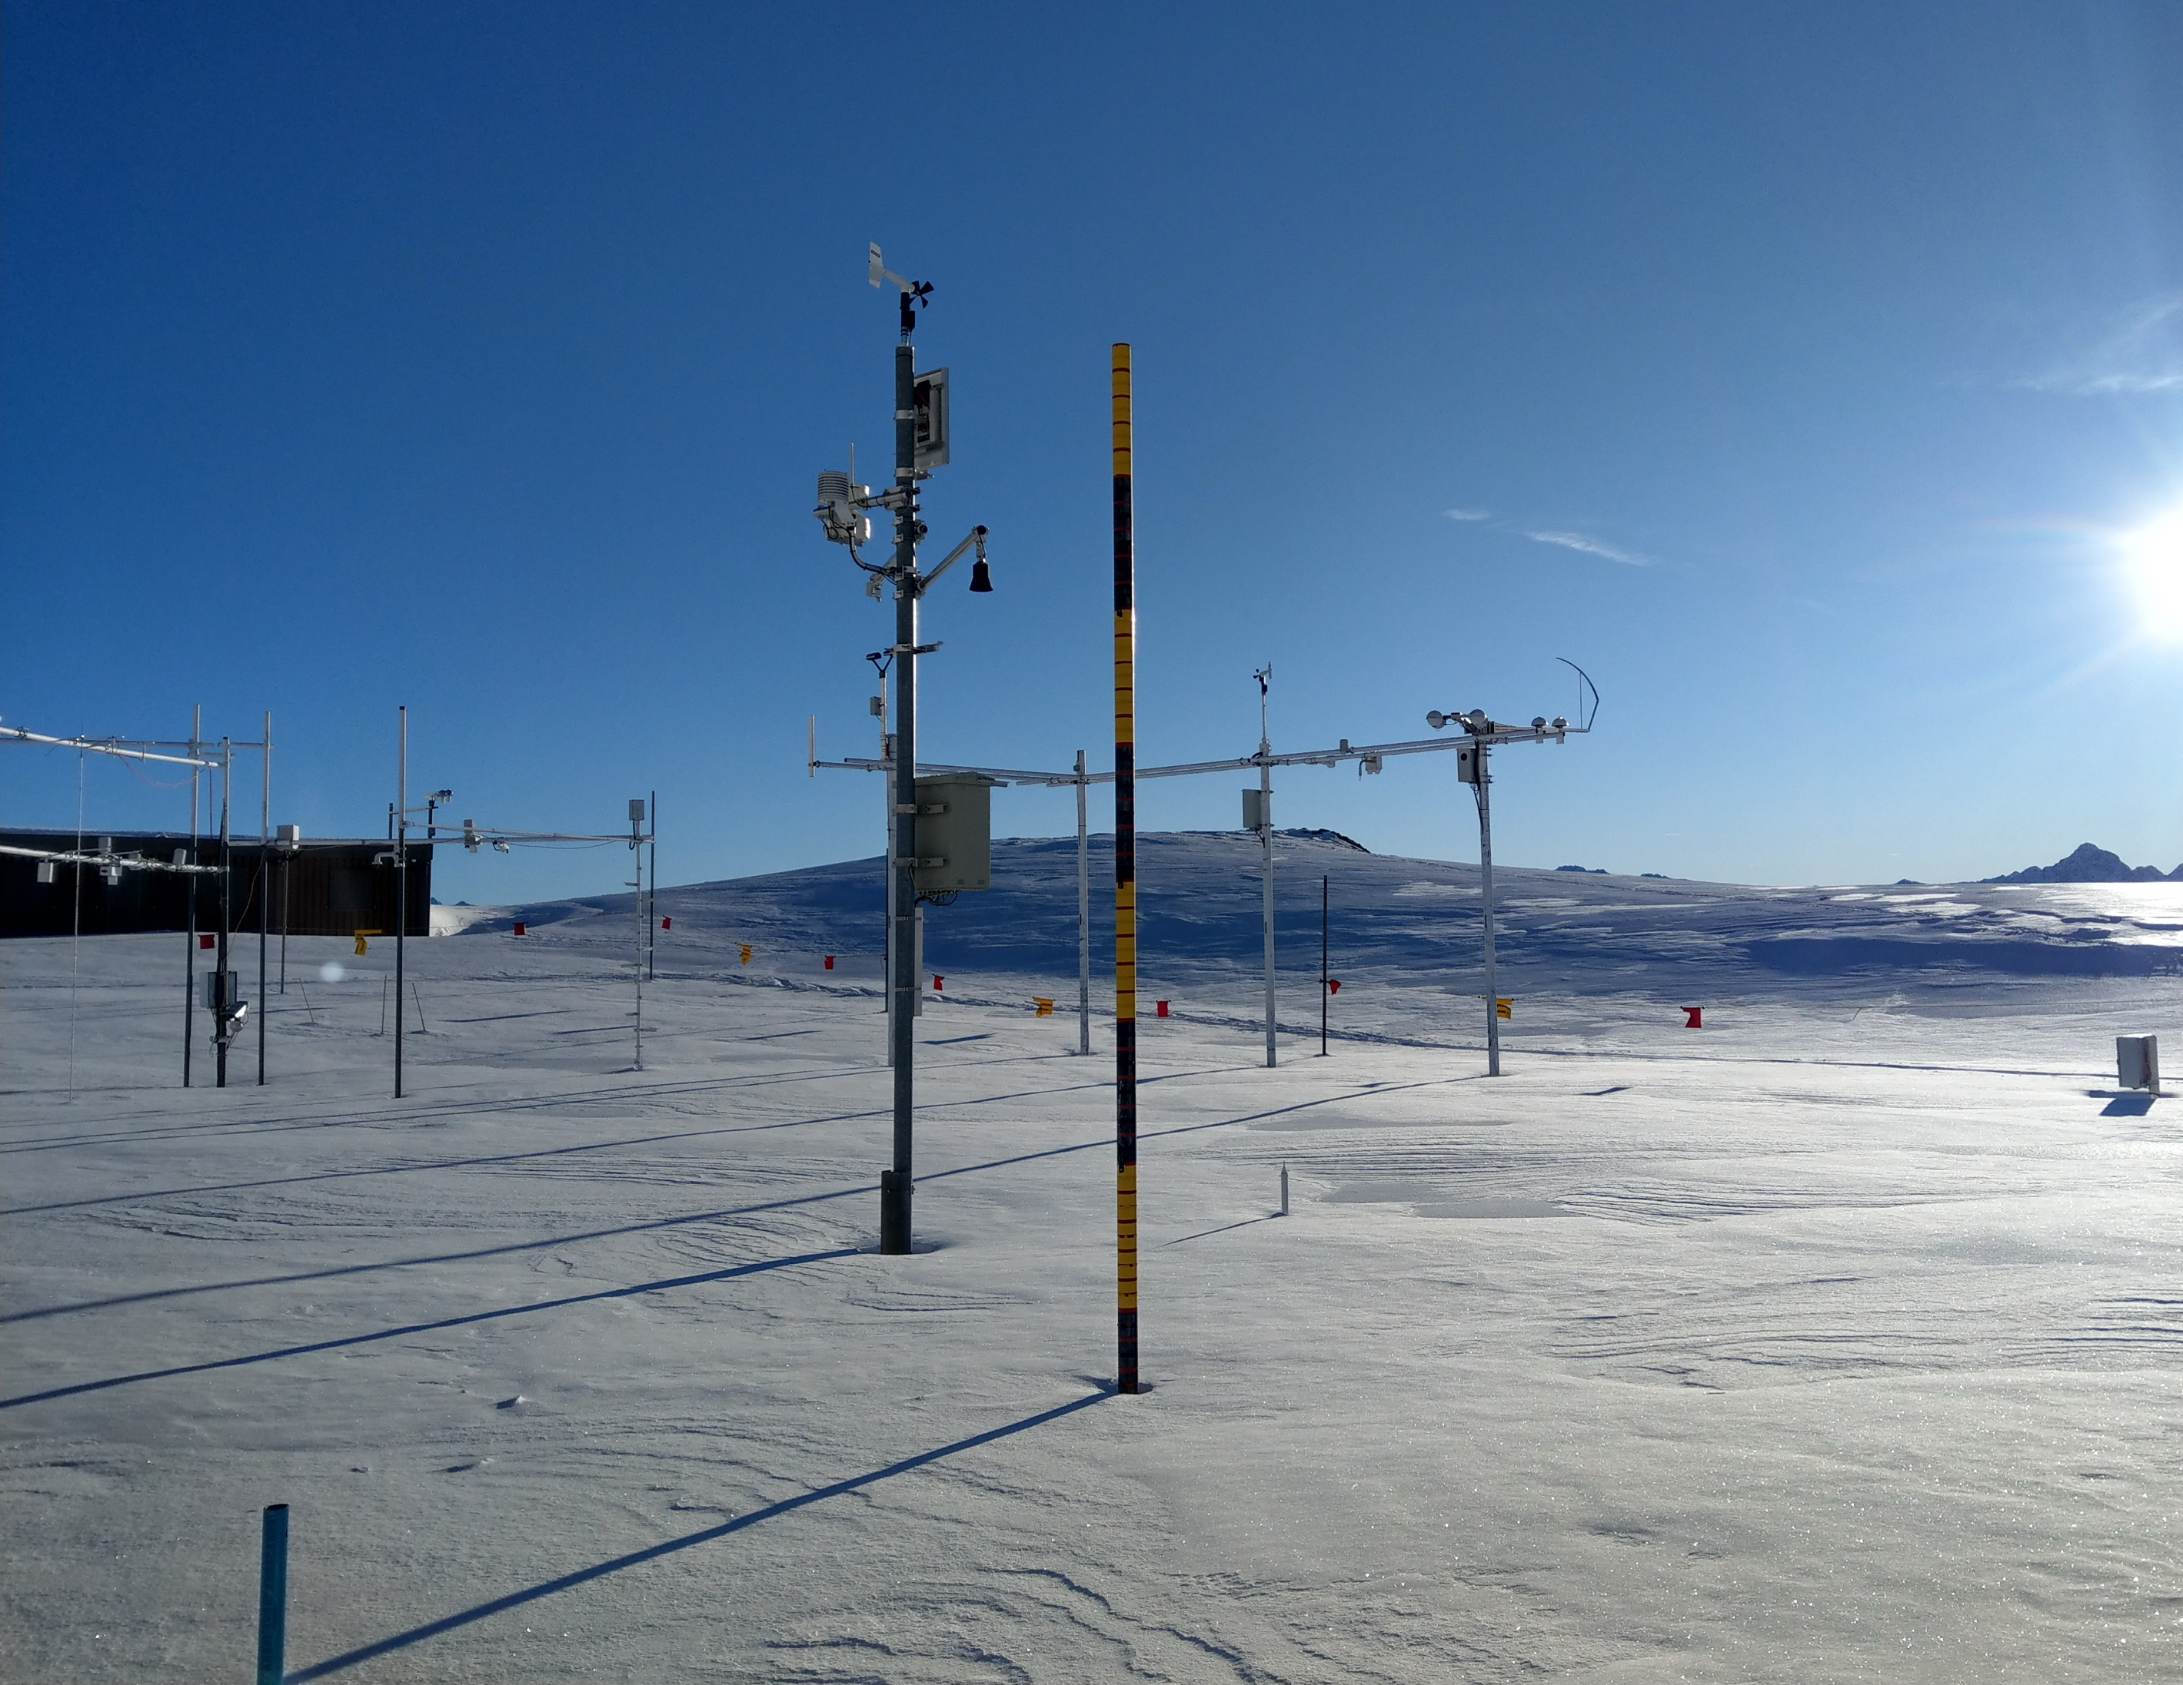
SNOW SURFACE TEMPERATURE
RevisionGIMO, Vol II, Chap2 - Snow
Snow surface temperature Physical temperature of the surface layer of the snow cover, that is of a thickness of typically a few but at most ten millimetres.
Comparable to Skin temperature? I.2 – BUFR/CREX Table B/12 — 2, 0 12 061 & 0 12 161
Measured with IR-thermometer (11-14 μm)
Contactless

Slide 3
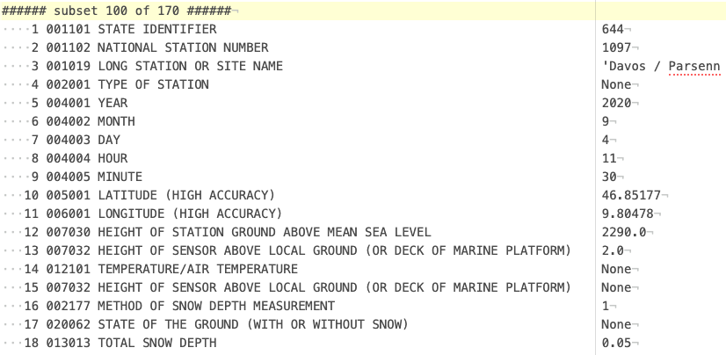
SNOW SURFACE TEMPERATURE
Data assimilation
Boundary condition / validation for snow-cover models
Excerpt BUFR msg MCHE to ECMWF
~ 90 Swiss stations BUFR msg to ECMWF
CEN – MétéoFrance?
Research stations

Slide 4
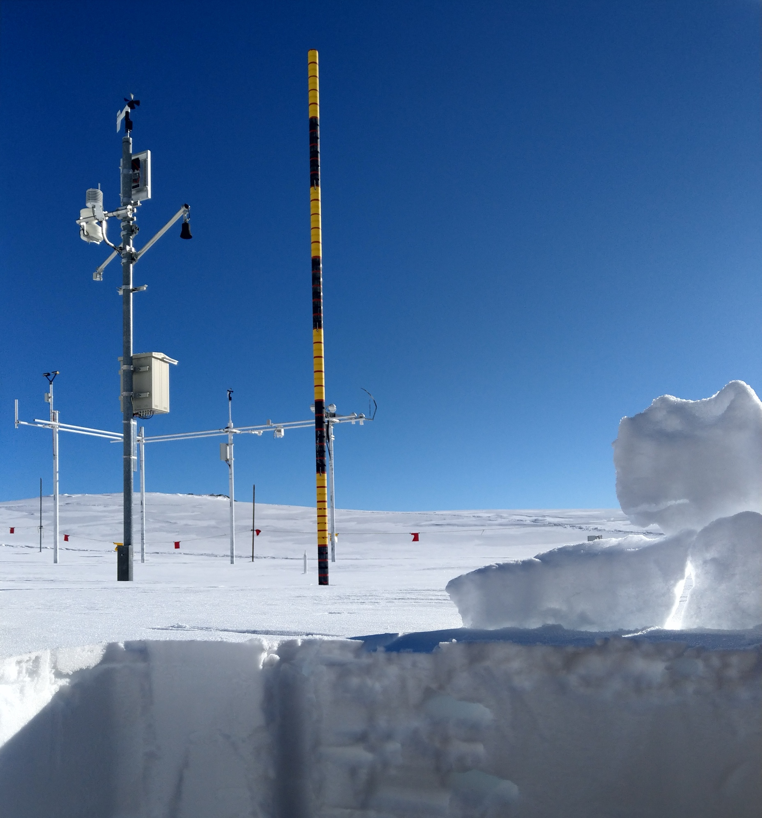
‘GENERIC’ TEMPERATURE PROFILE
RevisionGIMO, Vol II, Chap2 - Snow
Snow temperature Physical temperature of snow at any depth within the snow cover.
Comparable to Snow temperature? I.2 – BUFR/CREX Table B/12 — 2, 0 12 031 & 0 12 131
Snow temperature profile

Slide 5
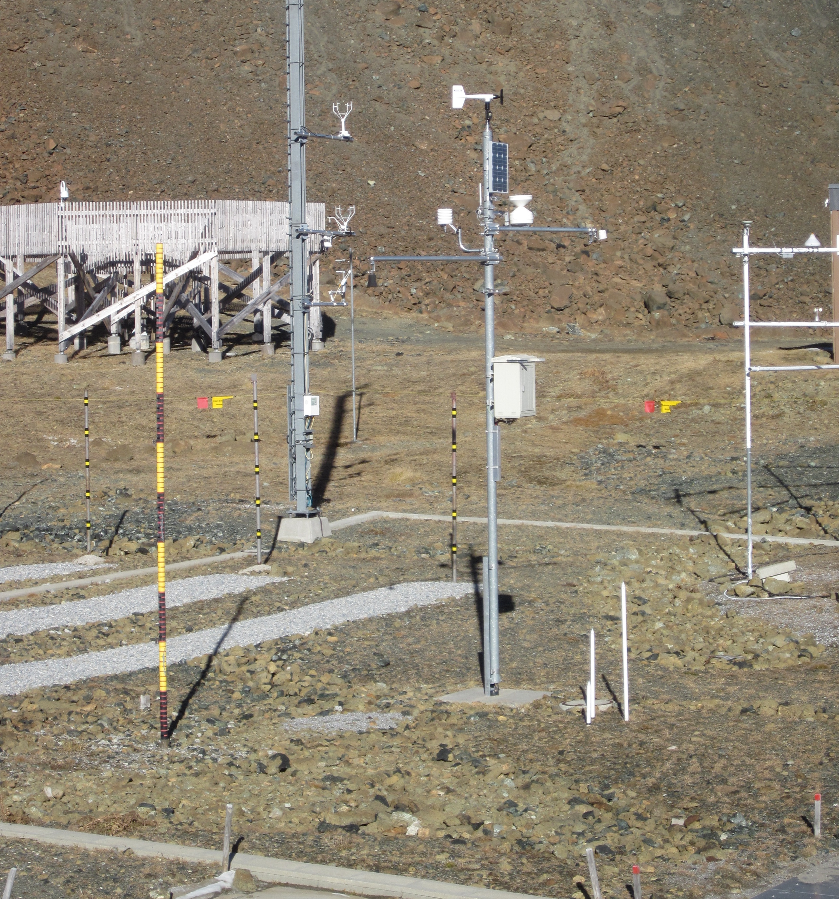
‘GENERIC’ TEMPERATURE PROFILE
Across boundaries Air - Snow – Soil temperature profile
Free(?) number of heights and depths relative to a reference horizon, e.g. land surface
‘Medium’ attribute needed
Air – snow – permafrost
Air – snow – sea ice – ocean
Air – snow – ‘polar’ firn / ice

Slide 6
Thank you!
GCW CryoNet cluster Davos

