Slide 1
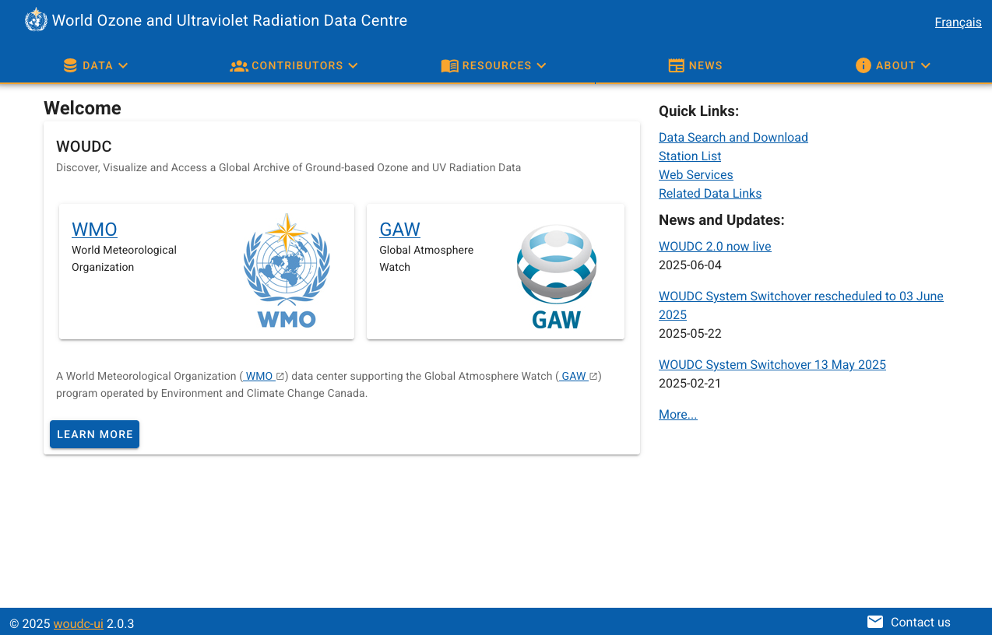
WMO WOUDC
Update
WMO SAG-O3-UV
2025-06-30
Tom Kralidis and Kevin Ngai
Geospatial and Open Data Systems
Meteorological Service of Canada
Environment and Climate Change Canada

Slide 2
WMO WOUDC Update
Data Centre status
Standard operating procedures
2024 by the numbers
WOUDC 2.0 updates

Slide 3
Data Centre Status
Meteorological Service of Canada
Collaboration with ECCC Science and Technology Branch
WMO reporting
  SAG on Ozone/UV
  WMO Expert Team on Atmospheric Composition Data Management
    formerly ET on World Data Centres (ET-WDC)
  Data Centre Interoperability (DCIO)

Slide 4
Data Centre Status
2015: renewal (WOUDC 1.0)
2025: platform upgrade (WOUDC 2.0)
Current operations
  Contributor support
  User support
  Continuous data improvement
    Data ingest
    Metadata quality assessment / correction
  Enhancements
Notes:
1 - 2 website / API releases per year

Slide 5
DATA CENTRE STATUS
2024-02-01 to 2024-03-14: Metrics server issue resulted in missing logs
WOUDC 2.0 implementation
Complete data re-ingest, numerous corrections:
  Metadata QC
  Data files updates (moving to various folders)
  Discarded empty data files with contributor’s permission
    Remaining empty files on the WAF are not ingested in WOUDC 2.0

Slide 6
Standard operating procedures
Submissions, contact validation, metadata QC ongoing, unchanged
  See Annex for details
WOUDC Guidebook: guide.woudc.org

Slide 7
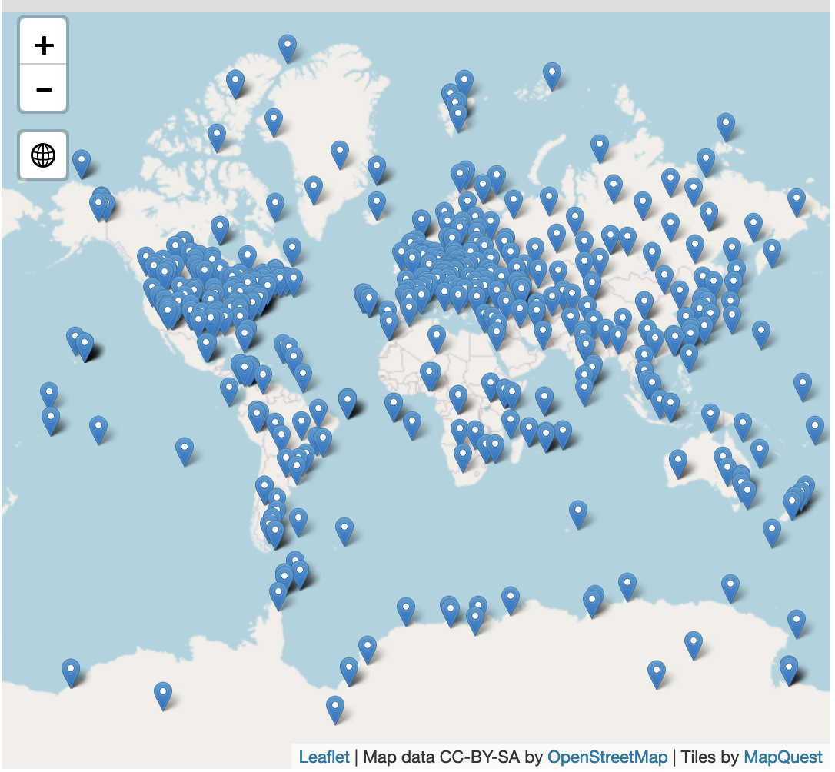
Number of Files by Dataset (2025-06-27)
Broad-band 1.0 | 172588
Broad-band 2.0 | 4084
OzoneSonde 1.0 (form 1) | 100807
OzoneSonde 1.0 (form 2) | 1638
Lidar | 675
Multi-band | 93778
TotalOzoneObs 1.0 | 167255
TotalOzone 1.0 | 91874
TotalOzone 2.0 | 494
Spectral 1.0 | 325286
Spectral 2.0 | 4050
UmkehrN14 1.0 | 10886
UmkehrN14 2.0 | 10240
RocketSonde | 176
TOTAL | 983821
471 stations (duplicates removed)

Slide 8
NEW CONTRIBUTORS
National Agency of Civil Aviation and Meteorology (Comoros)
Hokkaido University (Japan)
Center of Atmospheric Watch and service, China Meteorological Administration (China)
Yunnan University (China)
Center of Excellence Telesensing of Environment and Model Prediction of Severe Events - University of L'Aquila (Italy)
Uruguayan Institute of Meteorology (Uruguay)
NEW STATIONS
Moroni
Akedala
Shangdianzi
Kunming
Casale Calore
Bharati
Hokkaido Sapporo University
Salto Grande [returned]

Slide 9
Processing Runs 2024
Month | Total Files | Passed | Fixed | Failed (extCSV) | Failed (non-standard) | % Passed | % Passed With Fixes | % Failed
January | 1567 | 1060 | 351 | 499 | 338 | 67.65 | 22.40 | 53.41
February | 1189 | 768 | 296 | 421 | 57 | 64.59 | 24.89 | 40.20
March | 1859 | 1538 | 293 | 326 | 125 | 82.73 | 15.76 | 24.26
April | 3203 | 2517 | 21 | 573 | 14 | 78.58 | 0.66 | 18.33
May | 5778 | 5392 | 215 | 386 | 32 | 93.32 | 3.72 | 7.23
June | 3146 | 2825 | 819 | 284 | 1 | 89.80 | 26.03 | 9.06
July | 4056 | 2159 | 665 | 1885 | 1859 | 53.23 | 16.40 | 92.31
August | 1956 | 735 | 53 | 1221 | 4 | 37.58 | 2.71 | 62.63
September | 1328 | 1312 | 38 | 16 | 0 | 98.80 | 2.86 | 1.20
October | 3433 | 964 | 365 | 2468 | 351 | 28.08 | 10.63 | 82.11
November | 2836 | 2685 | 134 | 0 | 0 | 94.68 | 4.72 | 0.00
December | 5027 | 4328 | 80 | 697 | 0 | 86.10 | 1.59 | 13.87
Total | 35378 | 26283 | 3330 | 8776 | 2781 | 74.29 | 9.41 | 32.67

Slide 10
Processing runs 2024
Issues noted
  Hokkaido University: new contributor, duplicate files
  MeteoSwiss: publishing to 2 agencies
Removing these issues and duplicate file publishing results in 14.87 % Failed (last column)

Slide 11
Processing runs by year
Year | Total Files | Passed | Fixed | Failed (extCSV) | Failed (non-standard) | % Passed | % Passed With Fixes | % Failed
2016 | 34451 | N/A | N/A | N/A | N/A | N/A | N/A | N/A
2017 | 44022 | 28049 | 6863 | 2367 | 6743 | 63.72 | 15.59 | 20.69
2018 | 31224 | 19364 | 3496 | 1704 | 6560 | 62.02 | 11.20 | 26.47
2019 | 112249 | 98871 | 12121 | 927 | 330 | 88.08 | 10.80 | 1.12
2020 | 100662 | 73046 | 24439 | 2071 | 1056 | 72.57 | 24.28 | 3.11
2021 | 32529 | 21086 | 10199 | 897 | 615 | 64.82 | 31.35 | 4.65
2022 | 22192 | 22127 | 2317 | 1626 | 626 | 99.71 | 10.44 | 10.15
2023 | 50953 | 32813 | 2015 | 3399 | 491 | 64.40 | 3.95 | 7.63
2024 | 35378 | 26283 | 3330 | 8776 | 2781 | 74.29 | 9.41 | 32.67

Slide 12
Downloads 2024
(excludes 2024-02-01 to 2024-03-14)
Dataset | WAF (number of downloads)
OzoneSonde_1.0_1 | 25606035
TotalOzone_1.0_1 | 18754888
TotalOzoneObs_1.0_1 | 8685276
Spectral_1.0_1 | 3760790
Broad-band_1.0_1 | 1817432
Multi-band_1.0_1 | 1019017
UmkehrN14_2.0_1 | 305962
UmkehrN14_1.0_1 | 304584
Broad-band_2.0_1 | 47489
Spectral_2.0_1 | 43168
RocketSonde | 12148
TotalOzone_2.0_1 | 33393
Lidar_1.0_1 | 16394
SurfaceOzone_1.0_1 | 44759
Total | 60451335
Dataset | Geospatial Web Services (number of requests)
OzoneSonde | 16239
TotalOzone | 10240
uv_index_hourly (data product) | 7415
TotalOzoneObs | 4797
RocketSonde | 2926
Broadband | 2856
Spectral | 2638
Lidar | 2406
Multiband | 2189
UmkehrN14 1.0 | 810
UmkehrN14 2.0 | 610
Total | 53126

Slide 13
WOUDC 2.0 release
Simplified data management
New UI: woudc.org
New API: api.woudc.org
Notification services
All software is free and open source on GitHub
WIS2 implementation
Dobson cross-section correction in progress (Xiaoyi)

Slide 14
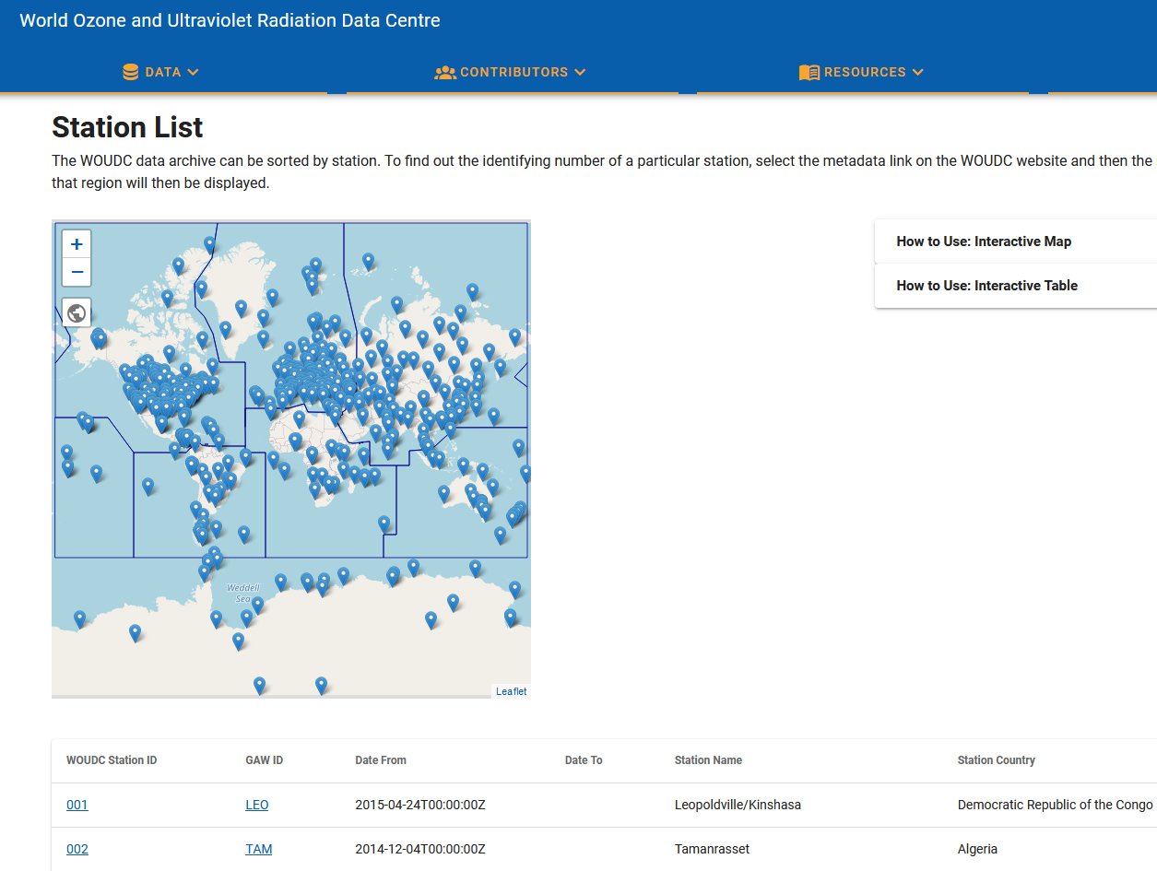
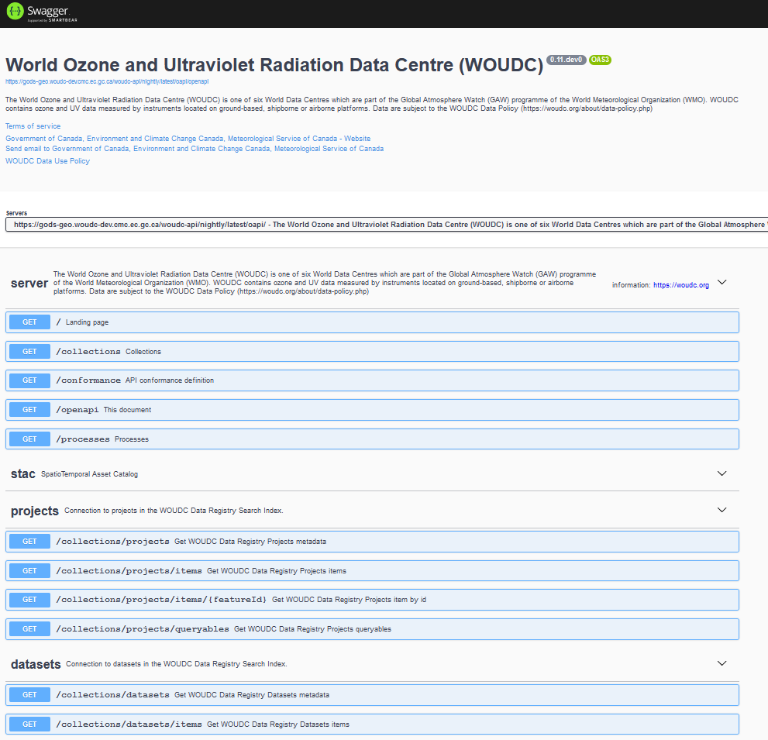
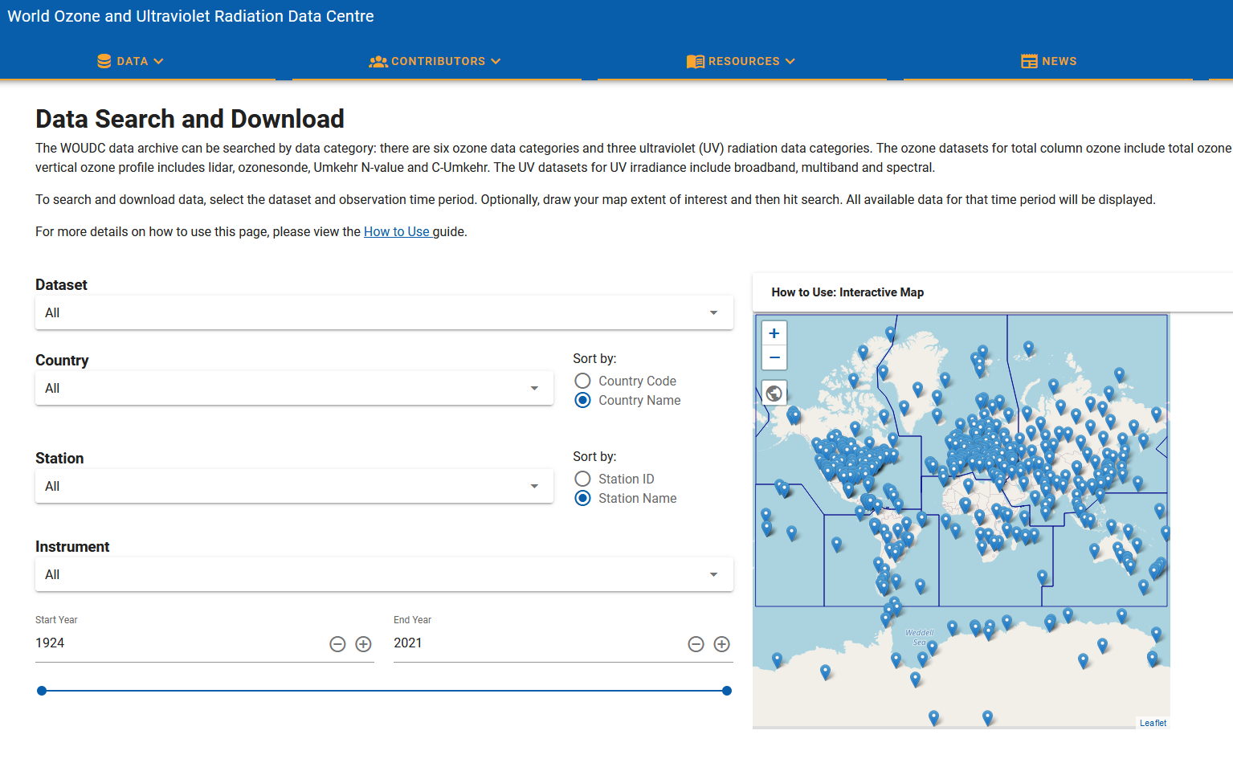
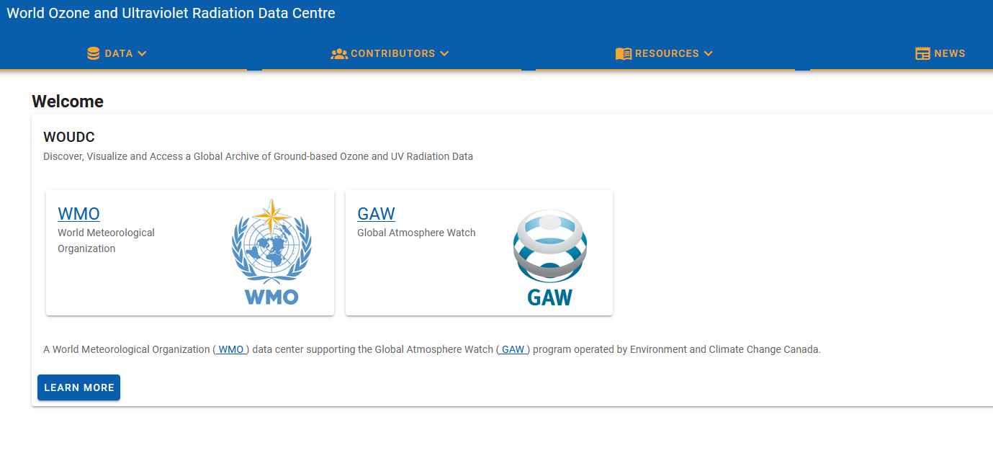
WOUDC 2.0

Slide 15







Evolution of WMO data exchange
1963 World Weather Watch
1970s Global Telecommunication System (GTS)
2007 WMO Information System (WIS)
2019 WMO Reform (Earth System Approach)
2021 WMO Unified Data Policy (Core, Recommended)
WIS 2.0
  … collaborative system of systems using Web-architecture and open standards to provide simple, timely and seamless sharing of trusted data and information …
  Open Standards (OGC, W3C, IETF, …)
  Free and Open Source tooling
  Data sharing through Web and real-time notifications with publication/subscription (Pub/Sub) protocols
  Cloud ready (turn-key solutions)
  Web APIs (Application Programming Interface)
Notes:
The exchange of weather, hydrological and climate data has continued to this day, now under the WMO, the successor to the IMO within the UN system.
Formation of world weather watch following start of satellite era and truly global coverage of weather and meteorological conditions.
Development of the WMO Global Telecommunication System in the 1970s
Evolution to the WMO Information System in the 2000s in an attempt to modernize the exchange of data. Due to the success of the GTS this was only partly successful with the GTS remaining as the main method for exchanging operational data.
However, the GTS is now struggling under the volume and variety of data to be exchanged.
In order to meet the future needs the WMO Information System is now undergoing another evolution, leveraging open standards, developments with cloud computing and cloud based infrastructure, OTS tools and open source software.
As part of this development and evolution reference implementations of the different components are being developed alongside the WIS 2.0 specifications.
----
WMO Strategic Plan (2020-2023): “Technological advances and the increasing demand for more and more diverse services from increasingly sophisticated and capable users changes rapidly the service delivery and business models in many parts of the world.”
Cg-17: “Most Members are ill-prepared for the explosion in data volumes and the growing diversity of new data sources.”
CBS led review of emerging data issues: “Cloud computing, Web services, data analytics, machine learning and other technologies present new operating concepts that will improve operational efficiency, information sharing and service delivery, and enable users to more effectively exploit data.”

Slide 16



WIS2 Components: WIS2 Nodes
Data users
Each WMO Member shall implement at least one WIS2 Node to share data in WIS2
Publishes real-time notifications about data
A WIS2 Node replaces the GTS Message Switching System
Publishes Core and Recommended data
Advertises what data is available (discovery metadata)
Data and metadata are shared using a WIS2 Node
A WIS2 Node shares data via an HTTPS service and sends notifications to MQTT subscribers
WIS2 Node
WIS2 Node
WIS2 Node

Slide 17
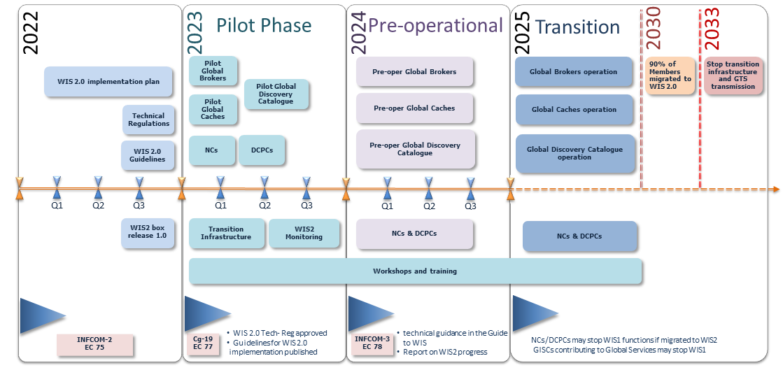
WIS2 Transition

Slide 18
WIS 2.0 Implementation
WOUDC datasets will be discoverable on the WIS2 Catalogue (search)
WOUDC data will be published and made available to WIS2 in real-time as part of the data processing/publication process
Topic definitions for atmospheric composition data publication (ET-ACDM)
  github.com/wmo-im/wis2-topic-hierarchy/issues/233

Slide 19
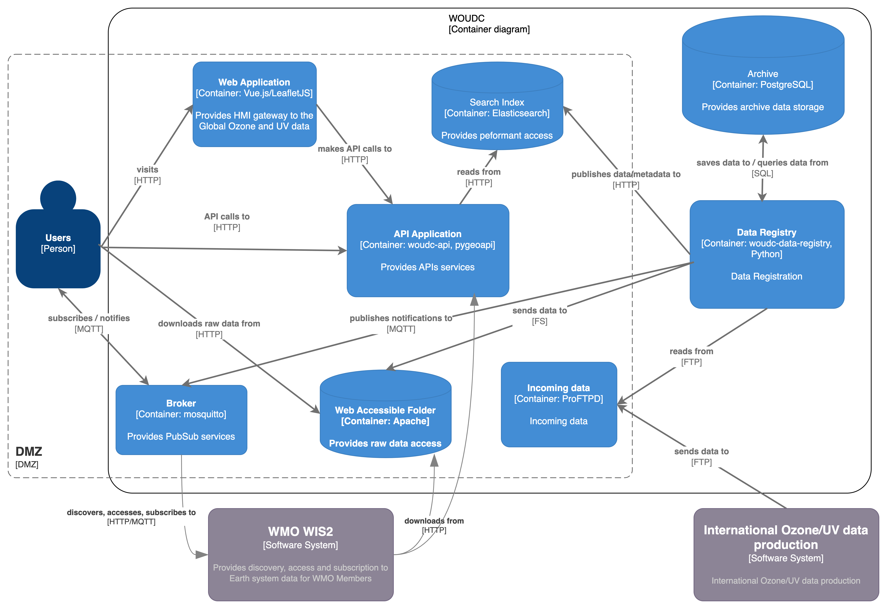

Slide 20
WMO WOUDC Update
Thank you!
Website: woudc.org
Guidebook: guide.woudc.org
GitHub/Code: github.com/woudc
Wiki: github.com/woudc/woudc/wiki

Slide 21
External Data Centre LInkages
European UV database: available via woudc.org/en/resources/links
EUBREWNET
  File indexing/discovery
NDACC
  File indexing/discovery
SHADOZ
  Full data conversion/ingest
    Action for follow-up

Slide 22
Standard operating procedures

Slide 23
Contributor Contact Validation
Annual notice sent to all contributors to validate their contact information

Slide 24
Contributor Data Submission Reminders
[1] Have contributed data within last 10 years
  AND
[2] No data received within the last 6 months
Reminder notification sent to all contributors who meet both [1] and [2]
The process runs monthly
Contributor will be notified until they do not meet [2]
10 years denotes active contributors and stations
Process can be configured as required; multiple messages, intervals between messages, sessions, cc list, bcc list, etc.
Record of notifications archived

Slide 25
Data Submission Notifications
Implemented December 2017
Contributors notified via email
  Data Submission Confirmation (nightly)
    List of submitted files to ftp.woudc.org contributor account
  Data Processing report (weekly)
    Total files received
    Number of passed files
    Number of manually repaired files
    Number of failed files
    Summary of Manual fixes

Slide 26
Metadata Quality Correction
Metadata qa/qc
Manual fixing of metadata for data submissions (in parallel to contributor feedback)
Bulk corrections (ongoing) in consultation with various stakeholders

