Slide 1
WIS2 Champions Training
​ (30 March – 4 April 2026 - Bali)​
Deep Dive on Global Monitor
Rémy Giraud, Chems Eddine El Garrai

Slide 2
Introduction

Slide 3
Why do we need monitoring ?
WIS 2.0 is a global IT system
Like any IT system to ensure its health, it must be monitored
Unlike, an IT system that it fully managed by one entity, WIS 2.0 is by design distributed
Therefore, we designed a solution that allows measuring the health of the system (among other things) without requiring extended privileged on the system

Slide 4
What for do we need monitoring ?
First and foremost, we need to monitor the IT system for successful operations
WIS2 Operations
Monitoring of WIS 2 (e.g. availability, SLAs, etc.)
However, other aspects could also benefit of the monitoring solution
GBON and SOFF
In order to follow GBON (and SOFF) implementation, it will be necessary to monitor the volume and the quality of data available
GTS to WIS2 Migration
An important element will be to follow the transition from the GTS to WIS2 and to know
Data quality monitoring
Improving what is currently available with WDQMS will require to review the solution currently used
…

Slide 5
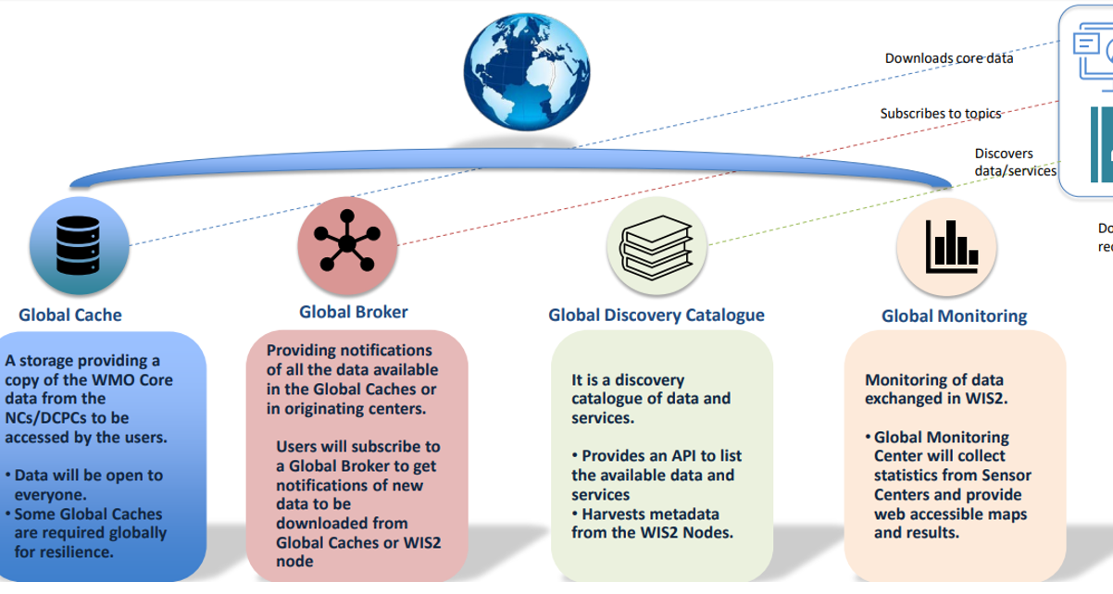
WIS2.0 Global Services(GS)
Global Monitor: Provides monitoring dashboards based on metrics collected from other Global Services and alerting mechanism to ensure 24/7 operations.
GM scrapes the metrics from the other Global Services and displays them on the dashboard, and raises alerts according the rules.
（GC）
（GB）
（GDC）
（GM）

Slide 6


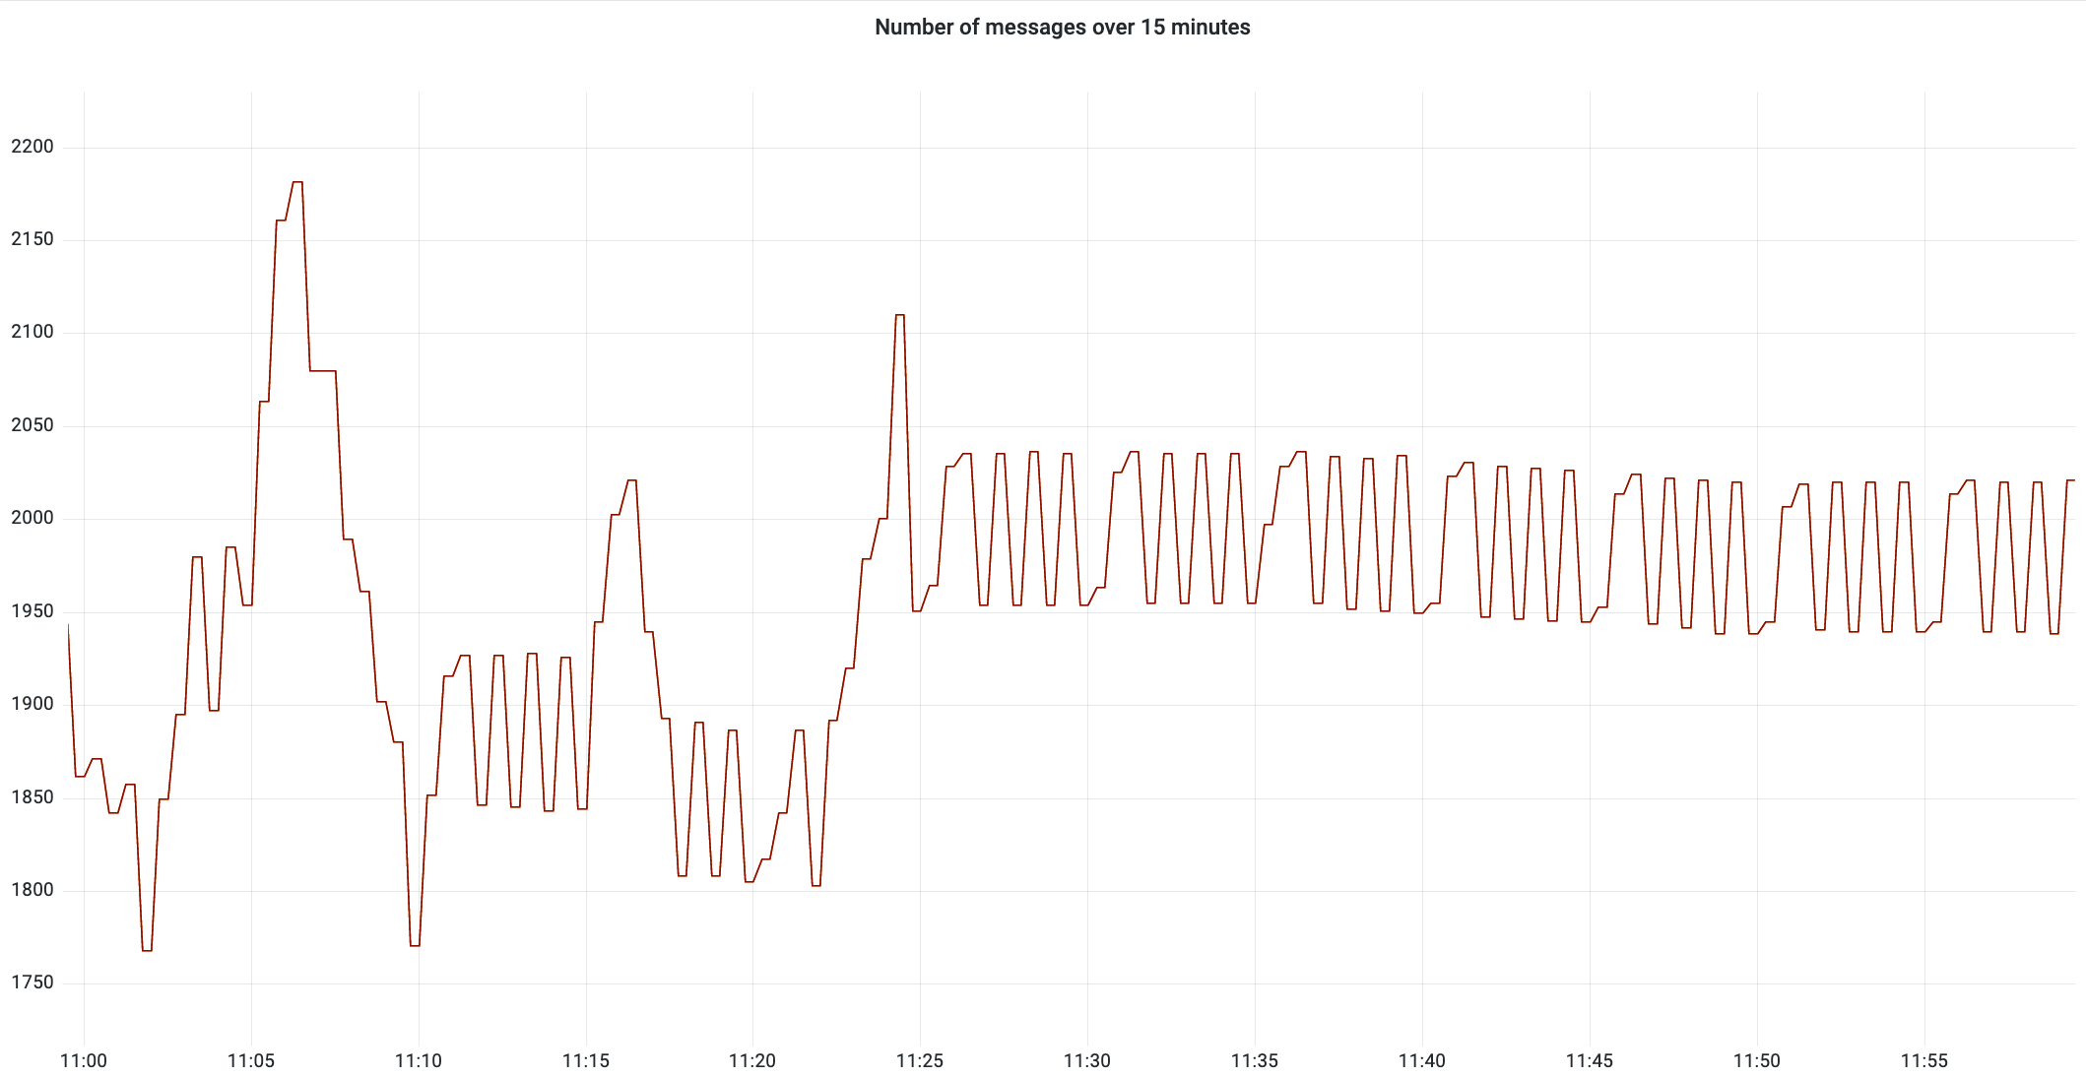











Monitoring architecture
Global Monitoring
Query
Global Broker
Access
Scrape
Subscribe
Store
Prometheus
Global Cache
Alert Manager
Download
Scrape
Alert
Inform
Scrape
Global Discovery Catalogue

Slide 7
The “Prometheus” logic
Prometheus is not a monolithic solution “Take it all or leave it”.
To work, Prometheus has defined what is called the “exposition format”. It has been further extended to openmetrics:
“It specifies the de-facto standard for transmitting cloud-native metrics at scale, with support for both text representation and Protocol Buffers.”
https://datatracker.ietf.org/doc/html/draft-richih-opsawg-openmetrics-00
It means that metrics are exposed (i.e. available at a HTTP(S)/metrics endpoint) for collection/scrape
Many tools (mosquito, nginx, docker,…) are now making there metrics available in such format:
https://prometheus.io/docs/instrumenting/exporters/
Prometheus collects those metrics, stores them in a time serie database and provide access using PromQL to tools like Grafana to create dashboards

Slide 8
OpenMetrics, Prometheus and Grafana
The “Manual on WIS2” indicates that monitoring is based on OpenMetrics
OpenMetrics is a draft standard based on the working principles of Prometheus
Systems, applications are providing metrics in an agreed format and those are collected at regular intervals by Prometheus.
Prometheus stores the metrics in a database
If the metrics are either missing or have unusual values, Prometheus can trigger an alert. AlertManager acts on such alerts
Typically, a tool like Grafana can query the Prometheus database to present graphically values from the database

Slide 9
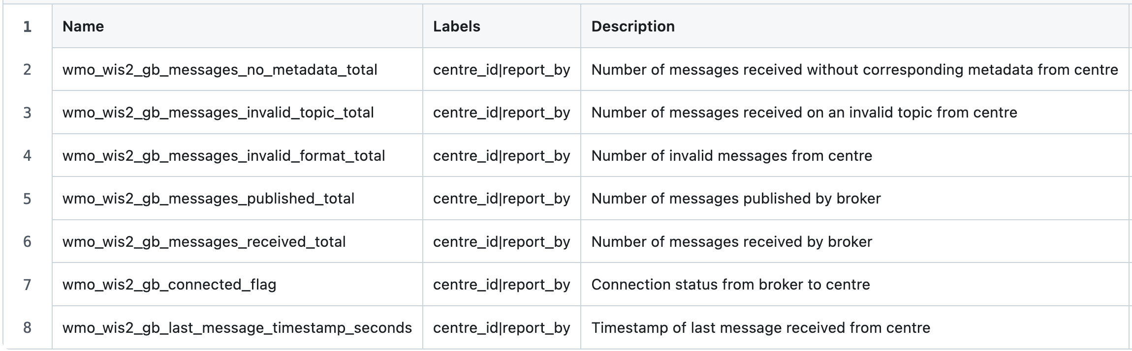
The defined metrics
Only Global Services are providing metrics. They have been defined as a mean to assess the health of WIS2 Nodes and other Global Services from a few designated centres
For each Global Service, metrics have been defined.
Eg. For Global Brokers :

Slide 10
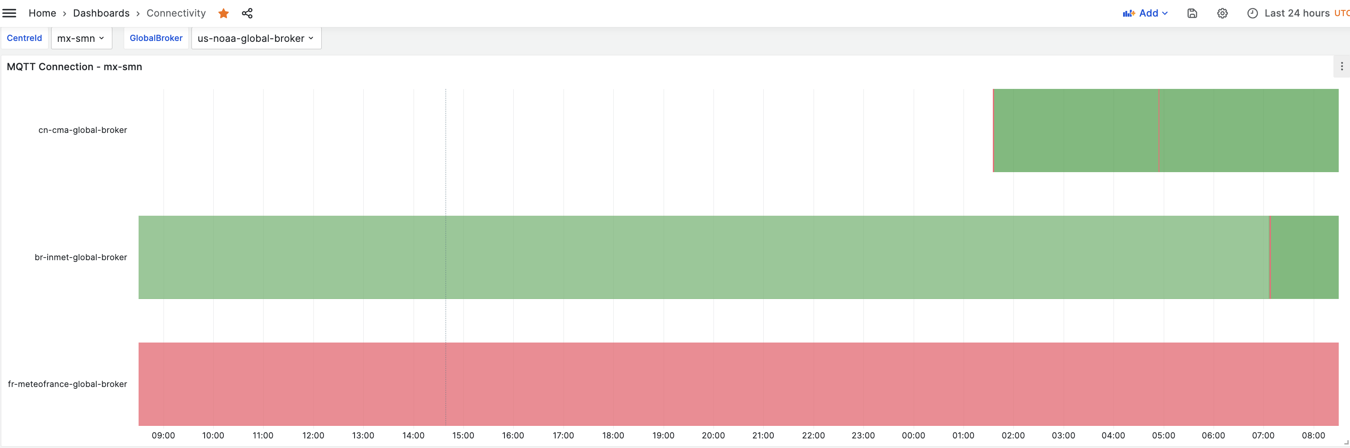
Connectivity Dashboard

Slide 11
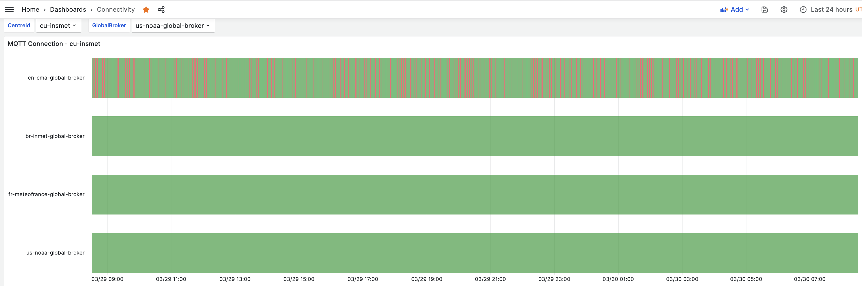
Connectivity Dashboard

Slide 12
Hands-on 1 : The Global Monitor in Morocco
Connect to : https://wis2gmc.marocmeteo.ma
(login: wis2-champions
password: wis2-champions)
Use the different dashboards.
Is there something not working as expected ?

Slide 13
ALERTING and JIRa

Slide 14






Alert Generation
GM scrapes the metrics from the other Global Services and raises alerts according the rules.
GM sends alerts to the local broker. GB subscribes to the GM's monitor topic, and after GISC subscribes to the alarms, it can provide them to responsible countries via various methods such as email, websites, message forwarding, and alarm files.
Global Monitoring
Query
Access
Scrape
Subscribe
Store
Prometheus
Alert Manager
Download
Scrape
Alert
Inform
Scrape

Slide 15
A companion of the metrics: alerts
When certain conditions are met, eg. a centre is disconnected from one or all Globa Broker for a certain period of time, this is considered as an operational incident.
Prometheus and its "companion" Alert Manager can be used to send a message on the monitor topic or even opening a jira ticket so that the incident is properly managed.

Slide 16
Example: Global Broker alert
groups:
- name: GlobalBroker
rules:
- alert: disconnectedwis2nodeonegb
expr: wmo_wis2_gb_connected_flag == 0
for: 10m
labels:
severity: warning
annotations:
summary: Disconnected WIS2 Node from one Global Broker
- alert: disconnectedwis2nodemultiplegb
expr: count by (centre_id) ( wmo_wis2_gb_connected_flag == 0 ) > 1
for: 20m
labels:
severity: error
annotations:
summary: Disconnected WIS2 Node from multiple Global Brokers
- alert: disconnectedwis2nodeallgb
expr: ( globalmonitor:wmo_wis2_gm_gb_connectivity:total - count by (centre_id) ( wmo_wis2_gb_connected_flag == 0 ) == 0 )
for: 1h
labels:
severity: critical
annotations:
summary: Disconnected WIS2 Node from all Global Brokers
groups:
- name: monitoring
rules:
- record: globalmonitor:wmo_wis2_gm_gb_connectivity:total
expr: count by (centre_id) (wmo_wis2_gb_connected_flag{report_by=~".*-global-broker"} == 0 or wmo_wis2_gb_connected_flag{report_by=~".*-global-broker"} == 1)

Slide 17
Webhook received
Jira Ticket Creation Workflow
Extract data
Status = ‘firing’?
No
End
Yes
Create summary
Yes
Already processing this alert (locked)?
End
No
Sleep for 3 minutes
Yes → unlock alert
Find ticket by summary and not closed
End
End
Yes
No
Success?
Ticket exists?
Create ticket

Slide 18
The ticketing system
jira.wmo.int

Slide 19
A step beyond

Slide 20
The Sensor Centres
WIS2 architecture has been designed to be extensible. We often talk about the foundations and then, additional floors can be added
EG., some of the future work will allow using APIs on WIS 2.0
That extensibility is also true for monitoring
What if, beyond metrics provided by each Global Services, we could have other metrics to measure, for example:
How Global Brokers are performing ?
How Global Caches are performing ?
How Global Discovery Catalogue are performing ?
What kind of data is available on WIS 2.0
Welcome to the Sensor Centres !

Slide 21

Sensor Centre
Sensor Centre
Global Monitor
Process
Scrape
Subscribe
Query
Global Broker
Access
Download
Scrape
Store
Prometheus
Subscribe
Global Cache
Alert Manager
Download
Scrape
Alert
Inform
Scrape
Global Discovery Catalogue

Slide 22
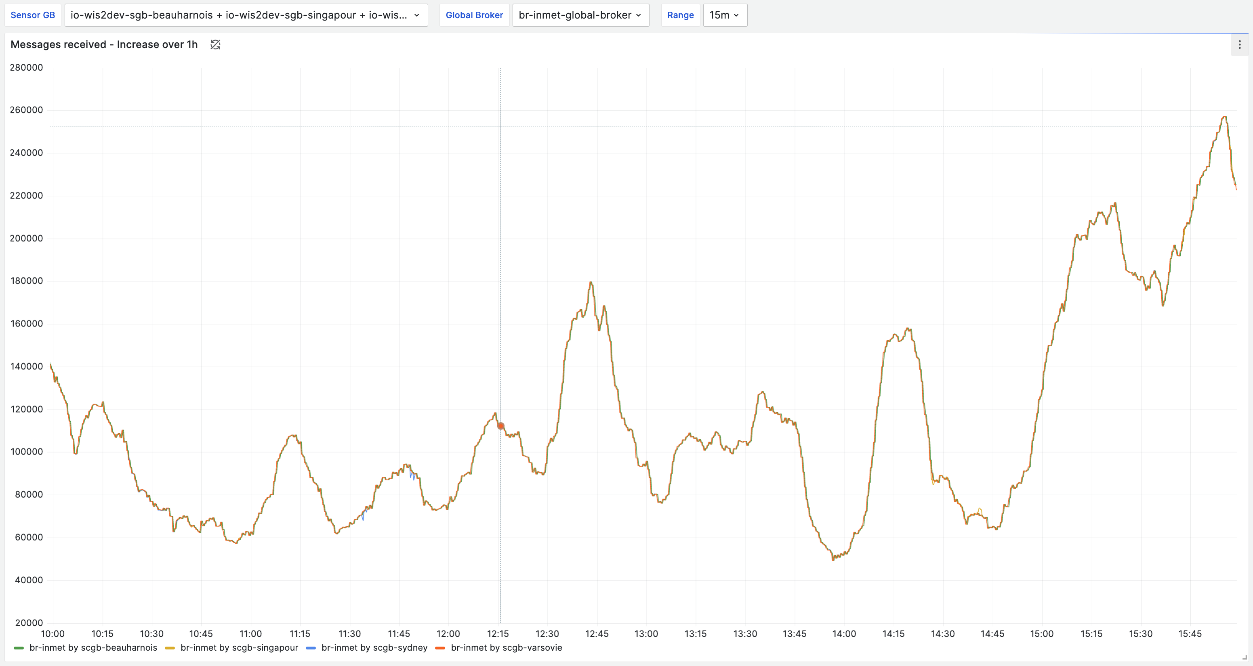
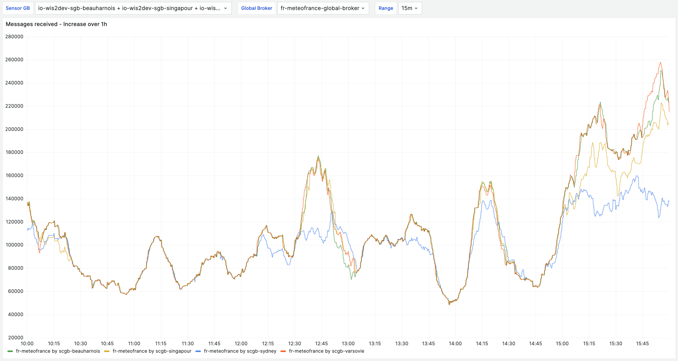
Sensor Centre for Global Broker

Slide 23
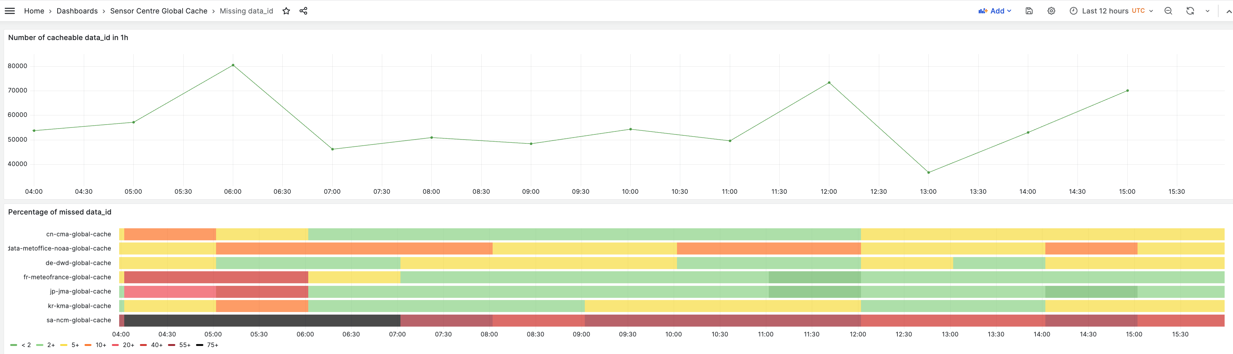
Sensor Centre for Global Cache

Slide 24
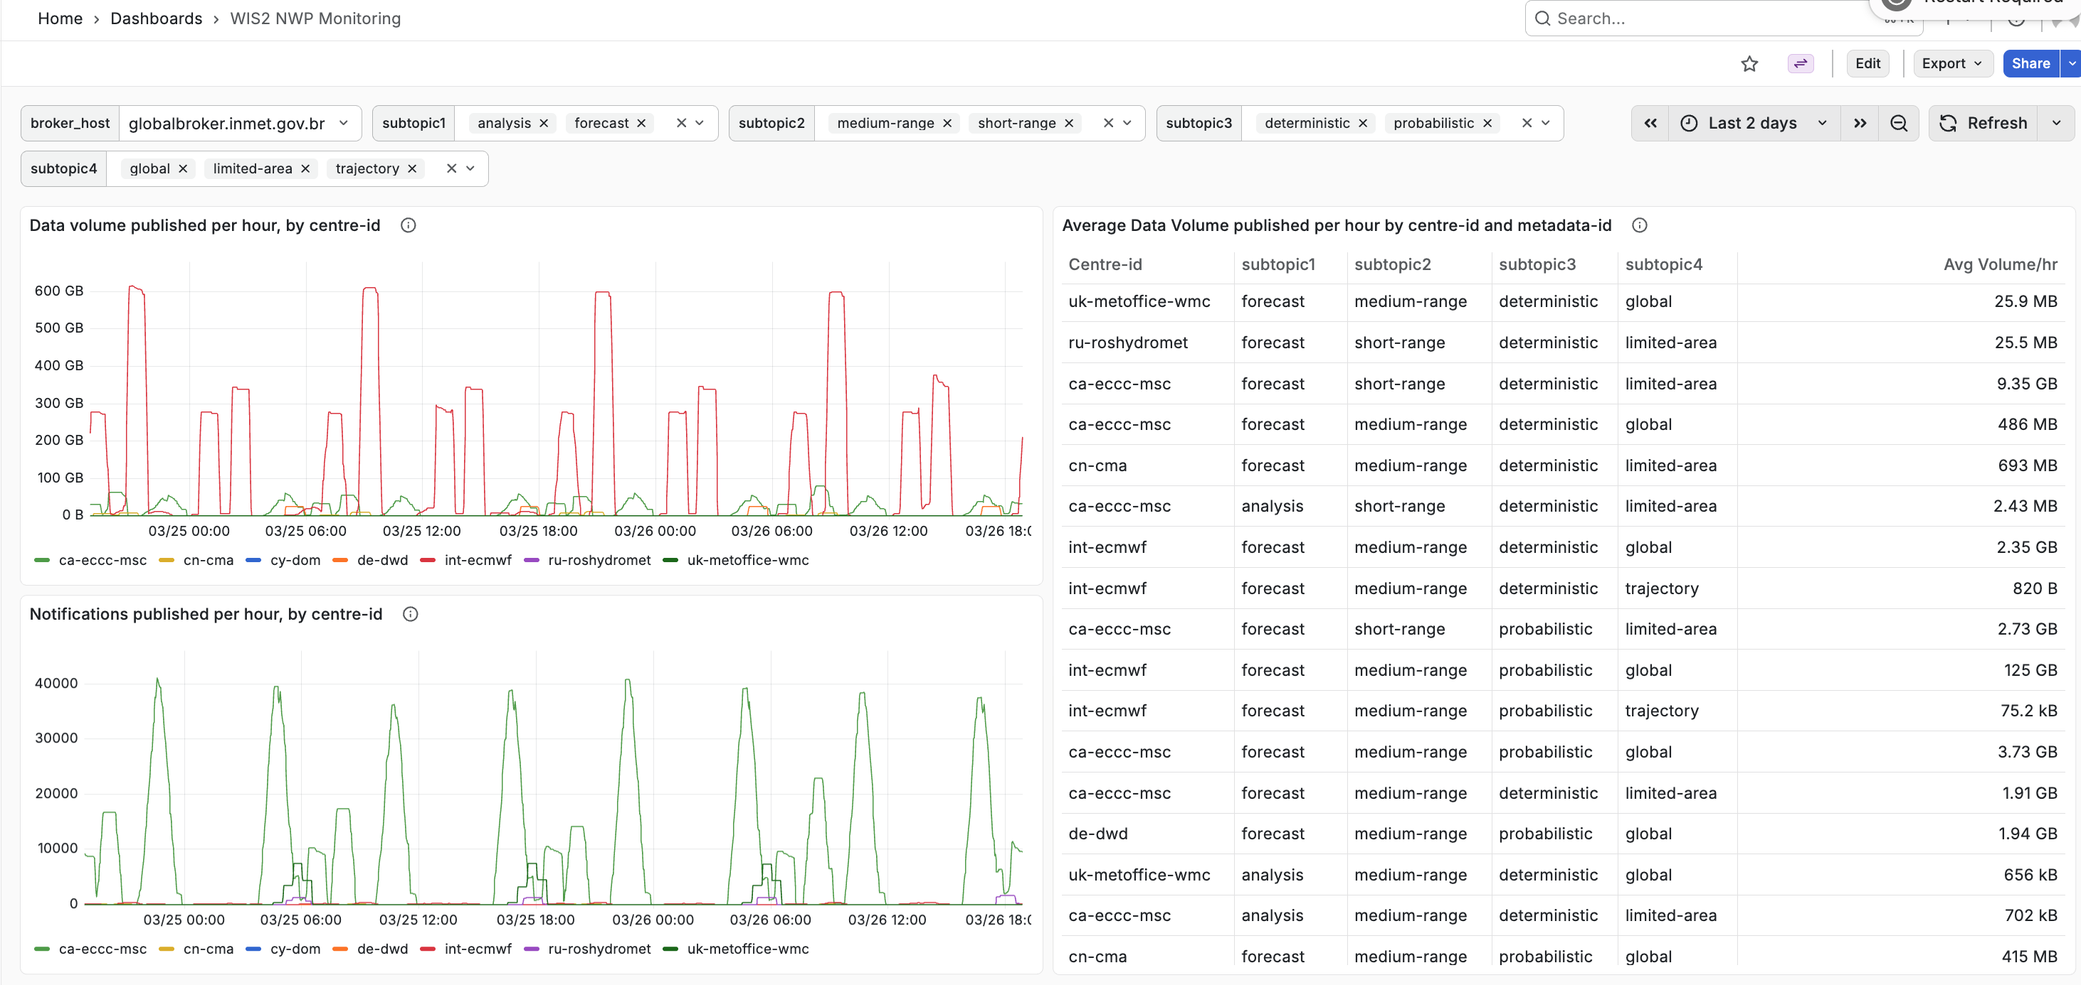
Sensor Centre for Data Type: NWP

Slide 25
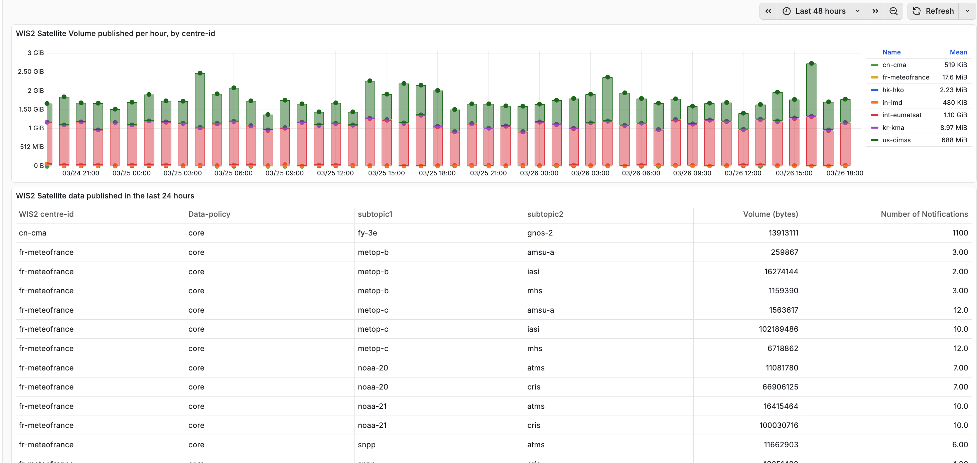
Sensor Centre for Data Type: Satellite

Slide 26
Hands-on 2 : SC GB, prometheus and grafana
Install the SCGB on the EWC VM in the same docker network
Add to prometheus (in prometheus.yml) the information to connect to the SCBG
Restart prometheus
Go to prometheus interface: https://XXX.champion.wis2dev.io/prometheus/
Then go to "Query..." and start typing "wmo_" prometheus will prompt you with the list of known metrics.
Then, go to grafana https://XXX.champion.wis2dev.io/grafana/
Add prometheus as a source of data
Create a new dashboard, add a panel using one of the existing metric
Import the panel (get the json in slack)

Slide 27
Thank you!

