Slide 1
WIS2 Global Replay Deep Dive 2026-04-01
Tom Kralidis Senior Geospatial Architect WIS 2.0, WIS 2.0 in a box

Slide 2
Outline
Requirement for a Global Replay Service (GRep)
Component definition
Technical considerations
Reference Implementation

Slide 3
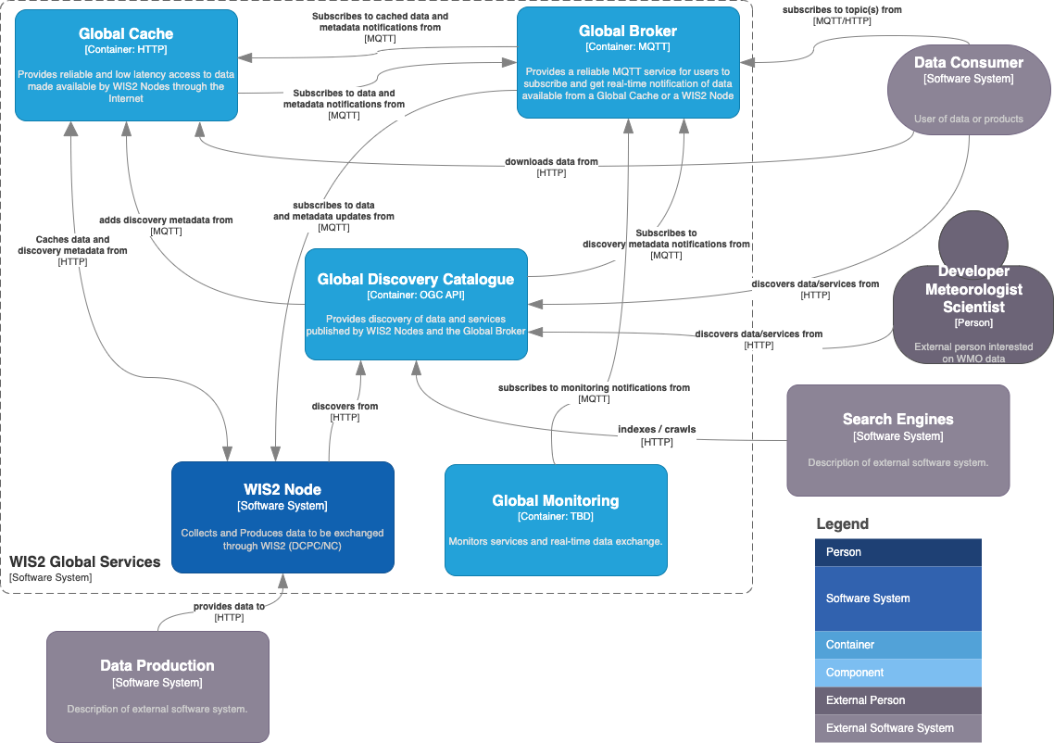

Slide 4
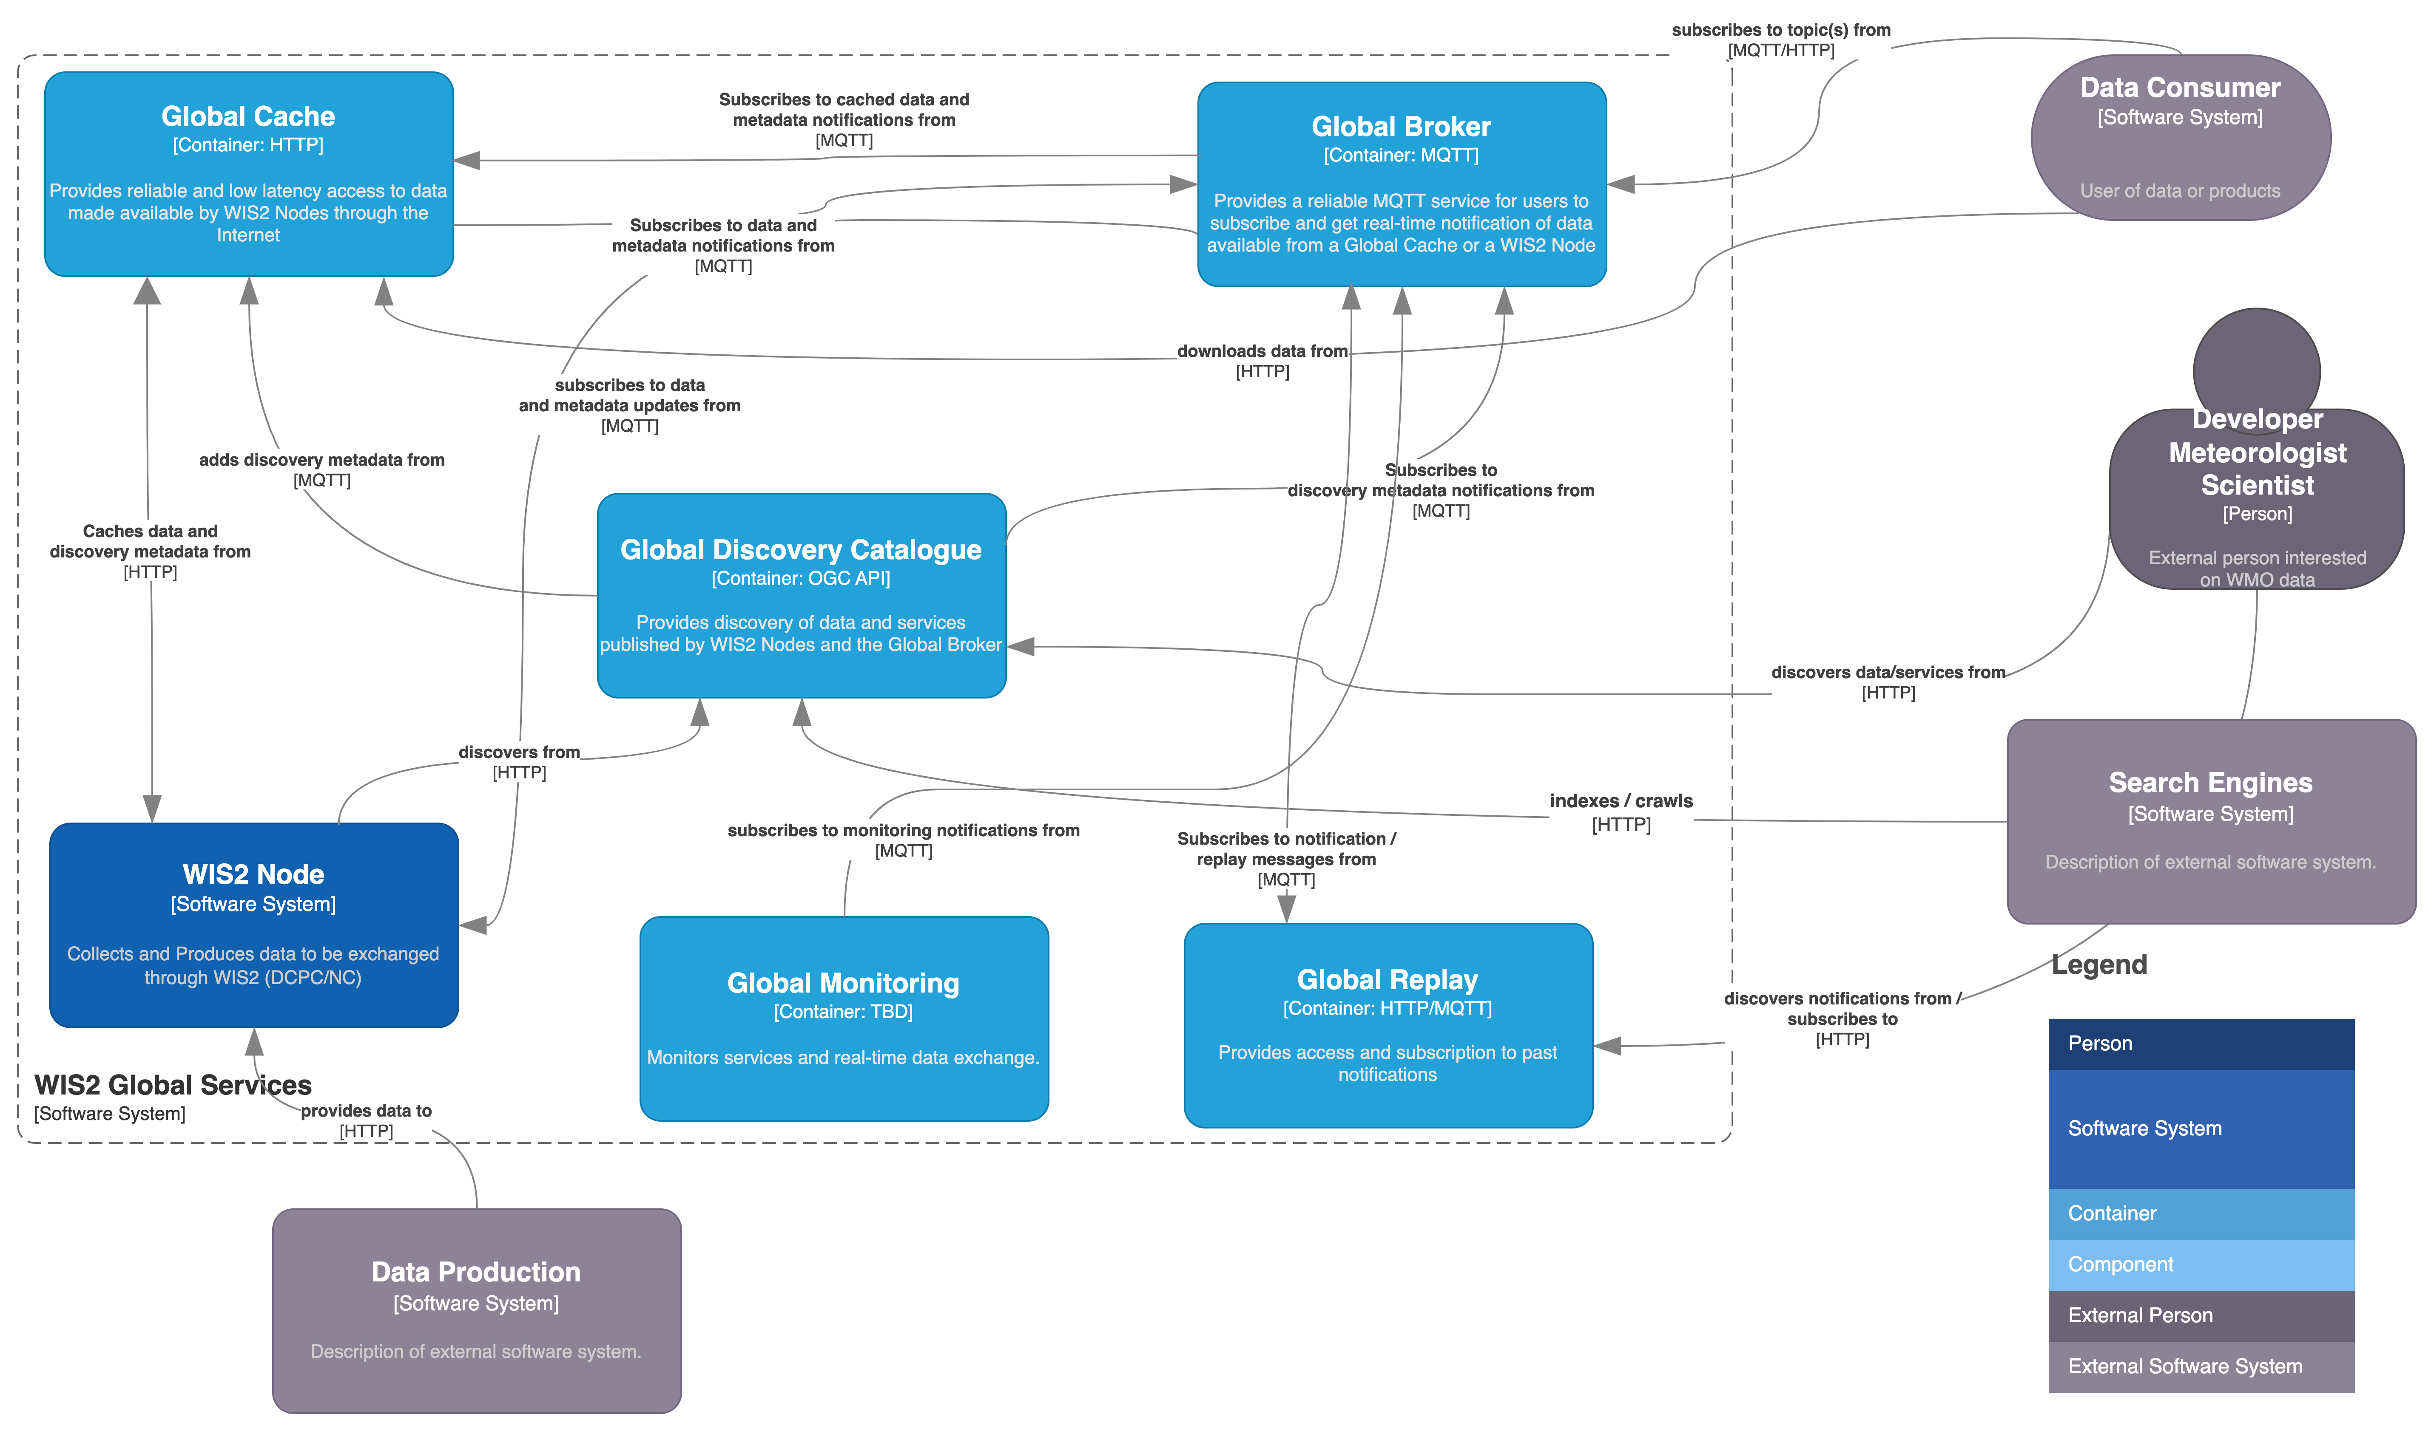

Slide 5
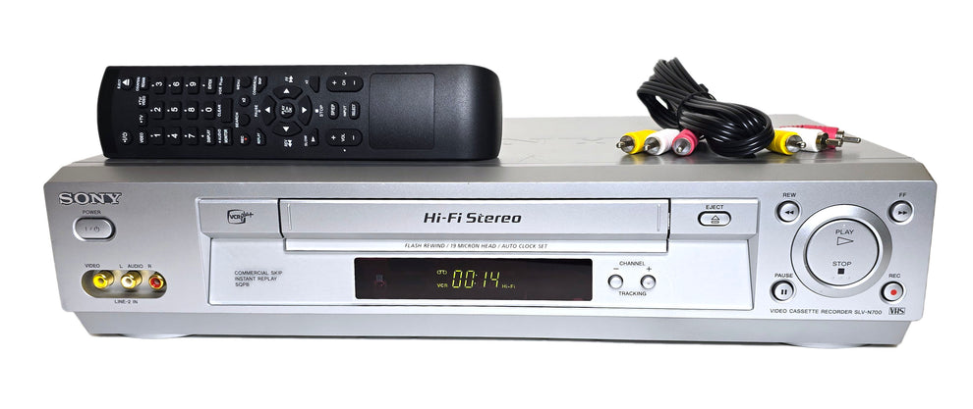
Requirement for a Global Replay Service
Notification messages / monitoring events are emitted at time of publication to WIS2
Clients subscribed may encounter connection outages for a given period of time (i.e. 4 hours)
4 hours of messages lost
Diagnosing metadata issues
How to retrieve?
On demand “replay” of notifications
Image source: vcr-dvd.com/products/sony-slv-n700-vcr-4-head-hi-fi-stereo (2025-07-07)

Slide 6

Component definition
The aim of a Global Replay is to provide access and subscription to past WIS Notification Messages.
WIS2 may include a Global Replay.
The Global Replay provides the Global Cache, Global Discovery Catalogue and data consumers with a mechanism to search, query and subscribe to past notification messages and monitoring events of interest as published by the Global Broker.
A Global Replay subscribes to all notification messages and monitoring events as published by Global Broker. It stores the notification message and monitoring events.
A Global Replay shall store copies of notification messages and monitoring events for a duration compatible with the real-time or near real-time schedule of the data and not less than:
3 days for notification messages.
7 days for monitoring events.
A Global Replay will discard notification messages and monitoring events once the retention period has expired.

Slide 7
Technical considerations
The Global Replay provides Global Services and data consumers with a mechanism to search, query and subscribe to notification messages and monitoring events of interest.
The Global Replay implements the OGC API – Features – Part 1: Core standard, adhering to the following conformance classes and their dependencies:
Core
GeoJSON
The Global Replay implements the OGC API – Processes - Part 1: Core standard, adhering to the following conformance classes and their dependencies:
Core
OGC Process Description
JSON
A Global Replay shall subscribe to all Global Broker instances, to the topics origin/a/wis2/#, cache/a/wis2/# and monitor/a/wis2/#.
A Global Replay shall use the notification message and monitoring event identifier to deduplicate notifications and events.
The Global Replay will make notification messages available via the API collection identifier wis2-notification-messages.
The Global Replay will make monitoring events available via the API collection identifier wis2-monitoring-events.

Slide 8
Technical considerations
The Global Replay will provide an API process to trigger the republication of previously sent messages, allowing users to subscribe to messages with various criteria (spatial and / or temporal extent, topic selection) via the Global Broker.
the API process request accepts the following inputs:
datetime: a temporal range of messages to republish (example 2025-04-06T17:21:26Z/2025-04-06T19:21:26Z).
subscriber-id: a unique identifier (UUID) defined by the user/client. This identifier may be reused.
topic: the topic on which to trigger message replication (centre-id required, allowing + and # for subsequent topic levels)
the resulting topic subscription in the API process response will be replay/a/wis2/<centre-id>/<subscriber-id>/<topic>, where:
topic is the full topic of the message as previously published to WIS2.
the API process will set temporal boundary limits to 15 minutes. When exceeded, it will result in an error message prohibiting the republishing of messages.
an example topic would be replay/a/wis2/ca-eccc-msc-global-replay/fdb6dae4-95fe-465a-80fb-498ebd61dce8/cache/a/wis2/br-inmet/data/core/weather/surface-based-observations/synop

Slide 9
Technical considerations
A single Global Replay instance is sufficient for WIS2.
Multiple Global Replay instances may be deployed for resilience.
Global Replay instances operate independently of each other; each Global Replay instance will hold notification messages and monitoring events according to the required retention period. Global Replays do not need to synchronize with each other.
A Global Replay is populated with notification messages and monitoring events received via a Global Broker instance.
A Global Replay is connected to at least two (2) Global Brokers.
A Global Replay instance will discard duplicate messages as needed.
A Global Replay can validate notification messages against the standard format (see Manual on WIS, Volume II – Appendix E. WIS2 Notification Message). Valid messages will be stored. Invalid or malformed messages will be discarded.
A Global Replay can validate monitoring events against the WIS Monitoring Events Message Encoding (see Manual on WIS, Volume II – Appendix TODO. WIS2 Monitoring Events Message Encoding). Valid WIS Monitoring Events Message Encoding Messages will be stored. Invalid or malformed monitoring events will be discarded.
A Global Replay will remove notification messages after the required retention period.
A Global Replay will remove monitoring events after the required retention period.
A Global Replay may choose to implement access control for controlling usage.
As a convention Global Replay centre-id will be tld-{centre-name}-global-replay.

Slide 10
wis2-grep: the WIS2 GRep RI
To provide a Global Replay, members may use whichever software components they consider most appropriate to comply with WIS2 Technical Regulations.
To assist Members participation in WIS2, a free and open-source Global Replay Reference Implementation is made available for download and use. wis2-grep builds on mature and robust free and open-source software components that are widely adopted for operational use.
wis2-grep provides functionality required for the Global Replay, providing the following technical functions:
notification messages and monitoring event subscription from a Global Broker insrtance
notification message and monitoring event ingest and API publication
user defined subscription for MQTT message replay from a Global Broker instance
OGC API - Features - Part 1: Core compliance
OGC API - Processes - Part 1: Core compliance
wis2-grep is managed as a free and open source project. Source code, issue tracking and discussions are hosted in the open on GitHub: https://github.com/wmo-im/wis2-grep.

Slide 11
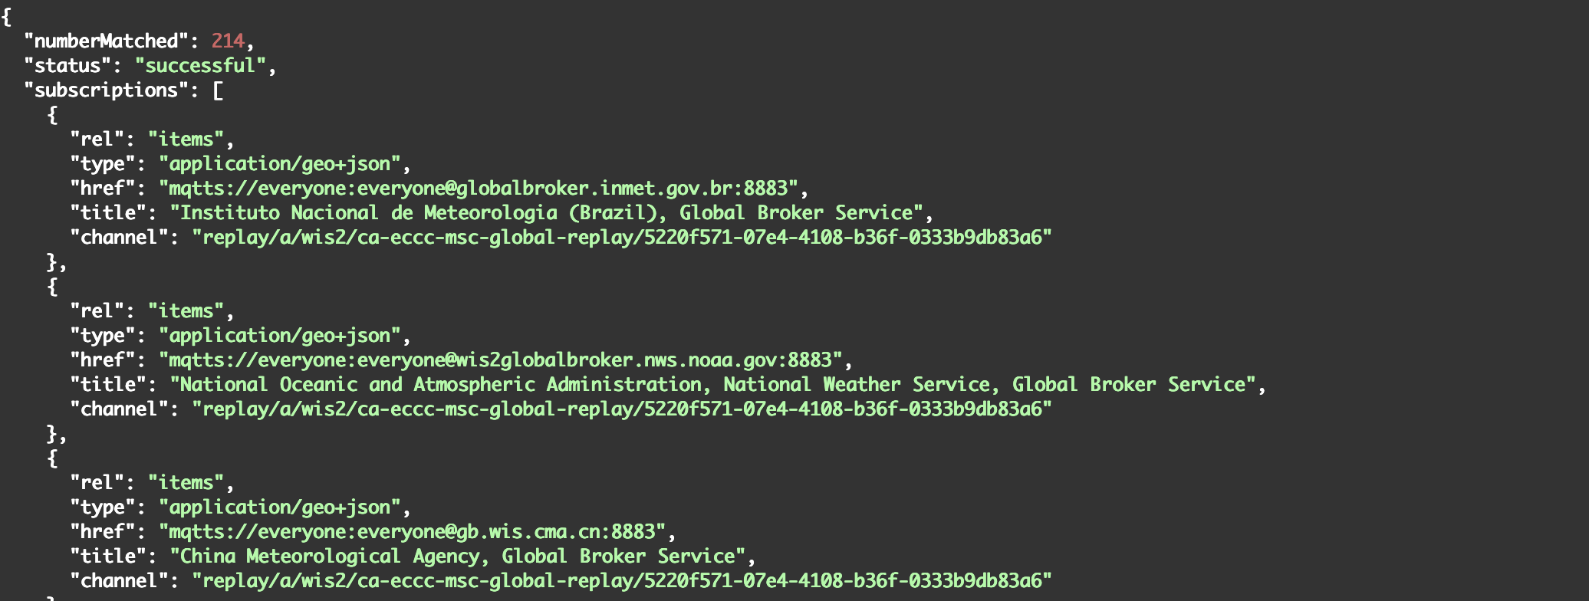
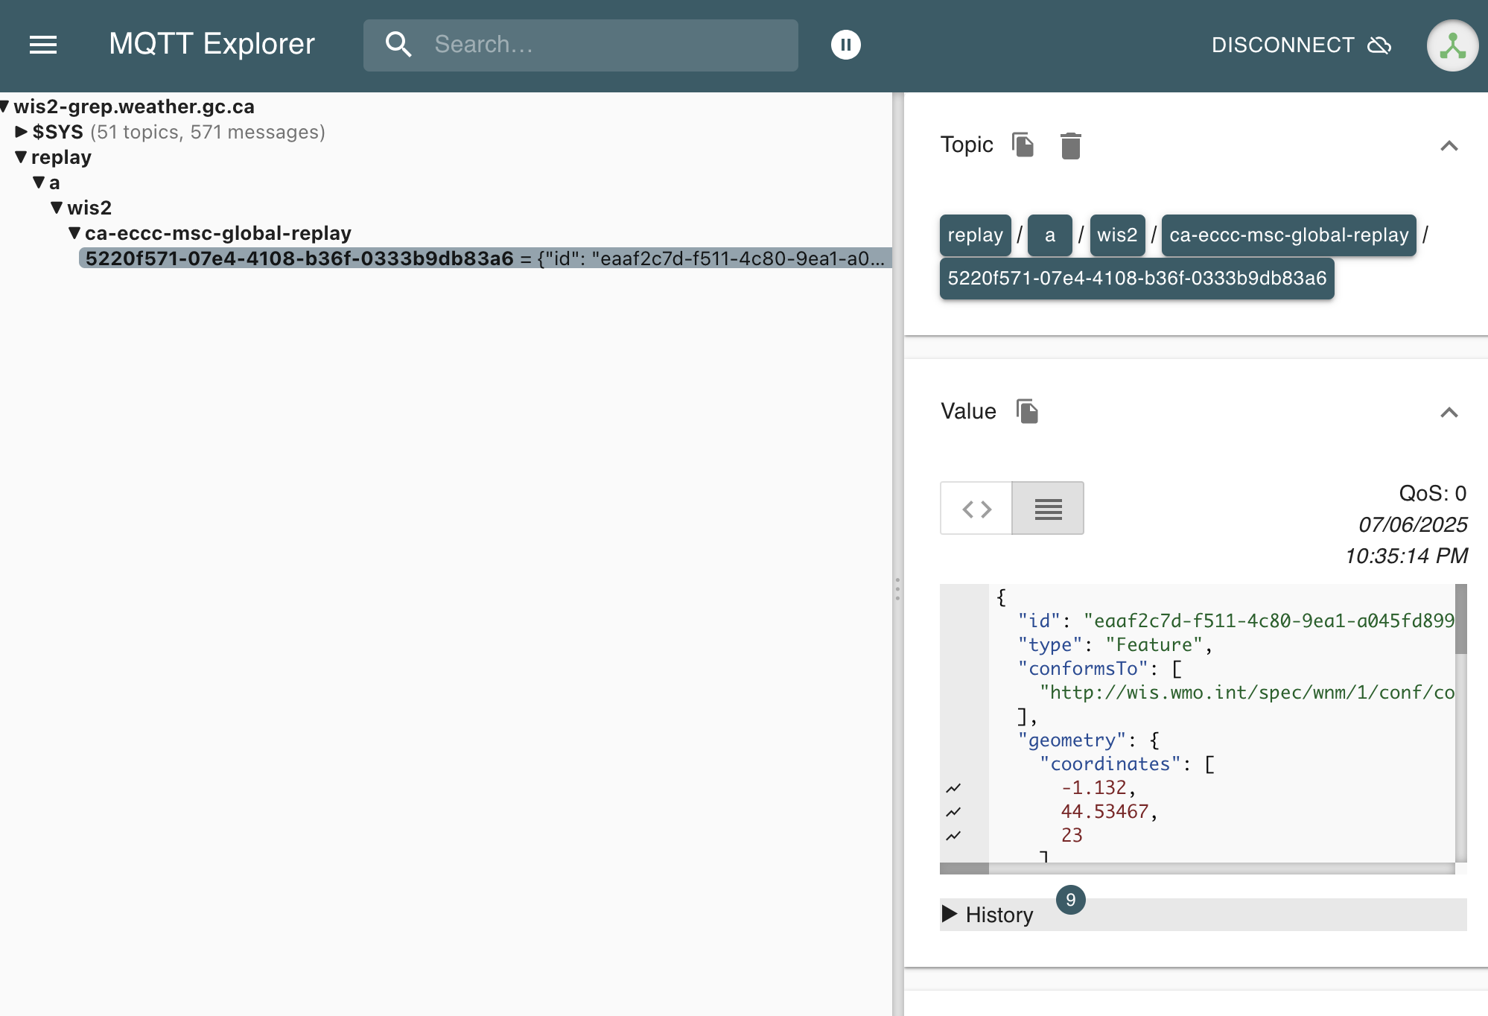
WIS2 GRep Technical considerations

Slide 12
Reference Implementation: wis2-grep
Docker Compose stack
pygeoapi
Elasticsearch
Mosquitto
Python
pywis-pubsub
OWSLib
github.com/wmo-im/wis2-grep

Slide 13
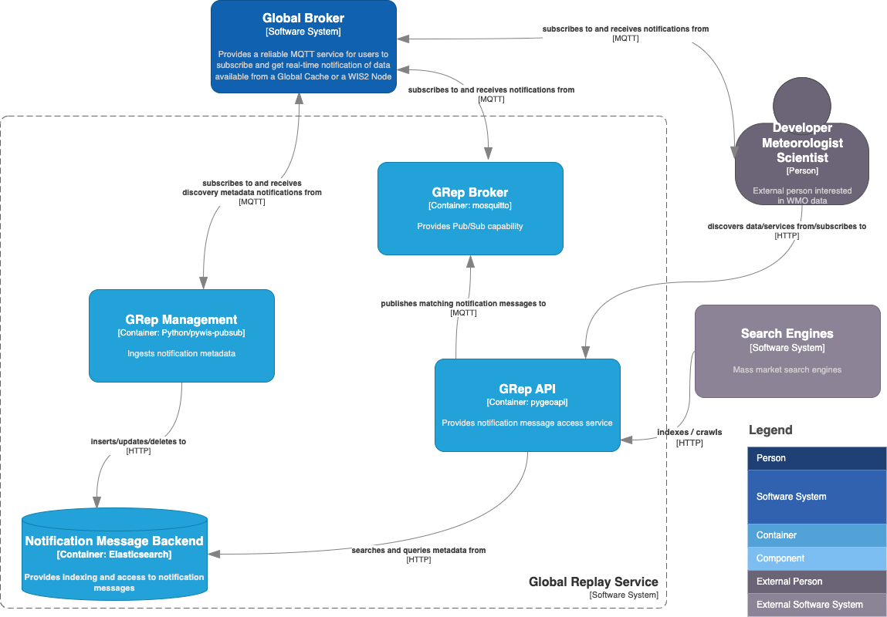

Slide 14
wis2-grep exercise
Follow steps at:
github.com/wmo-im/wis2-champions/blob/main/Bali-workshop-MAR2026/presentations/day3/wis2-grep-exercise.md

Slide 15

Thank you
^{wmo.int}

