Slide 1
WIS2 Champions Training
​ (30 March – 4 April 2026 - Bali)​
Deep Dive on the Global Broker
Including WTH, WNM and WMEM
Rémy Giraud, France
SC-IMT Chair

Slide 2
Wis2 Architecture

Slide 3



Global Services
Data users
Global Monitoring
Discovers datasets
Subscribes to topics
Downloads core data
Global Discovery Catalogue
Global Broker
Global Cache
Downloads recommended data
Downloads recommended data
Downloads recommended data
Provides an API to discover datasets and services
Sends notifications of new data to be downloaded from Global Caches or WIS2 nodes
Provides users HTTP download of core data cached from WIS2 nodes
WIS2 node
WIS2 node
WIS2 node
Scale to highly-available, global data sharing

Slide 4


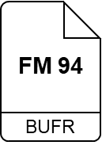
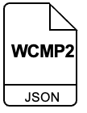


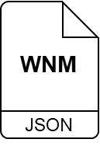




Global Services and WIS2 Nodes
Global Broker: Provides highly available global distribution of notifications about new (meta)data available for downloaded from WIS2 Nodes or Global Caches
Global
Broker
HTTPS
Global Cache: Provides highly available HTTP(S) download of Core¹ data cached from WIS2 Nodes
Global
Cache
MQTTS
WIS2 Node
On March 30th, 2026 we have
~100 WIS2 Nodes
up and running
Global Discovery Catalogue: Provides users an API to discover datasets and services
Global
Discovery
Catalogue
Global Monitor: Reports the health of WIS2 using metrics aggregated from all Global Services
Global
Monitor

Slide 5

Exchange of core data
WMO core data (free and unrestricted) can be downloaded from a Global Cache
WIS 2.0
Global Discovery Catalogue
Data Consumer subscribes to cache/a/wis2/…/data/core/…
and downloads data from Global Cache
WIS2-Node publishes on origin/a/wis2/…/data/core/…
HTTP
WIS2-node
MQTT
Global Broker
HTTP
Global Cache
download core data
Global Cache subscribes to origin/a/wis2/…/data/core/…
downloads data from WIS2-Node
and publishes new notification on
cache/a/wis2/…/data/core/…

Slide 6
Exchange of recommended data
WMO recommended data shall be downloaded directly from the WIS2 Node, access can be open or restricted
WIS 2.0
Global Discovery Catalogue
Data Consumer subscribes to origin/a/wis2/…/data/recommended/…
and downloads data from WIS2-Node
WIS2-Node publishes on origin/a/wis2/…/data/recommended/…
HTTP
WIS2 Node
MQTT
Global Broker
access control
HTTP
Global Cache
download recommended data

Slide 7
Wis2 Notification messages

Slide 8

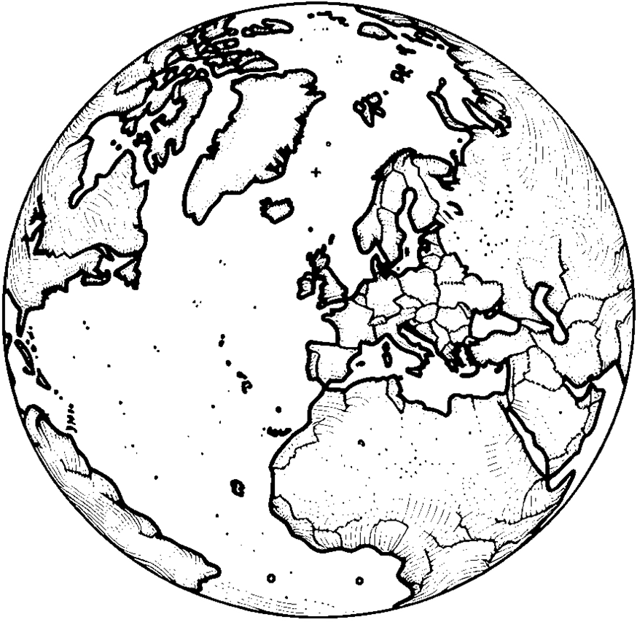
Step 1 - Global Brokers subscribe to Notification Messages from WIS2 Nodes and republish the messages for onward distribution
Global
Broker
HTTPS
MQTTS
we-wms
Global Brokers also subscribe to each other for resilience, discarding duplicate messages they have already received and republished – fully meshed network is not required

Slide 9





A closer look at the flow of WIS2 Notification Messages (WNM)
sub
Anti-loop
Global
Broker1
Anti-loop
Global
Broker2
The anti-loop tool:
Subscribes to as many brokers as needed. The brokers might be “linked” to a WIS2node, a Global Cache or another Global Broker
Publishes only to its Global Broker
The publication to the local Global Broker only occurs if the “id” of the message is unknown to the “anti-loop system” of the particular Global Broker.
This ensures that the subscribers to the Global Brokers will only see each message only once per Global Broker
The id is positioned by the originating center or the cache after having downloaded and stored the data.
The id is a unique identifier (a UUID) to enable the anti-loop mechanism
Therefore, the same data/file will be “linked” to various id (origin and one per cache)
sub
pub
Global
Catalogue
WIS2
Node
sub
pub
pub
sub
Anti-loop
pub
pub
sub
Anti-loop
Global
Broker3
Global
Broker4
sub
pub
sub
Anti-loop
sub
pub
sub
sub
Anti-loop
sub
sub
Global
Cache
#1
Global
Cache
#2
2
1

Slide 10
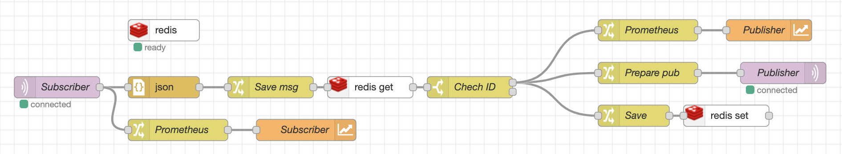
An example : Météo-France setup
The Broker
A cluster of 3 instances of VerneMQ broker running on EWC
VerneMQ is one of the state of the art MQTT broker
Implemented in Erlang
Having clustering capabilities
MQTT 3.1.1 and MQTT 5.0 compliant
Only the anti-loop software is publishing to it
All interested clients are subscribing to the broker
The minimalist anti-loop function:

Slide 11
geoJSON
GeoJSON is a standard format for encoding geographic data structures using JSON (JavaScript Object Notation).
What it is: GeoJSON represents geographical features like points, lines, polygons, and multi-part collections along with their properties. It's built on JSON, making it lightweight, text-based, and human-readable while maintaining machine-parseable structure.
Simplicity: Unlike complex GIS formats (Shapefiles, KML), GeoJSON uses familiar JSON syntax that web developers already know. A point location is simply {"type": "Point", "coordinates": [-122.4, 37.8]}, making it easy to create, read, and debug.
Web-native: GeoJSON integrates seamlessly with web technologies—JavaScript can parse it natively without special libraries, REST APIs can serve it directly, and modern web mapping libraries (Leaflet, Mapbox, OpenLayers) support it out-of-the-box.
Interoperability: It's an open standard (RFC 7946) supported across the entire geospatial ecosystem—from QGIS and ArcGIS to PostGIS databases and cloud platforms. This universal support eliminates format conversion headaches.
Lightweight: GeoJSON files are typically smaller than XML-based formats like KML, reducing bandwidth usage and speeding up data transfer—critical for web applications and mobile devices with limited connectivity.

Slide 12
The WIS2 Notification Message
{
"id": "b51ddf4f-5749-4148-a7cd-9b6f6aa4df19",
"type": "Feature",
"conformsTo": [
"http://wis.wmo.int/spec/wnm/1/conf/core"
],
"geometry": {
"coordinates": [
6.07344,
50.51078,
673
],
"type": "Point"
},
"properties": {
"data_id": "be-rmib:hourly-synop/WIGOS_0-20000-0-06494_20260320T070000",
"pubtime": "2026-03-20T07:08:11Z",
"integrity": {
"method": "sha512",
"value": "IjMq4LWxxI4mzSxlzu+nEm6pjU+6se+fVMElIPf7TzPOL469jCuJaATpoGZumLkNuqt1hcebIUceI6GPmrYCag=="
}
},
"links": [
{
"rel": "canonical",
"type": "application/bufr",
"href": "https://wis2node.meteo.be/data/2026-03-20/wis/urn:wmo:md:be-rmib:hourly-synop/WIGOS_0-20000-0-06494_20260320T070000.bufr4",
"length": 399
}
]
}
This is the unique identifier for each WNM on WIS 2.0. This is the id used by GBs to deduplicate messages. It is a UUID (RFC 9562)
type, conformsTo, geometry are all mandatory. geometry can be null or provide a location for the product
properties is mandatory. It has some mandatory elements data_id, pubtime and some possible additions. It is also extensible to provide eg. client-side filtering...
links is mandatory. It provides, href to get access to the data granule.
https://wmo-im.github.io/wis2-notification-message/standard/wis2-notification-message-STABLE.html

Slide 13
Hands-on 1 : MQTT Explorer and MQTTX CLI
Setup:
MQTT Explorer: on your laptop configure a subscription to one of the Global Brokers (eg. wss://globalbroker.meteo.fr and subscribe to origin/a/wis2/# only. Start the capture, look at the various centre-id, copy/paste some examples of WNM. Can you see some differences ?
MQTTX CLI: on your VM:
Install MQTTX CLI: https://mqttx.app/cli
Start the capture:
mqttx sub -h globalbroker.inmet.gov.br -u everyone -p 8883 -P everyone -l mqtts -t origin/a/wis2/#
Store the capture in a file or grep for various items: content, wigos,...
Go to https://jsonbeautifier.org copy some examples of WNM or beautify with mqttx or use jq on the VM :
sudo apt install jq
mqttx sub -h globalbroker.inmet.gov.br -u everyone -p 8883 -P everyone -l mqtts -t origin/a/wis2/# --format json |grep -v "^topic" | jq '.'

Slide 14
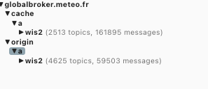
Hands-on 2 : MQTT Explorer – View of WTH
Setup:
MQTT Explorer: on your laptop configure a subscription to one of the Global Brokers (eg. wss://globalbroker.meteo.fr and subscribe to origin/a/wis2/#, cache/a/wis2/#. Start the capture, look at the various centre-id, and the WIS2 Topic Hierarchy
In particular, look at de-dwd-gts-to-wis2, int-ecmwf...
After a while, MQTT explorer window will be similar to :
Q1 : Why many more topics on origin vs. cache ?
Q2 : Why many more messages on cache vs. origin ?

Slide 15
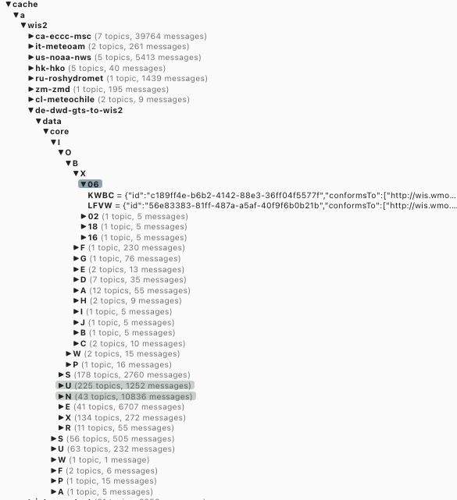
Hands-on 2 : MQTT Explorer – de-dwd-gts-to-wis2
de-dwd-gts-to-wis2 in one of the two gateway sending data from the GTS to WIS2
The Topic Hierarchy is based on TTAAii CCCC of the GTS.
Unlike all other topics, the exact list is not defined in the WTH standard
Therefore, the GB do not verify if the topic is valid.

Slide 16
Hands-on 2 : MQTT Explorer – int-ecmwf (1)
{
"id": "e0ddd4ef-06fa-4e08-ac99-4867ff5d2b2c",
"conformsTo": [
"http://wis.wmo.int/spec/wnm/1/conf/core"
],
"type": "Feature",
"geometry": null,
"properties": {
"datetime": "2026-03-20T06:00:00.000Z",
"pubtime": "2026-03-20T11:13:40.000Z",
"data_id": "wis2/int-ecmwf/data/core/weather/prediction/forecast/medium-range/probabilistic/global/20260320/06z/ifs/0p25/waef/20260320060000-21h-waef-ef.grib2",
"metadata_id": "urn:wmo:md:int-ecmwf:ifs:enfo:short-forecast",
"cache": false
},
"links": [
{
"href": "https://ai4edataeuwest.blob.core.windows.net/ecmwf/20260320/06z/ifs/0p25/waef/20260320060000-21h-waef-ef.grib2",
"rel": "alternate",
"length": 213126418,
"type": "application/grib;edition=2"
},
{
"href": "https://data.ecmwf.int/forecasts/20260320/06z/ifs/0p25/waef/20260320060000-21h-waef-ef.grib2",
"rel": "canonical",
"length": 213126418,
"type": "application/grib;edition=2"
}
],
"generated_by": "open-ecpds 7.3.4-09122025"
}
The purpose on this "cache": false is to instruct Global-Cache that they should not download the data.
Nevertheless, as it was published on origin/a/wis2/int-ecmwf/data/core/weather/prediction/forecast/medium-range/probabilistic/global
Global Caches MUST publish a message on cache/a/WIS2/... With the href unchanged.
See if you see can such a message on cache/a/origin/int-ecmwf, look at the links

Slide 17
WIS2 Operations: events

Slide 18
Events
Once connected to WIS2, any WIS2 Node, Global Cache, Global Discovery Catalog, Global Broker will be monitored as previously agreed
Either through the metrics directly, or by detecting events using the metrics or else, GISCs and Global Services will be able to detect “events” that could jeopardize WIS2 Operations
Typical events could be:
WIS2 Node/Global Cache download service not working
WIS2 Node/Global Cache/Global Broker/… broker failing or not providing messages
WIS2 Node publishing malformed messages
Those events should be detected, interested parties should be informed, the underlying issue, if any, fixed rapidly
Planned outages should also announced

Slide 19
How to announce those events ?
WIS2 is based on using Notification Messages to inform about new data
Using MQTT to publish/subscribe about alerts
For data, we have defined the topic hierarchy and notification message format.
Each WIS2 Node or Global Service will operate a broker
When detecting an event, or to publish an announcement, the Centre (WIS2 Node or any Global Service) will publish onto its local broker (same as Notification Message).
Global Broker collect, deduplicate and republish the notification message
All Centres (and in particular GISCs and Global Services) shall subscribe to the monitoring messages published by the Global Broker
We then defined:
Topic Hierarchy
Event message format

Slide 20
Topic Hierarchy for events
Considering WIS2 as a global IT system with access for users on origin/a/wis2/… and cache/a/wis2/…, alerting is part of the “internal” operations. So, events shouldn’t be accessible to external users (internal users being the WIS Centres)
Use monitor/a/wis2 for the first three levels
The centre-id “target” of the event is in the Topic Hierarchy
To be able to filter the alert for the “target” centre-id, add this information on the TH by using this for the 4th level of monitoring TH
monitor/a/wis2/ma-marocmeteo an alert about Maroc-Météo to inform about an event affecting that centre
In summary : monitor/a/wis2/{centre-id-target}

Slide 21
Message format of events
WIS2 is based on standards and on reusing defined solution as much as possible
https://cloudevents.io/ has been defined to describe events in a standard way.
As it applicable to our situation and has some similarities with the existing data/metadata Notification Message
We have decided CloudEvent format for WIS2 alerts
This will be formally accepted during INFCOM4

Slide 22
Specifications of Cloud Events
Accessible on github: https://github.com/cloudevents/spec/blob/v1.0.2/cloudevents/spec.md
Draft document: https://wmo-im.github.io/wis2-monitoring-events/standard/wis2-monitoring-events-DRAFT.html
This will be presented for approval at INFCOM4. In the meantime, and following the agile/pilot based approach on WIS2, some Global Services have already implemented this.

Slide 23
Hands-on 3 : The monitor topic
Setup:
MQTT Explorer: on your laptop configure a subscription to one of the Global Brokers (eg. wss://globalbroker.meteo.fr and subscribe to monitor/a/wis2. Start the capture, look at the various centre-id and the different kind of messages

Slide 24
Hands-on 3 : The monitor topic
{
"specversion": "1.0",
"type": "int.wmo.wis.wme.event",
"source": "br-inmet-global-broker",
"subject": "sa-ncm",
"id": "27694f8f-c36e-4e2b-8876-9a49389db477",
"time": "2026-03-20T13:47:02.284Z",
"datacontenttype": "application/json",
"dataschema": "https://schemas.wmo.int/wme/1.0.0/schemas/wis2-event-message-encoding-bundled.json",
"data": {
"conformsTo": [
"http://wis.wmo.int/spec/wme/1/conf/monitoring-event-message-encoding-core"
],
"content": {
"channel": "origin/a/wis2/sa-ncm/data/core/weather/surface-based-observations/temp",
"wnm": {
"id": "38cb2038-3c7c-46fe-9c4a-1a7b3399100d",
"conformsTo": [
"http://wis.wmo.int/spec/wnm/1/conf/core"
],
"type": "Feature",
"geometry": null,
"properties": {
"pubtime": "2026-03-20T13:47:01.873Z",
"datetime": "2026-03-20T13:47:01.873Z",
"integrity": {
"method": "sha256",
"contentEncoding": "base64",
"value": "fZoK9/gsD03hCLa7OTiw79zcOTmdiBQqdNDMdbC5iiU="
},
"data_id": "weather/surface-based-observations/temp/A_IULD13OEJD201200RRB_C_OEJD_20260320134701",
"metadata_id": "urn:wmo:md:sa-ncm:observations.surface.temp-bufr",
"cache": true,
"gts": {
"ttaaii": "IULD13",
"cccc": "OEJD"
}
},
"links": [
{
"href": "https://wis2.ncm.gov.sa/weather/surface-based-observations/temp/A_IULD13OEJD201200RRB_C_OEJD_20260320134701.00054956",
"rel": "canonical",
"type": "application/x-bufr",
"length": 253
}
]
},
"title": "Missing Metadata record for data announced in WIS2 Notification Message"
},
"severity": "ERROR"
}
}

Slide 25
Hands-on 3 : The monitor topic
{
"specversion": "1.0",
"type": "int.wmo.wis.wme.event",
"source": "fr-meteofrance-global-broker",
"subject": "fr-meteofrance",
"id": "81bb7ce4-aa01-4cea-b897-f794ed549e99",
"time": "2026-03-20T13:48:01.917Z",
"datacontenttype": "application/json",
"dataschema": "https://schemas.wmo.int/wme/1.0.0/schemas/wis2-event-message-encoding-bundled.json",
"data": {
"conformsTo": [
"http://wis.wmo.int/spec/wme/1/conf/monitoring-event-message-encoding-core"
],
"channel": "origin/a/wis2/fr-meteofrance/data/recommended/weather/surface-based-observations/synop",
"content": {
"wnm": {
"id": "259b65c0-d8a2-4445-8260-31fb401284d4",
"type": "Feature",
"conformsTo": [
"http://wis.wmo.int/spec/wnm/1/conf/core"
],
"geometry": null,
"properties": {
"data_id": "fr-meteofrance:esoh/ISXN20_LFPW_201342_RRL.41d7259ff3555eb4e915d51385b83988_20260320",
"datetime": "2026-03-20T00:00:00Z",
"pubtime": "2026-03-20T13:48:01Z",
"integrity": {
"method": "sha512",
"value": "5sTBpJdkQQ7aRnnOXzefQlmwPVEDXp/uLD8UwyaHgq2XQK86ZtGHi32eXp3Beg5B4TRW9DiXcRN/n1qd8UF+rw=="
},
"metadata_id": "urn:wmo:md:fr-meteofrance:esoh",
"content": {
"encoding": "base64",
"value": "CkJVRlIADxoEAAAWAABVAAAAAAAAzBwV
.....
W/////////////////////////+J/Zb//////////////////////+ASz/SwVswAA//+AAA3Nzc3",
"size": 3867
}
},
"links": [
{
"rel": "canonical",
"type": "application/octet-stream",
"href": "https://wis2nc.meteo.fr/data/2026-03-20/wis/urn:wmo:md:fr-meteofrance:esoh/ISXN20_LFPW_201342_RRL.41d7259ff3555eb4e915d51385b83988_20260320.bin",
"length": 3867
}
],
"generated_by": "wis2box 1.1.0"
},
"title": "WIS2 Notification Message not compliant with the defined schema",
"errors": [
{
"keyword": "maxLength",
"dataPath": ".properties.content.value",
"schemaPath": "#/properties/properties/properties/content/properties/value/maxLength",
"params": {
"limit": 4096
},
"message": "should NOT be longer than 4096 characters"
}
]
},
"severity": "ERROR"
}
}

Slide 26
Hands-on 3 : The monitor topic
{
"specversion": "1.0",
"type": "int.wmo.wis.wme.event",
"source": "br-inmet-global-broker",
"subject": "cn-cma-global-cache",
"id": "a2bca111-6c71-49ed-b01f-2ed37f4599a9",
"time": "2026-03-20T13:52:44.446Z",
"datacontenttype": "application/json",
"dataschema": "https://schemas.wmo.int/wme/1.0.0/schemas/wis2-event-message-encoding-bundled.json",
"data": {
"conformsTo": [
"http://wis.wmo.int/spec/wme/1/conf/monitoring-event-message-encoding-core"
],
"content": {
"channel": "cache/a/wis2/us-noaa-nws/data/core/weather/surface-based-observations/wind-profile",
"wnm": {
"id": "36260910-15e2-4e7b-a529-b59538e3396b",
"type": "Feature",
"version": "v04",
"geometry": {
"type": "Point",
"coordinates": [
"-10000000000000000000000000000000000000000000000000000000000000000000000000000000000000000000000000000",
"-10000000000000000000000000000000000000000000000000000000000000000000000000000000000000000000000000000"
]
},
"time": {
"interval": "2026-03-20T13:52:44Z"
},
"properties": {
"data_id": "origin/a/wis2/us-noaa-nws/data/core/weather/surface-based-observations/wind-profile/PILOT_0-20000-0-72388_20260320T120000.bufr4",
"pubtime": "2026-03-20T13:52:44Z",
"integrity": {
"method": "sha512",
"value": "MEdgfbpeOsmwbEu4hdF8+UdF28AhIiV08MCCxtDwq7oIxl3xEvej6imY9OSkitAnpGI6tOLlT+zTTbqpuvVR7A=="
},
"datetime": "2026-03-20T12:00:00Z",
"metadata_id": "urn:wmo:md:us-noaa-nws:surface-weather-observations:wind-profile",
"station_identifier": "0-20000-0-72388",
"origin": "A_IUJN50KWBC201200RRD_C_KWBC_20260320134018_00010-066984.bin",
"global-cache": "cn-cma-global-cache"
},
"links": [
{
"rel": "canonical",
"type": "application/octet-stream",
"href": "https://gc.wis.cma.cn/20260320/cache/a/wis2/us-noaa-nws/data/core/weather/surface-based-observations/wind-profile/
PILOT_0-20000-0-72388_20260320T120000.bufr4",
"length": 540
},
{
"type": "application/octet-stream",
"rel": "alternate",
"title": "Incoming Report",
"href": "https://wis2node.globaldata.nws.noaa.gov/wis2-data/incoming/IUJN/50/KWBC/A_IUJN50KWBC201200RRD_C_KWBC_20260320134018_00010-066984.bin",
"length": 4507
}
]
},
"title": "WIS2 Notification Message not compliant with the defined schema",
"errors": [
{
"keyword": "enum",
"dataPath": ".geometry",
"schemaPath": "#/properties/geometry/oneOf/0/enum",
"params": {
"allowedValues": [
null
]
},
"message": "should be equal to one of the allowed values"
},
{
"keyword": "type",
"dataPath": ".geometry.coordinates[0]",
"schemaPath": "#/properties/geometry/oneOf/1/properties/coordinates/items/type",
"params": {
"type": "number"
},
"message": "should be number"
},
{
"keyword": "type",
"dataPath": ".geometry.coordinates[1]",
"schemaPath": "#/properties/geometry/oneOf/1/properties/coordinates/items/type",
"params": {
"type": "number"
},
"message": "should be number"
},
{
"keyword": "enum",
"dataPath": ".geometry.type",
"schemaPath": "#/properties/geometry/oneOf/2/properties/type/enum",
"params": {
"allowedValues": [
"Polygon"
]
},
"message": "should be equal to one of the allowed values"
},
{
"keyword": "type",
"dataPath": ".geometry.coordinates[0]",
"schemaPath": "#/properties/geometry/oneOf/2/properties/coordinates/items/type",
"params": {
"type": "array"
},
"message": "should be array"
},
{
"keyword": "type",
"dataPath": ".geometry.coordinates[1]",
"schemaPath": "#/properties/geometry/oneOf/2/properties/coordinates/items/type",
"params": {
"type": "array"
},
"message": "should be array"
},
{
"keyword": "oneOf",
"dataPath": ".geometry",
"schemaPath": "#/properties/geometry/oneOf",
"params": {},
"message": "should match exactly one schema in oneOf"
}
]
},
"severity": "ERROR"
}
}

Slide 27
Thank you!

