Slide 1
wis2box development and architecture 2026-03-30
Tom Kralidis Senior Geospatial Architect WIS 2.0, WIS 2.0 in a box

Slide 2
Table of Contents
wis2box development
Architecture and design
Components and code deep dive
Demos of core/recommended data, data formats
public services
wis2box-api
Security
Entry point integration (Dwayne)
multi-tenancy (Dwayne)

Slide 3
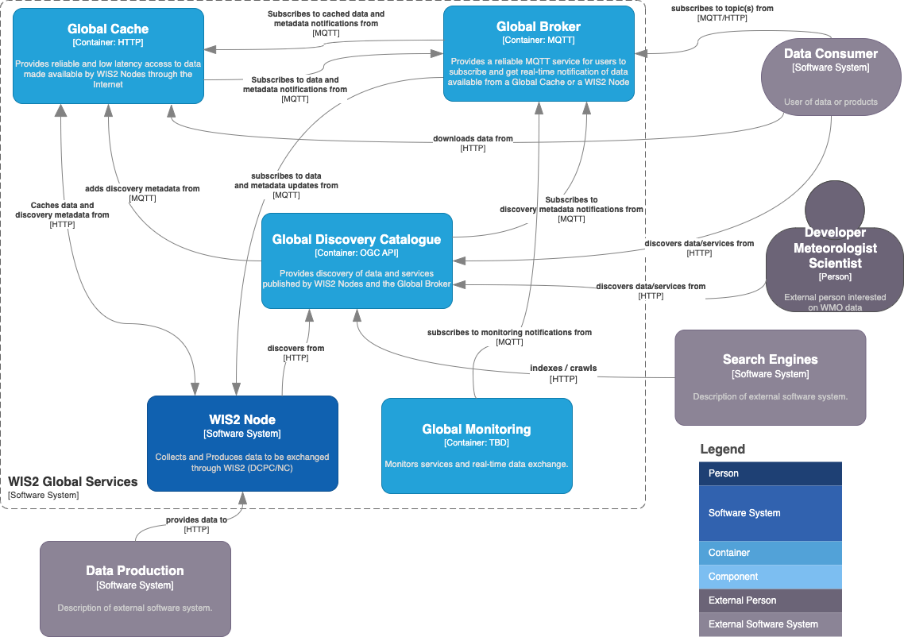

Slide 4

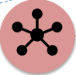






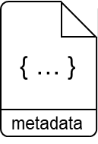
WIS2 in a box: What is it?
WIS2 in a box is a reference implementation of a WIS2 Node
MQTT
HTTP
Software (not hardware)
Publishing facility/capability compliant to WIS 2.0 Architecture
Provides basic data transformation
Can integrate with existing data management systems
Global Broker
subscribe
notification
of new data
notification
of new data
Data
Consumer
subscribe
download
Message Broker
Core Data
WIS2 Node
Recommended
4

Slide 5









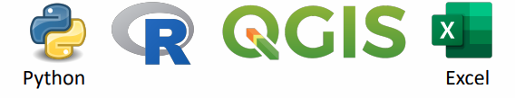
WIS2 in a box services
WIS2 in a box
storage
Global Discovery Catalogue
proxy
HTTP proxy
HTTP
incoming
public
listen to incoming- bucket
publish to public- bucket
MQTT
Global Broker
MQTT broker
wis2box-management
apply data mappings
create WIS2 notifications
create WCMP2 records
publish WIS2-notifications
HTTP
Global Cache
WIS2 Node core services:
HTTP storage endpoint (MinIO)
MQTT broker (mosquitto)
'wis2box-management': create WCMP2 records and WIS2 notifications
web-interfaces
API-backend
wis2box-api
monitoring
map-display
timeseries
dataset-editor
FM-12 input form
station-editor
+ tools to facilitate international data sharing:
data conversion: csv2bufr, synop2bufr, bufr2bufr
OGC API to share data via an API
data visualization and monitoring to detect issues and trigger corrective action
Web interfaces for manual data input (FM-12/CSV), configure datasets and station metadata
Import station metadata
OSCAR/Surface
query data-items

Slide 6















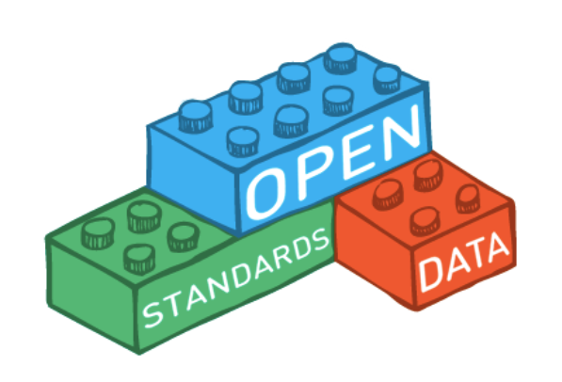
WIS2 in a box is Free and Open
Free and Open Source Software
Open Standards
MQTT
GeoJSON
OGC APIs

Slide 7
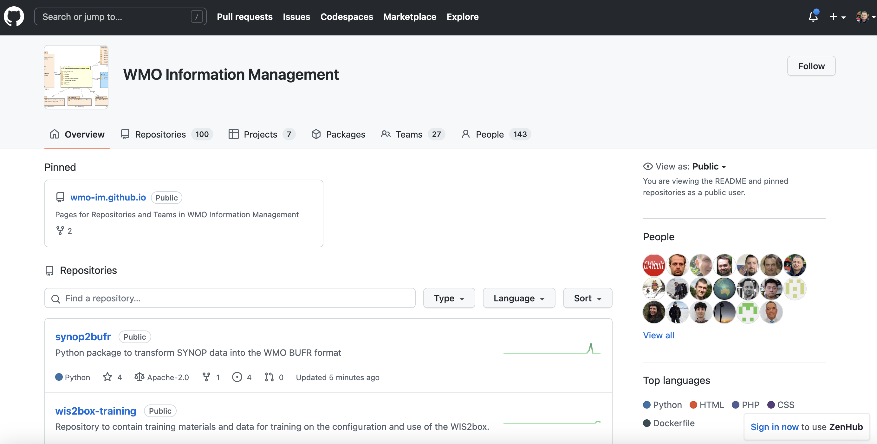
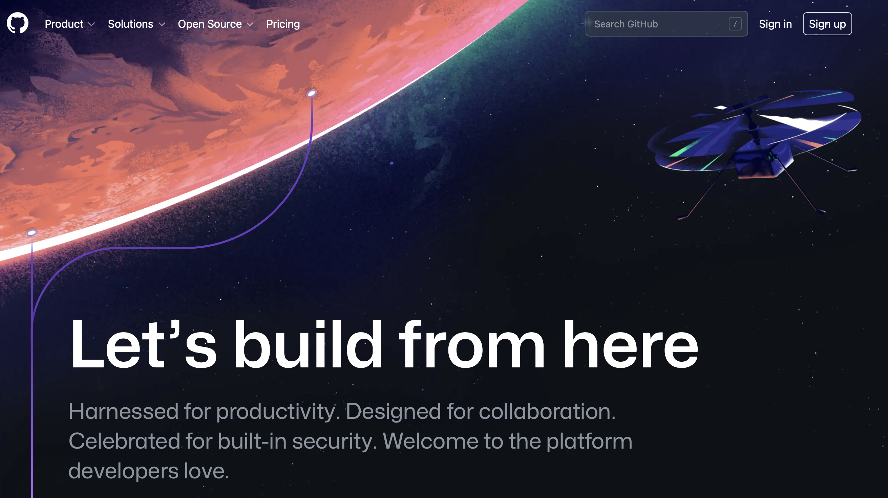

GitHub Overview
GitHub is a hosting service for software development using Git
Software / source code
Issues/bugs
Documentation
Automated testing
Used by numerous organizations (including WMO)

Slide 8

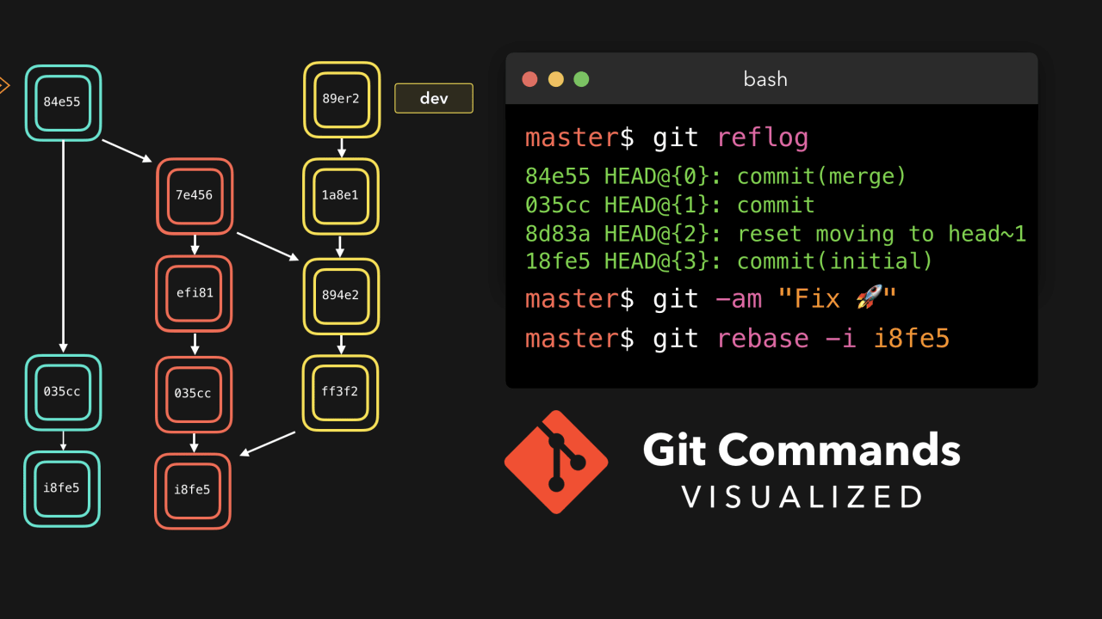
Git Overview
Git is a version control system originally developed for software / code management

Slide 9
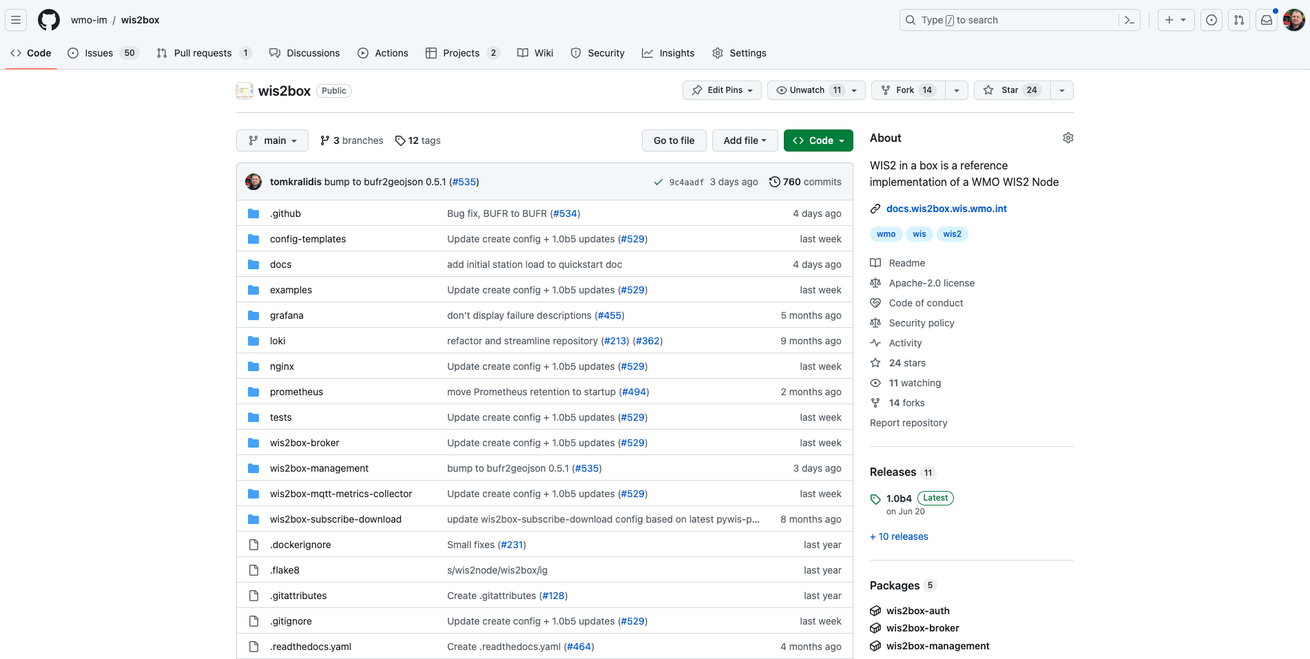
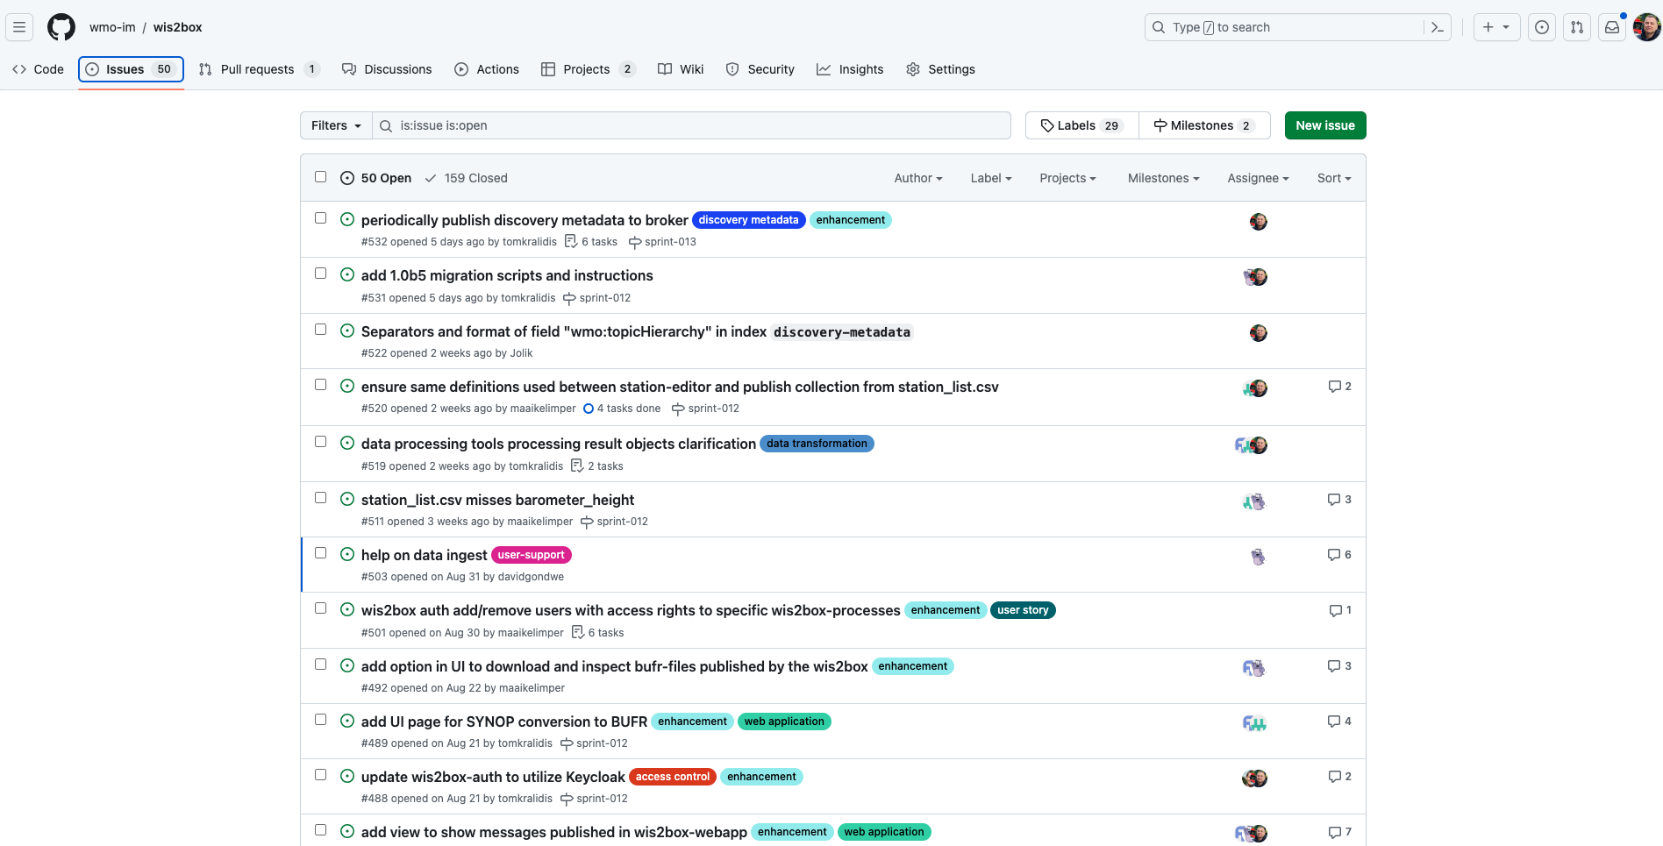
WIS2 in a box on GitHub
Software
Issue tracker
Releases
Automated testing
Discussions
github.com/wmo-im/wis2box

Slide 10
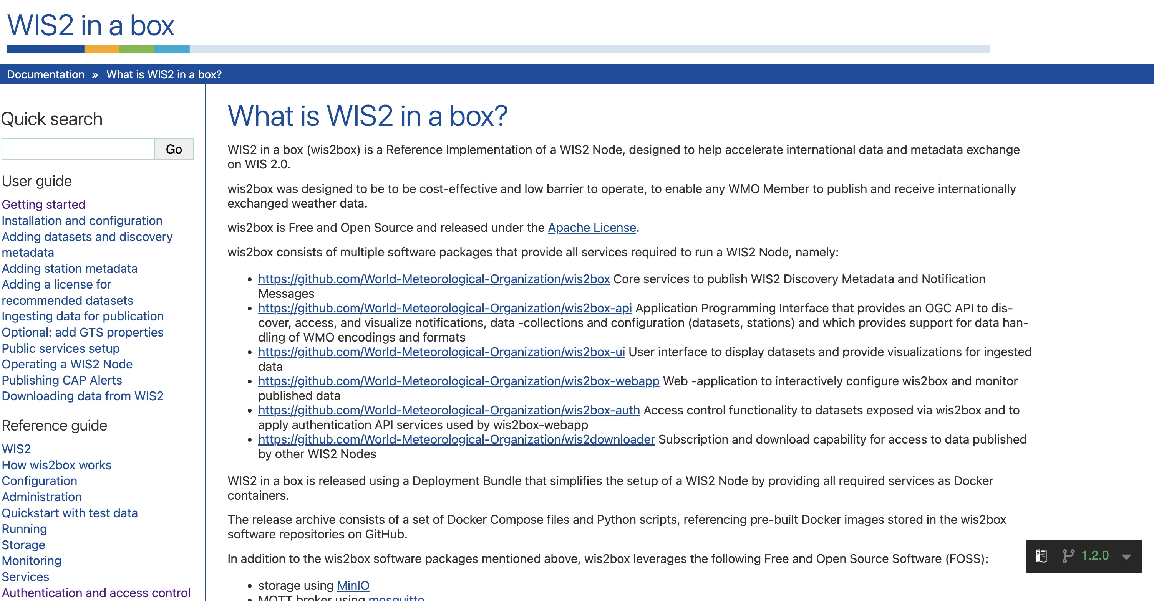
Documentation

Slide 11
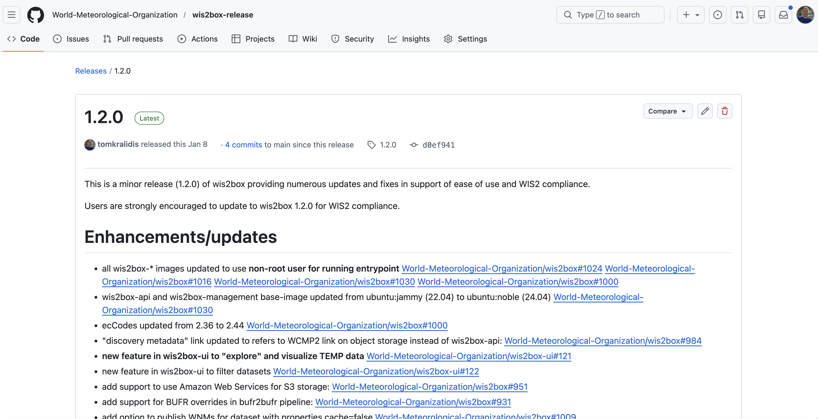
Releases

Slide 12
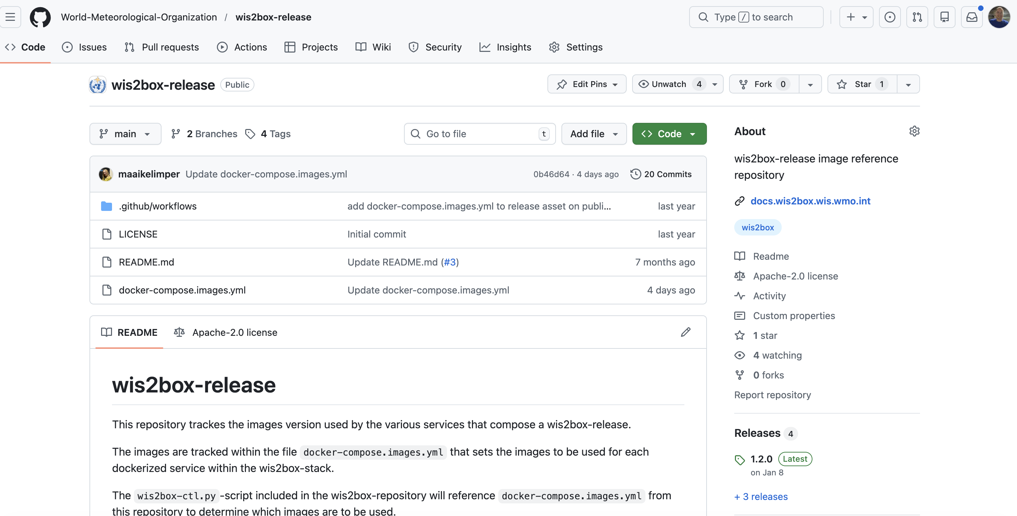
Code

Slide 13
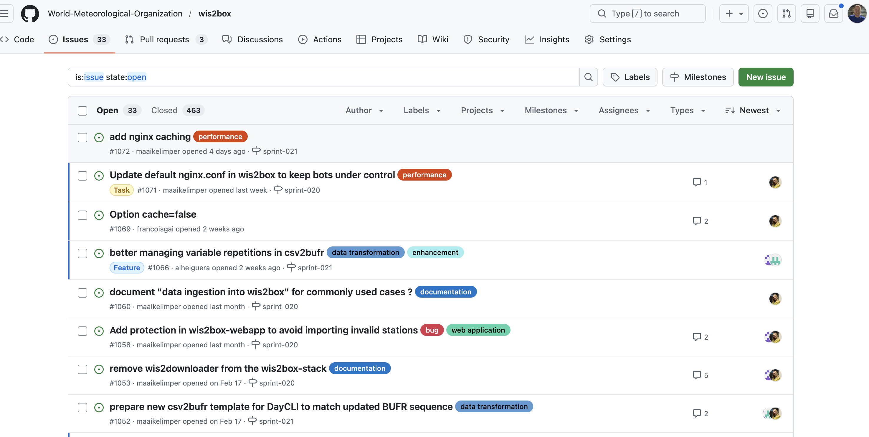
Issue tracker

Slide 14
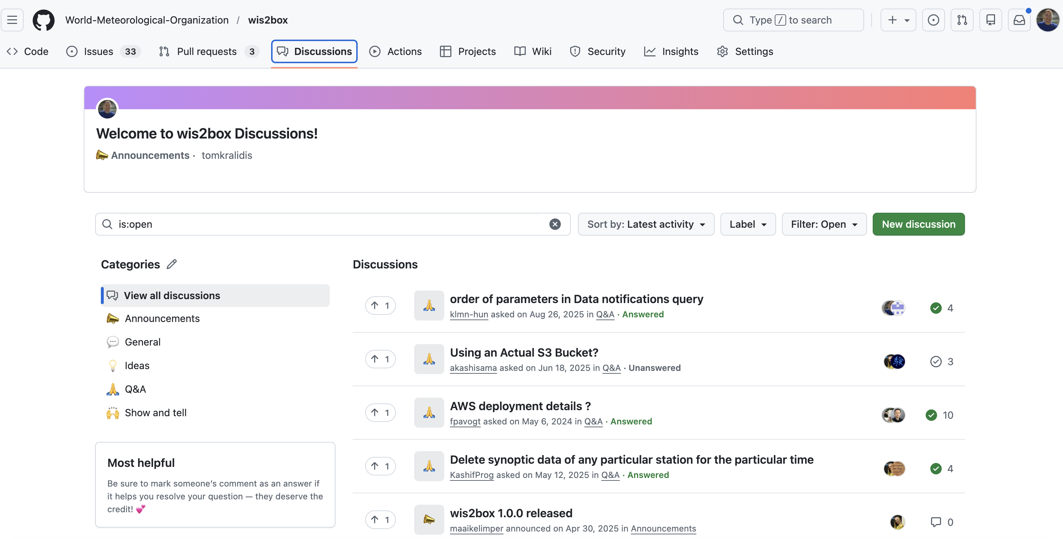
Open Discussion Forum

Slide 15
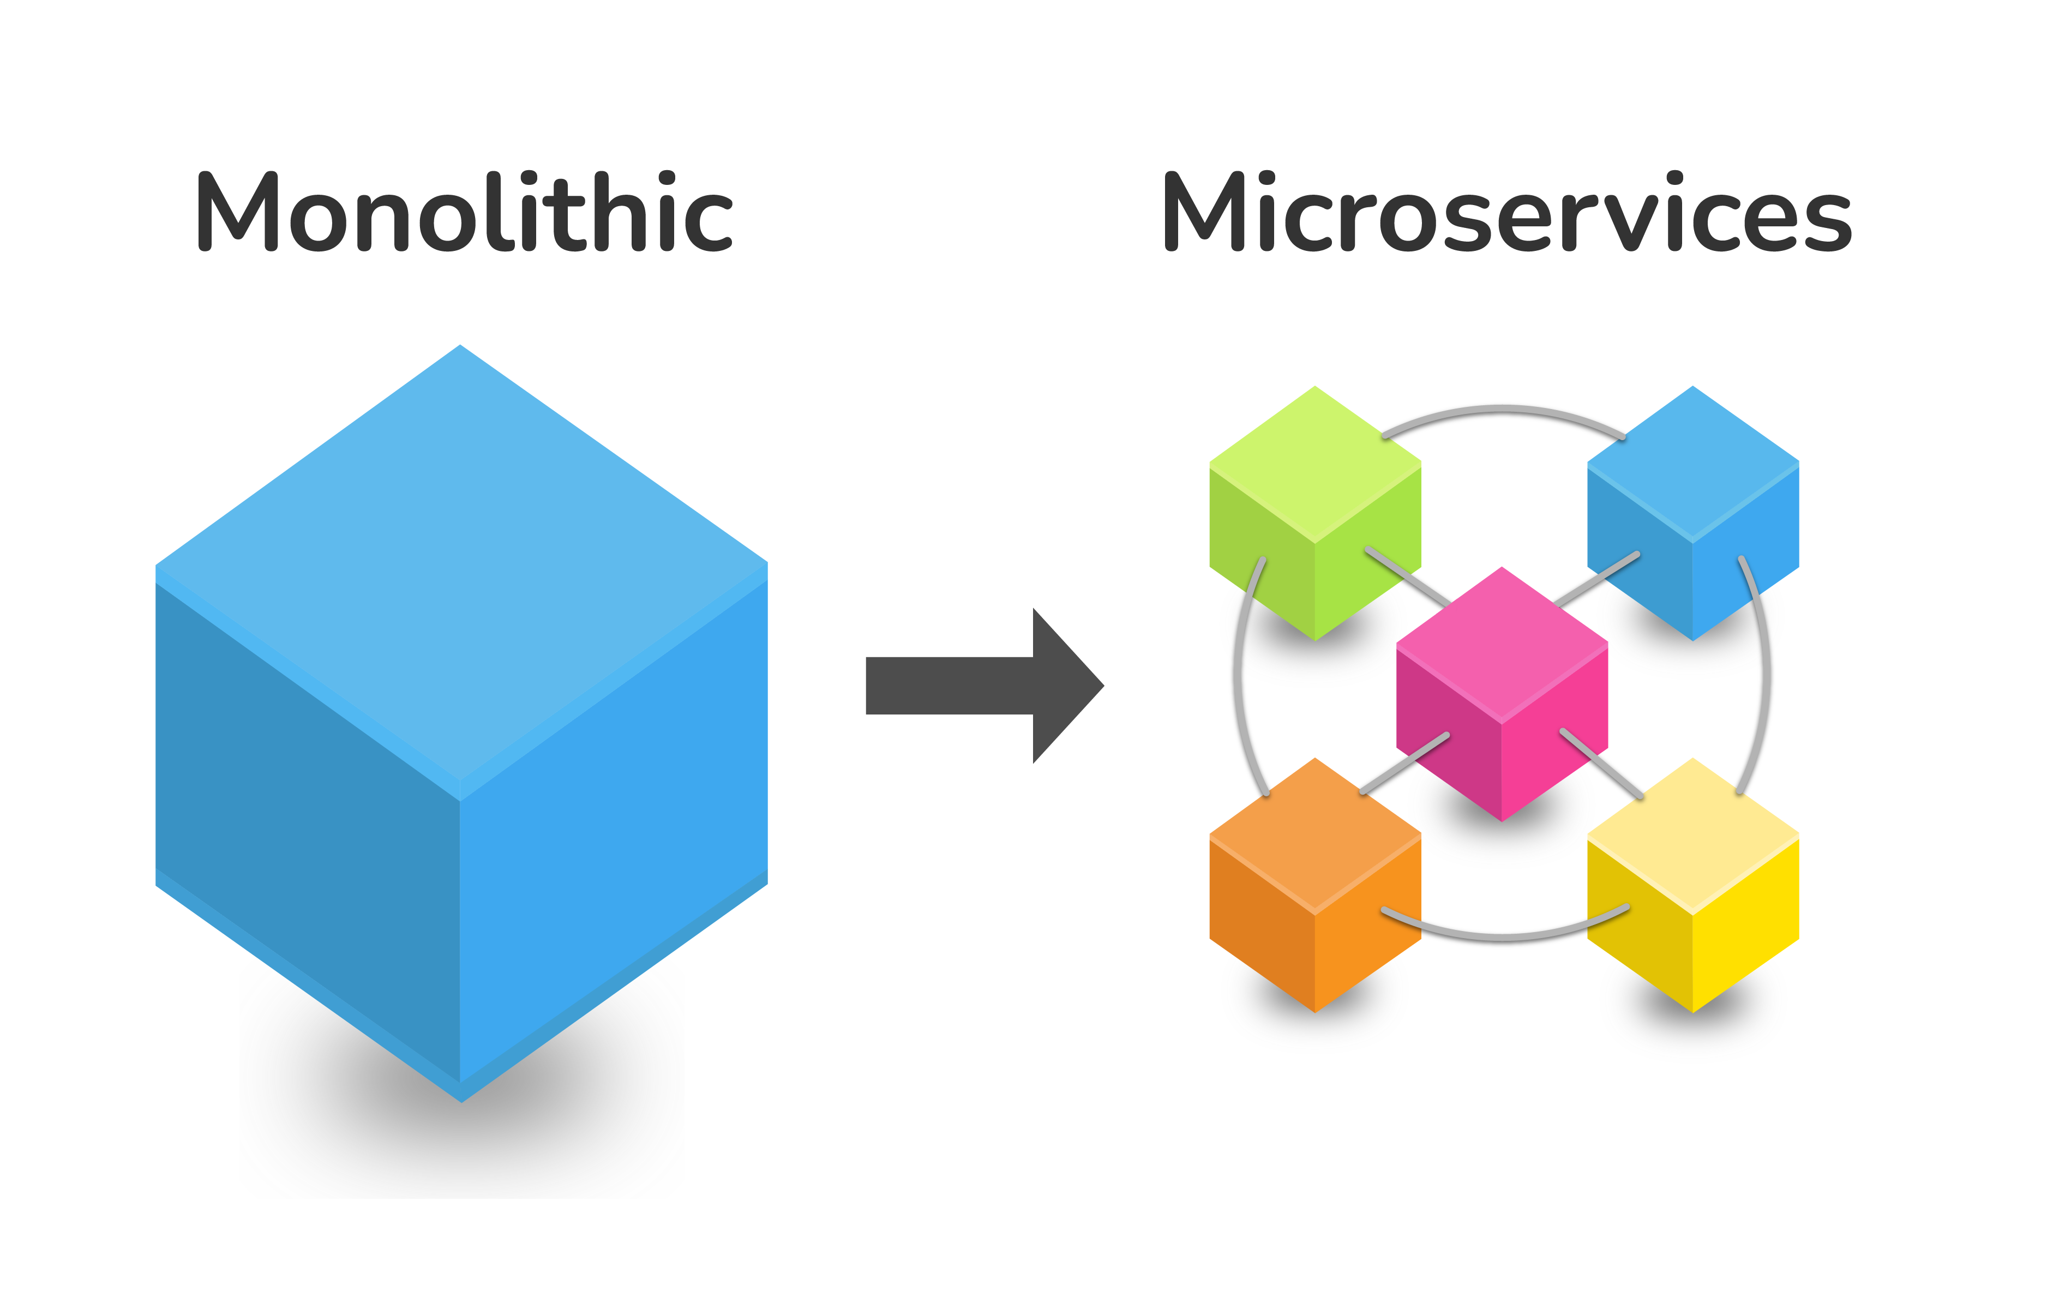

Docker
wis2box uses Docker for application management
Containerization
Microservices
Building blocks

Slide 16
Technical Architecutre of wis2box
Docker
Components providing services (management, api, broker, storage, auth, metrics, etc.)

Slide 17
Containers
Broker
Web Applications
Management
API
Storage
Auth
Metrics

Slide 18
WIS2 Components
Component | Technology | Docker Container
Storage | MinIO | wis2box-minio
Broker | mosquitto | wis2box-broker
Management, Auth | Python | wis2box-management wis2box-auth
API | pygeoapi | wis2box-api
Web Applications | Vue.js/LeafletJS | wis2box-ui wis2box-webapp
Metrics | Grafrana/ Prometheus/Loki | grafana

Slide 19

Storage
Technology: MinIO
Object storage (S3)
Container: wis2box-minio
Management of:
Data (observations, etc.)
Metadata (discovery, station)
Configuration

Slide 20

Broker
Technology: mosquitto
Container: wis2box-broker
Subscription and notifications
Data ingest
Data publication to WIS2

Slide 21

Management
Technology: Python
Container: wis2box-management
Metadata management
Discovery
Station
Configuration

Slide 22
Auth
Technology: Python
Container: wis2box-auth
Access control (tokens)
Protect resources

Slide 23

API
Technology: pygeoapi
Container: wis2box-api
Geospatial web API
OGC standards
Discovery
Access
Visualization
Processing
API Backend: Elasticsearch

Slide 24


Web Applications
Technology: Vue.js/Leaflet
Container: wis2box-ui
Visualization (stations, observations)
Maps
Tables
Graphs

Slide 25
Web Applications
Technology: Vue.js/Leaflet
Container: wis2box-webapp
Data entry
Station metadata management
Notifications

Slide 26

Core Workflows
Publish
Discovery metadata
Data
Notifications
Subscribe
WIS 2.0 Global Services subscription
Notifications
Download
Notifications
Core data
Design Time
Run Time
This Photo by Unknown Author is licensed under CC BY-NC

Slide 27

wis2box plugins
Plugins enable custom data integration into wis2box
Python
Abstract model/approach
Extensibility
Reuse
Notes:
Image credit: https://ithemes.com/blog/what-is-a-plugin/

Slide 28

Thank you
Merci
Gracias
شكرا
谢谢

