Slide 1
Please Note
This example uses CSV files being sent to the wis2box, using the csv2Bufr converter, However the principle can be applied to any file being sent to the wis2box needing GTS headers to be added.

Slide 2
Adding GTS header to a CSV file based on UTC hour

Slide 3
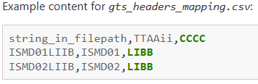
GTS Headers
WIS2.0 documentation - https://docs.wis2box.wis.wmo.int/en/latest/user/gts-headers-in-wis2.html
If you want to add GTS headers to your WIS2 notifications, a CSV file, mapping your GTS header to incoming file names will need to be created and stored within your wis2box.
This CSV file, should be named exactly “gts_headers_mapping.csv” and should be placed in the directory defined using the WIS2BOX_HOST_DATADIR environment variable.
The CSV should contain the following columns:
string_in_filepath, TTAAii, and CCCC

Slide 4
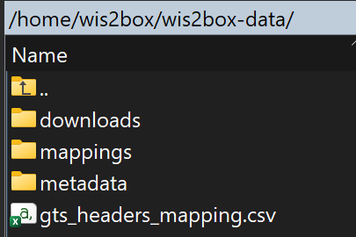
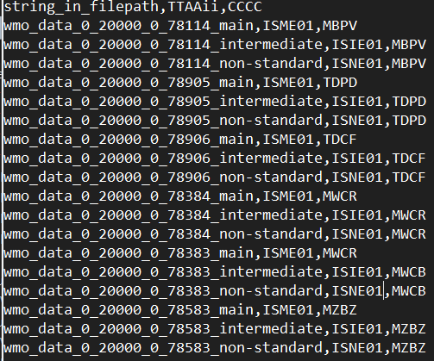
GTS Headers
CSV file in wis2box
Internal csv format
Turks and Caicos
Dominica
Cayman Islands
Belize

Slide 5
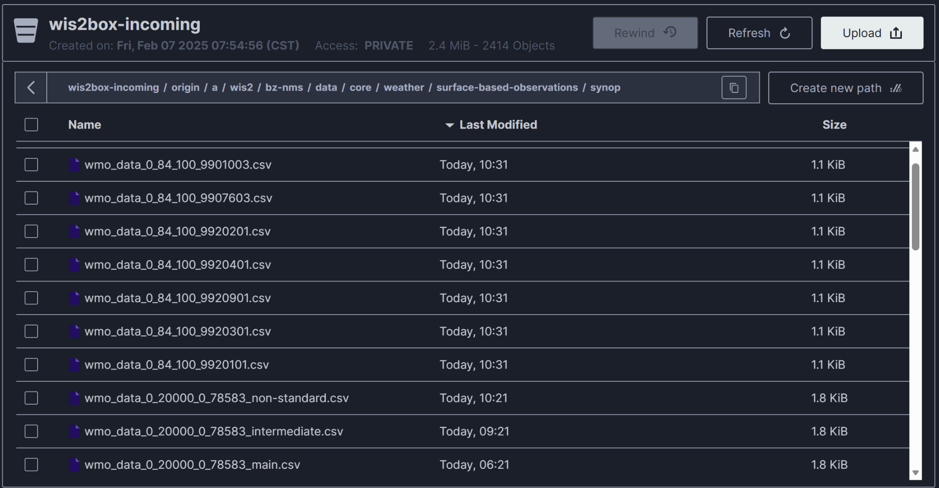
GTS Headers
Files sent to WIS2box with GTS tags

Slide 6
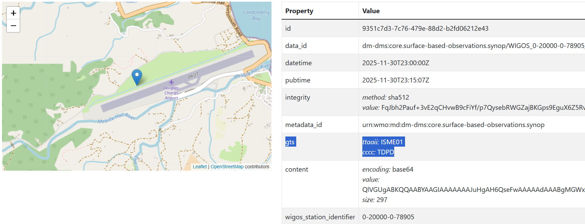
Example of SURFACE sending messages and adding GTS headers to WIS2box(Dominica)
https://wiscaribbeancmo.org/oapi/collections/messages/items?wigos_station_identifier=0-20000-0-78905&sortby=-pubtime

Slide 7
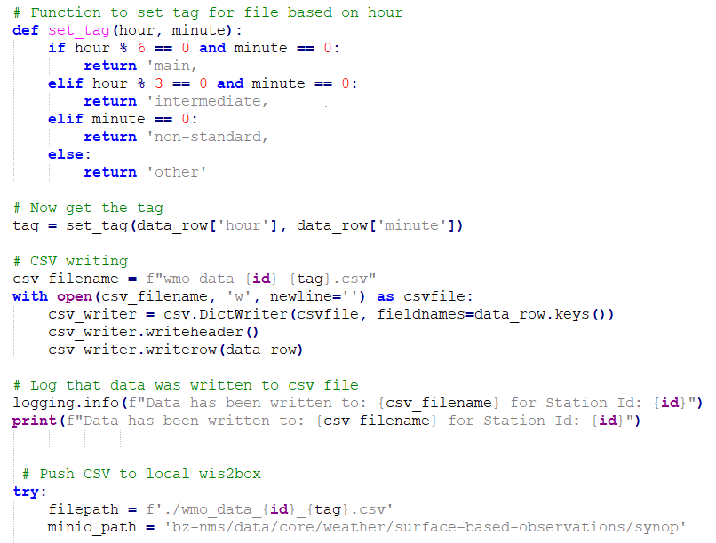
GTS Headers
Logic inside sample script to append headers to csv file

