Slide 1
WIS2 to GTS Gateways
(from WIS2 beta-test, Mar-2025)
INFCOM Standing Committee on WIS

Slide 2
2. Overview of beta-test and data-flows
Jeremy Tandy (Chair, Expert Team on WIS2 Implementation and Transition)

Slide 3

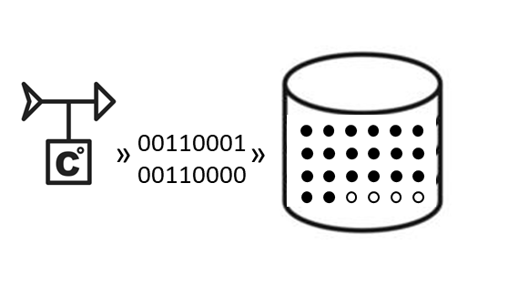

WIS Centre includes WIS2 Node and Message Switching System (MSS) for distribution of data from NMHS
WIS2
WIS Centre
WIS2 Node
data management system
MSS
GTS

Slide 4

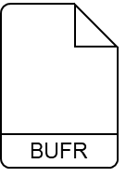
GTS distribution example:
Bulletin ISMD01TEST routinely contains reports from 4 stations (A, B, C and D) packaged as a “collective”
WIS2
WIS Centre
WIS2 Node
data management system
CCCC = TEST
MSS
A
B
A
B
C
D
C
D
TTAAii CCCC
ISMD01TEST
GTS

Slide 5
GTS distribution example:
Bulletin ISMD01TEST is relayed via RTHs according to Routing Tables; WDQMS centres validate inclusion of
observation reports from stations
A, B, C & D in NWP models
WIS2
WIS Centre
WIS2 Node
data management system
CCCC = TEST
RTH
Exeter
ISMD01TEST
RTH
Beijing
ISMD01TEST
MSS
A
B
RTH
ISMD01TEST
RTH
ISMD01TEST
A
B
C
D
C
D
RTH
ISMD01TEST
RTH
ISMD01TEST
TTAAii CCCC
ISMD01TEST
WDQMS
GTS
A
B
C
D

Slide 6
WIS2
A
B
C
D
WIS Centre
WIS2 Node
https
data management system
CCCC = TEST
RTH
Exeter
RTH
Beijing
MSS
A
B
RTH
RTH
C
D
WIS2 distribution example:
Reports from stations A, B, C and D published as individual data-objects encoded in BUFR, accessible via the https data-server
RTH
RTH
WDQMS
GTS

Slide 7
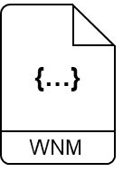
WIS2
A
B
C
D
WIS Centre
WIS2 Node
https
mqtts
data management system
CCCC = TEST
RTH
Exeter
RTH
Beijing
MSS
A
B
RTH
RTH
C
D
WIS2 distribution example:
WIS2 Notification Messages (WNM) are generated for each data-object and published via the mqtts broker
RTH
RTH
WDQMS
GTS

Slide 8

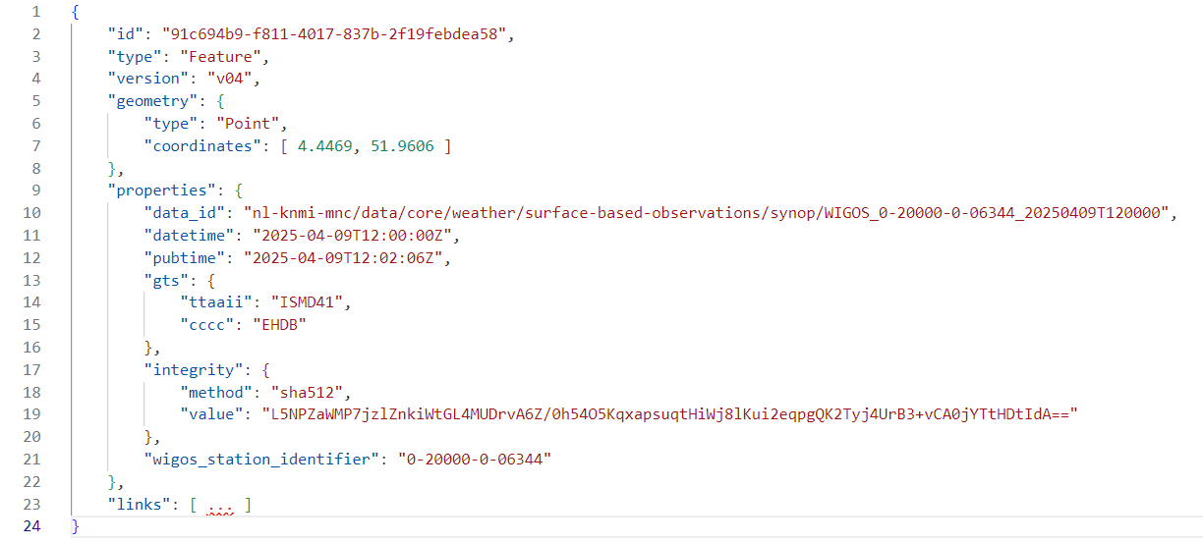
Example WNM for observation report from Rotterdam The Hague (NL)
WIS2
A
B
C
D
WIS Centre
WIS2 Node
Include the GTS header information in properties.gts …
TTAAii = ISMD41, CCCC = EHDB
https
mqtts
data management system
CCCC = TEST
RTH
Exeter
RTH
Beijing
MSS
A
B
RTH
RTH
C
D
WIS2 distribution example:
Because these data-objects relate to reports distributed on GTS extra information is needed in the WNM …
RTH
RTH
WDQMS
GTS

Slide 9
Example WNM for observation report from Rotterdam The Hague (NL)
WIS2
This SYNOP is available at the main synoptic hours 00, 06, 12, 18 utc (in this case 12 utc) – the properties.datetime should be set to the ‘normal’ bulletin time
A
B
C
D
WIS Centre
WIS2 Node
https
mqtts
data management system
CCCC = TEST
RTH
Exeter
RTH
Beijing
MSS
A
B
RTH
RTH
C
D
WIS2 distribution example:
Because these data-objects relate to reports distributed on GTS extra information is needed in the WNM …
RTH
RTH
WDQMS
GTS

Slide 10
Example WNM for observation report from Rotterdam The Hague (NL)
WIS2
A
B
C
D
WIS Centre
The WIGOS Station Identifier should also be included – it helps the WIS2 Gateways in recompiling bulletins and provides a mechanism for data consumers to identify which WNMs relate to data they need
WIS2 Node
https
mqtts
data management system
CCCC = TEST
RTH
Exeter
RTH
Beijing
MSS
A
B
RTH
RTH
C
D
WIS2 distribution example:
Because these data-objects relate to reports distributed on GTS extra information is needed in the WNM …
RTH
RTH
WDQMS
GTS

Slide 11
Example WNM for observation report from Rotterdam The Hague (NL)
WIS2
A
B
C
D
WIS Centre
WIS2 Node
Including a checksum to validate integrity of the data is recommended practice too
https
mqtts
data management system
CCCC = TEST
RTH
Exeter
RTH
Beijing
MSS
A
B
RTH
RTH
C
D
WIS2 distribution example:
Because these data-objects relate to reports distributed on GTS extra information is needed in the WNM …
RTH
RTH
WDQMS
GTS

Slide 12


Example WNM for observation report from Rotterdam The Hague (NL)
WIS2
But take care: bulletin headers vary with time. For example, SYNOPs for station 06344 are also available at non-standard times with the header ISND41
A
B
C
D
WIS Centre
WIS2 Node
https
mqtts
data management system
CCCC = TEST
RTH
Exeter
RTH
Beijing
MSS
A
B
RTH
RTH
C
D
WIS2 distribution example:
Because these data-objects relate to reports distributed on GTS extra information is needed in the WNM …
RTH
RTH
WDQMS
GTS

Slide 13


WIS2
A
B
C
D
WIS Centre
Global Broker
WIS2 Node
https
mqtts
data management system
CCCC = TEST
RTH
Exeter
RTH
Beijing
MSS
A
B
RTH
RTH
C
D
WIS2 distribution example:
Global Brokers subscribe to the
WIS2 Node’s broker; all the WNMs are sent to the Global Brokers and republished
RTH
RTH
WDQMS
GTS

Slide 14

WIS2
A
B
C
D
Global Cache
WIS Centre
Global Broker
WIS2 Node
https
mqtts
data management system
CCCC = TEST
RTH
Exeter
RTH
Beijing
MSS
A
B
RTH
RTH
C
D
WIS2 distribution example:
Global Caches subscribe to the Global Brokers; all the WNMs are sent to the Global Caches
RTH
RTH
WDQMS
GTS

Slide 15
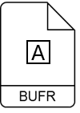
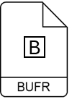
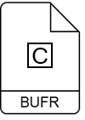
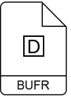
WIS2
A
B
C
D
Global Cache
WIS Centre
Global Broker
WIS2 Node
https
mqtts
data management system
CCCC = TEST
RTH
Exeter
RTH
Beijing
MSS
A
B
RTH
RTH
C
D
WIS2 distribution example:
Global Caches parse the WNMs and download data-objects from the WIS2 Node and republish; new WNMs are created for the cached data
RTH
RTH
WDQMS
GTS

Slide 16
WIS2
A
B
C
D
Global Cache
WIS Centre
Global Broker
WIS2 Node
https
mqtts
data management system
CCCC = TEST
RTH
Exeter
RTH
Beijing
MSS
A
B
RTH
RTH
C
D
WIS2 distribution example:
Global Brokers subscribe to the
Global Caches; new WNMs are sent to the
Global Brokers and republished
RTH
RTH
WDQMS
GTS

Slide 17




WIS2
A
B
C
D
Global Cache
WIS Centre
Global Broker
WIS2 Node
https
mqtts
data management system
CCCC = TEST
RTH
Exeter
RTH
Beijing
MSS
A
B
RTH
RTH
C
D
WIS2 distribution example:
WIS2 users subscribe to Global Brokers;
they receive and parse the WNMs, identifying which data they want;
they download the data objects from Global Caches
RTH
RTH
WDQMS
GTS

Slide 18
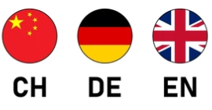

WIS2
A
B
C
D
Global Cache
WIS Centre
Global Broker
WIS2 Node
https
mqtts
W2-GTS Gateway
W2-GTS Gateway
data management system
CCCC = TEST
RTH
Exeter
RTH
Beijing
MSS
A
B
RTH
RTH
C
D
RTH
But how do GTS users get their data from WIS2?
WIS2-to-GTS gateways
RTH
WDQMS
GTS

Slide 19
WIS2
A
B
C
D
Global Cache
WIS Centre
Global Broker
WIS2 Node
https
mqtts
W2-GTS Gateway
W2-GTS Gateway
data management system
CCCC = TEST
RTH
Exeter
RTH
Beijing
MSS
A
B
RTH
RTH
C
D
RTH
WIS2-to-GTS gateways:
UK and Chinese gateways subscribe to Global Brokers and receive WNMs – but nothing else happens yet …
RTH
WDQMS
GTS

Slide 20
WIS2
A
B
C
D
Global Cache
WIS Centre
Global Broker
WIS2 Node
https
mqtts
W2-GTS Gateway
W2-GTS Gateway
data management system
CCCC = TEST
RTH
Exeter
ISMD01TEST
RTH
Beijing
ISMD01TEST
MSS
A
B
ISMD01TEST
RTH
ISMD01TEST
RTH
ISMD01TEST
A
B
C
D
A
B
C
D
C
D
RTH
ISMD01TEST
WIS2-to-GTS gateways:
GTS users are still getting their data via their RTH
RTH
ISMD01TEST
WDQMS
GTS
A
B
C
D

Slide 21
WIS2
A
B
C
D
Global Cache
WIS Centre
Global Broker
WIS2 Node
https
mqtts
whitelist:
ISMD01TEST
W2-GTS Gateway
whitelist:
ISMD01TEST
W2-GTS Gateway
data management system
CCCC = TEST
RTH
Exeter
RTH
Beijing
MSS
A
B
ISMD01TEST
RTH
RTH
C
D
RTH
WIS2-to-GTS gateways:
When a WIS Centre stops sending (a subset* of) bulletins via GTS the gateways will add those bulletin headers to their “whitelist”
RTH
WDQMS
GTS
Notes:
Beta-test participants must decide which GTS bulletins they will only distribute via WIS2 during the 24-hours of the beta-test

Slide 22
WIS2
A
B
C
D
Global Cache
WIS Centre
Global Broker
WIS2 Node
https
mqtts
whitelist:
ISMD01TEST
W2-GTS Gateway
whitelist:
ISMD01TEST
W2-GTS Gateway
data management system
CCCC = TEST
RTH
Exeter
RTH
Beijing
MSS
A
B
ISMD01TEST
RTH
RTH
C
D
RTH
WIS2-to-GTS gateways:
Based on the whitelisted GTS Headers, gateways will parse the WNMs they receive and download the related data-objects from the Global Caches*
RTH
WDQMS
GTS
Notes:
* Or directly from the origin WIS2 Node in the case of Recommended Data (or for Core Data where properties.cache = false) – in these cases you must make sure that the WIS2-to-GTS gateways can access the data-server of the WIS2 Node without needing authentication (i.e., open access or IP whitelist)

Slide 23
WIS2
A
B
C
D
Global Cache
WIS Centre
Global Broker
WIS2 Node
https
mqtts
whitelist:
ISMD01TEST
W2-GTS Gateway
A
B
whitelist:
ISMD01TEST
W2-GTS Gateway
A
B
C
D
C
D
data management system
CCCC = TEST
RTH
Exeter
RTH
Beijing
MSS
A
B
ISMD01TEST
RTH
RTH
C
D
RTH
WIS2-to-GTS gateways:
The “single report” BUFR data-objects are then compiled by the gateways into “collectives” according to the properties.gts in the WNM
RTH
WDQMS
GTS

Slide 24
WIS2
A
B
C
D
Global Cache
WIS Centre
Global Broker
WIS2 Node
https
mqtts
whitelist:
ISMD01TEST
W2-GTS Gateway
A
B
whitelist:
ISMD01TEST
W2-GTS Gateway
A
B
C
D
C
D
data management system
CCCC = TEST
ISMD01TEST
RTH
Exeter
ISMD01TEST
RTH
Beijing
MSS
A
B
ISMD01TEST
RTH
ISMD01TEST
RTH
ISMD01TEST
A
B
C
D
C
D
RTH
ISMD01TEST
WIS2-to-GTS gateways:
… and sent to the gateway’s RTH for onward distribution on the GTS, to eventually be received by the users
RTH
ISMD01TEST
WDQMS
GTS
A
B
C
D

Slide 25
WIS2
A
B
C
D
Global Cache
WIS Centre
Global Broker
WIS2 Node
https
mqtts
whitelist:
ISMD01TEST
W2-GTS Gateway
whitelist:
ISMD01TEST
W2-GTS Gateway
data management system
CCCC = TEST
RTH
Exeter
RTH
Beijing
MSS
?
A
B
ISMD01TEST
RTH
RTH
C
D
RTH
WIS2-to-GTS gateways:
During the best-test preparation phase we will work with RTHs to determine if gateways need to establish a direct connection to the “origin” RTH
RTH
WDQMS
GTS

Slide 26



WIS2
A
B
C
D
A
B
WIS Centre
C
D
WIS2 Node
https
mqtts
W2-GTS Gateway
W2-GTS Gateway
data management system
CCCC = TEST
RTH
Exeter
A
B
ISMD01TEST
RTH
Beijing
A
B
ISMD01TEST
MSS
C
C
A
B
ISMD01TEST
RTH
RTH
A note on bulletin compilation:
Gateways operate a “compilation window” during which they expect all the data-objects for a given bulletin to arrive
This duration is set globally for each bulletin type (e.g., 300 sec for SYNOP)
If only a partial set of data-objects have arrived at the gateway at the end of the compilation window, the gateway will publish an (incomplete) bulletin
C
D
RTH
RTH
WDQMS
GTS

Slide 27
WIS2
A
B
C
D
WIS Centre
WIS2 Node
https
mqtts
W2-GTS Gateway
W2-GTS Gateway
data management system
CCCC = TEST
RTH
Exeter
A
B
ISMD01TEST
RTH
Beijing
A
B
ISMD01TEST
MSS
C
C
A
B
ISMD01TEST
RTH
D
ISMD01TEST RRA
D
ISMD01TEST RRA
RTH
A note on bulletin compilation:
When the remaining reports arrive,
the gateway will issue a new bulletin as a RETARD (RRx)
Note that variations in the time at which each gateway receives the data-objects may lead to publication of different bulletins
C
D
RTH
RTH
WDQMS
GTS

Slide 28
WIS2
A
B
C
D
WIS Centre
WIS2 Node
https
mqtts
W2-GTS Gateway
W2-GTS Gateway
data management system
CCCC = TEST
RTH
Exeter
A
B
ISMD01TEST
RTH
Beijing
A
B
ISMD01TEST
MSS
C
C
A
B
ISMD01TEST
RTH
D
ISMD01TEST RRA
D
ISMD01TEST RRA
RTH
A note on corrections:
If a data-object is changed, this is considered as a CORRECTION (CCx)
Here, the WNM for a given data-object will have a newer pubtime than previous messages and the link-relation to the data-object will indicate update
A
A
ISMD01TEST CCA
ISMD01TEST CCA
C
D
RTH
RTH
WDQMS
GTS

Slide 29
WIS2
A
B
C
D
Global Cache
WIS Centre
Global Broker
WIS2 Node
https
mqtts
whitelist:
ISMD01TEST
W2-GTS Gateway
whitelist:
ISMD01TEST
W2-GTS Gateway
data management system
CCCC = TEST
ISMD01TEST
RTH
Exeter
A
B
ISMD01TEST
RTH
Beijing
A
B
MSS
C
D
C
D
A
B
ISMD01TEST
RTH
ISMD01TEST
RTH
ISMD01TEST
A
B
C
D
Beta-test objective?
When a WIS Centre stops sending (a subset of) bulletins via GTS, we must ensure that data is correctly propagated through WIS2 to the GTS, with only minor variations in bulletin compilation
C
D
RTH
ISMD01TEST
RTH
ISMD01TEST
WDQMS
GTS
A
B
C
D

Slide 30
WIS2
A
B
C
D
Global Cache
WIS Centre
Global Broker
WIS2 Node
https
mqtts
whitelist:
ISMD01TEST
W2-GTS Gateway
whitelist:
ISMD01TEST
W2-GTS Gateway
data management system
CCCC = TEST
ISMD01TEST
RTH
Exeter
A
B
ISMD01TEST
RTH
Beijing
A
B
MSS
C
D
C
D
A
B
ISMD01TEST
RTH
ISMD01TEST
RTH
ISMD01TEST
A
B
C
D
Beta-test evaluation:
Evaluation of data transfer will be based on comparing bulletins and reports received at participating RTHs and WDQMS during the 24hrs with the baseline information captured the previous week
C
D
RTH
ISMD01TEST
RTH
ISMD01TEST
WDQMS
GTS
A
B
C
D

Slide 31
Thank you!

